Slide 1
Satellites, Ground Segment, and Data Access Evolution at DLR
K. Molch, S. Kiemle, E. Diedrich, E. Mikusch, G. Schreier
German Remote Sensing Data Center
German Aerospace Center DLR
CEOS-WGISS
Satellite Applications Catapult
Harwell, UK
28 September – 02 October 2015

Slide 2
Overview
Missions: TerraSAR-X, TanDEM-X, EnMAP, Tandem-L
DLR ground segment & system landscape: archiving and access, processing, decision support
Services evolution: NRT maritime services, OPUS-GMES
Copernicus: German core & collaborative ground segment contributions

Slide 3
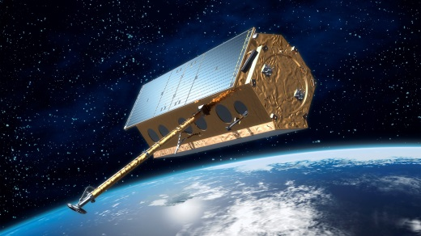
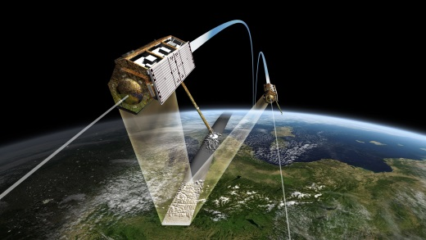
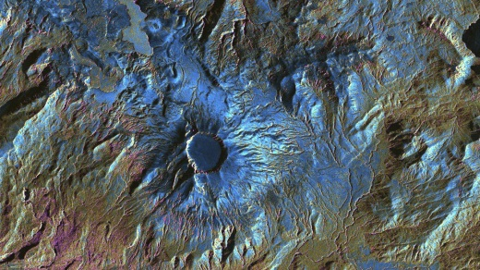
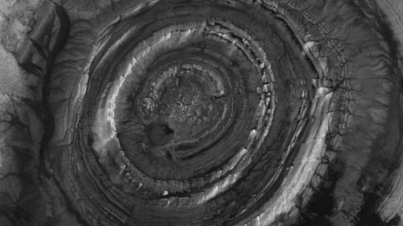
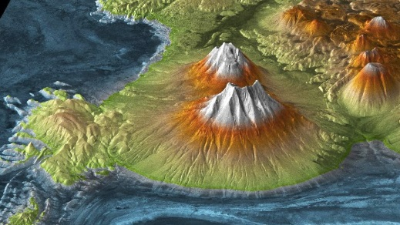
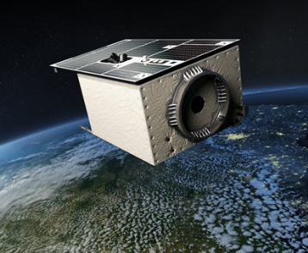
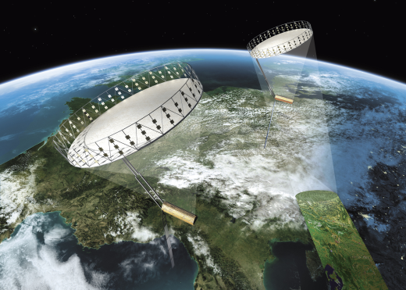
Missions
TerraSAR-X / TanDEM-X
Polarimetric, interferometric radar Earth observation
2007 – 2018 (tbd.)
Public-private partnership DLR / Airbus-DS
Global high-resolution DEM
generation completed 09/2016
EnMAP
Imaging spectroscopy
Launch planned for 2018
Tandem-L (concept)
Polarimetric, interferometric radar Earth observation
Monitoring dynamic processes
Phase-A Study DLR/JAXA ongoing

Slide 4
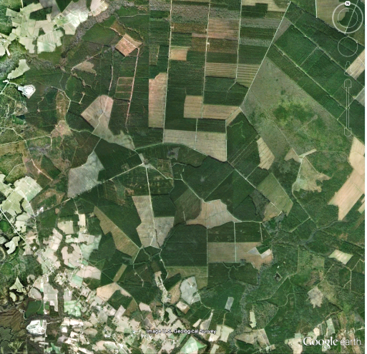
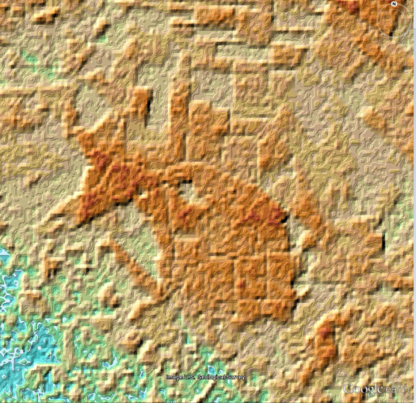
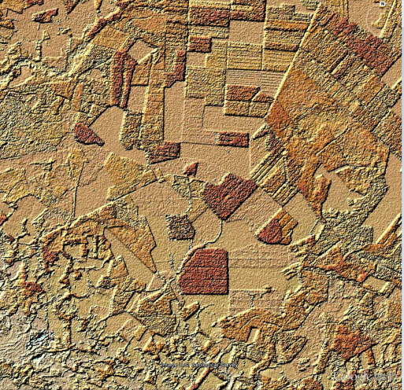
TanDEM-X DEM Example
Google Earth
SRTM C-Band
TanDEM-X

Slide 5
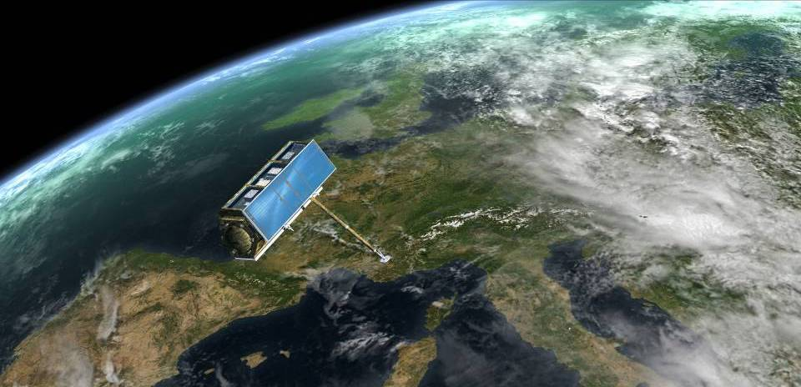
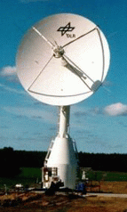

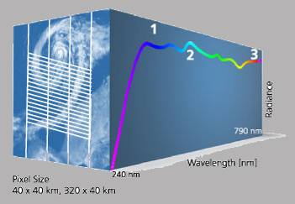
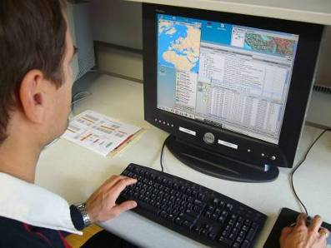
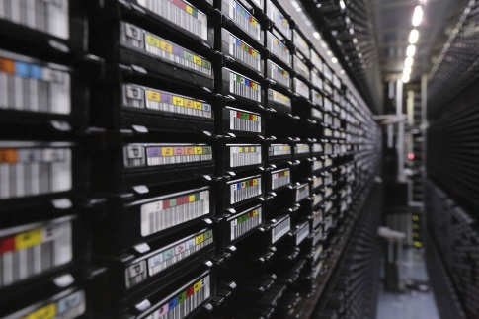
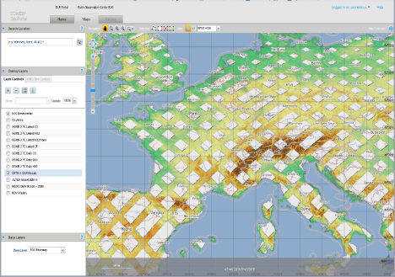
End-to-End production chain
from raw data reception to providing access
to value-added Earth observation information products
Data reception
Application
Calibration
Product generation
Archiving
Access

Slide 6
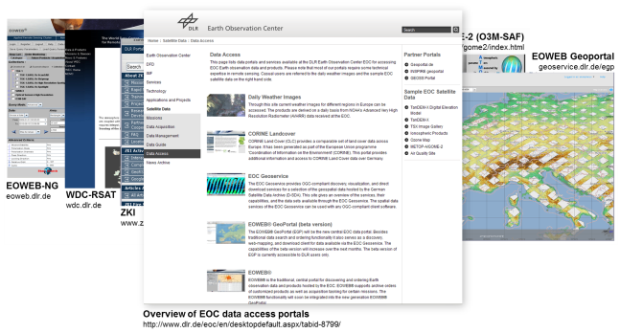

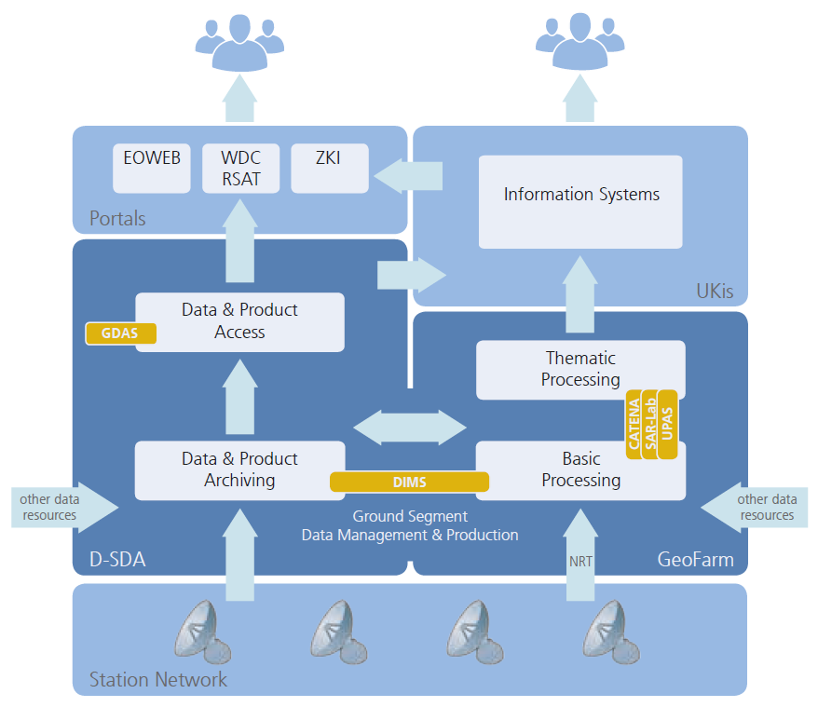
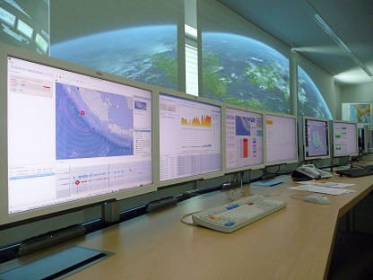
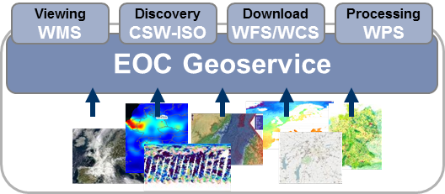
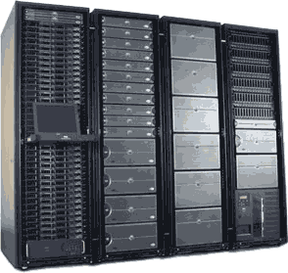
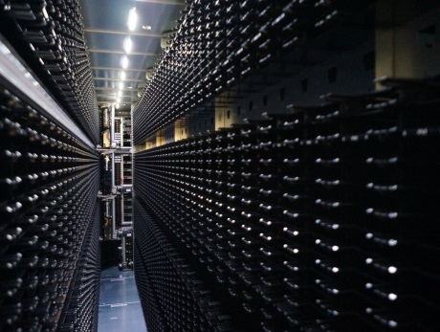
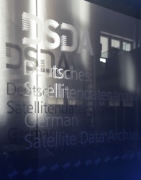
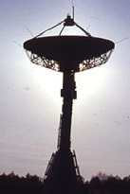
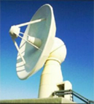
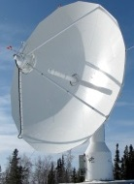
DLR Earth Observation Ground Segment
System Landscape
Image courtesy
server-rack-cabinet.blogspot.de
Neustrelitz
Germany
O'Higgins
Antarctica
Inuvik
Canada

Slide 7

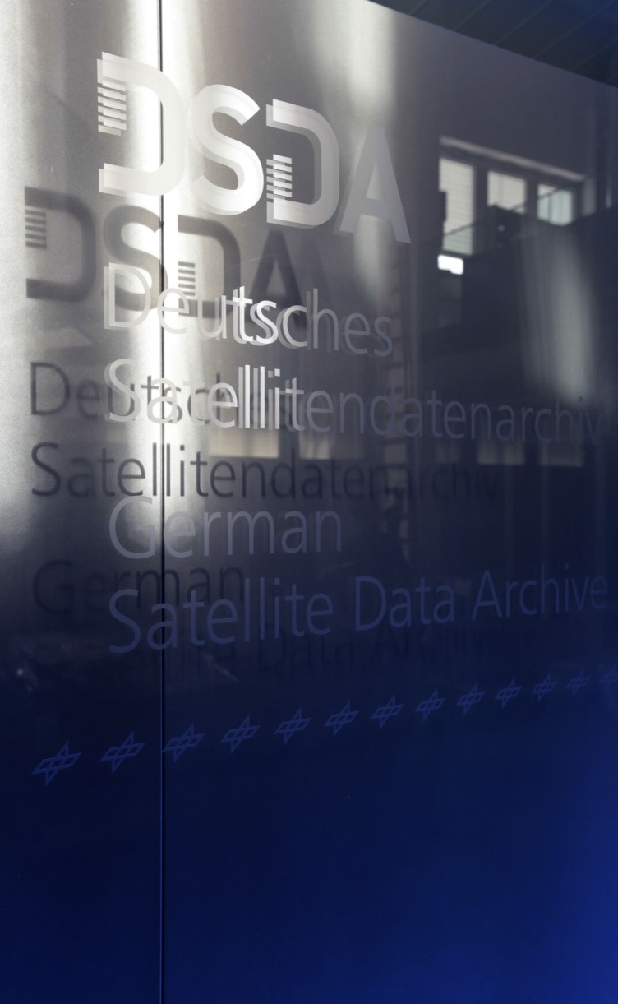
Archiving and Access
Archiving and Access
German Satellite Data Archive 'D-SDA'

Slide 8

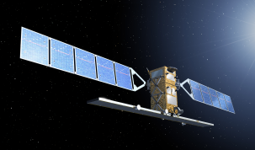
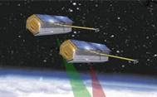


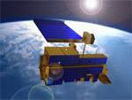
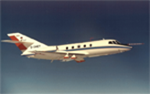

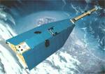

EO Missions Supported by DLR
Future
Multi-Mission Payload Data Ground Segment
National missions
ESA / EU missions
Scientific / commercial partner missions
Sentinels
TanDEM-X
TerraSAR-X
EnMAP
METOP
Terra & Aqua
Airborne Imaging
Past
Current
ENVISAT
On behalf of scientific & commercial partners
MetOP-A/-B
WorldView-2 /-3
RADARSAT-2
IRS-1C /-1D, IRS-P3, Cartosat-1 (IRS-P5), Resourcesat-1 (IRS-P6), Resourcesat-2
CHAMP
SRTM
On behalf of ESA
Landsat-8
Sentinel-1 /-3
Sentinel-5 Precursor

Slide 9
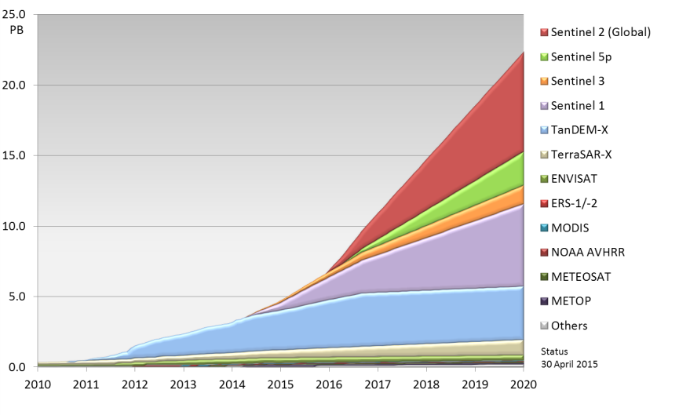
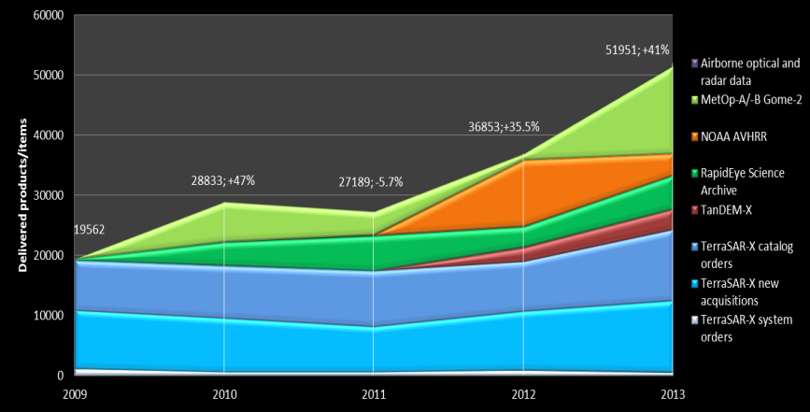
D-SDA Data Volume and User Access
Today
Data volume growing exponentially
  Currently: 6 petabytes
  >20 petabytes expected until 2020
  Current archive capacity: 50 petabytes
Increasing demand for data and products
  2009: 20 000 data sets delivered to users
  2013: 52 000 data sets

Slide 10
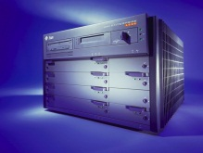
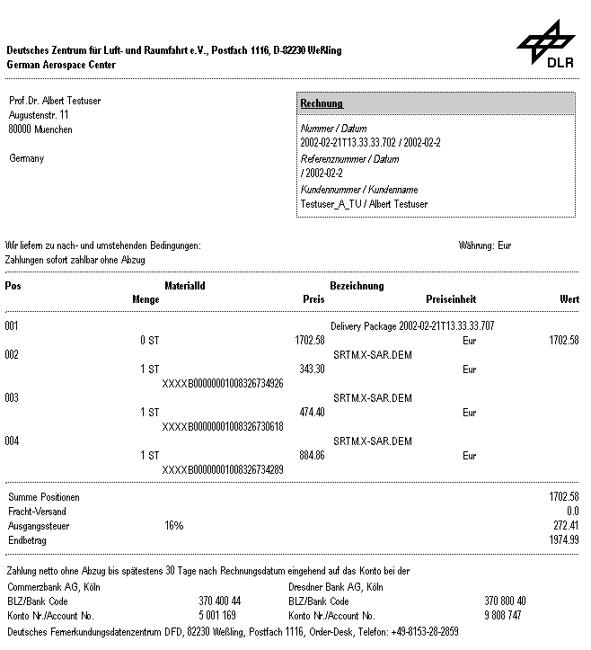

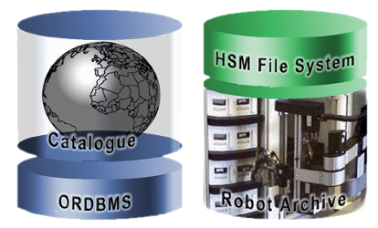

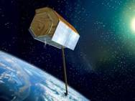













Multi-Mission Data and Information Management System DIMS
Scientific & Commercial Users
Related
Systems
User Information Services
EOWEB® / Geoservice
DIMS
Order Manage-ment
Online/
Offline
Delivery
Product Library
MMFI
Inventory
Archive
Product & Order
Interface
Operator Interface
TSXX
Operators
UMARF
Receiving Stations Interface
Mission Planning Interface
Production Control
Processing
Systems
Atmospheric
Optical
Radar

Slide 11
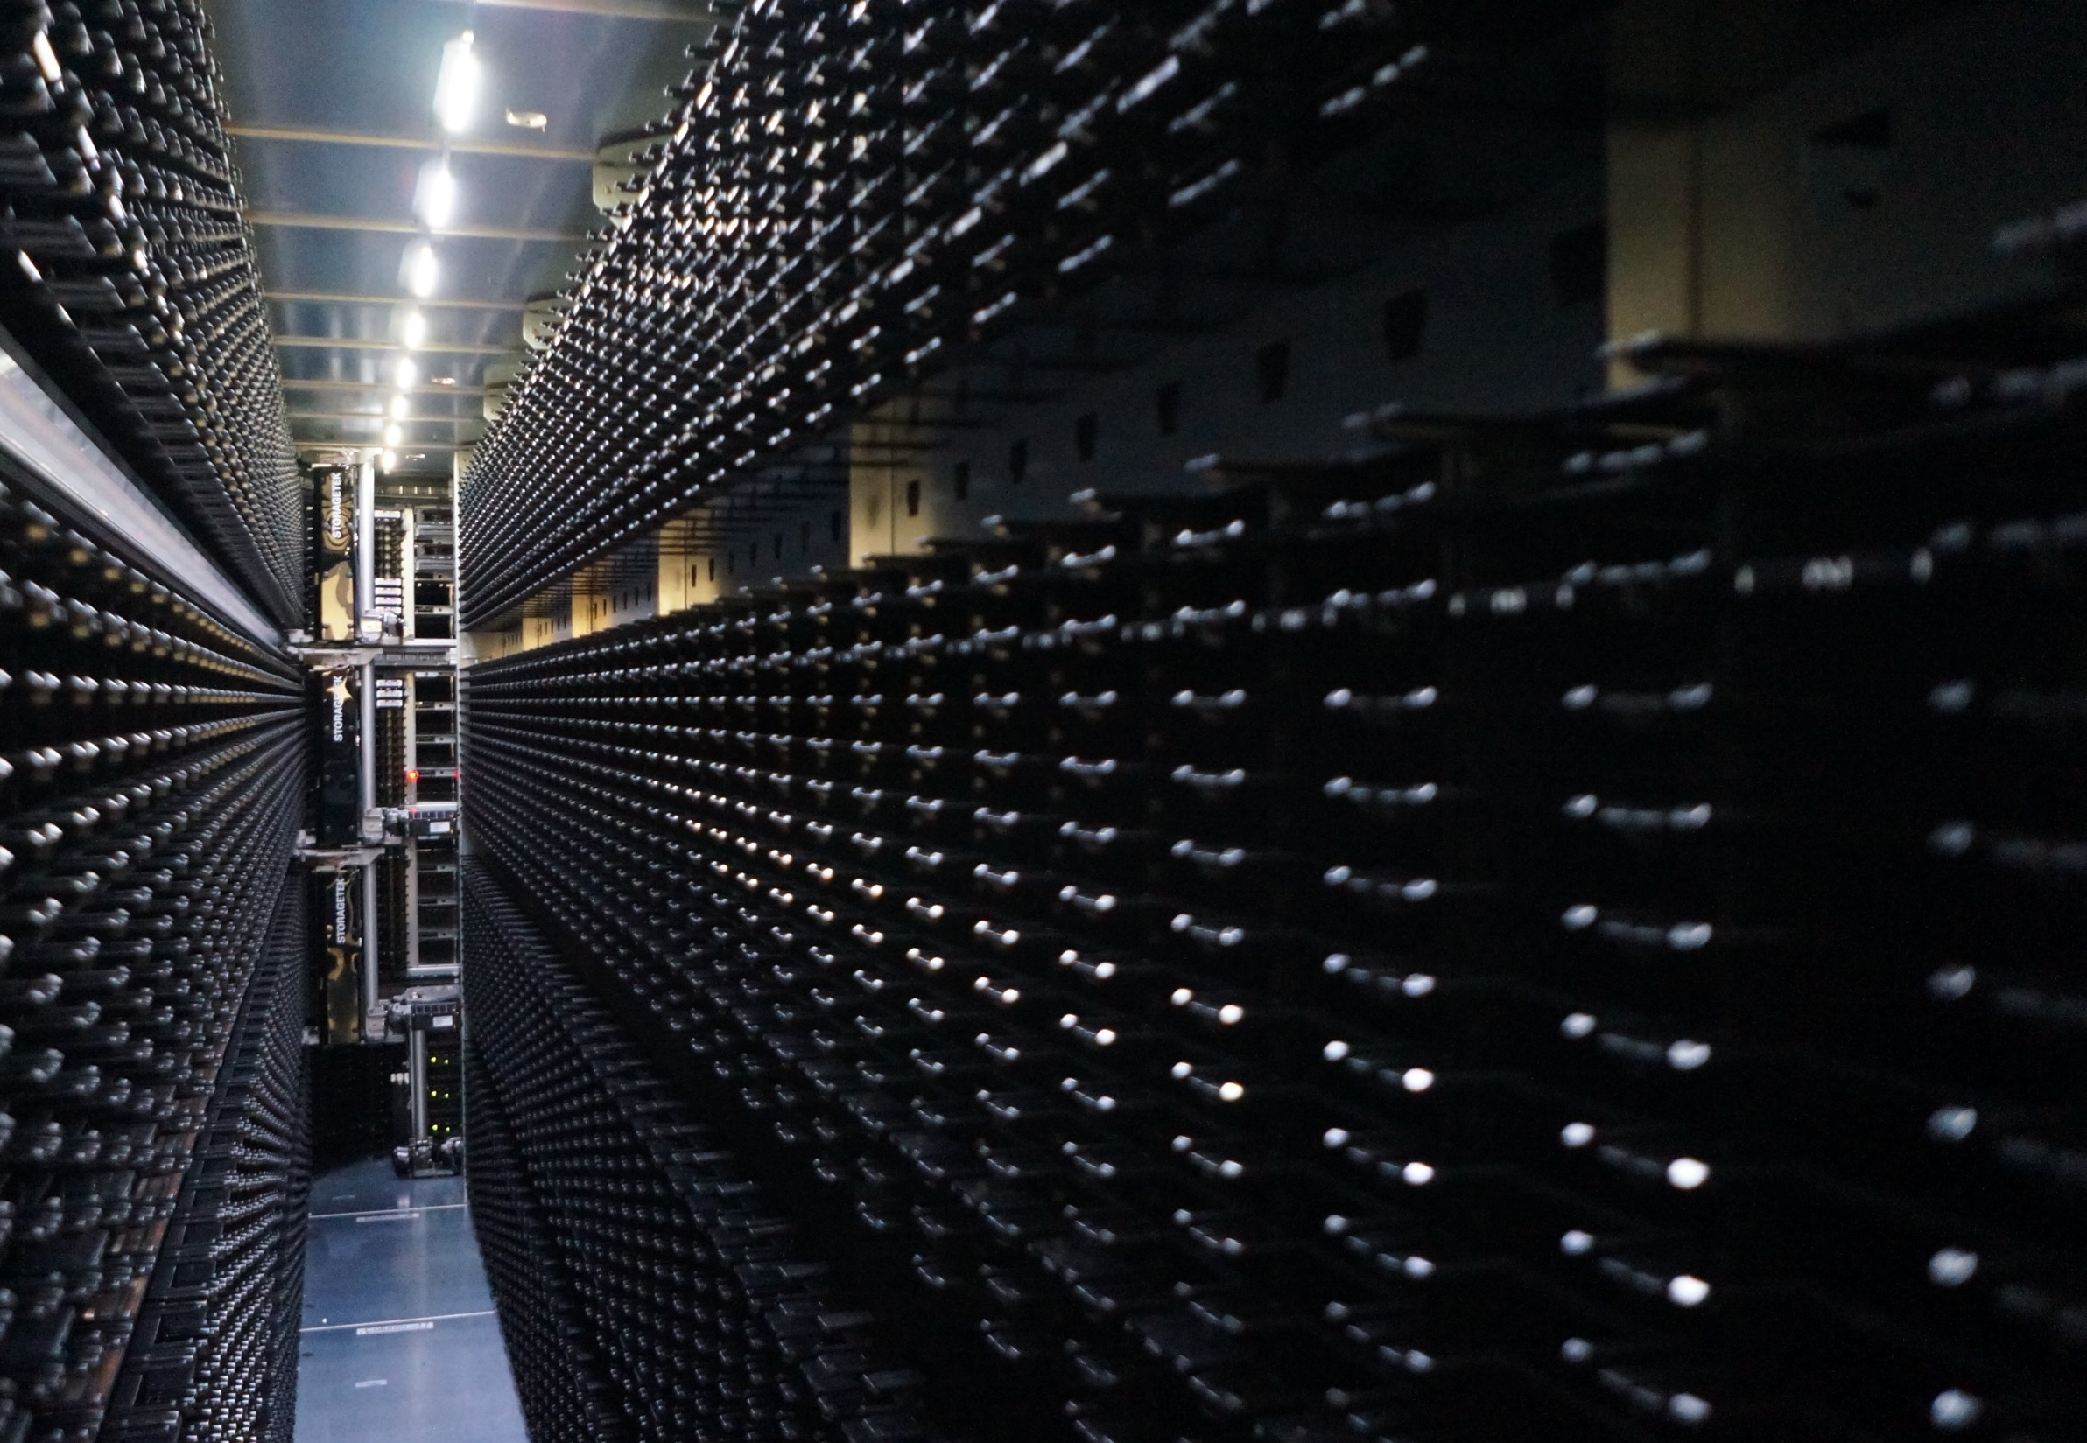
German Satellite Data Archive
'D-SDA 3.0'
Ensuring long-term data preservation
  Seeking sustainable funding through national government
'National Remote Sensing Data Service'
  Central EO data discovery and access for for national public service
  Cooperation with German defence mapping and federal surveying agency
'Big Data' concepts for Copernicus
  '1 peta online'
  Copernicus data hub relay
  Collaborative ground segment initiative
Data discovery & access
  EOWEB-Geoportal – our new EO data portal
  OGC-compliant spatial data infrastructure
  ISO collection metadata and landing pages
'D-SDA Application Services'
  Archiving and access services for DLR scientific projects
  Services, governance, cost model
Data stewardship
  Infrastructure and data curation, transparent product quality and conditions-of-use, persistent identifiers

Slide 12
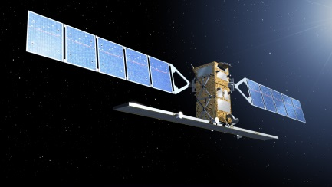
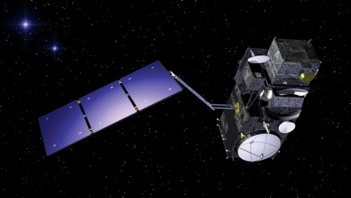
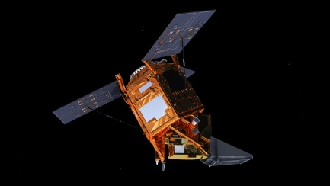
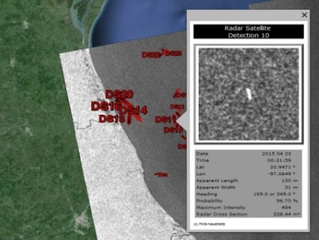
Role in Copernicus Sentinel Ground Segment
DLR ground segment
Copernicus 'core GS'
Sentinel-1 PAC and long-term archive
Sentinel-3 OLCI PAC and long-term archive
Sentinel-5 Precursor PDGS
Data Hub Relay
© ESA
© ESA
© ESA
German national initiatives
X-band receiving station Neustrelitz
→ NRT services maritime security
Copernicus 'collaborative GS'
'CODE-DE' - Copernicus Data and Exploitation Platform – Deutschland
  Online data archive
  Hosted processing
  Extended product portfolio

Slide 13
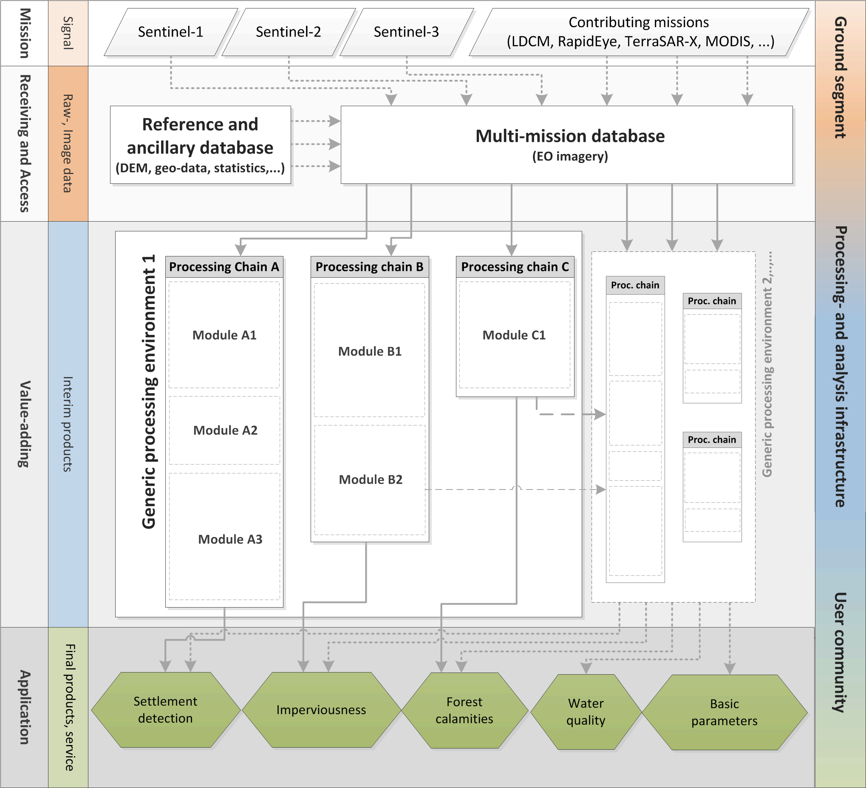
EO Services Evolution
OPUS-GMES – connecting the Copernicus space component
and the service sector
Objectives
Establishing a powerful link between Copernicus space component and service sector
Testing innovative concepts and technologies for implementing geo-information services based on Sentinel data streams
Core elements
Data access and distribution
Multi-mission / multi-data processing systems
Innovative data management and analysis tools
Standardization and quality assessment
Inside DLR
Outside DLR

Slide 14

Thank you for your attention -- Questions?
Katrin Molch
German Aerospace Center DLR
German Remote Sensing Data Center
Information Technology
katrin.molch@dlr.de

