Slide 1
UK Sentinel Data Access
Richard Hilton

Slide 2
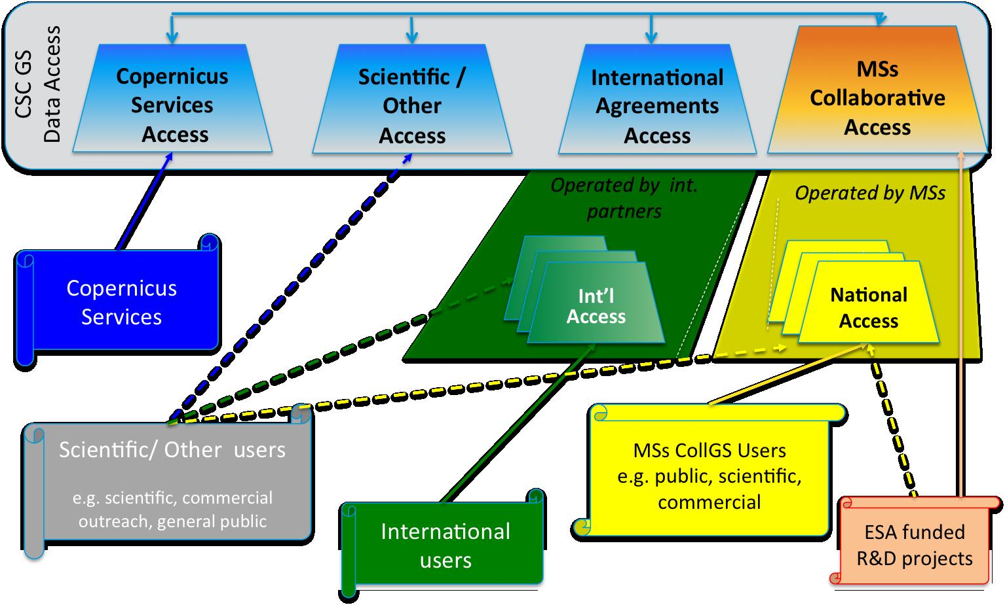
ESA Copernicus Data Access
Notes:
Science users can access direct from Sci Hub. S3 marine products and Atmospheric products will also be available via Eumetcast.

Slide 3
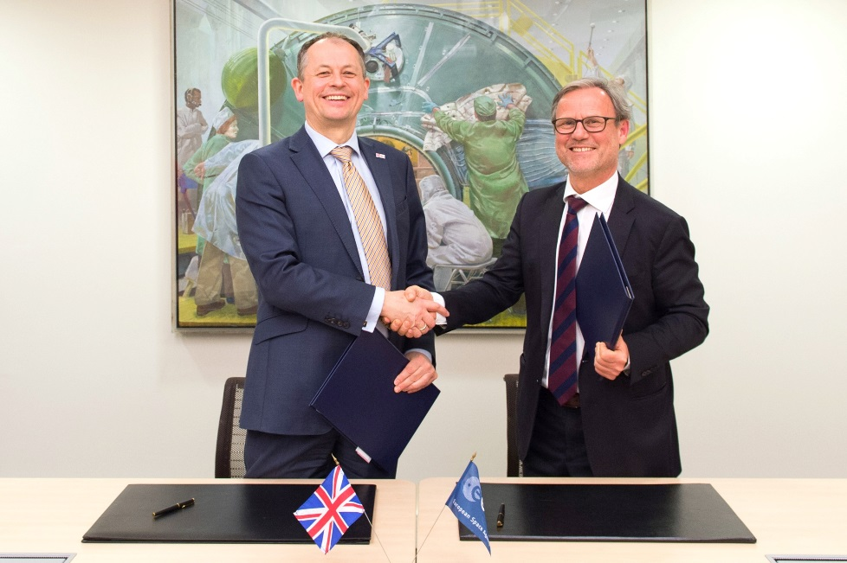
ESA-UKSA Collaboration agreement
Understanding for the Sentinel Collaborative Ground Segment
Signed 18th March 2015
Enables UK Collaborative GS data access
Direct access to Sentinel data
Technical advice and data processing and archival software
Notes:
Technical advice on data archival and dissemination. Software made available by ESA to national initiatives.

Slide 4
Background
UK CGS - Partnership
Airbus DS Geo-intelligence (Farnborough) operates the Processing and Archiving facilities for Sentinel 1 and Sentinel 2
Satellite Applications Catapult responsible for managing and disseminating the data to UK commercial users
STFC-CEDA responsible for managing and disseminating the data to UK academic users
& other UK partners involved in CGS development

Slide 5
Proposed Use Cases
The Catapult is responsible for user management including, user registration, licence issues etc.
It is anticipated to have 3 uses cases for access:
A short term rolling archive (time period TBD- nominally 1 month)
Data will be automatically pulled or pushed across the network
Access via spatial or temporal searches
Automatic routines/scripts for translating the geographical/temporal searches need to be developed to extract the required data scenes (Catapult responsibility).
Access for large volume remote processing of data using users own algorithms on the Airbus (Astrium) Processing cloud.

Slide 6
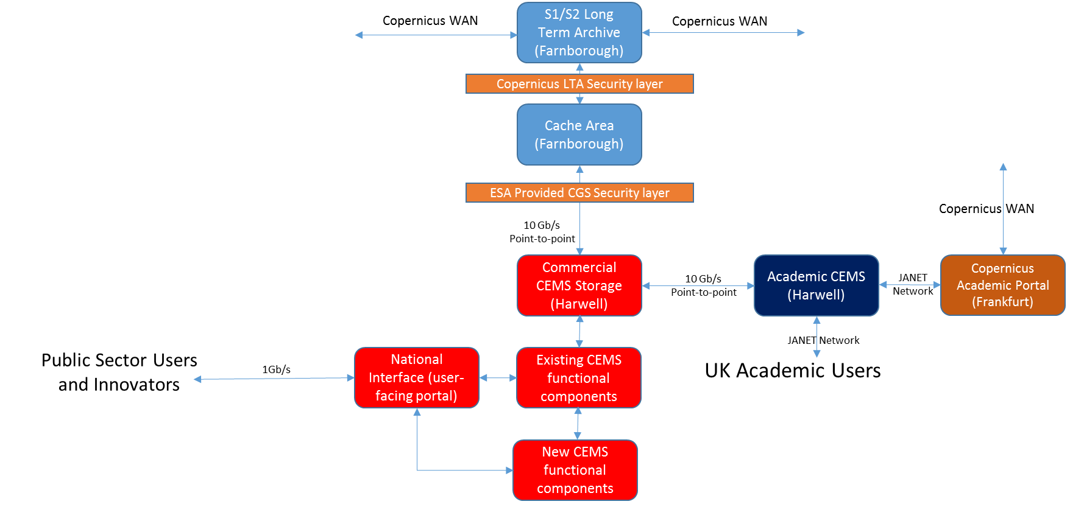
Baseline System

Slide 7
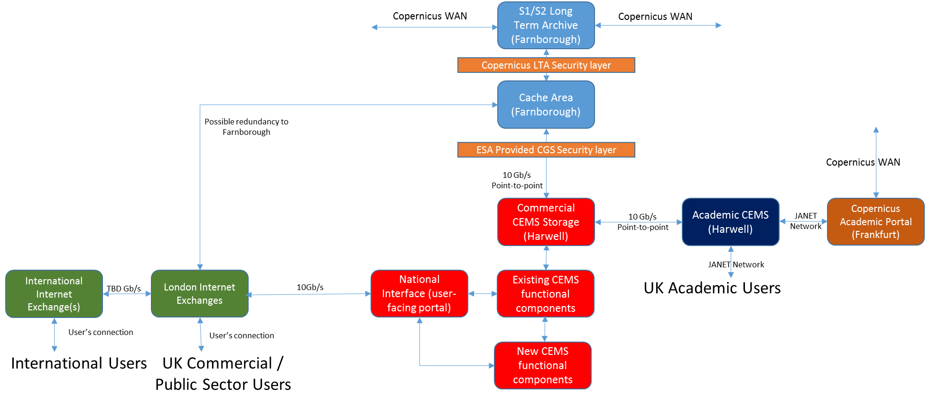
Evolved System

Slide 8
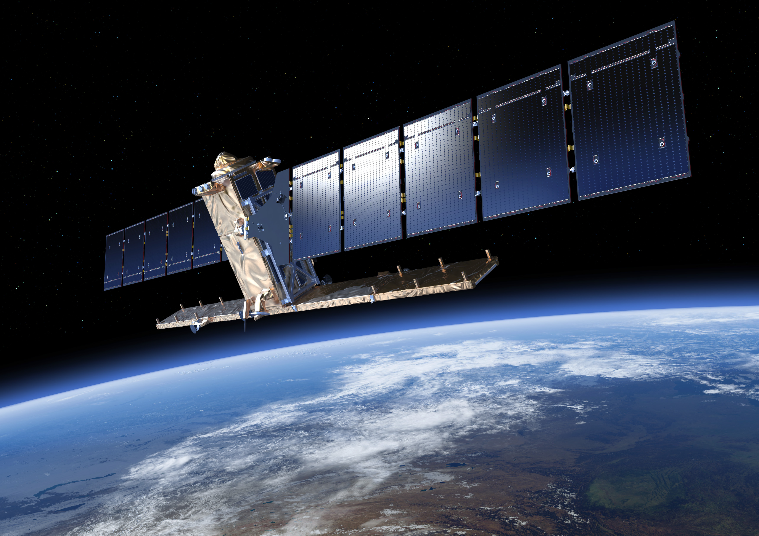
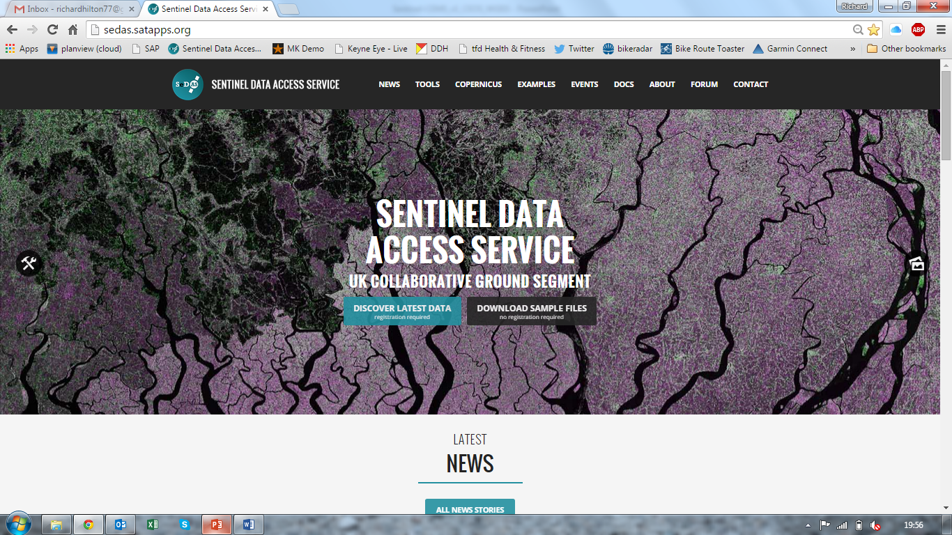
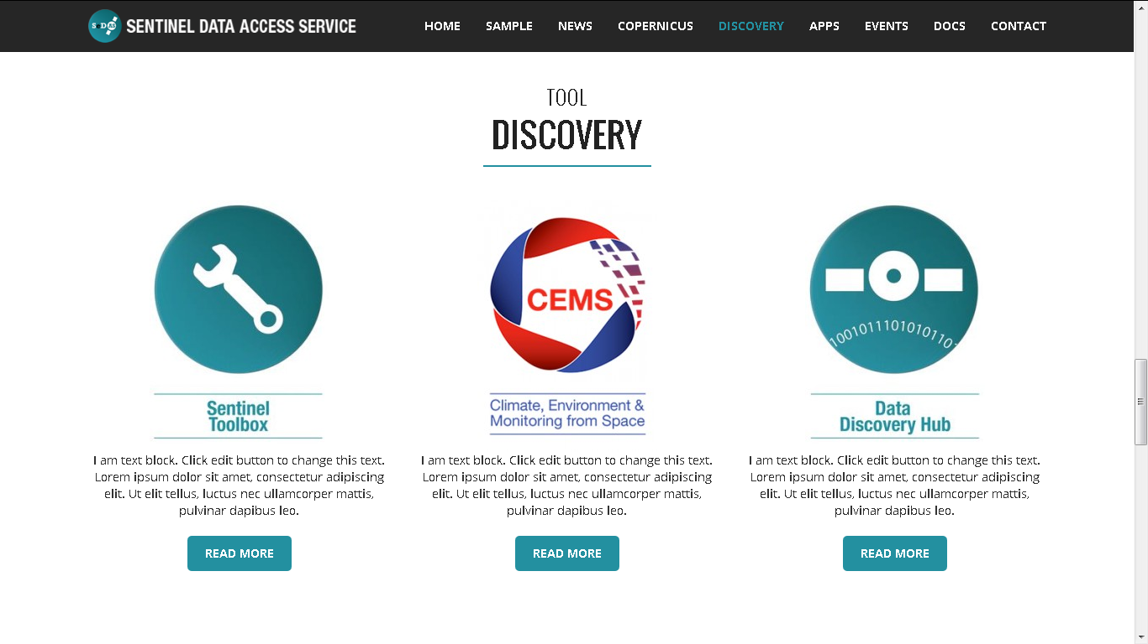
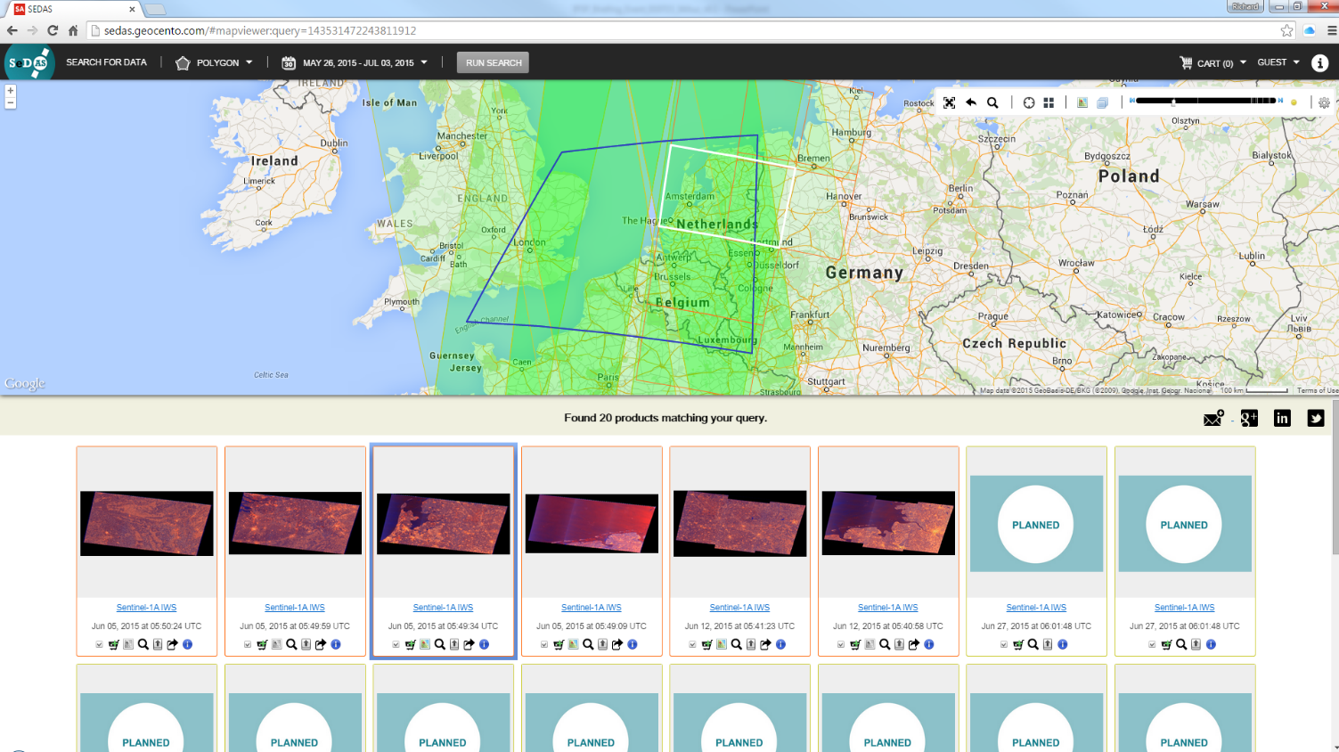

Slide 9
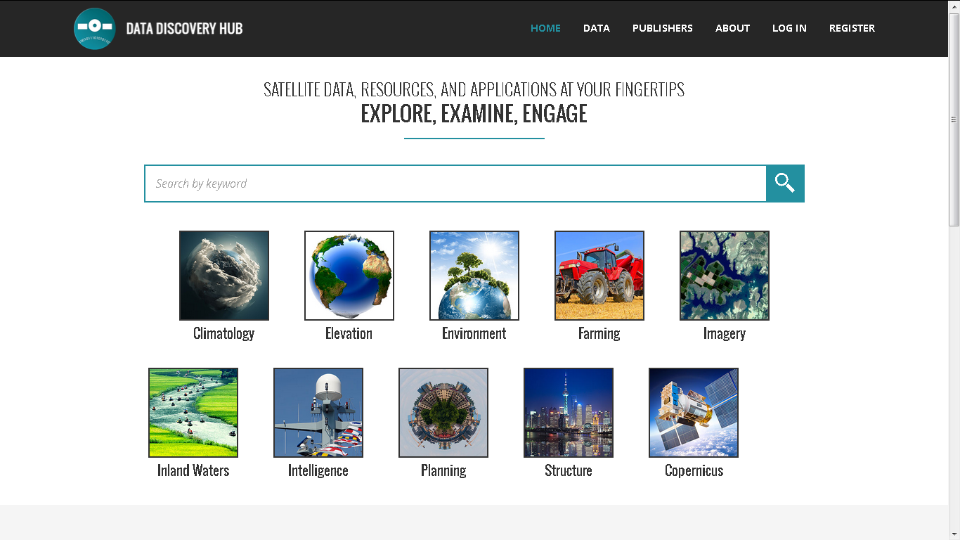
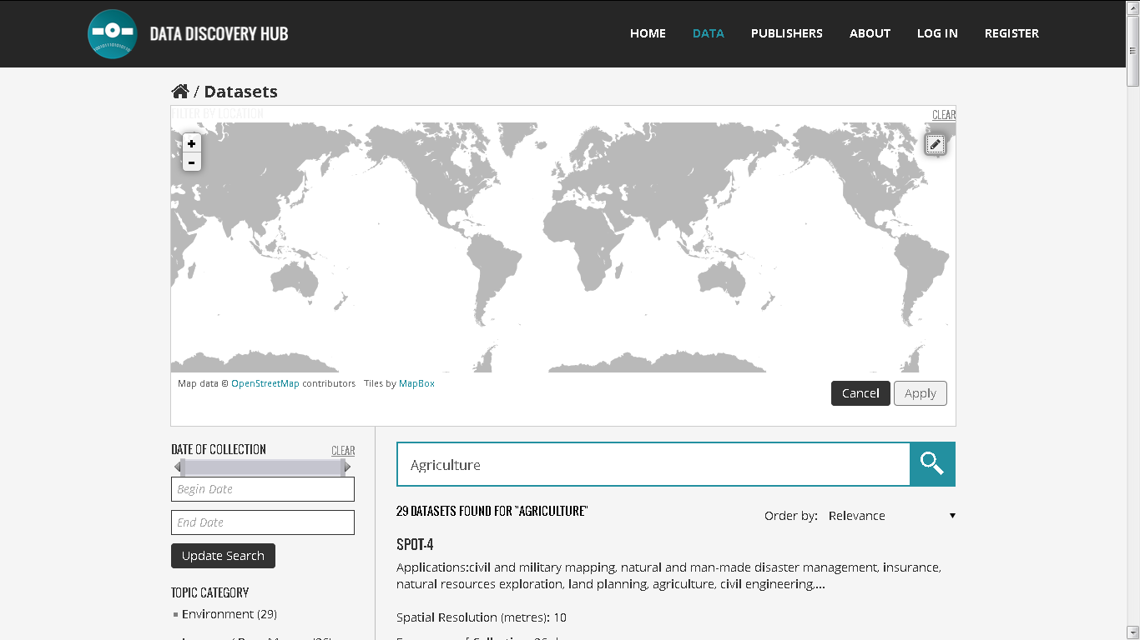
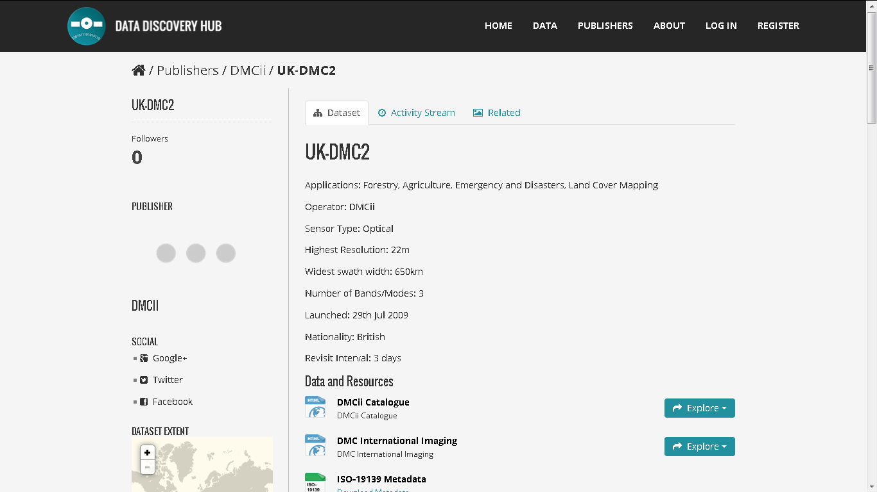
Notes:
Looking at other models for Data hubs around the world we felt that many resided within the community leaving little or no room for other markets and industries to engage even at a level that enables new users of the data to understand at a most basic level what can be done with what. Also we are aware that we have no wish or right to try and store the world’s satellite data and although we have an environment capable of storing a number of petabytes of data this was not going to be an economically viable option. However due to the standards work being undertaken within the public, academic and commercial institutions around the world a network of metadata catalogues already exist.

Slide 10
Development Planning
Items that need attention | S1 ready | T1 | T2 | T3
Home Page
First beta | ✓ | V1 by KO+4m | V2 | V3
Image of the Month | ✓ | ✓ | ✓ | ✓
News Area | ✓ | ✓ | ✓ | ✓
Intro to EODEP | ✓ | ✓ | ✓ | ✓
Account access | ✓ | ✓ | ✓ | ✓
Access to DDH | ✓ | ✓ | ✓ | ✓
Links | ✓ | more | more | more
Feedback | ✓ | ✓ | ✓ | ✓
Contact Us | ✓ | ✓ | ✓ | ✓
Data Discovery Hub
Sentinel swath planner integration | S1 only? | ✓ | ✓ | All Sentinel
Allow searches by AoI, geo-extents, sorted-listing, application, key word | ✓ | ✓ | ✓ | ✓
Registration (check requirements) | ✓ | ✓ | ✓ | ✓
Allow both online view and download | limited | limited | Less limited | Unlimited
Direct access to local archives | ✓ | ✓ | ✓ | ✓
Direct access to offsite archives | ✓ | ✓ | ✓ | ✓
Dedicated Sentinel area | ✓ | More developed | More developed | More developed
Direct access to processed data | - | - | ✓ | ✓
Links to other datasets | ✓ | ✓ | ✓ | ✓
Items that need attention | S1 ready | T1 | T2 | T3
Thematic Platforms
Facilitating VMs | ✓ | ✓ | ✓ | ✓
Facilitating comms between tools and data accessed by DDH | - | - | ✓ | ✓
Access to std processing tools | - | - | ✓ | ✓
SDK facilitating tool development | - | - | ✓ | ✓
Access to hi-level info-extraction tools | - | - | - | ✓
In situ small-data (single-scene) processing | - | - | ✓ | ✓
In situ big-data (batch) processing | - | - | - | ✓
Commercial/operational platforms | - | - | - | ✓
Merchandising | - | - |  | ✓
Collaboration Tools
Document libraries | ✓
Fora | ✓
Event calendar | ✓
Online platform journal | - | - | ✓ | ✓
Publishing capability | - | - | - | ✓
Security
ESA SSO integration | ✓ | ✓ | ✓ | ✓
…more from systems | - | ✓ | ✓ | ✓
Platform Outreach and Promotion
Promotional campaign | ✓ | ✓ | ✓✓
Dedicated animator |  | partial | partial | ✓
Back-office support?
CATAPULT RESTRICTED

Slide 11
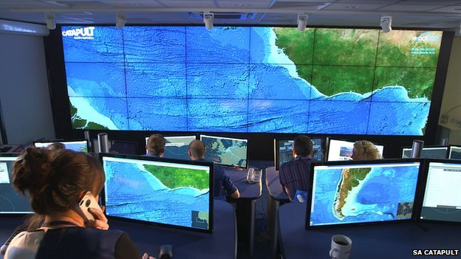
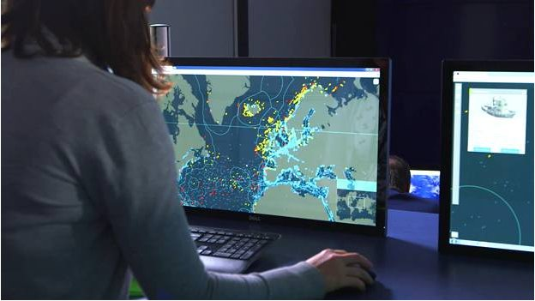
Example Use Case – Maritime Situational Awareness
Notes:
whaleshark

Slide 12
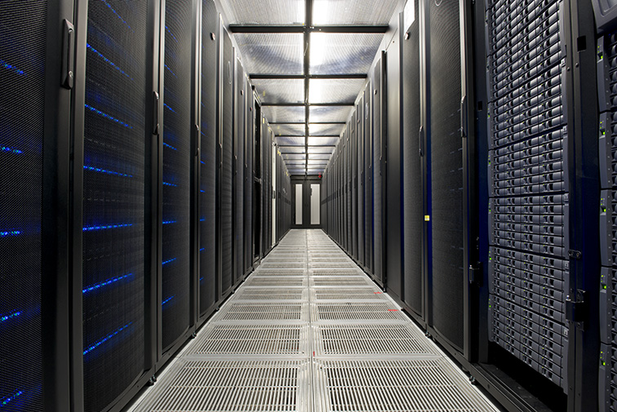
Academic User Access via JASMIN-CEMS and CEDA
User community primarily in UK universities
Working on projects funded by ESA (CCI), EC (H2020) and NERC (e.g. NCEO)
Requirements
S3: Full archive on JASMIN-CEMS hardware for long term dataset processing and analysis for climate applications
S1, S2: Large subsets of data on JASMIN-CEMS hardware for science processing

Slide 13
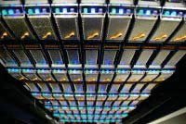
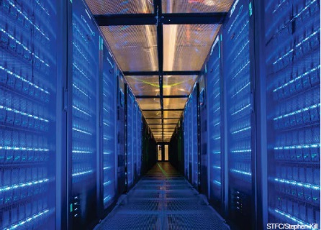
Academic User Access via JASMIN-CEMS and CEDA
JASMIN-CEMS Big Data Infrastructure:
Big Data Storage and Computing
17 Petabytes & 4,000 cores, of which a fraction will be allocated to Sentinel data, processing and analysis
Connected to JANET academic network (linked to GEANT European network)
Successfully used to transfer O(10) TB/day climate model data from modelling centres into CEDA archives
RAL-Catapult dedicated link
Eumetcast receiver

Slide 14
Sentinel data at CEDA
User management, access control, helpdesk and data download services through CEDA
Continuous transfer via Airbus-Catapult Collaborative GS route (S1, S2) and direct from ESA Collaborative Hub (CollHub)
Recent data (O)6-12 months stored on-line
Older data stored near-line
Self-service access for data download or local processing on JASMIN-CEMS for science projects

Slide 15
Example science use
Scientists from NERC COMET/U.Leeds using Sentinel 1A data to determine strain rate: measure of how continents deform.
Observations of strain rate help to improve knowledge of the distribution of earthquake hazard.
Developing system to continuously process data into high accuracy ground deformation products

