Slide 1

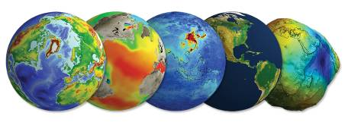
Data Stewardship Interest Group
WGISS-39 Meeting
Preservation of Software & Documents at CEOS Agencies: approaches & lessons learned
Tsukuba, Japan (JAXA) – 11 - 15 May, 2015
Mirko Albani, European Space Agency

Slide 2
Digital Objects Preservation
Generic definition:
Digital Preservation is the management and maintenance of digital objects so they can be accessed and used by future users.
In Earth Observation Context
Digital Objects:
Data Records: these include raw data and/or Level-0 data, higher-level products, browse images, auxiliary and ancillary data, calibration and validation data sets, and descriptive metadata;
Associated Knowledge: this includes all the Tools used in the Data Records generation, quality control, visualization and value adding, and all the Information needed to make the Data Records understandable and usable by the Designated Community.

Slide 3
Some Challenges
Long-term accessibility and exploitability of Earth observation data requires that not only sensed data but also associated knowledge is properly preserved and made accessible.
Information technology is changing rapidly affecting EO digital data preservation and use: risk of obsolescence of file formats, extant hardware and operating environments that could make data unreadable on the physical and logical level.
EO data hardware and software management environments are made obsolete by technology evolution in short timespans: need to find ways to preserve both data and their execution context.
For some digital objects, like software programs, the absence of source code may be a problem. Legal aspects, like copyrights or copy protection mechanisms, can make this even more complex.

Slide 4
Associated Knowledge Preservation

Slide 5
Associated Knowledge elements
Software/Tools:
Software Applications:
  Data Product generation
  Quality control
  Product visualization
  Value adding
Information:
Documentation
Images
Metadata file (information on creation, access rights, restrictions, preservation history, and rights management)
Multimedia (Video/Audio)
SW related “IT Infrastructure”:
  Compiler
  Programming language
  Storage system
  Operative System
  Libraries
  Databases
  Workflows
  Bi directional links
  Schemas
  Email

Slide 6
Information Preservation

Slide 7
Features of Information Format for Digital Preservation (not exhaustive)
Open Format with no patents or licenses preferred
In wide use and endorsed by other established repositories
Variety of writing and rendering tools available for the format
Interoperable: tools available for conversion to other formats
Inclusion of error-correction capabilities and data integrity features
Supporting a stable mechanism for metadata management
Lossless formats preferred for image, video and audio

Slide 8
Proprietary vs Open Formats
PROPRIETARY | OPEN
Full Documentation not always available | Unlimited use
License and patent rules may apply | No license fees
License agreements subject to change | No patents owners
Restrictions for use and modifications may apply | Full Documentation Available
 | Open for self-made modifications

Slide 9
Information Format for Digital Preservation
Text documents (often MS Word, Excel Files, txt, etc.) can be preserved as:
  PostScript, PDF, DSSSL, RTF, ASCII, SGML, TIFF, CGM
    PostScript, PDF, RTF are proprietary
    DSSSL, SGML not (yet?) widely used
    CGM has multiple variants in use
Images can be preserved as:
  Loss of Quality JPEG, JPEG2000
  Lossless compression TIFF, PBM, PNG, FITS.
Metadata can be preserved as:
  ASCII, the most durable format for metadata because it is widespread, backwards compatible when used with Unicode (superset of ASCII), and utilizes human-readable characters, not numeric codes.
  For higher functionality, SGML or XML should be used.
Multimedia can be preserved as:
  AVI, QuickTime, MPEG, WMV, MJ2.
From various Standards and Publications Sources
PDF, PDF/A, FITS
TIFF, FITS
ASCII, XML
MJ2

Slide 10

PDF/A Format (suitable for documents)
PDF/Archive standards (ISO 19005-1:2005, Document management – Electronic document file format for long-term preservation – Part 1: Use of PDF 1.4 (PDF/A-1)
PDF/Archive was created because several organizations were being faced with large collections of electronic documents that they needed to manage, preserve, and make searchable and available for generations to come.
The standard specifies two levels of compliance for PDF files:
    PDF/A-1a – Level A compliance in Part 1
    PDF/A-1b – Level B compliance in Part 1
PDF/A-1b's objective of ensuring reliable reproduction of the visual
appearance of the document
PDF/A-1a includes all the requirements of PDF/A-1b and additionally
requires:
    Document structure must be included (hierarchy)
    Tagged PDF (use of alternative texts for images, tagging text spans and giving them an ID, replacement texts for symbols)
    Unicode character maps
    Language specification
  PDF/A-1a's objective is to ensure that document content can be searched and repurposed

Slide 11

PDF/A Format (suitable for documents)
PDF/A-1 (ISO 19005-1) files allow:
  Embedded fonts which includes only those fonts which may be legally embedded without a royalty fee
  Device-independent color
  XMP Metadata (open but proprietary metadata methodology that is used for metadata creation, processing, and interchange).
PDF/A-1 files do not allow:
  Encryption as the method of encryption may not be supported when the files are opened at a later date
  LZW (Lossless Data Compression Algorithm) Compression due to intellectual property constraints
  Embedded files
  External content references because the references may change or be broken
  PDF Transparency - a file can use other techniques than the use of transparency keys to provide the visual effect of partially transparent graphics
  Multimedia
  JavaScript

Slide 12
TIFF Format (suitable for images)
Tag-based file format for storing and interchanging raster images.
The most recent version of TIFF (Tagged Image File Format) is 6.0 (1992)
  Disclosure: Fully documented.
  Adoption: The format is widely supported by image-manipulation applications (Adobe Photoshop and many others), by desktop publishing and page layout applications (QuarkXPress, Adobe InDesign, and others), and by scanning, faxing, word processing, optical character recognition, and other applications.
  Licensing and Patents: Not exploited for the TIFF wrapper format.
  Transparency: Depends on bit stream encoding.
  Self-Documentation: The TIFF specification defines a framework for an Image File Header (IFH), Image File Directories (IFDs), and associated bitmaps.

Slide 13

TIFF Format (suitable for images)
    External dependencies: None.
    Technical protection considerations: None
    Clarity: Excellent support for images with very high spatial resolution
    No support for vector graphics.
    Multi-page files supported for a sequence of images
    Embedded metadata enables people in and outside an organization to work more efficiently, provides valuable data to the systems that preserve digital content, and can assist in disaster recovery.

Slide 14
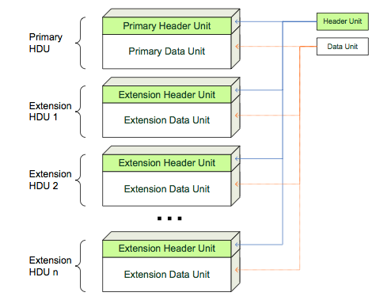
FITS Format (suitable for images)
Flexible Image Transport System (FITS) is not only a format for images but it is a very general format capable of storing many types of data, including bitmaps, ASCII text, multidimensional matrices, and binary tables.
NON Proprietary: maintained by the international scientific community and, as such, is not proprietary. Specifications currently maintained by the IAU FITS WG.
Disclosure: FITS is an open format based on a specification, the “FITS Reference”, publicly available. No royalties to pay for the use of the format, so anyone can create software applications able to manage FITS files.
Complete Documentation: FITS is fully documented in the FITS Reference
Standardization: FITS is a standard format recognized by the NOST since 1993.
Wide Adoption: currently the most commonly used format in astronomy. Many software applications available for creating and viewing files in FITS format and for their conversion from and to other image formats.
Simple Structure
Notes:
The FITS file format is a well-established format for exchange and archiving of astronomical data. It is supported by the International Astronomical Union, NASA, and other national and international bodies engaged in astronomy and related fields. Data from major international programs, such as the Hubble Telescope , the Sloan Digital Sky Survey, and the orbiting Chandra X-ray Observatory are released in the FITS format. So are records from land-based observatories, such as the National Optical Astronomy Observatory (NOAO), the National Radio Astronomy Observatory (NRAO), and the Keck Observatory. In Europe, the land-based European Southern Observatory (ESO) and recent missions of the European Space Agency (ESA) release their data in the format.

Slide 15
FITS Format (suitable for images)
Robustness: Its simplicity and the fact that it is not compressed, the corruption of certain sequences of bits does not produce, as a rule, the loss of information content and the image degradation generally remains within acceptable levels.
Stability: The FITS format is very stable: over more than thirty years there have been only three official versions
Compatibility: The format is backward and forward compatible. FITS has been designed keeping in mind the aspect of long-term preservation. The maxim "once FITS, always FITS" that has been coined for it clearly establishes that any changes to the format that makes a FITS file not longer valid is not allowed.
Self-containment: All the information necessary to correctly represent (on screen or print) a FITS file, are included in it the file itself. Links to external resources are not allowed.
Self-documentation: FITS file format is self-documented. In fact, a major feature of the FITS format is that meta-data are stored in the Header Unit in a human-readable ASCII format so anyone can easily examine, using a simple text editor, the header unit to get information on the file itself. These keywords aim to document the file and provide information such as size, origins, history data and anything else the creator wishes. Furthermore, in addition to standard keyword is also possible to create custom keywords to better describe the particular type of data that will be stored in the file.

Slide 16
FITS Format (suitable for images)
Device Independence: FITS is a multi-platform format, a file in FITS format can be viewed, printed or otherwise reproduced in a reliable and consistent way regardless of hardware and software used.
The FITS format does not provide technical protection mechanisms. Is not provided, for example, encryption, as well as control of access through username and / or password.
Impact of patents: The FITS format has no restrictions on its use neither now nor in the future.
Accessibility. It is possible to define a keyword to specify the "alternative text" that can be read by the visualization software to describe the image, and this is very useful in cases where the image is enjoyed by persons with impaired vision
Unmodifiability. The FITS can be modified using specially designed software (FITS editor). However, if necessary, its modifiability can be ensured by the use of technical measures such as using checksums or digital signatures, etc.
Security. In the current state of knowledge, FITS can not contain viruses or other forms of malware.
Efficiency. The FITS format is not compressed, so files encoded in this format have often a a larger size than file encoded in other (compressed) formats.
Extract from Stefano Allegrezza presentation

Slide 17
Software/Tools Preservation

Slide 18

Software & Applications Preservation
Needs: preservation of software and data records are two sides of the same coin.
Need to preserve in several cases the execution environment for the software related to EO data.
In some cases, if the source code is preserved, there could be the possibility of rebuilding the software in modern computing environments.
More usually, there is the need to preserve the running environment with the data.
Software is reliant on hardware, and hardware changes quickly.

Slide 19
Approaches
Preservation of hardware (techno-centric)
Emulation (data-centric)
Virtualization (data-centric)
Migration (functionality-centric)
Cultivation (process-centric)
Hibernation (knowledge-centric)
Deprecation (budget-centric)
Procrastination (I'll-get-round to it eventually -centric)

Slide 20
Preservation of Hardware
Easiest way to ensure that there will always be hardware on which to run your software is to preserve the hardware (and its operating system and any other reliant software).
Advantages:
  It is easy and clearly defined
  Can change to Hardware Emulation at later date
Disadvantages:
  Costly, especially when hardware fails
  Does not guarantee future access if dependent on other hardware/software (e.g. networking)
  Maintenance (over time hardware components will wear out and must be replaced; If the hardware is no longer manufactured components become scarce and expensive)
  Isolation (if your software only works with very specific hardware, you limit your users to those people with the right hardware)

Slide 21
Emulation
Emulation addresses the original HW & SW environment of the digital object, and recreates it on a current machine. The emulator allows the user to have access to the software on a current platform as if it was running in its original environment.
Emulate hardware platforms with another piece of hardware, typically a special purpose emulation system
Emulate applications & Operating System: ability of a software to emulate (imitate) another software (e.g. application or operating system).
Advantages:
Emulating hardware easier to manage
If emulation layer continues to be developed, software can continue to be run indefinitely
Disadvantages:
Right and ad-hoc emulator should be found; if old hardware is rare, no emulator might exists
Need all aspects of hardware to be emulated correctly
The emulation software could itself become obsolete

Slide 22
Virtualization
Hardware virtualization or platform virtualization refers to the creation of a virtual machine that acts like a real computer with an operating system. Software executed on these virtual machines is separated from the underlying hardware resources.
Different types of hardware virtualization include:
Full virtualization – complete simulation of the actual hardware to allow software to run unmodified.
Partial virtualization – some but not all of the target environment attributes are simulated.
Hardware virtualization is not the same as hardware emulation. In hardware emulation, a piece of hardware imitates another, while in hardware virtualization, a hypervisor (a piece of software) imitates a particular piece of computer hardware or the entire computer.
Advantages:
No need to update/migrate software running on a Virtual Machine when underlying hardware changes
Disadvantages:
Need to virtualize SW to run on virtual machines

Slide 23
Migration
Updating software as required to maintain same functionality, porting/transferring before platform obsolescence. Periodic transfer from one HW and/or SW configuration to another, or from one generation of computer technology to a subsequent one.
Migration approaches:
  Complete re-write of the code allows the software to be used on a completely different system
  Continual migration, keeping code up to date with the latest changes to the hardware and software that code relies on
Advantages:
  Enables access on other platforms
  Retain ability to retrieve/access/use data exploiting technology progress
Disadvantages:
  Requires continued effort for development; significant effort if complex SW; time-consuming, costly, error-prone

Slide 24
Cultivation
Cultivation is the process of opening development of an own software. It aims at keeping software “alive” by moving to a shared development model through:
Distributing and spreading knowledge about the software to minimize single point of failures (e.g. departure of a developer)
Building a self-sustaining community of developers working together and sharing efforts to keep software up to date
Advantages:
Increases chances of further development of software and possible migration to other platforms
Disadvantages:
Long process, requiring more coordination
Possibility for loss of control of direction
Time investments into building the community, which requires work to understand what the community wants and how to appeal to them

Slide 25
Hibernation
Aim to preserve the knowledge of how to resuscitate/recreate the exact functionality of the software at a later date. Applicable for example when:
the software has come to the end of its useful life, but there is the possibility that it might need to be resurrected to double-check analysis or prove a result in future
Currently there is not a user community but this might occur in the future
Advantages: allows break in effort
Disadvantages:
Can be difficult to check if hibernation processes are rigorous until after it is too late
Preparing software for hibernation can be resource heavy, and if the software is never resurrected you may feel that those resources were wasted

Slide 26

Deprecation & Procrastination
Deprecation
Not properly a preservation approach; it is easy to perform but often marks the end of a software package’s life and is typically only chosen when no other option is available.
It might be expensive or impossible to resurrect the software in future.
Procrastination
“Never put off until tomorrow what can be done the day after tomorrow... or the next day”
Advantages:
Comes naturally, very easy and very cheap
Disadvantages:
Not a valid preservation technique!
May require software archaeology skills in the future

Slide 27
Software preservation principles (1)
Once the Software Preservation approach is selected, the following steps are to be followed:
Preservation
Retrieve
Reconstruct
Replay
Preserve: a copy of a software “product” needs to be stored for long term preservation. Software is a complex digital object (c.f. an information package as in OAIS); what is actually preserved is dependent on the software preservation approach taken. There should be a strategy to ensure that the storage is secure and maintains its authenticity (fixity again using OAIS terminology) over time, with appropriate strategies for storage replication, media refresh, format migration etc.
Retrieve: in order to retrieve it at a date in the future, it needs to be clearly labelled and identified, with a suitable catalogue. This should provide search on its function and origin (provenance information).

Slide 28
Software preservation principles (2)
Reconstruct: The preserved product can be reinstalled or rebuilt within a sufficiently close environment to the original that it will execute satisfactorily. For software, this is a particularly complex operation, as there are a large number of contextual dependencies to the software execution environment which are required to be satisfied before the software will
execute at all.
Replay: In order to be useful at a later date, software needs be replayed, or executed and perform in a manner which is sufficient close in its behavior to the original. As with reconstruction, there may be environmental factors which may influence whether the software delivers a satisfactory level of performance.

Slide 29
ESA Approaches
&
Lesson Learned

Slide 30

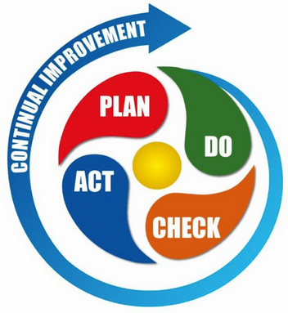
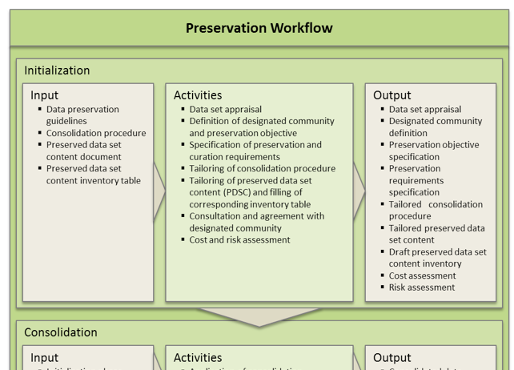
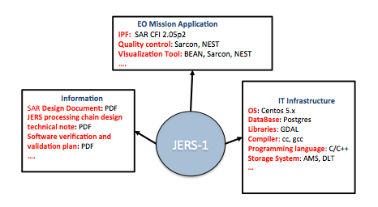
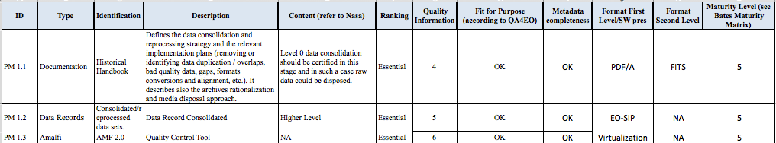
ESA Approach – Preservation Life cycle
Mission Preservation Requirements
Appraisal, Preservation Requirements, Objectives and Cost Assessment
Lesson Learned
Preservation Workflow
IMPLEMENTATION
Application/Infrastructure/Information
Schema
What to preserve, Information Format & Software preservation approach
PDSC Tailoring Checklist

Slide 31
ESA Approach – Preservation Life cycle
Mission Preservation Requirements: Designated community requirements.
PRESERVATION WORKFLOW: during the initial phase a dataset appraisal will provide an initial conception of whether the data set should be preserved and kept accessible and usable for the long term. Topics to be considered include mission relevance, economic considerations, temporal and geographical coverage, size, storage media and archiving format. The results of this phase are some main decisions on Preservation Requirements but also on File Format and how preserve the Software.
  Application/Infrastructure/Information Schema: result of the dataset appraisal and allows the definition of a preservation network used by Curator to take decision in terms of Risk and Cost management.
PDSC TAILORING CHECKLIST: Preserved Dataset Content addresses on WHAT preserve and it should be used as a “checklist” and opportunely tailored for each EO mission/instrument according to their specific characteristics to generate one or more inventory documents.The checklist shows the relevant fields on Format File for any documents to be preserved and for which it is foreseen also another secondary file format to grant the preservation. For the Software preservation the file indicates which strategy needs to be pursued.
IMPLEMENTATION: during the preservation process all lessons learned are collected in order to improve the mission preservation cycle

Slide 32
Approaches at ESA: Information and SW
Two categories of Documents to be preserved have been identified:
  Mission Specific documentation (mandatory for preservation) for which two preservation formats are currently considered for implementation → PDF/A and FITS
  Other kind of documentation (e.g. papers, presentations) for which one preservation file format is enough → PDF/A
Images related to EO missions considered preservation format is TIFF or FITS depending on the level of metadata schema to be preserved.
The Metadata files are preserved in XML.
The Multimedia file format is under analysis.
The Software Preservation approach at ESA is based on different strategies depending on the software (e.g. virtualization, periodic migrations, hybernation).

Slide 33
Approach at ESA – Experiences
Instrument Processing Facilities and Multi-Mission Facilities Infrastructure Virtualization projects
Dependency on legacy hardware, difficult to maintain, was a critical issue for long-term exploitation of the EO products archive and a typical situation for IPFs of historical missions.
IPFs: A series of mission data processors was virtualised: AVHRR, SeaWiFS, Landsat TM, Envisat ASAR, Envisat MERIS, Envisat AATSR, Envisat GOMOS, Envisat MIPAS, Envisat SCIAMACHY, Envisat MRA2/MWR, ERS SAR, ERS Scatterometer, ERS GOME, ERS Altimeter.
MMFI: Migration of MMFI building elements including IPF processors to a virtual-machine hosted environment, identifying and eliminating as much as possible dependencies on specific HW and related SW libraries.
IPFs and MMFI components can be executed in virtual environments and have been installed on Cloud for many pilot and operational activities.

Slide 34
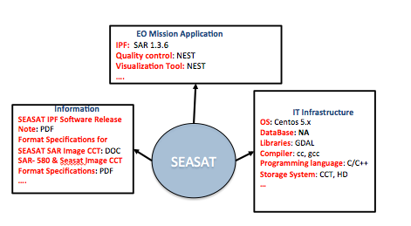
Approach at ESA
Preserved Missions examples
SEASAT and JERS-1:
Missions documentation preserved in PDF/A (2nd copy in FITS TBC)
SEASAT:
  After an initial dataset appraisal the decision on DEPRECATION of the original Processing Software was taken
  SAR IPF derived from ALOS-JERS processors: virtualized to run on cloud
JERS-1:
  After an initial dataset appraisal JERS-1 Processing Software was improved and VIRTUALIZED
  Reprocessing campaign will be performed in Cloud environment
Other Historical Missions
  Processing software hibernation (e.g. after reprocessing campaigns)
A result of the Dataset Appraisal is the Application/Infrastructure/Information Schema filled with the AS-IS mission information.
The CURATOR uses this kind of information to take decisions on Information format and software preservation approach.

Slide 35
DISCUSSION
ITEMS

Slide 36
Information Formats
What format is the most convenient for preserving:
Text Documents (word, txt, ppt) → PDF/PDF/A, FITS, other
Images (bmp, tif, jpg, gif) → TIFF, FITS, other
Metadata file → XML, ASCII
Video (avi, vob, m4v, mov, mpx, etc) → MJ2, other
What are the approaches, experiences and lessons learned at CEOS agencies?
Is there any ongoing activity in this domain?

Slide 37
Software Preservation Techniques
Preservation
Procrastination
Virtualization
HOW???
Deprecation
Emulation
Hibernation
Migration
Cultivation
What are the approaches, experiences and lessons learned at CEOS agencies?
Is there any ongoing activity in this domain?

Slide 38
Standards & Publications on Topics

Slide 39




Some Standards & Publications
EO Data Preservation Guidelines
GUIDELINE 7.3 – Processing software environment - (Level B)
Actively monitor the evolution of the environment (e.g. hardware and software operating systems) used to run “Processing Software” and perform hardware migration and software porting when necessary to maintain the original capabilities.
GUIDELINE 7.4 – Processing software virtualization - (Level C) Virtualize mission specific Processing Software to minimize dependency on the underlying environment (e.g. hardware and software operating systems).
“Reference model for an OPEN ARCHIVAL INFORMATION SYSTEM
Main Standard for digital data preservation. Potential Emulation Approaches recommendation was considered in this presentation.
“Selecting File Formats for Long-Term Preservation”: general advice in relation to electronic records preservation and management
“ELECTRONIC RECORDS - Recommendations for Preservation Formats“: guidelines on file formats for electronic records preservation
“The Significant Properties of Software: a Study”: information on software components and their preservation

Slide 40
Thank you for your attention !!!
Questions ??
Thank you for your attention

