Slide 1


Data Stewardship Interest Group
WGISS-39 Meeting
CEOS Best Practices
Tsukuba, Japan (JAXA) – 11 - 15 May, 2015
Mirko Albani, European Space Agency

Slide 2
Data Stewardship Best Practices
Document Tree
Policy Documents
Individual organizations'
policies (stewardship, access, ...)
EO Data Stewardship
Cooperative Framework
Applied to
CEOS EO Space Data Sets
High level framework documents
Applied to
Technical Documents
Preservation Workflow
EO Data Stewardship Definitions
General guidelines and best practices
Support
Guidelines and best practices on specific topics
Persistent Identifiers Best Practice
EO Data Preservation Guidelines
Preserved Data
Set Content
…
Technical implementation procedures
Data Purge Alert Procedure
EO Data Set
Consolidation Process
…

Slide 3



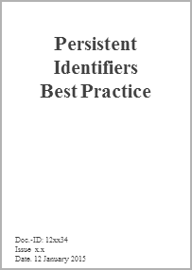

Data Stewardship Best Practices/Guidelines Drafting/Approval Cycle
Japan
USA
Brazil
Spaceborne
Earth Observation
Europe
CEOS
Other
Spaceborne,
airborne, and in-situ
Earth Observation
ESA LTDP Team and GSCB
LTDP WG
CEOS
CEOS-WGISS DSIG
GEO
DRAFT
?
?
NEEDS
OGC
CCSDS

Slide 4
Documents for adoption today
Assessment of Drafting Status and Discussion
Issue to DSIG for Review
Comments & Feedback
Final Presentation and Formal Approval
v
v
v
Preservation Workflow
Generic EO Data Set Consolidation Process
Persistent Identifiers
Purge Alert *
EO Data Stewardship Definitions **
Final Issue to WGISS
v
REVIEW
FINALIZATION
WGISS#38
WGISS#39
07/14
08/14
09/14
10/14
11/15
12/15
01/15
02/15
03/15
04/15
05/15
06/15
07/15
08/15
09/15
* Data Purge Alert Procedure discussion in a dedicated session during WGISS#39
** As contribution to CEOS WGISS Definitions

Slide 5
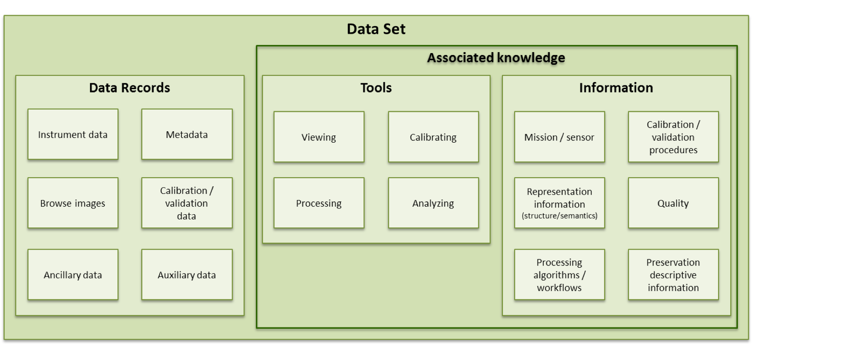
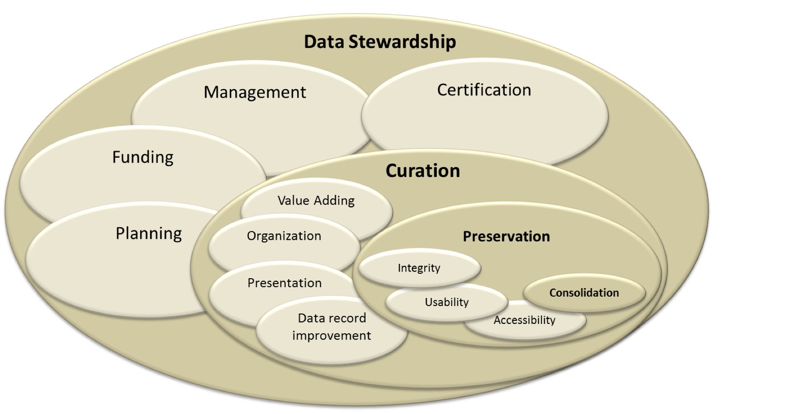
Preservation Workflow – Definitions
Content and relationship of concepts within data stewardship
Components of an Earth observation data set

Slide 6
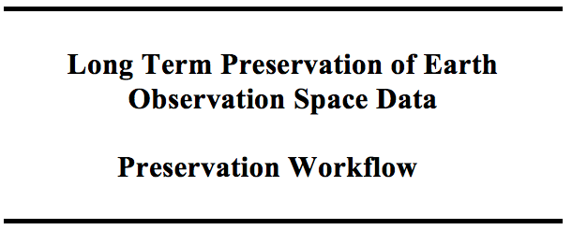
Preservation Workflow – Content
Procedure recommended to be applied to achieve EO data sets preservation and to optimize their reuse in the long term.
Output will be a complete, discoverable, accessible, and useable Earth observation data set and a series of documents describing the preservation strategy pursued, the implementation plan, and individual activities conducted.
Generic workflow to be tailored for individual Earth observation data sets and applicable to heritage, current, and future Earth observation missions.

Slide 7
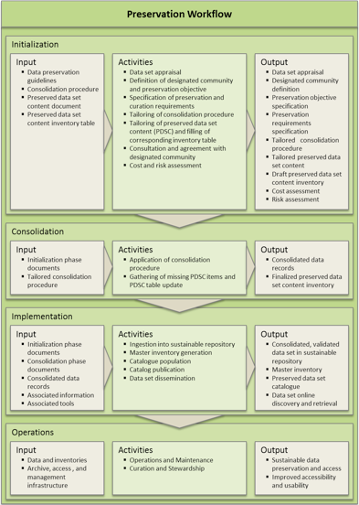
Preservation Workflow – Phases
The preservation workflow consists of four phases:
  Initialization (preservation planning)
  Consolidation
  Implementation
  Operations

Slide 8
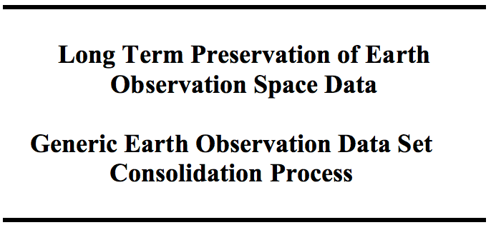
Generic EO Data Set Consolidation Process Objectives
The Generic EO Data Set Consolidation process produces a consistent, consolidated and validated set of "Data Records" and "Associated Knowledge”
It can be applied to any Data Record (e.g. raw data, Level 0 data, higher-level products, browses, auxiliary and ancillary data, calibration and validation data sets, metadata)
It should be tailored for each mission depending on objectives, budget availability, operational constraints, and according to the sensor category.

Slide 9
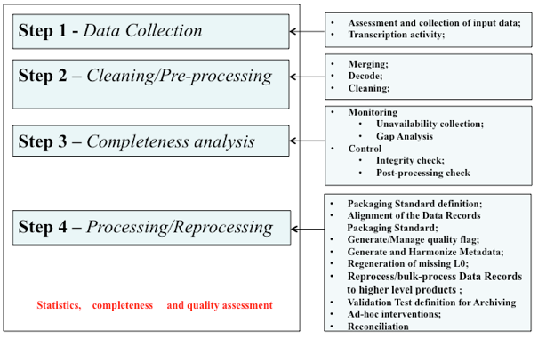
Generic EO Data Set Consolidation Process
Steps
Notes:
It consists of all the activities needed for Data Records and Knowledge Collection, Analysis, Cleaning, Gap Analysis/Filling, Pre-processing, Processing/Reprocessing (including software integration steps), Completeness Analysis and Cataloguing. “Consolidated Data Records” represent the basic input for any further higher level re-processing and for the long-term preservation

Slide 10
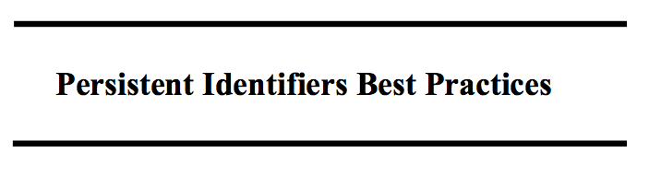
Persistent Identifiers Best Practice
Provides recommendations on the use of Persistent Identifiers to Earth Observation mission data, allowing globally unique, unambiguous, and permanent identification of a digital object.
Content
  Choosing a PID system
  PID numbering
  Permanence
  Resolving
  Granularity
  Documentation
  Interoperability
  A special note on DOI and on registration agents
  Use case and scenarios

Slide 11
Persistent Identifier Best Practice
Recommends DOI as the most suitable solution/system for adoption in EO

Slide 12
Future documents timeline proposal
Assessment of Drafting Status and Discussion
Issue to DSIG for Review, comments and feedback
Final Presentation and Formal Approval
v
v
EO Data Preservation Guidelines
Preserved Data Set Content
Final Issue to WGISS
v
REVIEW
FINALIZATION
WGISS#40
WGISS#41
09/15
10/15
11/15
12/15
01/16
02/16
03/16
04/16
05/16

Slide 13
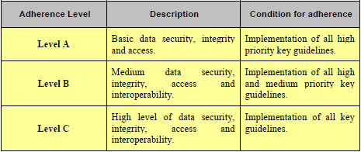
EO Data Preservation Guidelines - Definition & Adherence Levels
The LTDP guidelines constitute a basic reference for the long term preservation of EO data. Their application by Earth Observation space data holders and archive owners is fundamental in order to preserve the EO space data set and to create the LTDP Common Framework.
The application of the identified guidelines is not a requirement or a must for EO data holders and archive owners but is strongly recommended along with following a step-wise approach starting with a partial adherence. To this end different levels of adherence (Levels A, B, and C) have been assigned to each key guideline.

Slide 14
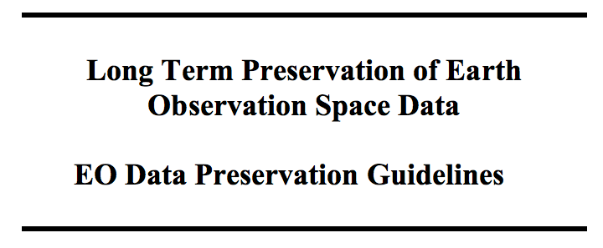
EO Data Preservation Guidelines - status
UNDER CONSOLIDATION
The EO Data Preservation Guidelines document is under consolidation in order to include comments from LTDP WG, NASA and QA4EO Study, and for alignment with GEO Data Management Principles

Slide 15
EO Data Preservation Guidelines
Implementation Steps of the Workflow Procedure
The document addresses eight main “themes” consisting of “guiding principles” and a set
of “key guidelines” that should be applied to guarantee the preservation of EO space data in the long term ensuring also accessibility and usability
It should be aligned with GEO Data Management Principles
PRESERVED DATA SET CONTENT DEFINITION AND APPRAISAL
ARCHIVE OPERATION AND
ORGANIZATION
ARCHIVE SECURITY
DATA INGESTION
ARCHIVE MAINTENANCE
DATA ACCESS AND INTEROPERABILITY
DATA EXPLOITATION AND REPROCESSING
DATA PURGE PREVENTION

Slide 16
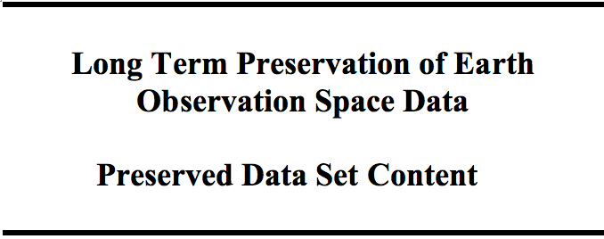
Preserved Dataset Content - Status
UNDER CONSOLIDATION
The PDSC document is under consolidation in order to include comments from LTDP WG, NASA and QA4EO Study and for alignment with GEO Data Management Principles

Slide 17
Preserved Data Set Content
It provides a description of the composition of the Earth Observation “Preserved Data Set Content (PDSC)” indicating what to preserve in terms of data and associated knowledge and information during all phases of an Earth Observation mission.
PRINCIPLES:
Minimum time reference for long term preservation is usually defined as the period of time exceeding the lifetime of the people, application and platforms that originally created the information.
Preservation of the data records is mandatory.
Data record context surrounding information (hidden or implicit information) shall be also captured and preserved preferably at the time of the information creation
The criticality of preserving the data set content is dynamic, an outcome of past commitments on the consumer community, information curators and holding institution.

Slide 18
Document Management Table
Document name | Custodian | Document ID | File name | Current version | Date | Status | Planned release date
EO Data Preservation Cooperative Framework (DSIG Plan) | M. Albani, ESA | None | Presentations |  |  | Updated at each WGISS meeting
Preservation Workflow | I. Maggio, ESA | CEOS/WGISS/DSIG/PW | Preservation Workflow_v0.7 | 0.7 | 12/2014 | Under approval CEOS | Q2/2015
EO Data Stewardship Definitions | I. Maggio, ESA | CEOS/WGISS/DSIG/DEF | EO-DataStewardshipDefinitions_v0.7 | 0.7 | 12/2014 | Under review CEOS | Q3/2015
EO Data Preservation Guidelines | M. Albani, ESA | GSCB-LTDP-EOPG-GD-09-0002 | EuropeanLTDPCommonGuidelines_Issue2.0.pdf | 2.0 | 06/2012 | Update ongoing | Q1/2016
EO Data Set Consolidation Process | R. Cosac, ESA | CEOS/WGISS/DSIG/GEODSCP | Generic Earth Observation Data Set Consolidation Process v0.7 | 0.7 | 12/2014 | Under approval CEOS | Q2/2015
Preserved Data Set Content | R. Leone, ESA | LTDP-GSEG-EOPG-RD-11-0003 | LTDP_PDSC_4.0 | 4.0 | 07/2012 | Update ongoing | Q1/2016
Persistent Identifiers Best Practice | T. Christensen, DLR | CEOS/WGISS/ DSIG/PIDBP | CEOS Persistent Identifier Best Practices_v0.7 | 0.7 | 12/2014 | Under approval CEOS | Q2/2015
Data Purge Alert | M. Albani, ESA | None | Presentation; to be published on WGISS web site | --- | n/a | Under approval CEOS | Q3/2015

