Slide 1

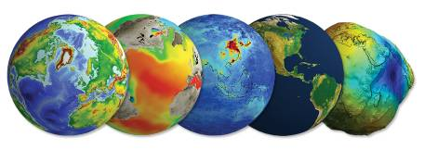
Data Stewardship Interest Group
WGISS-39 Meeting
DSIG Overview & Updates
Tsukuba, Japan (JAXA) – 11-15 May, 2015
Mirko Albani, European Space Agency

Slide 2
Background - DSIG Activities (1)
Sharing Information and experiences during WGISS meetings through:
  Reporting from CEOS agencies about their investigations, developments, studies, and lessons-learned relating to EO data management and stewardship
  Dedicated Sessions on specific topics
  Drafting common cross-agency best practices or guidelines on data management and stewardship for possible adoption by WGISS. Preliminary list:
  Preservation Workflow
  Data Preservation Guidelines
  Preserved Data Set Content
  EO Data Generic Consolidation Process
  Purge Alert Procedure
  Persistent Identifiers
  Appraisal Procedure
  Archived data media transcription
  EO Data Stewardship Definitions

Slide 3
Background - DSIG Activities (2)
Conduct Joint Activities and/or Pilot Projects on specific data stewardship topics
Contribution to GEO and Standardization activities:
  Contribute to GEO activities in the domain of data management and stewardship in the frame of Component C1 - Advances in Life-cycle Data Management within Task IN-02 Earth Data Sets
    Leads: China (BNU), Japan (University of Tokyo), Spain (CSIC), United States (DOE), CEOS (CNES, Richard Moreno) and ESA
  Propose WGISS best-practices/guidelines drafted by DSIG for adoption in GEO and possibly as input to standardization bodies (e.g. OGC/CCSDS);

Slide 4
DSIG sessions during this meeting
Overview and Updates
Purge Alert Procedure (Action WGISS-38-19)
CEOS Best Practices
Persistent Identifiers Piloting Session
Dedicated Session on Preservation of Software and Documents at CEOS Agencies: approaches and lessons learned

Slide 5
Feedback from GEO
Data Management Principles Task Force
DMP-TF

Slide 6
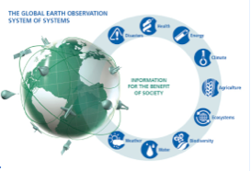
GEOSS Data Management Principles: Progress Report DMP-TF
Uniqueness of An Earth Observation
Each Earth observation is an irreplaceable asset to understand the past, describe the present, and forecast the future of the global integrated Earth system.
Objectives:
Facilitate data management approaches that encompass a broad perspective of the observational data life cycle, from input through processing, archiving, and dissemination, including reprocessing, analysis and visualization of large volumes and diverse types of data.
GEO Secretariat established DMP-TF in May 2014

Slide 7
DMP-TF Members
Alessandro Annoni (Co-Chair) EC/JRC IIB
Massimo Craglia (Co-Chair) EC/JRC IIB
David Halpern (Co-Chair) COSPAR DSWG
Wenbo Chu GEO Secretariat GEO Secretariat
Osamu Ochiai GEO Secretariat GEO Secretariat
Mirko Albani ESA IIB
Ali Didehvar Asl Iran
Garry Baker UK
Jeff de La Beaujardiere US
Tony Boston Australia
Won Young Choi Republic of Korea
Ivan Deloatch US IIB
Françoise Genova France
Florian Haslinger EPOS
Simon Hodson ICSU-CODATA DSWG
Siri Jodha Khalsa IEEE IIB
Youn-gi Kim Republic of Korea
Mustapha Mokrane ICSU-WDS
Reynaldo Mondragon Mexico
Richard Moreno CEOS
Aboubakar Mambimba Ndjoungui Gabon
Chan-Ho Park Republic of Korea
Peiliang Shi WMO
Ryosuke Shibasaki Japan IIB
Alfred Stein ITC

Slide 8
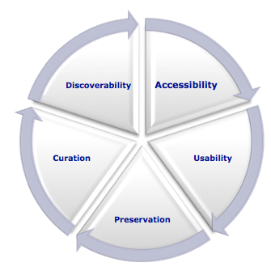
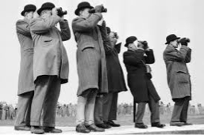
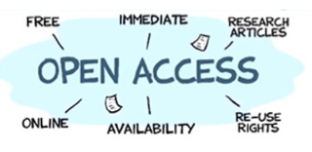
Data Management Principles (1)
The value of each EO is maximized through data life-cycle management, including five foundational elements.
Discoverability
DMP-1 Data and all associated metadata will
be discoverable through catalogues
and search engines, and data access
and use conditions, including licenses,
will be clearly indicated.
Accessibility
DMP-2 Data will be accessible via online services,
including, at minimum, direct download but
preferably user-customizable services for
visualization and computation.

Slide 9

Data Management Principles (2)
Usability
DMP-3 Data will be structured using encodings that are widely accepted
in the target user community and aligned with organizational
needs and observing methods, with preference given to non-
proprietary international standards.
DMP-4 Data will be comprehensively documented, including all elements
necessary to access, use, understand, and process, preferably via
formal structured metadata based on international or community-
approved standards. To the extent possible, data will also be
described in peer-reviewed publications referenced in the
metadata record.
DMP-5 Data will include provenance metadata indicating the origin and
processing history of raw observations and derived products, to
ensure full traceability of the product chain.
DMP-6 Data will be quality-controlled and the results of quality control
shall be indicated in metadata; data made
available in advance of quality control will be
flagged in metadata as unchecked.

Slide 10
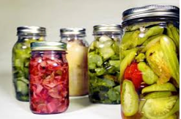

Data Management Principles (3)
Preservation
DMP-7 Data will be protected from loss and preserved for
future use; preservation planning will be for the
long term and include guidelines for loss
prevention, retention schedules, and disposal or
transfer procedures.
DMP-8 Data and associated metadata held in data
management systems will be periodically
verified to ensure integrity, authenticity and
readability.
Curation
DMP-9 Data will be managed to perform corrections
and updates in accordance with reviews,
and to enable reprocessing as appropriate;
where applicable this shall follow
established and agreed procedures.
DMP-10 Data will be assigned appropriate
persistent, resolvable identifiers to enable
documents to cite the data on which they
are based and to enable data providers to
receive acknowledgement of use of their data.

Slide 11
DMPs included in GEO strategic plan 2016-2025
To further maximize the value and benefit from data sharing, GEO will continue to work with partners to promote the use of key Data Management Principles, including the need for common standards and interoperability arrangements. This will ensure that data and information of different origin and type are comparable and compatible, facilitating their integration into models and the development of applications to derive decision support tools. GEO therefore strives to promote and encourage the implementation of Data Management Principles (Annex), which are summarized as:
Earth observations will be catalogued or otherwise advertised on the internet so that they can be discovered, and will be accessible online using open-standard encodings and services. Data and services will be comprehensively documented using international or community-approved standards, and to the extent possible, peer- reviewed publications, so that users can understand and make use of the data. Metadata will include access and use conditions, the results of quality control procedures, and provenance statements indicating the origin and processing history of the dataset or product. Data and associated metadata will be protected from loss and periodically verified to ensure integrity, authenticity and readability. Corrections and updates to data and metadata records will be performed as required. Finally, persistent identifiers will be assigned to data so that they can be tracked and cited and data providers can be acknowledged.

Slide 12
DMP-TF Next Steps: draft implementation guide for discussion at GEO-XII Plenary
Guide Target Audience: implementation guidelines are primarily for organisations that contribute, or may contribute, data and services to GEOSS. The document enables organisations to implement their specific data management system to meet users’ needs and comply to the greatest extent that is practical for them with the GEO DMPs.
Guide Format: the Guide should be pitched at the strategic or managerial level. It provides a high level view to guide implementation and is not intended as a detailed technical guide.
Implementation Guide will:
  Take each principle in turn and provide key definitions and explanations of terms.
  Provide guidance and examples of how the principles may be implemented.
  Suggest metrics indicating the level of adherence to the GEO DMPs. Such metrics may be used by data managing organizations for internal (quality) control, and will also be used in aggregate to monitor progress in achieving DMPs in GEOSS as a whole.
  It should provide indications of resource requirements for implementation of the GEO DMPs as well as examples of successful and cost-efficient implementations of data management best practices.

Slide 13
DMP-TF Next Steps: draft implementation guide for discussion at GEO-XII Plenary
Drafting Approach: assign teams of 2-3 people to create a first draft implementation guide for each principle. An additional team will draft an introduction and/or summary addressing the common issues across all or most of the principles (e.g. cost). These drafts will then be shared, amalgamated and edited for coherence and consistency. These initial drafts should be produced quickly, they can be rough and should be no more than 2 pages each.
Timescale:
  First rough draft should be completed by mid-July.
  Consultation in late July-early September.
  Finalisation by early-mid October (i.e. one month before the Mexico plenary).

Slide 14
Projects and Conferences

Slide 15
Interagency Piloting Projects
AVHRR Dataset curation in Europe
Interagency project in Europe for AVHRR coherent data series generation (harmonized L0 data consolidation, processing, discovery & access).
  User requirements collected and analyzed
  Several inventories (ESA, DLR, Unibern, Dundee) analyzed for temporal and spatial coverage and gaps
  Definition of common processing baseline ongoing
  Next steps: generation of European AVHRR Dataset combining dataset from different agencies

Slide 16
Interagency Piloting Projects
SCIDIP-ES
Main goal:
Development and deployment of preservation services, validation in Earth Science
Consolidation of EO LTDP Framework & extension to Earth Science
Main Outputs:
Harmonization
Services and toolkits
Services Final Assessment and review successfully held in December 2014.
Deliverables and S&T available at:
http://www.scidip-es.eu

Slide 17
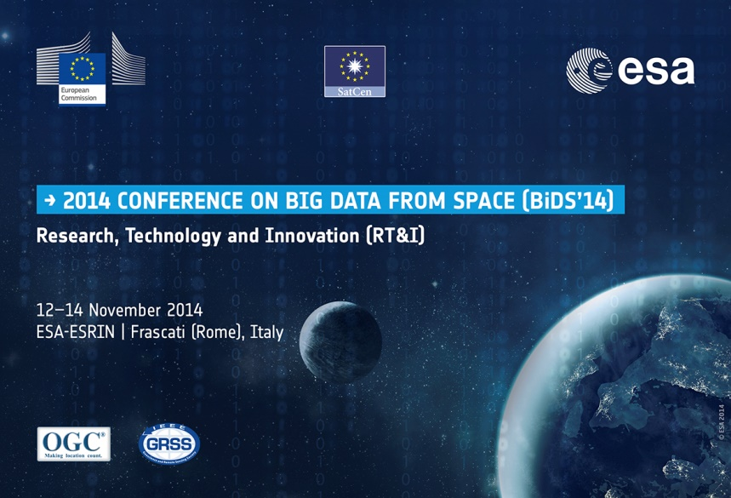
Conferences Overview (1)
Information: http://congrexprojects.com/2014-events/BigDatafromSpace/introduction
Presentations: http://congrexprojects.com/2014-events/BigDatafromSpace/presentations
Proceedings:http://bookshop.europa.eu/is-bin/INTERSHOP.enfinity/WFS/EU-Bookshop-Site/en_GB/-/EUR/ViewPublication-Start?PublicationKey=LBNA26868
BIG DATA 12-14 Nov 2014 Recommendations
Establish a Research, Technology Development and Innovation agenda for Big Data from Space;
Foster research activities and innovative solutions in the “Data Science” domain, in view of future downstream services;
Coordinate the European efforts for developing and promoting new models and platforms for Big Data from Space exploitation (from data­to­users to users­to-data);
Contribute to the exploration and implementation of new “partnership models” for the actual exploitation of future Big Data flows;
Include in technology programmes activities supporting the development in cross-sectorial Big Data fields.

Slide 18
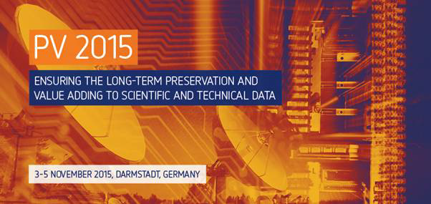
Conferences Overview (2)
Hosted by EUMETSAT on 3-5 November 2015 in Darmstadt (Germany)
http://www.eumetsat.int/website/home/News/ConferencesandEvents/DAT_2447480.html
PV 2015 03-05 Nov Sessions:
Session 1: Data Stewardship approaches to ensure long-term data and
knowledge preservation;
Session 2: Adding value to data and facilitation of data use;
Session 3: Metadata, formats, standards and interoperability;
Session 4: Data preservation lessons learnt and future prospects

Slide 19
  Thanks you for your attention !!!
  Questions ??

Slide 20
  BACK-UP SLIDES

Slide 21
Group Objectives
Goals:
  Enable the sharing of agency investigations, developments, and lessons-learned relating to EO data stewardship
  Share experiences and lessons learned
  Draft common cross-agency best practices or guidelines of data stewardship for possible adoption by WGISS
  Sponsor technical exchanges at WGISS meetings or elsewhere
Scope: Focus on Data, Metadata and Product Topics Including:
  Long-Term Archive Strategies
  Data Formats
  Data Preservation
  Data Lifecycle Concepts
  Archive Media

Slide 22
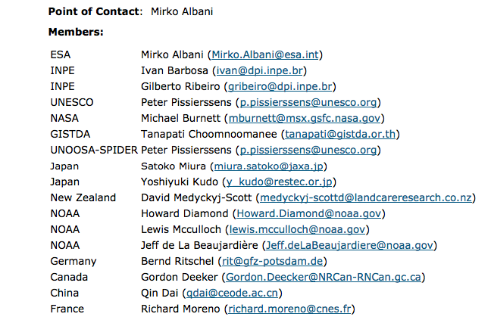
Point of Contact and Members
DSIG mailing list: dsig@wgiss.ceos.org
DSIG plan of activities will be circulated after WGISS to WGISS-all for possible extension of DSIG membership and inclusion in mailing list.

Slide 23
Background – Past Results
White Papers/Reports:
  Long-Term Archive Strategies
  Data Preservation Techniques
  Data Lifecycle Models and Concepts
  Browse Survey 1997-2010
  Guidelines for GIS-Ready Products
  Browse Guidelines Document (version 2)
  Offline Media Trade Study
Best Practices/Recommendations:
  European Long Term Preservation of Earth Observation Space Data
  Preview Image Principle
  Data Management Statement

