Slide 1
Data Stewardship Interest Group WGISS-39 Meeting
Data Purge Alert Procedure
Tsukuba, Japan – 11-15 May, 2015
Mirko Albani, European Space Agency

Slide 2
Data Loss Prevention
WGISS realizes that it is a responsibility of all organizations holding EO space data to assess the relative value of their holdings and to preserve them for the long term.
Sometimes an organization must make the decision to “purge” one or more datasets that could be important to help meeting the mission requirements of another organization.
Data Purge: to permanently and irrecoverably remove all copies of an EO dataset held in an organization.

Slide 3
Data Purge Alert Procedure
The “Data Purge Alert” procedure aims at preventing, or at least minimizing, the loss of EO space data.
Organizations intending for whatever reason to purge an EO dataset should apply the procedure (before purging the data) to inform other organizations with the goal to trigger a possible transfer of preservation responsibility to another interested entity.
The procedure will vary slightly depending on dataset uniqueness and purging organization responsibility versus the dataset (e.g. ownership).

Slide 4
Data Purge Alert Procedure
Dataset appraisal
Positive purge decision
Dataset holder is owner?
Contact owner/preservation responsible and discuss way forward
No
Yes
Dataset unique?
Dataset unique?
Contact second copy holder(s) and discuss way forward
No
No
Yes
Transfer dataset and/or purge
Contact owner/preservation responsible and discuss way forward
Intersted in taking over responsibility?
Yes
Transfer dataset and purge
Interested in taking over dataset responsibility?
No
No
Contact CEOS
Yes
Yes
Transfer responsibility and knowledge (if any) and purge
Discuss way forward with interested organizations
Transfer dataset, knowledge and responsibility and/or purge

Slide 5
Purge Alert Information
The following information should be provided by the initiator when contacting organizations:
Data Records description as a minimum in terms of: mission/sensors characteristics, products specifications, temporal coverage, geographical coverage, dataset size, media of storage, archiving format, IPRs, ownership and access policies.
List of available associated knowledge (e.g. tools, information)
Results and documentation of a Data Record Appraisal (e.g. http://eros.usgs.gov/government/ratool/)
Overview of constraints and conditions if any
Point of Contact

Slide 6
Purge Alert Response & Implementation
Organisations contacted in the frame of the Purge Alert procedure (e.g. dataset owners, copy holders or entities interested to take on the responsibility for the preservation of a dataset) should respond to the “Data Purge Alert” within three months to start conducting negotiations/assessment with the alert initiator.
CEOS shall be involved when needed through CEOS Chair, SIT Chair and WGISS Chair.

Slide 7
NEXT Steps and Actions
Consolidate and finalize Purge Alert Procedure (today)
Insert Purge Alert page in new CEOS WGISS Web Site

Slide 8
Thanks you for your attention !!!
Questions ??

Slide 9
BACK-UP SLIDES

Slide 10
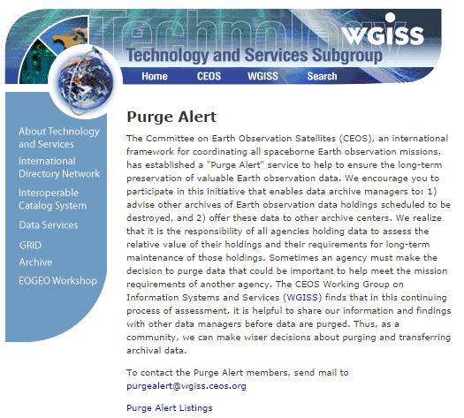
CEOS Purge Alert service
http://wgiss.ceos.org/purgealert/

Slide 11
APPRAISAL PROCEDURE
The data appraisal procedure consists in performing an assessment of an EO space data set under evaluation (for example in case of possible preservation discontinuing) through answering to a set of categorized questions extracted from the USGS EROS Appraisal Online Tool (http://eros.usgs.gov/government/ratool/) or from the CEOS online questionnaire http://wgiss.ceos.org/archive/index.html.
The list of questions should cover:
Mission relevancy
General policy (ISO Standard)
Physical properties (Media)
Metadata
Cost / benefit analysis.
When performing the appraisal, an appraisal report should be produced in order to properly document the different steps performed in the appraisal procedure and the final results. The appraisal report should be provided, in case of purge decision, to other data holders and archive owners together with a description of the data set when applying the data alert procedure.
A link to a template document containing the list of questions and to generate the appraisal report is provided hereafter: http://eros.usgs.gov/government/ratool/export.php?blank

