Slide 1
CWIC + OpenSearch:
It Works With Browsers, Too
  Archie Warnock (warnock@awcubed.com)
  Lingjun Kang (lkang3@masonlive.gmu.edu)
  Genyong Yu (gyu@gmu.edu)

Slide 2
Summary
Not all data providers are accessible via OpenSearch
CWIC provides an OpenSearch (and CSW) gateways to remote data partners, regardless of their native search protocol
Custom clients like CWIC-Smart use this capability to greatly simplify and enhance the process
BUT
  Your browser can do OpenSearch, too

Slide 3
Background
This is the essence of the two-step search
  Search Collections at IDN
  IDN provides pointers to CWIC granule search and a template URL to search CWIC
  CWIC OpenSearch provides a template URL to search remote data partners
Clients (ideally, fully-programmatic ones) can do this for you
BUT
  Your browser can do this, too

Slide 4
Search IDN OSDD
ISRO INSAT-3D Imager L2B SST
  Request generic IDN OSDD (it tells you how to search the IDN)
http://gcmd.gsfc.nasa.gov/KeywordSearch/default/openSearch.jsp?clientId=CWIC
  Find the IDN OSDD URL template in the Atom response
<Url type="application/atom+xml" template="http://gcmd.gsfc.nasa.gov/KeywordSearch/OpenSearch.do?searchTerms={searchTerms}&amp;count={count?}&amp;startPage={startPage?}&amp;geoBox={geo:box?}&amp;timeStart={time:start?}&amp;timeEnd={time:end?}&amp;MetadataType=0&amp;output=atom&amp;Portal=GCMD&amp;clientId=CWIC">

Slide 5
IDN Response
ISRO INSAT-3D Imager L2B SST (continued)
  Use the URL template to request the dataset OSDD
http://gcmd.gsfc.nasa.gov/KeywordSearch/OpenSearch.do?searchTerms=INSAT*&MetadataType=0&output=atom&Portal=cwic&clientId=fromgcmd
  Find the CWIC OSDD URL Template in the Atom response
<entry>
<!-- cwic Specific OpenSearch -->
<link rel="search" type="application/opensearchdescription+xml“
title="CEOS WGISS Integrated Catalog (CWIC)”
href="http://cwic.wgiss.ceos.org/opensearch/datasets/
3DIMG_L2B_SST/osdd.xml?clientId=fromgcmd"/>

Slide 6
Search CWIC OSDD
Use CWIC OSDD for INSAT-3D Imager L2B SST
  Request the OSDD for the dataset (it tells you how to search)
http://cwic.wgiss.ceos.org/opensearch/datasets/3DIMG_L2B_SST/osdd.xml?clientId=fromgcmd
  Find the template in the Atom response
<Url type="application/atom+xml" template="http://cwic.wgiss.ceos.org/opensearch/granules.atom?datasetId=3DIMG_L2B_SST&amp;startIndex={startIndex?}&amp;count={count?}&amp;timeStart={time:start?}&amp;timeEnd={time:end?}&amp;geoBox={geo:box?}&amp;clientId=fromgcmd">

Slide 7
Search CWIC for Granules
Search CWIC for ISRO INSAT-3D Imager L2B SST granules
  Get the request URL (it does the search)
http://cwicdev.wgiss.ceos.org/opensearch/granules.atom?datasetId=3DIMG_L2B_SST&startPage=1&count=1&timeStart=2013-10-01T00:00:00Z&timeEnd=2015-05-04T23:59:59Z&geoBox=0.843296,-81.04153,163.15671,81.04153&clientId=fromgcmd
  Look for granules in the Atom response
<entry>
<title>3DIMG_20OCT2014_1330_L2B_SST</title>
<id>http://cwicdev.wgiss.ceos.org/opensearch/granules.atom?
uid=3DIMG_L2B_SST:MOSDAC:3DIMG_L2B_SST:20OCT2014:1330</id>
...

Slide 8
ISRO Granule
Continued -
…
<georss:box>-81.04 163.15 81.04 0.84</georss:box>
<link title="large_thumbnail" href="http://www.mosdac.gov.in/servlet/Image?image=preview&amp;loc=/mosdac_preview/3D_IMG/preview/2014/20OCT/3DIMG_20OCT2014_1330_L2B_SST.jpg" rel="enclosure"/>
<link title="Browse image URL" href="http://www.mosdac.gov.in/servlet/Image?image=preview&amp;loc=/mosdac_preview/3D_IMG/preview_thumb/2014/20OCT/3DIMG_20OCT2014_1330_L2B_SST.jpg" rel="icon"/>
<link title="Browser" href="http://www.mosdac.gov.in/servlet/Image?image=preview&amp;loc=/mosdac_preview/3D_IMG/preview_thumb/2014/20OCT/3DIMG_20OCT2014_1330_L2B_SST.jpg" rel="enclosure"/>
<link title="MOSDAC" href="http://mosdac.gov.in/DirectOrder.do?mode=getProduct&amp;metadataid=2285454" rel="enclosure"/>
<link title="Order" href="http://mosdac.gov.in/DirectOrder.do?mode=getProduct&amp;metadataid=2285454" rel="enclosure"/>

Slide 9
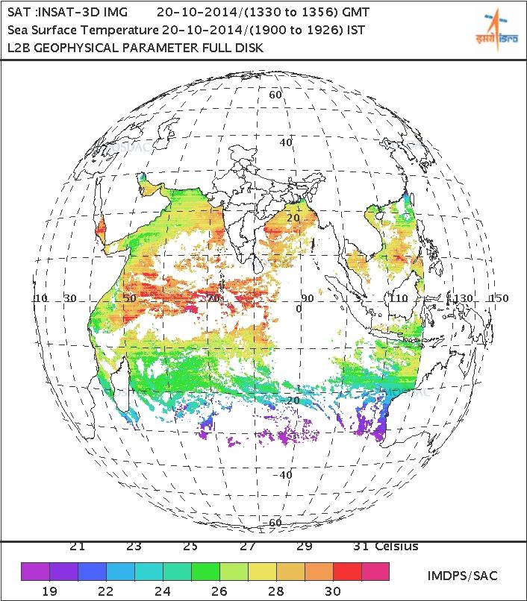
ISRO Browse Image

Slide 10
In Conclusion
We mean it when we say OpenSearch is simple
  Easy to implement (for programmers – it’s just HTTP)
  Functional, even without a specialized client
  Users gain access to remote collections that don’t natively support OpenSearch by going through CWIC

