Slide 1

Recovery Observatory
WGISS-39 Meeting
Tsukuba Japan
May 12, 2015
Mathieu GOND

Slide 2
Natural disasters
“Over the course of the past decade, the world has seen an unprecedented number of disasters, which are growing both in number and severity of impact. Recovery after such disasters costs billions of dollars and lasts years, even as long as a decade.”

Slide 3
Recovery Observatory (RO)
While satellite imagery is used on an ad hoc basis after many disasters to support damage assessment and track recovery efforts, there is currently no system to support the coordinated acquisition of data and facilitate its access.
The concept of a “Recovery Observatory” was initially born from seeing huge quantities of Earth observation data that are made freely available following major disasters to many different users.
CEOS Working Group – Disaster
  Increase satellite Earth Observation contributions to all the Disaster Management Cycle phases
  http://ceos.org/ourwork/workinggroups/disasters/
  CNES is RO project responsible for CEOS WG-Disaster

Slide 4
Summary
  Main features
  Technologies and cots
  Technical issues
    Drupal / RESTo coupling
    CMS / Map bidirectionnal navigation
    Product Ingestion
  Future features
  Live demo

Slide 5
MAIN FEATURES

Slide 6
Main features
  A collaborative Web based workspace to groups of users
    Public Web portal
    Groups and communities collaborative tools
  Products Search capabilities
    With multi-criteria search (including geographic and temporal)
    With map-based search
  Display of full resolution geo-referenced images

Slide 7
Main features
  Earth Observation products available for download
    high resolution and very high resolution optical imagery
    high and very high resolution radar imagery (X, C, L-bands)
    airborne data
  Community contribution capability
    In Situ data, ground truth, Maps…
    added-value product, reports, publications…

Slide 8
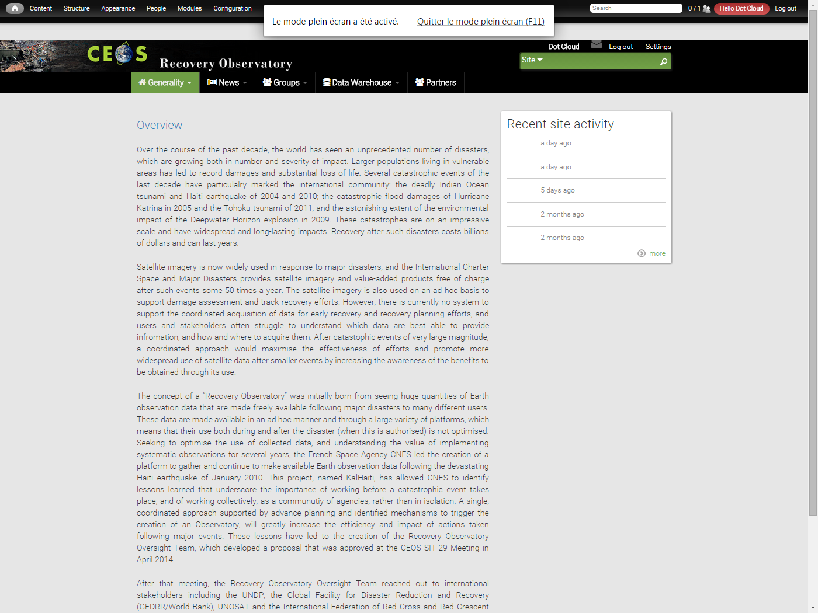
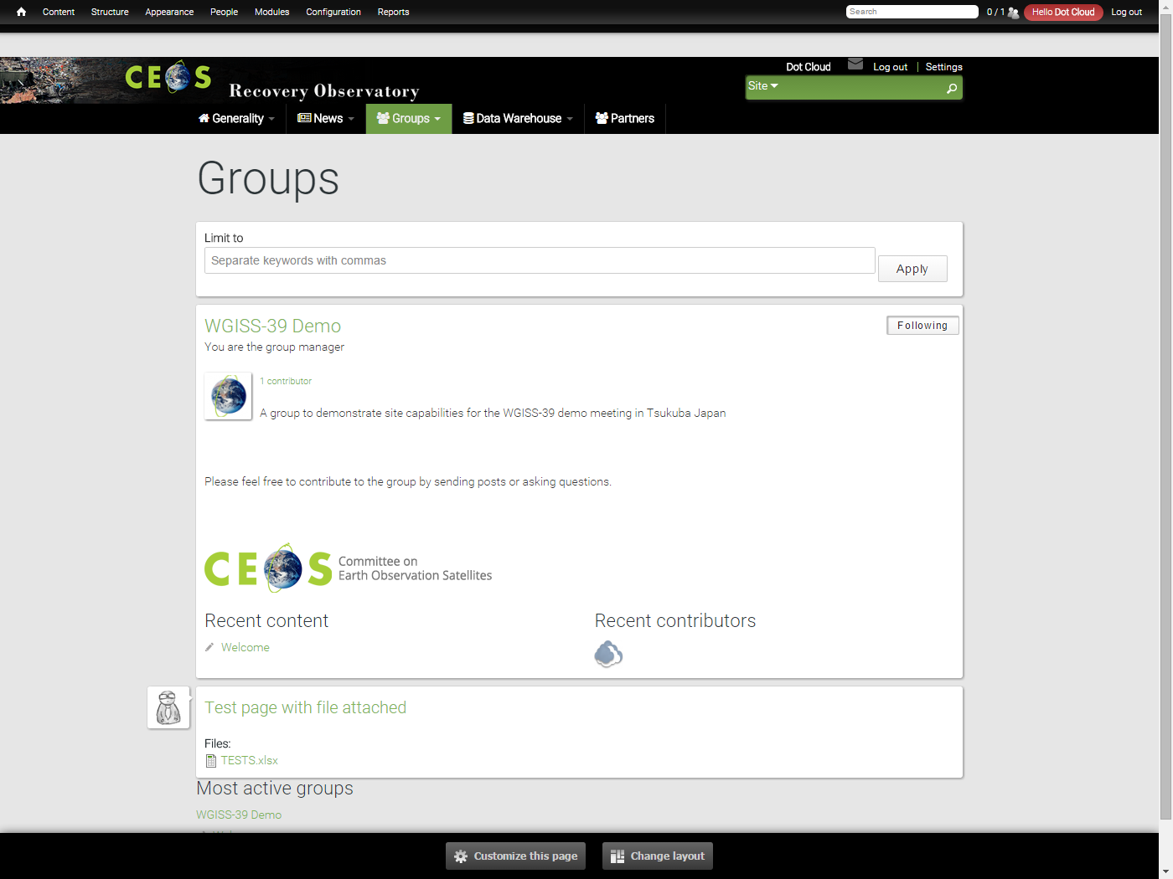
Public Web portal features
  Editorial content
    News
    Partners
    Project presentation
    …
  Collaborative groups
    Thematic based
    User post, file attachment
    Security management
      Private groups
      Semi private groups
      Public groups

Slide 9
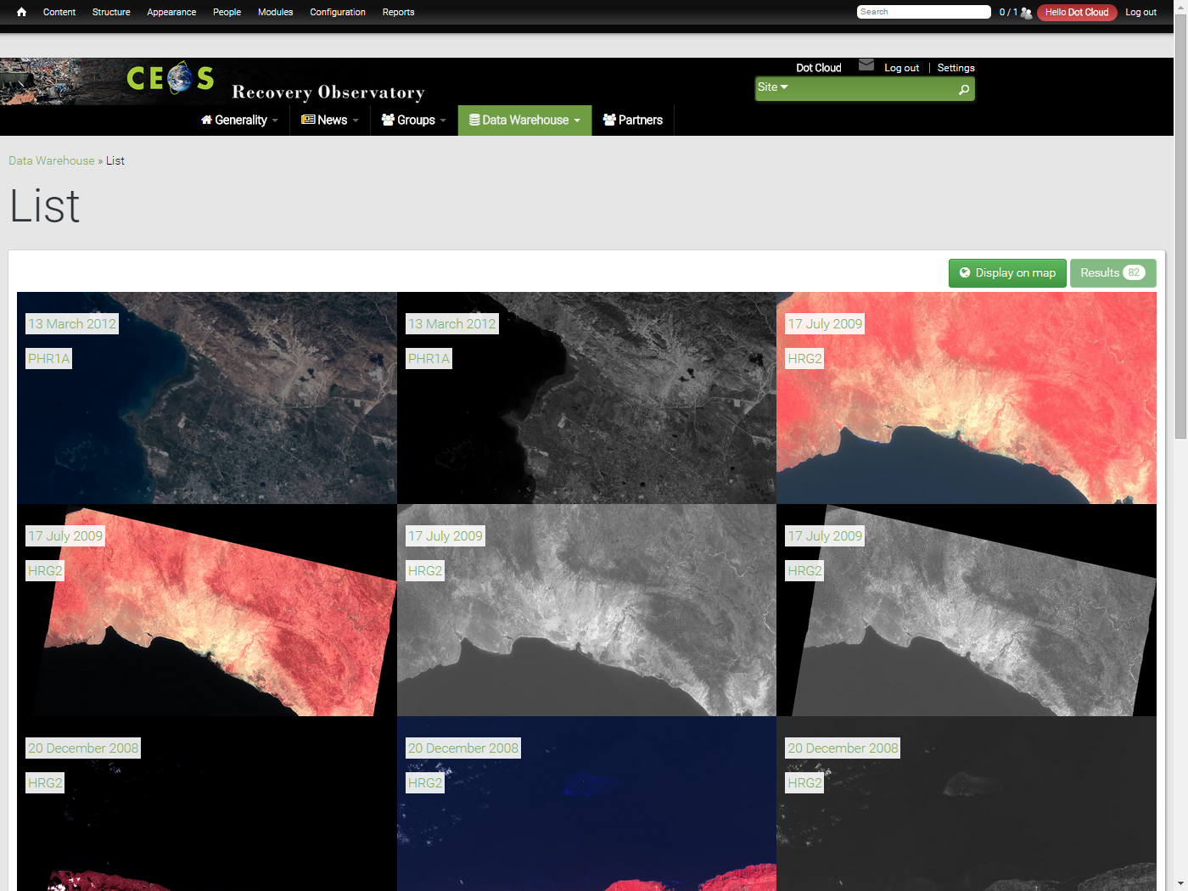
Public Web portal features
  Map with products footprints
    Full resolution products displayed
    on the map
    Product download
  List of available products
    List of products ordered by date of acquisition
    Product download
    Product details containing metadata , quicklook and footprint
  Multi criteria search
    Opensearch parameters
    Search performed by RESTo but rendered by Drupal

Slide 10
TECHNOLOGIES AND COTS

Slide 11



Technologies & COTS
  Main technologies
    PHP
    Java (Spring, Spring Boot, Spring MVC)
    HTML5, CSS3, JavaScript, OpenLayer
  COTS used
    Drupal 7 with Acquia Commons
    PostgreSQL & PostGIS
    MapServer & GDAL
    RESTo, iTag & Mapshup

Slide 12
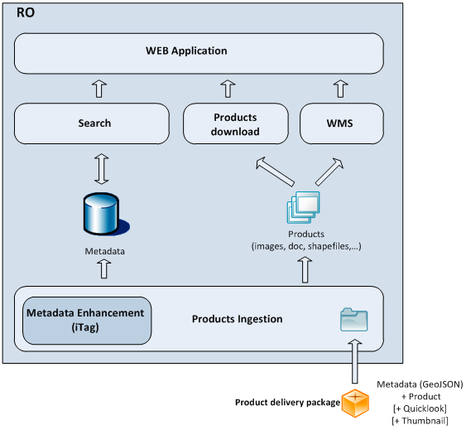
Technologies & COTS

Slide 13
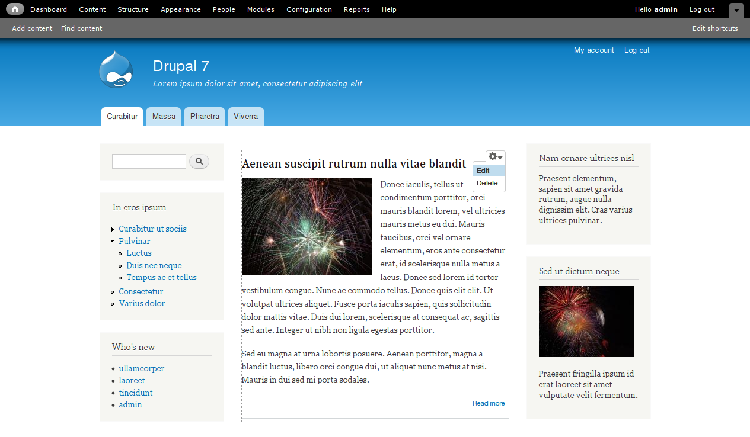

Technologies & COTS
Drupal - CMS
  Open Source Content Framework system written in PHP
  Core with basic features
    User account
    Menu
    Page customization
    System administration
  Tons of plugins to extend the core
    Available on Drupal.org
    Community plugins
  Fully customizable using themes

Slide 14
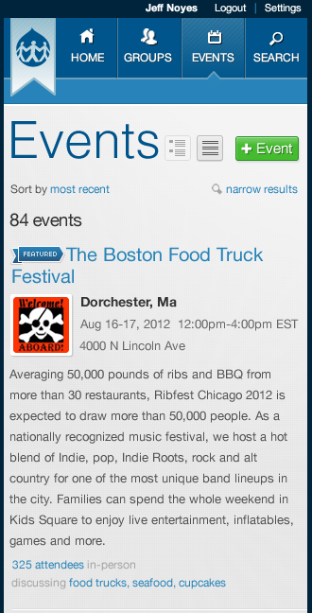
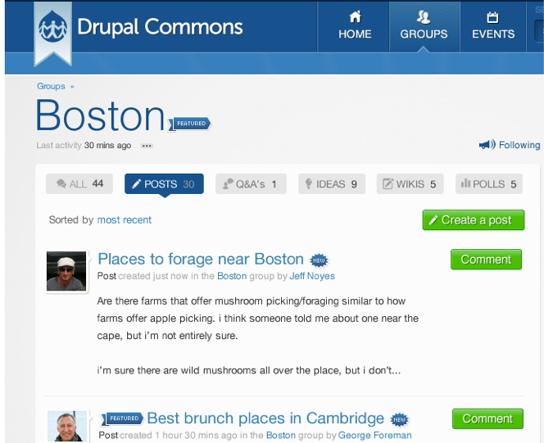
Technologies & COTS
Acquia Commons
  Group of Drupal plugins to build a collaborative website
  Developed Acquia, creators of Drupal

Slide 15
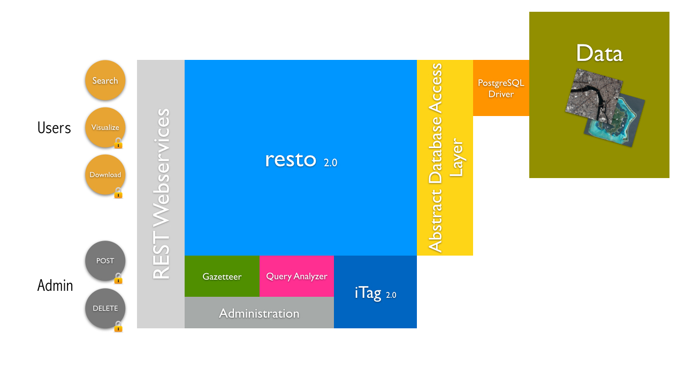
Technologies & COTS
RESTo

Slide 16
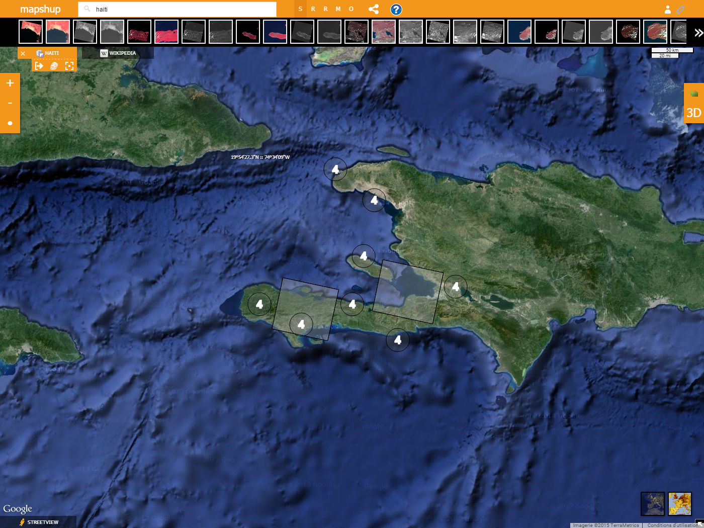
Technologies & COTS
Mapshup

Slide 17
TECHNICAL ISSUES

Slide 18
Product ingestion
  Ingest Ingestion Unit in RESTo
  Ingestion Unit is an archive containing
    A metadata.json containing all the metadatas of all the products
    A set of Product Archives
      Full Product
      Thumbnail
      Quicklook

Slide 19
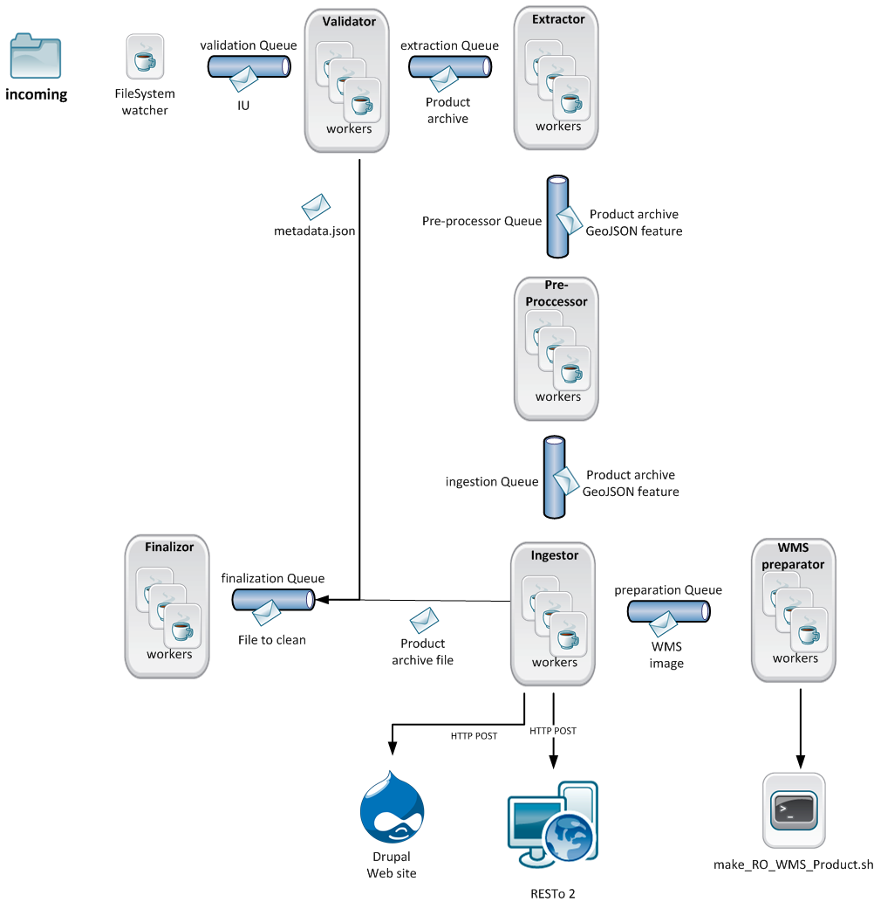
Product ingestion
  JAVA JMS Queues based architecture
  Scalable system

Slide 20
Drupal / RESTo coupling
  RESTo stores the products and the metadatas
    Product download rights are defined in RESTo.
  Drupal stores the articles and documents.
  How to make those 2 words to communicate?
    User session sharing
    Product metadata duplication in Drupal
    Multi criteria search form

Slide 21
Drupal / RESTo – User session sharing
  Create a RESTo account for each Drupal account
    With standard Drupal registration
    With a google account through OpenID connect
  When Logging into Drupal, a session is automatically started on RESTo
    Logged both on Drupal and on RESTo
    Download product permission allowed, depending on RESTo user rights
  When logging out from Drupal, RESTo session is automatically destroyed

Slide 22
Drupal / RESTo – Product metadata duplication
  Create a Drupal page for each product in RESTo with all the metadata
    Automatically during ingestion of new products
    By harvesting RESTo to keep in sync
  Products can be browsed in Drupal
    Specific templates developed to display products
  Products can be searched using standard Drupal search
  User can add comment

Slide 23
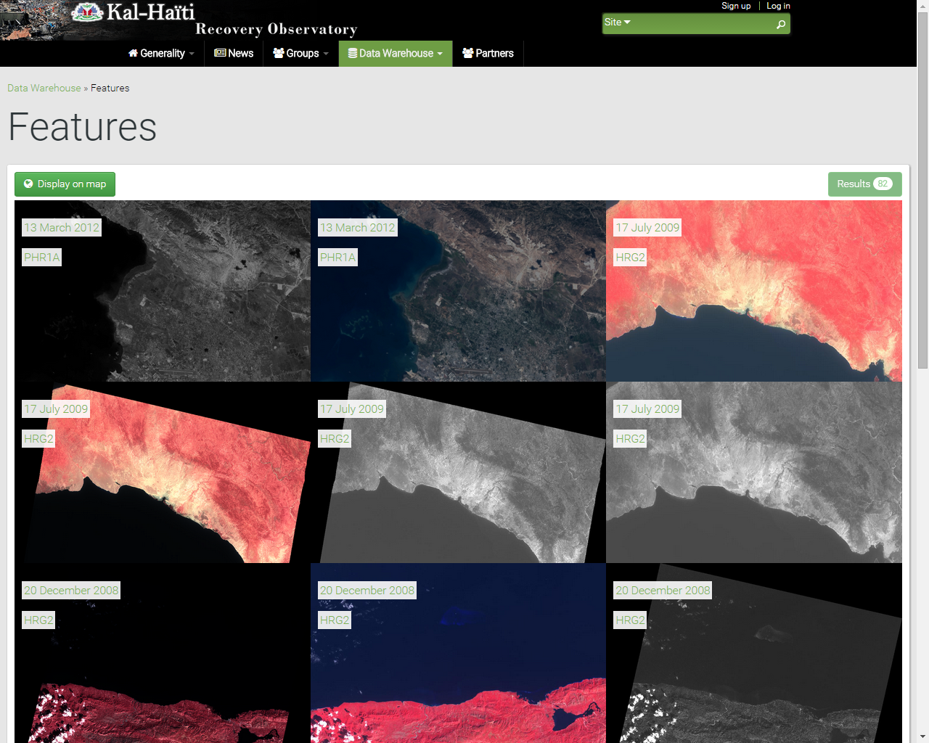
Drupal / RESTo – Product metadata duplication

Slide 24
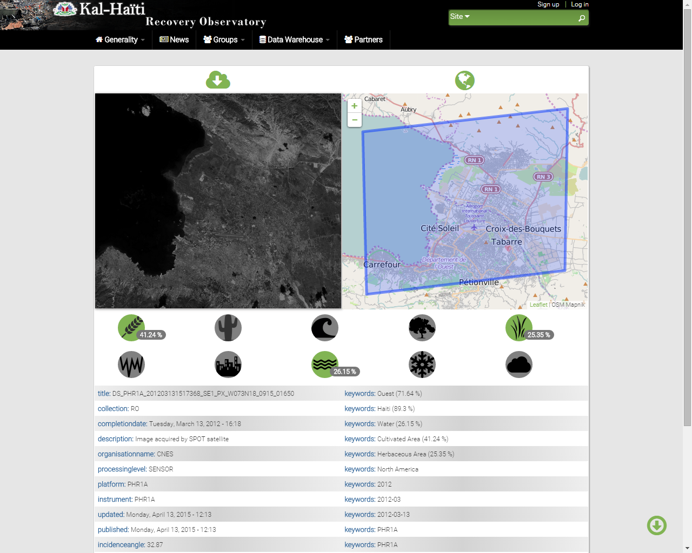
Drupal / RESTo – Product metadata duplication

Slide 25
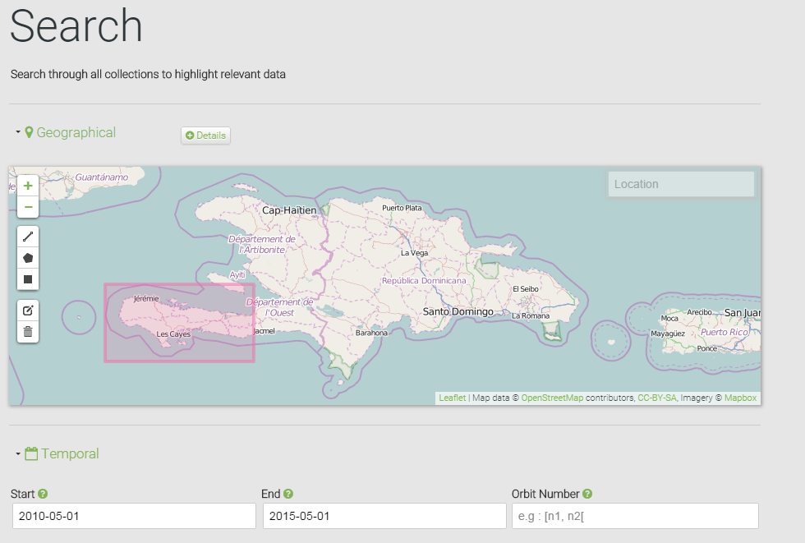
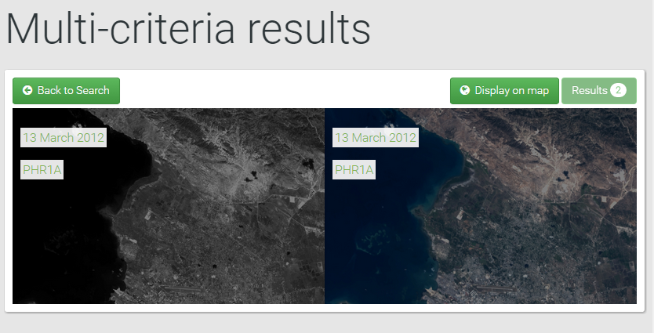
Drupal – RESTo / Multi criteria search form
Opensearch query
Format results as a Drupal page

Slide 26
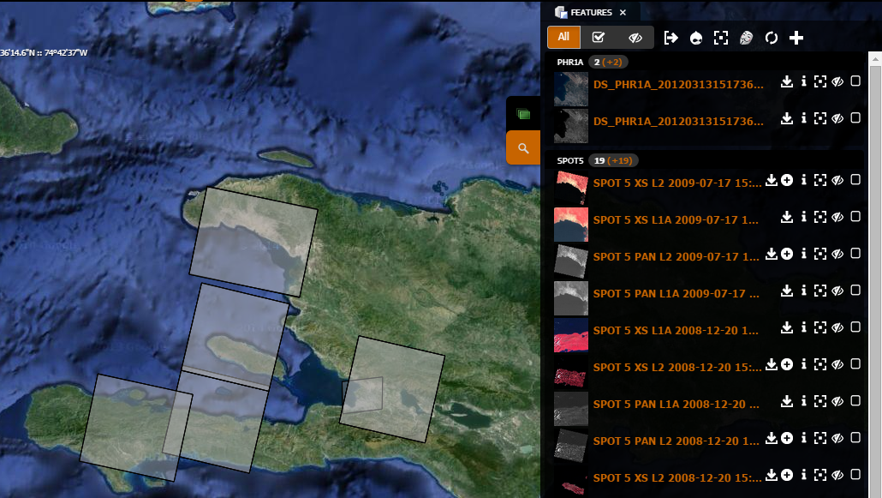
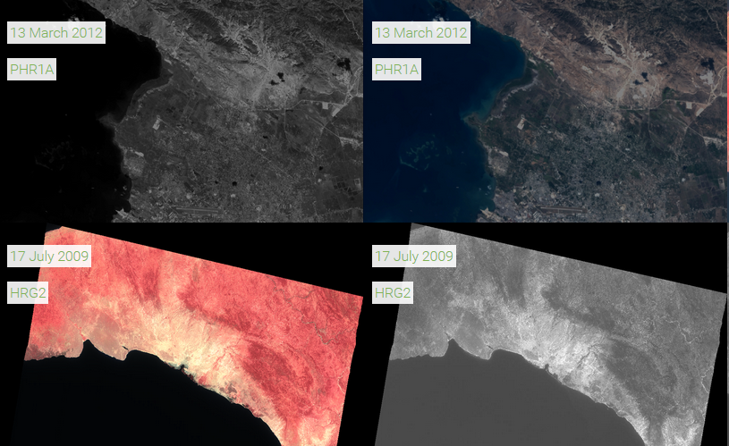
Drupal / Map - Coupling
  Bidirectional navigation between Drupal list of product and Mapshup cartographic viewer
    Search in the Map and display on Drupal
    Browse on Drupal and display on the Map

Slide 27
FUTURE FEATURES

Slide 28
User contribution
  Allow any authenticated user to add a product contribution to the system
    Contribution will be moderated
    Some trusted user’s contribution won’t be moderated
  User contribution can be of different types
    Full Ingestion Unit (Ingestion Unit specification will be published as a single document)
    Supported product types (currently SPOT5 and PLEIADE)
  User contribution products will be added to the RESTo metadata catalog
  User will be notified of the progress of its contribution

Slide 29
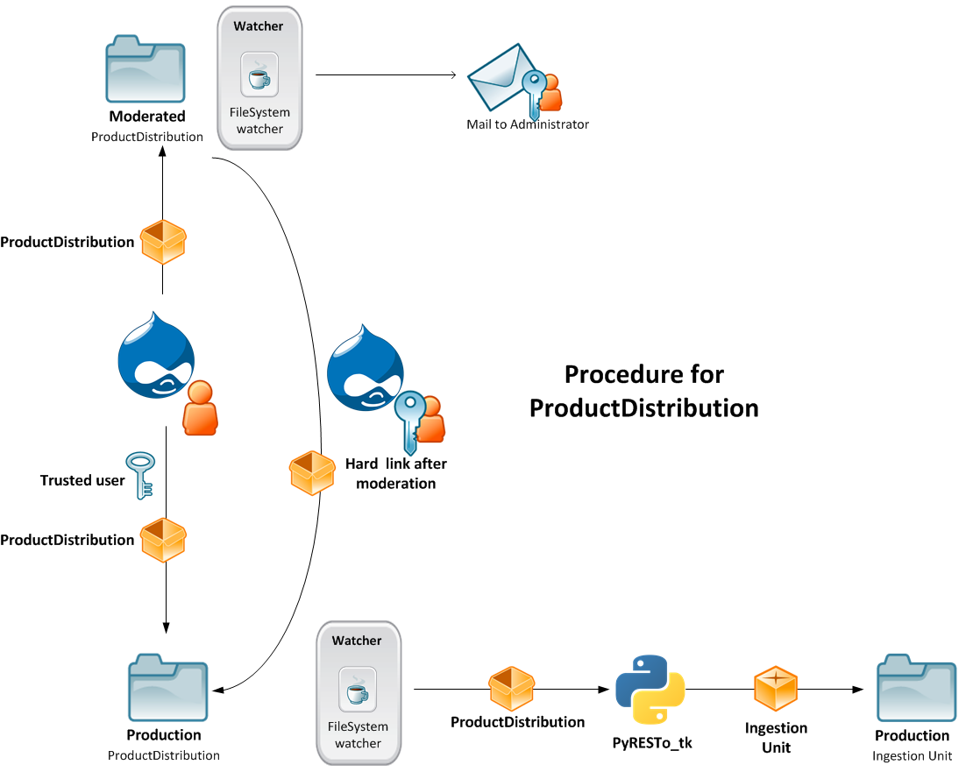
User contribution

Slide 30

License management
  Currently there is no license for any product
  In the near future, each product will have its own license
  User will have to sign this license in order to download a product

Slide 31
User permission search results filtering
  Currently all products that maps with a given search query are returned
  In the near future, depending on the user permissions, some results will be hidden
    Will be implemented as a RESTo plugin
    User permissions will be specified in the Drupal web site

Slide 32
LIVE DEMO

Slide 33
Any question ?

