Slide 1
CEOS Data Cube Concept and Prototype Project Plans
Brian Killough CEOS Systems Engineering Office (SEO)
WGISS-39
May 11-15, 2015

Slide 2
There is a global need for Space Data Services
Many countries lack the knowledge, infrastructure, and resources to access and use space-based data.
Countries have expressed a desire for support from CEOS by providing: search & discovery tools, cloud-based storage and processing, and training & capacity building.
CEOS is leading several projects to demonstrate data services tools and build an architecture that supports a growing volume of data.
It is expected that these data services pilot projects will provide a foundation for future operational systems that will be funded and managed by UN organizations and individual countries.
CEOS agencies have a keen interest in this activity since it promotes the use and benefit of satellite data.

Slide 3
What is the CEOS Data Services Vision?
CEOS will provide the architecture and tools for countries to access and utilize satellite data.
CEOS will provide the training and capacity building necessary to utilize those tools and manage satellite data.
CEOS will fund prototype projects to demonstrate tools and services for data access and utilization.
CEOS will consider low bandwidth contraints (poor internet) and the growing volume of satellite data in its architecture and tools.
CEOS will utilize advanced technologies in its architecture and tools, such as Data Services Platforms and Data Cubes based on cloud computing

Slide 4
An Example Space Data Problem in Kenya
A significant growth in land imagery data (optical and radar) from Landsat (NASA-USGS) and Sentinel (EC-ESA) will increase data volumes by >10 times in the next few years.
Kenya could have 5TB of annual Landsat and Sentinel-2 data by 2017.
Recent testing ... Processing a scene takes ~1 minute in U.S. and ~1 hour in Kenya. Downloading a scene takes ~6 seconds in U.S. and ~30 minutes in Kenya. Too much time is spent with image preparation!
We need a better solution ...
Increased Data Volume
Low Computing Capacity
Slow Internet

Slide 5
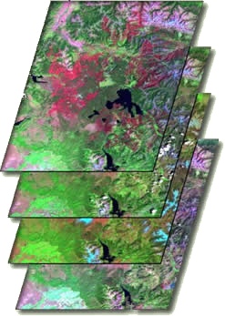
What is the Solution?
Proven concept in Australia by Geoscience Australia and the Australian Space Agency (CSIRO).
A multi-dimensional (space, time, data layers) Data Cube is an efficient and effective solution!
Shift in Paradigm ... Scenes vs. Pixels (no pixels lost)
Analysis Ready” Data Products vs. Unprocessed Data (leave processing to the Space Agencies).
Data Cube approach supports an infinite number of applications, makes it easier for users to access and use space-based data, and allows efficient time series analyses and data assimilation.
Data Cubes!
Data Layer #1
Data Layer #2
Data Layer #3
Data Layer #4
TIME

Slide 6
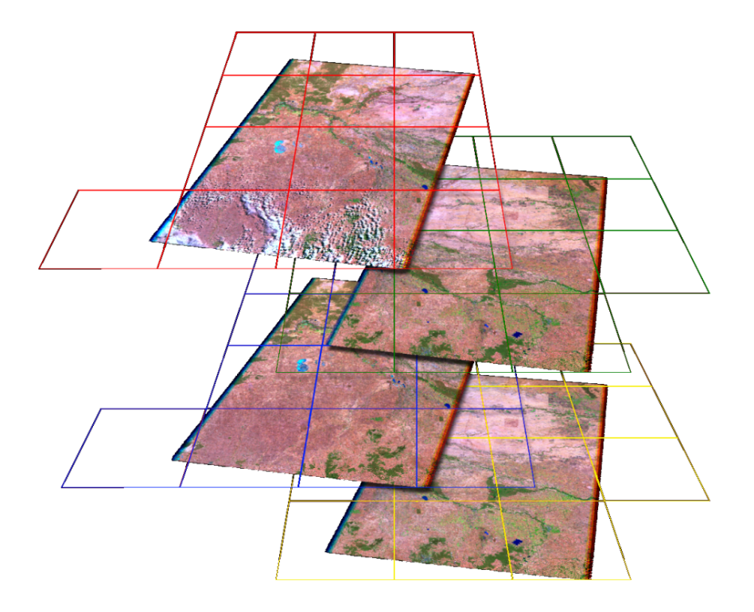
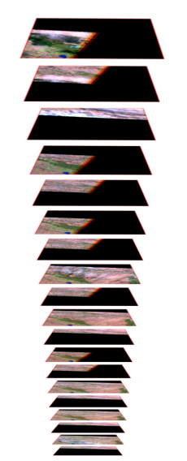
What’s different about the Data Cube approach?
The Data Cube arranges 2D (spatial) data temporally and spatially to allow flexible and efficient large-scale analysis.
The “Dice and Stack” method is used to subdivide the data into spatially-regular (nested grid), time-stamped, band-aggregated layers which can be managed as dense temporal stacks.
Dice…
…and Stack
Notes:
Remote sensing data is typically both spatially and temporally irregular: i.e. image footprints vary between repeat observations, and successful acquisitions do not occur on a regular basis.
Data is “clumped” both spatially and temporally and, hence, not suited to the monolithic array approaches traditionally employed due to large volume of no-data pixels.
The Datacube arranges the data spatially and temporally to allow efficient large-scale analysis.
“Dice’N’Stack” method used to subdivide the data into spatially-regular, time-stamped, band-aggregated tiles which can be traversed as a dense temporal stack.

Slide 7
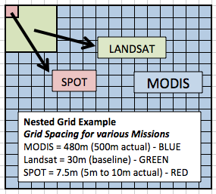
What is a Nested Grid?
A standard Universal Transverse Mercator (UTM) Nested Grid is an effective method for subdividing scene-based data.
The Nested Grid approach improves interoperability and sharing of data across domains and observation types with spatial consistency.
Datasets from various missions can be subdivided with a grid spacing similar to their base pixel resolution.
Example ... Landsat surface reflectance products are 30-meters resolution (baseline). MODIS is a 4x multiple of Landsat and SPOT is a ¼ multiple of Landsat.

Slide 8
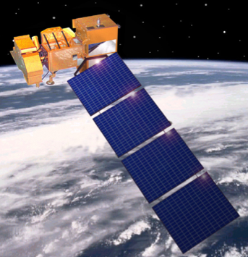
General Data Cube Architecture
Applications
Web-based
Mobile Phone
A flexible architecture that supports infinite user applications, increasing and diverse datasets, local or cloud-based deployment, and automated ingestion of new datasets.
Open Source (Apache v2.0) software to allow free and open access, Advanced Programming Interface (API) access, future data and capability growth, and commercial opportunities.
API
Data and Application Platform
Access Control
Data Management
Job Management
API
Data Cube Access
Analytics
Visualization
API Toolset
Analysis-Ready Data Products
Data Cube
Space Agency
Satellite

Slide 9
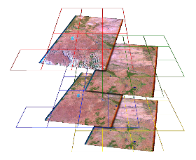
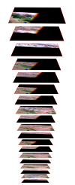
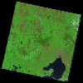
Detailed Data Cube Architecture
UI & Application Layer
Forest
Economics
App N
SLEEK
SEO (GFOI/GEOGLAM)
SLEEK Integrating Tool
Application / UI
Mobile App
API
Data & Application Platform
GA + CCI
TBD
Virtual Lab
Platform
Data & Application Platform
(Data Management, Access Controls,
Job Management, Etc.)
Database
Data Cube
Infrastruct.
GA
SEO
SEO
SEO + GA
AGDC Higher-level API
Data Presentation API
Visualization
API
Analytics
API
TBD
N-Dimensional Array
GA
AGDC Low-level API
GA
GA
GA + SEO
Architecture Considerations:
Short-term vs. Long-term
Flexible Deployment Model (Hybrid, AWS)
Technology Decisions
Performance vs. Flexibility
AGDC API vs. Platform
Resources / Timeline
Datacube
Files
AGDC
Database
Data
Data
Metadata, Records, Etc.
GeoTIFF, HDF, NetCDF
Data Acquisition
& Inflow
Space Segment/Ground Station Operation
Analysis-Ready Data Supply

Slide 10
High-Level Data Cube Requirements
Free and open access to software and APIs
Documented processes for Data Cube generation, new data ingestion, and application interfaces
Automated ingestion of new data layers and new data acquisitions
Support cloud-based or local deployment
Utilize “Analysis Ready” data products for satellite data layers
Enable user development of applications through flexible APIs
Utilize a UTM “nested grid” for multiple dataset interoperability and spatial consistency
Develop a baseline user interface that supports Data Cube statistics/analysis and optical image preparation (e.g., mosaics).
Architecture flexibility and standards to support multi-country Data Cubes

Slide 11
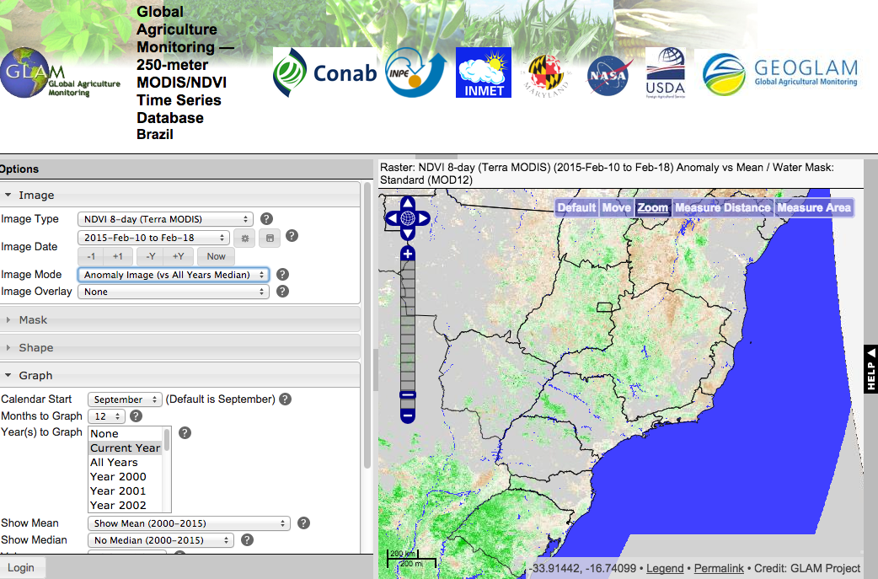
User Interface Concept
Web-based tool that utilizes a Map Panel and a Tool Panel similar to many existing GIS tools.
Tool Panel
Map Panel
Example User Interface: GEOGLAM MODIS Time-Series Tool
Map Panel would allow the user to zoom in/out of the region and draw a region to select for an analysis. This panel would also be used to display analysis results as overlays or separate images or graphs.
Tool Panel would provide analytics and application functions. The tool panel would allow the user to issue queries of the Data Cube content through various APIs.
Once all of the APIs are in place, then it will be possible for anyone to create their own user interface for any application using the Data Cube.

Slide 12
Detailed Requirements for the Data Cube User Interface
(1) Image Preparation ... Highest Priority (baseline interface)
Automate the image preparation process (no manual review)
Perform cloud masking and identify data gaps (utilize Landsat CFmask output to identify clouds and cloud shadows)
Report statistics after masking (e.g., % cloud or cloud shadow, pixel time stamp)
Create mosaic images for further analyses (e.g., GEOTIFF output, local storage)
(2) Forest Extent Mapping ... Lower Priority (example application)
Run unsupervised classifiers (e.g., custom, K-means, ISODATA)
Allow upload of “training data” (e.g., input file of forest locations)
Run supervised classifiers (e.g., Nearest Neighbor using training data)
Allow users to upload or create their own algorithms
Create forest/non-forest maps
(3) Change Detection ... Lower Priority (example application)
Run specific change detection algorithms (e.g., CCDC)
Allow users to upload or create their own algorithms
Create change detection maps and statistical output

Slide 13
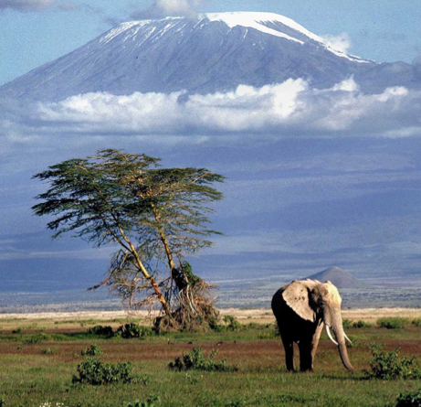
Kenya Data Cube Project
The Kenya Data Cube Project is led by NASA-SEO and the Australian Government (Geoscience Australia, CSIRO and the Dept. of the Environment).
The project will involve a large number of stakeholders and funders ... Australian Government, NASA, USGS, United Nations REDD+ and FAO, Gates Foundation, Clinton Foundation (CCI and SLEEK), SilvaCarbon.
The project will involve a large number of CEOS groups ... Space Agencies (satellites), NASA-SEO (data tools), SDCG for GFOI, LSI-VC, WGISS (data archives), WGCapD (training) and GEOGLAM.
Team met on March 9-11 to develop a vision, architecture and task plan for the project.

Slide 14
Now and in the Future
Australia Data Cube
Kenya Data Cube
Web Application
Web Application & Mobile App
Now
Future
New Datasets
New APIs
New Data Platform
Improved Data Cube API
Flexible web applications
Enhanced documentation
Enhanced performance
Data and Application Platform
Data Cube API
Analytics API Visualization API Presentation API
Data Cube API
Landsat + MODIS
Landsat-7/8, SRTM, MODIS, SPOT, ALOS-1, Sentinel-1A/2A

Slide 15
Who is involved?
Kenya Data Cube
CEOS
Non-CEOS
Applications
NASA-SEO SDCG for GFOI
CCI-SLEEK ?
Gates Foundation ?
SilvaCarbon ?
Data & Application Platform
NASA-SEO
CCI-SLEEK ?
Gates Foundation ?
GA
NASA-SEO
CSIRO ?
API Toolset
GA: Australia Cube
NASA-SEO: Kenya Cube
CSIRO: South America Cube ?
WGISS Studies?
Landsat-7/8, SRTM, MODIS, SPOT, ALOS-1, Sentinel-1A/2A

Slide 16
Project Phase 1
Phase 1: thru December 2015
Develop an initial Kenya Data Cube with Landsat and SRTM data layers.
Demonstrate a user interface with statistics/analysis tools and image preparation capability (e.g. mosaics).
Demonstrate an application including a land classification algorithm and a temporal change detection algorithm.
Present results at the United Nations COP-21 Climate Change Meeting.

Slide 17
Future Project Phases
Phase 2: thru 2016
Expand datasets (e.g., MODIS, SPOT, ALOS, Sentinel-1A, Sentinel-2A)
Expand regions (e.g., Colombia, East Africa)
Expand applications (e.g., GFOI, SLEEK, GEOGLAM)
Demonstrate automated data ingestion of new products.
Expand analysis tools, application platform and APIs.
Phase 3: 2017+
More data layers, more regions, more applications.
Optimization of ingestion, data cube processing, and APIs for expanded applications support.
Demonstrate a mobile application.

