Slide 1
SEO Report to WGISS
Brian Killough CEOS Systems Engineering Office (SEO)
WGISS-39
May 11-15, 2015

Slide 2
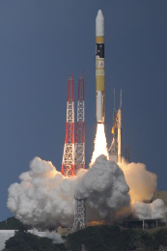
CEOS Mission Summary
CEOS currently operates 131 missions!
12 successful CEOS launches in 2014
12 new CEOS launches planned for 2015 Sentinel-2A, Sentinel-3A (ESA/EC), ELECTRO-L-N2, RESURS-P-N3, OBSUR-O (Russia) SMAP, CATS-ISS, Jason-3 (NASA), KOMPSAT-3A (DLR/KARI), Meteosat-11 (EUMETSAT), Ingenio (CDTI), SAOCOM-1A (CONAE) (recent launches in RED)

Slide 3
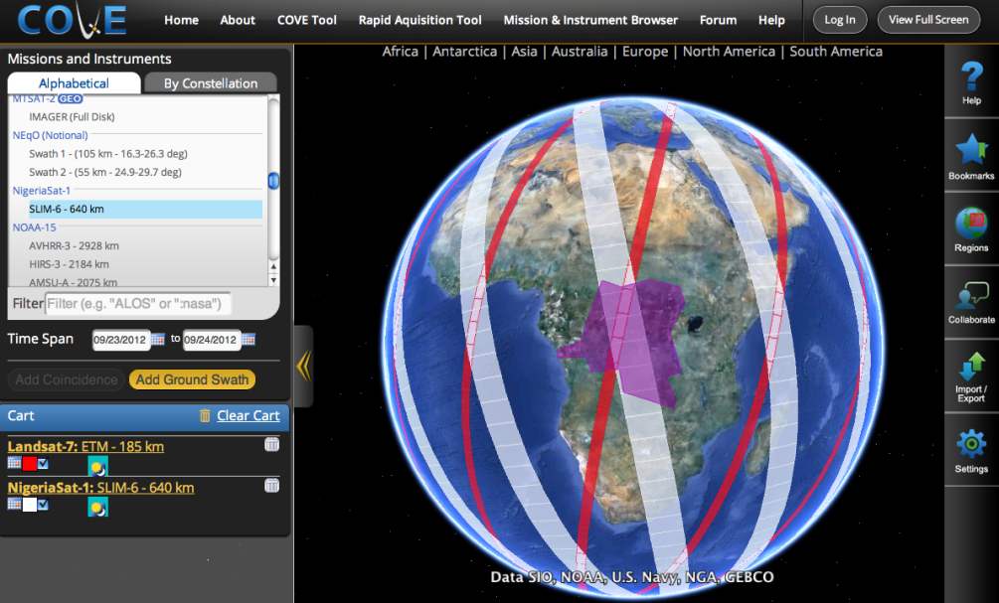
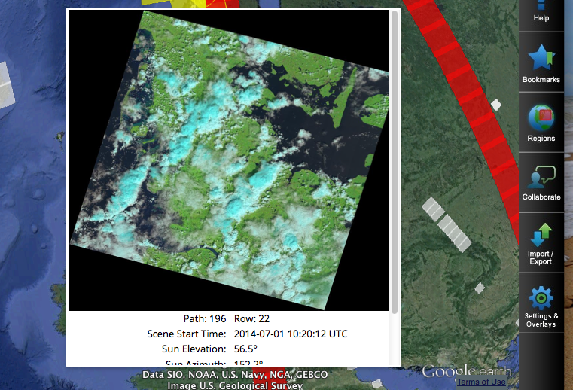
New Features in COVE
259 missions, 697 instruments
Data Overlays: Landsat tiles, Sentinel-2 tiles, ASTER DEM, GlobCover, MODIS LCC.
Future Overlays: Vegetation Phenology, Cloud Probability Maps for Agriculture
Data Archive Links: Landsat 7/8, SPOT 1-6, Pleaides-1A/1B, Radarsat-2, ALOS-1
Future Data Archive Links: Envisat, ERS-1/2, RapidEye, Sentinel-1A/2A.
>20,000 unique users in 2014
www.ceos-cove.org

Slide 4
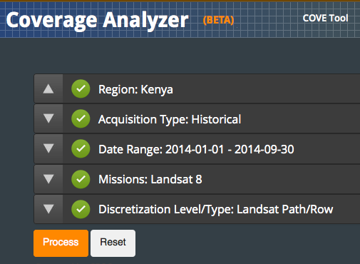
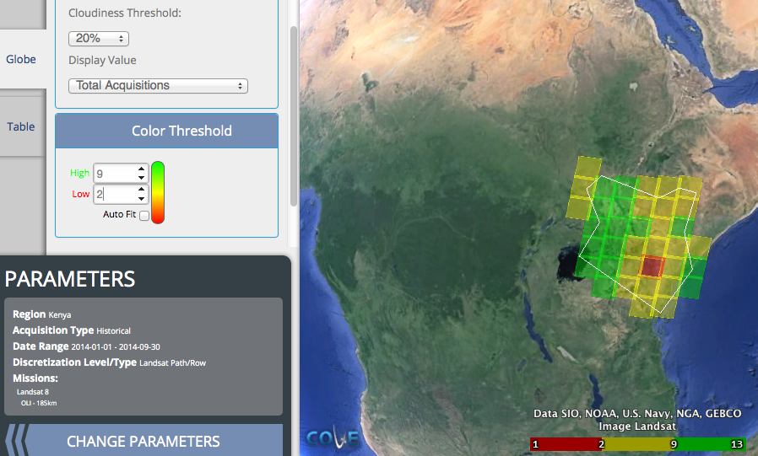
Coverage Analyzer Tool
New release is available!!!
Improved menu selections for Region, Past/Future, Dates, Missions, Discretization.
Improved processing performance.
Output in global or table format.
Selection of cloud filtering, color scaling.
KML and CSV export.
Example on Right >>> Landsat-8, 2014, <20% cloudy, Kenya

Slide 5
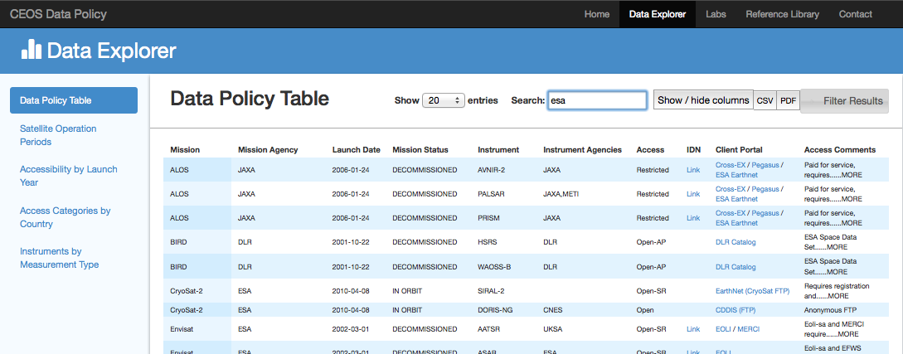
Data Policy Portal
A new release of the Data Policy Portal is available!!!
www.ceos-datapolicy.org
Data Summary
Open Access = 59% , Restricted or Unknown = 41%
Database includes 352 missions launched since 1990 and 646 mission-instrument combinations.
Tool includes direct links to primary data portals.

Slide 6
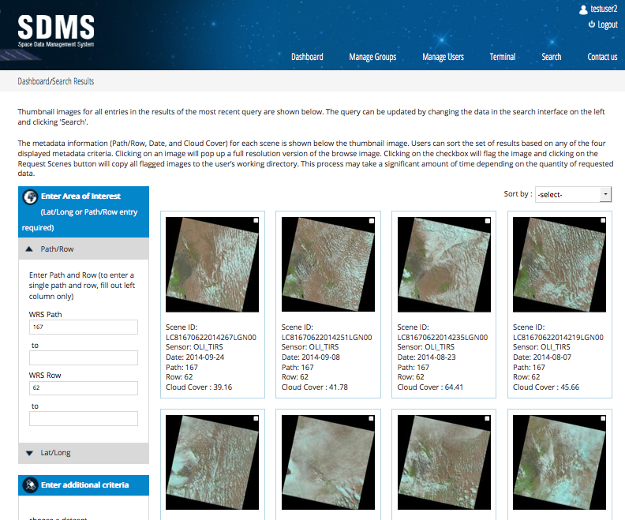
FAO Project
Traditional scene-based file manager and user interface.
User and Group Control
Terminal Line Editor for OpenForis toolset
Search tool for Landsat archive searches and data download
Initial delivery in Oct-2014 anbd deployment to 4 countries in early 2015. Expanded deployment to 14 countries through 2018, led by FAO.

Slide 7
Asia-Rice Project
Developed a Data Services portal with secure access for JAXA and Indonesia Asia-RICE science users.
Dedicated storage for up to 35 Radarsat-2 images (provided by CSA) and Amazon cloud processing of SAR datasets using INAHOR tool.
STATUS: Datasets and processing tools installed. Initial tests in Indonesia showed poor processing performance due to internet and graphics demands of INAHOR processing tool. Moved server from USA to Japan in late 2014. Now considering moving server to Singapore.
The Asia-RICE data services portal will be expanded in 2015 to include: Vietnam, India, Indonesia, Japan, Lao PDR, Malaysia, Philippines, Taiwan and Thailand. There will be separate data folders for each country.

Slide 8
Colombia Project
Working directly with Sylvia Wilson (USGS, SilvaCarbon), Edersson Cabrera Montenegro (Colombia) and Gustavo Galindo Garcia (Colombia).
March 2014 – SEO develops a proposal to DLR for TanDEM-X datasets over Colombia. Accepted in June 2014.
December 3, 2014 – SEO delivers Data Services tool to Colombia including downloaded datasets.
Amazon cloud storage and processing with secure access to datasets in 8 regions over Colombia (see figure).
CEOS facilitated data access and Amazon Web Services to demonstrate enhanced computing performance and improved digital elevation model data.
Feedback expected in mid-2015.

Slide 9
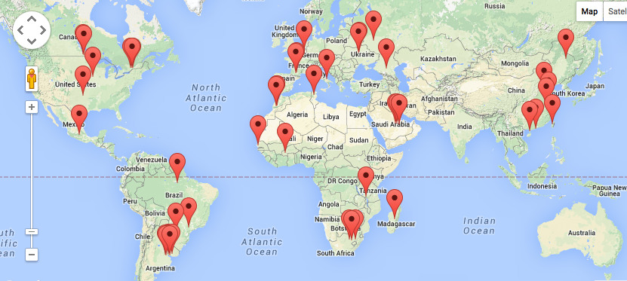
JECAM Project
Worked with CSA to develop a data sharing agreement for Radarsat-2 data. The approved document will allow sharing of datasets across all JECAM sites. In the past, data was restricted to only individual sites based on separate proposals.
The SEO plans to develop a user interface for file storage and data processing to support a SAR intercomparison study for JECAM.
The data services tool will support: Canada, Ukraine, Belgium, Argentina, China and France. There will be separate data folders for each country.
9

