Slide 1

WGISS Working Group for Information Systems & Services
GEO Task Sheet Review
Committee on Earth Observation Satellites
Richard Moreno
CNES – WGISS chair
WGISS-39
Tsukuba - JAPAN
11th May – 15th May 2015

Slide 2
IN02C1

Slide 3
IN02C1

Slide 4
IN02C1

Slide 5
IN02C1

Slide 6
IN02C1

Slide 7
IN02C1

Slide 8
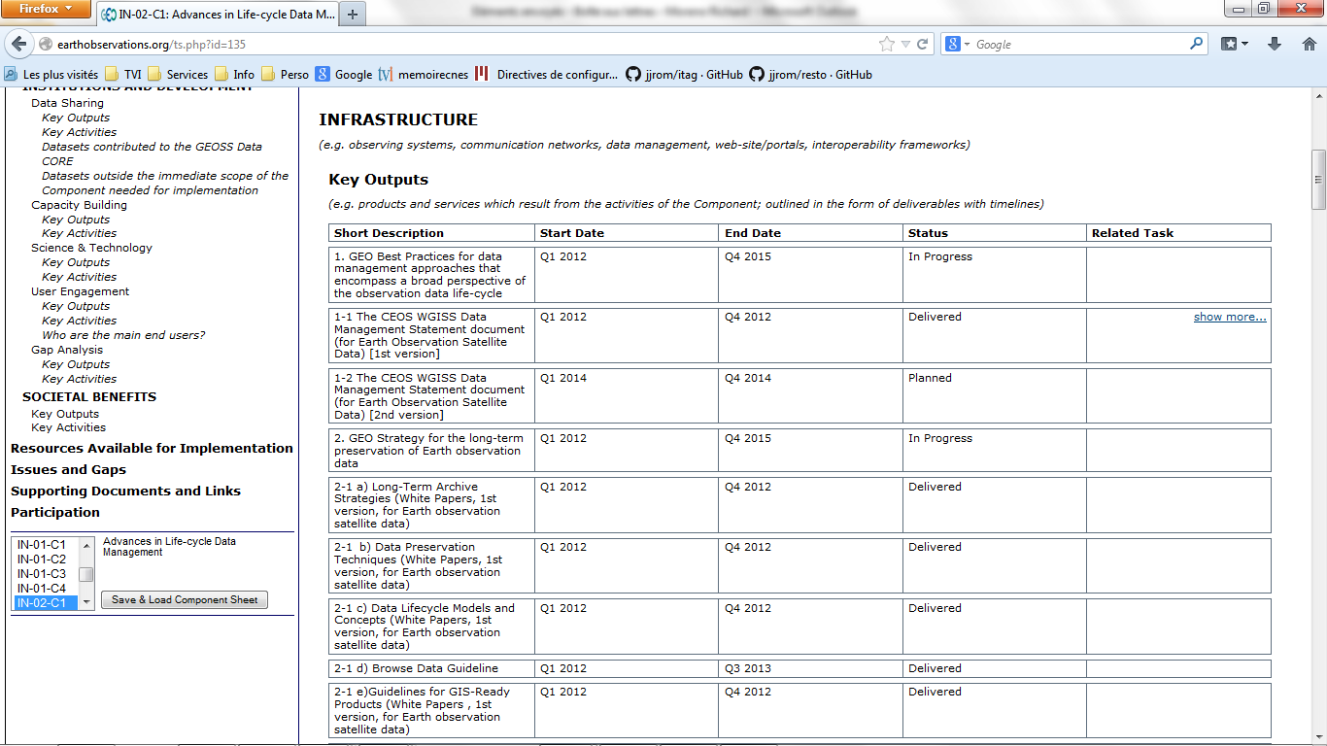
http://earthobservations.org/ts.php?id=135
http://earthobservations.org/ts.php?id=135

Slide 9
Request from GEO - Osamu
Request to provide an update on the progress and the achievements associated with the GEO task components for which you act as Point of Contact, as well as plans and perspectives for the future.
2015 will be a year of transition from the first to the second GEO decade. While renewing the GEO mandate for the period 2016-2025, the Geneva 2014 Summit asked that a new ten-year plan be developed.

Slide 10
Request from GEO - Osamu
Implementation Plan Working Group-IPWGwas put in place to develop this new plan
  will be presented for adoption at the next Ministerial Summit scheduled for 13 November 2015 in Mexico City.
The IPWG has already presented three interim reports
  the new Strategic Plan will determine substantial changes on how the GEO activities are identified, organized and implemented.
  need to appropriately transition from the current Work Plan to the new Work Programme, taking stock of the achievements made and re-organizing the activities to meet the new strategic framework.

Slide 11
Request from GEO - Osamu
the input from the Community, through you, is essential. We kindly ask you to fill the enclosed table that we have developed to gather the basic information timeframe,

Slide 12
Questions sent to the co-lead
First question : is the list of priority action listed in the section 3 of the word document “Geo work status” up-to-date ? Do We have to add or remove some activities.
Second question : could you give me some element to feed the word document “Geo Task Template” (sections TBW)

Slide 13
Questions sent to the co-lead
For my understanding,
Activity 1 (Improve and coordinate data management approaches) is linked to CEOS WGISS activities. I will provide information on this topic
Activity 2 (data quality ) is linked to CEOS WGCV activities. Albrecht will provide information on this topic
Activity 3 (long term preservation) is linked to GSCB LTDP and CEOS Data Stewardship. Mirko will provide information on this topic
Activity 4 (Geodetic reference) ??? I have no clue.
Activity 5 (DIAS, …) For me this is linked to water portal. Maybe Satoko is able to provide information on this topic?

Slide 14
Questions sent to the co-lead
Third question : as you maybe probably know, there is a ‘Data Management Principles’ Task Force. Can we and how should we include the work of this TF in this component ? This question is more for Osamu.
Fourth and last question : do you have any suggestions for modification of the IN02-C1 web page (http://www.earthobservations.org/ts.php?id=135) ?
For information, we have foreseen to discuss about it during the next CEOS WGISS meeting in mid-May in Tsukuba.
I guess for example that We should add Albrecht as co-lead.

