Slide 1
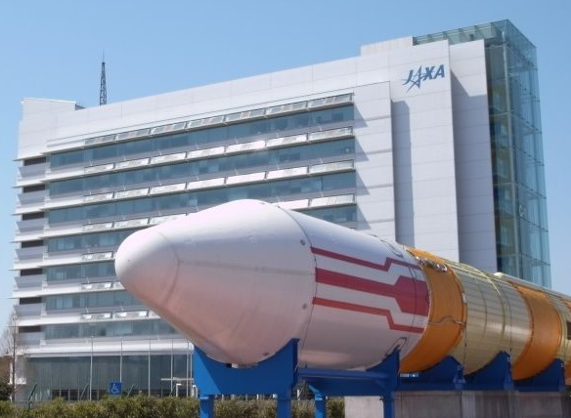
Welcome to WGISS-39 Welcome to JAXA Tsukuba Space Center (TKSC)
Notes:
JAXAロゴ入れること

Slide 2
Hotel <-> TKSC
Hotel Departure
9:00 a.m.
Come to the hotel lobby by 8:50 a.m.
TKSC Departure (planned)
5:45 p.m. (Monday – Thursday)
1:00 p.m. (Friday)

Slide 3
Name Tag
Please DO NOT LOSE your name tag. It is your security pass to the JAXA TKSC.
Please wear the name tag at all times while you stay in the TKSC.

Slide 4
Floor Plan
Meeting Room (small)
Stairs
WGISS-39 Meeting Room
Lobby
Stairs
Lobby
Vending
Machines
Entrance
Slope
WC
WC
Reception
Table
* Scale is not correct!!

Slide 5
Internet Connection
Wireless internet is available in this meeting room.
Details including SSID and PWD are shown in the manual on the table.

Slide 6
Coffee Break
Beverage
Various kinds of beverages are available on the vending machines (100~200JPY/1 drink).
Snack
Some snacks are available in the meeting room.

Slide 7
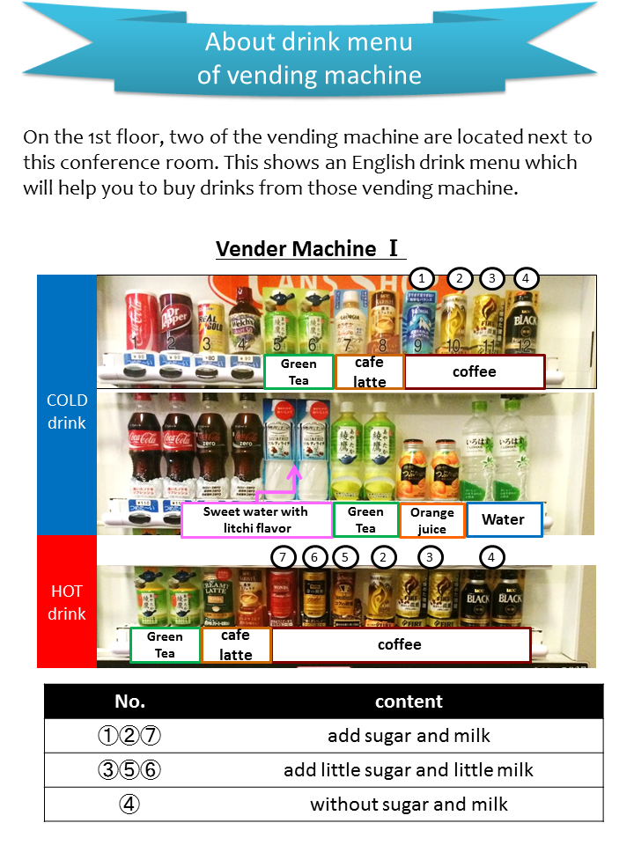
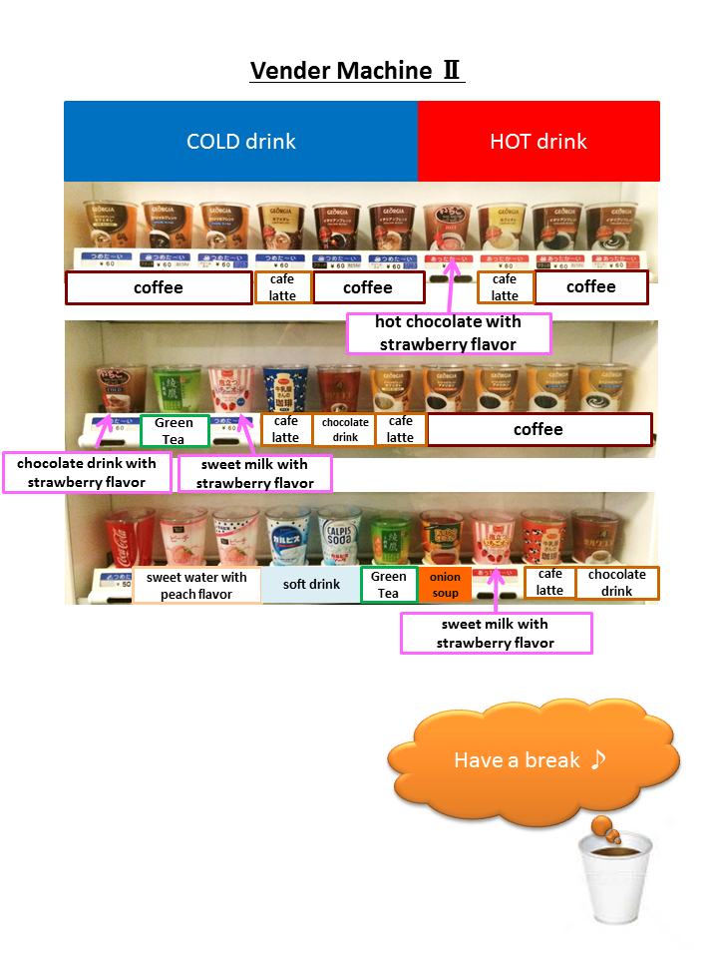

Slide 8
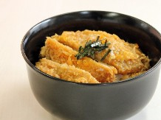
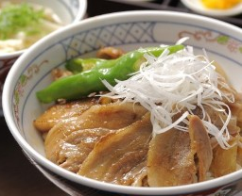
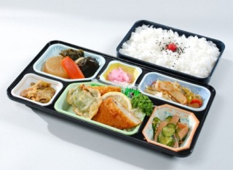
Lunch
Order sheets for a lunch box were on the table.
Please return the sheets to the JAXA WGISS Team BY 10:00am of each day.

Slide 9
After business hours…

Slide 10
Non-host Dinner 1
Date: May 11th (TODAY)
Venue: Kura-zushi (Sushi go-round restaurant)
Transportation to/from the hotel: Taxi
Most taxies accept major cards. Please pay by yourselves!
Price: Depending on how much you eat
One dish is normally 100JPY (without tax), but some dish is 200 JPY.
Payment
Only ONE BILL will be issued for ONE TABLE (with 4 seats). Please divide the bill among 4 persons of that table.
Cards are NOT accepted.
Various types of foods are available, including raw-fish sushi, meat sushi, ramen-noodle, tempura bowl, etc.
Let’s meet at the hotel lobby at 18:30 today.
If you do NOT want to join this dinner, please contact one of the JAXA WGISS Team by 15:00, today.

Slide 11
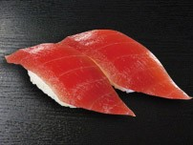
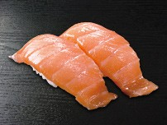
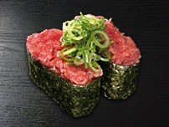
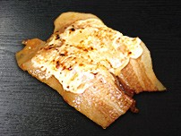
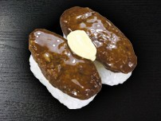
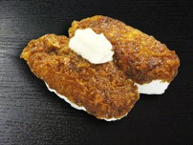
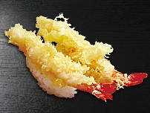
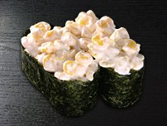
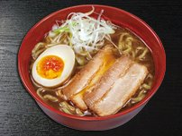
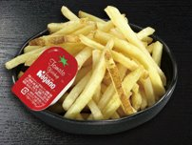
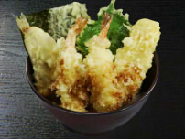
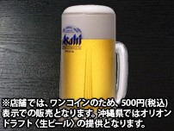
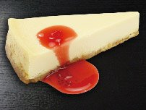
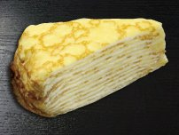
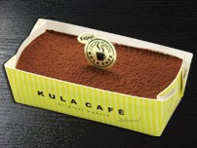
Sushi
Tsuna
Salmon
Tsuna & Green Onion
Grilled Pork & Cheese
Burger
Pork Cutlet
Shrimp Tenmpura
Corn & mayonnaise
Others
** These are some examples. You can find much more ! **
Beer
Ramen
French Fry
Tempura Bowl
NY Cheese Cake
Various Cakes
Tiramisu
Coffee
Notes:
あぶりチーズ豚カルビ

Slide 12
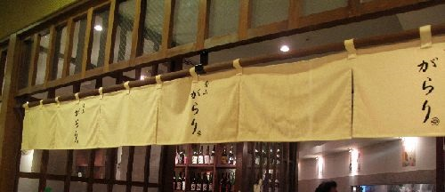
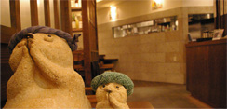
Non-host Dinner 2
Date : May 13th (Wednesday)
Cost : 5,000 JPY (Cards accepted)
Venue: "GARARI", Japanese style restaurant within walking distance from the hotel
Let’s meet at the hotel lobby at 18:45 on Wednesday.
If you do NOT want to join this dinner, please contact one of the JAXA WGISS Team by 15:00, today.

Slide 13
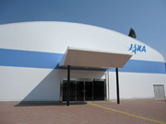
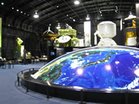
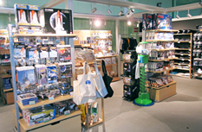
The Exhibition Hall "Space Dome“ and " Space Shop “
Open 10:00 to 17:00
Closed Every Monday
Free Admission
Space Dome
Space Shop
Notes:
宇宙センターミュージアム

Slide 14
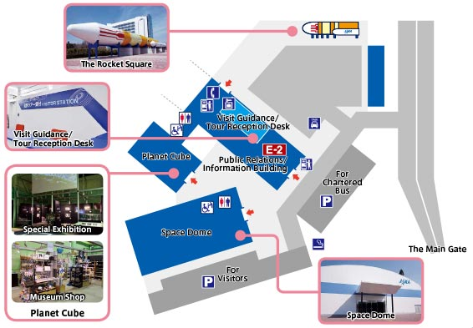
Meeting Venue
Building

Slide 15
If you like shopping
CREO & Q’t
Within walking distance from the hotel
Several dinner options are available.
Open: 10:00-20:00(most shops), 11:00-23:00(restaurants)
Iias Tsukuba
Transportation to/from the hotel : train (one stop) and walking (about 5min)
Several dinner options are available inside the shopping center.
Open: 10:00-21:00(most shops), 11:00-22:00(restaurants)
And others. Please ask the JAXA team for more details.

Slide 16
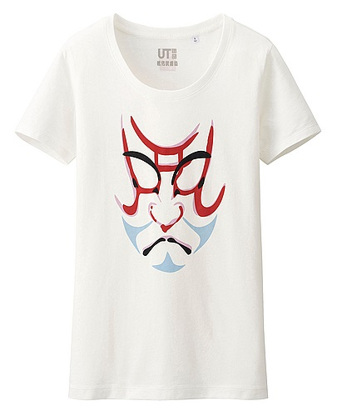
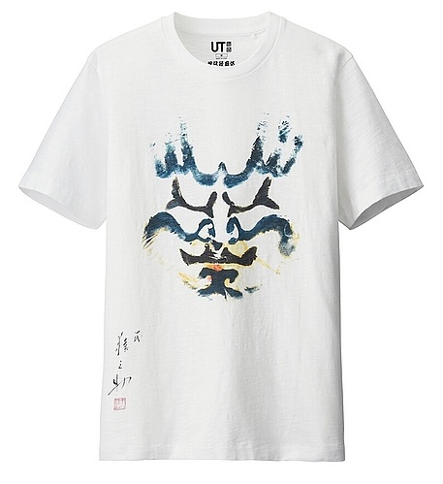
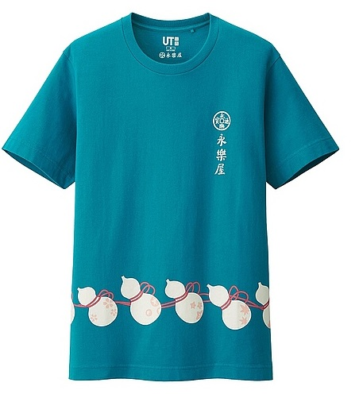
Are you interested in these “Japanese taste” T-shirt?
If so, please ask the JAXA team. You can purchase these in Tsukuba.

Slide 17
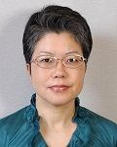
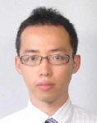
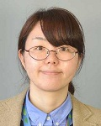
Please do not hesitate to ask
the JAXA WGISS Team!!
Satoko MIURA
Shinichi SEKIOKA
Akari YONEYAMA

