Slide 1
Open Data Cube Jupyter Notebooks
A powerful way for demonstration, research, and teaching
WGISS Webinar-3: Burgeoning Role of Python for Earth Observation Data Analysis
Tuesday, August 22, 2017

Slide 2
About this talk
All the contents are from public domain
Introduction to data cube
What is Python? Why Python?
Python modules and libraries
Jupyter Notebooks Demos

Slide 3
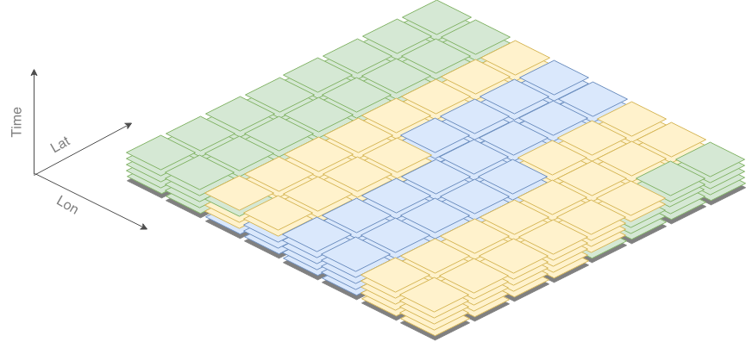
Dense Data
-A versatile representation
-All points map to a value
-Easy to select/index
-Efficient representation in memory
-Called “Raster Data”
-Data Cube analysis case is spatially and temporally dense

Slide 4
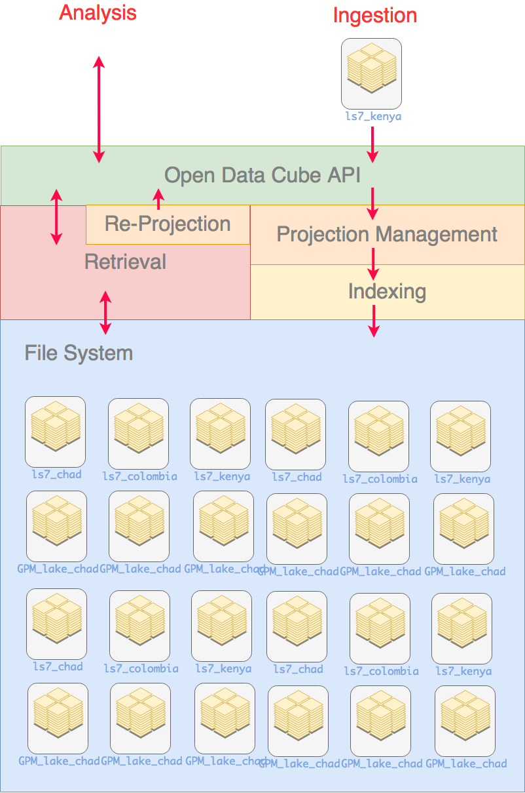
Open Data Cube: Storage
When someone asks you about datacube, you might say:
“It’s an efficiently indexed file system for satellite imagery”
Open Data Cube focuses on the storage of dense data
Open Data Cube’s storage system can handle and automate:
Storage
Projections
Retrieval

Slide 5
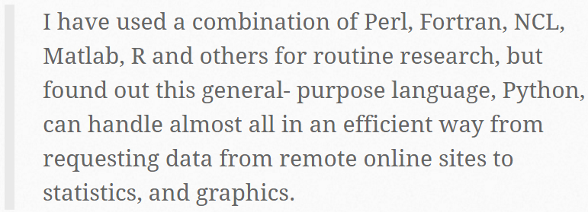
What is Python? Why Python?
Numpy
Scipy
Scikit-learn
Matplotlib
The advantages of Python were once succinctly summarized by a UCAR scientist:

Slide 6
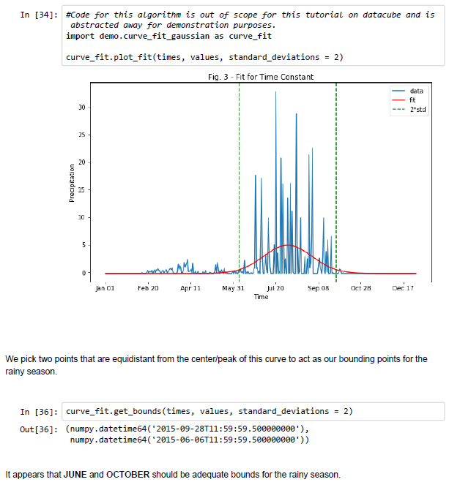
Jupyter Notebooks Demos
The Jupyter notebook allows developers to parse their code into blocks which can be run independently of each other, with variables stored in the background.
Dividing the code up in this way can save vast amounts of time while developing a program, as it allows developers to test their code a few lines at a time, without running other lengthy processes included in the program.

