Slide 1


Search Relevancy in GEO Data Access Broker
CEOS WGISS Tech Expo Webinar
March 14, 2017
Stefano Nativi and Mattia Santoro
(Earth and Space Sciences Informatics laboratory, CNR)

Slide 2












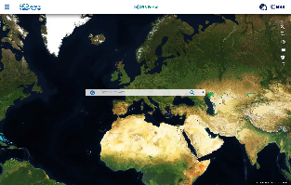








GEOSS
end-Users
DOWNSTREAM
GEOSS Applications
GEOSS Applications
GEOSS Applications
GEOSS Applications
GEOSS Portal
GEOSS Application Developers
(intermediate Users)
GEOSS Common Infrastructure
APIs
MIDSTREAM
Mediation modules
GEOSS Supply Chain
Enterprise System 1
… .
Enterprise System 3
System 4
Enterprise System 1
Enterprise System 2
Enterprise System 2
Enterprise System 3
Enterprise System 2
… .
Enterprise System 3
System 4
System 4
Enterprise System Z
Enterprise System 1
SBA 8
… .
… .
Enterprise System j
Enterprise System K
UPSTREAM
SBA 1
SBA 2
GEOSS Providers

Slide 3
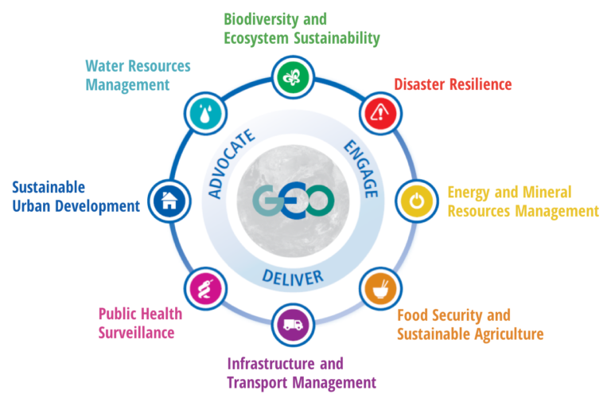
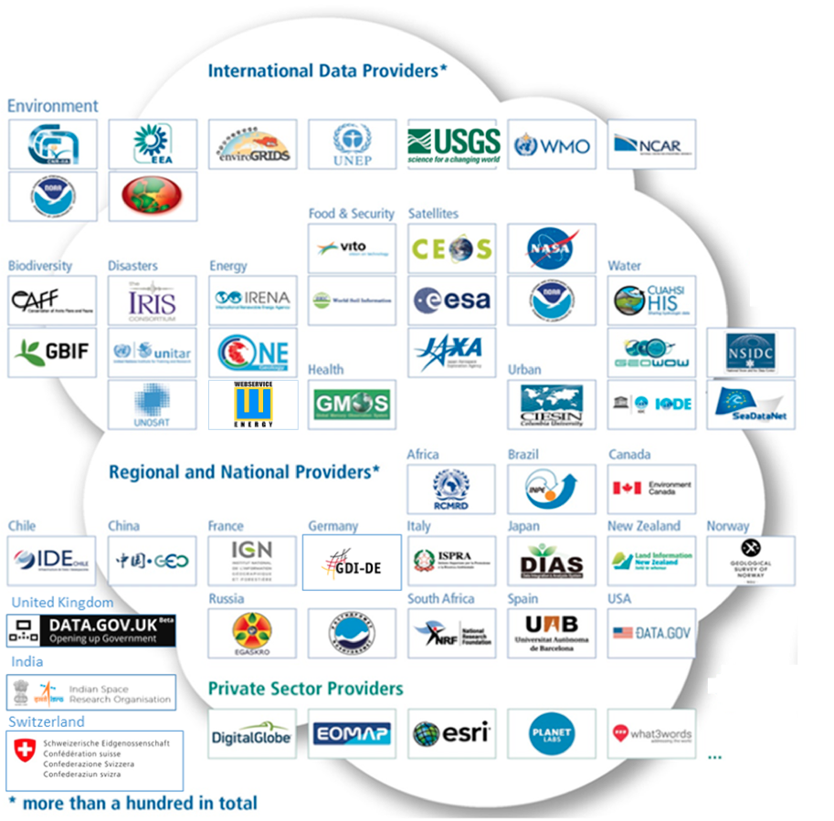
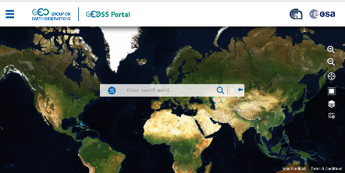

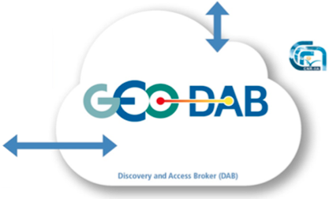
GEOSS Common Infrastructure (GCI)
More than 150 GEOSS Data Providers
More than 40 million Datsets
About 200 million Granules
Societal Benefit Areas
Ranking and Pagination of discovery results
Data Providers
> 200 million data resources spanning all SBAs
Notes:
Societal Benefit Areas are ‘implemented’ via GEO-Community Activities, GEO Initiatives and GEO Flagships (in order or becoming more ‘mature services’)
SBAs need access to data/other EO-resources from data/resource providers
GEO is implementing this via a GEOSS Common Infrastructure (GCI) – and the GEOSS portal is the main Graphical User Interface for the Users, while the GEO-DAB (Discovery and Access Broker) is the middleware. Machine to Machine access to the DAB is as well possible via different API’s.

Slide 4




Ranking (and pagination)
Weighted quality scores approach
Static Score
Pre-calculated in batch, based on:
  Metadata Quality
  Accessibility
  Etc.
Dynamic Score
Calculated on-the-fly, based on:
  Query Constraints
Weights
Applied to scores (configurable)

Slide 5
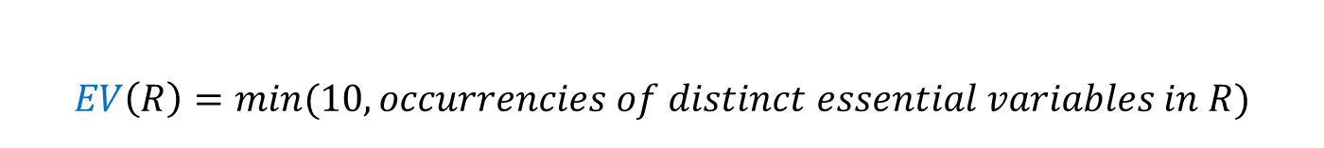

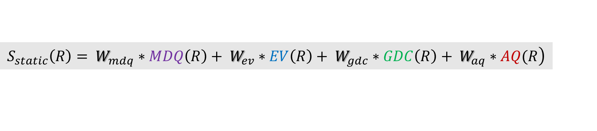
Static Score for metadata record R
Essential Variable Quality
Access Quality
$$\left.S_{static}\left(R\right)= W_{mdq}∗MDQ\left(R\right)+ W_{ev}∗EV\left(R\right)+ W_{gdc}∗GDC\left(R\right)+ W_{aq}∗AQ(R\right)$$
Metadata Quality
GEOSS Data Core Quality
$$EV\left(R\right)=min⁡(10, occurrencies of distinct essential variables in R)$$
$$GDC\left(R\right)=10∗ \left\{\begin{aligned}&1, if R is GEOSS Data Core \\ &0, otherwise\end{aligned}\right.$$

Slide 6
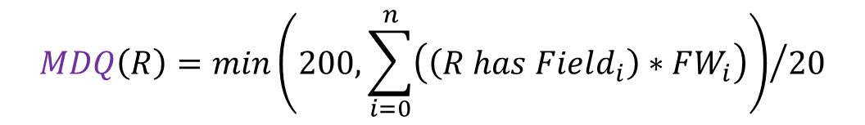
(discovery + access) Metadata Quality Score
$$MDQ\left(R\right)={min\left(200, \sum_{i=0}^{n}{\left(\left(R has Field_{i}\right)∗FW_{i}\right)}\right)}/{20}$$
Field | Description | Weight
DIRECT DOWNLOAD GEO-SPATIAL SERVICE | The metadata contains a link to directly download the dataset through a geo-spatial service (e.g. a GetCoverage request, an OPeNDAP request, etc.). Resources provided with a preview (e.g. WMS layers) are ranked first. | 60
COMPLEX DOWNLOAD DIRECT DOWNLOAD GEO-SPATIAL SERVICE | The metadata contains a link to a geo-spatial service, including: the name of the data layer to which the metadata is referred to and the protocol of the geo spatial service to invoke. Resources provided with a preview (e.g. WMS layers) are ranked first. | 30
SIMPLE DOWNLOAD GENERIC SERVICE | The metadata contains a link to directly download the dataset from a non geo-spatial service (e.g. ftp links, HTTP GET request for a KML document, etc.). | 15
GENERIC LINK | The metadata contains a link to resource on the web (e.g. HTML pages). | 10
FILE IDENTIFIER | The metadata contains the File Identifier field. | 5
ABSTRACT | The metadata contains the Abstract field. | 5
SPATIAL EXTENT | The metadata contains the Spatial Extent covered for the resource. | 3
TIME | The metadata contains the Temporal Extent covered for the resource | 2
TITLE | The metadata contains the Title field. | 1
Access
Discovery

Slide 7



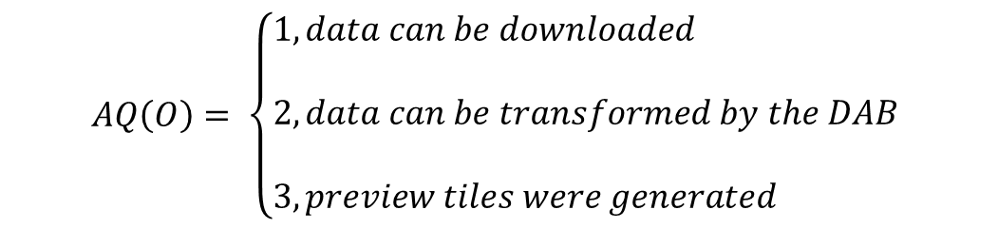
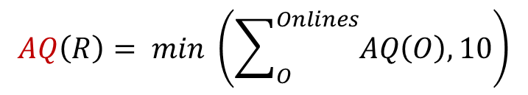
Access Quality Score
Iteration over the list of the OnlineResource elements characterizing
the record R
$$AQ\left(R\right)= min \left(\sum_{O}^{Onlines}{AQ\left(O\right), 10}\right)$$
$$AQ\left(O\right)= \left\{\begin{aligned}&1, data can be downloaded \\ & \\ &2, data can be transformed by the DAB \\ & \\ &3, preview tiles were generated\end{aligned}\right.$$

Slide 8
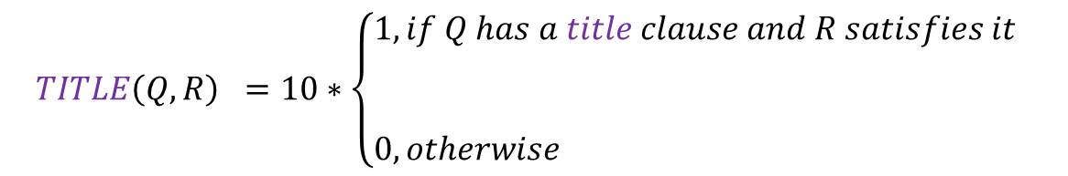
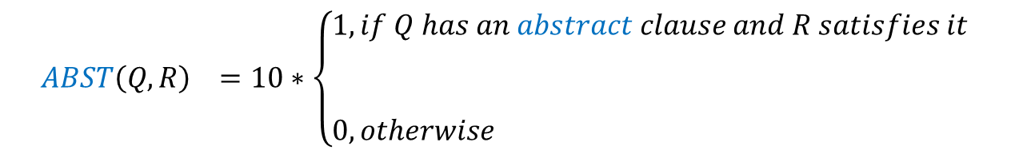
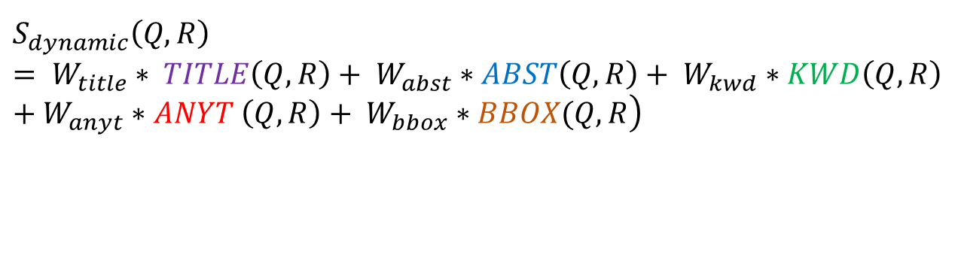
Dynamic Score of Metadata Record R for Query Q
$$\left.S_{dynamic}\left(Q, R\right)= W_{title}∗ TITLE\left(Q,R\right)+ W_{abst}∗ABST\left(Q,R\right)+ W_{kwd}∗KWD\left(Q,R\right)+W_{anyt}∗ANYT \left(Q,R\right)+ W_{bbox}∗BBOX(Q,R\right)$$
$$TITLE\left(Q,R\right) =10∗\left\{\begin{aligned}&1, if Q has a title clause and R satisfies it \\ & \\ & \\ &0, otherwise\end{aligned}\right.$$
$$ABST\left(Q,R\right) =10∗\left\{\begin{aligned}&1, if Q has an abstract clause and R satisfies it \\ & \\ & \\ &0, otherwise\end{aligned}\right.$$

Slide 9
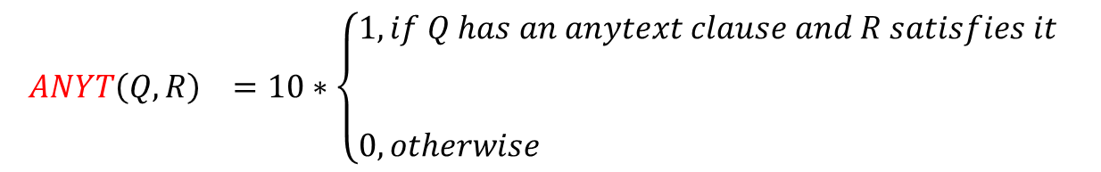
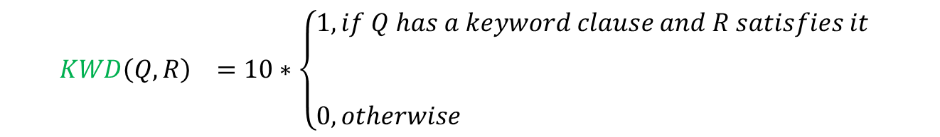
Dynamic Score of Metadata Record R for Query Q
$$KWD\left(Q,R\right) =10∗\left\{\begin{aligned}&1, if Q has a keyword clause and R satisfies it \\ & \\ & \\ &0, otherwise\end{aligned}\right.$$
$$ANYT\left(Q,R\right) =10∗\left\{\begin{aligned}&1, if Q has an anytext clause and R satisfies it \\ & \\ & \\ &0, otherwise\end{aligned}\right.$$

Slide 10
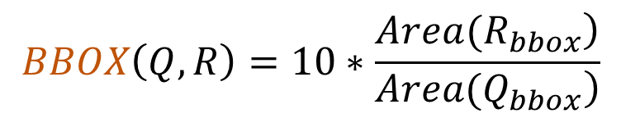
Dynamic Score of Metadata Record R for Query Q
Q contains a spatial clause: (Qbbox) ;
R has a bounding box (Rbbox);
If (Rbbox) ⊂ (Qbbox), then
$$BBOX\left(Q,R\right)=10∗\frac{\left.Area(R_{bbox}\right)}{\left.Area(Q_{bbox}\right)}$$

Slide 11
Thank you !

