Slide 1
Earthdata Search and the
Common Metadata Repository:
Assessing and Improving Relevancy
James Norton
james@element84.com
EED2 Program
The material is based upon work supported by the National Aeronautics and Space Administration under Contract Number NNG15HZ39C

Slide 2
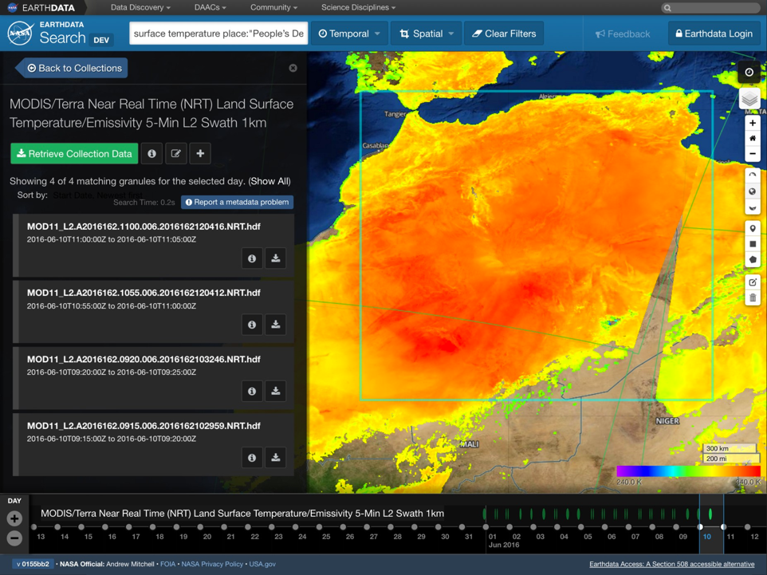
Notes:
Background: What is Earthdata Search?

Slide 3
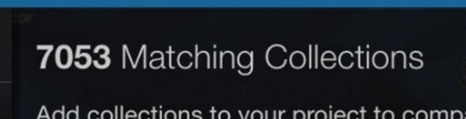
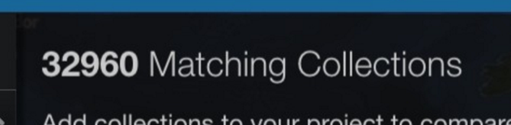
Late 2015: Our catalog grew

Slide 4
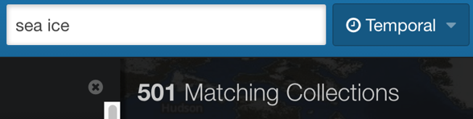
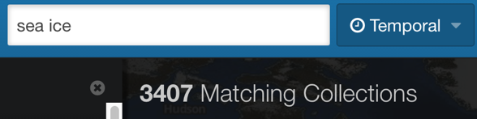
… as did our relevancy needs

Slide 5
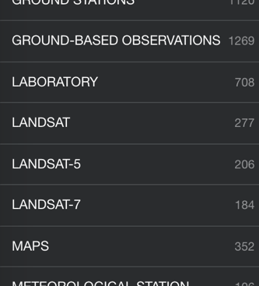
Facets felt the strain

Slide 6
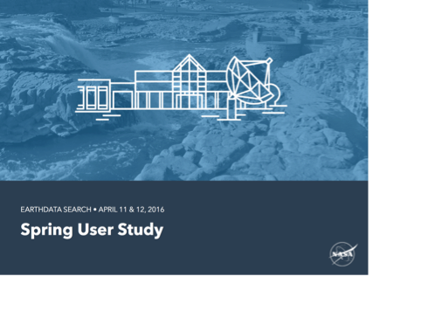
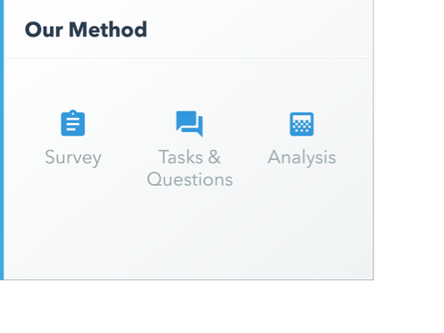
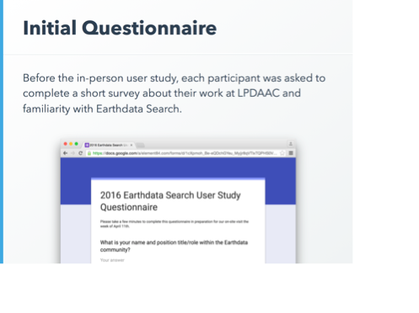

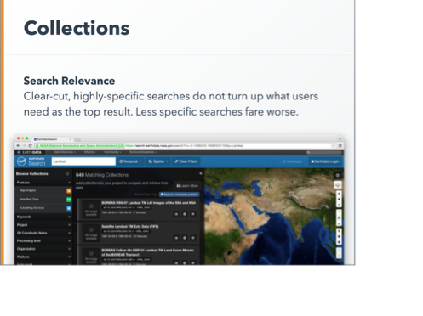
Users echoed the need for better relevance

Slide 7
If users can’t find the collections they need, none of our other work matters

Slide 8
Discovery Challenges beyond Relevance
Earthdata Search

Slide 9
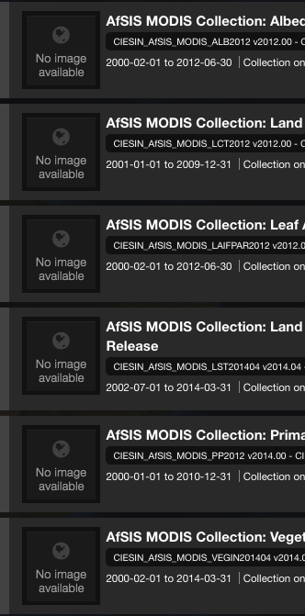
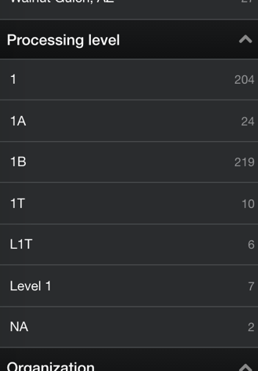
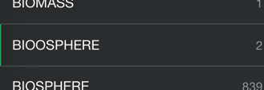
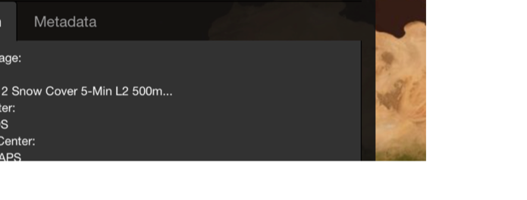
Metadata is imperfect

Slide 10
What Have we Done?
Earthdata Search / Common Metadata Repository

Slide 11
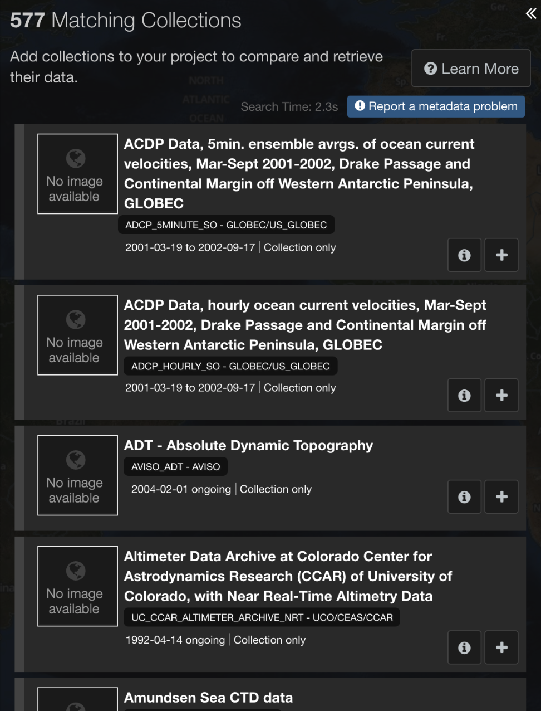
Relevance: Temporal Overlap
“Ocean Circulation” 1/1/2000 – 1/1/2010

Slide 12
Relevance: Community Usage
ESDIS Metrics System (EMS)
Collection access counts
Community usage score computed and indexed with collections
Applied as a sub-sort for results after keyword relevancy and temporal relevancy

Slide 13
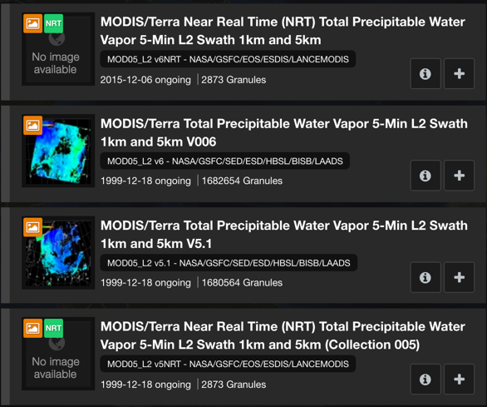
Relevance: Newer versions first
Version 6 Near-Realtime
Version 6
Version 5.1
Version 5 Near-Realtime

Slide 14
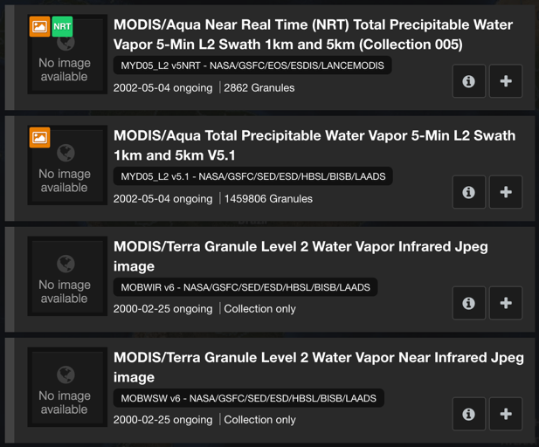
Relevance: Collections with granules first
2,862 Granules
1,459,806 Granules
Collection only
Collection only

Slide 15
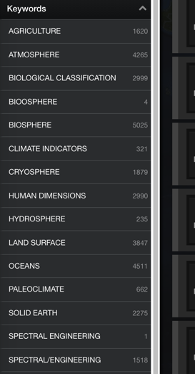
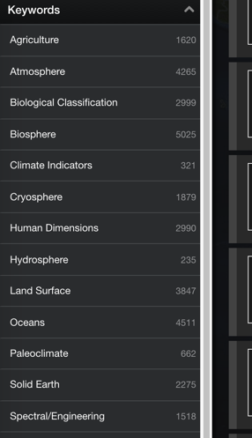
Facets: Humanizers

Slide 16
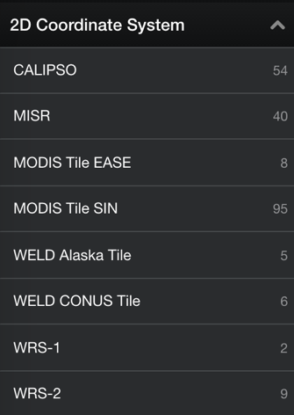
Facets: Relevance

Slide 17
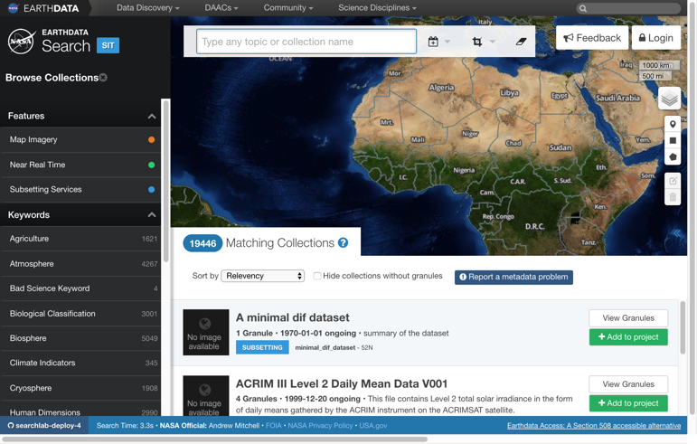
Interface Updates

Slide 18
Measuring Success
Earthdata Search

Slide 19
Metric Challenges
Statistical significance with a small population
Definitions of “success” in a free site with multiple uses
Tail wagging the dog

Slide 20
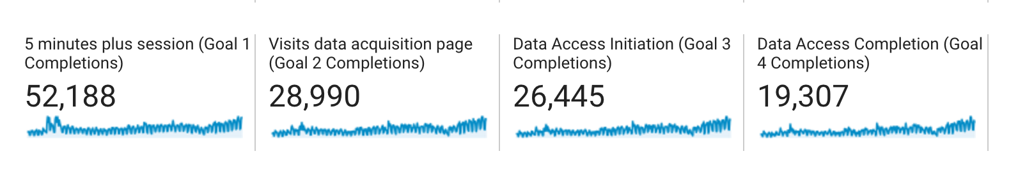
Metric Results
 | October 2016 | November 2016 | December 2016 | January 2017 | February 2017
Average Search Rank of Accessed Data | 5.80 | 4.60 | 4.63 | 4.48 | 4.20

Slide 21
Thank You!
James Norton
james@element84.com

Slide 22

This material is based upon work supported by the National Aeronautics and Space Administration under Contract Number NNG15HZ39C.

