Slide 1
OSS And FDA Inventory – Governance and Sustainability

Slide 2
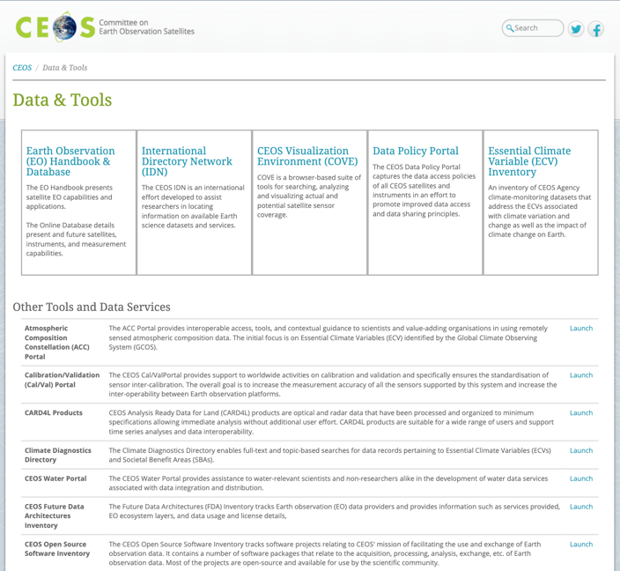
OSS and FDA Inventory
http://ceos.org/data-tools/

Slide 3
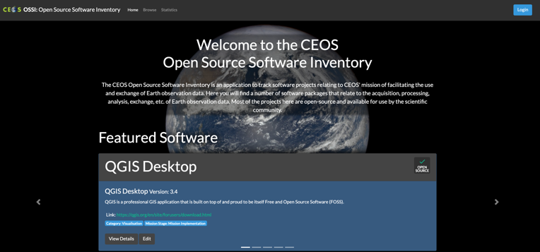
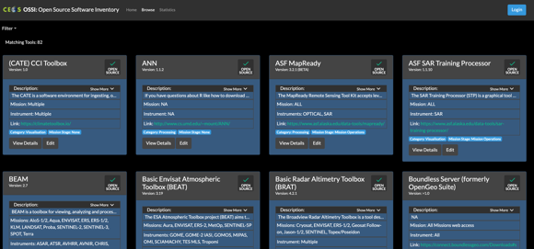
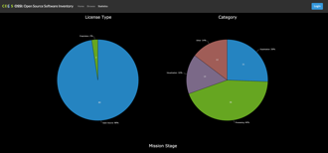
OSS Inventory

Slide 4
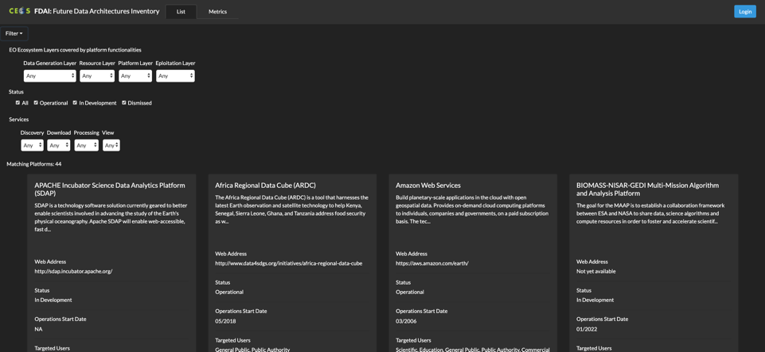
FDA Inventory

Slide 5
Governance and Sustainability
PULL - Open Source Software (OSS) and FDA Elements Inventory will be updated every 2 years (input template circulated to all WGISS members);
PUSH - CEOS agencies can provide new OSS/FDA Elements for inclusion in the inventory sending filled template to M.Albani/I.Maggio;
CHECK - Every 6 months a consistency check will be performed in order to verify the linked repository of OSS/FDA;
FEEDBACK - Contact person (email) to be added in each OSS/FDA inventory element for any user request/question.

