Slide 1
WGDisasters-14 Meeting
Committee on Earth Observation Satellites
Philippe Bally, Theodora Papadopoulou, Michael Foumelis
ESA, BRGM
CEOS Geohazards Lab
Virtual meeting
1 – 3 September 2020

Slide 2
GeoHazards Lab Initiative
A platform with federated resources to provide data access and an online processing and e-collaboration environment to exploit EO data to assess geohazards and their impact
Supports and complements the CEOS WG Disasters thematic activities (on-going pilots, follow-on activities and the RO), GSNL and users from the broader geohazards community.
Maximize use of EO techniques and cloud processing by the EO expert community
Achieve acceptance of EO products by the non-expert EO scientific community, non-EO downstream users and decision makers

Slide 3
Overview of activities
Started Federation with A2S/HPC Mésocentre at CNRS EOST for exploitation of Optical services for landslide detection, inventory mapping and monitoring of landslide motion
Pleiades licence of CNES signed by ESA TO ALLOW online explotation of data in place
Online processing jobs for various CEOS WGD thematic activities (RO, Landlside Pilot etc.)
Animation and promotion of results

Slide 4
Animate & Communicate Scientific Results

Slide 5
GEP Examples – Flood around the cultural heritage site of Sergiopolis in Syria
Multi-temporal analysis of the flooding event in Sergiopolis through the Sentinel-1 time series accessed and processed in GEP using SNAC-SNAP S-1 GRD Amplitude Change and COIN—Coherence and Intensity change for Sentinel-1 services.
Credits: ASI
This example shows how the CEOS Flood Pilot could use a processing environment with advance processors (e.g. InSAR coherence) for flood monitoring
Notes:
( a ) SAR amplitude ratio map from the pre-event pair acquired in ascending orbit, VV polarization, on 16/10/2018 and 22/10/2018.
( b ) RGB colour composite of the cross-event pair, ascending, VV, R: 28/10/2018, G and B: 16/10/2018 and
( c ) the matching interferometric coherence map.
( d ) RGB colour composite of the cross-event pair, ascending, VV, R: 03/11/2018, G and B: 28/10/2018 and
( e ) the matching ratio map. White arrows indicate patterns of increased radar backscatter in the nearby of Sergiopolis fortification walls and water basins.
( f ) Ratio map of the post-event pair, descending, VV, 04/11/2018 and 29/10/2018. Contains modified Copernicus Sentinel-1 data 2018. Figure reproduced from Tapete and Cigna (2020) under the terms of the Creative Commons CC BY license.

Slide 6
Federation between CNRS EOST’s HPC infrastructure and GEP
Enabling seamless job submission from the GEP of all processing services implemented by CNRS EOST on their HPC infrastructure.
Since these services have been specifically designed to run optimally on HPC resources rather than on Cloud resources, the main advantage for users is better performances and the possibility to always access up-to-date software.
Activities performed to allow seamless access of these services and related results from the GEP:
Implementation of a REST interface to the internal resource management system of the A2S/HPC-Mésocentre
Implementation of a component for synchronizing user management at the GEP and at the A2S/HPC-Mésocentre
Implementation and setup of an OGC WPS compliant front-end to the A2S/HPC-Mésocentre system in order to allow submission and monitoring of processing jobs from the GEP
Implementation of a Workflow Management System for the services running on the A2S/HPC-Mésocentre infrastructure to allow EO data provisioning and results publication through the GEP
Implementation of compute-cost estimation measure and metrics module to allow proper accounting for services on this infrastructure

Slide 7
CEOS Pleiades users agreement – Fully in place
ESA and CNES reached an agreement:
CEOS-Pleiades users can now access via GEP any existing (or newly requested) Pleiades images stored on GEP
SCA signed by ESA in July 2020

Slide 8
CEOS Pleiades users agreement - Data order/delivery Procedure
A CEOS user submits a Pleiades data request form to isis-pleiades@cnes.fr , provided the request is approved by the thematic CEOS Demonstrator/Pilot lead*
CNES checks that the entity/public institution to which belongs the « User » has signed the SCA
If 2 is OK, CNES asks Airbus to acquire/produce the image
Airbus informs the user and the platform operator for the delivery of the images by FTP
The dataset is made available on the platform by the platform operator
The platform operator grants access to all CEOS-Pleiades users and the Pleiades lisence is signed (electronically if possible) before each download
The dataset is shown on the catalogue for all platform users; no processing/download is permitted but any user can see the (metadata) catalogue of imagery.
*Leads responsible for Pleiades data requests
Landslides: Jean-Philippe Malet
Seismic: Theodora Papadopoulou, Stefano Salvi
Volcano: Michael Poland
RO: Hélène Deboissezon

Slide 9
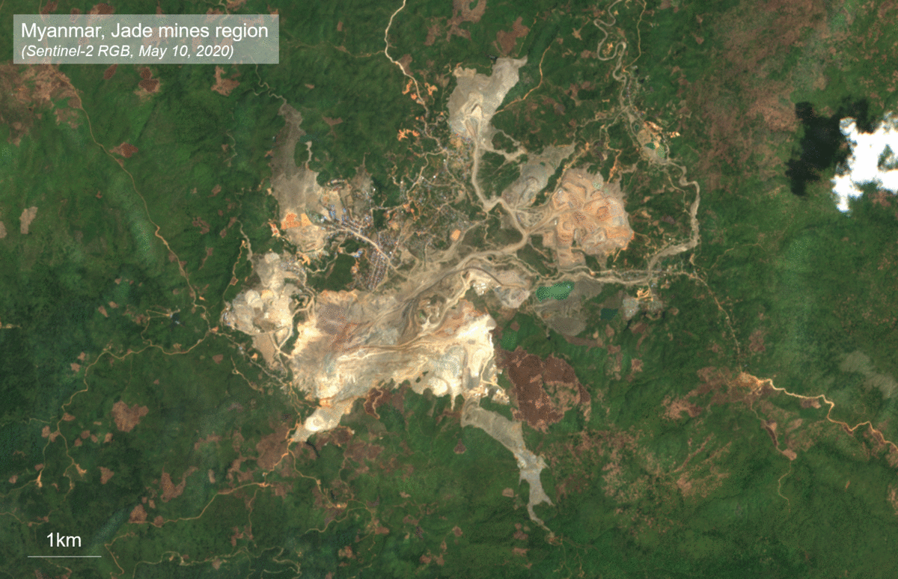
Charter implementing a processing environment based at the same platform as the GEP
Jade mines landslide in Myanmar 2020
Pre-and post-event Sentinel-1 amplitude extracted using COIN service show the mine on June 28, 2020 before the collapse and the mine on July 10, 2020 after the wall collapse. White dotted lines show the possible part of the mine that collapsed. Contains modified Copernicus Sentinel-1 and -2 (2020).
Credits: ESA
The Charter has decided to have a processing environment. The system will use the same processing environment as the GEP. In this basis for the Charter Processing Environment provided by ESA.

Slide 10
Network of Resources
GEP on-boarded on NoR since June 2020
Single access point for:
Resource tier providers (ICT Providers hosting collocated EO data)
Platform service providers (built on top of a resource tier provider)
Addressing:
Self-funded user: Any user world wide requiring for any reason Resource Tier or Platform Services (e.g. Science, Development, Pre-commercial and Commercial) who funds the consumption themselves;
Sponsored user: (Science, Development, Pre-commercial) by ESA and other entities via Announcement of Opportunity
Sponsorship upon application (evaluation depends on project merit on a scientific and engineering viewpoints, schedule adequacy to complete the project and achieve positive results etc.)
Article and detailed guide published on GEP https://discuss.terradue.com/t/gep-offer-expands-to-include-commercial-service-packs/917

Slide 11
Outreach and Capacity building Q2 – Q3 2020
CEOS GLab webpage updated
Blog posts and tweets
Demo of GEP services to the World Bank for the Cities Resilience Programme, under which 10 cities in Africa and Asia have been processed on GEP
Upcoming:
A paper under preparation by BRGM and the World Bank on the City Resilience Programme
Demo & training on GEP services to support the CRL 2020 Workshop (organized by NOA) in September 2020.

Slide 12
Thank you
Geohazards Lab:
Philippe Bally, ESA philippe.bally@esa.int
Michael Foumelis, BRGM m.foumelis@brgm.fr
Theodora Papadopoulou, ARGANS Ltd. c/ ESA tpapadopoulou@argans.co.uk
Floriane Provost, ESA floriane.provost@esa.int

