Slide 1
Report on the GEO-GSNL initiative
Mike Poland
……
CEOS WG Disasters meeting #13

Slide 2
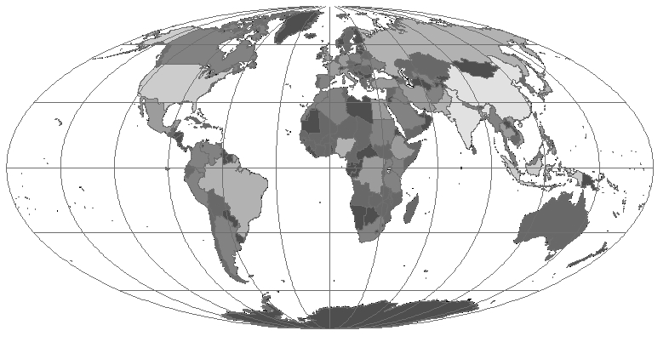
The Supersite network in 2020 (new proposals in blue)
Icelandic volcanoes
Campi Flegrei
& Vesuvius volcano
Mt. Etna Volcano
Marmara Supersite
San Andreas Fault Natural Laboratory
EnCeladus Supersite
Taupo volcanic zone
Hawaiian volcanoes
Virunga volcanoes
Ecuadorian volcanoes
Southern Andes Supersite

Slide 3
 | Supersite | Next Biennial report | Use of CEOS data in 2019
1 | Hawaiian volcanoes | 25-Oct-20(4th) | Very good use of CEOS data
2 | Icelandic volcanoes | 5-Nov-21 (4th) | Good use of CEOS data
3 | Etna volcano | 9-Apr-20 (3rd) | Good use of CEOS data
4 | Campi Flegrei/Vesuvius volcano | 9-Apr-20 (3rd) | Good use of CEOS data
5 | Marmara Fault | 9-Apr-20 (3rd) | Good use of CEOS data
6 | Taupo volcano | 15-Apr-21 (4th) | Good use of CEOS data
7 | Ecuador volcanoes | 15-Apr-21 (4th) | Good use of CEOS data
8 | Corinth Gulf/Ionian Islands | 8-Nov-20 (2nd) | Limited use of CEOS data
9 | San Andreas Fault NL | 27-Apr-21 (2nd) | Limited use of CEOS data
10 | Southern Andes volcanoes | 14-Nov-21 (2nd) | Limited use of CEOS data
11 | Virunga volcanoes | 14-Nov-21 (2nd) | Good use of CEOS data

Slide 4
Event Supersites
 | Supersite | Supporting agencies | Use of CEOS data in 2019
1 | Azgeleh earthquake, Iran-Iraq | ASI, CNES | InSAR data processed, scientific manuscript sent for publication Optical data under processing

Slide 5
New Supersite proposals
 | Proposal | Coordinator | Data requested
1 | China faults | Prof. Yun Shao, Aerospace Information Research Institute Chinese Academy of Sciences | CSK (200/year), TSX (120/year), ALOS 2 (Ultra fine stripmap images to continue an existing time series) Sentinel 1 at 6-day repeat pass
2 | Kamchakta/Kuriles volcanoes | Dr. Alina Viktorovna, Institute of Volcanology and Seismology / GFZ German Research Centre for Geosciences | CSK (700 from archive + 100/year), TSX – TanDEM X (100 from archive + 100/year), ALOS 2 (400 from archive + 50/year), RSAT 2 (200 from archive + 50/year), Pleiades (monoscopic: 30-195 for baseline DEMs + 10/year for updates and activity monitoring)
decision to take, see later

Slide 6
EO data provision progress
CNES and ESA have agreed to use the GEP for the distribution of Pleiades data to the WGD initiatives, including GSNL.

Slide 7
Data processing resources
Data processing resources are supported by the ESA-GEP and INGV/PSNC:
The ESA-GEP provides InSAR data processing capacities using 4 different softwares. It also provides optical data processing tools for DEM extraction and deformation mapping. The services are available to several Supersite users.
INGV and PSNC (Poznan Supercomputing and Networking Center) provide, as a follow-on of the EVER-EST project, access to virtual machines including software for high performance computing of InSAR and optical data. The VMs are reserved to the Supersite coordinators from less developed countries.

Slide 8
Improving Supersite capacities
Ecuador & Chile Supersite: InSAR training by INGV at a course organized by USGS-VDAP was planned for early March, but had to be canceled due to the COVID-19 travel difficulties
Virunga Supersite: one scientist has applied for an ICTP (UN center) 2020 fellowship partly funded also by INGV, for a 6-month training in volcano seismic data analysis.

Slide 9
GSNL contribution to the Sendai Framework
The GSNL Chair presented at the GEO Program Board how the Supersites can contribute to the Sendai Framework implementation.
Supersite Coordinators have been put in contact with the SF reference persons in each country, to be able to contribute to the national reports.
A guideline document for the community is being prepared.

Slide 10
Results from the Supersites
(from the 2018-2019 biennial reports)
Southern Andes
Virunga
Results from the Iceland Supersite were reported during WGD meeting #12

Slide 11
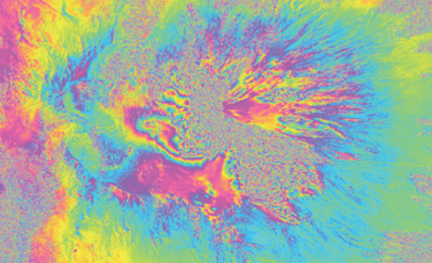
Southern Andes Supersite, Chile
Due to external problems and the initial lack of EO data processing capacities, activities have started late, but now the Volcano Observatory (OVDAS) is able to process InSAR data locally, using the ISCE and GIAnT softwares.
1-day CSK interferogram of Villarrica volcano showing loss of coherence in the glacier area

Slide 12
Southern Andes Supersite, Chile
Preliminary InSAR analysis of potential precursory deformation related to conduit processes at Villarrica Volcano was not successful (mainly due to decorrelation) but served as experience and allowed to detect morphological changes.
ESA granted a 6-day repeat pass over the Sollipulli and Copahue volcanoes, and 12 days over the Villarrica area. The normal mode would be 24 days.
Areas of interest were selected for requesting Pleiades data. They will serve for production of HR DEMs to be used for geodesy, and as input for physical models of debris flows.
A PhD student is working on atmospheric correction of InSAR data and exploitation of time series.

Slide 13
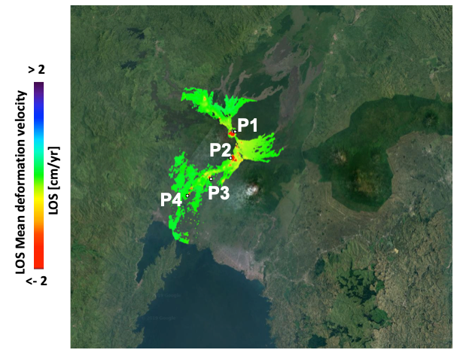
Virunga Supersite, D.R. Congo
Over 800 CSK archive data were obtained. IREA-CNR used 476 of them to generate a deformation time series between 2011 and 2019.

Slide 14
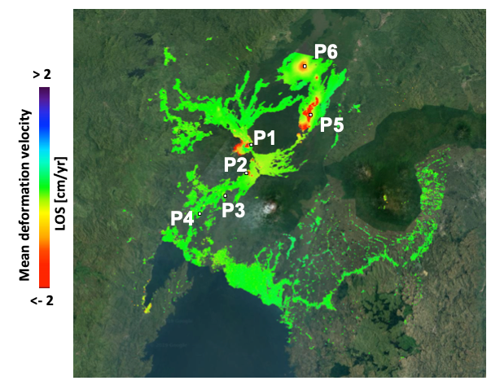
Virunga Supersite, D.R. Congo
IREA-CNR also used 96 Sentinel 1 images to generate a deformation time series between 2016 and 2019. Both results show similar patterns of volcano deflation.

Slide 15
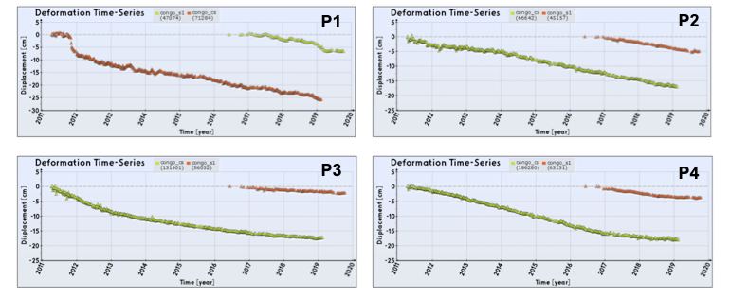
Virunga Supersite, D.R. Congo
Time series show a nearly linear trend of ground lowering in recent years.

Slide 16
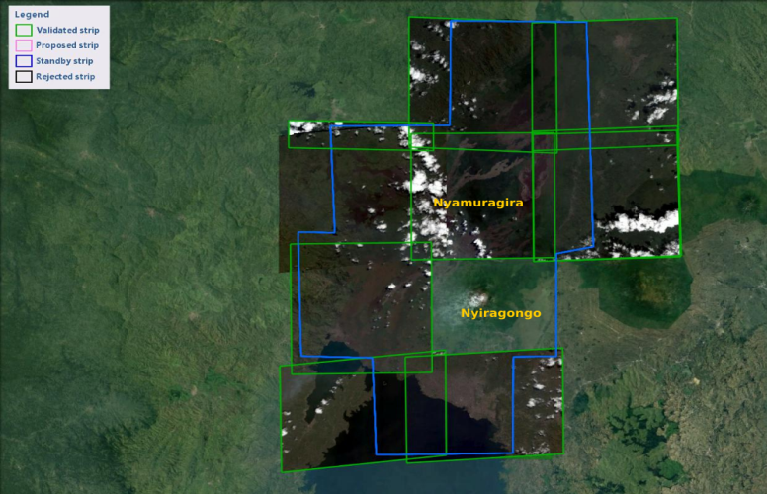
Virunga Supersite, D.R. Congo
INGV Catania is supporting GVO for the acquisition and processing of tri-stereo Pléiades data. In the figure below, the intersection between the green and blue areas represents the Pléiades data available. The Nyragongo volcano has not yet been acquired due to the nearly permanent plume presence.

Slide 17
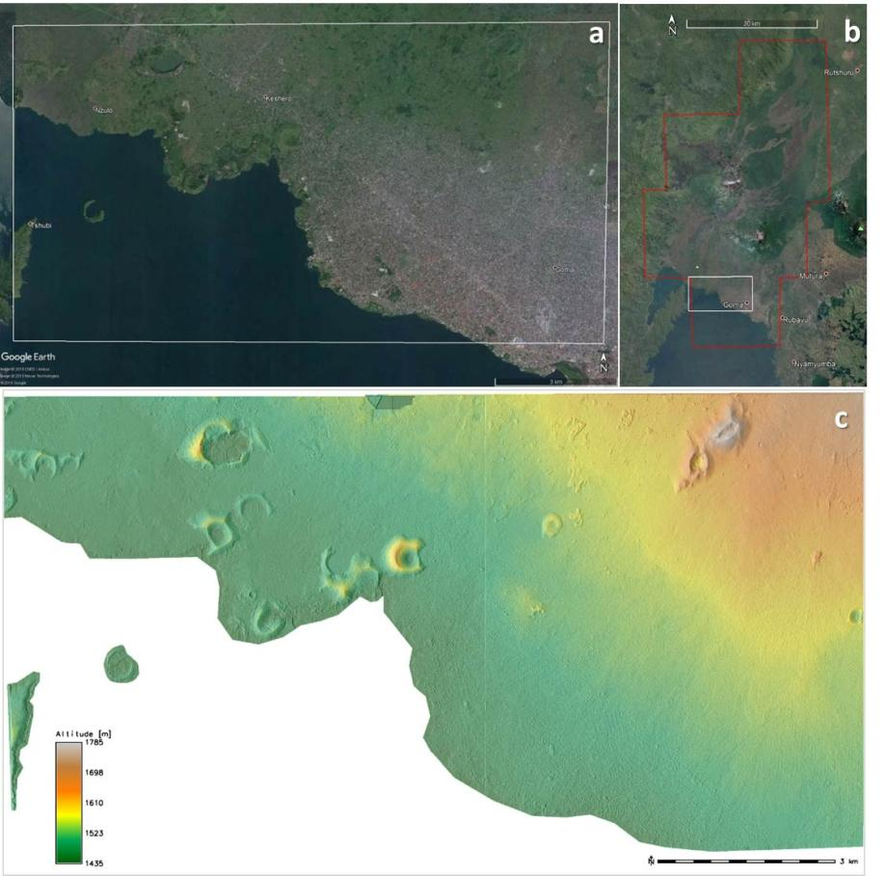
Virunga Supersite, D.R. Congo
DEM obtained from Pléiades data by INGV-Catania for the western Goma City.

Slide 18
Virunga Supersite, D.R. Congo
Ground data sharing is still a problem, due to technological (very poor Internet access), and management issues (some data producers, also external to the Volcano Observatory, do not share their data).
A Data Policy has been agreed with the GSNL SAC and with time it should help overcome the data sharing problem.
A GVO scientist is coming to INGV-Catania to be trained in volcano seismic data analysis.
The Supersite has brought a much increased international attention to the Virunga volcanoes and this is slowly contributing to an increased scientific understanding of the volcanoes.

Slide 19
New Supersite proposals
The China earthquake Supersite
The Kamchakta/Kuriles volcano Supersite

Slide 20
China Supersite proposal objectives
Objective 1: Imaging of new earthquakes. Acquire multi-sensor SAR imagery for all significant earthquakes in China to study co-seismic and post-seismic deformation.
Objective 2: Longmenshan Fault post-seismic deformation. Acquire 6-day Sentinel-1 data on the 2008 Sichuan eq region to resolve post-seismic deformation and understand how it affects nearby faults.
Objective 3: Haiyuan Fault interseismic deformation. Acquire high-resolution imagery of selected sections of the Haiyuan fault to study the interseismic deformation and aseismic creep.
Objective 4: Support the China Seismic Experimental Site (CSES). Acquire 6-day Sentinel-1 imagery and ALOS2 PALSAR2 imagery at CSES sites to map the interseismic deformation.
Objective 5: Data sharing. Advance data sharing in China (GNSS, Seismic, InSAR). Promote the GEO data sharing principles and the GEO objectives. Promote international collaboration and participation of China in the GSNL initiative (with two L-band satellites to be launched in 2021, China could become an important data provider).

Slide 21
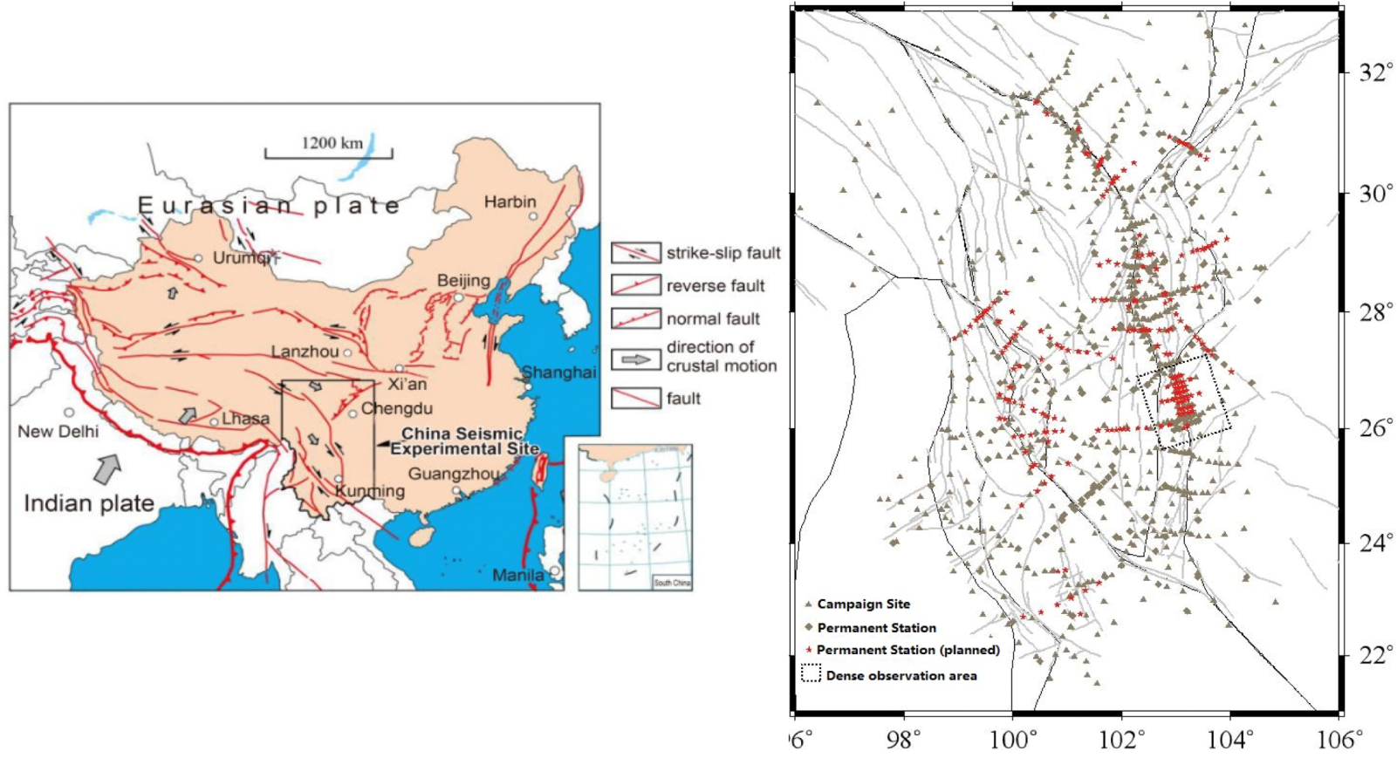
The China Seismic Experimental Site (CSES).
The China Seismic Experimental Site (CSES) was launched in 2018 at the 10year anniversary of the 2008 Wenchuan earthquake. CSES follows international initiatives such as the Southern California Earthquake Center (SCEC) and has open data policy.

Slide 22
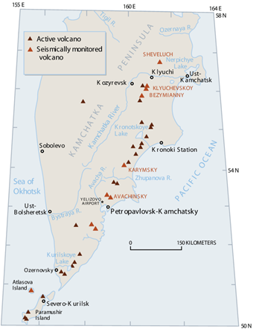
The Kamchatka/Kuriles Supersite proposal
The Kamchatka/Kuriles region. By combining ground truth (geophysical and geochemical instrumentations) with satellite remote sensing, the proposal aims at the scientific monitoring of all large Holocene volcanoes.

Slide 23
Kamchatka/Kuriles proposal objectives
To collect space-borne data for active volcanoes in the area for hazard mapping and rapid response actions at volcanoes under red alert level.
To establish regional source models mostly based on ongoing research at Kamchatka Institute of Volcanology and Seismology.
To develop a strategy for deformation monitoring based on InSAR and optical (Pleiades) data processing.
To develop an early warning system for volcanic unrest integrating seismicity with deformation and gas measurements.
To improve the capability to track effusion/emission rates based on optical and radar image products.
To improve the capability to generate high resolution hazards maps for lahars and other debris flows.
To develop new products and services based on collaborations within GSNL, for first responders, civil and scientific communities.

Slide 24
Status of new proposals
The proposals have been positively reviewed by the GSNL SAC in December 2019.
They have been circulated to the CEOS DCT in January 2020.
A decision is expected at this meeting

Slide 25
On TSX data use
Action T24/8:
Raise awareness of different TSX acquisition modes within GSNL community.
Coordinators are aware that TSX data can be used with initial orbits, however they raised two other issues.
The procedure to order data is not straightforward as for CSK. New acquisitions must be ordered in small quantities and the user cannot place an order for a long period of time as for CSK or Pleiades.
Moreover all the data which are part of an order are delivered only when the last image of the order has been acquired, and this causes delays.
Users would love to use TSX, given the very controlled baseline, but apparently these issues discourage them from using TSX in a more massive way.

Slide 26
Decisions for GSNL at WGD meeting #13
Decision on renewal of support to Iceland Supersite
Decision on renewal of support to Southern Andes Supersite
Decision on renewal of support to Virunga Supersite (a quota increase of 100 images was requested after the report was delivered)
Decision on support to the China earthquake Supersite
Decision on support to the Kamchatka/Kuriles Supersite

