Slide 1
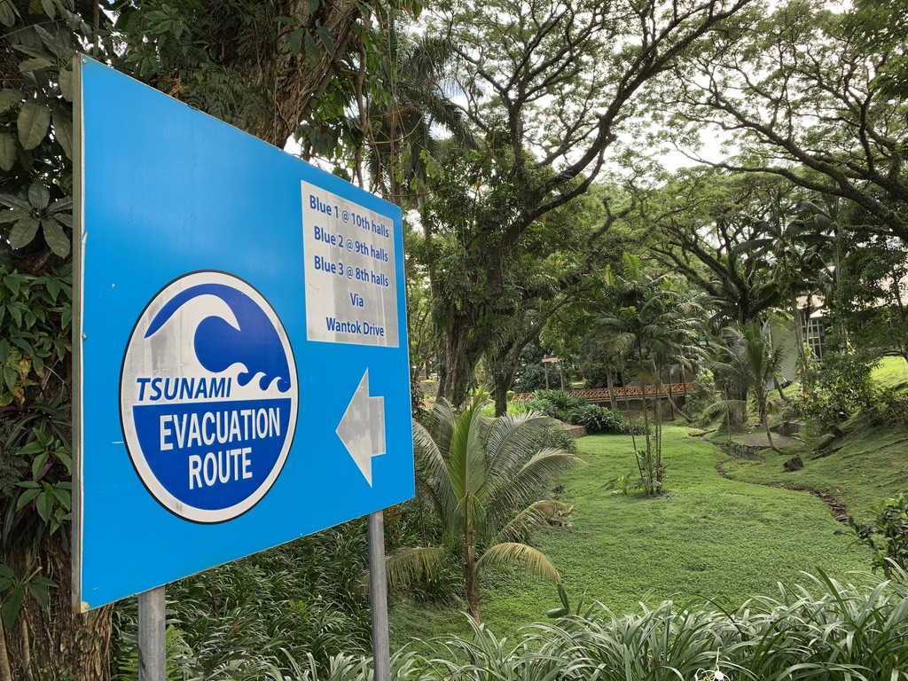

GEO Geodesy4Sendai Community Activity
…First Steps…
Allison Craddock (United States)
Director, International GNSS Service (IGS) Central Bureau
Manager of External Relations, Global Geodetic Observing System (GGOS)
John Rundle
University of California (United States)
John LaBrecque
Center for Space Research,
University of Texas (United States)
© 2020 California Institute of Technology. Government sponsorship acknowledged

Slide 2


International Association of Geodesy (IAG)
Global Geodetic Observing System (GGOS)
Vision:
  Advancing our understanding of the dynamic earth system by quantifying our planet’s changes in space and time.
Mission:
  To provide the observations needed to monitor, map, and understand changes in the Earth’s shape, rotation, and mass distribution
  To provide the global geodetic frame of reference that is the fundamental backbone for measuring and consistently interpreting key global change processes and for many other scientific and societal applications
  To benefit science and society by providing the foundation upon which advances in Earth and planetary system science and applications are built
http://www.ggos.org
Programme Board Participating Organization
Associate Member Organization
Notes:
In 2019, the International Association of Geodesy’s Global Geodetic Observing System identified the need to form a policy, advocacy, and capacity building group complimentary to the GGOS Geohazards Focus area, which resulted in establishing the Group on Earth Observations (GEO) “Geodesy for the Sendai Framework” (short form: “Geodesy4Sendai”) Community Activity.

Slide 3


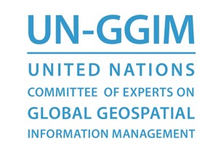

International Union of Geodesy and Geophysics (IUGG)*
International Association of Geodesy (IAG)*
Global Geodetic Observing System (GGOS)
How does Geodesy contribute to United Nations Initiatives
and other Earth Observation Multilateral Organizations?
United Nations Committee of Experts on Global Geospatial Information Management (UN-GGIM)
Subcommittee on Geodesy (SCoG)
Promoting development of an accurate, sustainable, and accessible
Global Geodetic Reference Frame (GGRF) to support science and society.
United Nations Office for Outer Space Affairs (UNOOSA)
International Committee on GNSS (ICG)
Ensuring the best satellite based positioning, navigation and timing
for peaceful uses for everybody, anywhere, any time.

Slide 4
How does Geodesy contribute to United Nations Initiatives
and other Earth Observation Multilateral Organizations?
Capacity Building Initiatives
United Nations Committee of Experts on Global Geospatial Information Management (UN-GGIM)
Subcommittee on Geodesy (SCoG)
Education, Training, and Capacity Building Working Group
United Nations Office for Outer Space Affairs (UNOOSA)
International Committee on GNSS (ICG)
Working Group C: Information Dissemination and Capacity Building

Slide 5
How does Geodesy contribute to United Nations Initiatives
and other Earth Observation Multilateral Organizations?
Disasters Initiatives
United Nations Committee of Experts on Global Geospatial Information Management (UN-GGIM)
Working Group on Geospatial Information and Services for Disasters

Slide 6
Supporting Sendai
Coordinating Earth Observations for Disasters
E: Substantially increase the number of countries with national and local disaster risk reduction strategies by 2020;
F: Substantially enhance international cooperation to developing countries through adequate and sustainable support to complement their national actions for implementation of the present framework by 2030;
G: Substantially increase the availability of and access to multi-hazard early warning systems and disaster risk information and assessments to people by 2030.
GEO supports implementation of Sendai Framework targets E,F and G through engagement with UNISDR.

Slide 7
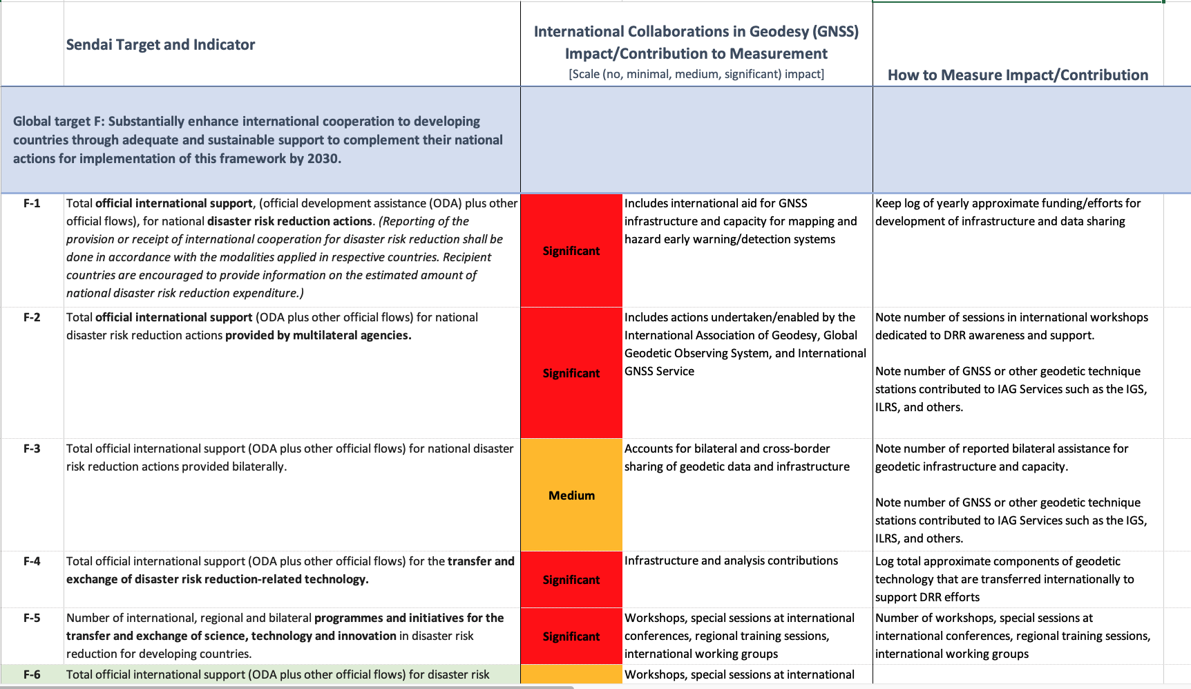

Slide 8
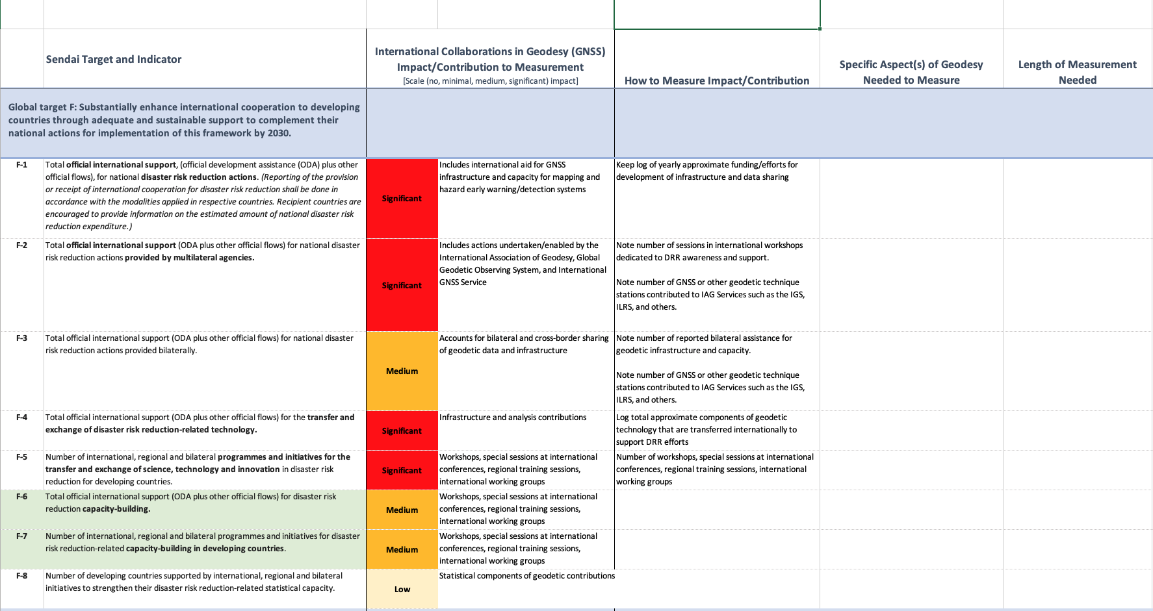

Slide 9
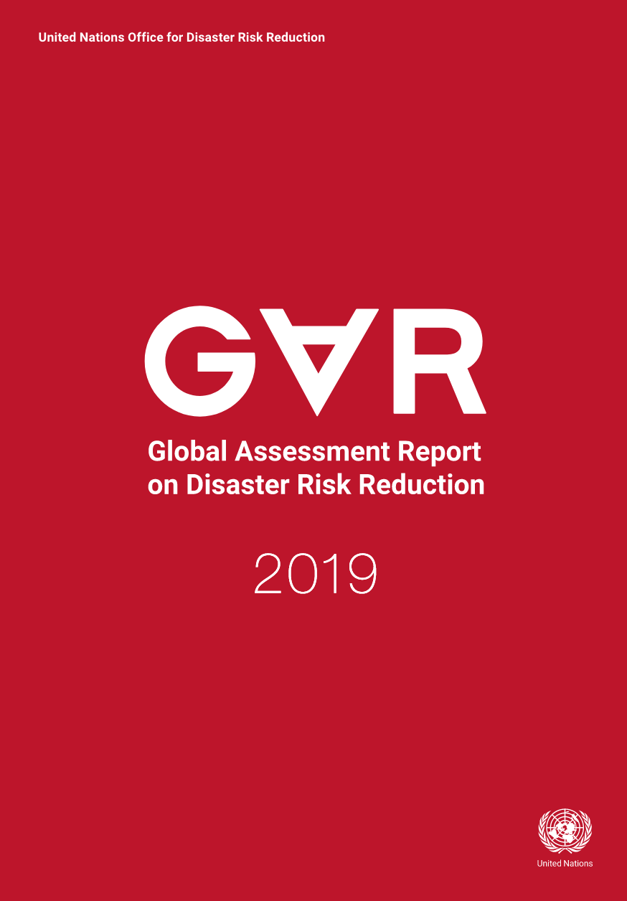
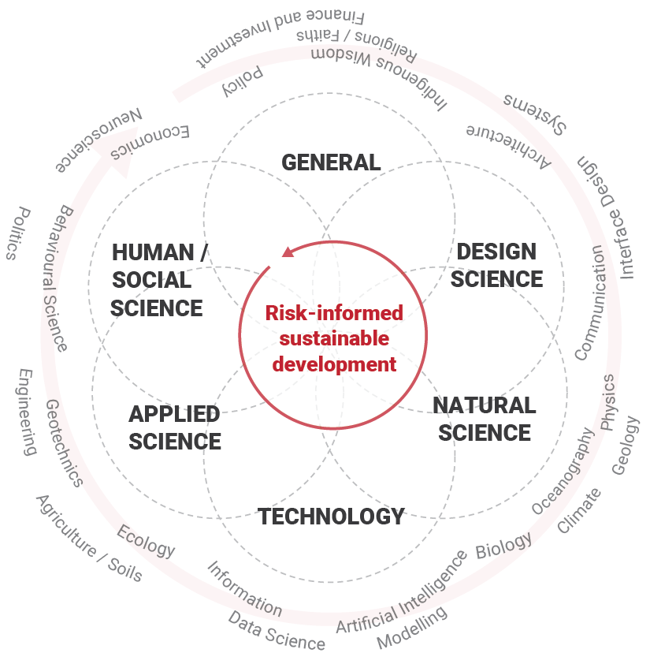
Notes:
The Global Assessment Report on DRR is a biennial snapshot contextualising progress in realising the global targets of the Sendai Framework, and contributes to the High Level Political Forum on Sustainable Development.

Slide 10
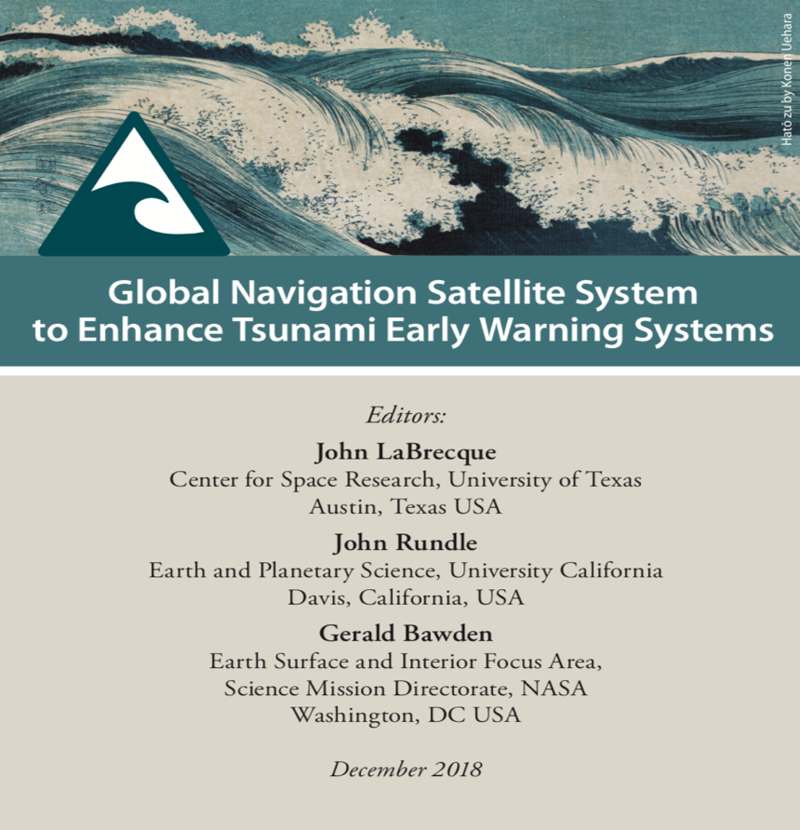

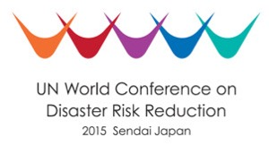
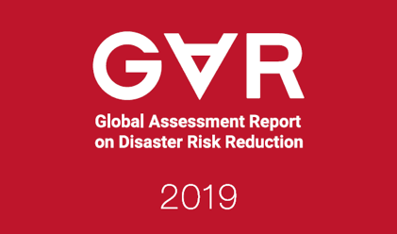
Connecting Geodesy with United Nations Initiatives :
GNSS Enhanced Tsunami Early Warning Systems
Geodetic observations have a clear role in helping to reduce the risk of disasters, as well as contribute to disaster preparedness with better mitigation and response.
GGOS-Geohazards Working Group contributed content for the 2019 UN Global Assessment Report on Disaster Risk Reduction (GAR19)
  Download GTEWS report: http://bit.ly/gtews2018
Notes:
The successful GGOS contribution to this prestigious document is a direct result of the current chair’s leadership priorities for GGOS, especially in his identification of External Relations as a key element. Furthermore, it ensures that GGOS work is in strong support of NASA goals and objectives in the context of the United Nations.
- page 84, 87: reference to a "growing emphasis on geodesy” in the context of global seismic models
- pages 48 and 49: dedicated feature box noting the critical role GNSS plays in logistics, food, and health systems.
... and other places.
You can download the full report, as well as a summary, here: https://gar.unisdr.org/
Additionally, the Global Risk Assessment Framework (GRAF) was launched as the next step - this will serve as a means to officially harmonize and link the Sendai Framework for Disaster Risk Reduction and the SDGs, which is something that our work within GGOS and with our partners at GEO has been leading up to.

Slide 11
2017 Sendai Workshop Recommendations
The GGOS/IUGG, Association of Pacific Rim Universities (APRU) and the UN-GGIM are encouraged coordinate efforts to develop a GNSS Shield Consortium for the Indo-Pacific.
The GNSS Shield Consortium should work to encourage software, data exchange, and continued improvement of network design and performance.
Strengthen broadband communication to underserved regions of the GNSS Shield.
Work with national organizations including those mandated for natural hazards mitigation to develop agreements for [openly sharing] GNSS receivers within the GNSS Shield.
Design an optimal GNSS Shield network for both crustal displacement and high resolution TEC monitoring.
Understand the operational requirements of existing tsunami warning systems and determine the steps required to interface with existing tsunami warning systems.

Slide 12
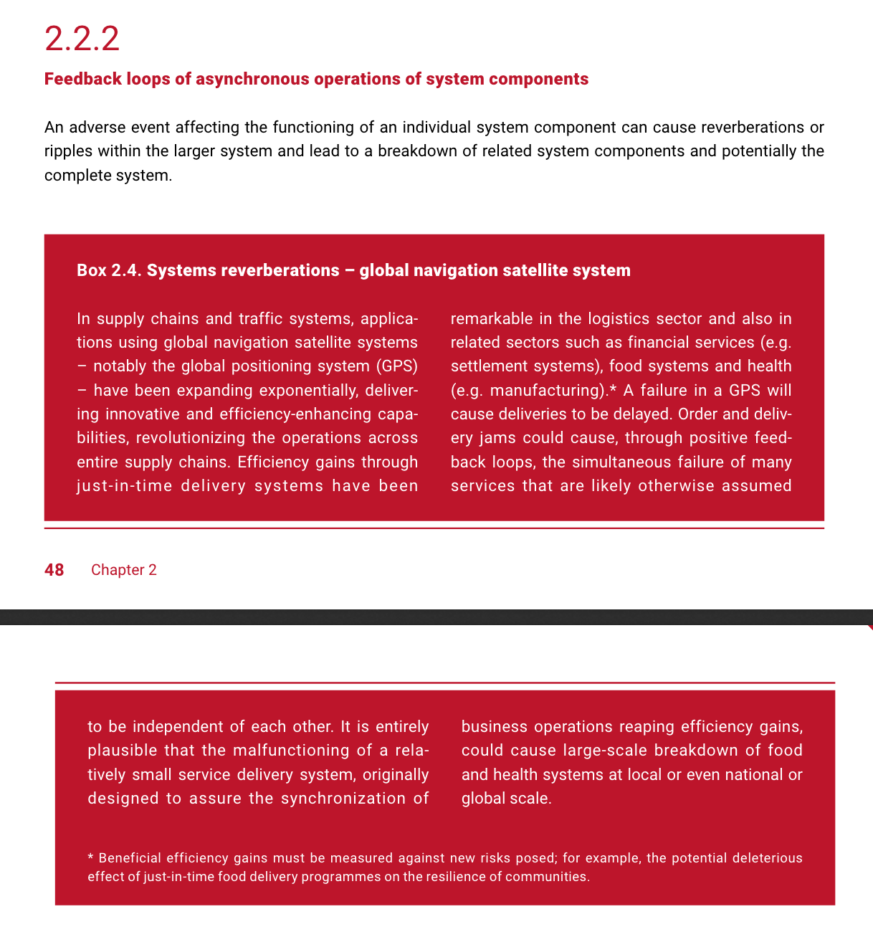
Notes:
The successful GGOS contribution to this prestigious document is a direct result of the current chair’s leadership priorities for GGOS, especially in his identification of External Relations as a key element. Furthermore, it ensures that GGOS
- page 84, 87: reference to a "growing emphasis on geodesy” in the context of global seismic models
- pages 48 and 49: dedicated feature box noting the critical role GNSS plays in logistics, food, and health systems.
... and other places.
You can download the full report, as well as a summary, here: https://gar.unisdr.org/
Additionally, the Global Risk Assessment Framework (GRAF) was launched as the next step - this will serve as a means to officially harmonize and link the Sendai Framework for Disaster Risk Reduction and the SDGs, which is something that our work within GGOS and with our partners at GEO has been leading up to.

Slide 13
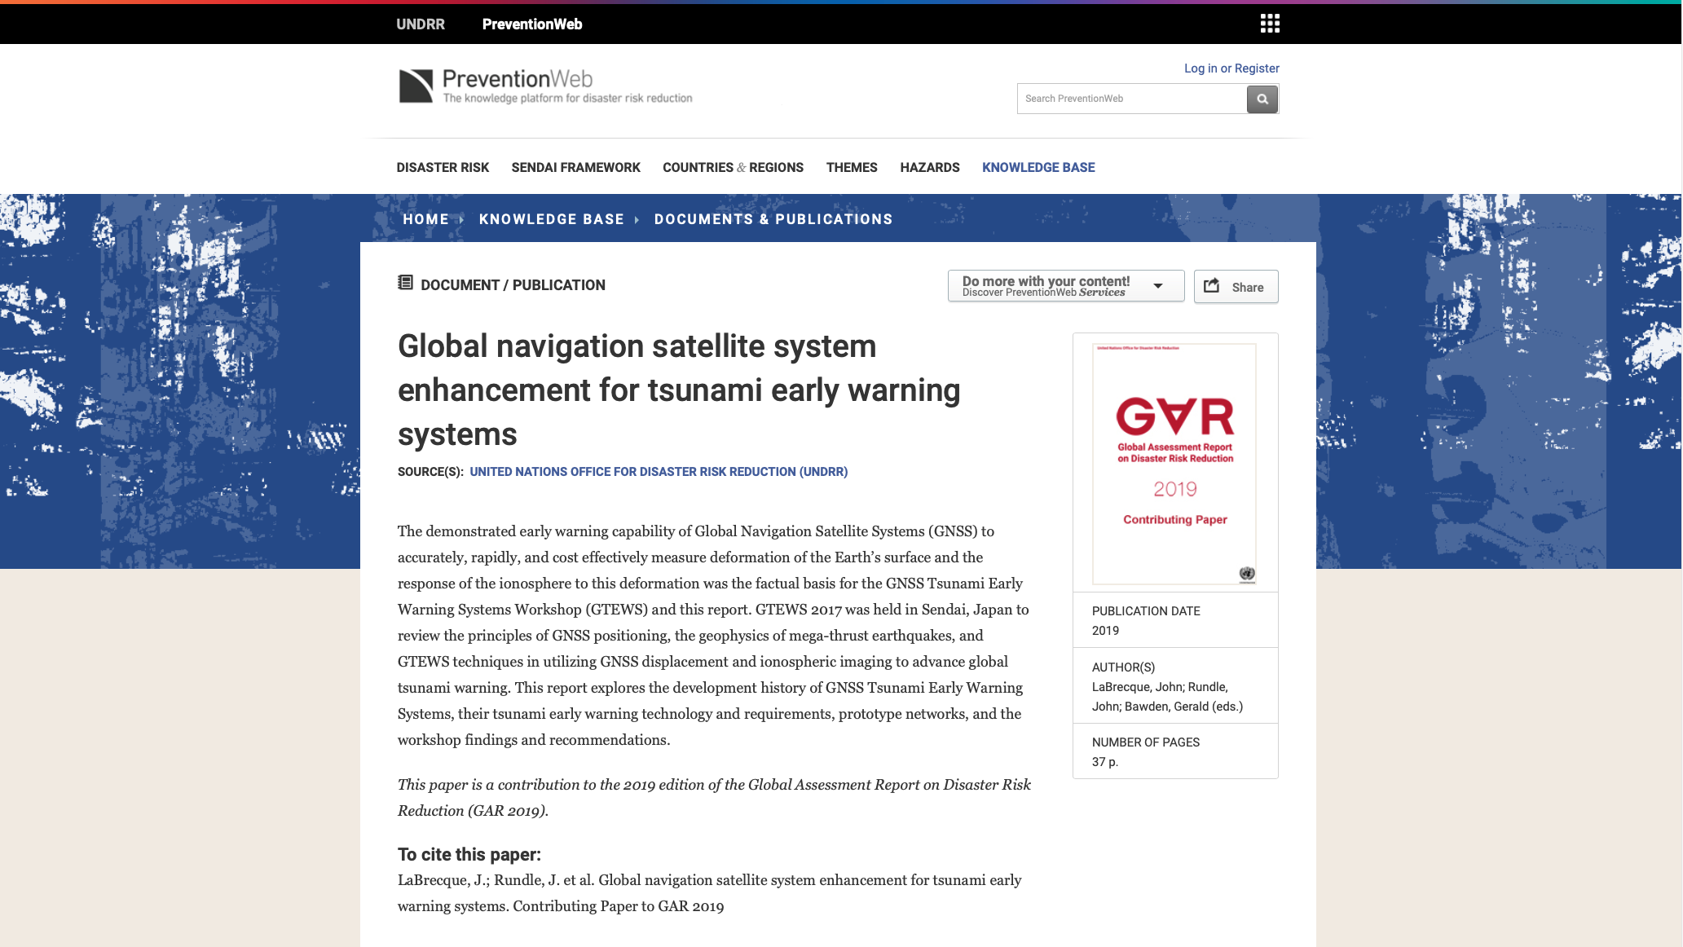
GGOS Contributing Paper to the GAR is available for viewing and download

Slide 14
Geodesy for the Sendai Framework
Community Activity
How do we support
GNSS Enhanced Tsunami Early Warning Systems and other Geodetic Contributions to
Disaster Risk Reduction + Resilience?
Supporting geodetic development and capacity building for disaster risk reduction and resilience
Identifies existing resources and stakeholder communities, and makes connections
Identifies geodetic elements of targets and indicators of the Sendai Framework for Disaster Risk Reduction
Provides opportunity for other GEO efforts to interact with geodesy community
Integration with UN Sustainable Development Goals and UN-GGIM World Bank Integrated Geospatial Information Framework
… and more…

Slide 15
Key Objectives within GEO
Geodesy for the Sendai Framework
Community Activity
Ministerial-level political support and funding for GNSS-enhanced tsunami early warning systems in the Circum-Pacific Belt (Pacific Ring of Fire) and Caribbean basin.
Ministerial-level political support and funding for geodetic capacity building for disaster risk reduction and resilience.

Slide 16
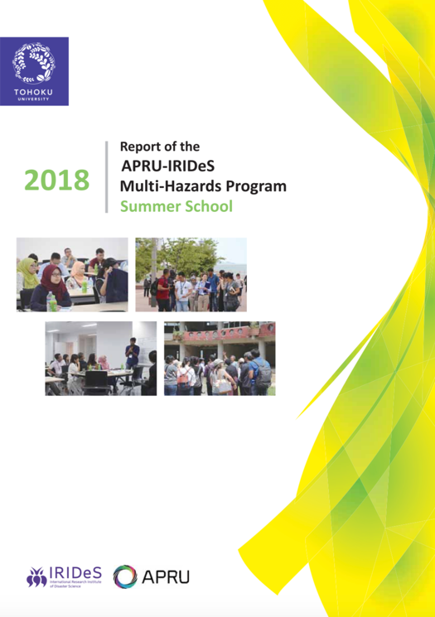
GTEWS/geodesy4sendai Workshop 2020
Next GTEWS workshop, organized in conjunction with GEO Community Activity “geodesy4sendai” is in development, and scheduled to take place June 1-5, 2020 in Sendai.
Organized to complement relevant sessions at JpGU-AGU 2020 (to be held one week before the workshop in Chiba, Japan)
Followed by APRU-IRIDeS Multi-Hazards Summer School (held one week before and after the GTEWS Workshop at Tohoku University)
POSTPONED TO 2021

Slide 17
geodesy4sendai Next Steps
What does the Geodesy community need from this GEO Community Activity?
What does the Disaster Risk Reduction + Resilience community need from geodesy?
How can geodesists better engage with the broader Earth observation and disasters community?
What resources already exist, and how can we better identify and discover them?
Where are the gaps in our resources, communications, and capacities?

Slide 18
CEOS WG-Disasters Potential Overlap
Landslide Pilot – potential collaboration also with IAG/GGOS and GEO-GNOME for advocating use of GNSS data (position, as well as reflectometry, radio occultation) and densification of GNSS ground stations in mountain monitoring
  Demo D2?
Collaborative identification and logging of applicable Sendai Framework Targets and Indicators
  Develop scale depicting impact of international collaborations/advocacy in support of near-real-time and other geodetic information
  Metrics needed to record progress against target/indicator
Opportunities for collaboration with WGCapD?

Slide 19
Allison Craddock
craddock@jpl.nasa.gov

