Slide 1

GEO & Disaster Risk Reduction
James Norris
GEO Secretariat
CEOS WGDisasters, 13th Meeting
10th March 2020
Pasadena, California, USA

Slide 2

Key activities and progress
Since our last physical meeting
Outcomes from the GEO Plenary
GEO Work Plan and CEOS Involvement
New GEO Disaster Risk Reduction Working Group
Regional GEO alignment

Slide 3
GEO DRR activities
Strategic/operational activities
Operational
CEOS WGDisasters
GEO DRR Working Group
Strategic
UNDRR
Focus on Members and POs
Core (GEO)
Maintain focus on Sendai-related activities
Promote Regional activities
Global Risk Assessment Framework
WP Alignment
GAR Advisory Board

Slide 4
Key activities and progress
Since our last physical meeting
Outcomes from the GEO Plenary
GEO Work Plan and CEOS Involvement
New GEO Disaster Risk Reduction Working Group
Regional GEO alignment

Slide 5


GEO Plenary 2019
Overview of the event
29 Ministers or Ambassadors
65 Countries represented
394 GEO Member delegates
129 Participating Organization delegates
419 Industry Track registrants
379 Side event registrants
108 Exhibitors
47 Observers/guests
More information and announcements can be seen on the GEO Website
Feedback from participants showed that 78% of respondents were satisfied with the Action of Disaster Risk Reduction session – only the Opening Session had a higher satisfaction rate (79%).

Slide 6
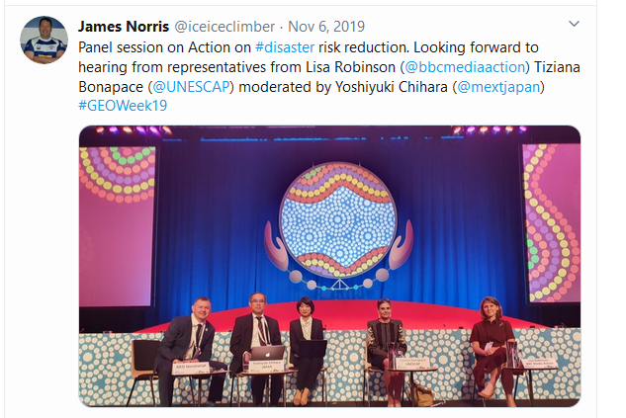
GEO Plenary 2019
Special Session on Disaster Risk Reduction
Objective: GEO Principals to provide guidance on the actions that GEO needs to take to accelerate its efforts to support implementation of the Sendai Framework for Disaster Risk Reduction.
Format: The session was organized with an introductory keynote talk, followed by a moderated open discussion with GEO Members. The Session closed with a talk from a GEO PO and a summary of the discussions.
Session speakers:
Yoshiyuko Chihara, GEO Principal of Japan
Lisa Robinson, BBC Media Action
Tiziana Bonapace, UN ESCAP

Slide 7
GEO Plenary 2019
Special Session on Disaster Risk Reduction
Outcomes from the open discussion included:
Relevant communication of risk information is crucial to action including behavioural change (process not a product).
Significant progress has been made in the use of open science for disaster risk reduction (such as eShape and Copernicus Emergency Management Service).
Growing future engagement in the GEO Work Programme disaster risk reduction activities, and building on existing activities (such as UN-GGIM, OGC, UNOOSA, UNDRR and the International Charter).
Coordinated efforts within and among Regional GEOs is beneficial to the sharing of knowledge and experiences.
For a number of countries DRR is a national priority, linked to the work of GEO and the Sendai Framework. We should learn from past experiences and undertake future planning.

Slide 8
GEO Programme Board
Deep Dive with UNDRR
A day-long session was held between GEO Programme Board and UNDRR. Some of the aims for the session were:
Develop a common understanding of how GEO is currently supporting UNDRR, the Sendai Framework, the GAR, and the GRAF.
Identification of opportunities for additional GEO / UNDRR collaboration.
Outcomes
Involvement in risk assessment activities in national platforms, especially in pilot countries.
Review GWP activities (and external activities) that can contribute to the GAR 2021 Special Report on Drought.
Engage GEO participants who work in civil protection and other disaster-related areas to better understand requirements.
Transfer demand into activity (turning applications into action).
Participate in the Global Risk Assessment Framework Working Groups.

Slide 9
Key activities and progress
Since our last physical meeting
Outcomes from the GEO Plenary
GEO Work Plan and CEOS Involvement
New GEO Disaster Risk Reduction Working Group
Regional GEO alignment

Slide 10



GEO Work Programme 2020-22
Developing a fit-for-purpose offering
The 2020-2022 GEO Work Programme is the second three-year Work Programme to be developed within the framework of the GEO Strategic Plan 2016-2025.
It was endorsed & adopted by GEO Members during GEO Week 2019.
Demonstrated or piloted products or services
Have an active relationship with GEO
Often has a policy mandate from an international body
Early stage of development
Not necessarily delivering a product or service
Recognised as a GEO Activity

Slide 11
GEO Work Programme 2020-22
Sendai/ disaster-related activities
GFOI
GEOGLAM
AquaWatch
Blue Planet
DIAS
EO4Heatlth
GDIS
GEODARMA
GEO GNOME
GEO VENER
GSNL
GWIS
Human Planet
Chinese Satellite
Crop Pest Monitoring
EO4DRM
EO4Minerals
EO4SendaiMonitoring
Geodesy4Sendai
Global AgriDrought
Global Flood Risk Monitoring

Slide 12
Key activities and progress
Since our last physical meeting
Outcomes from the GEO Plenary
GEO Work Plan and CEOS Involvement
New GEO Disaster Risk Reduction Working Group
Regional GEO alignment

Slide 13
Disaster Risk Reduction Working Group
Continuing to coordinating activities across GEO
The Disaster Risk Reduction Working Group (DRR-WG) is convened to develop and implement a coherent and cross-cutting approach within GEO to advance the use of Earth observations in support of countries’ disaster risk reduction and resilience efforts.
Membership in the Working Group is by nomination from GEO Member, Participating Organizations, and Associates.
Participation is encouraged from organizations and bodies relevant to disaster risk reduction.
Group will be formally launched following adoption of the GEO Executive Committee meeting, 19-20 March 2020.

Slide 14
Key activities and progress
Since our last physical meeting
Outcomes from the GEO Plenary
GEO Work Plan and CEOS Involvement
New GEO Disaster Risk Reduction Working Group
Regional GEO alignment

Slide 15
Regional GEO alignment
Delivering on the outcomes from the Canberra Declaration
Regional cooperation
AmeriGEO
AOGEO
EuroGEO
AfriGEO

Slide 16
Upcoming Events
Community events:
GFDRR Understanding Risk – (joint session between GEO and CEOS) – Postponed to Nov/Dec 2020
2020 Asia-Pacific Ministerial Conference on Disaster Risk Reduction – June 2020 – Partner Event Submitted.
VII Regional Platform for Disaster Risk Reduction in the Americas and the Caribbean – July 2020 – Being let by AmeriGEO
GEO Events:
GEO Symposium – 16-18 June 2020, Geneva, Switzerland
GEO Plenary 2020 – 2-7 November, Port Elizabeth, South Africa

Slide 17
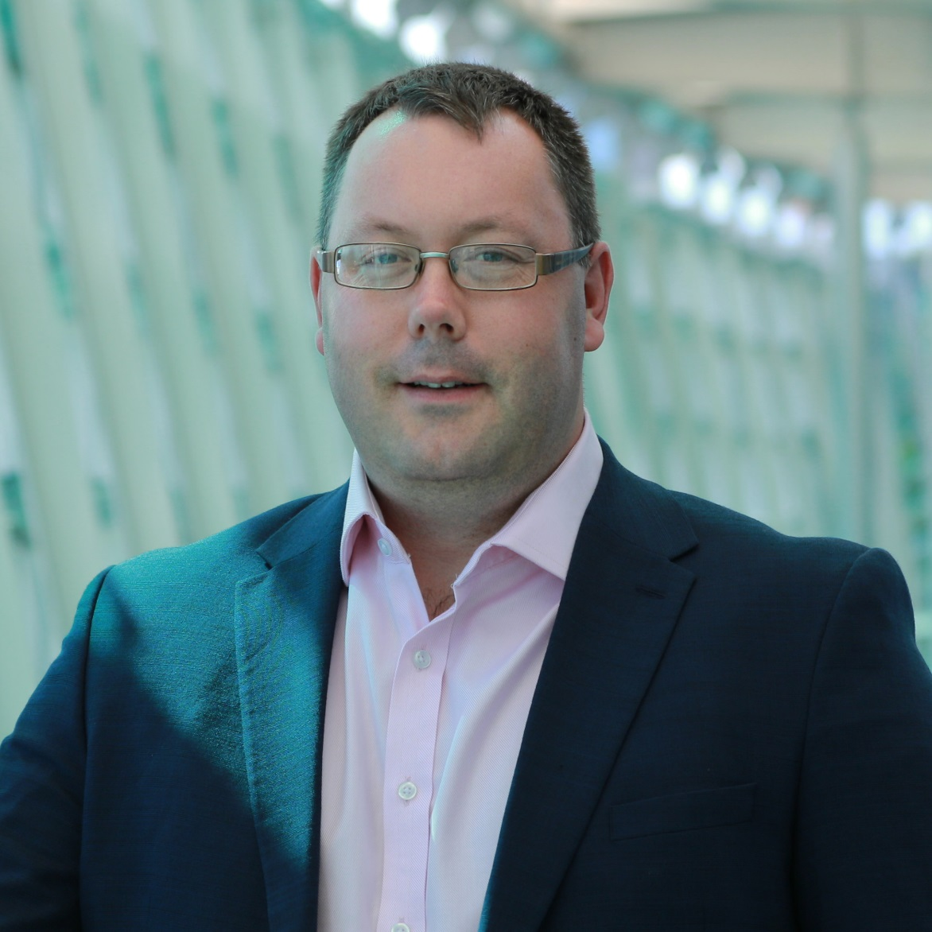
Please keep in touch…
https://twitter.com/iceiceclimber
www.linkedin.com/in/james-norris
jnorris@geosec.org (from 31 March james.norris@os.uk)
https://www.earthobservations.org/area.php?a=dr

Slide 18

