Slide 1

ISRO – Disaster Management - Priorities
Committee on Earth Observation Satellites
Shantanu Bhatawdekar
G Srinivasa Rao
ISRO, India
CEOS WGDisasters-13
Pasadena, California
09 – 13 March 2020

Slide 2
ISRO – Disaster Management Support Programme
ISRO would pursue the following initiatives:
Focus on Actual Constellation (AC) with regard to EO satellites - Gap analysis in priority areas, global studies….
Applications focus on SDGs for BIMSTEC Region - Vegetation, Water etc. through DataCube Concepts
Renewable energy assessment (Solar & Wind) from Space
Explore new tools for disasters management: Geo-Leo based solution !

Slide 3
ISRO – Disaster Management Support Programme
RRES
Rapid Response & Emergency Services
Institutional Mechanism
in association
with Nodal Agencies
  MHA
  NDMA
  State Agencies
Emergency
Communication
VSAT based VPN
DATs
AFS
Alerts & Forewarning Services
Satellite Navigation
Alerts to Fishermen
Capacity Building
States, NDRF
R-DRR Nodes
Regional Disaster Risk Reduction Nodes
International Collaborations
International Charter
Space & Major Disasters
Sentinel Asia
UNESCAP
Advanced Studies

Slide 4
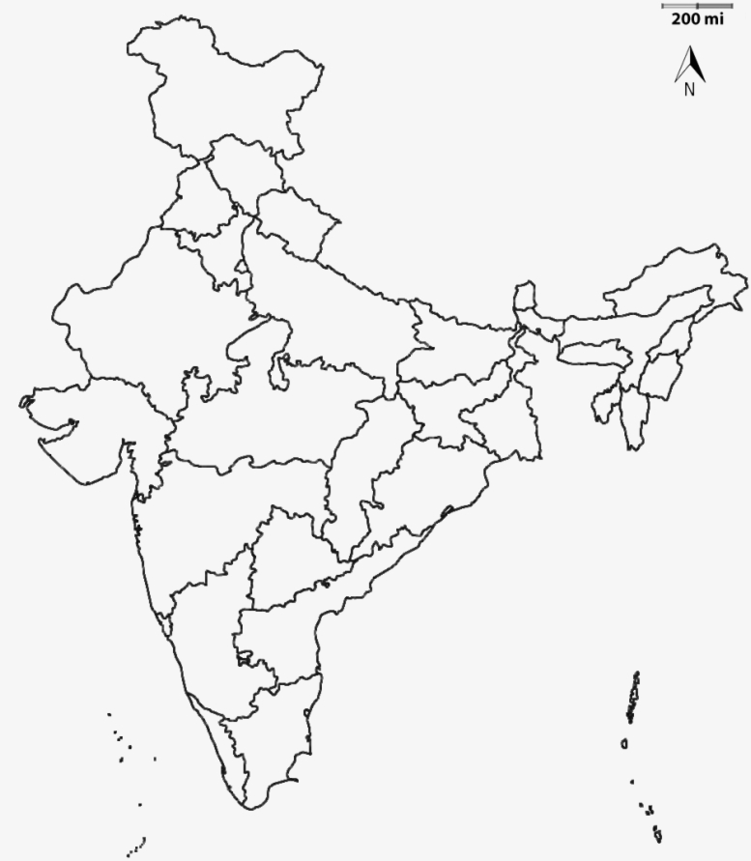
India – Disasters - 2019
2019
State-wise
Disaster Situation Products
Total Products - 268
10
1
1
7
52
138
1
3
35
6
1
6
4
1
Flood Products
3
1
Cyclone Products
1
Forest Fire Products

Slide 5
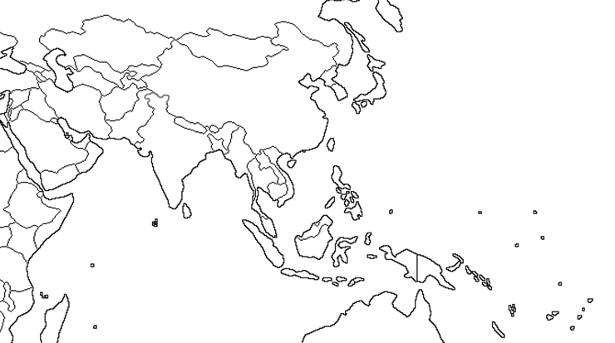
Support to other countries during 2019
Sentinel Asia Framework
11 countries / 19 Disaster Events
COUNTRIES
TURKEY
NEPAL
BHUTAN
MYANMAR
LAOS
THAILAND
VIETNAM
PHILIPPINES
CHINA
S KOREA
JAPAN
TURKEY
JAPAN
S KOREA
NEPAL
BHUTAN
CHINA
MYANMAR
LAOS
THAILAND
VIETNAM
PHILIPPINES
FLOODS
LANDSLIDES
EARTHQUAKES
FOREST FIRES
MULTIPLE DISASTERS

Slide 6
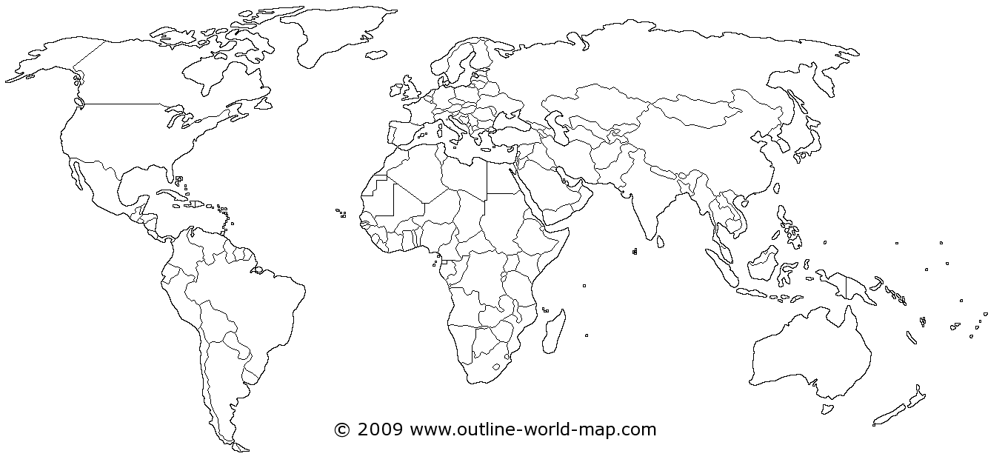
Support to other countries during 2019
International Charter Framework
17 countries / 21 Disaster Events
Russia
Japan
Bahamas
India
Bangladesh
Philippines
Uganda
Cameroon
Kenya
Indonesia
Peru
Bolivia
Mozambique
Zimbabwe
Fiji
Paraguay
Chile
Earthquake
Flood
Volcano
Ocean Storm
Forest Fire
Land Slide

Slide 7
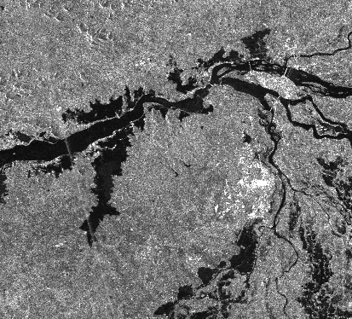
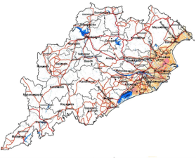
ISRO Proposed Contribution
Data Availability
ISRO has launched several Geo-Leo Satellites and a few Satellites are proposed
GEO Satellites - INSAT-3D / 3DR; GISAT-1,
LEO Satellites-ResourceSat-2 / 2A; RISAT-1A/1B, NISAR, (DMC-SAR), ResourceSat-3, …
DEM – CartoDEM, …
Disaster Applications
Improved Flood Monitoring using GEO-LEO-SAR
Forest Fire Danger Index
On-line Processing Tools
Online satellite data processing tools
Proto-type initiative for International Charter

Slide 8
Flood Pilot – ISRO Proposed Contributions
GEO / LEO / SAR Satellites
GEO – Present - INSAT-3D / 3DR – 1 km (Visible, IR), 15 minutes with two satellites
GEO – Near Future - GISAT – 42m, Multiple coverages for a given area in a day
LEO – Present – ResourceSat-2/2A – 56m, 740 km swath, 3 days with two satellites
LEO – Near Future – ResourceSat – 3/3A – 20m, 925 km swath, 2 days with two satellites
Resourcesat – 3S – 1.25 m PAN (STEREO) + 2.5 m Mx
SAR – Near Future – RISAT-1A/1B – C-band SAR; 50m, 240 km swath (CRS mode),
12 days (with 2 satellites)
    NISAR – L & S band SAR;
    DMC-SAR – C-band SAR, Inclined orbit, Sub-daily (4 Satellites)

Slide 9
Flood Pilot – Proposal
Improved Flood Monitoring
Daily estimation of flood inundation extent is very important for effective monitoring
LEO-Optical-SAR sensors, though useful, have limitations wrt revisit, swath cloud
GEO-Sensors have advantages wrt revisit, swath, though coarse in resolution
DEMs are useful in in improving the resolution of water theme in the Coarser Grids of GEO / Passive Microwave Sensors.
Integration of GEO-LEO-SAR-DEM, improve the flood monitoring capabilities, substantially
Broad Methodology
1
2
LEO
Optical
SAR
High Res.Water
Index
GEO Optical
Passive
Microwave
Low Res.Water
Index
Model
Model
3
DEM
Flood
Susceptibility
Index
4
Integrate
Flood
Extent
Model

Slide 10
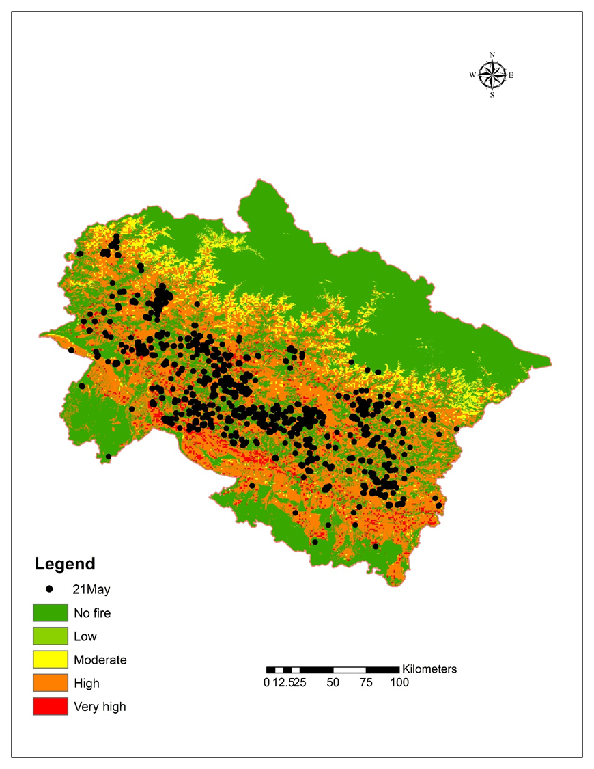
Forest Fires Pilot – Proposal
Decision Support System for forest fire danger
Inputs: Temperature, relative humidity, fuel characteristics, topographic conditions, vegetation type, edaphic conditions.
Two biophysical components:
  STATIC INDEX: based on the constant parameters such as fuel characteristics, topographic conditions, vegetation type, edaphic conditions.
  DYNAMIC INDEX: based on weather parameters such as air temperature, relative humidity, wind speed and rainfall;
  INTEGRATED INDEX: Static & Dynamic Indices are integrated to provide the fire danger rating
Western
Himalaya
  Indexing into different classes of fire danger viz. No danger, Low, Moderate, High and very High for rapid characterization.
  Validation based on Active fire points from SNPP-VIIRS

Slide 11
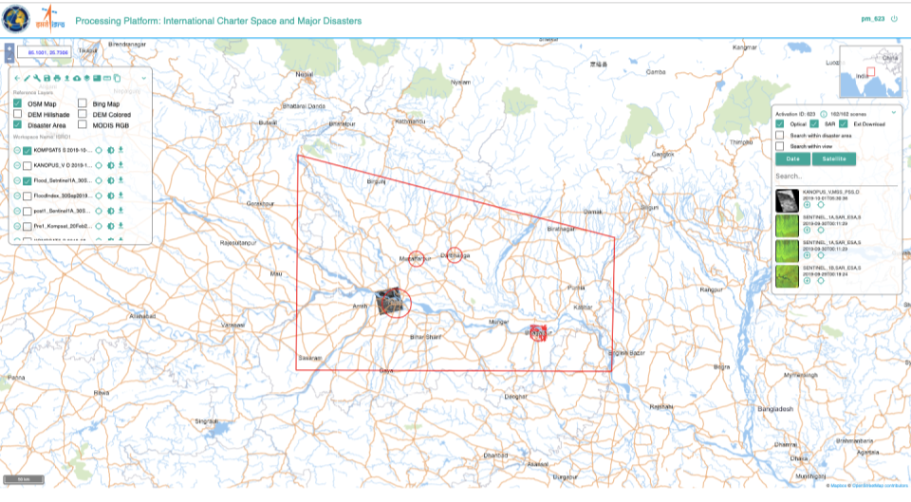
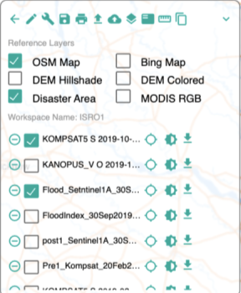
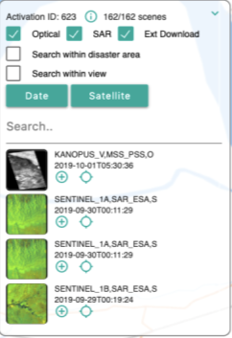
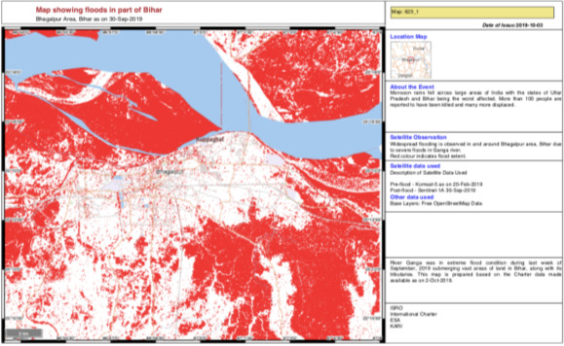
On-line Processing Tools
Need for Online Tool for
    Selection of Satellite Data
    Visualization of full resolution Satellite Data
    Sub-setting / Extraction of required area
    Extraction affected area – Flood, Fire, …
    Generation of Value-Added Products – Flood Maps, …
Ex: Bihar Floods – Sep, 2019
Final Product
Data
Products

