Slide 1

Volcano Demonstrator: March 2020 update
Committee on Earth Observation Satellites
Michael Poland Susi Ebmeier
USGS University of Leeds
CEOS WGDisasters-13
Pasadena, California
09 – 13 March 2020

Slide 2
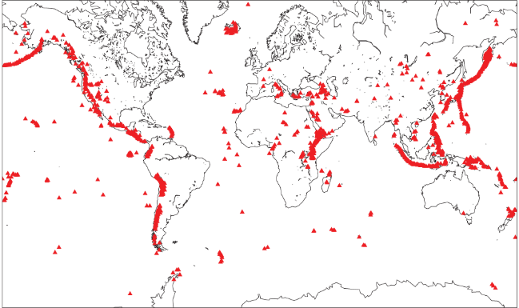
Volcano Demonstrator—project review
Expand use of satellite remote sensing for volcano monitoring
Research link between volcanic unrest and eruption from satellite observables
International coordination of satellite tasking to maximize its usefulness to volcano observatories
Supporting capacity building initiatives to increase the uptake of satellite imagery
Long term goal: to demonstrate the necessity and viability of international coordination of satellite tasking for volcano monitoring (after polar science community)

Slide 3
Work Activity Updates Since WGDisasters-12
Milestones and achievements
  Taal, Philippines, eruption response
  TerraSAR-X tasking is being executed
  15 Pleiades scenes for volcanoes in Peru and Chile, used by multiple institutions; also TDX data (Fuego)
Contributions of notable interest to CEOS Principals
  Planned workshops at Cities on Volcanoes 11 (May ’20) and IAVCEI General Assembly (Feb ‘21) meetings
  Active outreach to scientists in the Philippines, Ethiopia, Vanuatu, and other countries
Noteworthy progress identified by external stakeholders
  Ecuadorian and Chilean scientists are processing their own InSAR data
  PHIVOLCS benefitted from InSAR response to Taal eruption
Any delays or challenges related to time; challenges related to access to data or other resources
  Some confusion related to DLR data server, but can be overcome with better bookkeeping
  Time of contributors is an issue, but some student availability is helping with data analysis

Slide 4
Work Activity Outcomes and Outputs
High level outcomes:
  Increased uptake of satellite imagery for volcano monitoring in the target regions
  Increased global coverage of volcano deformation measurements
  Advances in our ability to interpret deformation, degassing, thermal, and topographic change
Specific outputs:
  Annual report to CEOS WG Disasters detailing progress
  Feedback from Demonstrator Participants
  Publications in academic journals describing the scientific results

Slide 5
Work Activity Deliverables
Year 1 (2019) Milestones:
Q2 - International leads and regional leads all in place and reporting process agreed
  Achieved—leads for all regions are in place, and a listserv has been established for ease of communication. Demonstrator leads coordinate reporting.
Q3 - Teleconference to discuss priorities for satellite tasking: produce a list of priority volcanoes and data requirements for each region (identify data gaps)
  Achieved—tasking is being conducted for TSX and Pleiades; CSK data are ordered on an as-needed basis.
Q4 - Expansion to involve new scientists not previously involved with the Volcano Pilot in data analysis
  Achieved—numerous scientists from around the word have agreed to contribute.

Slide 6

Work Activity Deliverables
Year 2 (2020) Milestones:
Q2 - Contribution to International capacity building workshop (‘Cities on Volcanoes 11’)
  Planned (https://pcoconvin.eventsair.com/volcanoes11/workshops-special; Workshop #4) 45 registrants from Philippines, Indonesia, Chile, Peru, Ecuador, Guatemala, Colombia, Japan, Iceland, Italy, USA, Ethiopia, and Montserrat
Q2 - Data orders for all three regions
  In progress for TSX and Pleiades
Q4 - First feedback on the impact of data provided by observatories
Q4 - Regional leads update tasking lists.
Years 3 (2021) Milestones:
Q2 - Major gaps in the use of satellite data filled in all regions
Q4 - Reporting of impact of CEOS data on hazard assessment

Slide 7
Work Activity / ToR Alignment
To support the efforts of Disaster Risk Management authorities in protecting lives and safeguarding property by means of satellite-based EO and science-based analyses;
  Monitoring of active volcanic systems is ongoing; response to specific eruption crises as needed (e.g., Taal)
To foster increased use of EO in support of Disaster Risk Management;
  During a crisis, timely SAR data have been critical for assessing volcanic activity
  During non-crisis periods, SAR data are valuable for assessing the status of a volcano and helping determine alert levels
  Capacity building activities are ongoing at volcano observatories in the 3 target regions
To support the Implementation of the Sendai Framework for Disaster Risk Reduction, and in particular contribute to its Priority 1 “Understanding Risk”; and
  Remote sensing data, particularly SAR and optical, are especially valuable before a volcano erupts, by allowing for assessments of activity, and also for understanding how hazards may manifest (for example, mass flows)
To raise the awareness of politicians, decision-makers, and major stakeholders of the benefits of using satellite EO in all phases of Disaster Risk Management.
  Volcano observatories are increasingly aware of the importance of remote sensing, which is a big part of the reason that conference workshops on the topic are so well attended.
Work along these lines will continue, as it seems well-aligned with hazard-specific WG objectives

Slide 8
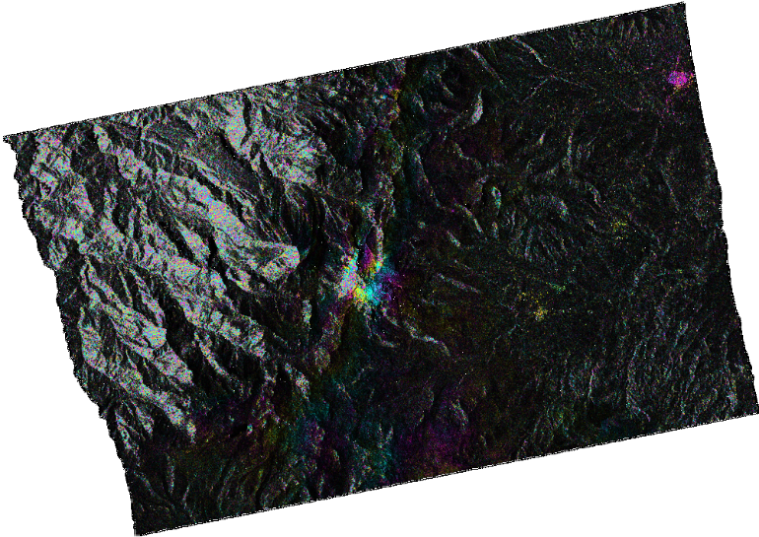
Example: SAR data use in Ecuador
Chiles-Cerro Negro, Ecuador
Instituto Geofisico scientists are using ISCE to process TSX data for Ecuadorian volcanoes, including Chiles-Cerro Negro (left).
They will soon be working on data from Reventador, Cotopaxi, and Guagua Pinchincha collected by the Ecuadorian volcano Supersite.
All data are being downloaded from DLR supersites portal.
Image courtesy Pedro Espín and
Patty Mothes, IG, Ecuador

Slide 9
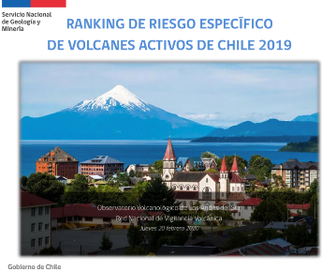
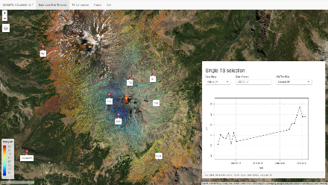
Example: SAR data use in Chile
Sentinel-1 track 83 swath 2 spans 76% of the category 1 and category 2 volcanoes in Chile. L-band data required south of 42ºS, almost no longer acquired
Deforming volcanoes in the past year:
  Laguna del Maule: at least since January 2007
  Domuyo, up to May 2019?
  Nevados de Chillan: since July 2019
  Cordon Caulle: up to May 2019
Data courtesy Loreto Cordova, SERNAGEOMIN,
and Francisco Delgado, IPGP

Slide 10
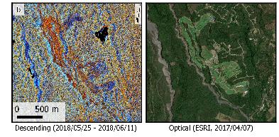
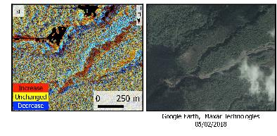
Example: Fuego pyroclastic flows
Data courtesy Fabien Albino, University of Bristol
Data courtesy Edna Dualeh, University of Leeds

Slide 11
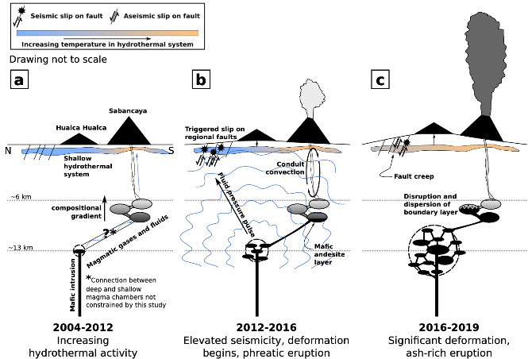
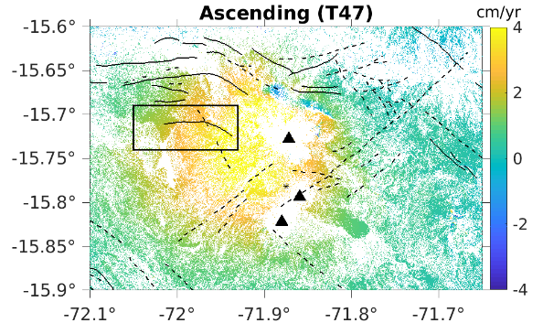
Example: Understanding Sabancaya, Peru
Phreatic eruptions starting 2014
M5 earthquakes in 2017
Magmatic eruptions starting late 2016
Apr. 30 2017
Jan. 10 2017
Creep
Inflation
Data and models courtesy Patricia Macqueen, Cornell University

Slide 12
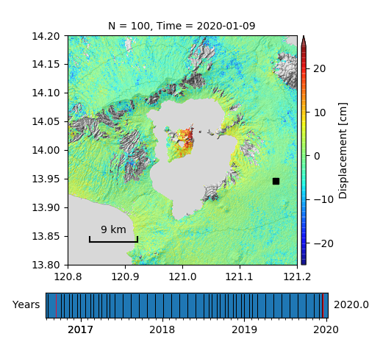
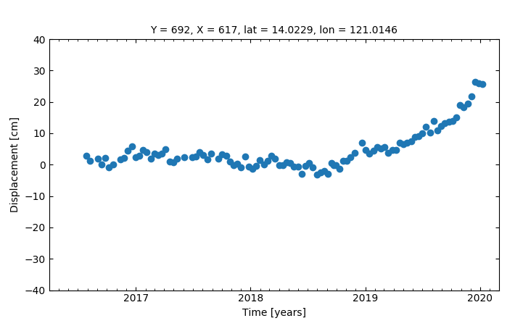
Example: Eruption of Taal, Philippines
Jan 12: phreatic eruption, pre-eruption ALOS-2 and Sentinel data processed
Jan 13: phreatomagmatic eruption, ALOS-2 sent to PHIVOLCS, Sentinel 6-day repeats requested
Jan 14: ALOS-2 pre-eruptive data modeled, sent to PHIVOLCS
Jan 15: PHIVOLCS sends thank you, using data in decisions; first co-eruption interferogram processed and communicated to PHIVOLCS
Data courtesy Mary Grace Bato, JPL

Slide 13
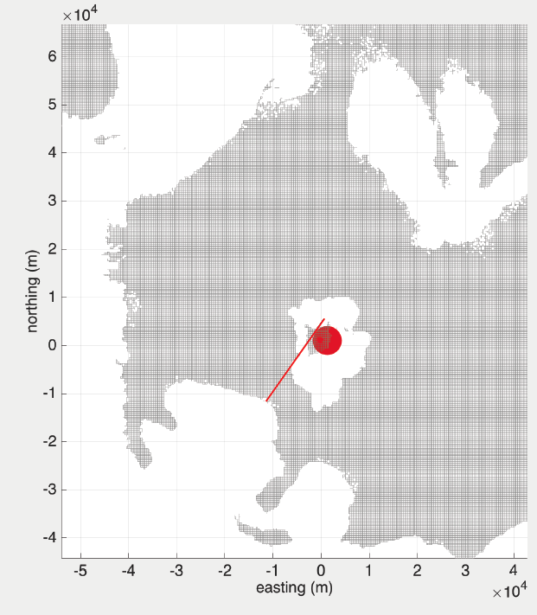
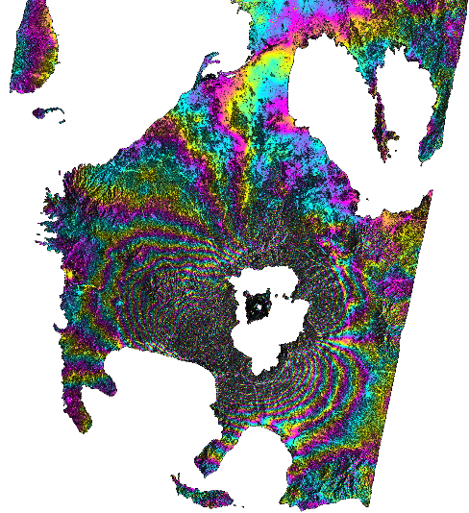
Example: Eruption of Taal, Philippines
09Jan2020 - 15Jan2020
Jan 16: message from PHIVOLCS, “PHIVOLCS would like to thank your great effort. Based on our science meeting last night, your results helped us understand what’s happening in Taal and it corroborates our field data, seismicity, and GPS results. Your [surfboard] model is well appreciated and our seismologists and geologists agree.”
Jan 17-onward: regular timely data sent to PHIVOLCS, emphasis on providing easily interpretable products (E-W and U-D displacements), valuable given loss of GPS network, good complement to field observations
Data and model courtesy Mary Grace Bato, JPL

Slide 14
Value of the WG and Recommendations
What is working well?
  TSX tasking is simple and effective, and CSK response for tasking has been impressive; there is an ability to respond to requests (i.e., Nevado del Ruiz, Colombia)
  Multiple independent groups are reaching out to volcano observatories in developing countries to work on capacity building projects
  Limited student time dedicated to evaluating the data being tasked
  Growing emphasis on utility of SAR amplitude data (Fuego is a good example)
What needs improvement?
  DLR data portal is confusing, but better to have easy access to data than none at all
  Africa is underrepresented, but more is coming soon upon a C-band survey
What needs to change?

