Slide 1

Working Group Disasters:
Chairs Perspectives and Flood Pilot
Committee on Earth Observation Satellites
David Green
NASA, CEOS WGDisasters Chair
CEOS WGDisasters-13
Pasadena, California
09 – 13 March 2020

Slide 2
Overview
Introduction
  CEOS and GEO: Strategies, Communities and Work plans
  Partnerships within UNDRR Sendai Framework for “Disaster Risk Reduction”
WGDisasters serving CEOS member agencies
  Terms of Reference http://ceos.org/wp-content/uploads/2014/09/WGDisasters_ToR_2019_v5.docx
  Members, Deliverables
Implementation
  Project Pilot: Charter (Members, Scope, Geography, Milestones, Dependencies, )
  Partnerships: CEOS, GEO, UN, Humanitarian, S&T, UR/Insurance, Financial, Operations…
  Deliverables: Work Plan, Data Plan, Reports (WG, SIT), Engagements and Outreach, Communications & Publications; Capacity Building; Information Services & Systems;
  Demonstrator and Continuity/Sustainability Plans

Slide 3
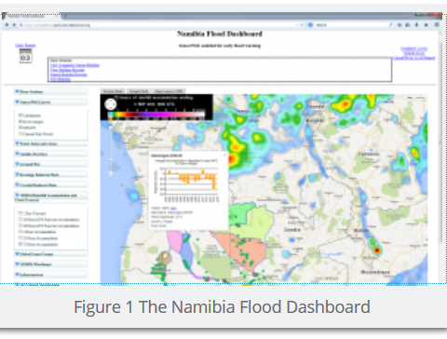
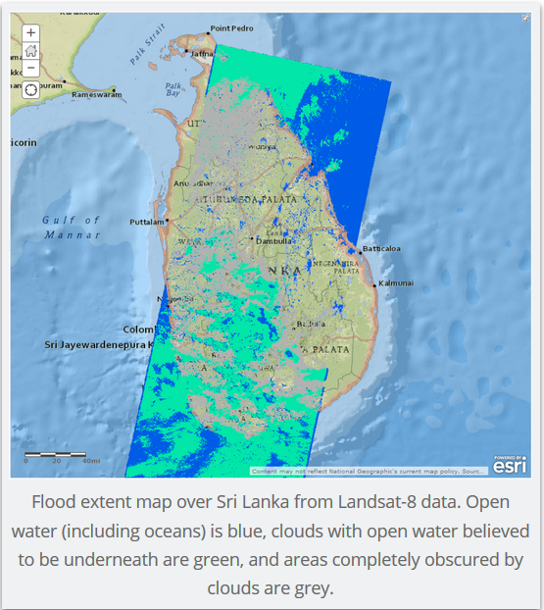
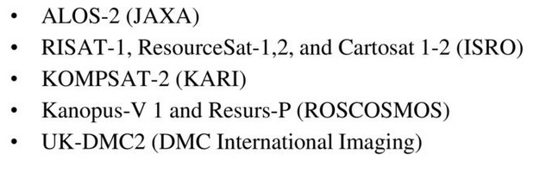
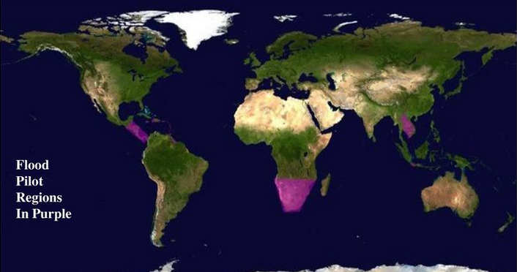
CEOS Flood Pilot 1: 2013-2018
(NASA, NOAA, Copernicus (CIMA, JRC ….
http://ceos.org/ourwork/workinggroups/disasters/floods/
Created a Community Created a Global Flood Dashboard to serve as a “one-stop shop”
for information from a number of existing systems for
monitoring and predicting floods in real-time.
  Inventory relevant EO data systems and capacity
  Show support of research and applications
  e.g. national mitigation, warning, response and relief
Created 3 regional Flood Pilots focused on delivering satellite products
with a greater amount of spatial detail for smaller areas, specifically:
  The Caribbean, with a particular focus on Haiti;
  Southern Africa, including Namibia, South Africa, Zambia, Zimbabwe, Mozambique and Malawi;
  Southeast Asia, with a particular focus on the lower Mekong River Basin and the island of Java, Indonesia.
Encourage each participating country to develop at least a basic capacity to access these data, understand them, and make them a part of their decision-making process.
Scope Demonstrator

Slide 4
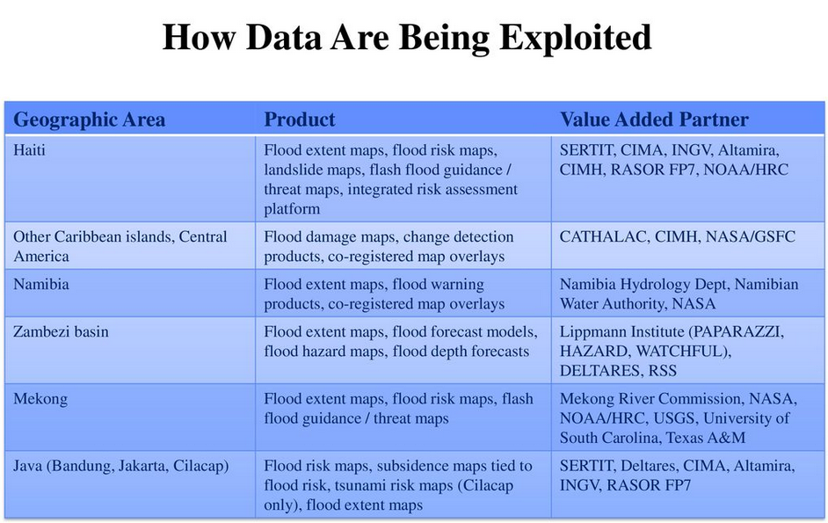
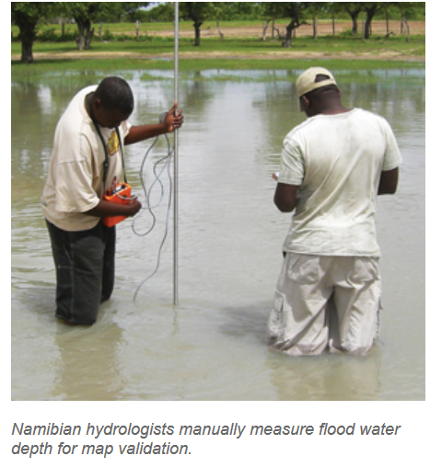
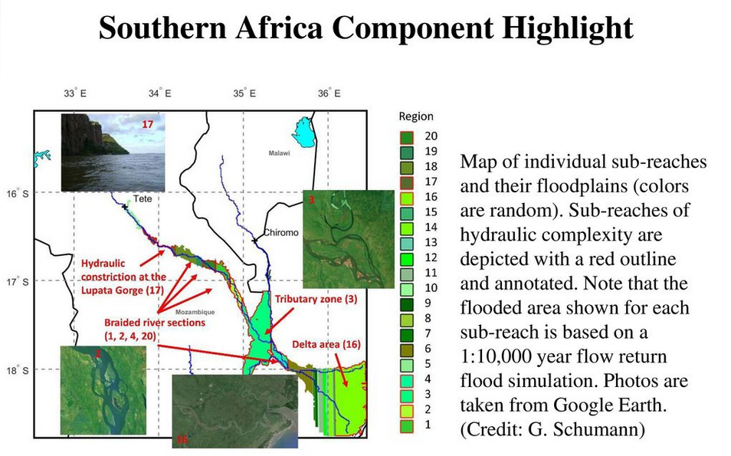
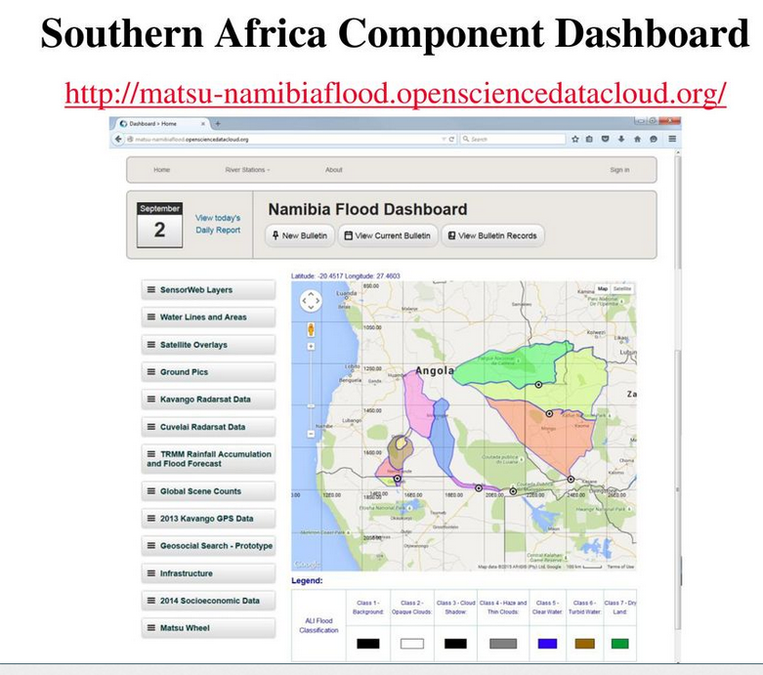
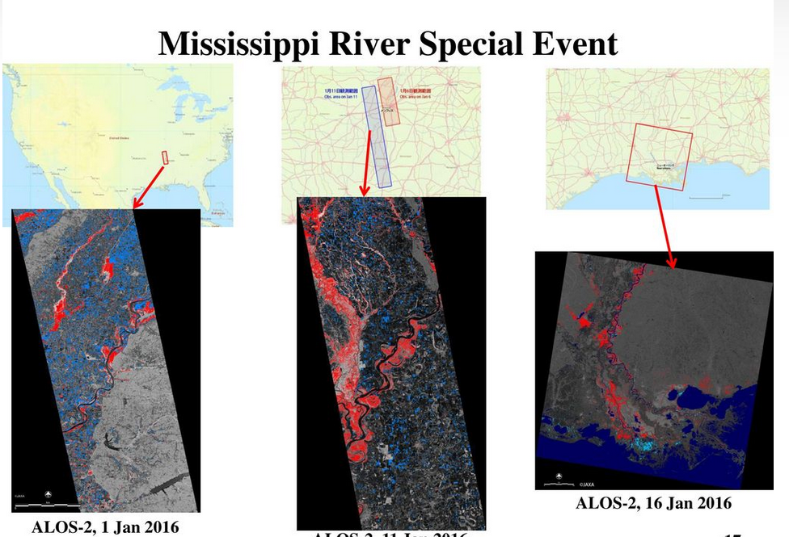
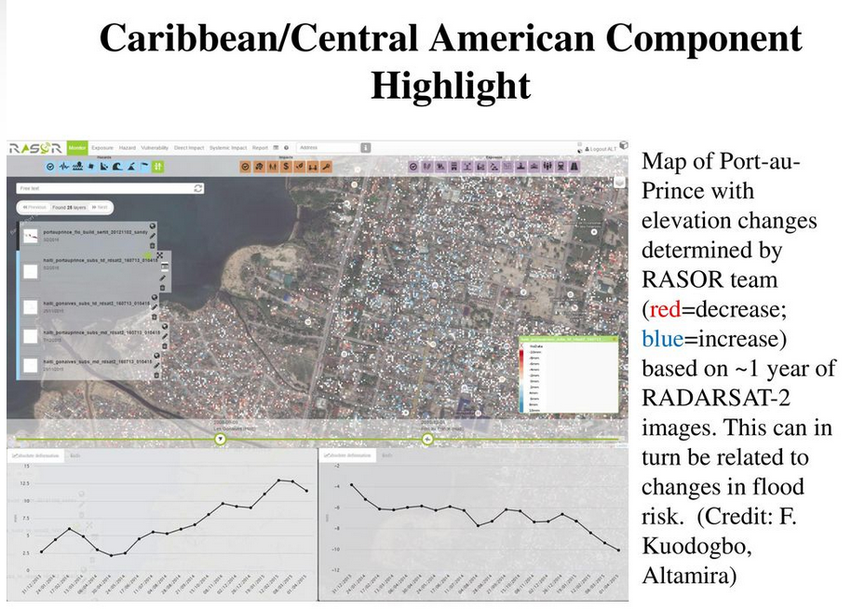
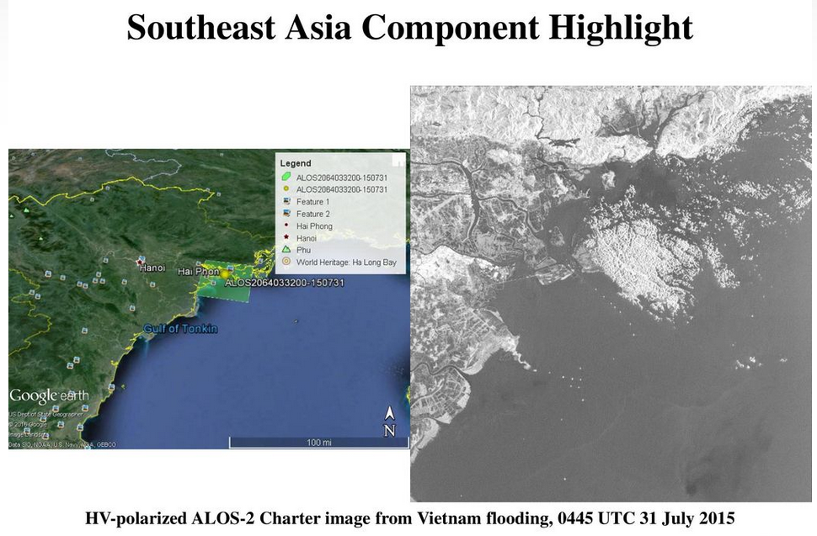
CEOS Flood Pilot 1

Slide 5
CEOS Flood Pilot 1: Demonstrator Not Implemented
http://ceos.org/ourwork/workinggroups/disasters/floods/
Demonstrator
  Transition from hazard identification to risk assessment, because identifying areas of flood risk before the event is the next critical step for improving Disaster Risk Reduction. This would be done by using archival EO data and flood models to quantify risk based on historic flooding;
  Provide spatial scaling for users between regional and global: This would build upon the foundational concepts established in the Flood Pilot to build upon the existing portals to create an integrated flood data portal that serves both global and regional users with both archive and real-time EO data products
  Map flooded areas where it matters the most, particularly urban areas with dense populations and significant flood risks. Improvements in sensor spatial resolution and in data analysis techniques are now making it possible to accurately map flood risk in urban areas.

Slide 6
WGDisaster ToR (2019)
Main Objectives
  Support efforts of DRM authorities in protecting lives and safeguarding property by means of EO and science-based analyses
  Foster increased use of EO in support of DRM
  Support implementation of Sendai Framework, and contribute to Priority 1 “Understanding Risk”
  Raise awareness of politicians, decision-makers, major stakeholders of benefits of EO in all phases of DRM
In pursuit of these objectives, WGDisasters should:
  Contribute to the monitoring of the implementation of this Framework
  Support the work of international initiatives such as for instance GEO
  Strive to increase the awareness of decision-makers of the critical role of EO
  Reinforce the need for enhanced satellite EO programs to address DRM

