Slide 1

Flood Pilot
Committee on Earth Observation Satellites
Shantanu Bhatawdekar
G Srinivasa Rao
ISRO, India
CEOS WGDisasters-13
Pasadena, California
09 – 13 March 2020

Slide 2
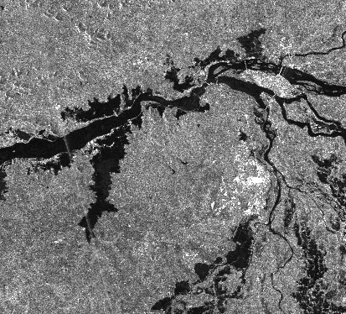
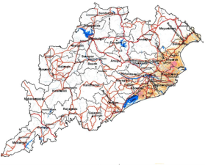
ISRO Present & Proposed Activities - FLOODS
Data Availability
ISRO has launched several Geo-Leo Satellites and a few Satellites are proposed
GEO Satellites - INSAT-3D / 3DR; GISAT-1,
LEO Satellites-ResourceSat-2 / 2A; RISAT-1A/1B, NISAR, (DMC-SAR), ResourceSat-3, …
DEM – CartoDEM, …
Disaster Applications
Preparedness: Flood Hazard Zonation based on Historic Satellite Observations
Experimental Flood Early Warning Studies
Flood Mapping using LEO-Optical & SAR
On-line Processing Tools
Online satellite data processing tools
Proto-type initiative for International Charter

Slide 3
Flood Pilot – ISRO Proposed Contributions
Inventory Data Sources
GEO / LEO / SAR Datasets
GEO – Present - INSAT-3D / 3DR – 1 km (Visible, IR), 15 minutes with two satellites
GEO – Near Future - GISAT – 42m, Multiple coverages for a given area in a day
LEO – Present – ResourceSat-2/2A – 56m, 740 km swath, 3 days with two satellites
LEO – Near Future – ResourceSat – 3/3A – 20m, 925 km swath, 2 days with two satellites
Resourcesat – 3S – 1.25 m PAN (STEREO) + 2.5 m Mx
SAR – Near Future – RISAT-1A/1B – C-band; 50m, 240 km swath (CRS mode), 12 days ( with 2 satellites)
    NISAR – L & S band;
    DMC-SAR – C-band, Inclined orbit, Sub-daily (4 Satellites)

Slide 4
Flood Pilot – ISRO Proposed Contributions
Collaborate with CEOS & CGMS
Flood Mapping Activities
Feasibility of integrating LEO-GEO optical with multi-frequency & multi-temporal SAR
Indian Case Studies: Ganga River (Bihar State), Brahmaputra River (Assam State)
Other Case Studies: Possibilities for Bangladesh, Sri Lanka shall be explored
1
LEO
Optical
SAR
High Res.Water
Index
Model
2
GEO Optical
Passive
Microwave
Low Res.Water
Index
Model
3
4
DEM
Grid-wise
Flood
Susceptibility
Model
Improved
Flood
Extent
Integrate

Slide 5
Flood Pilot – ISRO Proposed Contributions
Report on Best Practices
Report on the activities to be shared, that includes
    - Best Practices based on the experiences from the Case Studies
    - Documentation on Methodologies
Thank You

