Slide 1
Final Report on Volcano Pilot Project
Mike Poland (USGS)
Simona Zoffoli (ASI)
WG Disasters #8
Buenos Aires, Argentina
4–6 September 2017

Slide 2
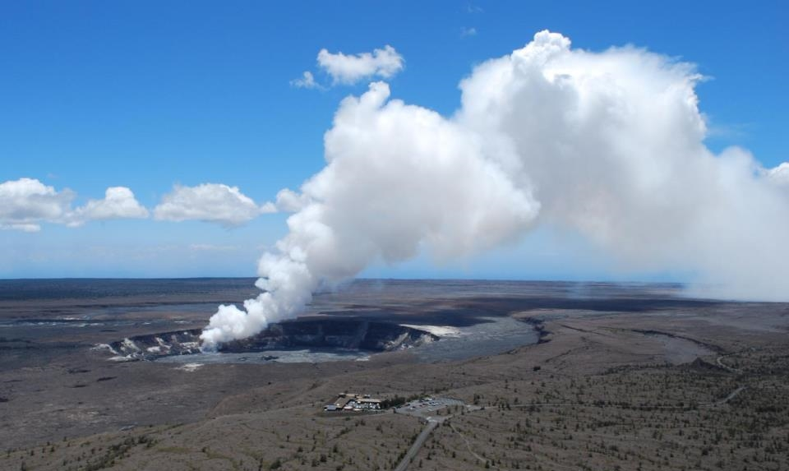
Overview
What was achieved against objectives?
What are the issues?
What lessons have been learned?
What did the users say?
Where does it go from here?

Slide 3
Objectives
Demonstrate the feasibility of integrated, systematic and sustained monitoring of Holocene volcanoes using space-based EO
Demonstrate applicability and superior timeliness of space-based EO products to the operational community (such as volcano observatories and Volcanic Ash Advisory Centers) for better understanding volcanic activity and reducing impact and risk from eruptions
Build the capacity for use of EO data in volcanic observatories in Latin America as a showcase for global capacity development opportunities.

Slide 4
Criteria for success
Identification of new areas of unrest through regional InSAR monitoring
Uptake by Latin American volcano monitoring agencies of EO-based methodologies for tracking deformation, as well as gas, thermal, and ash emissions
Utilization of EO data for operational monitoring by volcano observatories at Supersite targets
Interest expressed by volcano community to broaden approaches adopted in pilot (especially regional monitoring and new methodologies for EO-based monitoring) through representative bodies such as IAVCEI, WOVO or GVM

Slide 5
Issues
Participating research scientists are volunteers that depend on outside funding
Lack of a dedicated source of L-band SAR is problematic in many areas
Timely delivery of SAR data is critical for hazards assessment and mitigation
Satellite acquisitions need to be flexible (nighttime thermal data, ready changes to tasking, etc.)
Systematic background missions are essential

Slide 6
Lessons learned
A diversity of SAR data is important for any regional or global volcano monitoring strategy
Background SAR missions that are dedicated to volcano observation are essential
Tight orbital control is extremely advantageous for mapping deformation and topographic change over time
Freely available datasets, especially with high temporal resolution (and hopefully high spatial resolution), are a foundation for near-real-time detections of thermal anomalies and ash detection
Close collaboration between research scientists, space agency representatives, and end users—especially scientists based at volcano observatories—is critical for transferring the insights from volcano remote sensing data to actions for mitigating volcanic hazards and risk

Slide 7
Summary document
Summary of SAR aspects of Latin America pilot project are given in a manuscript that is in review at the Journal of Applied Volcanology

Slide 8
User feedback
Patricia Mothes, Geophysicist, Instituto Geofísico (Ecuador)
Luis Lara, Director, Observatorio Volcanológico de los Andes del Sur (OVDAS, Chile)
Carlos Andrés Laverde, Geohazards Direction team, Colombian Geological Survey (Colombia)
Gustavo A. Chigna, volcanologist, INSIVUMEH (Guatemala)
Lourdes Narvaes Medina, volcanologist, Observatorio Vulcanologio y Seismologico de Pasto (Colombia)
John Pallister, Chief, Volcano Disaster Assistance Program, U.S. Geological Survey (USA)
Ing. Victor Aguilar Puruhuaya, Jefe de Sismología, Instituto Geofísico, Universidad Nacional San Agustin de Arequipa (Perú)
Armando Saballos, Dirección Gral. de Geología y Geofísica, INETER (Nicaragua)
Christina Neal, Scientist-in-Charge, Hawaiian Volcano Observatory, U.S. Geological Survey (USA)

Slide 9
Next steps
Two options:
Pilot extension. No new funds are needed, but space agencies should continue to provide data at no cost and with quotas similar to those provided thus far for regional volcano monitoring activities. Teams of academic researchers will write proposals for data and summarize results in regular reports
Dedicated effort. One or more full-time employees will serve as bridges between academics, space agencies, and end users to ensure that user needs are met, and that space agencies receive the proposals and reports that are needed to justify their continued support.

Slide 10
Plan for the future
Going global:
Year 1: Continue working with volcano observatories in Latin America on data analysis and capacity building. Develop partnerships with research institutions around the world who are interested in contributing to a global monitoring effort.
Year 2: Expansion of operational monitoring efforts to volcanoes in Africa (where there are few volcano observatories).
Years 3–4: Expansion to Indonesia and the Philippines—both countries with abundant volcanic activity but little ability for the uptake of remote sensing.
Year 5: Demonstrate that global volcano monitoring from space is possible, and engage agencies with a volcano monitoring mandate to establish a permanent and funded program to sustain global volcano monitoring from space.

Slide 11
Additional considerations
Focus will be on the highest-risk volcanoes in developing nations
Quotas of SAR data will not simply be scaled, based on the Latin American pilot project, by the numbers of volcanoes in the countries to which monitoring will be expanded, but rather the hazard potential, activity history, and environment of those volcanoes
Primary need is for SAR and very-high-resolution optical data, which are not freely available in most cases
A particular focus will be topographic data
Need better integration with the Geohazards Supersites and Natural Laboratories (GSNL) initiative
Capacity building will continue to be a priority, with the goal of making volcano observatories and/or research institutions in developing countries self-sufficient with respect to obtaining, processing, and interpreting remote sensing data

Slide 12
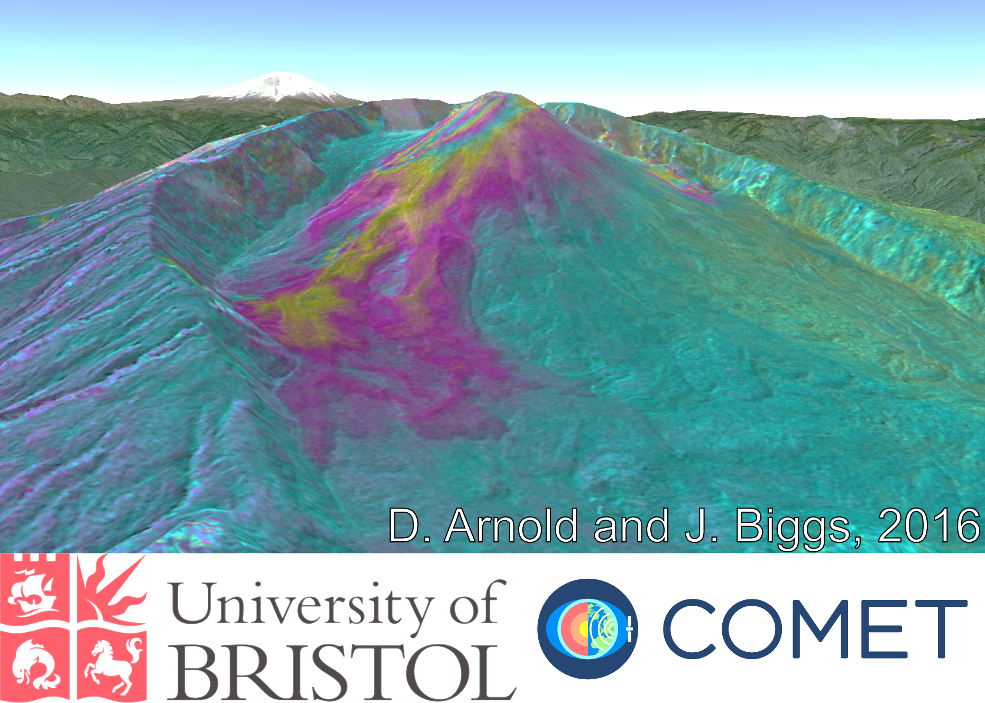
Fin
Thank you

