Slide 1
CEOS Disaster Risk Management Seismic hazards Pilot Final Report
CEOS WG Disasters meeting, 4-8 September 2017
Philippe Bally (ESA)
Stefano Salvi (INGV)
Theodora Papadopoulou (ARGANS c/ ESA)

Slide 2
Outline
Seismic Hazards pilot – Context, objectives
Outcomes
Data tracking
Success stories
Lessons learnt and way forward

Slide 3
Seismic Hazards pilot – Context, objectives

Slide 4
Seismic Hazards pilot Context and objectives:
With respect to the objectives derived from the Santorini report http://esamultimedia.esa.int/docs/EarthObservation/Geohazards/esa-geo-hzrd-2012.pdf
… the Seismic Hazards pilot set the following objectives:
Support the generation of globally self-consistent strain rate estimates and the mapping of active faults at the global scale by providing EO InSAR and optical data and processing capacities to existing initiatives, such as the iGSRM
[role of EO: wide extent satellite observations]
Concrete target for the Pilot: Test, validate and start production in representative priority areas.
Support and continue the GSNL
[role of EO: multiple observations focused on supersites]
Concrete target for the Pilot: Help the GNSL access and exploit data.
Develop and demonstrate advanced science products for rapid earthquake response
[role of EO: observation of earthquakes with M>5.8]
Concrete target for the Pilot: Generate EO based earthquake response products.
Notes:
“Derived objective for the Pilot”: THE SUBSET OF EACH BIG (10 years) SANTORINI OBJECTIVE

Slide 5
Seismic Hazards pilot – Contributors and examples of end users
The pilot is supported by:
6 space agencies: ESA, NASA, ASI, CNES, DLR, JAXA
8 geoscience centres with EO practitioners from 5 countries focusing on 11 sites (AOIs) worldwide:
INGV (IT)
COMET (UK)
NASA JPL (US)
CNR IREA (IT)
University of Miami (US)
NOA (GR)
UNAVCO (US)
ISTerre/IPGP(FR)
End users: Italian Civil Protection Department (DPC), Greek Earthquake Planning and Protection Organization (EPPO
Notes:
“Derived objective for the Pilot”: THE SUBSET OF EACH BIG (10 years) SANTORINI OBJECTIVE

Slide 6
Outcomes

Slide 7
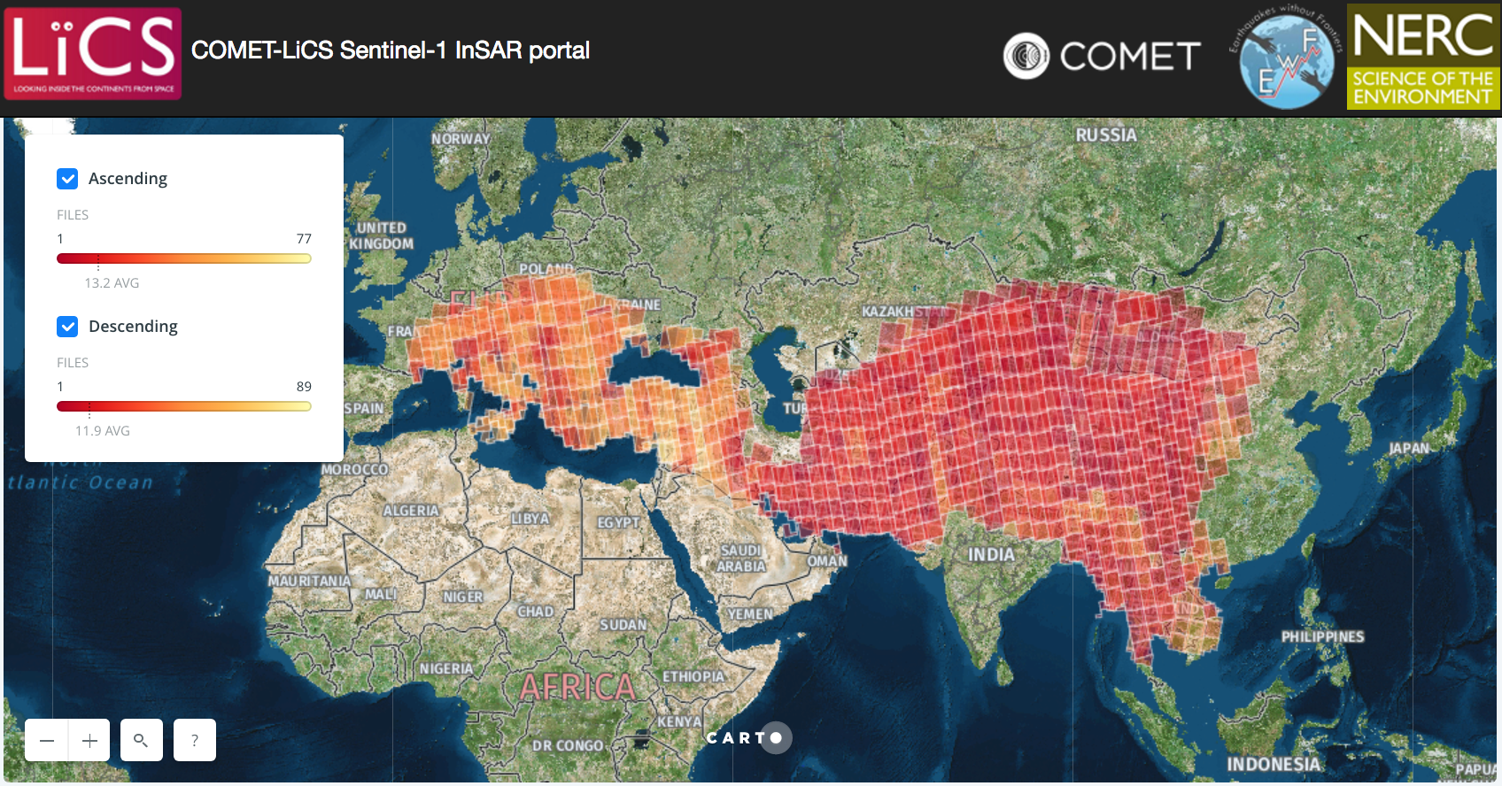
Achievements – Objective A
The Seismic Hazards pilot met its objectives, in particular:
Objective A: Support the generation of globally self-consistent strain rate estimates and the mapping of active faults at the global scale by providing EO InSAR and optical data and processing capacities to existing initiatives, such as the iGSRM [role of EO: wide extent satellite observations]
Pilot objective: Test, validate and start production in representative priority areas
Strain rate mapping:
The methodology is validated e.g. over Turkey by COMET (UK) and California by Univ. Miami (with EO data collections provided outside CEOS)
The global production has started: the entire length of the North Anatolian Fault System has been already processed by COMET
Active fault mapping:
Stereo optical data used to support fault reconnaissance mapping locally over limited areas (by University of Leeds and COMET)
First analysis of the need for large scale fault reconnaissance mapping
COMET’s LiCSAR portal.
Preliminary results over the Sagaing fault in Myanmar.
Notes:
There are already GSNL sciense users using the GEP (INGV, NOA).

Slide 8
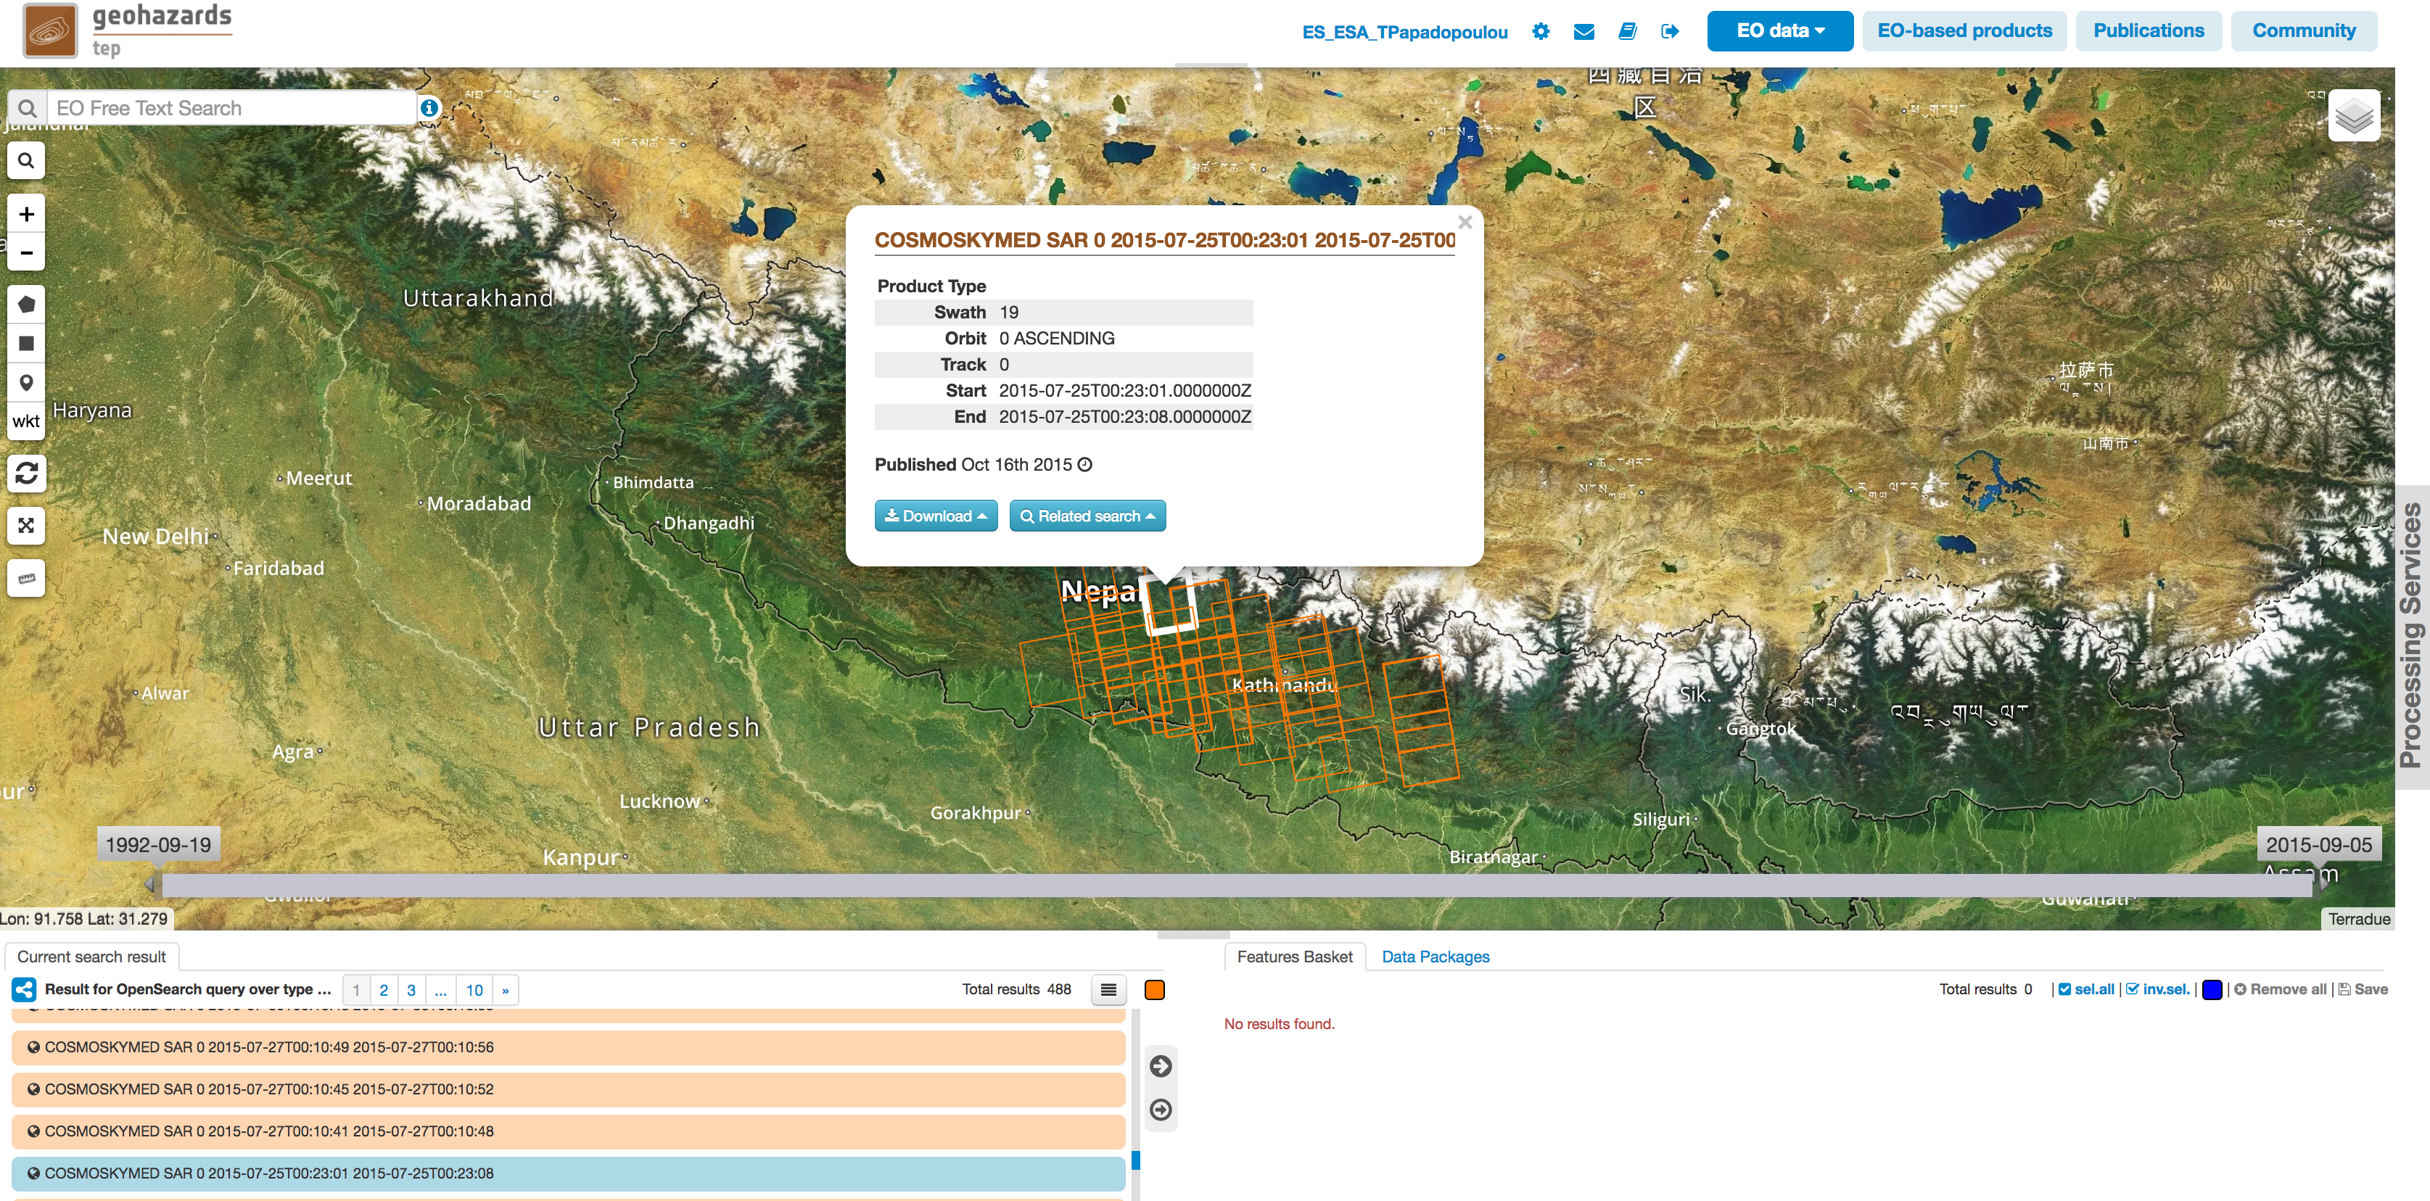
Achievements – Objective B
Objective B: Support and continue the GSNL [role of EO: multiple observations focused on supersites]
Pilot objective: Help the GNSL access and exploit data
The GEP successfully supported the GSNL experts for data delivery, on demand processing (mainly InSAR) and the integration of chains dedicated to GSNL activities (e.g. SISTEM by INGV Catania)
The pilot supported the Gorkha earthquake Event Supersite, with the additional analysis of ALOS-2 data (not provided through the GSNL).
Notes:
There are already GSNL sciense users using the GEP (INGV, NOA).

Slide 9
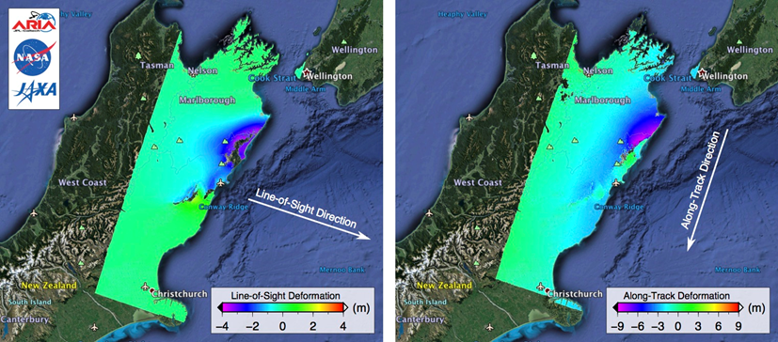
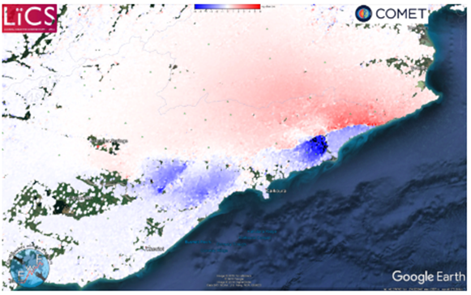
Achievements – Objective C
Objective C: Develop and demonstrate advanced science products for rapid earthquake response [role of EO: observation of earthquakes with M>5.8]
Pilot objective: Generate EO based earthquake response products
since November 2014 the seismic pilot provided support to 8 earthquakes with magnitude > 5.8 in 5 countries worldwide, in 5 countries: Nepal (Gorkha), Greece (Cephalonia and Lefkada), Ecuador (Muisne), New Zealand (Kaikura) and Italy (Amatrice, Visso and Norcia). Typically, users are geoscience centres.
In a few cases, products derived from pilot work were also used by end users (e.g. Italian Civil Protection, Greek Earthquake Planning and Protection Organization (EPPO))
Coseismic Range Offsets from Sentinel-1 SAR data highlighting the fault trace and numerous fault segments.
Results were online 5.5 hours after satellite acquisition.
ALOS-2 interferograms showing LOS and Along Track deformation, generated by NASA JPL over Kaikura, New Zealand.
Notes:
There are already GSNL sciense users using the GEP (INGV, NOA).

Slide 10
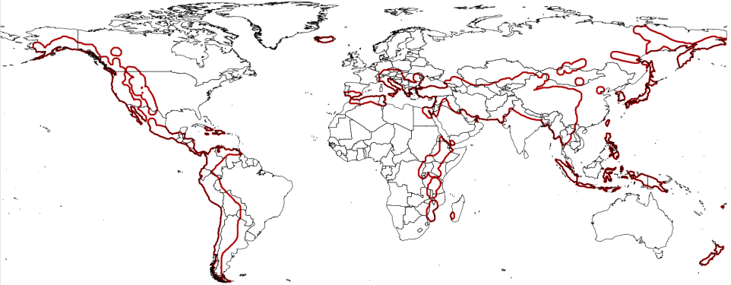
Achievements – Other
Other outcomes:
Collaboration with mission operators to optimize EO coverage against thematic priority areas of the pilot: there is a high correlation between the Sentinel-1 acquisitions and target areas of the pilot community
Examine gaps of the acquisition plans over high seismic risk megacities: confirmed that most sites at least partially covered by SAR data
Promotion: in total 23 publications, 2 presentations, 2 posters and 10 web-stories/ articles stemmed out of pilot work.
Notes:
There are already GSNL sciense users using the GEP (INGV, NOA).

Slide 11
Data tracking

Slide 12
Yearly Quota
Agency | ASI | CNES Pleiades | CSA | DLR | ESA | JAXA ALOS-2 | NASA | USGS Landsat-8
Number of Images | 300 | 50 | 2 | on request | * | 100 | - | -
*ESA: large dataset through the GEP (ERS & ENVISAT 70+ Tera and Copernicus Sentinel-1 & Sentinel-2 gradually)
DLR (TerraSAR-X): quota shall be provided, if requested
CNES (Spot): no quota provided
Freely available sources: no quota (e.g. USGS L8).
- ALOS-2 data available up to 31 March 2017.

Slide 13
Data use
Region of AOI | ASI | CNES (Pleiades) | CSA | DLR | ESA | JAXA
China | 92 | 18*
Iran | 46
NAF |  |  |  | 296 | ~1000 (Alpine-Himalayan belt) | 24
Nepal | Covered by GSNL event supersite |  |  |  |  | 27
Andes |  |  |  |  |  | 8
Greece (Cephalonia) | 20
Greece (Lefkada) | 159 |  | 6 | 65 | >2
Italy | 2 | 14 |  |  | 8 | 4
New Zealand |  | 27 |  |  | >2 | 12
Philippines |  |  |  |  |  | 13
Myanmar |  | 6
Chile |  | 2
Total | 302 | 67 | 6 | 361 | >1000 | 88
*In bold, images requested and used over the last 5 months. **Both Cephalonia and Lefkada regions.
For China and Iran, the entire dataset needs to be gathered in order to achieve concrete results (active fault mapping). Acquisitions are expected to end in March 2018.
For Myanmar and Chile, analysis is on-going. It was expected to be completed by September 2017, but this was not possible due to delays in data orders.
For NAF (TerraSAR-X dataset), the study has started by University of Miami.
Notes:
Barry Parsons informed me that the CSK acquisistions for China and Iran will end in October 2017 and March 2018 respectively. Can this be discussed within the meeting? Is it acceptable? If we find sustainable paths for the future of the pilot what happens in the meantime (the time between the end of the pilot and the start of a new project)?

Slide 14
Success stories

Slide 15
The Ecuador earthquake of 16 April 2016

Slide 16
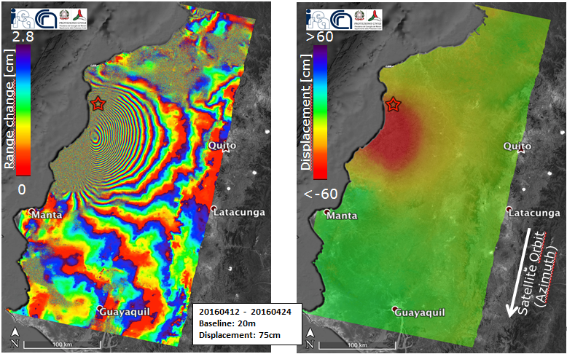
2016 Ecuador earthquake
Earthquake in Ecuador (Mw 6.0 in Muisne) on 16 April 2016
-April 17, 2016: the Ecuador government asked assistance to the Directorate-General Humanitarian Aid and Civil Protection of the European Commission. Italy declared the emergency state for the Ecuador earthquake (under the coordination of the United Nations).
CEOS Seismic Hazards Pilot partner: Institute for Electromagnetic Sensing of the Environment (CNR-IREA is a Center of Competence on DInSAR for the Italian Civil Protection Department, DPC).
A detailed report on the surface deformations was provided by CNR-IREA, which was also forwarded to the Ecuadorian authorities of civil protection. The generated deformation maps were used:
(a) to understand the extension of the area affected by displacement and better focus the activities during the emergency
(b) to model the seismogenic fault in order to increase the knowledge on the earthquake and its causes.
Interferogram and displacement map generated by CNR-IREA, exploiting two Copernicus Sentinel-1 acquisitions of 12 and 24 April 2016.

Slide 17
Central Italy earthquakes (24 August, 26 and 30 October 2016)

Slide 18
Central Italy Earthquakes: Activation
On 24 August 2016 at 3:36:32 CEST an earthquake hit Central Italy. It measured 6.0 on the moment magnitude scale and its epicentre was close to Accumoli in a depth of 4±1 km. Buildings in the villages of Amatrice, Accumoli and Arquata del Tronto collapsed and caused nearly 300 fatalities.
The same day as the earthquake hit Central Italy, the CEOS Seismic Pilot was activated by the specialists of INGV, the national institute of Geophysics and Volcanology of Italy, with the aim to access and exploit EO data for Active Tectonics Mapping.
Two months later, on October 26, two events of Mw 5.4 and 5.9 occurred about 30 km to the NW in Visso. These shocks were then followed on October 30 by an earthquake of Mw 6.5 occurring close to Norcia, which further increased the damage level in the area. This was the largest earthquake recorded in the last 30 years in Italy.
Products and detailed reports about the events were provided to the Italian Civil Protection Department (DPC) by the main CoC (INGV) and others CoCs (e.g. CNR-IREA)
Gregorio Borgia/AP Photo

Slide 19
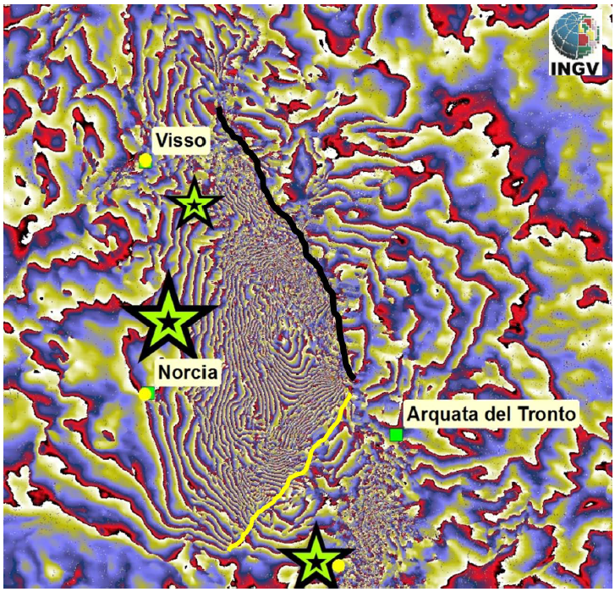
Visso and Norcia Earthquakes: Sentinel-1 interferogram generated by INGV
A detail of the descending Sentinel-1 interferogram, showing the linear fringe discontinuities corresponding to ground breakage. The black line has been identified with a co-seismic scarp with 1-2 m displacement on the Monte Vettore fault. The yellow line has not been verified into the field but may represent the surface expression of a lateral fault which has been modeled by the inversion of InSAR data. Credits: INGV, Sentinel-1 data: copyright Copernicus programme.

Slide 20
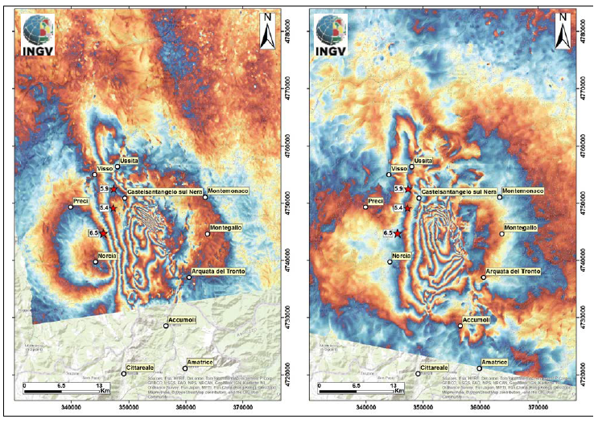
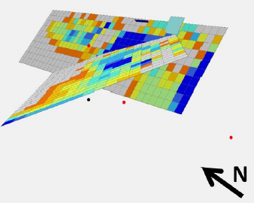
Earthquake source models by INGV based on ALOS-2 interferograms:
Source model based on ALOS-2 unwrapped interferograms for the October 26 and 30 events. The main rupture occurred on the Monte Vettore-Monte Bove fault for 25+ km.
ALOS 2 interferograms showing the cumulated ground deformation caused by the October 26 (Visso) and 30 (Norcia) earthquakes. The left image shows an ascending interferogram covering the period August 24 - November 02, 2016. The right image shows a descending interferogram covering the period August 31 - November 09. The mainshocks of October 26 and 30 are shown as red stars. Each colour fringe represents 12 cm of Line of Sight ground displacement. Credits: INGV and CNR IREA.

Slide 21
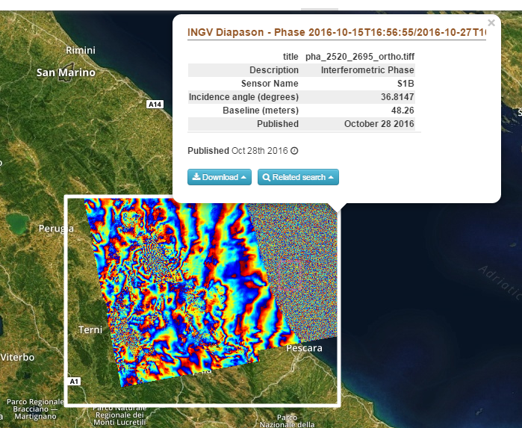
2016 Visso earthquake: example of GEP hosted processing executed by a thematic user.
Interferogram based on the GEP-hosted processing chain DIAPASON of the French space agency CNES and processed by INGV using Sentinel-1 acquisitions of 15th and 27th October 2016.

Slide 22
Strain rate mapping by COMET using the LiCSAR system

Slide 23
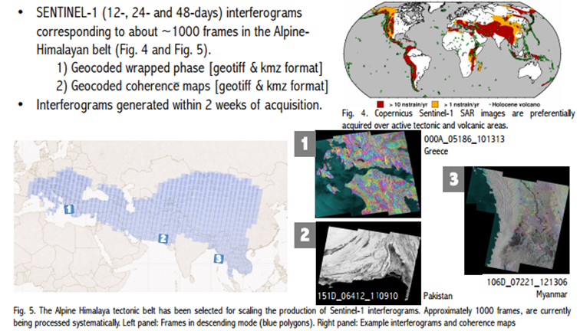
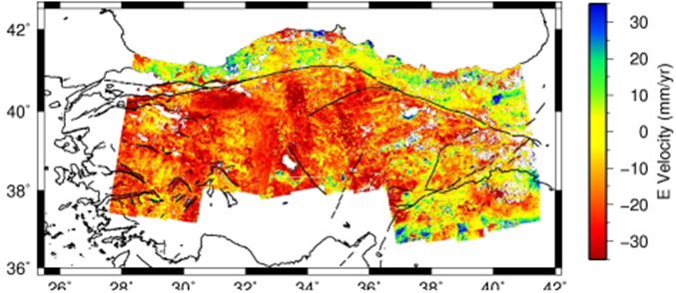
COMET-LiCSAR: Tools for automated generation of Sentinel-1 frame interferograms
Working with new types of data: SENTINEL-1 generates massive volumes of data with high duty cycle, shorter revisits, and wider swaths than previous missions (e.g. ENVISAT).
East-West component of the surface displacement rates from October 2014 to April 2016 using ascending and descending passes over the entire length of the North Anatolian Fault System.
The LiCSAR InSAR products are generated within two weeks of acquisition of Sentinel-1 images. Over 1000 frames have being processed systematically over the Alpine-Himalayan Belt. First LiCSAR results were presented in the AGU 2016 for large scale Sentinel-1 frames processing for the entire North Anatolian Fault.
Details: http://comet.nerc.ac.uk/COMET-LiCS-portal/

Slide 24
COMET-LiCSAR: comments and next steps
LiCSAR products will be made available through GEP in the next months. Next steps: process a larger area and reprocess the entire Sentinel-1 mission since 2014.
Strain-rate mapping will allow to determine how often earthquakes occur.
COMET is now producing interferograms routinely for the Alpine-Himalayan Belt. Time series and average line of sight velocities will follow in the next year.
Next priority area is the East African Rift.
Working with the GEP and EPOS to integrate COMET data into their portals.
Validation exercises in Turkey have shown that with 3 years of Sentinel-1 data are comparable in quality with the data from 7 years of Envisat, and accuracy is expected to continue to improve
Testing various strain rate mapping methods and establishing which of these are capable of incorporating constraints from InSAR.
The first regional high-resolution strain rate models will be produced within 2018.
COMET aims to monitor all of Earth’s tectonic zones using Sentinel-1.
Notes:
These are steps taken on board in the preparation of the Seismic Consolidation activity

Slide 25
Sagaing fault mapping (Myanmar) by University of Leeds / COMET

Slide 26
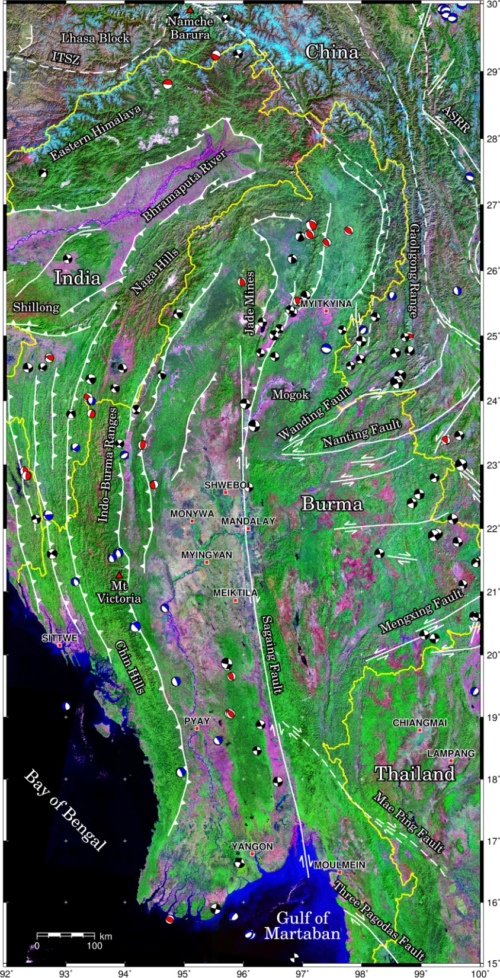
Sagaing fault mapping
One of the largest faults in SE Asia.
Runs north-south though Myanmar for over 1000 km.
Produced large earthquakes (M>6.5) more than 10 times in the last century.
Runs close to many major cities (combined population 9 million).
Fault is very active with a fast slip rate of 2 cm per year.

Slide 27
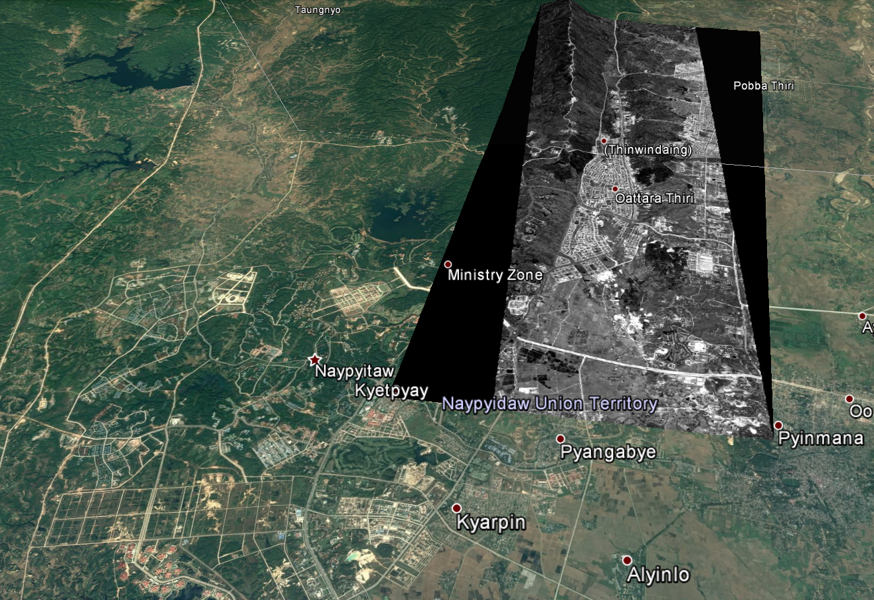
Sagaing fault mapping: methodology
Interpretation of fault geomorphology from optical imagery analysis based upon the panchromatic and multi-spectral bands
Construction of DEMs from high-resolution satellite stereo imagery to identify offset features and provide quantitative measures of displacements.
Incorporate DEMs into high resolution displacement maps made using Sentinel-1 SAR data to measure ground displacement, interseismic strain and potential sites of creep along the major fault.
Preliminary DEM extraction from stereo data undertaken on images from 4th April 2016 next to the new capital at the southern end of the AOI to test workflow
Photogrammetry software used: ERDAS imagine
B&W image: Pléiades, copyright CNES, 2016.

Slide 28
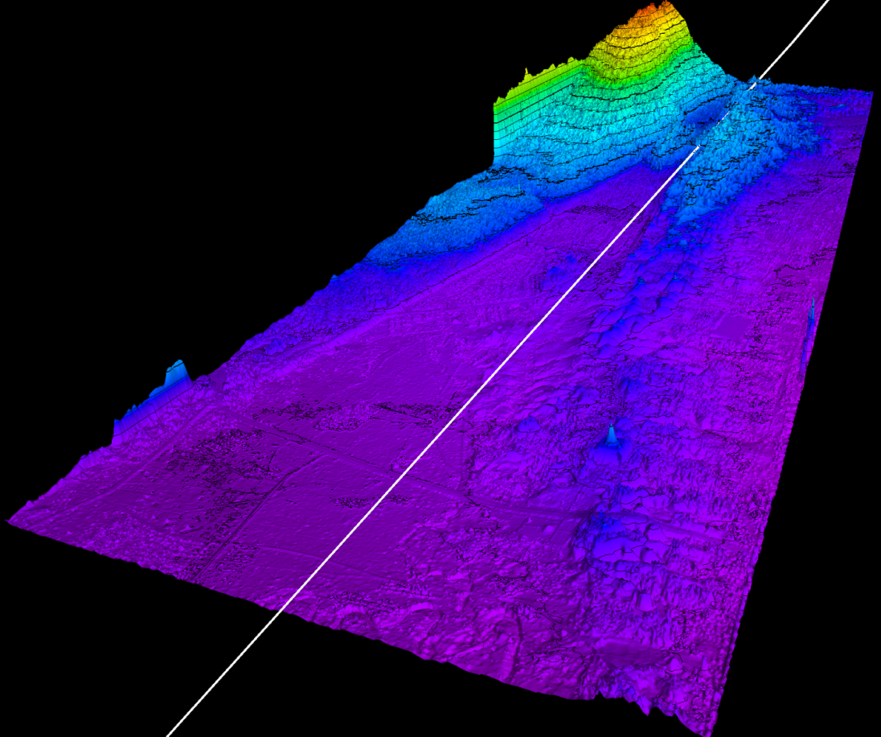
Sagaing fault mapping: preliminary results and foreseen outputs
DEM reveals fault landscape geomorphology and potential sub-parallel fault sections for further analysis
Anticipated Data product outputs
Point cloud of elevations for the 300 km long trace. 1 billion points anticipated.
Hillshaded DEMs of topography for geomorphic interpretation
Ortho-images of Pleiades Panchromatic and multispectral Imagery
3D-printed ABS models of fault trace
Peer-reviewed publication
Timeliness:
Overall data delivery was particularly slow.
Fault mapping results also expected from the University of Leeds/COMET and University of Oxford teams in the next months for the Santiago fault in Chile, Shahdad fault in Iran and Haiyuan fault in China.

Slide 29
Providing hosted processing and EO data access

Slide 30
GEP: an innovative response
An Exploitation Platform sourced with data and processing relevant to the GeoHazards theme:
EO data storage concerning wide extent tectonic analysis for which large data stacks are needed (typically 1000+ and 5000+ scenes and larger)
Access to advanced processing tools (e.g. InSAR and Optical based)
A collaborative work environment and scientific animation
61 users (5 user organisations are CEOS pilot users (4 Seismic pilot users and 1 Volcano pilot)
One of the 6 Thematic Exploitation Platforms originated by ESA
Follows the GPOD, SSEP and TEP-Qwin precursors

Slide 31
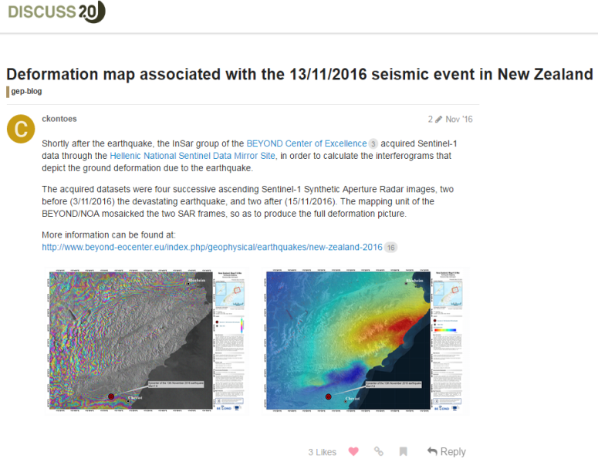
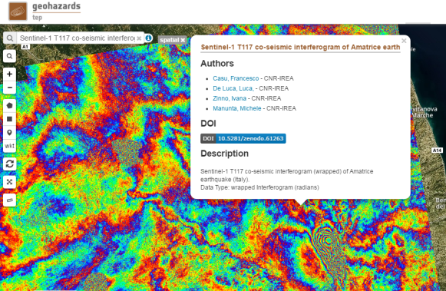
GEP: an innovative response
The Seismic Pilot in collaboration with the GEP (https://geohazards-tep.eo.esa.int) provided:
- EO data storage and delivery in a secured fashion ensuring that different EO sources are available for the CEOS Seismic Hazards team (and Volcano pilot team + GSNL users)
- Hosted processing for seismic hazard assessment: such as in the case of terrain motion monitoring based on InSAR or stereo-optical data
- e-collaboration about promoting pilot results (e.g. sharing pilot results with the community) and community building (Twitter, Blog, etc.).
Sentinel-1 co-seismic interferogram of Amatrice earthquake (Italy) generated by CNR-IREA through the ESA G-POD platform
A number of posts are published on the GEP Blog. In the example: Sentinel-1 deformation maps generated by NOA over Kaikoura.

Slide 32
Observations strategy

Slide 33
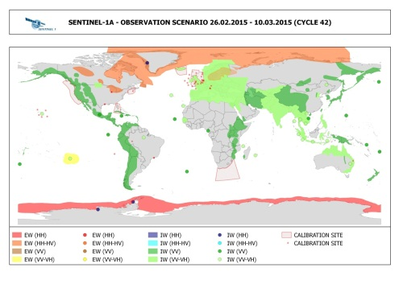
Observations strategy
Continuous exchanges between Seismic Hazards pilot lead and Sentinel-1 mission Project Manager in order to cover the entire tectonic mask. There is a high correlation between the Sentinel-1 acquisitions and target areas of the pilot community.
Study of the examination of the gaps of existing acquisition plans over megacities in areas of high seismic risk: Most sites are at least partially covered by SAR sensor and are:
-sites with high repeat coverage using Sentinel-1 and ALOS-2
-sites with rare coverage using ascending or descending acquisitions from Radarsat-2, TerraSAR X, and COSMO-SkyMed.
https://sites.google.com/a/ingv.it/satellite-monitoring-of-geohazard-prone-megacities---satgeomeg/home

Slide 34
Publications (1)
In total: 23 papers, 2 presentations, 2 posters and 10 web-articles published.
COMET
http://comet.nerc.ac.uk/
http://www.bbc.co.uk/news/science-environment-38323832
Elliott JR; Walters RJ; Wright TJ (2016) The role of space-based observation in understanding and responding to active tectonics and earthquakes, Nature Communications, 7, doi: 10.1038/ncomms13844
Hussain E; Hooper A; Wright TJ; Walters RJ; Bekaert DPS (2016) Interseismic strain accumulation across the central North Anatolian Fault from iteratively unwrapped InSAR measurements, Journal of Geophysical Research: Solid Earth, 121, pp.9000-9019. doi: 10.1002/2016JB013108
Floyd MA; Walters RJ; Elliott JR; Funning GJ; Svarc JL; Murray JR; Hooper AJ; Larsen Y; Marinkovic P; Bürgmann R; Johanson IA; Wright TJ (2016) Spatial variations in fault friction related to lithology from rupture and afterslip of the 2014 South Napa, California earthquake, Geophysical Research Letters, 43, pp.6808-6816. doi: 10.1002/2016GL069428
Hussain E; Wright TJ; Walters RJ; Bekaert D; Hooper A; Houseman GA (2016) Geodetic observations of postseismic creep in the decade after the 1999 Izmit earthquake, Turkey: Implications for a shallow slip deficit, Journal of Geophysical Research: Solid Earth, 121, pp.2980-3001. doi: 10.1002/2015JB012737
Wright TJ (2016) The earthquake deformation cycle, ASTRONOMY & GEOPHYSICS, 57.
Elliott JR; Jolivet R; Gonzalez PJ; Avouac JP; Hollingsworth J; Searle MP; Stevens VL (2016) Himalayan megathrust geometry and relation to topography revealed by the Gorkha earthquake, Nature Geoscience, 9, pp.174-180. doi: 10.1038/ngeo2623
Poster at AGU 2016: LiCSAR: Tools for automated generation of Sentinel-1 frame interferograms, Pablo J. González, Richard J. Walters, Emma Hatton, Karsten Spaans, Alistair McDougall, John Elliott, Andrew J. Hooper, and Tim J. Wright
Hamling, I. J., S. Hreinsdottir, K. Clark, J. R. Elliott, C. Liang, E. Fielding, N. Litchfield, P. Villamor, L. Wallace, T. J. Wright, E. D’Anastasio, S. Bannister, D. Burbidge, P. Denys, P. Gentle, J. Howarth, C. Mueller, N. Palmer, C. Pearson, W. Power, P. Barnes, D. Barrell, R. Van Dissen, R. Langridge, T. Little, A. Nicol, J. Pettinga, J. Rowland & M. Stirling (2017) Complex multifault rupture during the 2016 Mw 7.8 Kaikoura earthquake, New Zealand, Science, 356, 154, doi:10.1126/science.aam7194.

Slide 35
Publications (2)
INGV and CNR-IREA
Gruppo di lavoro IREA-CNR & INGV, 2016. Sequenza sismica di Amatrice: risultati iniziali delle analisi interferometriche satellitari, DOI: 10.5281/zenodo.60935
Gruppo di lavoro IREA-CNR & INGV, 2016. Sequenza sismica di Amatrice: aggiornamento delle analisi interferometriche satellitari e modelli di sorgente, DOI:10.5281/zenodo.61682
Gruppo di lavoro IREA-CNR & INGV, 2016 Sequenza sismica di Amatrice: risultati iniziali delle analisi interferometriche satellitari, DOI: 10.5281/zenodo.60938
Gruppo di lavoro IREA-CNR & INGV, 2016 “Sequenza sismica del Centro Italia 2016-2017: aggiornamento delle analisi InSAR e modello preliminare di sorgente per gli eventi del 18/1/17”, DOI: 10.5281/zenodo.266966
Gruppo di Lavoro INGV sul terremoto in centro Italia, 2016. Rapporto di sintesi sul Terremoto in centro Italia Mw 6.5 del 30 ottobre 2016, doi: 10.5281/zenodo.166019
Gruppo di Lavoro INGV sul Terremoto in centro Italia, 2017. Relazione sullo stato delle conoscenze sulla sequenza sismica in centro Italia 2016-2017 (aggiornamento al 2 febbraio 2017), doi: 10.5281/zenodo.267984
Presentation at AGU 2016 meeting: S. Salvi et al., 2016, Co-seismic deformation fields and source modelling for the 2016 Central Italy events from the inversion of InSAR and GPS data, AGU 2016
Bignami, C., Tomolei, C., Pezzo, G., Guglielmino, F., Atzori, S., Trasatti, E., Antonioli, A., Stramondo, S. and Salvi, S., 2016. Source identification for situational awareness of August 24th 2016 central Italy event. Annals of Geophysics, 59.
Poster at AGU 2016 meeting: Casu, F., et al., “The Mw 6.0 2016 Amatrice (Italy) Earthquake: Source Geometry Inferred from DInSAR Measurements and Geological Data”, S43F-3207 AGU Fall Meeting 2016
Lavecchia, G., R. Castaldo, R. de Nardis, V. De Novellis, F. Ferrarini, S. Pepe, F. Brozzetti, G. Solaro, D. Cirillo, M. Bonano, P. Boncio, F. Casu, C. De Luca, R. Lanari, M. Manunta, M. Manzo, A. Pepe, I. Zinno, and P. Tizzani (2016) “Ground deformation and source geometry of the August 24, 2016 Amatrice earthquake (Central Italy) investigated through analytical and numerical modeling of DInSAR measurements and structural- geological data”, Geophys. Res. Lett., 43, 12,389–12,398, doi: 10.1002/2016GL071723

Slide 36
Publications (3)
NASA JPL
Kargel, J. S., et al. (2016), Geomorphic and geologic controls of geohazards induced by Nepal’s 2015 Gorkha earthquake, Science, 351(6269), 140+online, doi:10.1126/science.aac8353.
Yue, H., et al. (2016, in press), Depth varying rupture properties during the 2015 Mw 7.8 Gorkha (Nepal) earthquake, Tectonophysics, doi:10.1016/j.tecto.2016.07.005.
Presentation at EGU General Assembly 2017: A Bayesian analysis of the 2016 Pedernales (Ecuador) earthquake by Baptiste Gombert et al., Session SM2.1/EMRP4.12 - Earthquake source processes - Imaging methods, numerical modeling and scaling , Abstract identification number EGU2017-12363.
Huang, M.-H., E. J. Fielding, C. Liang, P. Milillo, D. Bekaert, D. Dreger, and J. Salzer (2017), Coseismic deformation and triggered landslides of the 2016 Mw 6.2 Amatrice earthquake in Italy, Geophysical Research Letters, 44(3), 1266-1274, doi:10.1002/2016GL071687.
Liang, C., and E. J. Fielding (2016), Interferometric Processing of {ScanSAR} Data Using Stripmap Processor: New Insights From Coregistration, {IEEE} Trans. Geosci. Remote Sensing, 54(7), 4343--4354, doi:10.1109/TGRS.2016.2539962.
Liang, C., and E. J. Fielding (2017, in press), Measuring Azimuth Deformation With L-Band ALOS-2 ScanSAR Interferometry, IEEE Transactions on Geoscience and Remote Sensing, PP(99), 1-14, doi:10.1109/TGRS.2017.2653186.
Liang, C., and E. J. Fielding (2017, in press), Interferometry With ALOS-2 Full-Aperture ScanSAR Data, IEEE Transactions on Geoscience and Remote Sensing, PP(99), 1-12, doi:10.1109/TGRS.2017.2653190.
NOA
John Peter Merryman Boncori, Ioannis Papoutsis, Giuseppe Pezzo, Cristiano Tolomei, Simone Atzori, Athanassios Ganas, Vassilios Karastathis, Stefano Salvi, Charalampos Kontoes, and A. Antonioli, The February 2014 Cephalonia Earthquake (Greece): 3D Deformation Field and Source Modeling from Multiple SAR Techniques, Seismological Research Letters Volume 86, Number 1 January/February 2015
http://www.beyond-eocenter.eu/index.php/geophysical/earthquakes/new-zealand-2016

Slide 37
Lessons learnt and way forward

Slide 38
Lessons learnt from the pilot (1)
Scope and objectives
A Pilot with clear objectives (concrete community objectives, scientific products, operational context)
Good articulation with Charter & Copernicus EMS: no confusion nor interference with operational disaster response capabilities.
Data order & delivery
Procedure to acquire & deliver post-event sometimes too slow (e.g. Pléiades and TerraSAR-X).
Some data sources made available very late (months) in the project.
Need for integrated management of user requests to obtain accuracy in data accounting.
Data exploitation
Opportunity recognised in VHRO very useful for fault reconnaissance mapping & deformation mapping (Obj. A & C)
Sentinel-1 data boosted the use of SAR data for strain rate maps, at least over areas with considerable ground deformation.
Use of X-band data very useful to measure creep and local strain accumulation across large fault zones (results will be provided by June 2017).
Successful use of SAR data for Obj. C in most cases, however limitations due to lack of pre-event SAR coverage.
Many users hardly provide detailed feedback, hence difficulty in accounting for data used.
Access to hosted processing to simplify EO exploitation
Users don’t have to download large data files (benefit in countries with Internet bandwidth limitations)
Users don’t have to be processing experts (EO chains are automated);
Users can share, compare, reprocess data (persistency of results, back analysis)

Slide 39
Lessons learnt from the pilot (2)
Seismic pilot and end users
The pilot carefully addresses expectations of expert users (partners) and end users.
Work with expert users to adapt geo-information to ensure products are exploited / adopted by end users / decision makers.
Pre-existing relationship between the providers of the scientific information and the local decision-makers is fundamental to ensure the timely uptake of the information during the emergency.
Important to provide local users/decision makers with results generated with a consensus method when there is limited capacity to interpret EO based measurements.
Recommendations about advanced products for earthquake response:
Improving the accuracy of ground deformation measurements requires a multi-sensor InSAR coverage is needed. At least one X-, C- and L- interferogram to be used for each orbit direction
For timeliness and accuracy, several InSAR datasets need to be made available to generate the preliminary source models useful for the initial situational awareness.
Improve source detail: Constrain modeling with ground-based information and invert SAR results with geodetic and seismic data (GPS displacements, strong motion data, broadband seismograms).

Slide 40
Success and way forward
Seismic Hazards pilot successfully addressed seismic hazards by providing:
access to data
access to tools & hosted processing
Primarily focused on EO practitioners from geoscience centres (expert users) and has few end users (e.g. civil protections of Italy and Greece)
Benefit: helped analyze the impact of the events and better elaborate scientific advice to support end users in their decision making process.
High value benefit to geoscience centres and end users: some already expressed the need to continue the activity and expand its objectives, for instance:
strain rate and active fault mapping to be expanded in a global basis,
earthquake response to expand in 10-12 events per year)
Well-set example of collaboration to exploit data & tools; makes it a good basis for a new initiative with broader goals to achieve greater impact.
The partners confirm the relevance and importance of the long-term objectives defined in Santorini and the need to continue to address them through a consolidation activity to be started in end 2017.
In dialogue with the partners we defined new targets for a follow on activity.

Slide 41
Proposed follow-on: a Seismic Hazards
Consolidation activity
A follow-on activity is proposed and is based on the objectives from the Santorini report with new and theme-specific targets:
Not on an emergency basis
Pursue global strain rate mapping that is a long process
Expand active fault mapping from regional to global coverage primarily with VHRO for fault reconnaissance mapping
Pursue support to GSNL
Develop a collaborative framework with geoscience centres to achieve adoption of technology by decision makers, establish a consensus methodology for product generation and reach decision makers
On an emergency basis
Exploit EO data to derive advanced tectonic products for earthquake response: expand to target of at least 10-12 EQ per year
Articulate with EO disaster response capabilities e.g. the Charter to make sure users are aware of and use it.

Slide 42
Mapping of targets against Santorini objectives:
The 7 concrete targets defined are addressing the 3 high level objectives formulated in the Santorini report:
Santorini objective | Concrete Target of the Consolidation activity
A | Global strain rate mapping that is a long process
A | Active fault mapping from regional to global coverage primarily with VHRO for fault reconnaissance mapping
B | Pursue support to GSNL
Other | Develop a collaborative framework with geoscience centres
C | Advanced tectonic products for earthquake response: expand to target of at least 10-12 EQ per year
C | Articulate with EO disaster response capabilities e.g. the Charter to make sure users are aware of and use it.

Slide 43
Intended benefits to users
It is needed to better address the different segments of the user base:
Academia: able to access data for scientific research.
Expert users from geoscience centers (e.g. those from the Seismic pilot activity): will be able to:
access EO data that many wouldn’t afford to procure
provide accurate information to support end users
Geoscience centers doing research or operations (e.g. with a mandate to provide technical advice to national Disaster Response authorities) will retrieve advanced science products from expert users (B) to analyse the events and the impact and better support the decision making process.
Decision makers (e.g. Civil Protection agencies) that typically would receive results (e.g. scientific advice & reports) from the CEOS activity without necessarily being formally engaged.

Slide 44
Proposed follow-on: a Seismic Hazards
Consolidation activity
Why pursuing the activity about seismic hazards?
This is not to repeat the Pilot activity
Expand coverage (larger AOI’s, response to a higher number of events)
Apply new approaches (more cost effective solutions, define norms to achieve consensus in product generation, etc.)
Aiming to expand the user base to achieve more impact:
Continue working with the Pilot team
Take on board new EO practitioners with strong links to End users
Take on board and develop the capacity (train) other non-expert users from geoscience centres willing to collaborate and with strong links with End users.
Reach End users through geoscience centres.

Slide 45
Proposed follow-on: Contributions
Pilot leads have started gathering contributions from space agencies:
ESA
ASI
DLR
CNES
Partners from the community (8 geoscience centres so far):
COMET /UK
CNR-IREA /Italy
INGV /Italy
ISTerre/Institut de Recherche pour le Développement (IRD) /France
National Observatory of Athens (NOA) /Athens
Harokopeion University of Athens (HUA) / Greece
CEO-YachayTech / Ecuador
CNRS IPGP /France
(new partners)

Slide 46
Proposed follow-on: Data volumes expected by the user community
Agency | ASI Cosmo-SkyMed | CNES Pleiades | CSA RADARSAT | DLR TerraSAR-X | ESA Sentinel-1 & 2 | JAXA ALOS-2
Number of Images per year for Seismic Hazards | 200-400 | 50-100 | 50-100 | 60-120 | open | 60-120
Other EO data collections (SAR and Optical including VHRO) to be exploited with processing without download (EO data are accessed by the processing environment but the user can only download the value adding product).

Slide 47
Conclusion
The Pilot activity is closing
Formal closure End November
No additional data requests expected in this framework
Some VA results still pending, will be integrated in the Final Report (intended early Q4 2017)
A new Seismic Hazard Consolidation activity is proposed
A Draft was circulated on 30 August (Proposition_Seismic_Hazards_Consolidation_Phase)
Awaiting approval with the aim to kick off in End 2017.

Slide 48
Thank you!

