Slide 1

CEOS Disaster Risk Management Flood Pilot Final Report
Presented at the CEOS Disasters Working Group Meeting #8 in Buenos Aires, Argentina
Co-Lead Stu Frye (stuart.frye@nasa.gov)
Co-Lead Bob Kuligowski (bob.kuligowski@noaa.gov)
NASA DisWG Rep David Green (david.s.green@nasa.gov)
4-6 September 2017

Slide 2
Outline
Flood Pilot overview
Pilot Objectives and Outcomes
  Objective A: Global component
  Objective B: Regional component
    Caribbean/Central America
    Southern Africa
    Southeast Asia
  Objective C: Capacity Building
Final Data Tracking
Success Stories
Way Forward

Slide 3
CEOS DRM Flood Pilot Overview
Goal: demonstrate effective application of Earth Observation (EO) to the full cycle of flood management at all scales by:
  Objective A: Integrating information from existing Near Real Time (NRT) global flood monitoring / modeling systems into a Global Flood Dashboard;
  Objective B: Delivering EO-based flood mitigation, warning, and response products and services through regional end-to-end pilots in:
    Caribbean/Central America (focus on Haiti)
    Southern Africa (inc. Namibia, South Africa, Zambia, Zimbabwe, Mozambique, and Malawi);
    Southeast Asia (focus on lower Mekong Basin and Java)
  Objective C: Encouraging at least base-level in-country capacity to access EO and integrate it into their operational systems and flood management practices
3

Slide 4
How Data Are Being Exploited
Geographic Area | Product | Value Added Partner
Global | Flood extent maps and flood forecasts | Dartmouth Flood Observatory, University of Maryland
Haiti | Flood extent maps, flood risk maps, landslide maps, flash flood guidance / threat maps, integrated risk assessment platform | SERTIT, CIMA, INGV, Altamira, CIMH, RASOR FP7, NOAA/HRC
Other Caribbean islands, Central America | Flood damage maps, change detection products, co-registered map overlays | CATHALAC, CIMH, NASA/GSFC, RCCP (Costa Rica)
Namibia | Flood extent maps, flood warning products, co-registered map overlays | Namibia Hydrology Dept, Namibian Water Authority, NASA
Zambezi basin | Flood extent maps, flood forecast models, flood hazard maps, flood depth forecasts | Lippmann Institute (HAZARD, WATCHFUL), Deltares, RSS
Mekong | Flood extent maps, flood risk maps, flash flood guidance / threat maps | Mekong River Commission, ADPC, NASA, NOAA, HRC, USGS, Univ. of South Carolina, Texas A&M , IMWI
Java (Bandung, Jakarta, Cilacap) | Flood risk maps, subsidence maps tied to flood risk, tsunami risk maps (Cilacap only), flood extent maps | SERTIT, Deltares, CIMA, Altamira, INGV, RASOR FP7,
Products used by: national end users, civil protection agencies, World Bank, Red Cross, World Food Program, River Commissions (Kavango, Zambezi, Mekong)
4

Slide 5
Outline
Flood Pilot overview
Pilot Objectives and Outcomes
  Objective A: Global component
  Objective B: Regional component
    Caribbean/Central America
    Southern Africa
    Southeast Asia
  Objective C: Capacity Building
Final Data Tracking
Success Stories
Way Forward

Slide 6
Objective A: Global Component Milestones
Implement a Global Flood Dashboard website with linkages to major global projects and systems and archive flood products
Setup functional linkages between Global Flood Dashboard and the three regional flood component areas; indication of regions of interest based on reports of flooding; showcase at World Conference on Disaster Risk Reduction (WCDRR)
Draft a plan for longer-term sustainability; provide functional linkages to additional user-selected polygons of interest beyond the three regional Pilot areas
  Ongoing—Developed and demonstrated basic framework for dashboard but unable to identify a host. Two proposals submitted to NASA ROSES-Group on Earth Observations (GEO) grant call to support hosting at NASA; also will leverage Small Business Innovative Research (SBIR) award to Remote Sensing Solutions (RSS) and Dartmouth Flood Observatory to develop a “one-stop-shop” for global flood disaster response assistance

Slide 7
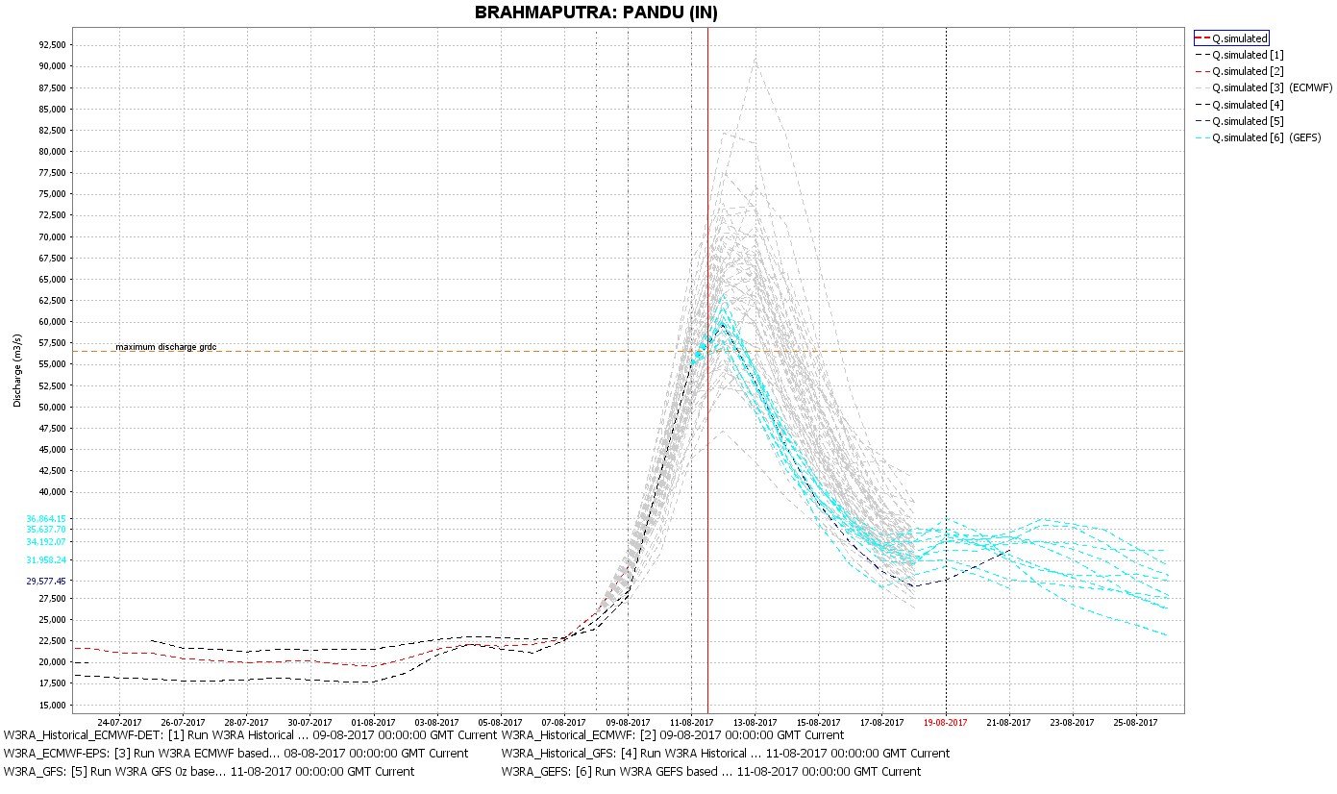
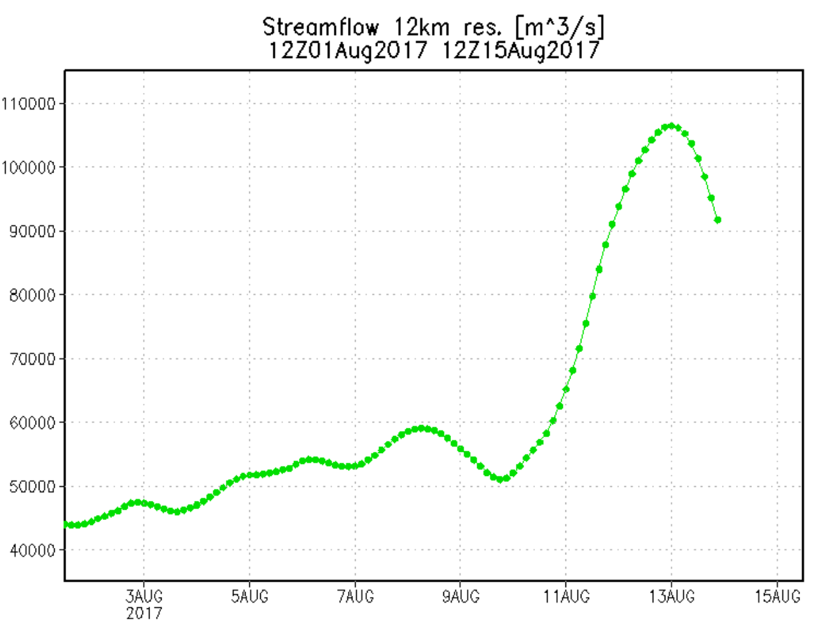
Objective A: Other Global Component Outcomes
Forecasts for flood events are routinely available via Deltares and the Global Flood Mapping System, among others:
Discharge forecasts for the Bramaputra River in Pandu, India from Deltares’ Global Forecast System (left) and the Global Flood Monitoring System (right)

Slide 8
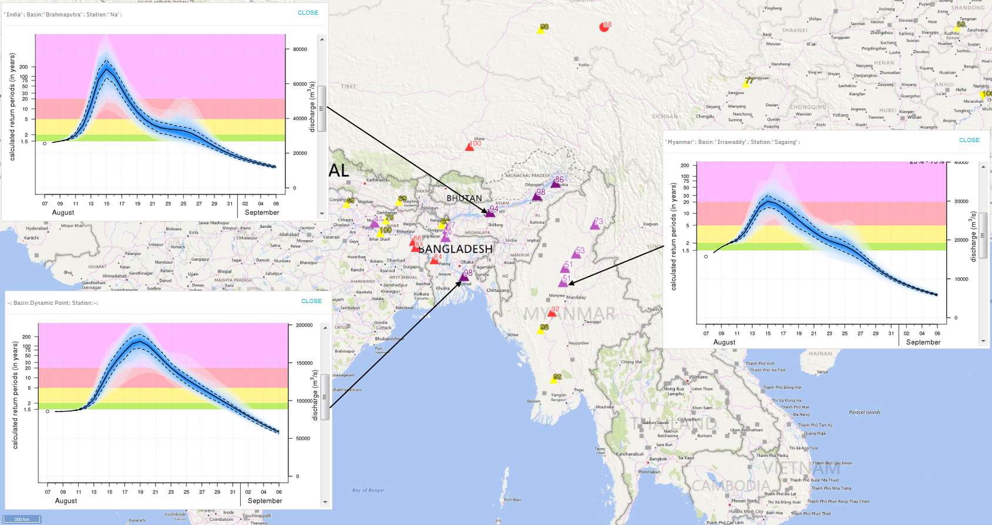
Objective A: Other Global Component Outcomes
Routine flood forecasts for flood events are also available via the Global Flood Project:
“Because of the good river forecasts, the Bangladesh Red Crescent was able to distribute cash to several vulnerable communities before the peak flooding, in a pilot of our Forecast-based Financing system.”
--Erin Coughlan de Perez, Red Cross Red Crescent Climate Centre

Slide 9
Objective B: Caribbean/Central American Component 2014 Milestones
Flood dashboard based on Namibia pilot adapted to Caribbean and Central American users: Completed
  Open GeoSocial Application Programmer Interface (API) for publishing / visualizing flood modeling and monitoring products installed March 2016 at DAI in Costa Rica: http://centroclima.org/powered-by-nasa/
Flood monitoring (i.e., targeted EO data acquisitions): Completed
  Images provided for floods in Guatemala, Panama, Trinidad, Haiti, and Belize
Contributions of data to KAL Haiti data base: Completed

Slide 10
Objective B: Caribbean/Central American Component 2015 Milestones
Flood monitoring during 2015 season: Completed
  Images provided for floods in in Panama, Dominica, and Bahamas
RASOR risk management platform operational for flood risk and landslide risk analysis in Haiti: Completed
  Subsidence mapping completed; proposal submitted to extend and deepen this work through the Global Facility for Disaster Reduction and Recovery (GFDRR) in collaboration with the Haitian government.
10-year flood archive based on Deltares Flood Monitoring Programme: Deltares did not receive funding (same applies to the corresponding milestones in the other two Pilot regions).

Slide 11
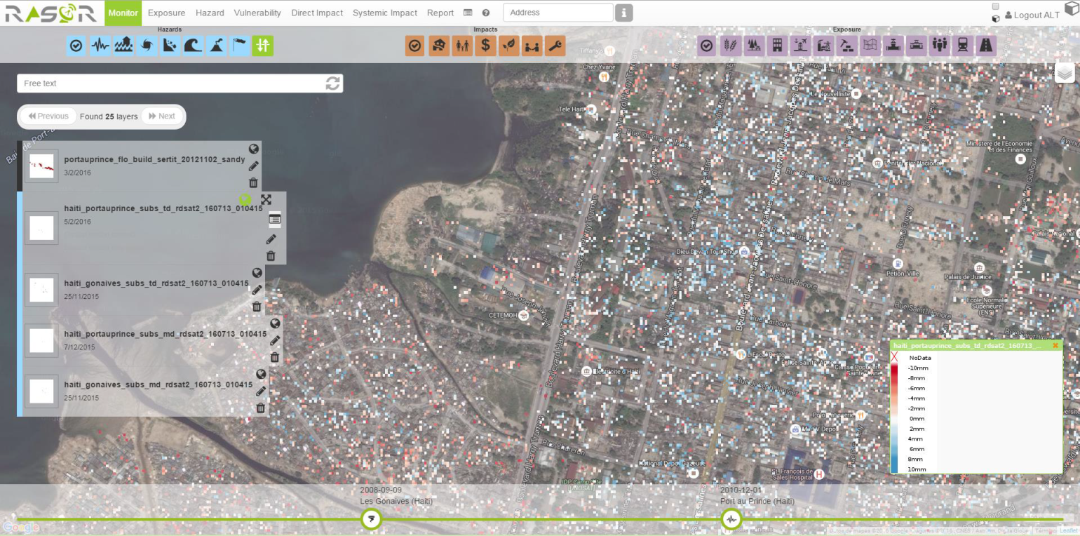
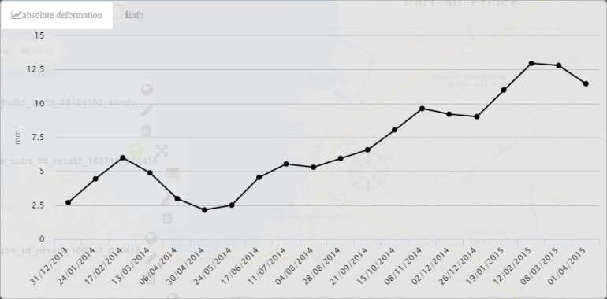
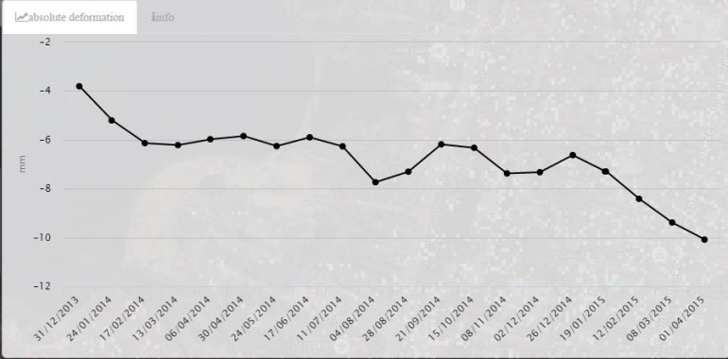
RASOR Flood Risk Mapping in Haiti
Map of Port-au-Prince with elevation changes determined by RASOR team (red=decrease; blue=increase) based on ~1 year of RADARSAT-2 images. This can in turn be related to changes in flood risk. (Credit: F. Kuodogbo, Altamira)

Slide 12
Objective B: Caribbean/Central American Component 2016-17 Milestones
Flood monitoring during 2016 season: Completed
  Images provided for floods in Mexico, Hispaniola, Panama, and Costa Rica
Draft a plan for longer-term sustainability: Ongoing
  Intend to transfer much of this work to AmeriGEOSS and GEO-DARMA but details remain to be worked out

Slide 13
Outline
Flood Pilot overview
Pilot Objectives and Outcomes
  Objective A: Global component
  Objective B: Regional component
    Caribbean/Central America
    Southern Africa
    Southeast Asia
  Objective C: Capacity Building
Final Data Tracking
Success Stories
Way Forward

Slide 14
Objective B: Southern Africa Component Milestones
Flood monitoring: Completed
  2014 acquisitions from NASA and Canadian Space Agency (CSA) under previous agreement within GEO task; images provided for 2015 floods in Namibia and Malawi and 2016 floods in Madagascar under CEOS pilot
Updates to flood dashboard: Completed
  http://matsu-namibiaflood.opensciencedatacloud.org/
Draft a plan for longer-term sustainability: Ongoing
  Intent is to transition much of this work into AfriGEOSS and GEO-DARMA but details need to be worked out.

Slide 15
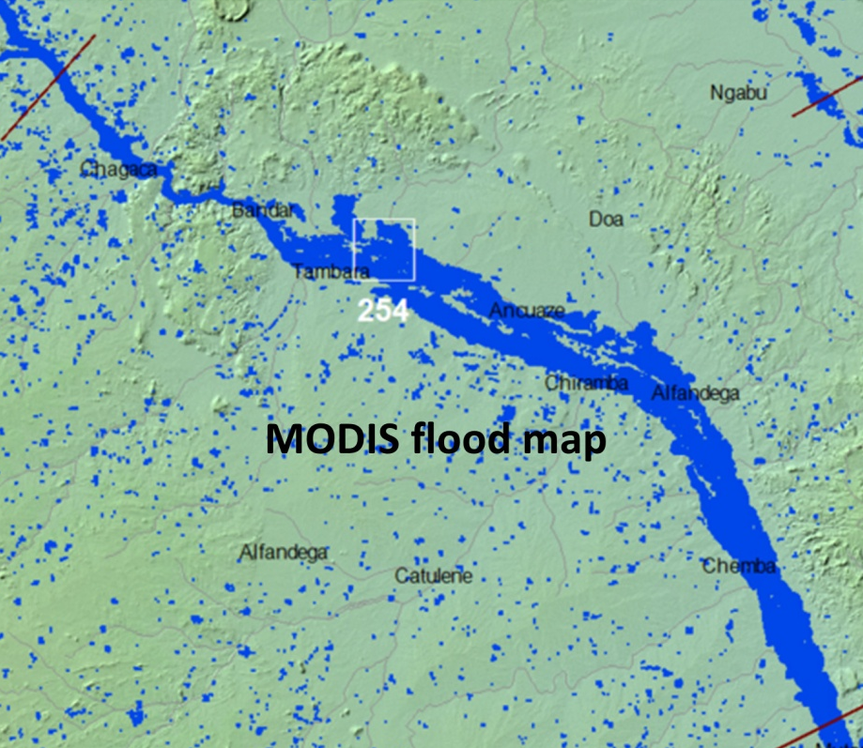
Objective B: Other Southern Africa Component Outcomes
Guy Schumnann (RSS) used more realistic and complete stream networks derived from Landsat-8 (provided by the Pilot) in a flood model, leading to more realistic forecasts
Pink outline: Simulation based on HydroSHEDS stream network & river widths.
Blue area: Simulation based on Landsat-derived stream networks & river widths.

Slide 16
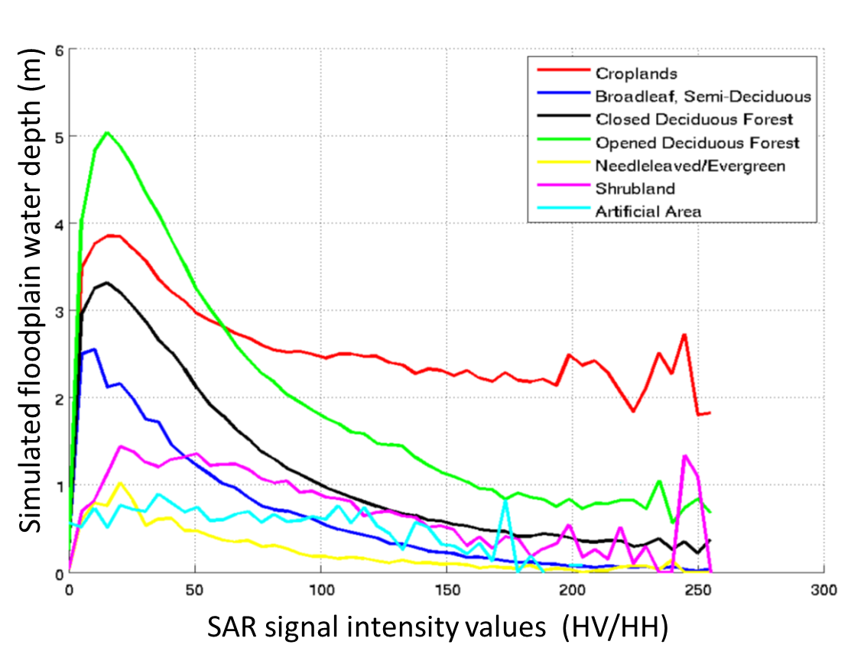
Objective B: Other Southern Africa Component Outcomes
Guy Schumnann (RSS) is also using EO data to validate flood model forecasts of extent (MODIS) and depth (PALSAR)

Slide 17
Objective B: Other Southern Africa Component Outcomes
Guy Schumann (RSS) used a flood modeling study of the Lower Zambezi to define areas for high-resolution LiDAR acquisitions over the floodplains to construct higher-resolution Digital Elevation Models (DEMs) for flood modeling / forecasting.
  Terms of access still being worked out with the World Bank

Slide 18
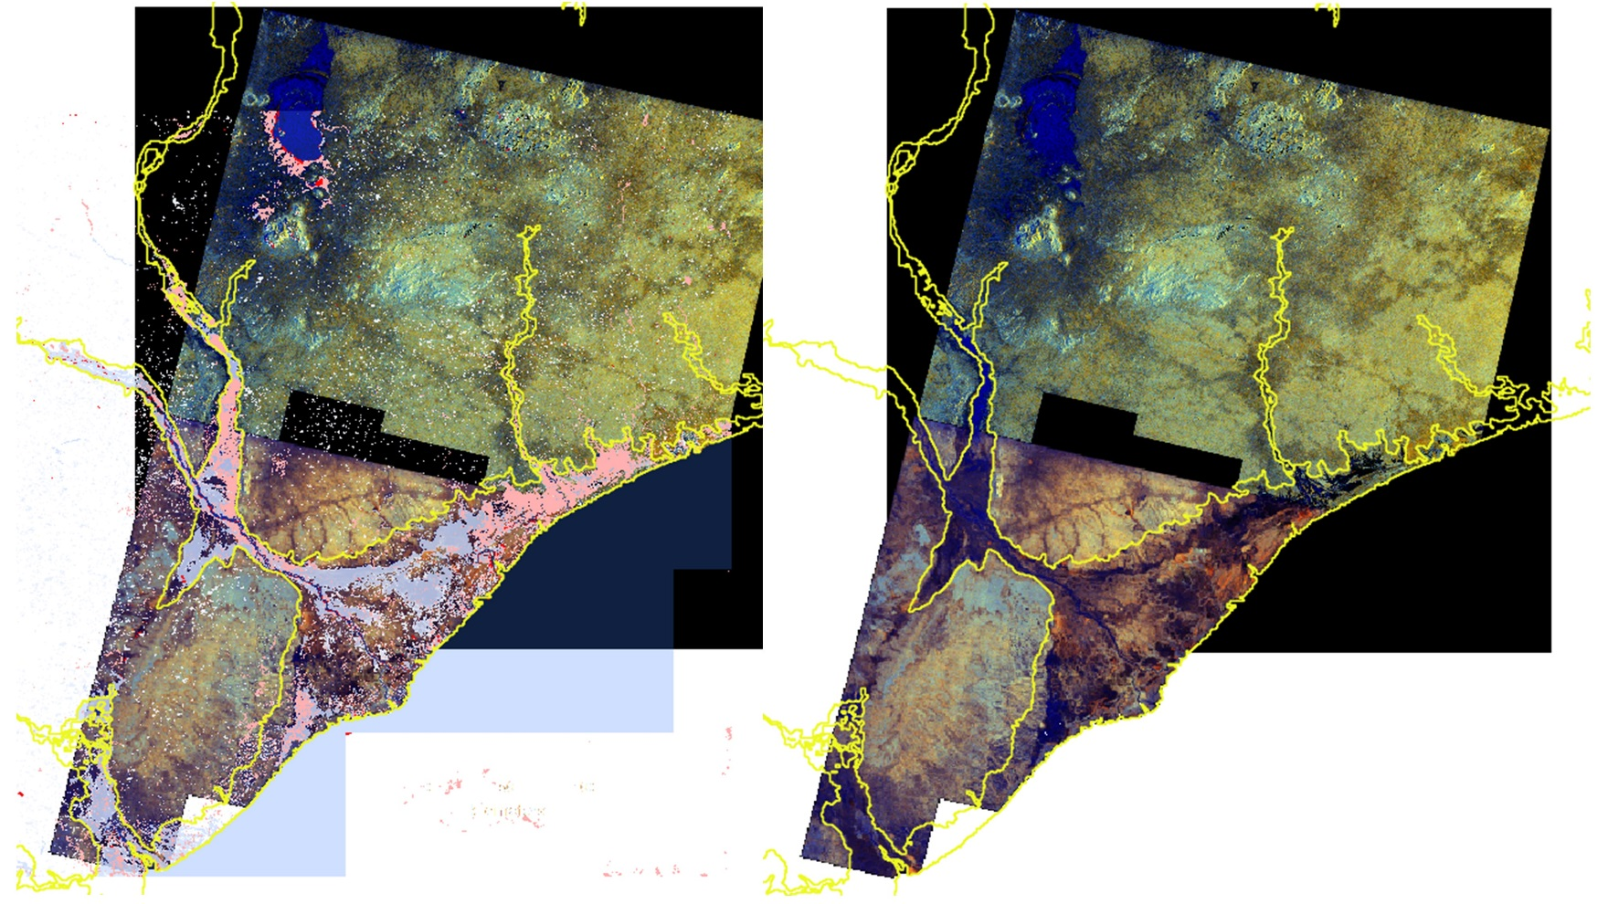
Objective B: Other Southern Africa Component Outcomes
Guy Schumann (RSS) developed tools for displaying current flood maps in the context of historic (simulated) floods:
2015 Malawi Flood
MODIS
PALSAR
Blue shades indicate land cover type and flood depth
Modeled historic maximum (yellow)
Flood extent (pink)

Slide 19
Objective B: Other Southern Africa Component Outcomes
Hong / Flaming (U. of Oklahoma / NOAA) installed Ensemble Framework for Flash Flood Forecasting (EF5) model at the Regional Centre for Mapping of Resources for Development (RCMRD) in Kenya.
This model produces real-time products on RCRMD’s Amazon cloud that are distributed through the Open GeoSocial API under RCRMD control.
Additional advanced training is planned in Kenya in November 2017 and then in individual member states afterward.

Slide 20
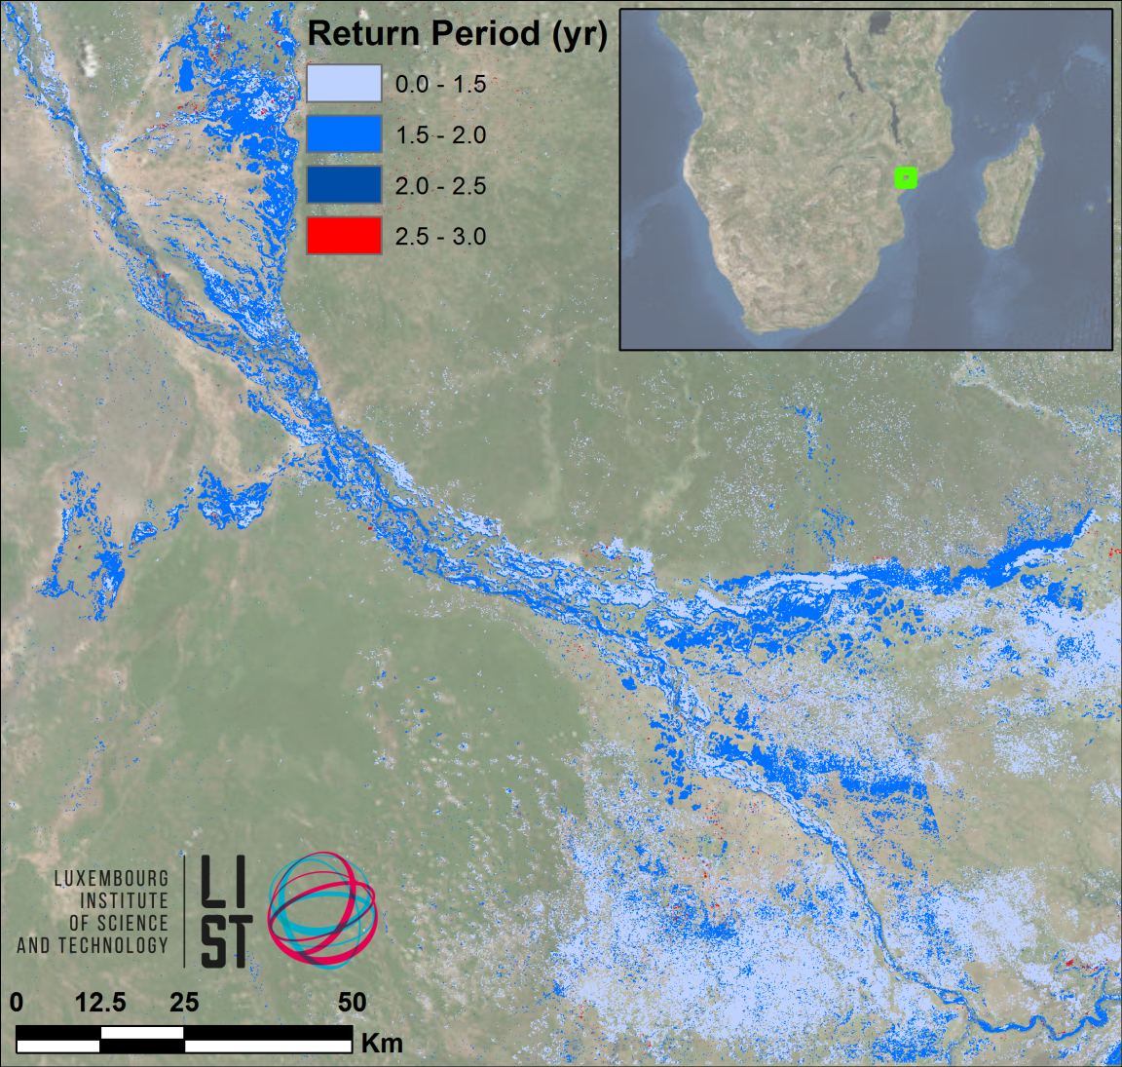
Objective B: Other Southern Africa Component Outcomes
LIST flood hazard maps determine flood severity by comparing flood extent in a SAR image with computed extent / return period from simulated historic floods
The UN World Food Programme has shown interest

Slide 21
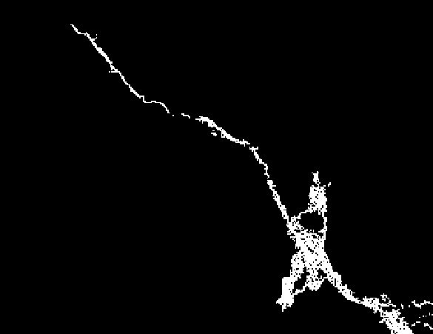
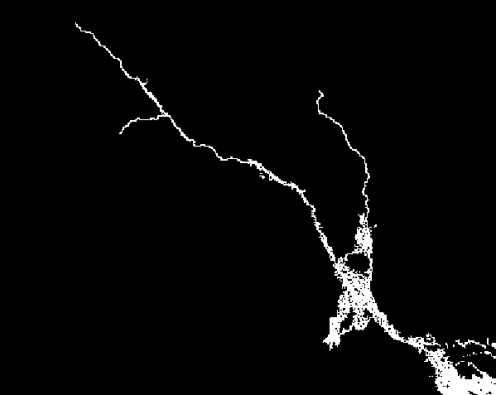
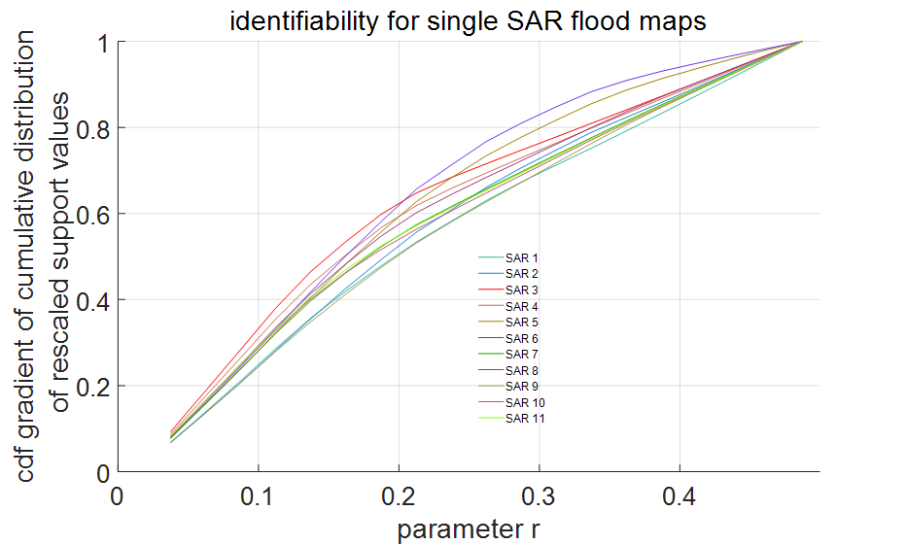
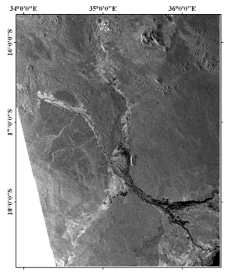
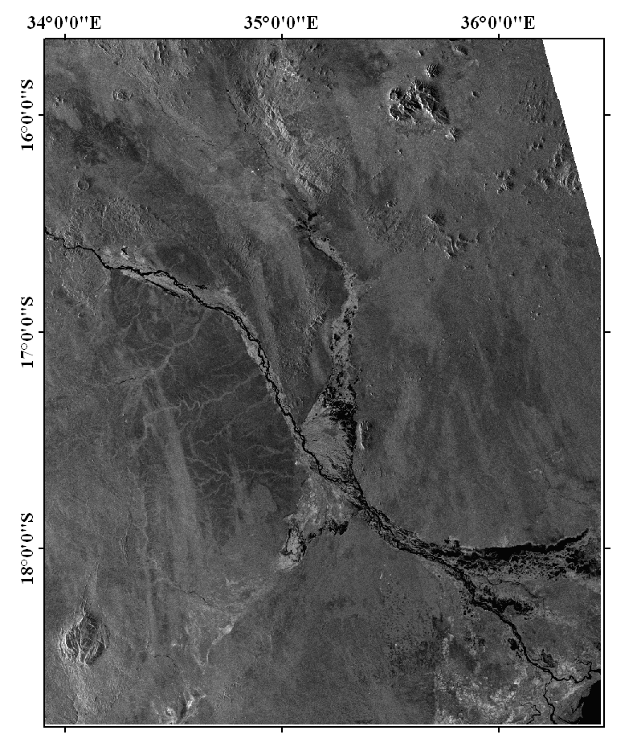
Objective B: Other Southern Africa Component Outcomes
Matgen et al. (LIST) developed an automated framework using satellite-derived flood extent maps to evaluate flood model forecasts (and adjust flood model parameters) in the Zambezi basin using satellite-derived flood extent maps
5 Feb 2008
8 Feb 2008
“Identifiability” to evaluate matches
LISFLOOD model forecasts
ENVISAT ASAR flood maps
Notes:
BK: Any updates here or should I reach out to Patrick?

Slide 22
Outline
Flood Pilot overview
Pilot Objectives and Outcomes
  Objective A: Global component
  Objective B: Regional component
    Caribbean/Central America
    Southern Africa
    Southeast Asia
  Objective C: Capacity Building
Final Data Tracking
Success Stories
Way Forward

Slide 23
Objective B: SE Asia Component 2014 Milestones
User consultations on new pilot products: Completed
  Open GeoSocial API flood forecasting and event mapping software installed at ICIMOD in 2015
Test TRMM/GPM-based Global Flood Monitoring System (GFMS) 1km resolution flood modeling product over the Lower Mekong Basin (contingent on river gauge data being obtained): Incomplete
  Unable to obtain gauge data for this application.
Flood Dashboard development based on Namibia pilot example adapted to SE Asia users: Incomplete
  http://matsu-seasia.opensciencedatacloud.org/ is not being updated due to lack of funding support
Notes:
BK

Slide 24
Objective B: SE Asia Component 2015 Milestones
Operational test bed for RASOR risk management system for test sites in Java: Completed
  Flood risk maps based on SAR-estimated subsidence rates completed.
  More accurate maps of urban landscape for damage potential assessment generated from Pleiades data.
  Recently obtained World Bank funding to highlight how EO can be used with flood models to improve loss estimates and DRR planning in Myanmar and SE Asia.
  See next slide for example
Integration of flood dashboard: Incomplete
  http://matsu-seasia.opensciencedatacloud.org/ not being updated due to lack of funding

Slide 25
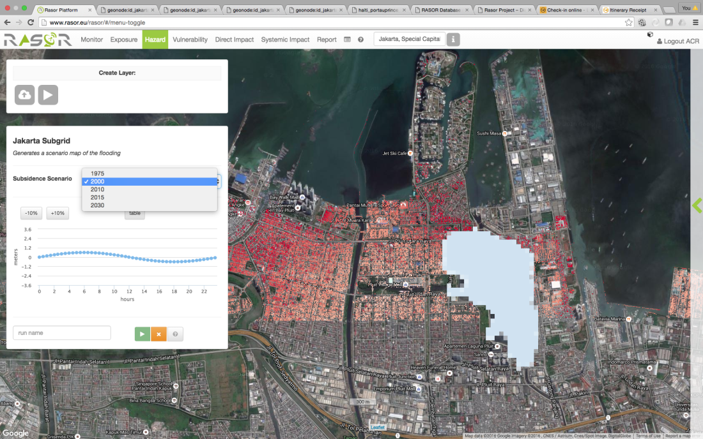
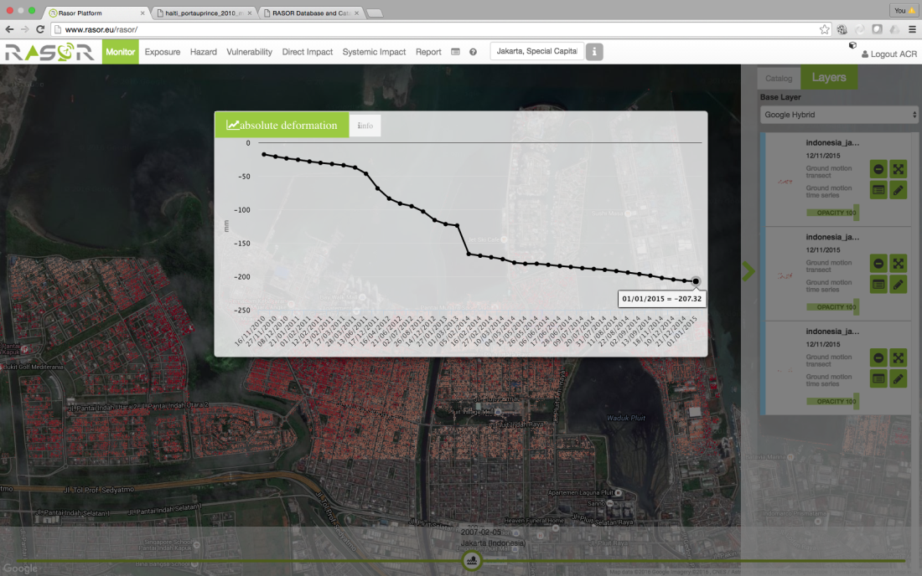
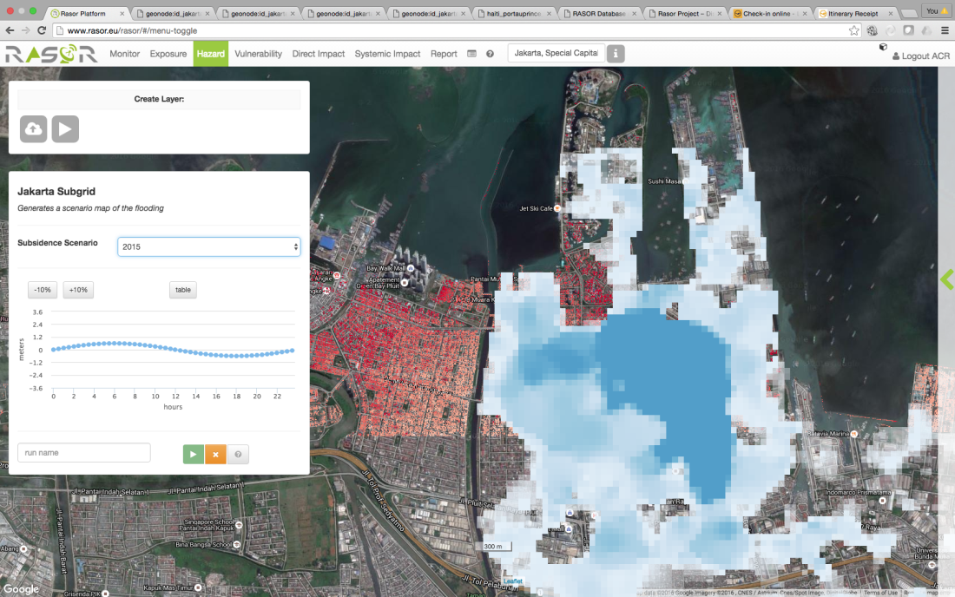
RASOR Subsidence / Risk Work in Java
Coverage area of the same (hypothetical) flood in 2000 (top right) and 2015 (bottom right) showing the impacts of subsidence.
Point subsidence in Bandung, 2010-2015 from ALOS (2007-11) and CSK (2013-15).

Slide 26
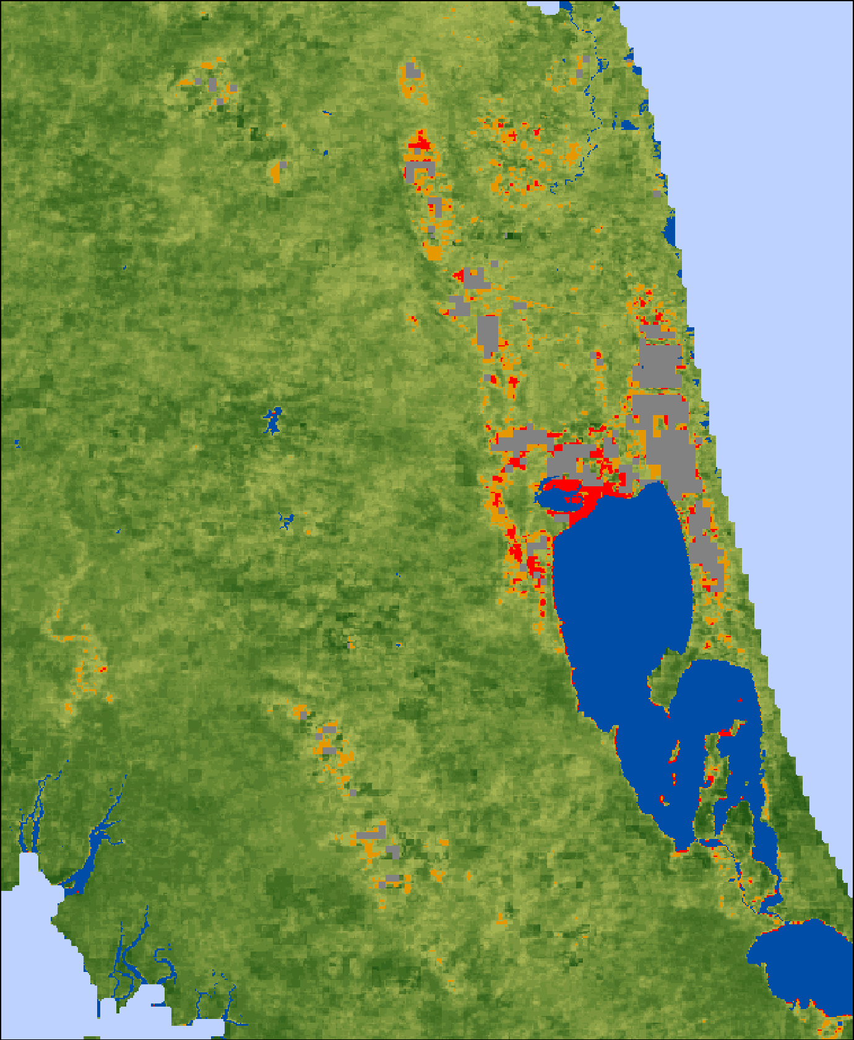
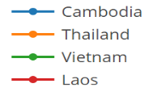
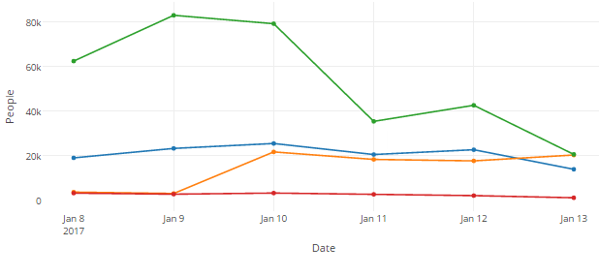
Objective B: SE Asia Component 2015 Milestones (continued)
Initial services for Mekong River Commission: Completed
  SERVIR-funded flood inundation system installed at ADPC in January 2017 at http://projectmekongnasa.appspot.com/
Southern Thailand Flooding as of 1/13/17
Population Exposed to Flooding (as of 1/13/17)

Slide 27
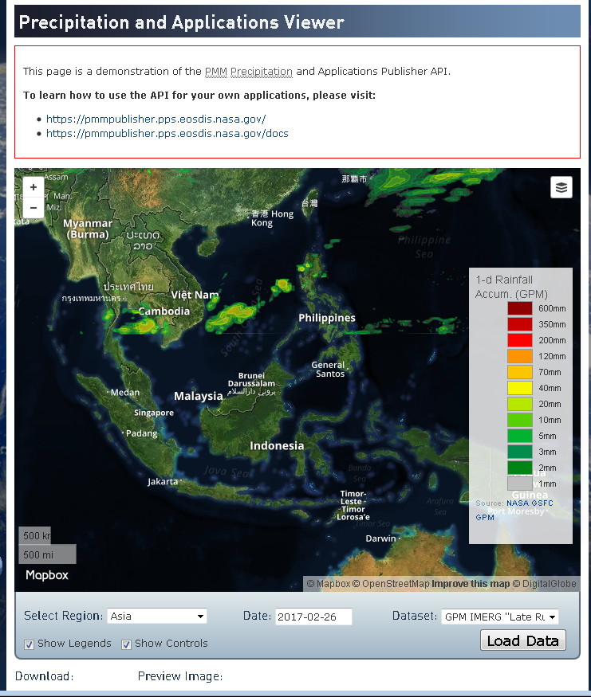
Objective B: SE Asia Component 2015 Milestones (continued)
1st new TRMM/GPM and other flood monitoring products: Completed
  iMERG rainfall and GFMS flood products served under Open GeoSocial API at https://pmm.nasa.gov/precip-apps

Slide 28
Objective B: SE Asia Component 2016-17 Milestones
Flood monitoring during 2016 season: Completed
  Provided optical imagery for flooding in Sri Lanka and Myanmar, and Indonesia.
Draft a plan for longer-term sustainability: Ongoing
  Intent is to build this capacity into Asia Disaster Preparedness Center (ADPC) via the SERVIR Applied Science Grant in cooperation with GEO-DARMA but details need to be worked out

Slide 29
Outline
Flood Pilot overview
Pilot Objectives and Outcomes
  Objective A: Global component
  Objective B: Regional component
    Caribbean/Central America
    Southern Africa
    Southeast Asia
  Objective C: Capacity Building
Final Data Tracking
Success Stories
Way Forward

Slide 30
Objective C: Capacity Building in Caribbean / Central America
2015: Trained forecasters and end users on how to run the Ensemble Framework for Flash Flood Forecasting (EF5) model
2017: Implemented previously mentioned Open GeoSocial API Flood Monitoring software suite in Costa Rica
  Working through AmeriGEOSS to extend this capability to other portions of the Americas (Chile, Colombia, Peru, Brazil, Ecuador, and Mexico)

Slide 31
Objective C: Capacity Building in Southern Africa
2015: Open GeoSocial API training for RCMRD
2015: SANSA hosted on-site training and capacity development for flood modeling using the newly-released SRTM-2 DEM
2015: Trained forecasters and end users in Namibia on how to run the Ensemble Framework for Flash Flood Forecasting (EF5)
2016: TIGER workshop in Addis Abbaba on EO for water resources management
2017: Worked with Namibia Department of Hydrology to monitor the status of small farming ponds using Radarsat-2 and EO-1 data

Slide 32
Objective C: Capacity Building in SE Asia
2015: Installation and training for Open GeoSocial API with ICIMOD in Kathmandu; in-country image processing capability used during earthquake aftermath to monitor stability of mountain lakes created by landslide dams
2016: ADPC began internally producing Normalized Differential Vegetative Index (NDVI) differences in the Mekong as a new flood product
2016: Demonstrated the Open GeoSocial API interface on the ojo-streamer client to ADPC, the Sri Lanka head disaster manager, and the Pacific Disaster Center.
Notes:
BK: Any updates on capacity building in SE Asia?

Slide 33
Outline
Flood Pilot overview
Pilot Objectives and Outcomes
  Objective A: Global component
  Objective B: Regional component
    Caribbean/Central America
    Southern Africa
    Southeast Asia
  Objective C: Capacity Building
Final Data Tracking
Success Stories
Way Forward

Slide 34
Final Data Table
Mission / Instrument | Repeat or Revisit | Swath Width | Spatial Resolution | Agency | Image Counts
 |  |  |  |  | Annual Quota | Since 3/2017 WGDisasters Meeting | Cumulative Total
Optical - Coarse Resolution (>100 m)
Terra / MODIS | 1 day | 2230 km | 250, 500, 1000 m | NASA
Aqua / MODIS | 1 day | 2230 km | 250, 500, 1000 m | NASA
NPP / VIIRS | 1 day | 3000 km | 375, 750 m | NASA
Optical - Moderate Resolution (10 to 100 m)
Sentinel-2A / MSI | 10 days | 290 km | 10, 20, 60 m | ESA |  | 0 | 0
EO-1 / ALI | 204 days | 185 km | 10, 30 m | NASA | 300 | 48 | 129
Landsat-8 / OLI | 16 days | 185 km | 15, 30 m | USGS |  | 39 | 117
Optical - High Resolution (<10 m)
SPOT (archive only) | 26 days | 60 km | 1.5 and 6 m | CNES |  | 0 | 0
Pleiades | 26 days | 20 km | 50 cm and 2 m | CNES | 50 | 0 | 10-12*
L-Band SAR
ALOS-2 / PALSAR-2 | 14 days | 25 to 350 km | 10 to 100 m | JAXA | 100 | 16 | 63
C-Band SAR
Sentinel-1A / SAR | 12 days | 80, 250, 400 km | 9, 20, 50 m | ESA |  | 12 | 64
Sentinel-1B / SAR | 12 days | 80, 250, 400 km | 9, 20, 50 m | ESA |  | 0 | 0
Radarsat-2 / SAR-C | 1-6 days | 50 to 500 km | 8 to 100 m | CSA | 500 (3 yr) | 21 | 144
X-Band SAR
Cosmo Sky-Med / SAR-2000 | 5 days | 10 to 200 km | 1 to 100 m | ASI | 300 | 37 | 144
34
*includes a set of 4 stripes over Jakarta corresponding to 7-9 individual images

Slide 35
Outline
Flood Pilot overview
Pilot Objectives and Outcomes
  Objective A: Global component
  Objective B: Regional component
    Caribbean/Central America
    Southern Africa
    Southeast Asia
  Objective C: Capacity Building
Final Data Tracking
Success Stories
Way Forward

Slide 36
Success Stories: New Distribution Interfaces
The development of standard interfaces for distributing products in compact vector map layer format via the Open GeoSocial API represented a significant step forward:
  Provides a flexible framework that allows local data providers to publish their own products instead of relying on a central “node”
  Vector map techniques greatly reduce the required system bandwidth and storage
  Interfaces have already been implemented at RCCP (Costa Rica) and RCRMD (Kenya)
  “This [GFMS flood products for Louisiana in May 2016 converted to GIS layers and submitted via an ojo-streamer client] is absolutely the direction we want to head [API based].” (C. Vaughan, FEMA)

Slide 37
Success Stories: Increased EO Data Usage
Access to previously unavailable data from CEOS agencies (particularly SAR) and the products from them has improved the flood disaster response cycle in all regions
  Some users have developed local capacity to generate products locally from these sources, including RCRMD (Kenya), RCCP, CIMH (Barbados—see next slide), the World Food Programme, and the Inter-American Development Bank

Slide 38
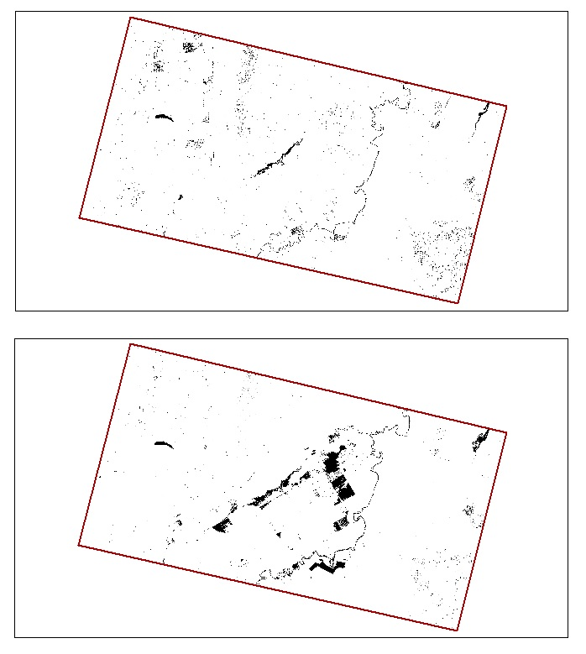
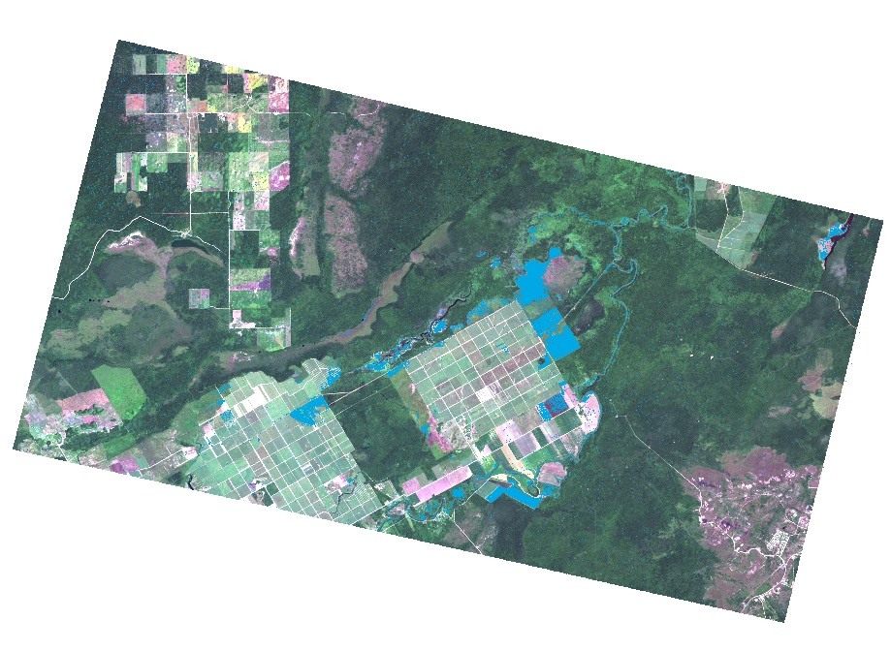
Success Stories: Local SAR Analysis at CIMH
CIMH flood analysis in Belize based on SAR reflectivity changes
Plans to use Flood Pilot-supplied imagery to study additional cases in Belize, Haiti, Dominica, and Saint Vincent and the Grenadines
Flood extent map (flooding in blue)
Pre-event surface water
Post-event surface water

Slide 39
Success Stories: In the Words of the Namibian Department of Water Affairs Hydrology Division
We (the Namibia Department of Water Affairs, Hydrology Division) see our success as the openings we made with all the assistance offered and given by our CEOS partners. Some components are:
The use of optical and radar images for flood mapping including access to the International Disaster Charter data
The tremendous access to satellite images and the actual use of these images by our staff
The customized rainfall estimates and flood forecast from models
The remote sensing flood extent estimates (Dartmouth Flood Observatory/European Commission Joint Research Centre)
How this all augments the conventional hydrological approach which is based on time series in points
And last but not least the capacity building and access to new techniques for our young professionals

Slide 40
Success Stories: 2015 Texas Floods
Though not a formal Flood Pilot region, provided EO data and high-resolution GFMS forecasts to numerous users during Texas floods in May-June 2015:
  FEMA, US Forest Service, EPA, Texas Water Development Board and Texas Commission on Water Quality, plus briefings by UT-Austin personnel to Texas Emergency Operations Center and Governor’s Emergency Management Council
Feedback from Theresa Howard and Gordon Wells (UT-Austin):
  “The imagery offered a detailed view of inundation impacting agriculture in rural areas, which is information that can be difficult to obtain from other sources. The imagery also helps to fill in the coverage gaps between stream gages that are monitored for current and forecast conditions.”
  Helpful even for gauged streams because “The greatest impacts do not necessarily coincide with the locations of the highest measured flood crests, but occur at sites that contain vulnerable features.”

Slide 41
Outline
Flood Pilot overview
Pilot Objectives and Outcomes
  Objective A: Global component
  Objective B: Regional component
    Caribbean/Central America
    Southern Africa
    Southeast Asia
  Objective C: Capacity Building
Final Data Tracking
Success Stories
Way Forward

Slide 42
Associated Projects Continuing Independently after Pilot Period
Lower Mekong River Basin Project (NASA GSFC/SERVIR)
Dartmouth Flood Observatory (Univ. Of Colorado)
NASA near-real-time (NRT) Global Moderate resolution Imaging Spectro-radiometer (MODIS) Flood Mapping
Global Flood Monitoring System (U. of Maryland)
Global Flash Flood Guidance (HRC)
Open GeoSocial API implementations at RCMRD and RCCP
JRC GDACS

Slide 43
General Steps Forward
Making retrospective data from normal (non-flood) scenes at the same look angles as the scenes from a flood event are essential for fully exploiting EO data in flood mapping (e.g., the ESA / Copernicus Sentinel system)
Progress toward common licensing and / or open access for humanitarian applications would greatly benefit users who lack the means to purchase data
Additional progress toward standardized and open interfaces, data formats, and data distribution methods would reduce the difficulty and delay in distributing and using data
GEO-DARMA would benefit from engaging the user base established in the Flood Pilot to determine the extent to which GEO-DARMA can leverage / extend modeling and monitoring capabilities developed during the Pilot

Slide 44
Specific Next Steps
Complete sustainability plan with specific capabilities to be transferred to regional partners
  Meet with RCCP, CIMH, Caribbean Disaster and Emergency Management Agency (CDEMA) and AmeriGEOSS Disasters Working Group to solidify plans for the Caribbean and Central America region beyond end of Flood Pilot
  Meet with RCMRD, Namibia Department of Water Affairs, and AfriGEOSS disaster representatives to solidify plans for Southern Africa continuity
  Conduct discussions with SERVIR program leads, Mekong River Commission, ADPC, PDC, and other countries in the South East Asia region to solidify plans beyond the end of the Flood Pilot
When available, analyze GEO-DARMA regional assessments (due in Sept-Oct 2017) to determine the extent to which GEO-DARMA might benefit from renewed effort and collaboration with Flood Pilot partners in all three regions

Slide 45
Questions / Discussion

