Slide 1

Status of the GEO-GSNL initiative
Stefano Salvi
Chair of the Supersites Advisory Committee
CEOS WG Disasters meeting #8, Buenos Aires, September 2017

Slide 2
Permanent Supersites
 | Supersite | Status | Next Biennial report
1 | Hawaiian volcanoes | Renewed at SIT 32 | 25-Oct-18 (3rd)
2 | Icelandic volcanoes | Renewed at Plenary 29 | 5-Nov-17 (2nd)
3 | Etna volcano | Renewed at Plenary 30 | 9-Apr-18 (2nd)
4 | Campi Flegrei/Vesuvius volcano | Renewed at Plenary 30 | 9-Apr-18 (2nd)
5 | Western North Anatolian Fault | Renewed at Plenary 30 | 9-Apr-18 (2nd)
6 | Taupo Volcano | To be renewed at Plenary 31 | 29-Oct-18 (2nd)
7 | Ecuador volcanoes | To be renewed at Plenary 31 | 29-Oct-18 (2nd)
8 | Corinth Gulf/Ionian Islands | 1st year of activity | 8-Nov-18 (1st)
9 | San Andreas Fault NL | Approved at SIT 32 | 27-Apr-19 (1st)

Slide 3
2017 Event Supersites
 | Supersite | Supporting agencies | Date started
1 | Sinabung volcano (Indonesia) | DLR (70 TSX), ASI (???) | ??

Slide 4
Scientific results for the Supersites
Hawai‘i (based on 2nd biennial report by Mike Poland)
Taupo (based on 1st biennial report by Ian Hamling)
Campi Flegrei (based on INGV work)
Ecuador (based on F. Amelung presentation and 1st biennial report)

Slide 5
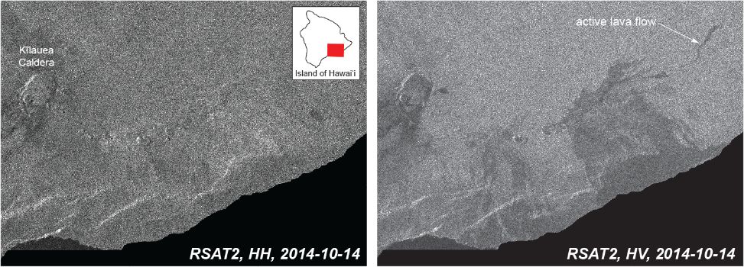
Hawai‘i Supersite
Radarsat 2 cross-pol data show new lava flows in forested areas
The backscatter differences between volcanic deposits and vegetation are large in cross-polarized SAR amplitude.
SAR data as those of RADARSAT-2 which are frequently acquired in high-res quad-pol modes, provide exceptional views of lava flow emplacement in forested areas

Slide 6
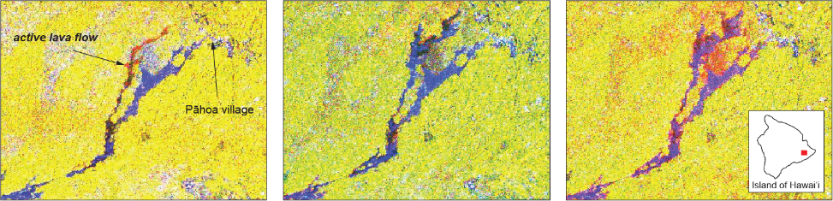
Hawai‘i Supersite
Sentinel 1 cross-pol data used to closely monitor new lava flows
TIME
Sequential false-color images (RGB: R=earlier HV, G=later HV, B=coherence) from Sentinel-1 showing development of the Pāhoa lava flow at Kīlauea during late 2014 - early 2015.
Each image is approximately 10 km across. New lava flow activity appears reddish.

Slide 7
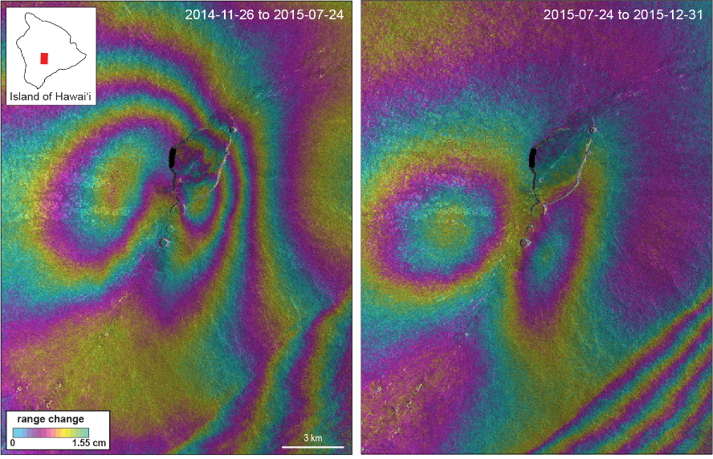
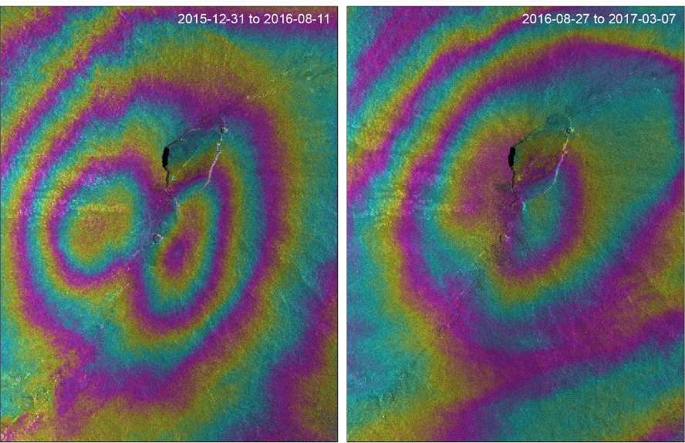
Hawai‘i Supersite
CSK data used to monitor Mauna Loa plumbing system complexities
The summit inflation pattern initially resembles the one occurred in 2002-2009, then shifts to the SW, then again to the previous location, suggesting magma accumulation in compartments that in certain conditions may become isolated from one another.
Note that GPS station density is not sufficient to map this complex dynamics.

Slide 8
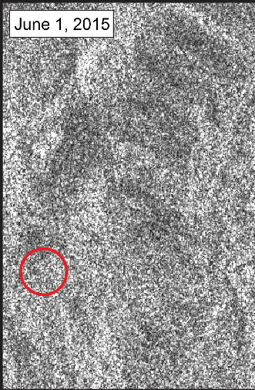
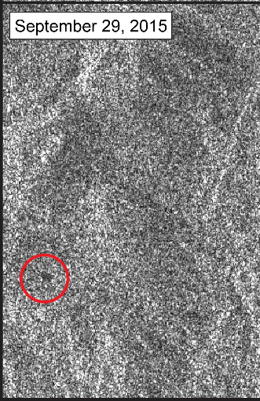
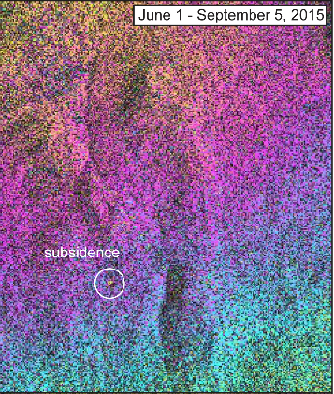
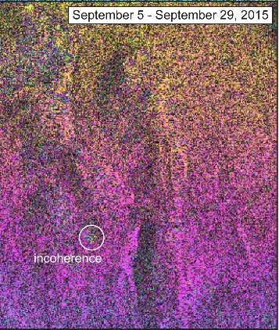
Hawai‘i Supersite
Radarsat 2 data used to study a new pit crater on Mauna Loa
The crater formation was temporally framed using Rsat images, then it was found that the ground collapse was preceded by about 1 cm of subsidence relative to the surrounding area in the days to weeks before the crater formed.

Slide 9
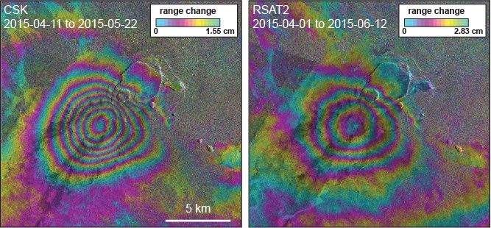
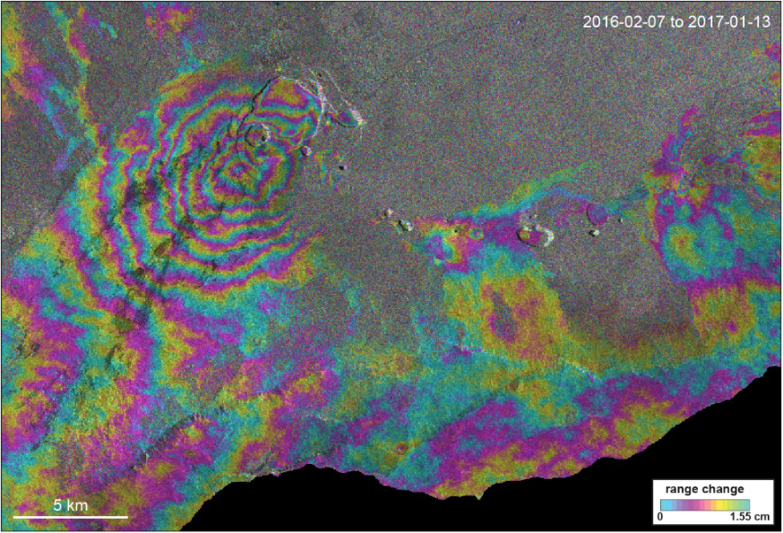
Hawai‘i Supersite
CSK, Rsat 2 and TSX reveal change in eruptive activity at Kilauea
The InSAR and differential DEM (from TanDEM X) analyses allowed to observe the fast dynamics of magma migration between two subcaldera reservoirs, as well as to monitor an increase of Kilauea inflation in 2016-2017 suggesting that a change in eruptive activity within the coming months may occur.

Slide 10
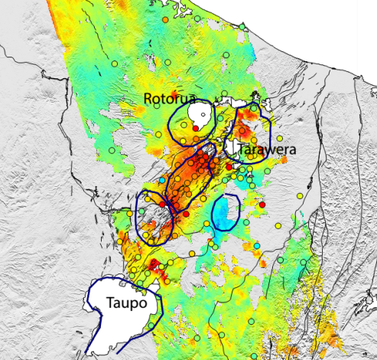
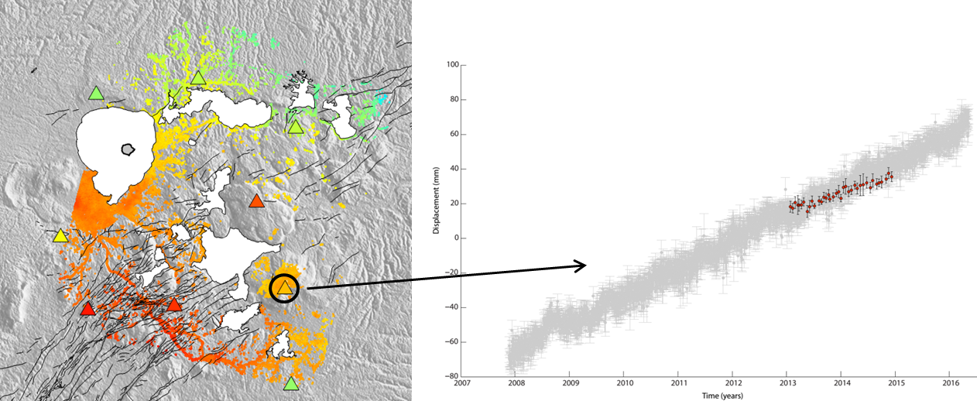
Taupo Volcanic Zone Supersite
New InSAR observations used to study the magmatic system
Pre-Supersite ENVISAT results
Ground displacements measured by CSK over the Okataina Caldera. On the right the comparison between the InSAR and GPS displacements. These results are used to study the magmatic plumbing beneath the northern TVZ, together with Magnetotelluric data and Finite element modelling.

Slide 11
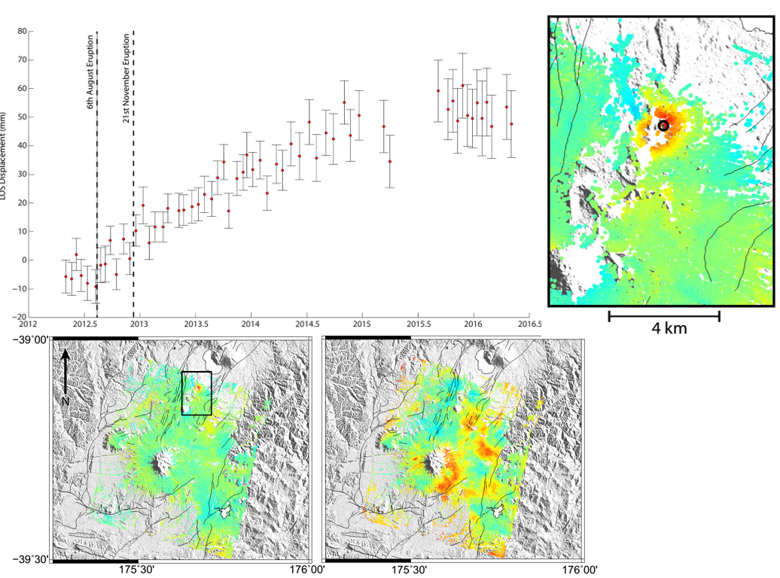
Taupo Volcanic Zone Supersite
CSK data show post eruptive deformation over Tongariro
Significant subsidence is observed over the Te Maari eruption site since the last eruption in November 2012.

Slide 12
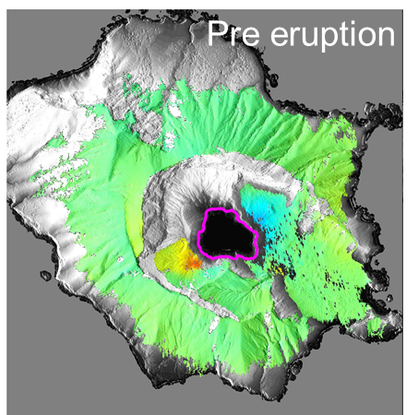
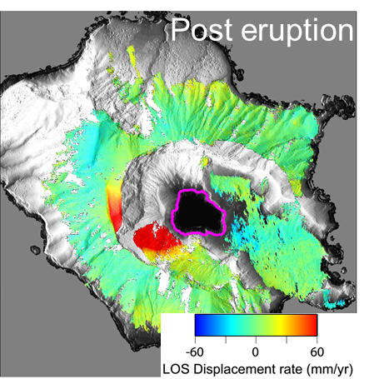
Taupo Volcanic Zone Supersite
TerraSAR-X spotlight data show deformation over White Island
TSX data reveal previously unrecognized deforming areas, including a landslide reactivated along the south-western crater wall, which has been moving at rates of 20 cm/yr after the 2016 eruption. The fast deformation rates prompted an access ban in the area by the Ministry of Civil Defense, to which GNS Science provides the scientific information.

Slide 13
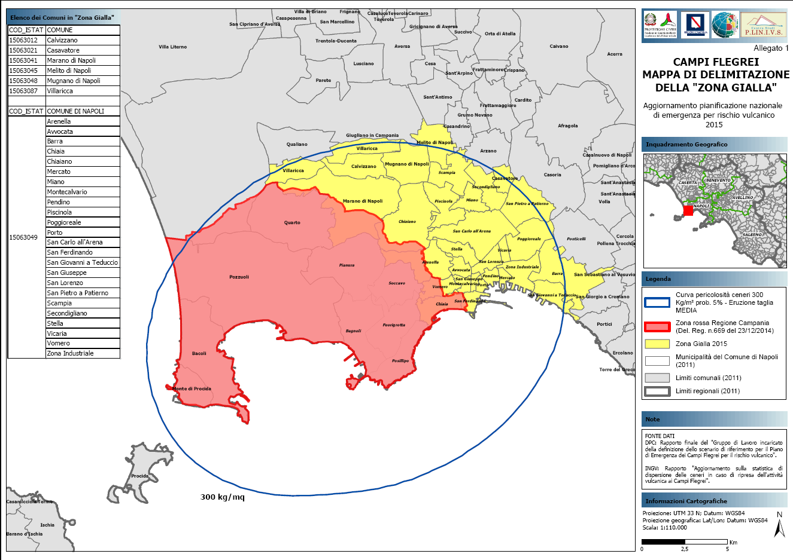
Campi Flegrei - Vesuvius Supersite
Scientific information is summarized in risk management maps
The new 2015 Emergency plan was developed based on several multidisciplinary scientific studies, including satellite data analyses.
The Red zone is potentially affected by fast pyroclastic flows (substantial damage is likely). The Yellow zone has >5% probability of ash fallout >300 kg/m2 (roof collapse threshold).

Slide 14
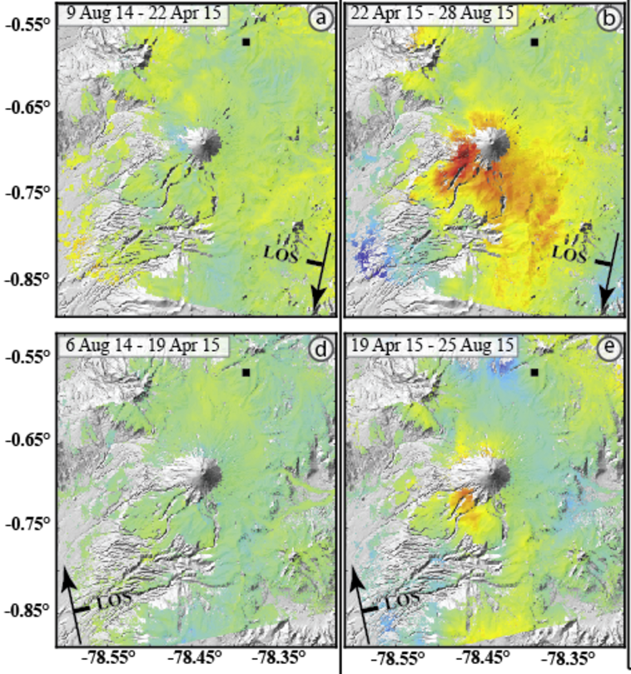
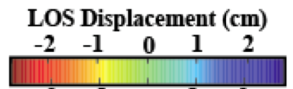
Ecuador Supersite
Precursory inflation from CSK time-series at Cotopaxi
Key findings:
InSAR detected 3 cm inflation on SW flank before the eruption.
before unrest
unrest period
Morales Rivera, Amelung et al., GRL in review

Slide 15
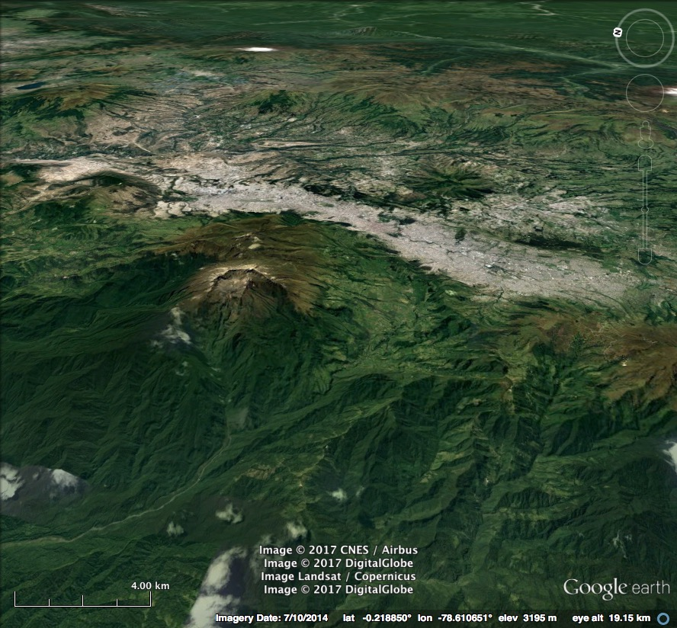
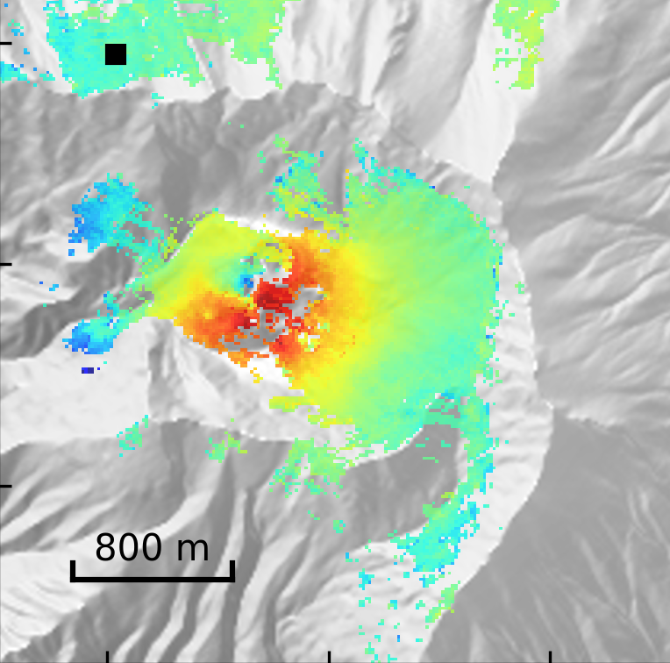
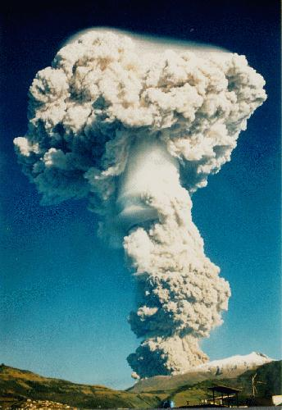
Ecuador Supersite
Inflation measured by TSX at Guagua Pichincha
Jan 2016-May 2017: 40 TSX scenes
1999 eruption

Slide 16
Supersite proposals submitted to the CEOS DCT for evaluation
Coupled geohazards at Southern Andes (Chile): Copahue-Lanín arc volcanoes and adjacent crustal faults (GeoHaZSA)
Virunga volcanic area (D.R. Congo)

Slide 17
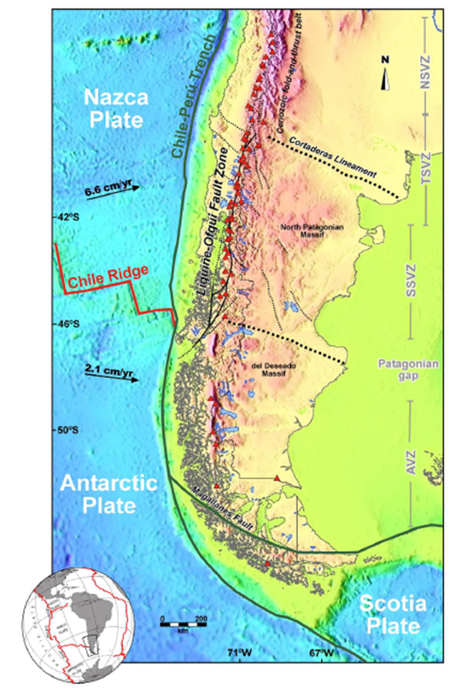
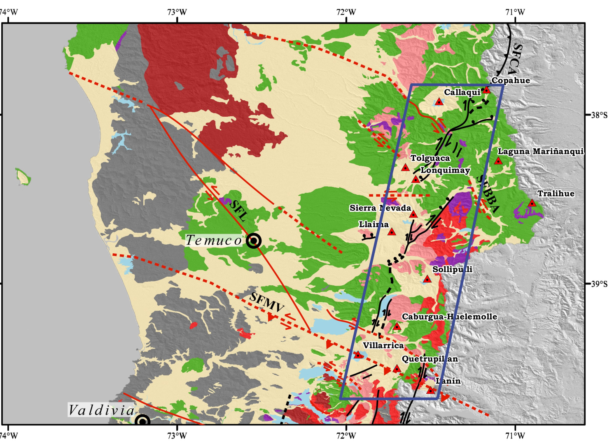
Permanent Supersite proposal:
Coupled geohazards at Southern Andes: Copahue-Lanín arc volcanoes and adjacent crustal faults (GeoHaZSA)

Slide 18
Core team of the GeoHaZSA Supersite
1 | Luis Lara | SERNAGEOMIN, Universidad de Concepción, Santiago, Chile
2 | Maria Cordova | SERNAGEOMIN, Temuco, Chile
3 | Francisco Delgado | Cornell University, Ithaca, NY, USA
4 | Andrés Tassara | Universidad de Concepción, Concepción, Chile
5 | Pablo Euillades | Universidad Nacional de Cuyo, Mendoza, Argentina
6 | Leonardo Euillades | Universidad Nacional de Cuyo, Mendoza, Argentina
7 | Felipe Aguilera | Universidad Católica del Norte, Antofagasta, Chile
8 | Paul Lundgren | Jet Propulsion Lab/California Inst. of Technology, Pasadena, CA, USA
9 | Charles Wicks | U. S. Geological Survey, Menlo Park, CA, USA
10 | Lucia Lovison | Sat-Drones, Wellesley, USA

Slide 19
General features of the GeoHaZSA Supersite
~50 x 200 km area, covering 9 stratovolcanoes, 2 volcanic fields, a large strike-slip fault
Strong volcanic hazards - lahars, tephra fallout, ash plumes; + seismic hazard
80 eruptions since the 1900
Potentially affected population ~200 k
EO data not widely used, little local capacity
GEO Chile strongly supports the proposal

Slide 20
Main goals of the GeoHaZSA Supersite
To establish regional source models for faults/volcanoes.
To develop a rapid strategy for ground deformation monitoring based on InSAR.
To develop an early warning system for volcanic unrest based on InSAR, GPS, seismicity and gas measurements.
To improve capability to measure effusion/emission rates.
To generate high resolution hazards maps.
To provide information to first responders, society and scientific communities.

Slide 21
In situ data sets for the GeoHaZSA Supersite
Type of data | Data source | Data access
Seismic data | SERNAGEOMIN (OVDAS) network (35 stations) | Open access with registration form; server to remote download scheduled. Time-series for registered scientists under specific agreements
GNSS data | SERNAGEOMIN (OVDAS) (16), IGM (1) and CSN (1) network and GPS Campaigns | Open access to GNSL scientists
DOAS and Gas measurements | SERNAGEOMIN (OVDAS) network (5 continuous stations) and Campaigns | Open access to GNSL scientists
Infrasound | SERNAGEOMIN (OVDAS) 2 stations | Open access to GNSL scientists

Slide 22
EO data requests for the GeoHaZSA Supersite
Sensor | Source | Data requested
SAR X-band CSK | ASI | Entire archive: ~ 1000 images, + ascending/descending coverage every 16 days for 9 volcanic areas: ~ 450 images/yr Monitoring should be intensified in case of unrest, rapid delivery would be needed.
SAR X-band TSX-TDX | DLR | Entire archive + ascending/descending coverage for DEM production: ~ 150 images/yr. The plan is to build one initial reference DEM for each volcano, then after any eruption new acquisitions are planned to update the DEMs.
SAR C-band Rsat 2 | CSA | Entire archive + ascending/descending coverage for monitoring in quiescent times: ~ 150 images/yr. The Rsat 2 data should be synergic with S1, i.e. with different angles/orbits, dates.
SAR C-band Sentinel 1 | ESA | Open. However, they request ascending/descending coverage every 6 days when volcanoes are under unrest.
SAR L-band ALOS 2 | JAXA | Entire archive + ascending/descending coverage: ~ 150 images/yr. Very important over strongly vegetated areas, that is in the lower parts of the cones.
Optical data Pleiades | CNES | One initial tri-stereo coverage for each volcano, then one more each time there are substantial morphological changes (1 coverage per year on average). Used for HR DEM creation and photo-analysis.
Optical data Sentinel 2 | ESA | Open. Used for geological and morphological analyses

Slide 23
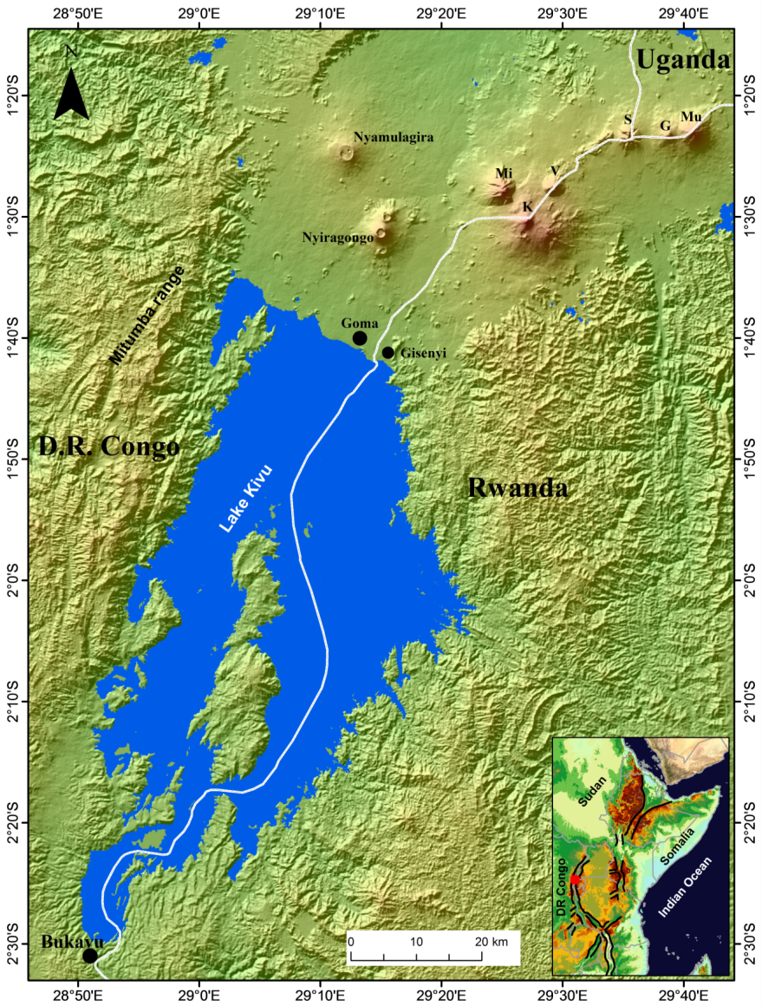
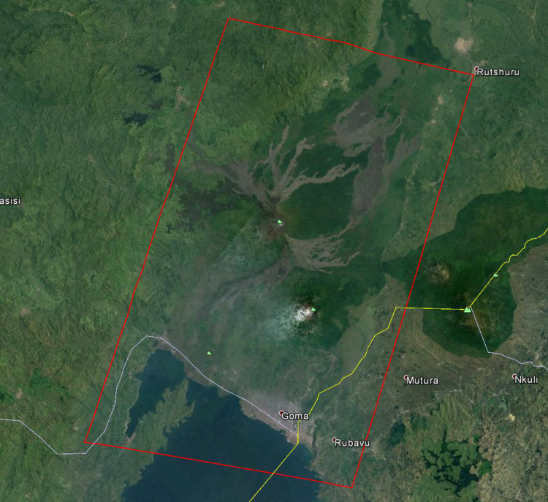
Permanent Supersite :
Virunga volcanic area (Democratic Republic of Congo)
The Supersite covers two active volcanoes,
Nyragongo and Nyamulagira

Slide 24
Core team of the Virunga Supersite
1 | Charles Balagizi | Goma Volcano Observatory, Goma, DR Congo
2 | Georges Tuluku | Goma Volcano Observatory, Goma, DR Congo
3 | Katcho Karume | Goma Volcano Observatory, Goma, DR Congo
4 | Celestin Mahinda | Goma Volcano Observatory, Goma, DR Congo
5 | Honoré Mateso | Goma Volcano Observatory, Goma, DR Congo
6 | Mathieu Mapendano | Goma Volcano Observatory, Goma, DR Congo
7 | Bo Galle | Chalmers University of Technology, Göteborg, Sweden
8 | Mike Poland | USGS – Cascades Volcano Observatory,Vancouver, WA, USA
9 | Marcello Liotta | Istituto Nazionale di Geofisica e Vulcanologia, Palermo, ITALY
10 | Yosuke Aoki | Earthquake Research Institute, University of Tokyo

Slide 25
General features of the Virunga Supersite
Nyragongo and Nyamulagira volcanoes account for 40% of historical African eruptions
Erupted on average every 6 years in the last 150 years
High volcanic risk for over 1.5 M people (Goma city), additional risk of disrupting vital agricultural resources by ash fall
Potential for huge disaster (affecting 3 M people) if volcanic activity triggers catastrophic discharge of CO2 and CH4 stored in the thermally stratified waters of Lake Kivu
Strong need for scientific investigations of the volcanic systems
Poor in situ monitoring capacities
No local capacities for EO data usage

Slide 26
Main goals of the Virunga Supersite
To increase the international collaboration for improved scientific understanding of the volcanoes, sharing data and knowledge
To improve geohazard assessment and monitoring in the Virunga
To improve local capacities to issue Volcano Observatory Notice for Aviation (VONA) messages to aviation authorities and VAACs
To obtain satellite data for scientific and monitoring applications
To develop a strategy for rapid volcano deformation monitoring based on InSAR
To attract attention from international agencies to develop local monitoring, scientific and DRM capacities
To provide scientific information for DRM to the national government

Slide 27
In situ data sets for the Virunga Supersite
Type of data | Description | # of stations
Seismic waveforms | Broadband Sensor | 14
SO₂ data | FIX DOAS | 4
GPS | Leica GNSS high performance system | 7
Soil temperature and gas emissions | Gas: Radon, CO₂ | 25
Virunga river water geochemical data | Monthly field campaigns for Physicochemical parameters, major and trace elements, stable and radiogenic isotopes , Gas concentrations (e.g. CO₂, CH₄, N₂O) | 14 rivers 7 cold springs 7 hot springs
Virunga rainwater geochemical data | Monthly field campaigns for Physicochemical parameters, major and trace elements, stable and radiogenic isotopes | 14
Lake Kivu physicochemical parameters profile | Field campaigns, profiles of physicochemical parameters, major and trace elements, stable and radiogenic isotopes , secondary mineral saturation | Main basin Kabuno Bay

Slide 28
EO data requests for the GeoHaZSA Supersite
Sensor | Source | Data requested
SAR X-band CSK | ASI | Entire archive: ~ 400 images, + ascending/descending coverage every 16 days for 2 volcanic areas: ~ 100 images/yr Monitoring may be intensified in case of unrest, also with Spotlight mode images.
SAR X-band TSX-TDX | DLR | Entire archive + TDX ascending/descending coverage for building one initial reference DEM for each volcano, then after any eruption new TDX data would be needed to update the DEMs. TSX for ground deformation in synergy with CSK, ~ 100 images/yr
SAR C-band Rsat 2 | CSA | Entire archive. Descending/descending coverage for long term monitoring in quiescent times: ~ 50 images/yr. The Rsat 2 data should be synergic with S1, i.e. with different angles/orbits, dates.
SAR C-band Sentinel 1 | ESA | Open. However, they request ascending/descending coverage every 6 days when volcanoes are under unrest.
SAR L-band ALOS 2 | JAXA | Entire archive + ascending/descending coverage: ~ 25 images/yr. Very important in this Supersite, considering the strong vegetation coverage.
Optical data Pleiades | CNES | One initial tri-stereo coverage for each volcano, then one more each time there are substantial morphological changes (1 coverage every 5 years on average). Used for HR DEM creation and photo-analysis.

Slide 29
Issues with the Virunga Supersite
Concern was raised by one reviewer and one SAC member on the capacity of the GVO to be able to carry out its duties, given the rather scarce resources and the limited capacities of its personnel.
The proposers replied that the Supersite is their best occasion to raise the level of attention on the area, and through that they expect international agencies and scientific communities to support further development of capacities at GVO and in DRC.
The SAC and GEOSec shared this view and thus approved the Supersite.
As an initial result, the Copernicus EMS Risk & Recovery Mapping (RRM) service has been activated and is generating a high resolution DEM of the area and volcanic hazard maps.

Slide 30
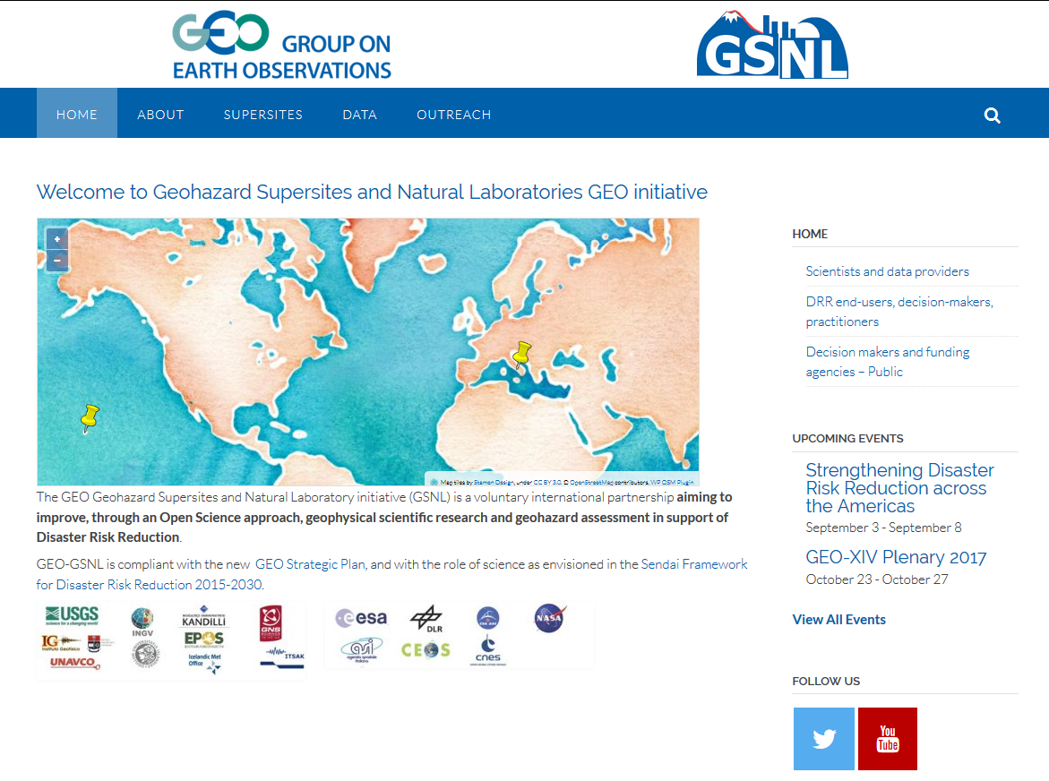
New GSNL website and Twitter account
To be published in October

Slide 31
Issues with EO data access
DLR portal ok but still has some issues, e.g. multiple data sets in one tar file
Some satellite datasets (CSK, RSAT, Pleiadés) are only available through the Supersite coordinators at the moment. We need to find a definitive solution to allow users easy access to the data collections (also for GEOSS).
UNAVCO already hosts some datasets (not Pleiadés data).
The ESA GEP has offered to host all data sets. It already provides discovery to TSX data on the DLR portal.
ASI now agrees that all Supersite data can be hosted on the GEP. We will repatriate all the global Supersite data on the ESA/GEP. The Supersite coordinators will maintain the control, providing access coordinates only after license signature.
A similar approach should be used for CSA and CNES data. Any problem?
Critical ALOS-2 data still not provided to GSNL. Need to find a solution.

Slide 32
Outstanding issues
The 2014-2016 Biennial Reports of the Taupo and Ecuador volcano Supersites should be approved at the Plenary. Questions/issues?
The proposal for a new Supersite in Chile Southern Andes (focus on volcanoes + fault) should be approved at the Plenary. Status, questions/issues?
The proposal for a new Supersite in D. R. Congo (two volcanoes in the Virunga volcanic area) should be approved at the Plenary. Status, questions/issues?
Discussion on the maximum number of Supersites that the agencies can support (separate meeting?).

