Slide 1

Committee on Earth Observation Satellites
Landslide Pilot
Working Group
Presentation
September 5th, 2017

Slide 2

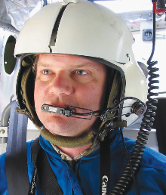


Co-leads of landslide pilot
Dr. Dalia Kirschbaum, NASA Goddard Space Flight Center, Maryland, USA
Dr. Jonathan Godt, Landslide Hazards Coordinator, U.S. Geological Survey, Colorado, USA
Dr. Jean-Philippe Malet, School and Observatory of Earth Sciences, University of Strasbourg, France
Dr. Sigrid Roessner, GFZ German Research Centre for Geosciences, Germany

Slide 3
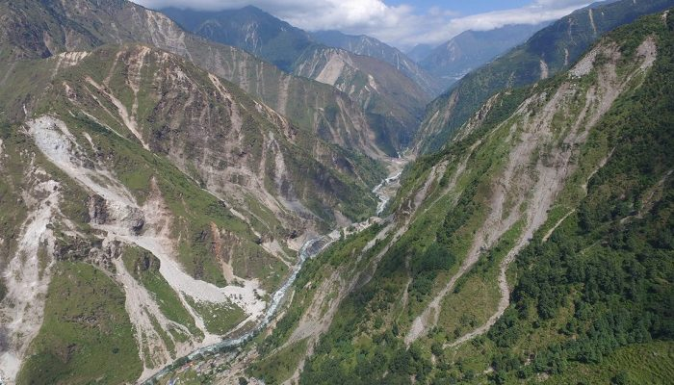
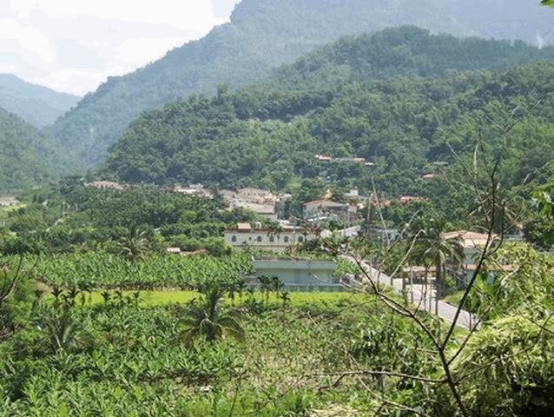
Landslides in multi-hazard environments
Major triggers
Hydrometeorologic extremes (e.g. typhoon)
Earthquakes
New Zealand: 2016 (7.8Mw) ca. 6,000 landslides
Nepal: 2015 (7.8Mw) ca. 20,000 landslides
Taiwan: 2009 Typhoon Morakot: ca. 20,000 landslides
Credits: K. Cook
Credits: Tsou Univ. Kyoto
Nepal: Bhote Koshi (drone image month after EQ)
Taiwan: fotos before and after

Slide 4
Status for Landslide WG
January 2017: Planning of data acquisitions for Nepal and Pacific Northwest
January 2017: Begin licensing agreement processes and querying of data requests from the group
April 2017: Landslide pilot meeting at the European Geological Society Annual meeting and presentation in Remote Sensing of Landslides session
July 2017: Completed most licensing agreements and data request submissions to space agencies
August 2017: Continuing to request data for main pilot areas

Slide 5
Landslides Pilot: Main Goals
  To demonstrate the effective exploitation of Earth observations (EO) data and technologies to detect, map and monitor landslides and landslide prone hillsides, in different physiographic and climatic regions.
  To apply satellite EO across the cycle of landslide disaster risk management, including preparedness, situational awareness, response and recovery with a distinct multi-hazard focus on cascading impacts and risks.
Notes:
Key message regarding the new pilot :
- it's about multi-hazard and multi-sensor approach to disaster resilience and risk reduction
- the multi-hazard tactic is to advance data fusion, integration and analysis, leveraging existing pilots as they end their 3 years. Starting with the new pilot we will look at earthquake, volcano and flood inducing cascading effects such as landslide and debris flow.

Slide 6
Pilot Objectives
Establish effective practices for merging different Earth Observation data (e.g. optical and radar) to better monitor and map landslide activity over time and space.
Demonstrate how landslide products, models, and services can support disaster risk management for multi-hazard and cascading landslide events.
Engage and partner with data brokers and end users to understand requirements and user expectations and get feedback through the activities described in objectives 1-2.

Slide 7
Key Pilot Outputs
& Deliverables
- Report on recommended practices for the combined exploitation of SAR and Optical imagery and technologies for landslide detection, mapping and monitoring”. (Objective A)
- Report on effective methodologies and strategies for considering multi-hazard and cascading aspect of landslides through multi-temporal landslide mapping from multiple triggers (leveraging information/interactions with the volcano, flood and earthquake pilots) (Objective A-C)
- Landslide event inventory and activity (monitoring) maps produced using optical and SAR imagery and technologies, and their combination, for selected case studies / geographical areas. (Objectives B-C)
- Report on end user engagement strategies and characterize enablers, challenges, barriers to effective transfer of information, knowledge and technologies. (Objective D)

Slide 8
Proposed key user communities
Users: national, regional and local governments, civil protection agencies, meteorological and geological services, land use planning decision makers, disaster risk reduction specialists with NGOs and international organisations, industry (including e.g., insurance, transport, forestry sectors).
Practitioners: landslide modelers, scientists and engineers in hydrology, water and environment ministries, meteorological and geological services, satellite data providers, volcano observatories, and value added service companies.
Institutional bodies responsible for communication of risk (gap between technical level and shared information with communities): research institutions with operational responsibilities.
General public: landslide event information for some of the case studies will be made available to the general public for increased awareness of these hazards and remote sensing capabilities, although the main focus of the pilot is on specialized users.

Slide 9
Proposed regional study leads
Region | Regional Point of Contact
Nepal | Nick Rosser, Sigrid Roessner, Dalia Kirschbaum
Pacific Northwest, US | Jonathan Godt, Dalia Kirschbaum
Southeast Alaska | Marten Geertsema
Peru | Jeff Kargel
Caribbean (Cuba/Lesser Antilles) | Enrique Castellanos, Jean-Philippe Malet
China | Zeng-Guang Zhou (TBD)
Indonesia | TBD
Other areas of interest to community:
Eastern Africa (POC Olivier Dewitte)
Notes:
Other potential focus areas

Slide 10
How data will be exploited
Geographic Area | Products | Value Added Partners
Nepal | Landslide monitoring and deformation analysis, multi-temporal landslide inventories, magnitude-frequency analysis of landslide occurrence, multi-temporal landslide hazard analysis | ICIMOD, Nepal Govt. Ministries, World Bank, Red Cross, US Army Corp of Engineers
Pacific Northwest, US | Landslide monitoring and deformation mapping, historical analysis and multi-temporal mapping | Washington and Oregon Departments of Transportation, National Parks Service, National Forest Service, FEMA, USGS
SE Alaska | Identify timing of rock avalanches and detection of precursory deformation | USGS and U.S. National Park Service
China | Technologies of spatial-temporal detection of landslides; Spatial-temporal mapping of earthquake-induced landslides | IMHE/CAS (Institute of Mountain Hazards and Environment, Chinese Academy of Sciences).
Haiti and Lesser Antilles | Multi-temporal landslide maps, Landslide monitoring and deformation mapping Methodological developments for automated processing of time series (GEP platform, other calculation). Frequency-magnitude relationships with triggers. Haiti and Lesser Volcanic Arc | CNES (Kal-Haiti), CNIGS, CIAT and UEH (Haiti) Permanent Risk Observatory of Guadeloupe and Martinique
Peru | In development
Indonesia | In development

Slide 11
Data requests/region
 | Total quota | Nepal |  | Pacific Northwest
 | All years | New | Archived | New | Archived
SPOT (archive only) | Not (presently) available |  | 60 |  | 60
Pleiades | 100 | 25 | 25 | 25 | 25
ALOS-2 / PALSAR-2 |  | 100 | 50 | 100
Radarsat-2 | 110 |  | 60 |  | 50
Cosmo Sky-Med | ? | 150 | 150 | 100 | 50
TerraSAR-X (StripMap) | ? | 100 | all archived datasets | 50
TerraSAR-X (Spotlight) | ? | 100

Slide 12
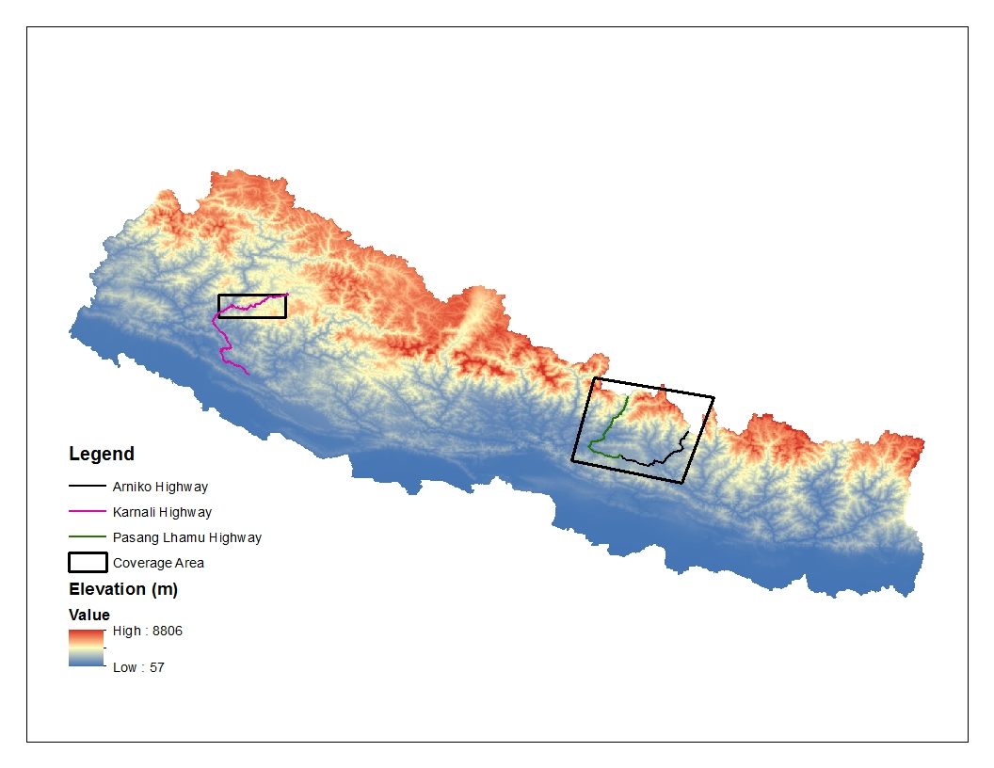
Nepal data request areas
Karnali
Trishuli
Arniko

Slide 13
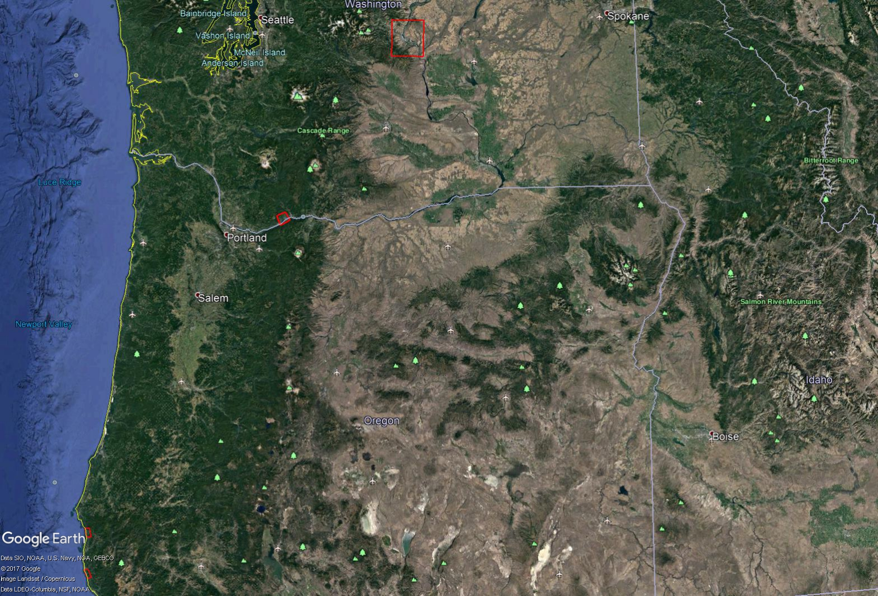
PNW data request areas
Wenatchee landslide
Cascade landslide
Arizona Inn landslide
Hooskanaden landslide

Slide 14
DLR/TerraSAR-X
PI: Sigrid Roessner
Nepal: Tasking requested submitted for Trishuli and Arniko highways. (GFZ Postdam)
PNW: Tasking request submitted for 3 landslide areas. (Oregon State University and Southern Methodist University)
Status: Confirming requested areas in Nepal and PNW

Slide 15
CSA/Radarsat-2
PI: Jean Philippe Malet
Status: Agreements have been signed and SOAR Geohazard proposal has been accepted by CSA. Access to acquisition planning tool has been established.
Image Quotas:
Nepal: 60 archived
PNW: 50 archived

Slide 16
ASI/COSMO-SkyMed
PI: Signatory PI is likely Sigrid Roessner (will be submitted on September).
Status: All the signatures of the participants have been collected. Detailed proposal will be submitted on September to establish the quota.

Slide 17
CNES - Pleiades/SPOT
Pleiades
Status: Received approval from CNES for images, working to sign the Specific user Agreement. A total of 40,000 km² can be requested within 3 year pilot. Agreements for specific data requests need to be confirmed with participants in CEOS landslide pilot
Nepal: Archived imagery request for Karnali, Arniko and Pasang Lhamu highway
PNW: Archived and tasking request for Arizona Inn and Hooskanaden landslides (Oregon State University)
SPOT
Most of the image request came for SPOT 6/7 which is not available from CEOS. CNES suggested and alternative way for requesting data through GEOSUD with Jean Philippe Malet as PI.
Status: Waiting for information from Jean-Philippe Malet

Slide 18
Suggested rapid response for landslide disasters
Disaster occurs
Co-leads have a coordination e-mail to determine next steps
Send out CEOS Landslide WG e-mail
  Determine potential end user group to be recipient of information
  Determine core response group from CEOS group
Establish frequency of coordinating calls and create lead for engaging with end users
Determine data availability from disaster charter
Request additional tasking from CEOS (coordinating with other pilots if relevant)

Slide 19
Recent research activities
Research activities focused on application of remote sensing data products utilizing either publically available data or scenes obtained through an alternative agreements

Slide 20
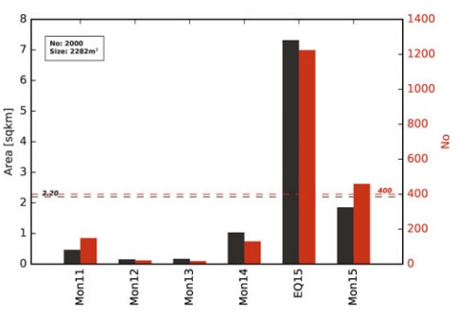
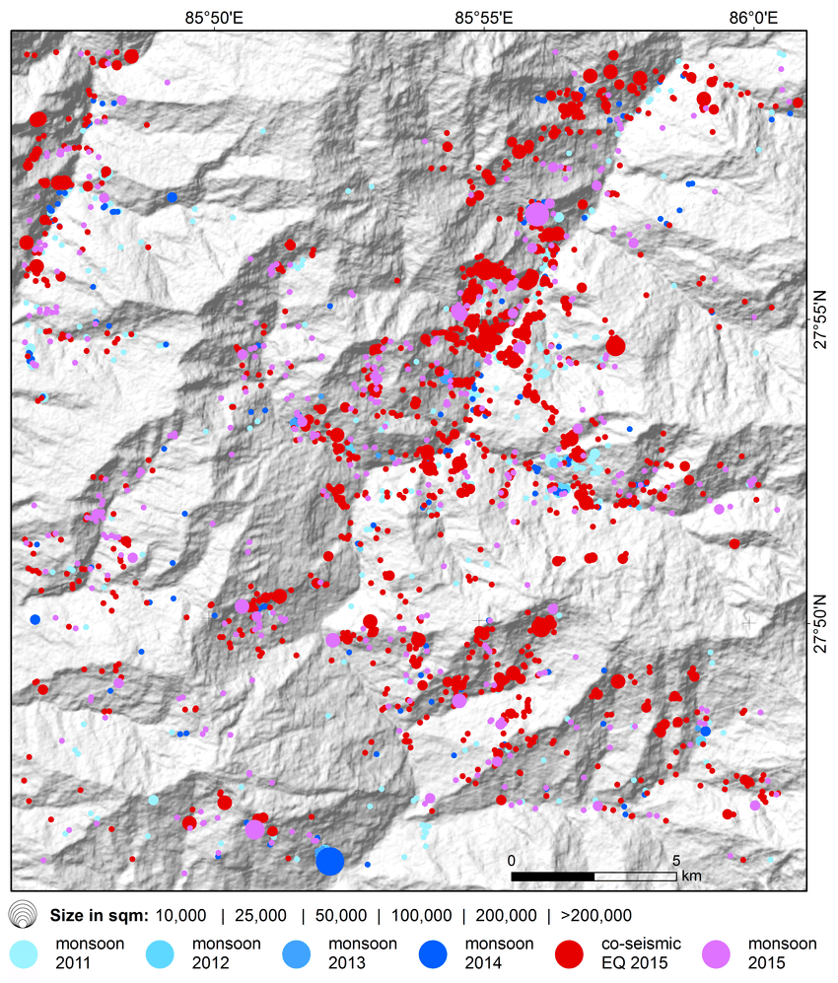
Multi-temporal monsoonal landslide along Pasang Lhamu Highway, Nepal
Multi temporal monsoonal landslide inventory (2011 – 2015) derived from a time series of 13 Rapideye Level 3A data.
2000 landslides with sizes ranging from 200 m² to 0.76 km² affecting a total area of 10.9 km².
1224 landslides triggered by 2015 Gorkha earthquake.
Behling and Roessner (2017)

Slide 21
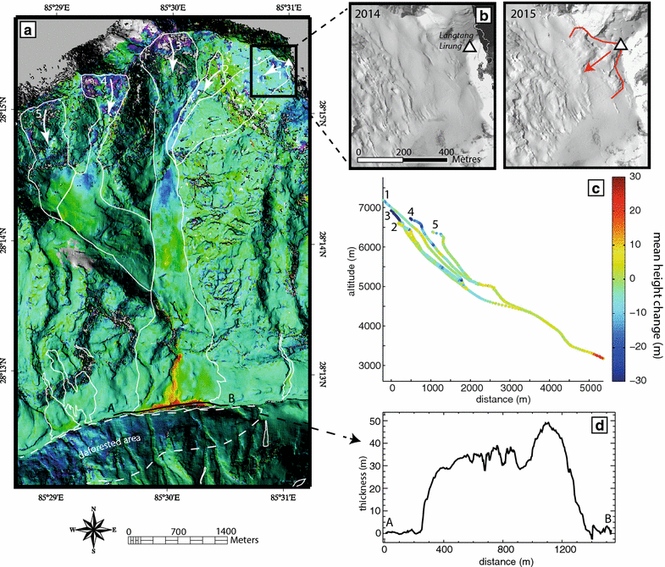
Landslide triggered by Gorkha Earthquake (Langtang, Nepal)
160 landslide identified using DSM prepared using SPOT 6/7 stereo pairs.
Main debris avalanches accumulated 6.95 × 106 m3 of deposits in the valley with thicknesses reaching 60 m, and 9.66 × 106 m3 in the glaciated part above 5000 m asl.
Lacroix (2017)

Slide 22
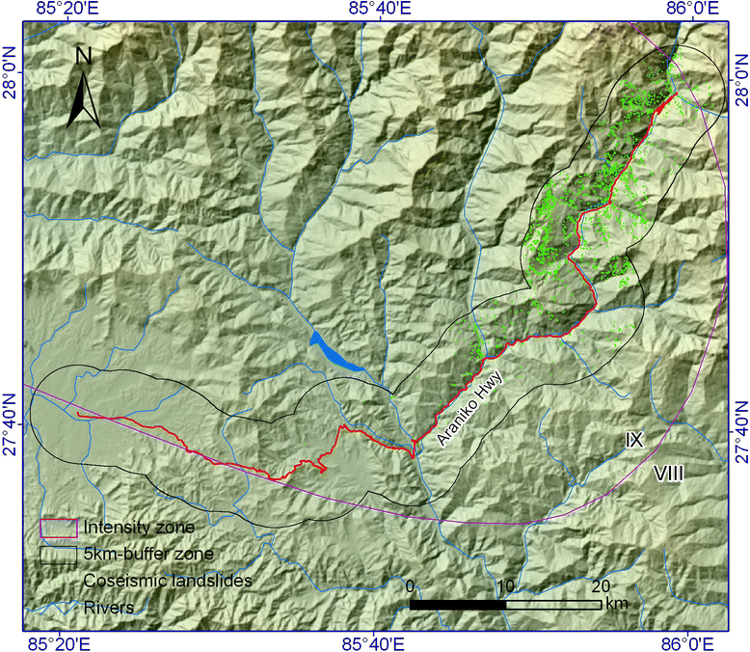
Landslide Damage along Arniko Highway during Gorkha earthquake, 2015.
Landslide inventory prepared using VHR satellite imagery and field visit (all derived from Google Earth Platform).
35 coseismic landslides damaged the Arniko Highway along a total length 1,415 m. The total volume of them was estimated to be 0.37 million m3
Xu et al (2017)

Slide 23
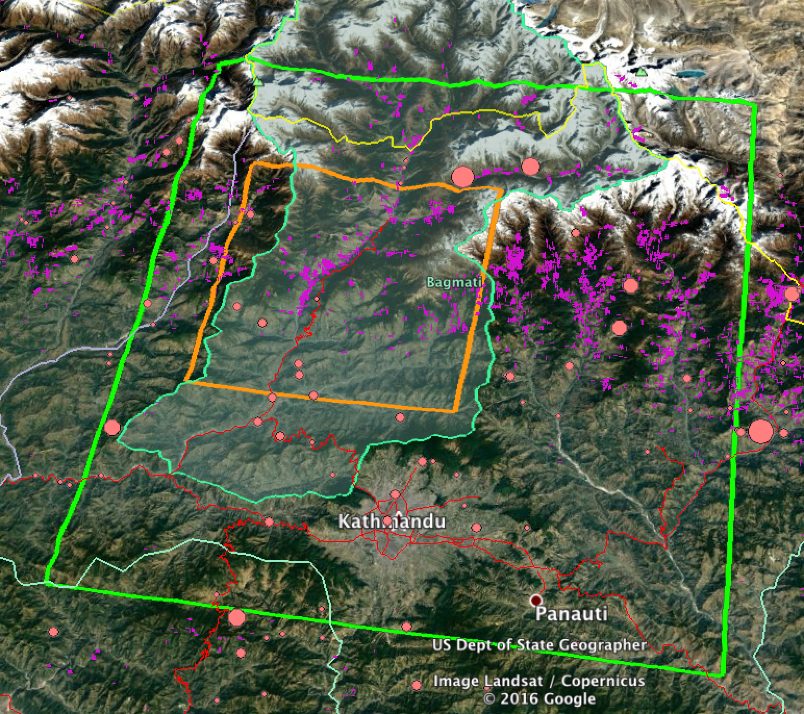
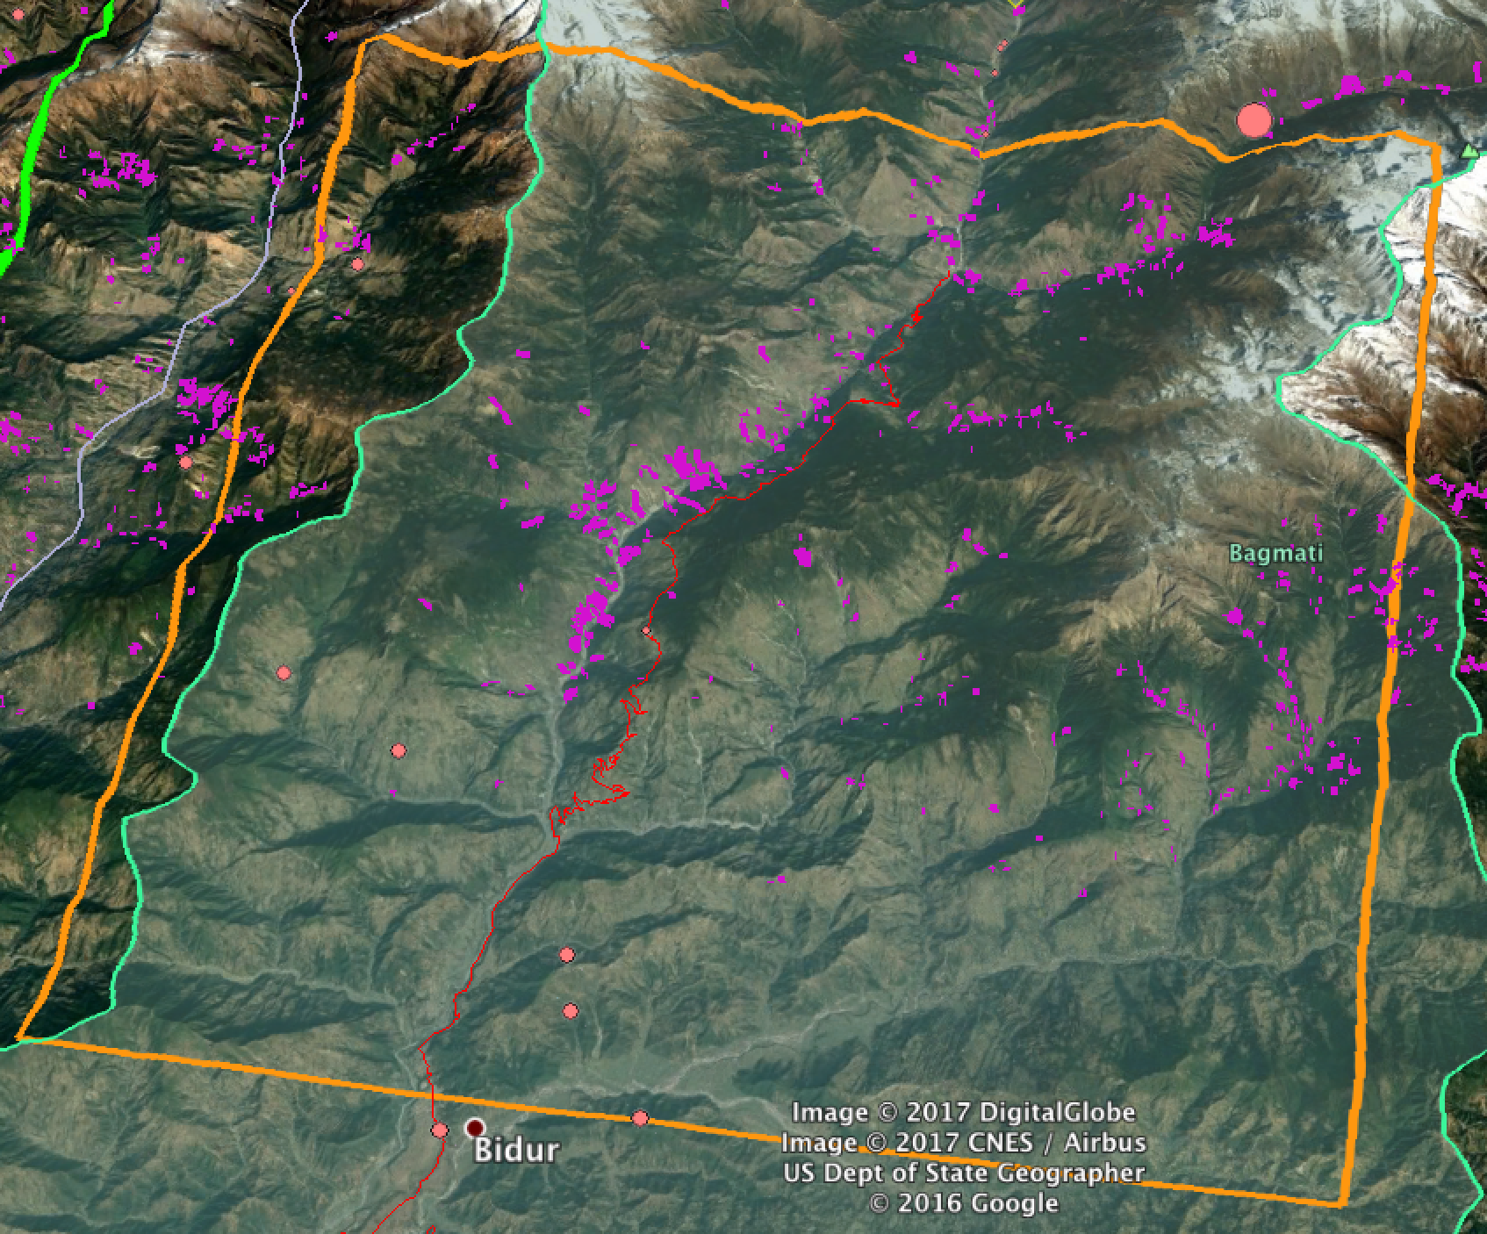
SAR feasibility for Landslide mapping in Langtang valley, along Trishuli highway
Zoom over focus area = Orange
Green poly = Trishuli basin (Kyle study Area)
Bordeaux = Roads
Red circle / magenta lines = landslides
Bekaert, JPL
© 2017 California Institute of Technology. Government sponsorship acknowledged.

Slide 24
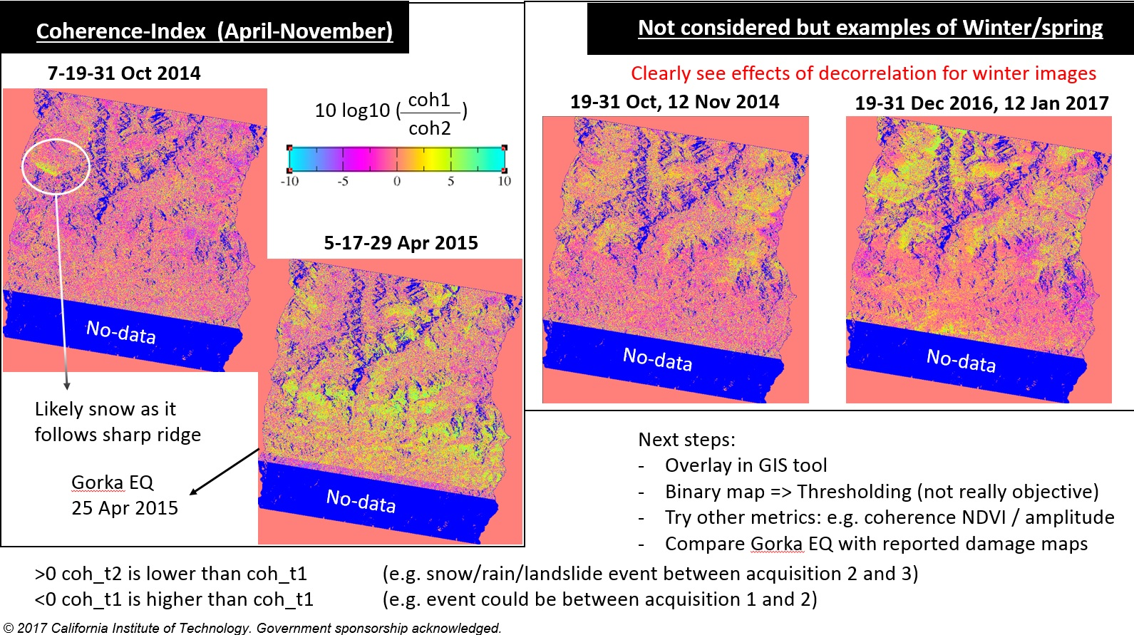
Coherence-Index (April-November)
© 2017 California Institute of Technology. Government sponsorship acknowledged.
Notes:
Coherence matrix for non-winter (and winter (right)). Much more decorrelation for winter period due to snowfall. Sentinel-1B, 1A SAR
Non-winter pairs. Pixel resolution of 100m is the main limitation because landslides aren’t that small. Snowfall causing decorrelation is confirmed.
Change detection for the earthquake period. Yellow – destroyed between second and third acquisition. Blue, has recovered from first date.
Only showing surface changes.
SRTM 30m.

Slide 25
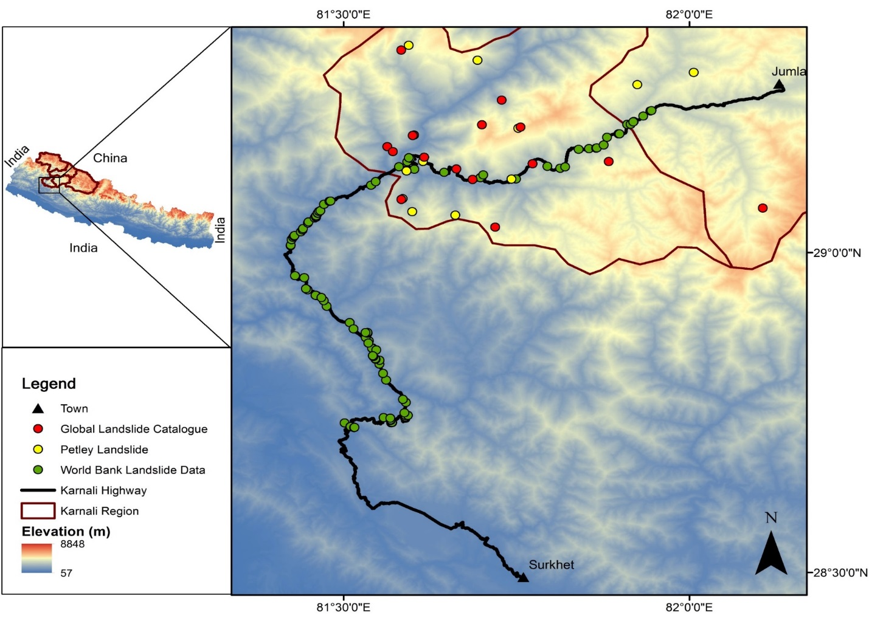
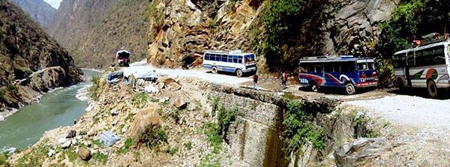
Landslide Mapping in Karnali Region
One of the poorest and least accessible region.
The Karnali highway is the only major road network connecting Jumla the capital with Terai region.
Out of 232 km only 11 km are blacktopped and is considered as one of the most dangerous highways in the world.
Reports of blockage every year due to landslides ultimately resulting in death of people due to food shortage.
This will be the first effort to map landslides in Karnali Highway in collaboration with The World Bank.
@KarnaliKo

Slide 26
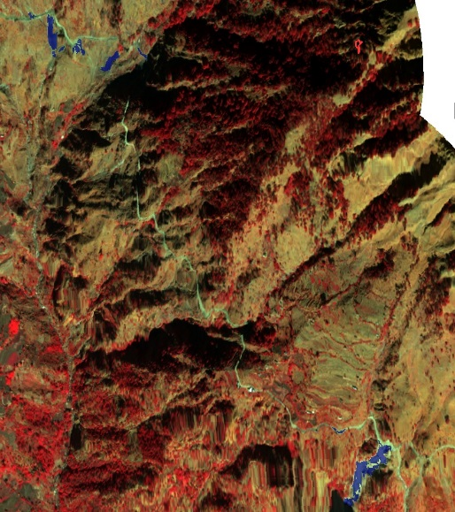
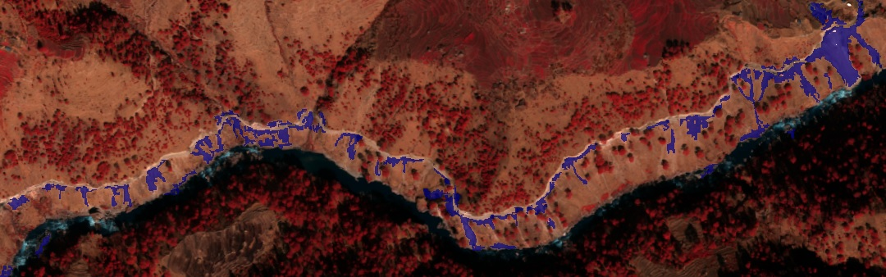
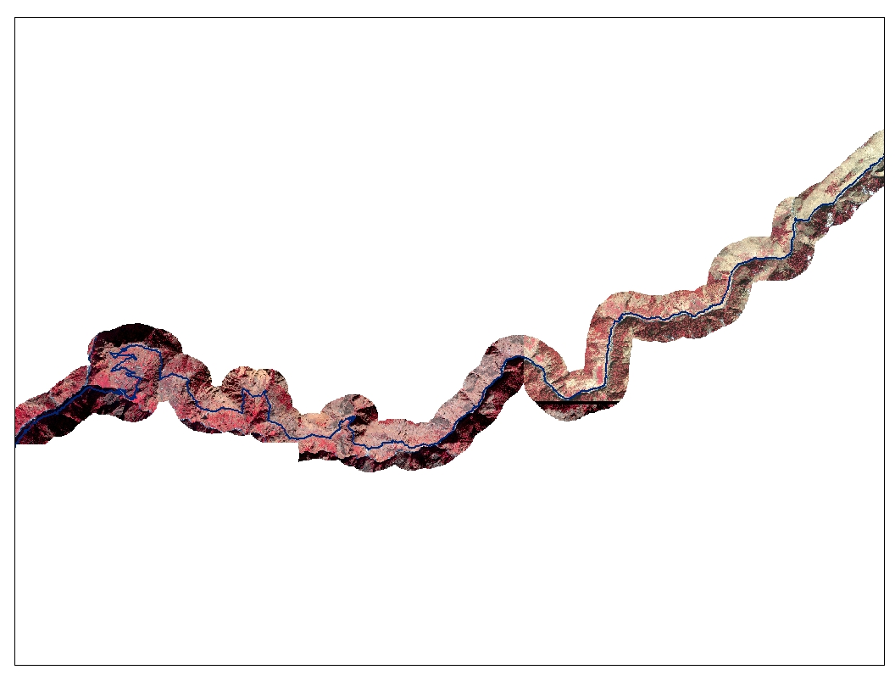
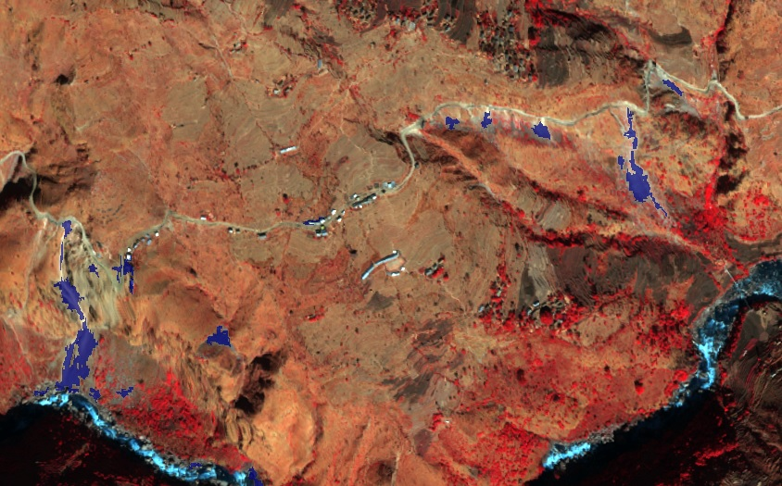
Object oriented analysis based landslide mapping (Karnali Highway, Nepal)
Three stretch along the 60 km highway identified to be highly affected by landslides.
Data obtained from Ditigal Globe
(NASA/USRA)

Slide 27
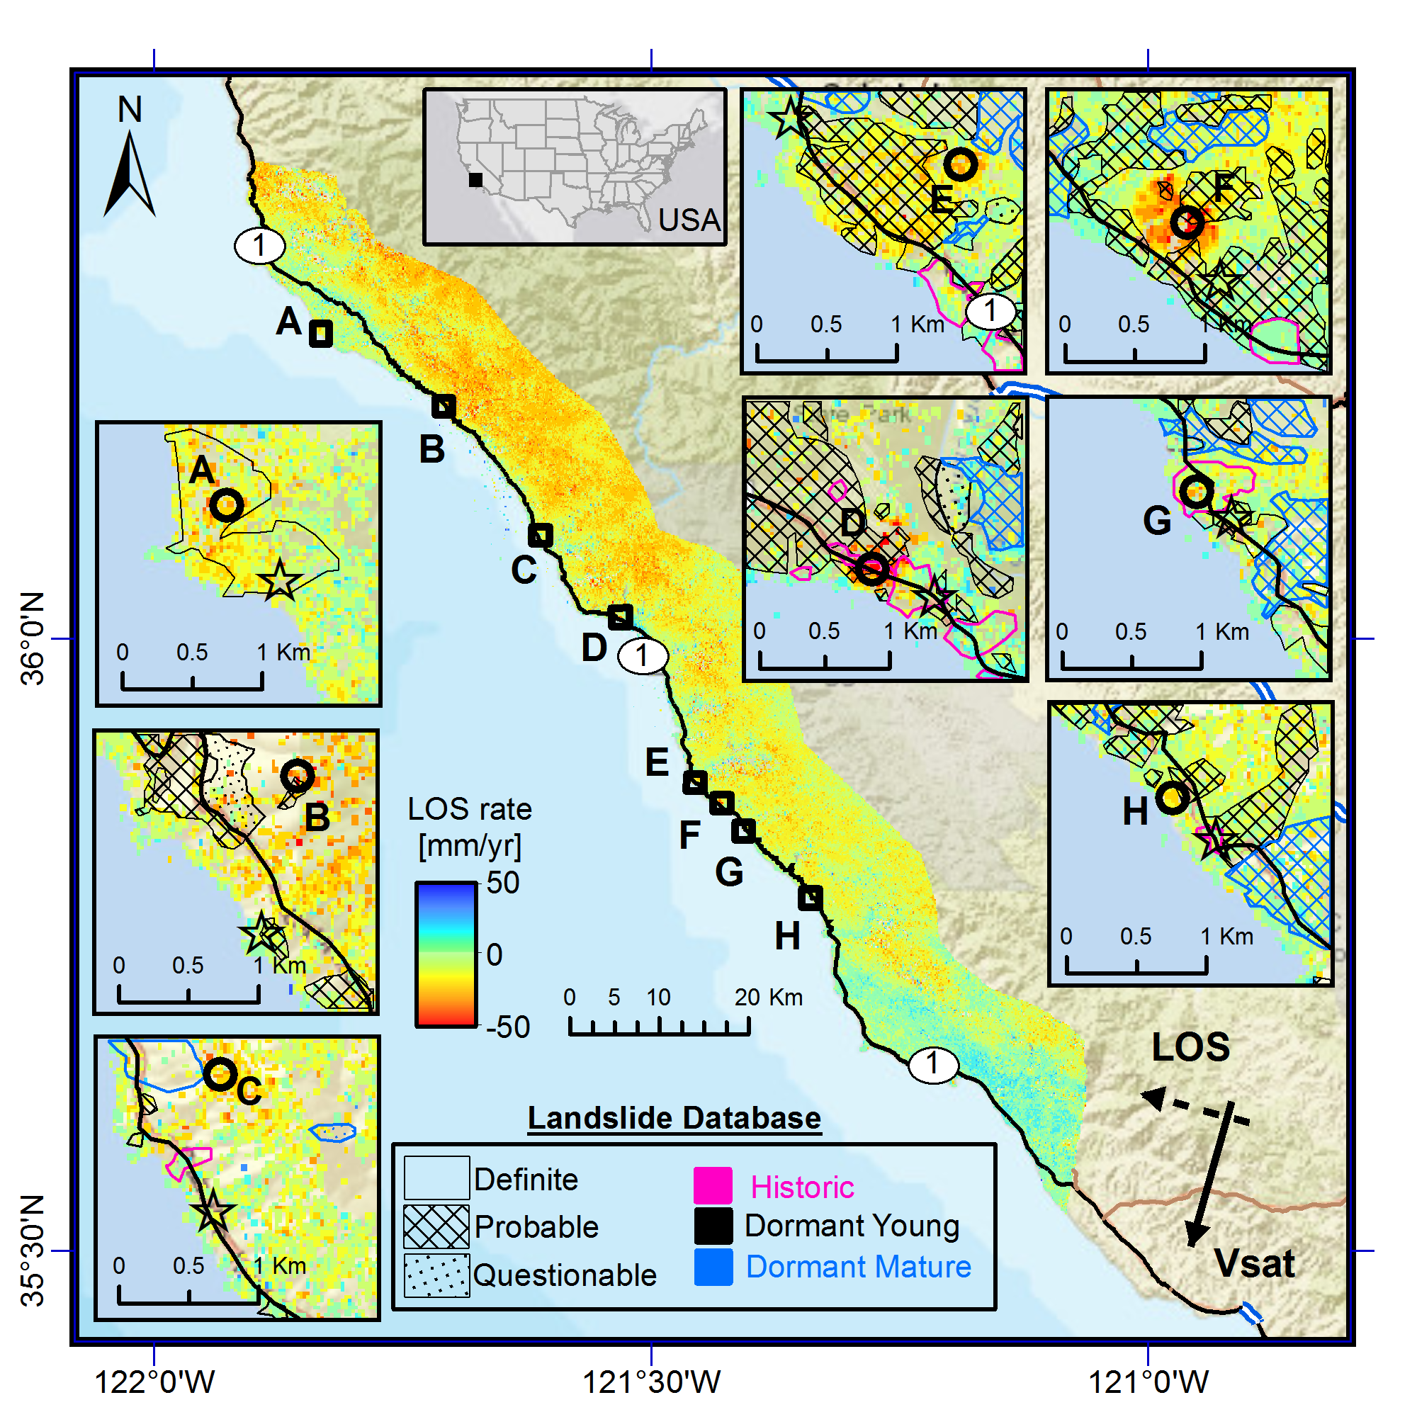
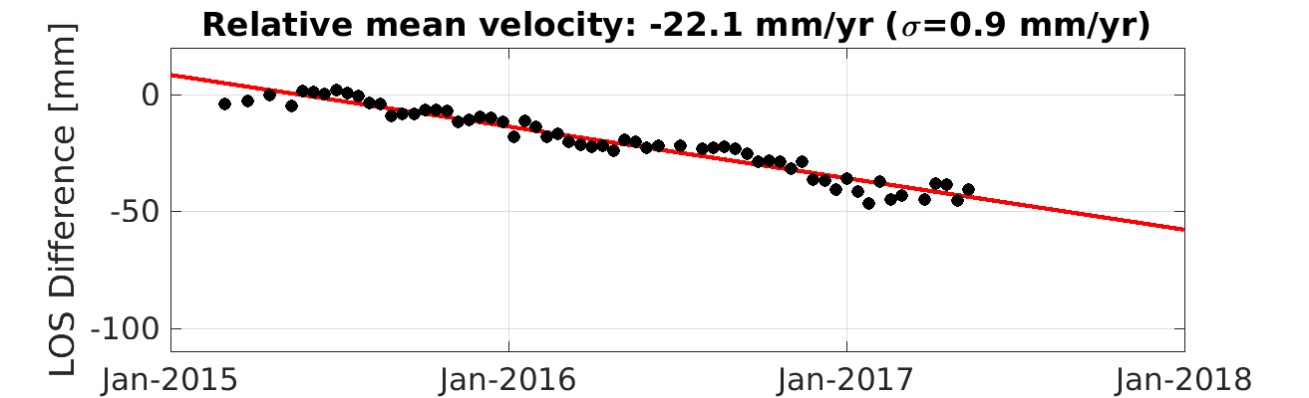
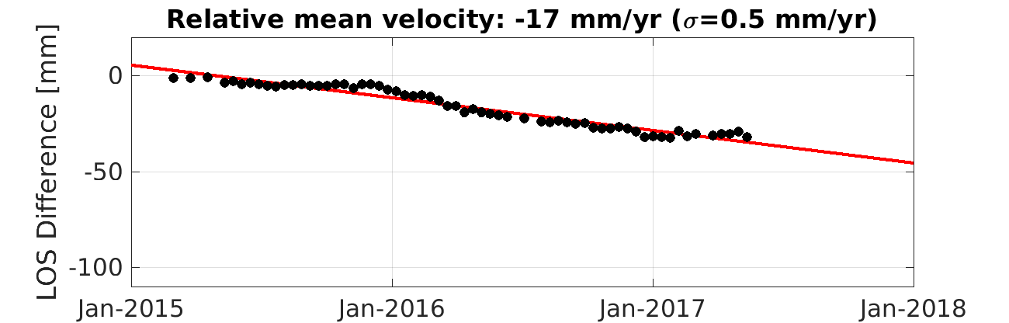
Time-series InSAR research Demonstration of landslide mapping using Sentinel-1 (PNW, USA)
Map shows average line-of-sight surface displacement rates between Oct 2014-May 2017 using Sentinel 1 SAR data and processed using JPL’s ISCE processor and StaMPS time-series package.
LOS time-series with respect to each reference
A
H
D. Bekaert, P. Agram, and H. Fattahi. (Jet Propulsion Laboratory, California Institute of Technology)

Slide 28
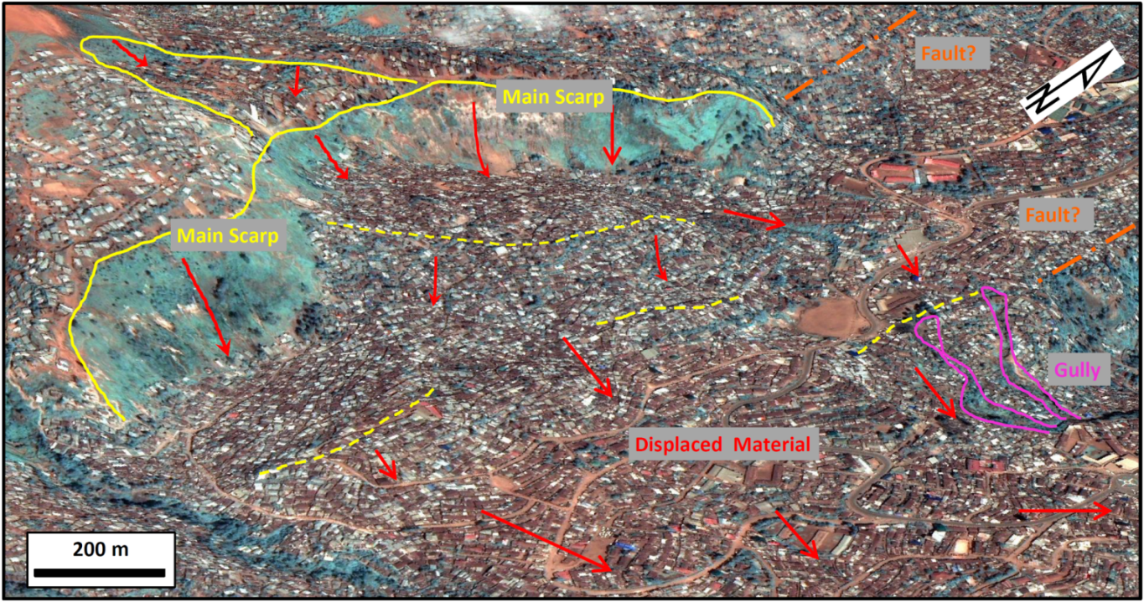
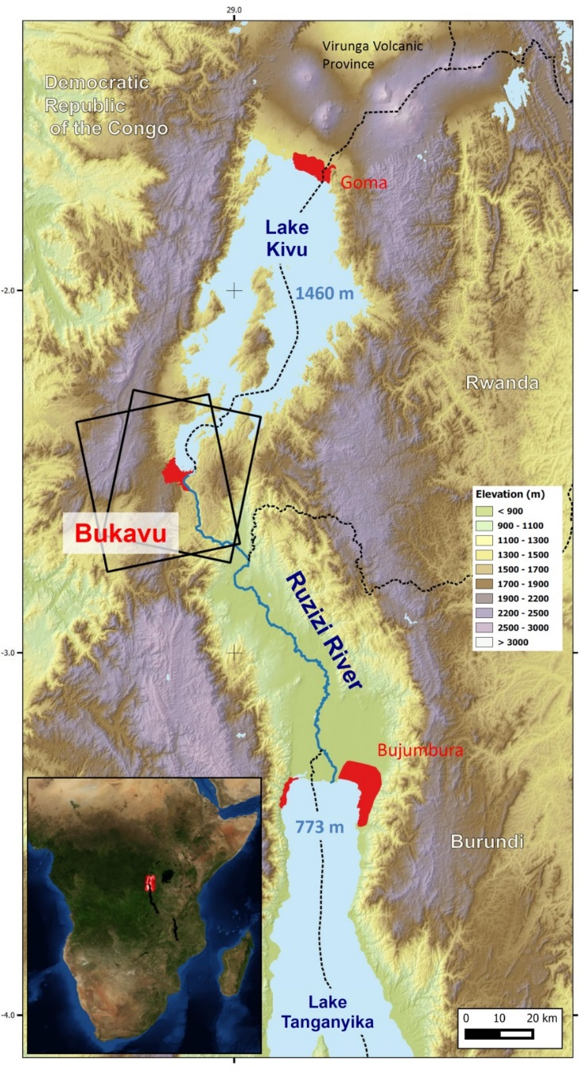
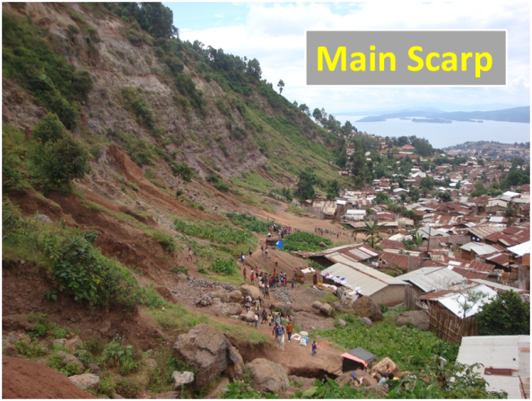
Bukavu, Africa landslide monitoring
HR Pléiades image draped on 5 m TanDEM-X DEM. This figure focuses on a large (1.5 km²), deep-seated and slow-moving landslide (Funu landslide) that affects the densely inhabited (~80 000 inhabitants in the landslide) south-western part of the city of Bukavu.
Dewitte et al. in preparation

Slide 29
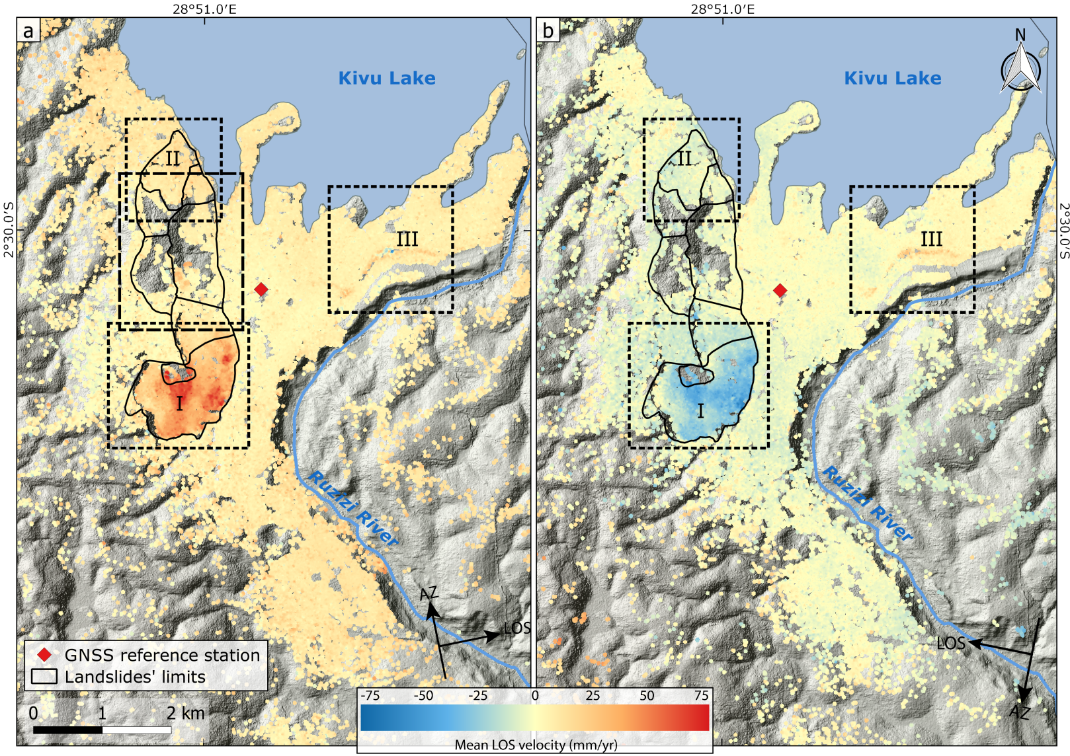
InSAR deformation rate maps
70 CSK images were acquired through the RESIST at a discounted rate through a specific agreement between Belspo (Belgian Science Policy) and A.S.I. - Agenzia Spaziale Italiana. This was possible thanks to the RESIST project which is supported by Belpso and its space program.
InSAR deformation rate maps for the ascending (a) and descending (b) CSK datasets. The combination of the LOS vectors from the ascending and descending datasets shows clearly the large (1.5 km²), deep-seated and slow-moving landslide affecting the SW part of the city (I) moving towards the east with an important subsidence component.
Dewitte et al. in preparation

Slide 30
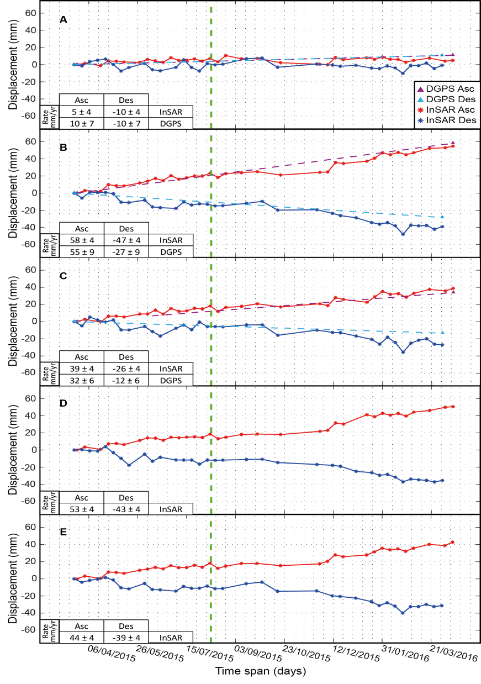
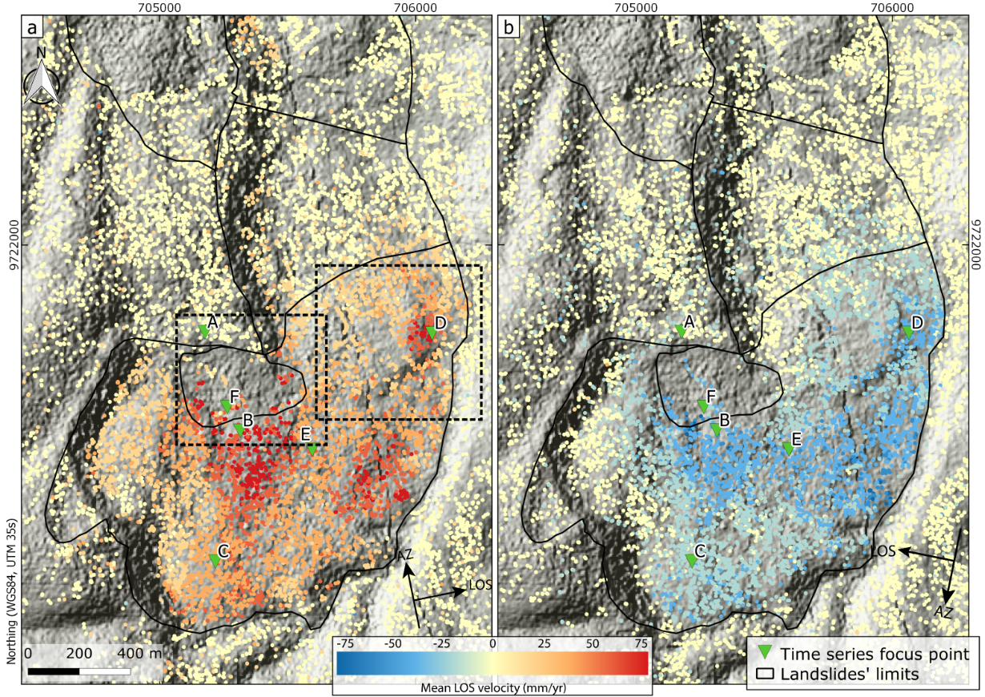
Bukavu ground deformation
Zoom on Funu landslide (I). Points A to F correspond to the positions where we extract the InSAR displacement time series in Figures 7 and 8 ; the points A, B and C also corresponding to DGPS benchmarks.
Time series of displacement obtained from InSAR on which are overlaid the rates obtained from DGPS measurements when available. The green dashed line corresponds to the Mw 5.8 August 2015 Lwiro Earthquake.
Dewitte et al. in preparation

Slide 31
Hold for CAS Slides
Slides coming from Chinese Academy of Sciences

Slide 33
Final Remarks
Operational Take-aways
Working through the data access pipeline has taken a long time, but we hope to begin receiving data within the month
A large impediment in the process has been the ability to sign agreements from another government agency
There is interest and there are opportunities to leverage the Landslide pilot for rapid assessment post-disaster; however, there have not yet been many examples (Sierra Leone is a recent one where Lorant was involved with Jean-Philippe Malet)
Science Take-aways
Cutting edge research on the potential for exploiting SAR imagery for landslide detection and monitoring in complex terrain with dense or seasonal vegetation (such as in Nepal) is ongoing, but decorrelation remains a major issue in this region. The majority of the community is still reliant on optical or multi-spectral imagery.
The pilot is keenly interested in gaining access to SPOT data, if possible, to expand the multi-temporal landslide mapping capabilities, particularly over Nepal

