Slide 1
CEOS Disaster Risk Management Proposition to the CEOS WG Disasters: The Geohazards Lab
CEOS WG Disasters meeting

Slide 2
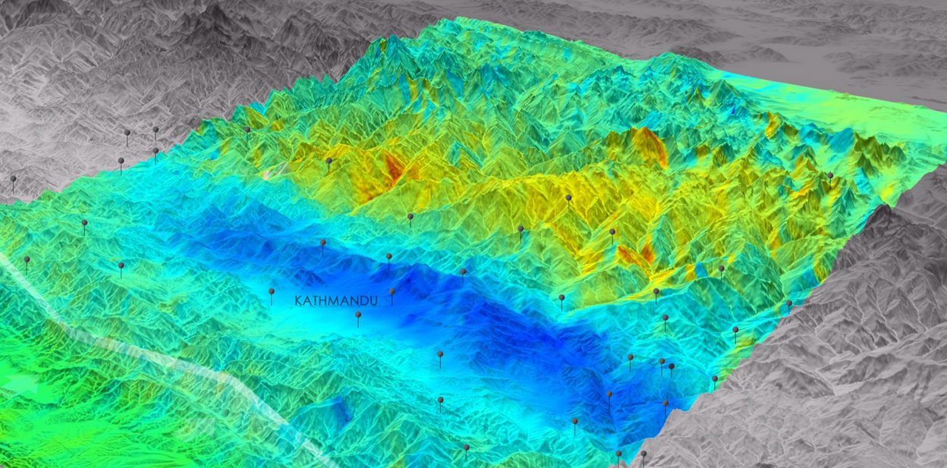
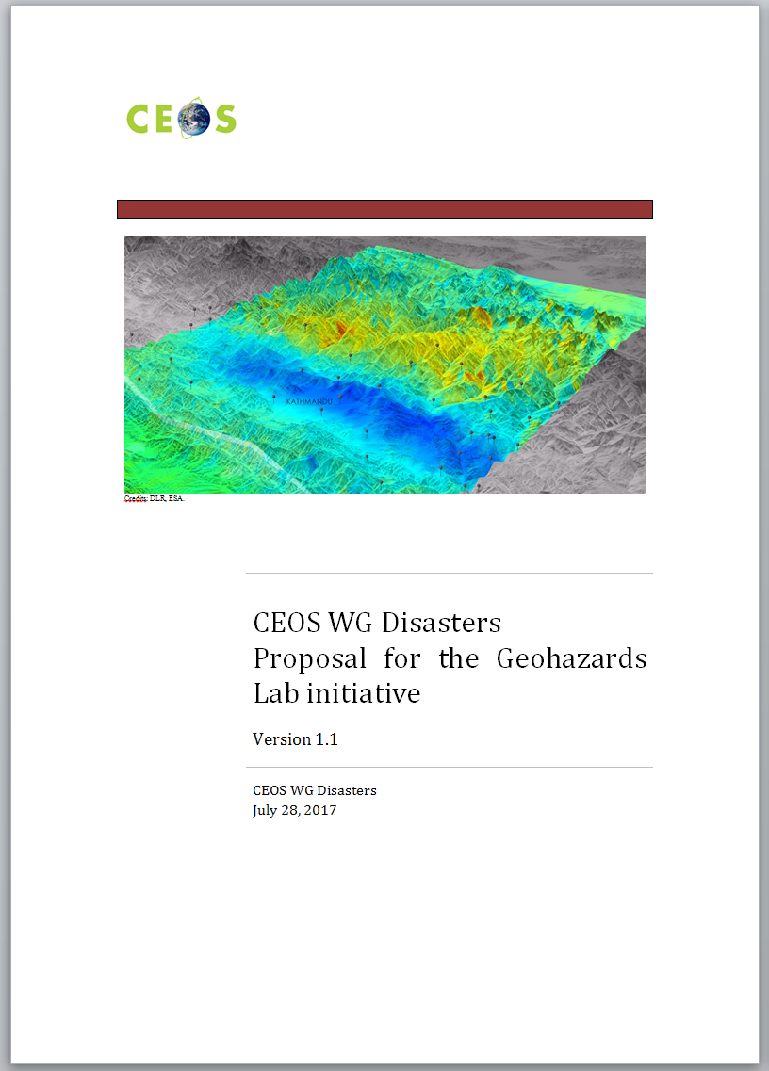
Overview of Proposal:
A new initiative (Jan 2017) proposed in the frame of CEOS
Initially combining processing platform activities and thematic exploitation activities (e.g. seismic/volcano/landslides Pilots and R.O.). Based on discussions during the 7th meeting in March 2017, the CEOS WG Disasters decided to define the Geohazards initiative as a stand alone activity and linking it to all relevant thematic activities under CEOS.
Approved by CEOS SIT during the SIT-32 in Paris, France, 27 April 2017
Credits: DLR, ESA, Copernicus programme.

Slide 3
Geohazards Lab overview:
Definition:
A platform with federated resources
to access, process
and publish satellite EO data
and derived products
Goal:
Provide data access and a processing
and e-collaboration environment
to exploit EO data to assess geohazards and their impact
Aims to address priorities of the Sendai Framework for Disaster Risk Reduction 2015-2030 using satellite EO (focus: better understanding hazards & risks)
Supports and complements the CEOS WG Disasters activities (on-going pilots, follow-on activities and the RO), the GSNL and GEODARMA.

Slide 4
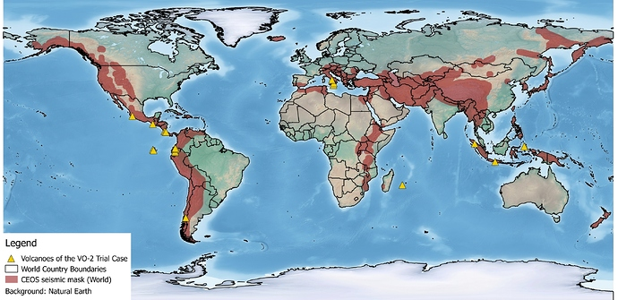
What are the Challenges?
Challenges identified in the past years:
many users aren't aware or cannot afford EO based solutions
the EO data and derived VA products are costly to generate for the objectives of the community (e.g. with regional/global coverage)
EO techniques need to be adopted by users (standards, norms)
some new EO missions' data are large in volume
some EO applications require complex or intensive processing
some EO applications require to maintain, reprocess and compare EO based VA products

Slide 5
A new activity with the geohazards community:
A new activity to start in late 2017 with the goals to:
Continue supporting CEOS and GSNL users to exploit data with hosted processing
Work on standards and support consensus results generation (e-collaboration)
achieve awareness and acceptance of EO based solutions with expert users and end users (in line with the CEOS pilots and follow-on activities, RO, GSNL and GEODARMA)
enable EO applications with massive volume and/or intensive processing, such as in the case of terrain motion monitoring based on InSAR or stereo-optical data,
reduce the cost of EO exploitation via the mutualization of resources (resources provisioning, processing chains)
increase access to users in regions where it is difficult to download large EO data products while the results of Cloud based processing generally are much smaller files (i.e. the democratisation of space technology),
ensure the persistency of results and allow to share and transform processing chains (geotagging results and publication, integration and evolution of processing chains)

Slide 6
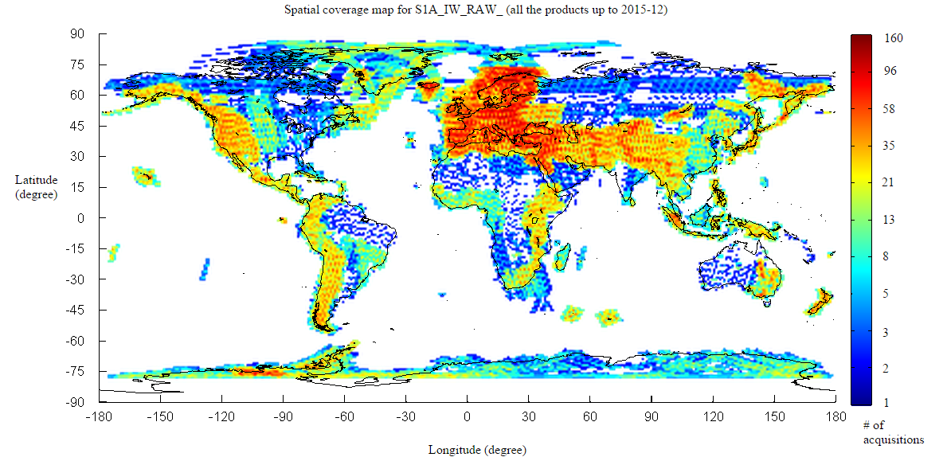
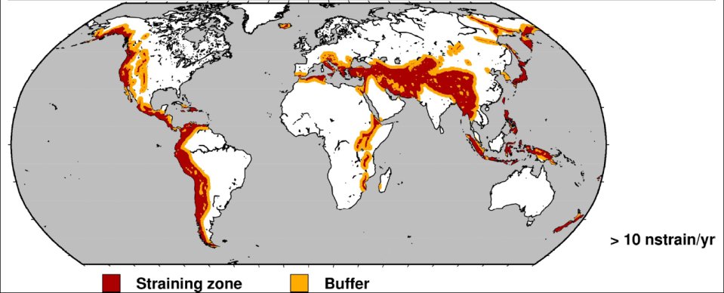
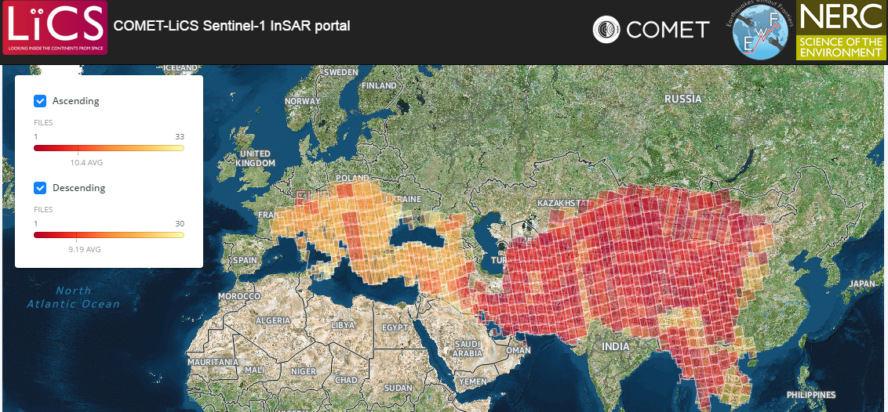
Examples of challenge:
Sentinel-1 and Sentinel-2 change the way satellite EO is exploited for DRR:
Using Sentinel-1 complex data over the world tectonic mask requires to process 200+ pairs of images every day (2800+Giga).
Similarly using Sentinel-2 all land surfaces of the world are covered every 5 days (4+ Tera per day).
To adress this requires
a new approach for data exploitation.

Slide 7
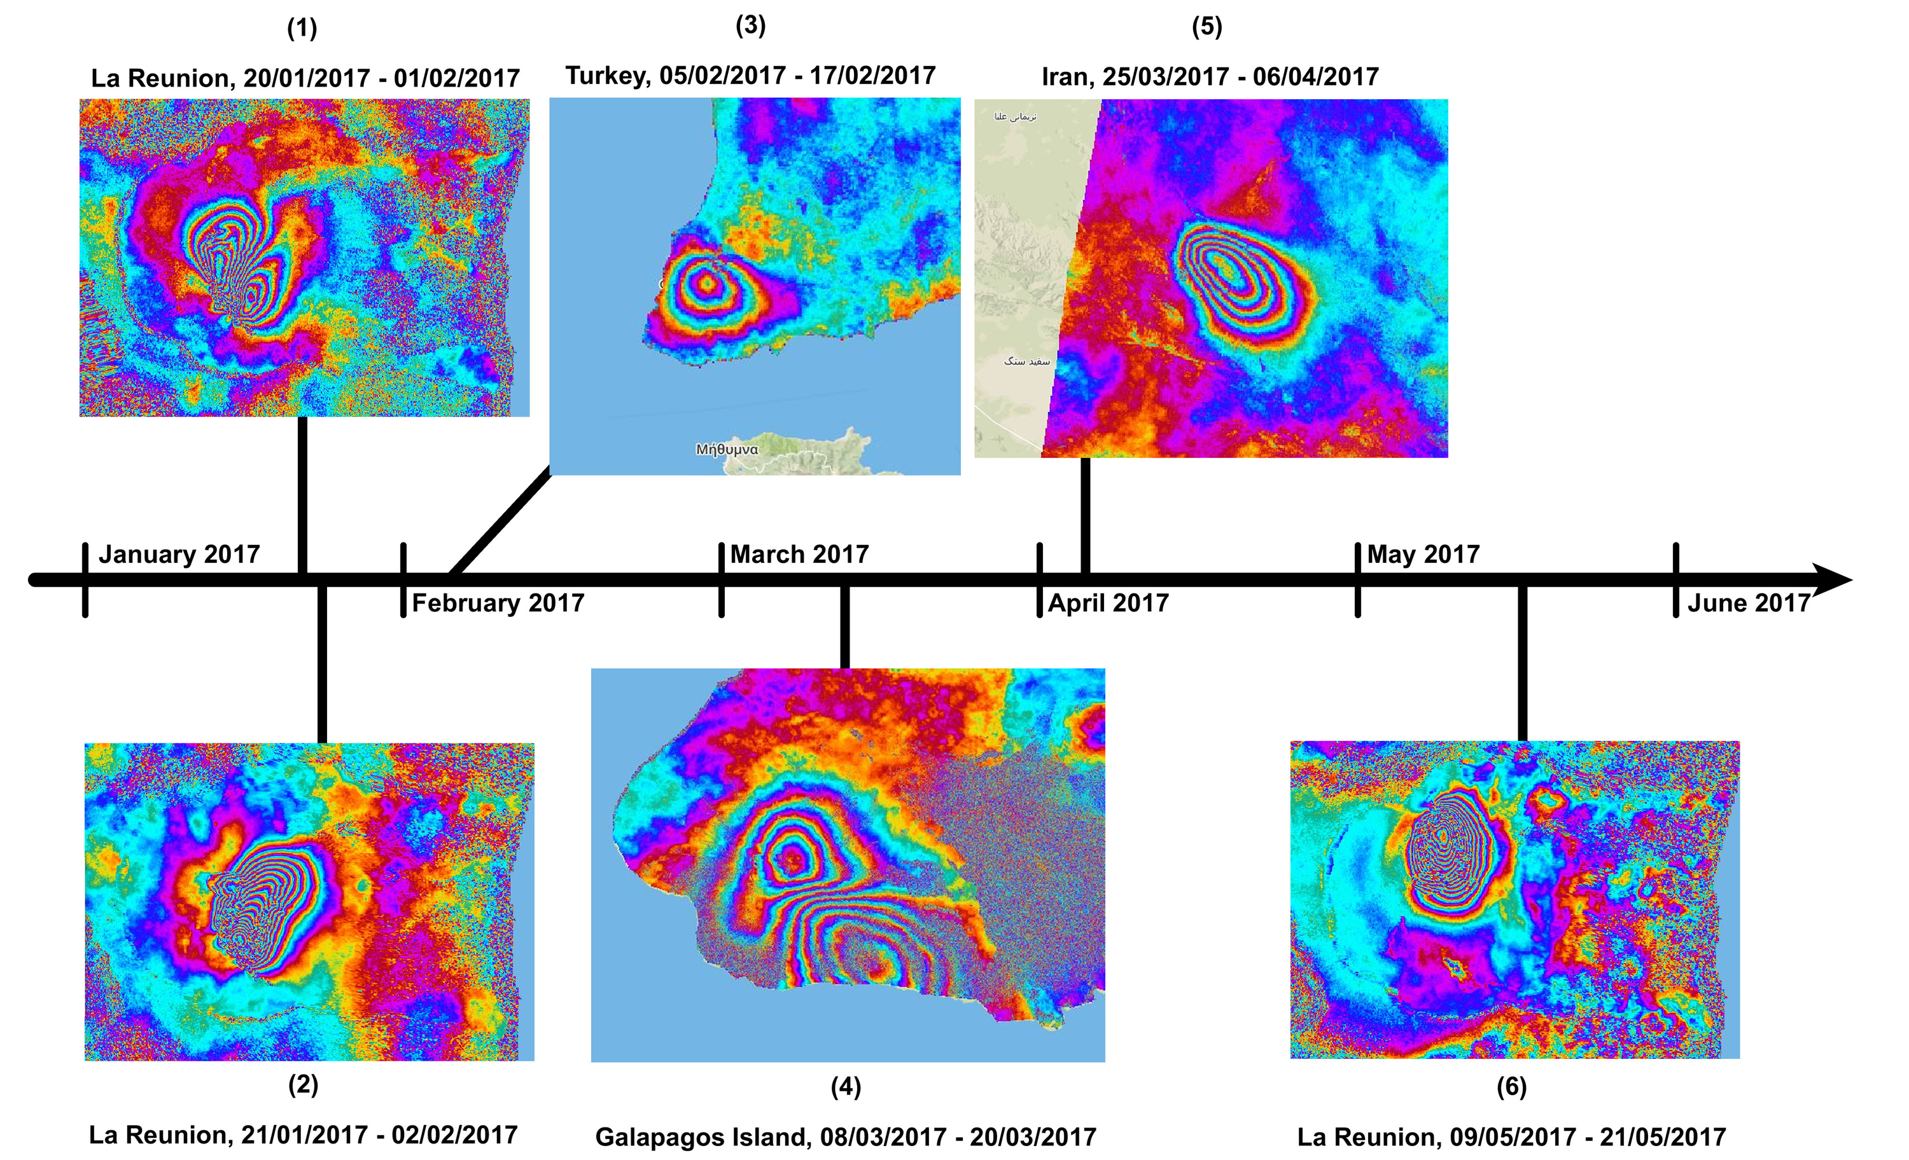
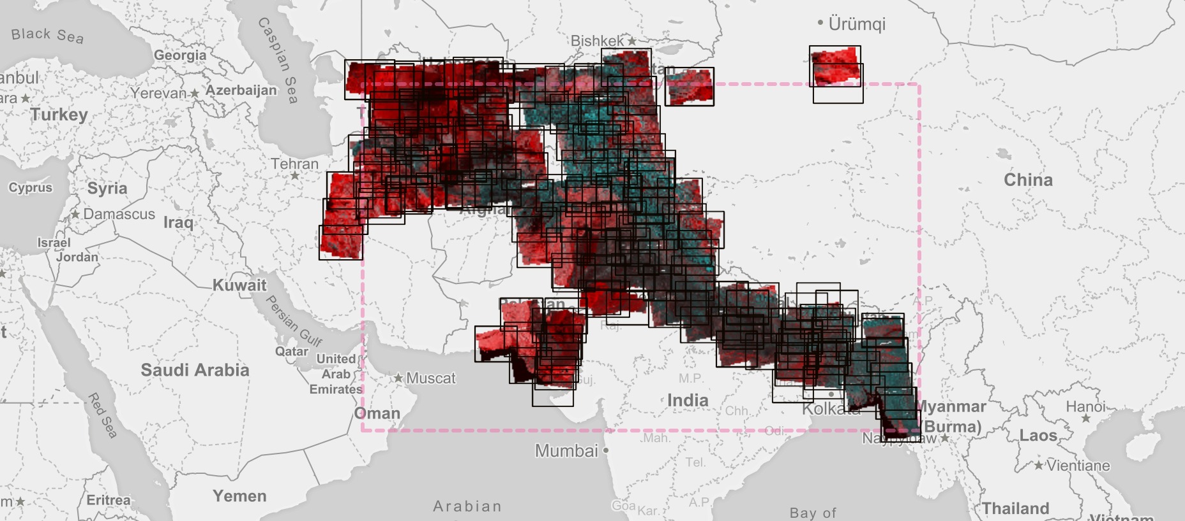
Example of opportunity:
The Geohazards Exploitation Platform generated large volumes of measurements shared with the user community in the context of the CEOS WG Disaster since 2015.
Note: the GEP is also a pilot within the CEOS WGISS
Notes:
Caption of the top left image: Deformation detected with the DLR InSAR Browse Service by an eruption of the volcano Piton de la Fournaise on January 31st, the earthquake close to Behram, Turkey, the volcano Cerro Azul on the Galapagos Island of Isabella in March 2017, the April 5th earthquake in north-eastern Iran and the second eruption of the volcano Piton de la Fournaise on May 17th.
Caption of the central image: Illustration of the systematic production of the DLR InSAR Browse chain using Sentinel-1 data on the GEP. Region: Himalayas.

Slide 8
Overview:
The Geohazards Lab intends to enable:
Integration & use of tools in an on-line environment: help the geohazard user community generate EO measurement with on line processing without downloading data.
Conducting e-science: accelerate the science use of satellite EO & promote research through new mechanisms using the web (sharing results, take advantage of the persistency of EO measurements executed and stored on-line, etc.).
Articulate with the relevant thematic activities of the WG Disasters and help them develop the user community: support CEOS activities, and, in parallel, develop and manage activities with other users of the geohazards community (that may not currently work in the framework of the CEOS WG Disaster).

Slide 9
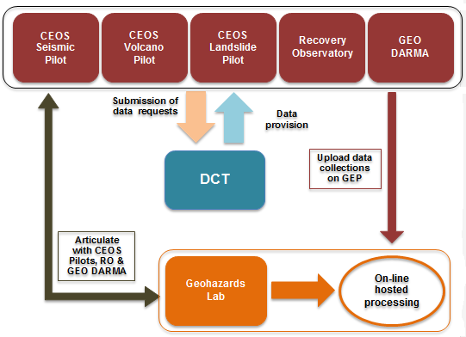
The idea of the Geohazards Lab
The Geohazards Lab will articulate with the Data Coordination Team (DCT) to make sure it does not interfere with data ordering and delivery of other CEOS WG Disasters activities.
It provides EO processing resources to exploit these data. It is directly accessing open & free data; it is able to upload other EO data collections associated to users of CEOS WG Disasters activities (e.g. pilot, RO, etc.) on a case by case basis provided permissions are granted and as per the DCT procedure.
It can also be used to deliver EO data e.g. to support CEOS pilots activities, the R.O. and the Geohazards Supersites (GSNL) initiative; for instance ASI confirms that GEP will be used for the GSNL concerning Cosmo data.
In addition the Lab is able to deliver VA products elaborated by partners on the platform or generated externally (e.g. off line) and published on the platform.

Slide 10
Concrete objectives concerning DRR activities (1)
Not on an emergency basis
Exploit commonalities across geohazards themes (tectonics, volcanoes, landslides) and need for common processing tools and systematic monitoring chains:
Support the GSNL initiative with on-line services e.g. provide access to processing tools for GSNL users.
Support other CEOS Pilots that are still pursuing their activities and other follow-on activities
Support the Recovery Observatory (RO) activity by providing access to tools and hosted processing about geohazards related issues relevant to the RO deployed
Support GEO-DARMA by providing access to tools and hosted processing about geohazards in the priority areas (as described in the GEO-DARMA implementation plan) for risk assessment

Slide 11
Concrete objectives concerning DRR activities (2)
On an emergency basis
Pursue and support the generation and distribution of advanced science products based on terrain motion mapping e.g. advanced tectonics mapping using Sentinel-1 for earthquake response (deformation maps, source models, etc.)
Pursue and support the generation and distribution of other advanced science products e.g. for landslide monitoring, thermal signatures of volcanic eruptions, etc.

Slide 12
Contributions from space agencies
… so far 4 space agencies …
ESA
-access to the Geohazards Exploitation Platform including: data storage, processing software (InSAR and stereo-optical processing chains), e-collaboration environment;
-man-power (staff & support under consultancy contract): scientific animation and promotion of information and results; support to coordination/governance.
CNES intends to provide:
-Processing services developed by the French Solid Earth community within the forM@Ter data centre including systematic InSAR processing, DEM processing and optical image correlation.
-Potential contribution to a pool of specific human resources dedicated to the Geohazards Lab initiative

Slide 13
Contributions from space agencies
… so far 4 space agencies …
ASI: shall make available CEOS and GSNL Cosmo-SkyMed collections through the GEP (already done for the Nepal event supersite). Further details TBD.
- DLR: on a voluntary basis provide:
-higher level science products derived from Sentinel-1 and TerraSAR-X data -access to the automated Sentinel-1 interferometric chain.
Contribution from other CEOS agencies :TBD

Slide 14
Contributions from the geohazards community
Geoscience centers with EO expertise that already have had an active role:
CNRS EOST /France
CNRS IPGP /France
COMET /UK
ISTerre/Institut de Recherche pour le Développement (IRD) /France
INGV /Italy (via the responsible of the Geohazards Supersites and Natural Laboratories initiatives)
BRGM /France (proposing to contribute to harmonize and improve acceptance of platform based EO techniques to support geohazards users)
CNR-IREA /Italy (via platform federation activities about InSAR data processing)
(these thematic users are proposing to take part to the Geohazards Lab activity about platform specific issues)

Slide 15
Proposed work
With CEOS agencies, the Geohazards Lab will take advantage of their mutual capabilities and resources to support on-line processing (with either interoperable but separate platforms or a federated environment, TBD).
With community partners, it will take advantage of complementarities and identify possible cooperations between different relevant projects (e.g. some geoscience partners provide hosted processing capabilities).
The Geohazards Lab intends to perform the following tasks:
Unify the method to access services, be it with separate platforms or a federated environment
Support a common authentication and authorization framework
Allow users developing EO based services to integrate algorithms & tools in a common shared environment
Ensure storage and processing resources are available to support on demand processing as requested by users
Define shared governance rules between the owners & operators of the underlying processing environment
Make sure the system capabilities enable EO services to be consistent across user groups and in time
Notes:
Expand capabilities to make sure that processing results are consistent across user groups: the knowledge base resulting from using hosted processing for geohazards may be accumulated between different user groups and over time by exploiting such products and access them over sequences and successive events in the case of future hazard impacts (over an area where historical measurements have already been provided and properly archived); the persistency of the products provided via the Geohazards Lab will support this.
make sure that users are aware of the assets available: clear access method and shared results Function: cataloguing external and internal EO data sources and processing chains, publishing and sharing results.
unify the method to access services, be it with separate platforms or federated platforms
Function: common orchestration of distributed resources, chaining of distributed processing services or integration of common tools and data; this includes linking the series of processing chains (e.g. the GEP calls a service integrated on PEPS via WPS, etc.) or just integrating the same chain in different environments (e.g. in two platforms and the effort for the integration is shared)

Slide 16
Proposed work: first ideas
Overall the collaboration of platforms under the Geohazards Lab will improve how users exploit EO in an on-line environment.
Examples:
ESA
The GEP will continue to be available for processing: it will be connected to Copernicus DIAS to access EO mission data from EO missions such as for instance Sentinel missions.
DLR
DLR intend to pursue & expand their InSAR Browse service on GEP (confirmed) and are studying the possibility of a new on-line processing capability using TerraSAR-X run be DLR (TBC) and connected to GEP.
CNES and ESA
Work with users from the Form@ter network and GEP users to establish a methodology about the generation of deformation data using InSAR and Optical data (TBC). This will support historical analysis and back analysis using hosted processing with different EO sources.
Notes:
make sure that users are aware of the assets available: clear access method and shared results Function: cataloguing external and internal EO data sources and processing chains, publishing and sharing results.
unify the method to access services, be it with separate platforms or federated platforms
Function: common orchestration of distributed resources, chaining of distributed processing services or integration of common tools and data; this includes linking the series of processing chains (e.g. the GEP calls a service integrated on PEPS via WPS, etc.) or just integrating the same chain in different environments (e.g. in two platforms and the effort for the integration is shared)

Slide 17
Users of the Geohazards Lab:
Type of users: typically geoscience centres in particular geohazard experts with skills in satellite EO that process, analyze, validate, integrate data to generate products for DRM purposes to be used by decision-makers (End Users).
End Users aren’t intended to be direct users of the Geohazards Lab.
Users come from several groups:
users of thematic activities of the CEOS WG Disasters i.e. seismic, volcano, landslides and the R.O.
the GSNL users
other users of the geohazards community (the Geohazards Lab itends to support other users of the geohazards community that are not in CEOS WG Disaster activities, for instance 60+ geohazards users in the GEP today).
Several scenarios:
A user runs on demand processing
A user downloads measurements generated systematically or on request
A user integrates a new processing chain or or modifies an on line processing chains
A user runs a chain globally to generate a new derived product

Slide 18
Examples of users
User | Affiliation | Country | Expert user processing data | End user (not doing processing) | Engaged in precursor pilot?
Stefano Salvi | INGV | IT | Expert user |  | Directly
Christian Bignami | INGV | IT | Expert user |  | Directly
Cristiano Tolomei | INGV | IT | Expert user |  | Directly
Haris Kontoes | NOA | GR | Expert user |  | Directly
Tim Wright | University of Leeds/COMET | UK | Expert user |  | Directly
Barry Parsons | University of Oxford/COMET | UK | Expert user |  | Yes
Francesco Casu | CNR IREA | IT | Expert user |  | Yes
Eric Fielding | NASA JPL | USA | Expert user |  | Yes
Falk Amelung | University of Miami | USA | Expert user |  | Yes
Erwan Pathier | ISTERRE / University of Grenoble-Alpes | FR | Expert user |  | Yes
Marie-Pierre Doin | ISTERRE / University of Grenoble-Alpes | FR | Expert user |  | Yes
N/A | DPC | IT |  | End user | No
Issak Parcharidis | HUA | GR | Expert user |  | No
N/A | OASP | GR |  | End user | No
Pierre Briole | ENS (Laboratoire de Géologie de l’Ecole normale supérieure) | FR | Expert user |  | No
Paul Arellano | School of Geological Sciences and Engineering Hacienda San José s/n - Proyecto Yachay | ECU | Expert user |  | No
Abdelilah Tahayt | University of Rabat | MA | Expert user |  | No
Fabio Bovenga | CNR ISSIA, GAP srl / Polytechnic and University of Bari | IT | Expert user |  | No
Tom Ingleby | University of Leeds | UK | Expert user |  | No
Raphael Grandin | Institut de Physique du Globe de Paris (IPGP) | FR | Expert user |  | No
Dominique Rémy | Laboratoire de Dynamique Terrestre et Planétaire | FR | Expert user |  | No
Morteza Sedighi | National Cartographic Center, Tehran – Iran | IR | Expert user |  | No
Pablo Jose Gonzalez Mendez | University of Liverpool | UK | Expert user |  | No
Example of users from the Seismic hazards community already using the GEP and potentially interested on the Geohazards Lab, some of them being Seismic pilot users. The Geohazards Lab will support the CEOS, GSNL and GEODARMA users and is open to users from the wide geohazards community.

Slide 19
More examples of users (on GEP today)
User organisation | Areas
Ecole Normale Supérieure de Paris (France) | Etna, Italy and Corinth Rift, Greece
DLR IMF (Germany) | European tectonic mask
Altamira Information (Spain) | Test sites on landslides and earthquakes
ISTerre / Institut de Physique du Globe de Paris (France) | Subduction zones of Latin America, the NAFZ and Tibet.
INGV Roma (Italy) | Alto Tiberina Fault and Fogo Cape Verde
INGV Roma (Italy) | Marmara, East sector of NAFS
INGV Roma (Italy) | Haiti and West Java
ETH (Switzerland) | Large surface deformations caused by landslides in Bhutan Himalaya
NOA (Greece) | Geohazard sites in Greece
SATIM (Poland) | Silesia & Warsaw (Poland)
Obs. Physique du Globe de Clermont-Ferrand (France) | Piton de la Fournaise in La Réunion, Cordon del Azufre / Lastarria in Chile–Argentina
INGV Catania (Italy) | Etna & Campi Flegrei / Vesuvius
British Geological Survey (UK) | Urban areas of Great Britain
University of Leeds (UK) | Active deformation in the Alpine-Himalayan belt
ESA | Over calibration sites: Rain forest, Germany (DLR targets), Australia Milan, Chicago, Sao Paulo
ESA(Progressive Systems SLR) | Greater Cairo, South Rayan dune field, Middle Egypt province and Aswan province
CNR IREA (Italy) | Tests on Italian volcanoes and Hawaiian and Japanese volcanic and seismic areas
Universita De L’ Aquila (Italy) | Abruzzo region: L’ Aquila and Teramo for post-seismic ground displacements
University College of London (UK) | UK landslides
University of Rabat(Morocco) | Morocco seismic activity
Volcanoes
Earthquakes
Landslides
Subsidence

Slide 20
More examples of users (on GEP today)
User organisation | Areas
CNR ISSIA (Italy) | Indonesia
IPGP (France) | Asia, N& S America, Indian Ocean
Universidad de Concepcion (Chile) | Southern Andean zone
Laboratoire de Dynamique Terrestre et Planétaire (France) | South America active volcanoes and tectonics
BRGM (France) | French coast subsidence
AIM CEA (France) | La Reunion
National Cartographic Center (Iran) | Iran
Instituto Geologico y Minero de Espana (Spain) | SouthEast Spain
USGS (USA) | Latin America volcanoes
CVGHM (Indonesia) | Indonesian and Mexican volcanoes
Volcanoes
Earthquakes
Landslides
Subsidence
61 users to date
5 user organisations are CEOS pilot users (4 Seismic pilot users and 1 Volcano pilot)
Mainly European users, but also 11 users from Asia (Indonesia, Thailand, Malaysia and Iran), Africa (Algeria, Morocco), South America (Chile, Mexico) and North America (USA).

Slide 21
Collaborations
GEODARMA: provide access to data, tools and processing resources (on a best effort basis) to GEODARMA.
GSNL: support the GSNL objectives by providing access to a processing environment. Host scientific products generated by Supersites and integrate collaboration and scientific processing services being developed for the GSNL community under the EVER-EST project.
Other CEOS WG Disasters activities:
fully articulate with current and follow-on CEOS activities
provide a mechanism to access data and a scientific processing and e-collaboration environment.
CEOS WGISS activities: collaborate to support the realisation of a WGISS pilot; identified contribution: the GEP. A workplan has been written to prepare the pilot exercise.
nextGEOSS: on-going discussions to include the Geohazards Lab and its services within the GEOSS Common Infrastructure.

Slide 22
Expected outcomes:
Increase access to hosted processing
Increase number of users that access on-line tools to support DRM
Increase type of users in the different segments of the user base; in particular address more types of hazards; keep focus on EO specialists from these user organisations (the thematic activities of the WG Disasters work with EO experts and end users/decision makers while in the short term the Geohazards Lab is intended to help EO specialists)
Increase awareness/promotion about satellite EO and DRM for different relevant themes (landslides, seismic hazards, volcanoes): if requested help Pilot Leads of other thematic activities of the WG Disasters to promote results (e.g. publish geospatial results on the Geohazards Lab).

Slide 23
Evaluating achievements:
Criteria | Min. effort
Number of EO processing chains available to the users by the end of the activity | 15 chains
Type of EO data available through the Geohazards Lab’s on-line platforms | 3 SAR and 1 VHR Optical data source
Volume of EO data available through the Geohazards Lab’s on-line platforms | 100 scenes per data source
Number and quality of products generated on-line | 30 products per year
Number of users and practitioners using the Geohazards Lab | 30 users
Number and quality of peer reviewed papers based on the work accomplished by the Geohazards Lab | 5 papers per year
Success in raising awareness (a) within the scientific community (e.g. through capacity building) and (b) the end users/decision makers (when these are recipients of information products and reports based on the the interpretation of Geohazards Lab’s products) | (a) Training courses, workshops and (b) positive feedback from end users, benefit etc.

Slide 24
Milestones and schedule:
Concept Phase: April 2017- Q1 2018
Currently: process of elaboration and discussion between CEOS agencies and other partners of the Geohazards Lab to better define the activities and key outcomes.
Implementation Phase: Q2 2018 – Q1 2021
Year 1:
Expand integration of services and tools to better meet community needs
Document procedures to access and use processing chains.
Define protocol with CEOS agencies that contribute to the Geohazards Lab. As a baseline ESA will provide access to the GEP. This protocol is to develop collaboration with agencies willing to contribute to the processing environment (e.g. platform resources federation).
Enhance procedure to make data available in a timely fashion.
Develop a Web site
Start promoting hosted processing and raising awareness (capacity building, training courses, workshops)
Analyse geohazards community requirements
Year 2:
Develop collaborative framework with geoscience centres and other initiatives to define common standards/methodologies
(example: agree rules to present terrain motion measurements irrespectively of the processing chain)
Start harmonization and improvement of EO results
Continue integration of services and tools
Validation and use of services and tools
Finalize definition of procedures to access and use processing chains.
Year 3:
Complete validation and full scale demonstration of services and tools
Summarize lessons learnt.
Complete implementation of geohazards community requirements
Complete harmonization and improvement of EO results

Slide 25
Governance approach
The Geohazards Lab shall be organized according to CEOS WG Disasters rules:
Coordination: ESA is proposing to play a role (Philippe Bally, Dorella Papadopoulou).
Data access: Data delivery procedures in collaboration with the Geohazards Lab coordinators; CEOS pilot/follow-on leads, GSNL PoC and GEODARMA PoC shall manage data requests.
the Geohazards Lab does not intend to request EO data (apart from open & free sources).
Processing chains & processing resources from different infrastructures contributing in the Geohazards Lab will be provided on a voluntary basis by CEOS space agencies and partners.
Platform resources federation: governance to be defined among the CEOS agencies willing to contribute to the Geohazards Lab.
Notes:
The users from the CEOS pilots and follow-on activities will use the data endorsed by CEOS for these activities. On a case by case basis, provided permission is granted, these data could be accessed/uploaded on-line for processing using the Geohazards Lab.

Slide 26
Next steps
Proposition of the Geohazards Lab approved by the SIT in April 2017.
Contributions gathered: 4 CEOS spaces agencies and 8 partners.
Further contributions are welcome if other CEOS space agencies or partners are interested.
A draft Implementation Plan was circulated on 30 August (WGDisasters_Geohazards_Lab-ImplementationPlan)
The Geohazards Lab is aiming for the approval of its Implementation Plan in the next CEOS Plenary (October 2017).
Aiming to kick off in early 2018.
Notes:
The users from the CEOS pilots and follow-on activities will use the data endorsed by CEOS for these activities. On a case by case basis, provided permission is granted, these data could be accessed/uploaded on-line for processing using the Geohazards Lab.

Slide 27
Thank you
For further information: Geohazards Lab initiative proposal:
http://esamultimedia.esa.int/docs/EarthObservation/Geohazards/2017-03-13_The_Geohazards_Lab_initiative_Draft_2.0.pdf
Philippe Bally, ESA philippe.bally@esa.int
Theodora Papadopoulou, ARGANS Ltd. c/o ESA tpapadopoulou@argans.co.uk

