Slide 1

Recovery Observatory (RO)
Haiti Hurricane Matthew RO Status and Next Steps
Presentation to WGD #8
Buenos Aires September 5th, 2017
Helene de Boissezon, CNES
Agwilh Collet, CNES
Andrew Eddy, AG - ROOT Secretary
Committee on Earth Observation Satellites

Slide 2
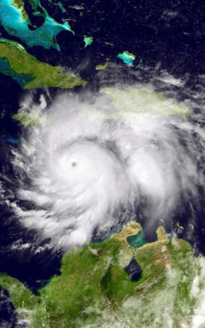
Outline
Haiti Recovery Observatory
  Status Overview
  Workshop in Port-au-Prince
  ROOP
  Steering Committee
  Next Steps

Slide 3
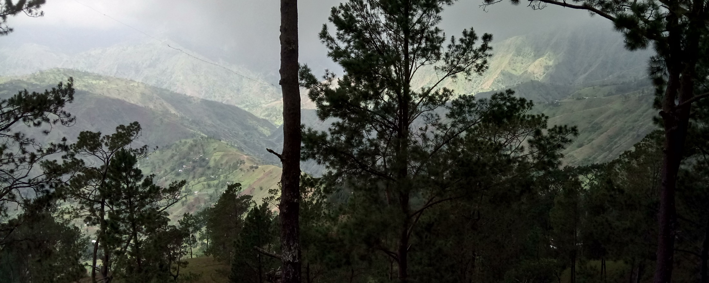
RO Status Overview
A Reminder of Haiti’s diversity
  Triggering of the RO decided by CEOS Chair in consultation with CEOS Principals, December 22, 2016, after Hurricane Matthew - October 2016
  Mission to Haiti 31 Jan - 3 Feb 2017 to establish partnership with Haiti RO users and stakeholders
  Mission to Haiti 29 May – 2 June 2017 to establish RO users connection and feedback from first products

Slide 4
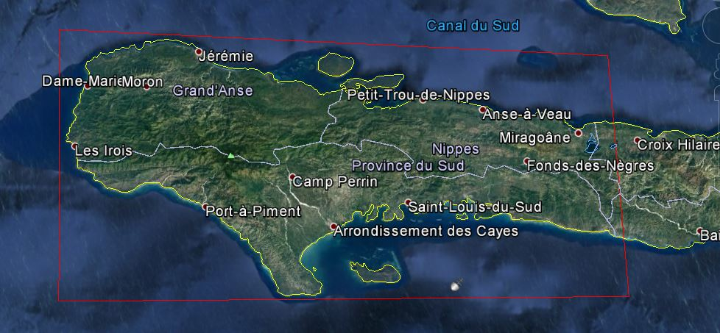
Haiti RO to cover three departments: Grand’Anse, Sud, and Nippes

Slide 5
RO Status Overview
Infra dvt
RO Lessons
learned
Product def.
Image requ.
RO Haïti Triggering
22/12/16
Early RO evaluation
2015 2016 2017 2018 2019 2020
jfmamjjasond jfmamjjasond jfmamjjasond jfmamjjasond jfmamjjasond jfmamjjasond
PDNA
Matthew hurricane
in Haïti
04/10/16
Malawi, Nepal demos
Missions (Haiti, WB/UN)
(2 to 3 per year)
1st
2nd
Workshop
29 May-1Jun

Slide 6
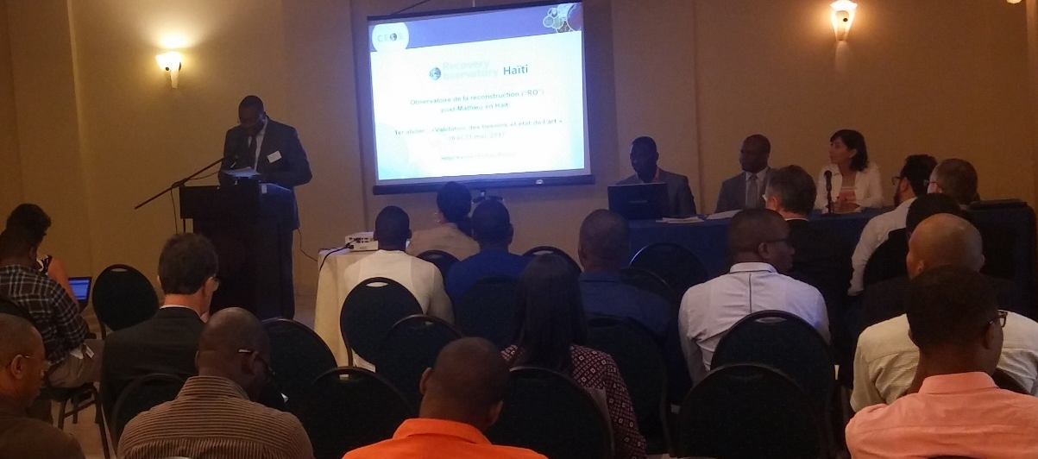
RO Mission to Haiti
Workshop users : 29 May to 2 June, 2017
Validation of needs and state of the art with Haitian users, organized by CNIGS/CNES.
Introduced by the Head of the Ministry of Planning cabinet, CNIGS director, UNDP deputy country director, ONEV director.
CNES :
Helene de Boissezon
Frederic Moll
Agwilh Collet
CIMA :
Giorgio Boni
RO Secretary :
Andrew Eddy

Slide 7
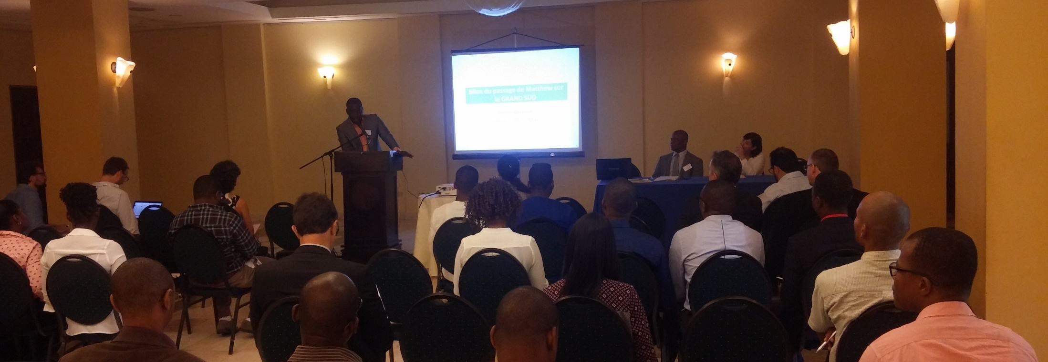
Workshop users #1
46 participants from
Ministry of Planning, CNIGS, CIAT, ONEV, Mining and Energy department, Ministry of Environment, Ministry of Agriculture, Nature Resources and Rural development, Delegation of European Union, Echo Field, French embassy, CNSA (National Coordination of Food Security) , UNDP, UNEP, SERTIT, CIMA

Slide 8
Workshop users #1
Forests, coastal and protected natural areas
Health, Populations displacement
Landslides, seismic risks
Watersheds, flooding
Infrastructure and road communication
Agriculture and food security
Technical web infrastructure
6 Value-added product themes, 1 technical
Haitian + CEOS speaker
Haitian concrete examples / showcases
Discussion to define priorities for value added products

Slide 9
Feedback from
Workshop users #1
(1/2)
Strong Haitian presence and support for RO concept
Plan to link existing tools & platforms for increased synergy: Common portal RO, HaitiData.org, RASOR, KAL-Haiti, future ONEV environmental information service.
In each theme:
  Definition of key partners and key users
  Feedback from first products and improvement
  Choose zoom area(s) to highlight
    Map of future works
Plan the Copernicus EMS Risk&Recovery requests
Strong need in Capacity Building (not directly addressed in CEOS WG Disasters framework)

Slide 10
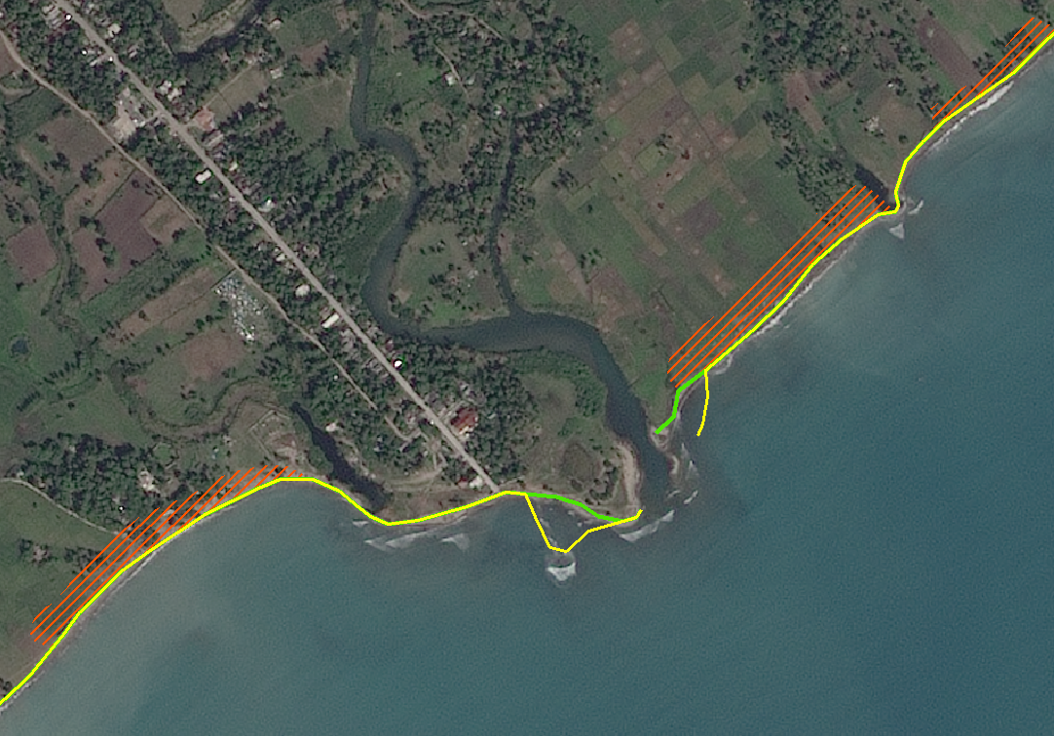
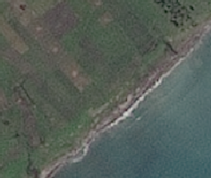

Workshop users #1 :
Concrete example
Forests, coastal and protected natural areas
Secteur 1 : Plaine des Cayes
Torbech
Spot 7 1,5m
Image before Matthew 08/01/2016
Deposits / Erosion
Deposits / Erosion
Geometry modification: Progress of Coastline
Study funded by CNES

Slide 11
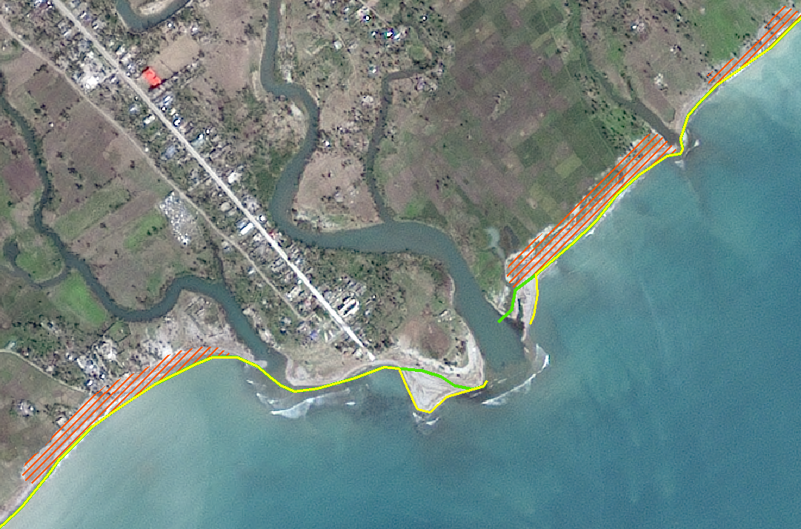
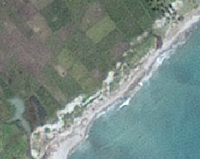
Workshop users #1 :
Concrete example
Forests, coastal and protected natural areas
Secteur 1 : Plaine des Cayes
Torbech
Spot 7 1,5m
Image post Matthew 14/02/2017
Deposits / Erosion
Deposits / Erosion
Geometry modification: Progress of Coastline
Study funded by CNES

Slide 12
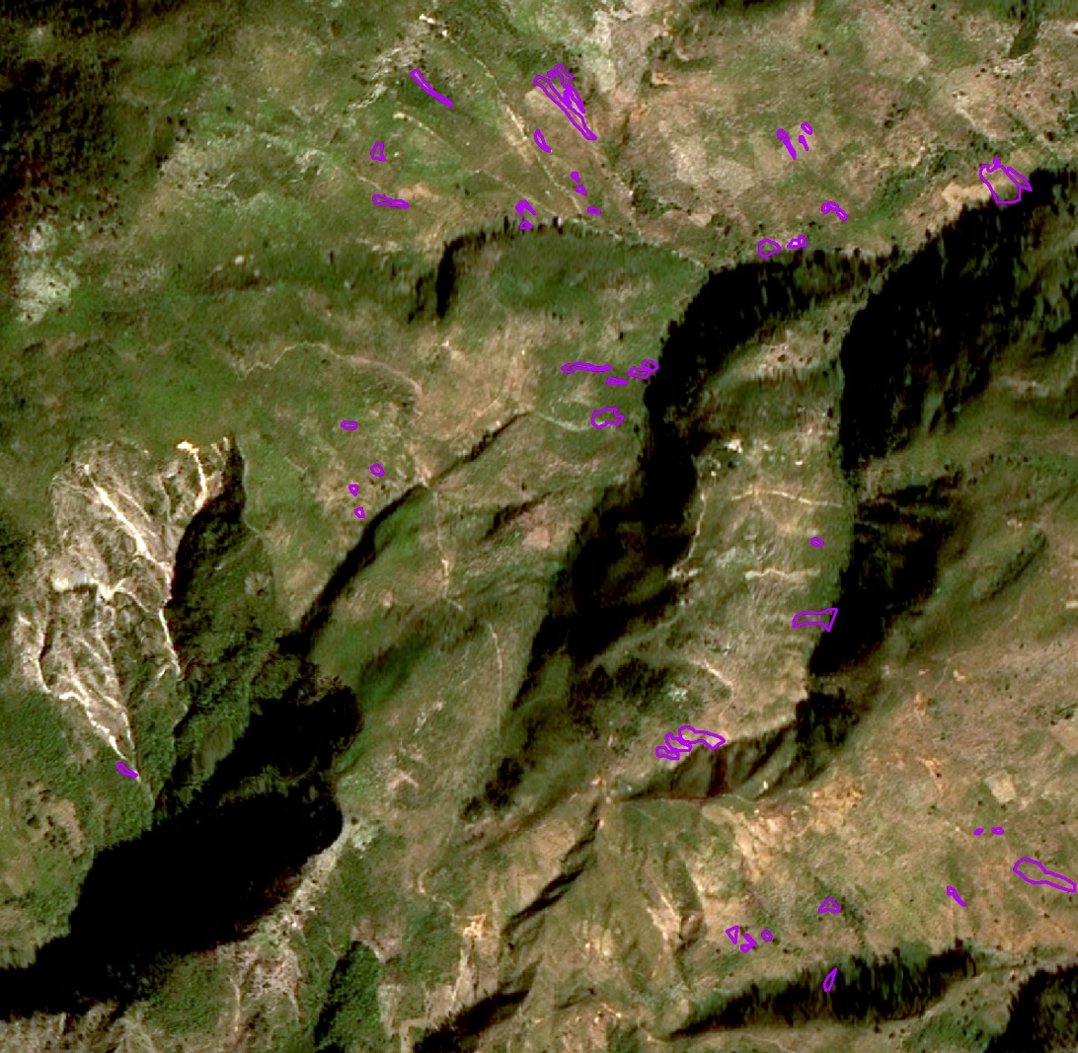
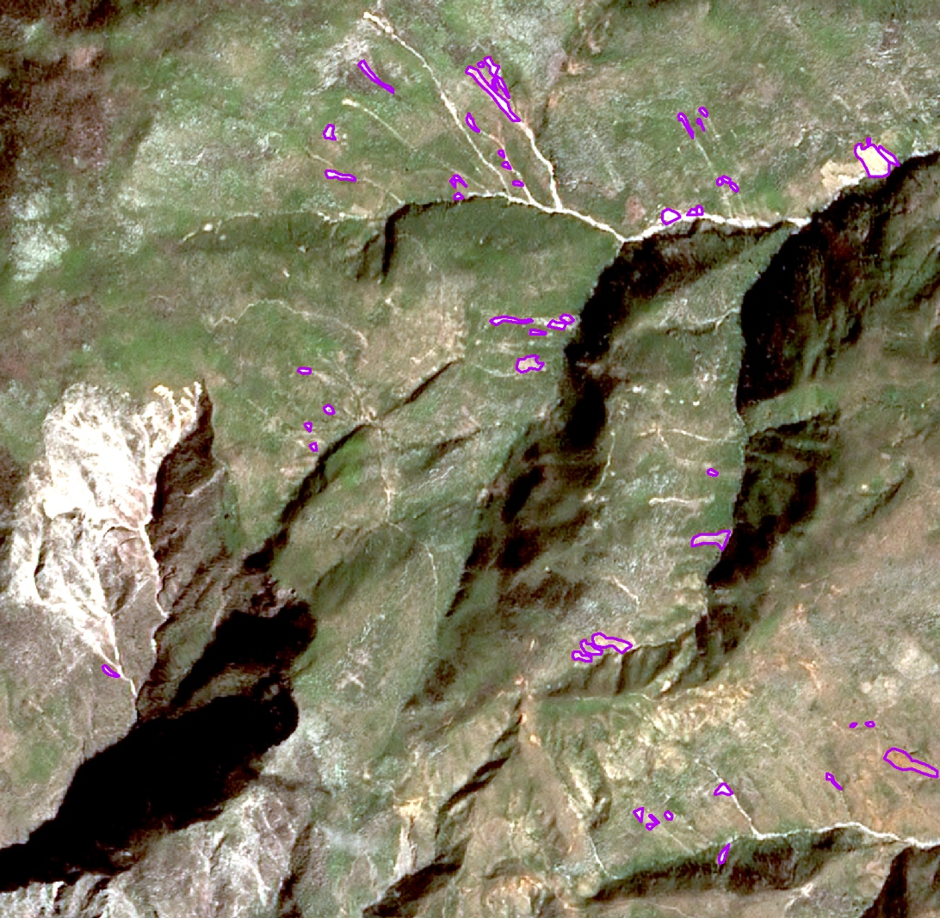
Workshop users #1 :
Concrete example
Landslides, seismic risks
SPOT 6 – Pre Matthew
January 2016
SPOT 7 – Post Matthew
February 2017
Application of ALADIM to pre / post-Matthews images (SPOT)
Deposit channels are difficult to map (+ ~ 30% of affected areas).
Shadows on the west and north slopes can cause an underestimation of total displacement.
Very complex landscape for automated mapping

Slide 13
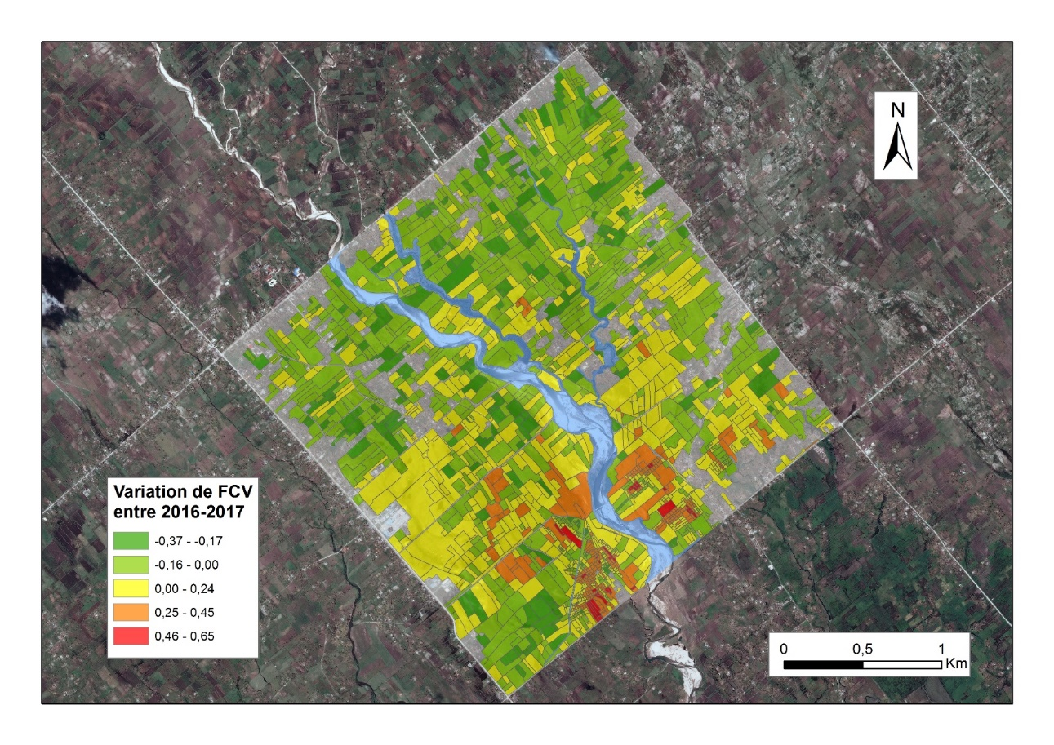
Workshop users #1 :
Concrete example
Agriculture
Secteur de la Plaine des Cayes
Evidence of pre/post-event variation
SPOT6 MS of 08/01/2016 and SPOT 7 MS du 14/02/2017
Fraction of the Vegetation Cover (calculate from NDVI) Evolution betwen 2016 and 2017
Study funded by CNES

Slide 14
Data collected
Workshop users #1
(1/2)
Bathymetry 50km from shoreline (Global Bathymetry and Elevation Data at 30 Arc Seconds Resolution 2009)
Data Base BRGM (Geological and mining research office)
  Risk Atlas 2017
  36 studies on haiti from 1999 to 2015 with GIS data related
Data Base CIAT
  Administrative boundaries
  Studies with GIS data related
  Works on Cap Haitian
CNIGS Orthophoto and MNT 2014 : cell size : 1,5m
Artibonite project (2014) Out of RO area (water uses and waterhsed )
PDNA : all documents and GIS Data (Boundaries / School / Health facilities / road etc)
Cyclonic threat ( 2009)

Slide 15
Planned works 1/3
Forests, coastal and protected natural areas
Health, Populations displacement
Thematic | Product | Frequency | DATA | Area
Forest and protected natural aresas | Status of regeneration in protected areas - Classification and detection of change Monitoring of habitat resettlement (if possible). Map of forest ecosystems Forest Monitoring Follow-up of the Mangrove | Annual | Optical THR and HR | Macaya Park Grand Bois RB la Hotte
Coastal Zone | Monitoring of the coastal zone (zoom on change – scientific product) OCS – Coastal ecosystem | Annual | Optical THR and HR Sentinel 3 | West and South coast only
Displacement of population and rural habitats | Removal / Construction of damaged buildings Change in use of urban land Temporary housing (progress and location) Type of reconstruction | 2 per years for 2 years | Optical THR | Jérémie Additional Areas TBD ?
Health | Mapping risk of vector-borne diseases | Baseline 2017 then Annual | TBD - Need not confirmed at this stage

Slide 16
Planned works 2/3
Agriculture and food security
Watersheds, flooding
Thematic | Product | Frequency | DATA | Area | Comment
Watersheds Monitoring | Monitoring : RéNOP (OCS); Ground movement ; loss of soil | Baseline + update after major events | MNT Optical and Radar HR and THR | Priority basins (vulnerability, stake, representativeness) | CIMA Foundation. / RASOR CNIGS Radar ability
 | Mapping and assessment of flooded areas | Crisis | SAR Lidar | Entire Area with identification of key points according to the event | CNIGS (+expert in hydraulic modeling) Capacity to activate the Charter
 | Early Warning : Hydrometeo monitoring model Flood routing | Real time (Flood period) | Pluviometry (automatic stations) ; weather image (Imerg); Radar; Caribbean Weather services | Priority basins (vulnerability, stake, representativeness) | CNIGS (+expert in hydraulic modeling)
Agriculture | Evaluation of agricultural change | Baseline before/after Then 2 to 3 times / year | HR and THR Optical | Zooms on the plains of Jérémie, Port Salut et Les Cayes Access required to field data (for sample sites and validation) | Nomenclature adapted to the South Basic product over the entire area, dynamically updated with Sentinel flows

Slide 17
Planned works 3/3
Landslides, seismic risks
Infrastructure and road network
Product | Frequency | DATA | Area | Comment
Landslide Automated change detection | Pré / Post event | Optical THR HR |  | Very high resolution required to identify low amplitude movement
Monitoring with quantification of displacements (horizontal deformation fields) By the application of correlation methods of time series images | 3 to 6 months TBC | Optical HR, THR Stereo for MNT ? | Zoom on les Cayes – Jérémie Road Jérémie, les abricots | Final product: Maps with displacement fields / speed per period and a map summarizing the sectors and their movements over the period Access to field data essential (for characterization) Catalog displacements on zoom
Quarry Detection and Development | Bi annual | THR | Arniquet quarry | For regulation
Landslide Monitoring by radar amplitude image correlation tests | Bi annual | Radar TerraSAR-X | Idem monitoring | (e.g. offset-tracking) need of HR radar data
Mapping of Road network | Baseline + annual | Optical HR (primary road), THR for secondary VHR or HR SAR (after storms) | RO area | Calculation of RAI Comparison with CNIGS and UNDP network Precise MTN required Secondary dirt road

Slide 18
Thematic coordinators
Produit | Key User | First Elaboration | Satellite data | Focal Point | Institution
Cartography of the building (Jérémie, Les Cayes, route d’Aquins) | CIAT/Ministry of Planning (MPCE) | Copernicus EMS; SERTIT (methodology); CNIGS (production); | Optical THR | Rose-May GUIGNARD | CIAT
 |  |  |  | Pierre Alexilien Versaille | MPCE/ CNIGS
Land Use | All (reference data) | CNIGS/CESBIO /SERTIT | Sentinel-2, HR Optical | Jacques Philemon MONDESIR | MPCE / CNIGS
Forest Evolution / Environmental Impact | Ministry of Environment (MDE) | Copernicus EMS | Sentinel-2, SPOT, Optique THR | Pierre Emmanuel PHILIPPE | MDE/ Directeur des forêts
 |  |  |  | Saint Phar JEAN | MDE/ ONEV
Agriculture | Ministry of Agriculture (MARNDR) | Copernicus EMS ; CNIGS/SERTIT | Sentinel-2, Optical HR, zoom THR | Ognel PIERRE-LOUIS | MARNDR/ DRFS
 |  |  |  | David TELCY | MPCE / CNIGS
State and monitoring of the Macaya Park | ANAP / ONEV (MDE) | Copernicus EMS ; SERTIT | Optical THR, radar THR | Sait Phar JEAN | MDE/ ONEV
State and monitoring of watersheds | ONEV (MDE) - Ministry of Agriculture (MARNDR) | CIMA Foundation | Digital terrain model 1m/20cm and Radar THR | Jean André PIERRE | MPCE/ CNIGS
 |  |  |  | Pradel FORMONVIL | MPCE/ CNIGS
 |  |  |  | Saint Phar JEAN | MDE/ ONEV
Landslide / Quarry monitoring | BME / Ministry of Public Works (MTPTC) | EOST | Optical HR/THR, Radar TerraSAR-X | Samuel GENEA | MTPTC/ BME
 |  |  |  | Eric CALAIS | ENS France

Slide 19
ROOP – Data Acquisition Plan (1/4)
Data Types | Possible sensor contribution | Images | Main applications
VHR Optical Pixel size: < 1 m | Pleiades, Geoeye, Wordlview-1, Worldview-2, Worldview-3, QuickBird | GeoEye, Worldview-1/2/3: approx. 225 km², swath approx. 15 km Pleiades: 400 km², swath 20 km Could be tasked per sq km to fit specific AOIs | Housing, transport, health and education Agriculture, landcover, environmental monitoring
HR Optical Pixel size: 1 m < 30 m | Landsat-8, Sentinel-2, SPOT 6m | SPOT: 3,600 km², swath 60 km Landsat-8: 34,000 km², swath 185 km, Sentinel-2: 84,100 km², swath 290 km | Agriculture, landcover, landslides, environmental monitoring
Medium/Low Resolution Optical Pixel size: > 30 m | Sentinel-3, MODIS | MODIS: 5,428,900 km², swath 2330 km Sentinel-3: 1,612,900 km², swath 1270 km | Coastal apps, environmental monitoring
Notes:
The complete AOI of three departments (100 km x 80 km, 8000 km²) is systematically completely covered by HR sensors (Sentinel-1 and 2, Landsat-8), and these data are in addition to the table below
A recovery monitoring activity based on VHR optical imagery is expected over 4 affected areas. The extent of each area is 15 km² x 15 km².
A recovery monitoring activity based on VHR SAR imagery is expected over 4 areas. The proposed extent of each area is 15 km² x 15 km².
During the period of 4 years, it is assumed that 2 subsequent events may have a major impact on the affected area, requiring opportunistic imaging.

Slide 20
ROOP – Data Acquisition Plan (2/4)
Data Types | Possible sensor contribution | Images | Main applications
VHR SAR Pixel size: < 4 m | Cosmo-SkyMed, ALOS-2 TerraSAR-X, Radarsat-2 | Cosmo-SkyMed,TerraSAR-X, Radardat-2, in Spotlight mode the swath is 10 km. ALOS-2 Spotlight mode: Swath 25 km Sentinel-1, SM full res. mode: Swath 80 km | Focus on science products (interferometry, polarimetry) Landslides Ground movements Fault mapping Flood products
HR SAR Pixel size: 4 m < 30 m | Cosmo-SkyMed, ALOS-2, Sentinel-1 Radarsat-2 (to be confirmed) | Cosmo-SkyMed, ALOS-2 Stripmap modes or ALOS-2 fine mode: Swath from 30 km to 50 km Cosmo-SkyMed, ALOS-2, Radarsat-2 ScanSAR modes and Sentinel-1 in SM/IW high res mode: Swath from 200 km to 350 km | Focus on science products (interferometry, polarimetry) Ground movements (fault mapping, landslides) Flood products
DEM | World DEM, Lidar DEM | Entire AoI | Flood and landslide hazard products
Notes:
The complete AOI of three departments (100 km x 80 km, 8000 km²) is systematically completely covered by HR sensors (Sentinel-1 and 2, Landsat-8), and these data are in addition to the table below
A recovery monitoring activity based on VHR optical imagery is expected over 4 affected areas. The extent of each area is 15 km² x 15 km².
A recovery monitoring activity based on VHR SAR imagery is expected over 4 areas. The proposed extent of each area is 15 km² x 15 km².
During the period of 4 years, it is assumed that 2 subsequent events may have a major impact on the affected area, requiring opportunistic imaging.

Slide 21
ROOP – Data Acquisition Plan (3/4)
Describes the current understanding of data needs based on planned applications and products. To be discuss
Period/Sensor | SPOT | Pleiades | Cosmo-Skymed | TerraSAR-X
Baseline Data
Pre-event | 10 |  | 4 | 8
Post-event | 4 | 8 | 4 | 11
Monitoring Data
2017 | 8 | 30 | 10 (34) | 30
2018 | 8 | 30 | 10 (34) | 30
2019 | 8 | 30 | 10 (34) | 30
2020 | 8 | 30 | 10 (34) | 30
Total | 14+32 | 8+120 | 8+40 (132) | 19+120
Main Applications | Agriculture, Forests and protected areas, health | Coastal zone monitoring, population displacement, road networks, rural settlements | Water system monitoring – rapid change detection/ obstructions, (landslides stacks of 24 added to 10 annual) | Landslides
Notes:
The complete AOI of three departments (100 km x 80 km, 8000 km²) is systematically completely covered by HR sensors (Sentinel-1 and 2, Landsat-8), and these data are in addition to the table below
A recovery monitoring activity based on VHR optical imagery is expected over 4 affected areas. The extent of each area is 15 km² x 15 km².
A recovery monitoring activity based on VHR SAR imagery is expected over 4 areas. The proposed extent of each area is 15 km² x 15 km².
During the period of 4 years, it is assumed that 2 subsequent events may have a major impact on the affected area, requiring opportunistic imaging.

Slide 22
ROOP – Data Acquisition Plan (4/4)
Period/Sensor | RADARSAT-2 | ALOS-2 | ROSKOSMOS VHR | Sentinel 2
Baseline Data
Pre-event | 3 | 6 |  | 3
Post-event | 7 | 6 | 4 | 6
Monitoring Data
2017 | 10 | 6 | 15 | 30
2018 | 10 | 6 | 15 | 30
2019 | 10 | 6 | 15 | 30
2020 | 10 | 6 | 15 | 30
Total | 10+40 | 12+24 | 4+60 | 9+120
Main Applications | Water system monitoring, post event status | Change detection (also landslide coherence) | Coastal zone monitoring, population displacement, road networks, rural settlements | Land Use (all topics), Agriculture, Forests and protected areas
Notes:
The complete AOI of three departments (100 km x 80 km, 8000 km²) is systematically completely covered by HR sensors (Sentinel-1 and 2, Landsat-8), and these data are in addition to the table below
A recovery monitoring activity based on VHR optical imagery is expected over 4 affected areas. The extent of each area is 15 km² x 15 km².
A recovery monitoring activity based on VHR SAR imagery is expected over 4 areas. The proposed extent of each area is 15 km² x 15 km².
During the period of 4 years, it is assumed that 2 subsequent events may have a major impact on the affected area, requiring opportunistic imaging.

Slide 23

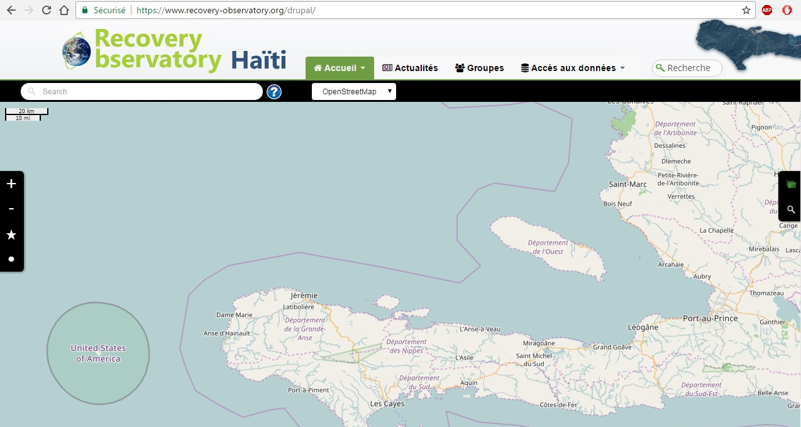
RO Dotcloud Platform
www.recovery-observatory.org
Translation of key texts. Multilingual by October.

Slide 24
Haiti RO Steering Committee #1
Day-to-day management of the RO – telcon every 3/4 months
Member of the Haiti RO Steering Committee (SC) :
- Michèle ORIOL (CIAT)
- Boby PIARD (CNIGS)
- Dwinell BELIZAIRE (ONEV)
- Martine THERER and Chiara MELUCCI (UNDP)
- Mare LO and Sergio DELL’ANNA (WB)
- Simona ZOFFOLI and Giorgio BONI (ASI/ CIMA)
- Stéphane CHALIFOUX (CSA)
- Hélène de BOISSEZON (CNES)
First SC meeting planned on 27th September 2017
Notes:
Centre national d’information geo-spatiale (CNIGS)
CIAT – Comite interministeriel pour l’amenagement du Territoire
ONEV – Observatoire national pour l’environnement et la vulnerabilite

Slide 25
Haiti RO - Next steps
Development of first applications based on identified requirements from Users workshop
Haitian Web Portal for all Spatial Data being established
Technical mission end 2017, to validate 1st products, plan capacity building and dissemination
Solicitation of new funding and partners to augment applications offered and to develop Capacity Building capacities
Reporting to major stakeholders (WB, GFDRR, UN)

Slide 26
RO Timeline
To August 2017 – Haiti RO Establishment
Discussion of MOUs with Haitian users and partners, Establishment of IT infrastructure with charter images, baseline pre/post-event
First User workshop in Haiti to provide further input to the ROOP and finalise the Haiti RO baseline.
Sept 2017 to early 2018 – Haiti RO Commissioning
Incorporating the first products into the Haiti RO and ensuring easy access
Definition of capacity building plan
Solicitation of new partnerships (for value-adding and capacity building)
Animating the user forum; Encouraging and promoting Haiti RO use. First “early evaluation”, with a report to Haiti RO Steering Committee
To end 2020 – Haiti RO Steady-state Operation / Generic RO definition
Ensure IT updates, engage in capacity building activities, generate regular products, report on Haiti RO annually to stakeholders and partners
Analysis of Haiti RO operation & results, to derive Generic RO specifications
Preparation of Haiti RO closure, including evaluation and legacy strategies.

Slide 27
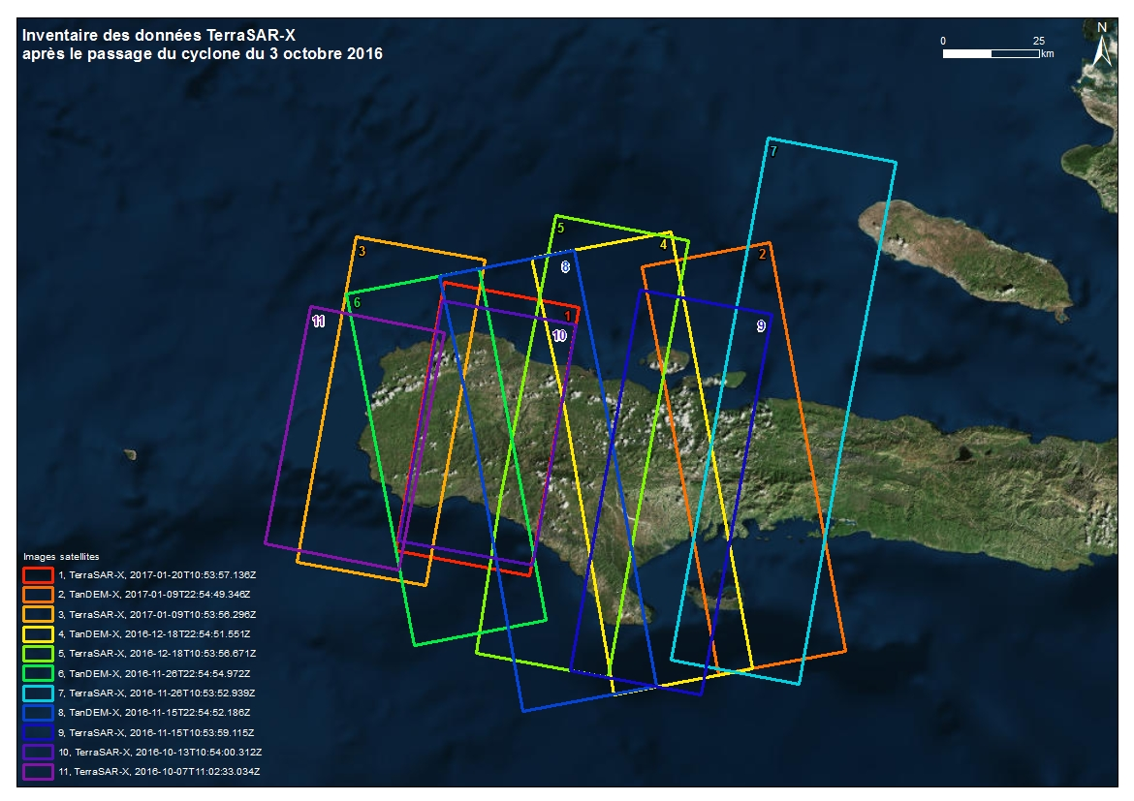
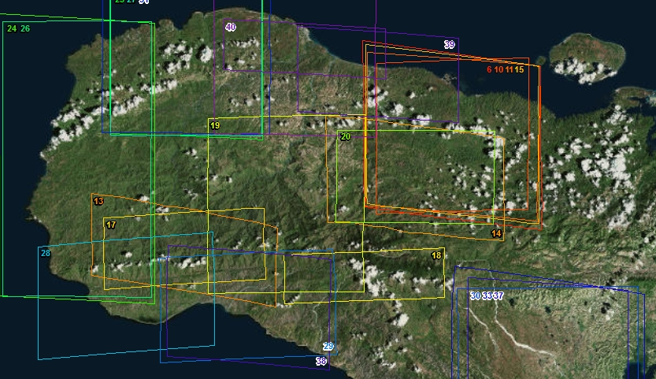
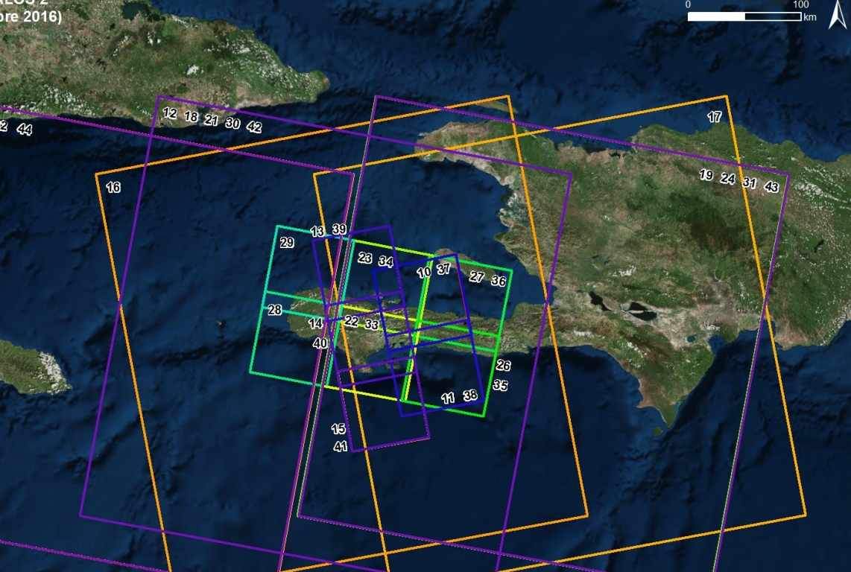
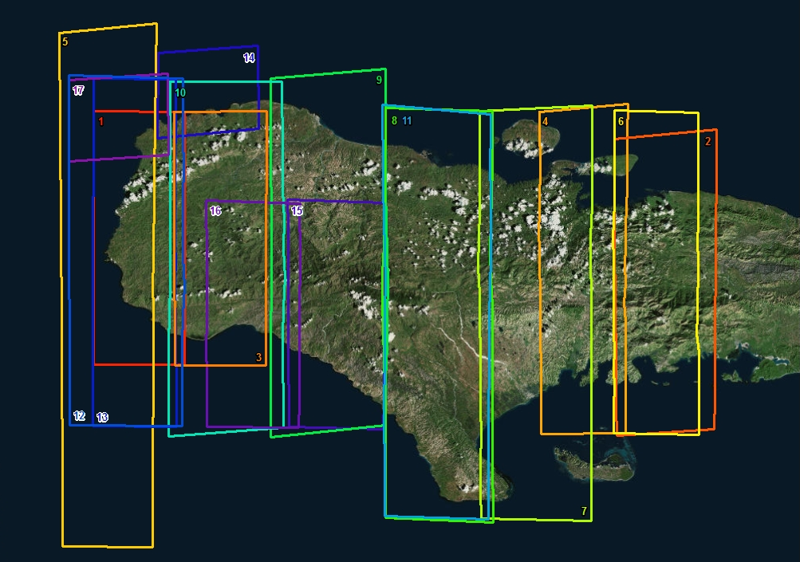
THANK YOU
FOR
YOUR ATTENTION
TerraSAR-X TanDEM-X (post-Matthew)
Pléiades (post-Matthew)
ALOS-2 (pré-Matthew)
WorldView-1/2, Geoeye (post-Matthew)

