Slide 1

Meeting Objectives
Committee on Earth Observation Satellites
Stéphane Chalifoux, WGD Chair
Andrew Eddy, WGD Secretary
WGD#8, Buenos Aires, Argentina
September 4-8, 2017

Slide 2
Accomplishments
Three thematic pilots completed
RO was triggered for Hurricane Matthew in Haiti and demonstrator to showcase/validate applications are completed; RO Operational Plan developed.
Landslide Pilot started and data starting to be collected.
Data flowing well for all existing pilots and supersites (including from the International Charter)
New GSNL supersites under evaluation at DCT
Awareness and Communications regarding pilots good, including up-to-date website information and glossy report in preparation

Slide 3
Objectives of this meeting
Objectives:
Reporting on pilots :
  Final reports for volcanoes, floods and seismic hazards;
  Review of sustainability strategies for each thematic area.
Moving forward with new activities – GEO-DARMA, Haiti RO, Landslide Pilot, New Proposal: Geohazards Lab
Plan of action:
Establish action plan to address outstanding elements and complete pilots on schedule and issues to be addressed and discussed related the landslide pilot, RO and GEO-DARMA
Prepare material for CEOS Plenary:
  Floods, Volcanoes and Seismic Hazards Reporting (based on the evaluation report and open discussion)
  New GSNL and biennial reports for approval
  Update on RO, GEO-DARMA and Landslide Pilot

Slide 4
Reporting @ Plenary 2017
Items for decision
WGDisasters: Disaster Risk Management pilot initiative final reports. Approval needed
WGDisasters: Report on follow-on actions to DRM Pilots Approval needed for Volcano and Seismic (Flood could be part of GEO-DARMA)
WGDisasters: the Recovery Observatory Operational Plan. Approval needed
WGDisasters: Geohazards Lab Implementation Plan. Approval needed
WGDisasters: GEO GSNL Proposal (Southern Andes Supersite) and Biennial Reports (Ecuador and New-Zealand Supersites).
WGDisasters: a new Vice-Chair: NASA.

Slide 5
Reporting @ Plenary 2017
Items for reference
Landslide Pilot status update.
Recovery Observatory Malawi and Nepal demonstrators final reports
Recovery Observatory status update.
GEO-DARMA concept phase summary.

Slide 6
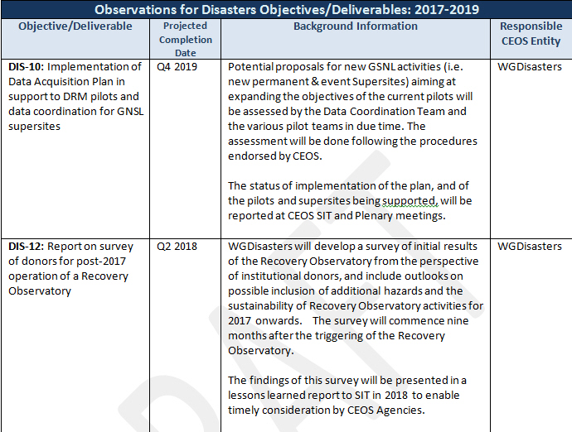
CEOS Work Plan 2017-2019
Disasters Objectives

Slide 7
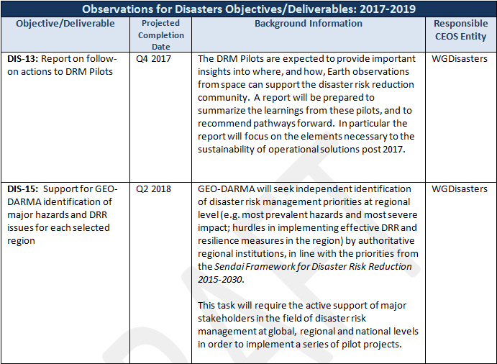
CEOS Work Plan 2017-2019
Disasters Objectives

Slide 8
Reporting @ Plenary 2017
CEOS Work Plan Milestones and Deliverables
DIS-10: Implementation of Data Acquisition Plan in support to DRM pilots and data coordination for GSNL supersites Will be amended in next round of CEOS WP Updates
DIS-12: Report on survey of donors for post-2017 operation of a Recovery Observatory (commences 9 months after Recovery Observatory triggering? Delayed: This will start in Spring 2018
DIS-13: Report on follow-on actions to DRM Pilots (already listed above)
DIS-15: Support for GEO-DARMA identification of major hazards and DRR issues for each selected region Update

