Slide 1

Use of EO for Improved Disaster Risk Management
Viewing Earth
Serving Society
Committee on Earth Observation Satellites
Stéphane Chalifoux, Chair of WG Disasters (CSA)
Andrew Eddy, Secretary CEOS WG Disasters (Athena Global)
Strengthening Disaster Risk Reduction Across the Americas – Panel discussion on improving the use of EO
Buenos Aires, 4 September, 2017

Slide 2
Lessons Learned from the CEOS
Pilots – Improving Use of EO for DRM
The CEOS Working Group on Disasters disaster risk management pilots (floods, seismic hazards, volcanoes, landslides) are providing demonstrations of this with local and regional levels disaster risk reduction activities that are scalable and can be adapted to different geographical and capacity contexts.
CEOS Agencies are supporting the Haiti Recovery Observatory which will collect satellite imagery, generate monitoring products and provide an informatics platform for recovery partners to collaborate in the reconstruction effort following Hurricane Matthew’s devastating impact in October 2016.
Other CEOS activities not showcased here are greatly contributing to improving the use of EO, including the Geoahzard Supersites and Natural Laboratories initiative, the emergin Geohazards Lab, and the GEO-DARMA (Data Access for Risk Management) initiative (included in GEO Work Programme 2016). These activities will facilitate the sustained provision of EO-based risk information products and services to decision-makers.

Slide 3
Agenda
The session highlights achievements of CEOS pilots, and opens the discussion on how to fast track successful satellite data use for widespread uptake within the disaster risk reduction community.
Speakers
Flood Pilot: Bob Kuligowski (NOAA);
Seismic Hazards Pilot: Stefano Salvi (INGV), Theodora Papadopoulou, (Argans Ltd/ESA)
Volcano Hazards Pilot: Simona Zoffoli (ASI)
Landslide Pilot: Dalia Kirschbaum (NASA)
Recovery Observatory: Helene de Boissezon (CNES)
Panel discussion with speakers and Laura Frulla (CONAE)

Slide 4
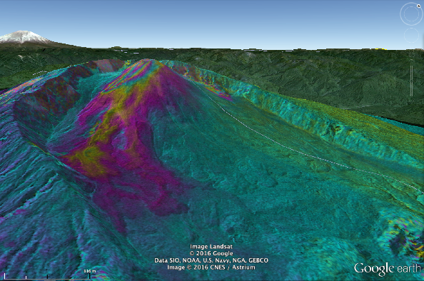
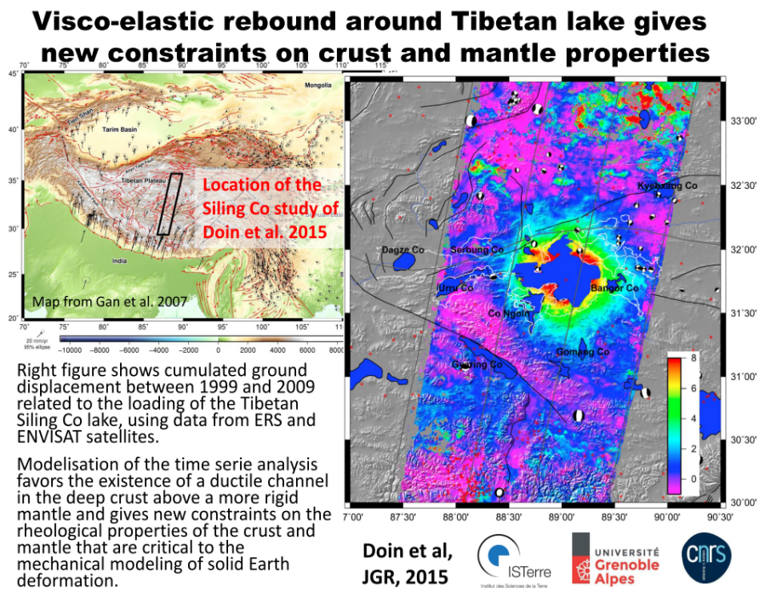
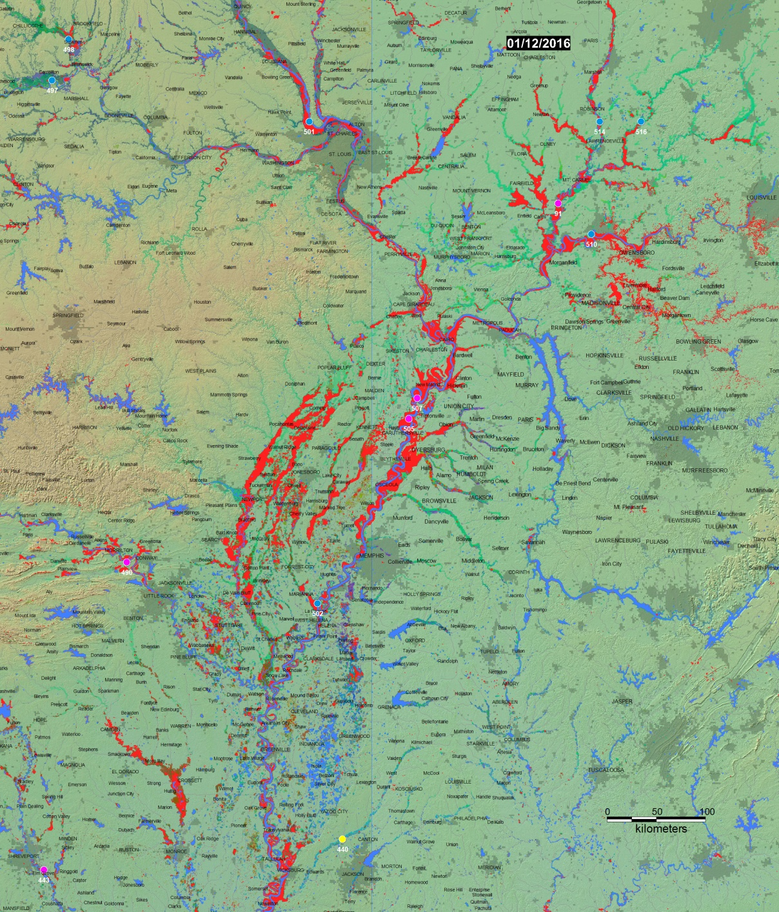
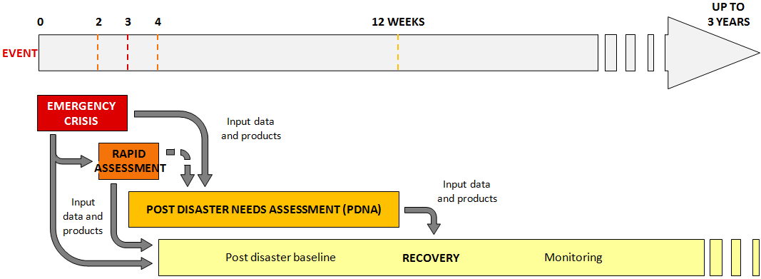
CEOS Mission and Objectives
Mission
CEOS ensures international coordination of civil space-based Earth observation programs and promotes exchange of data to optimize societal benefit and inform decision making for securing a prosperous and sustainable future for humankind.
Notes:
Three Primary Objectives
To optimize the benefits of space-based Earth observation through cooperation of CEOS Agencies in mission planning and in the development of compatible data products, formats, services, applications and policies.
To aid both CEOS Agencies and the international community by, among other things, serving as the focal point for international coordination of space-based Earth observation activities, including the Group on Earth Observations and entities related to global change.
To exchange policy and technical information to encourage complementarity and compatibility among space-based Earth observation systems currently in service or development, and the data received from them, as well as address issues of common interest across the spectrum of Earth observation satellite missions.

Slide 5
The Institutional Framework
The international community has undertaken a variety of initiatives on monitoring hazards, populations, and prevailing environmental conditions, to assist the most vulnerable nations to devise appropriate prevention and mitigation measures prior to such emergencies.
This includes the World Bank/ISDR Global Facility for Disaster Reduction and Recovery (GFDRR) launched in 2006.
Policy instruments & strategic guidelines:
Involving situation:
  Increasing economic and human losses by 2100 due to augmentation of frequent extreme weather events and growing population in megacities.
  Every $1 invested in disaster prevention, $4 to $7 are saved in disaster response (source: UNDP).
  Acting mainly in response phase: not anymore sustainable financially
Change of strategy in “Sendai Framework for Disaster Risk Reduction 2015-2030”:
  More investment needed on prevention and reconstruction.
  Recognition that remote sensing can contribute to a better risk information to Decision–Makers. For 1st time in 20 y, framework includes explicit references to satellite EO (articles 24-f and 25-c)
After Sendai, UN ISDR asked both CEOS & GEO to define and implement concrete follow-on actions based on the use of satellite EO, to address some priorities of the Sendai Framework.

Slide 6



Satellite EO & Disaster Risk Management
How do space agencies contribute to DRM?
operate satellite missions (Optical, Radar)
participate to joint initiatives e.g. International Charter Space & Major Disasters
Provide users with access to EO data as & when needed
have their own EO Exploitation programmes to grow use of EO
jointly participate to international collaborations (CEOS WG Disasters, IGOS, GEO, etc.)
participate to concrete activities to develop EO capacities (e.g. CEOS Pilots in various DRR themes)
Enable innovative EO applications support DRM users

Slide 7
Questions for the panel discussion
Data uptake: there’s clearly a lot of new data coming online, and a lot of potential users. What is the biggest hurdle to bringing data to users and seeing greater uptake?
Pilot success: we’ve seen a lot of great things from the pilot reports – what is the single most important outcome you see from your pilot, and how do you see this being carried forward beyond 2017?
Flooding: floods are the world’s most prevalent hazard – how can we do a better job to address regular flooding, especially in regions where disaster strikes year after year? What lessons learned from the Flood Pilot will carry forward, and through which mechanisms?
Beyond pilots: the pilots were all about bringing satellite data to the DRR community, ensuring satellites can effectively monitor and support prevention; three of the four thematic pilots are closing out at the end of 2017; what are some of the successes, and what challenges remain?
Haiti RO: addressing recovery head on is a new approach; what have the main challenges been? Is there a strong role for EO in recovery? Has implementing the project in Haiti been a challenge from a capacity building point of view?
Multi-hazard approach: there is a strong emphasis in the Sendai Framework on multi-hazard DRR; how will CEOS address this moving forward?

