Slide 1

Committee on Earth Observation Satellites
CEOS Landslide Pilot Working Group: An Overview
September 4th, 2017

Slide 2

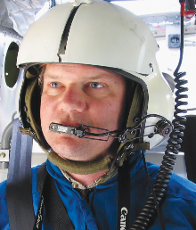


Co-leads of landslide pilot
Dr. Dalia Kirschbaum, NASA Goddard Space Flight Center, Maryland, USA
Dr. Jonathan Godt, Landslide Hazards Coordinator, U.S. Geological Survey, Colorado, USA
Dr. Jean-Philippe Malet, School and Observatory of Earth Sciences, University of Strasbourg, France
Dr. Sigrid Roessner, GFZ German Research Centre for Geosciences, Germany

Slide 3
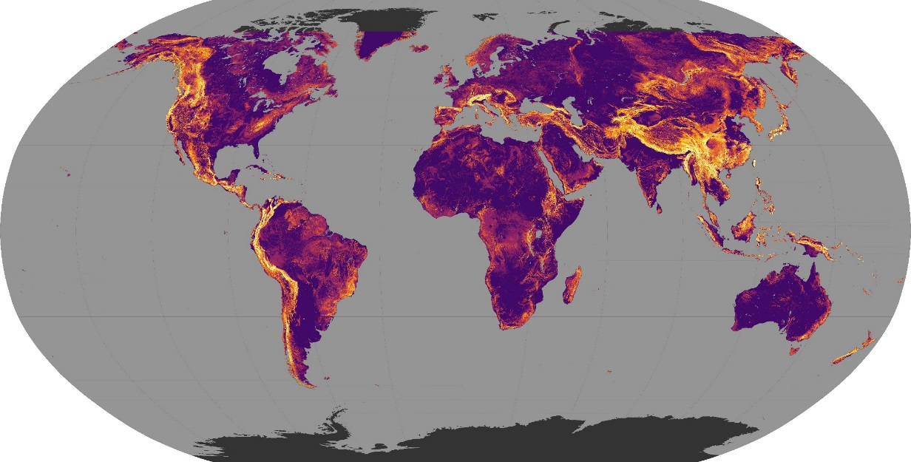
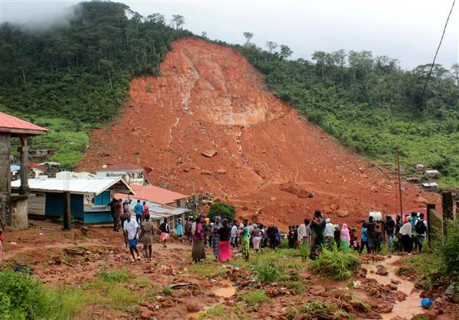
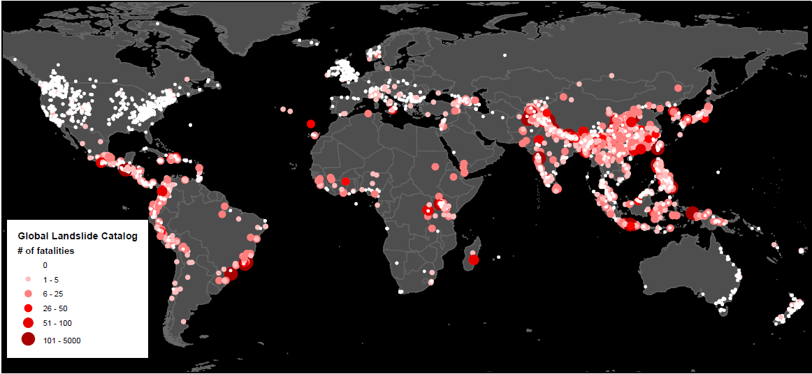
Landslides – global phenomenon
Global landslide susceptibility map
Stanley and Kirschbaum 2017
The Sierra Leone landslide triggered by heavy rainfall, with the main event appearing to be a large landslide in the Regent area, on the margins of the city of Freetown on August 14th, >500 fatalities estimated
David Petley estimates that landslides between 2002-2012 ca. 90,000 fatalities (http://blogs.agu.org)
Stanley and Kirschbaum 2017
UN-Spider Data application guidelines:
http://www.un-spider.org/links-and-resources/data-sources/daotm-landslides

Slide 4
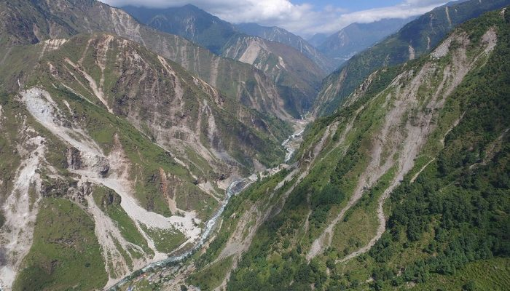
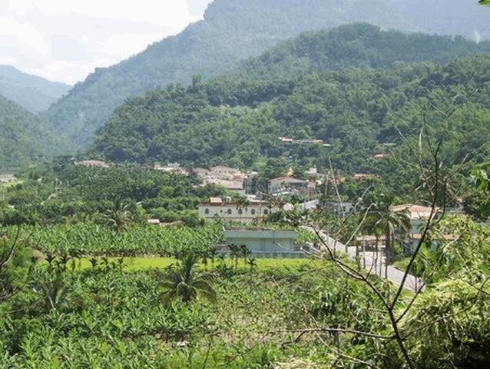
Landslides in multi-hazard environments
Major triggers
Hydrometeorologic extremes (e.g. typhoon)
Earthquakes
New Zealand: 2016 (7.8Mw) ca. 6,000 landslides
Nepal: 2015 (7.8Mw) ca. 20,000 landslides
Taiwan: 2009 Typhoon Morakot: ca. 20,000 landslides
Credits: K. Cook
Credits: Tsou Univ. Kyoto
Nepal: Bhote Koshi (drone image month after EQ)
Taiwan: fotos before and after

Slide 5
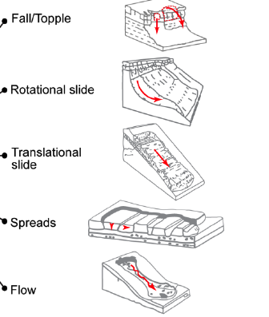
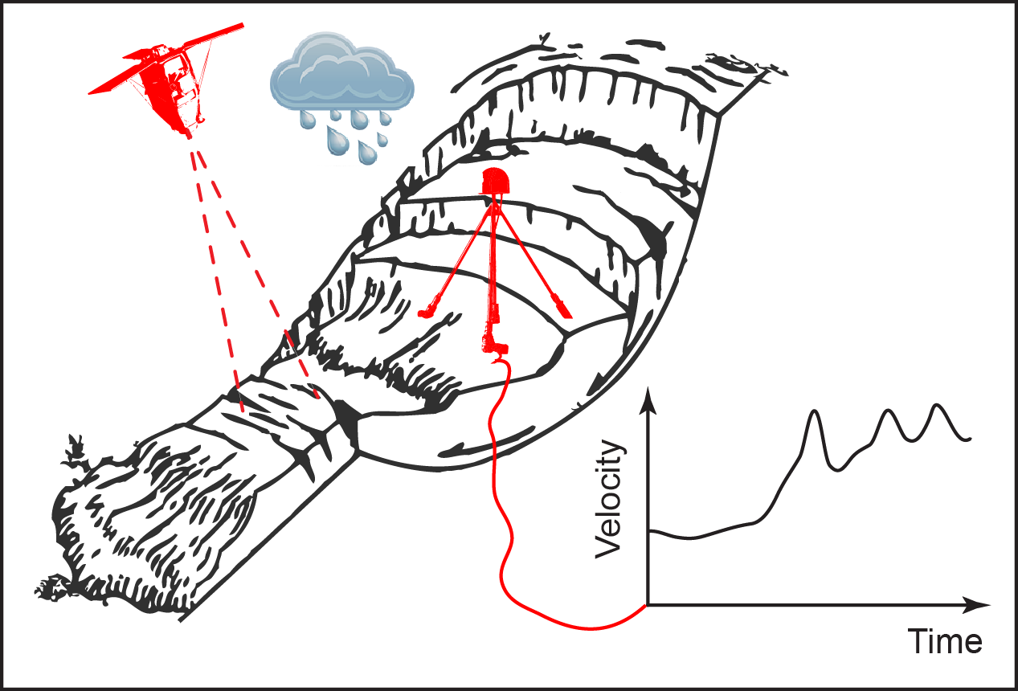
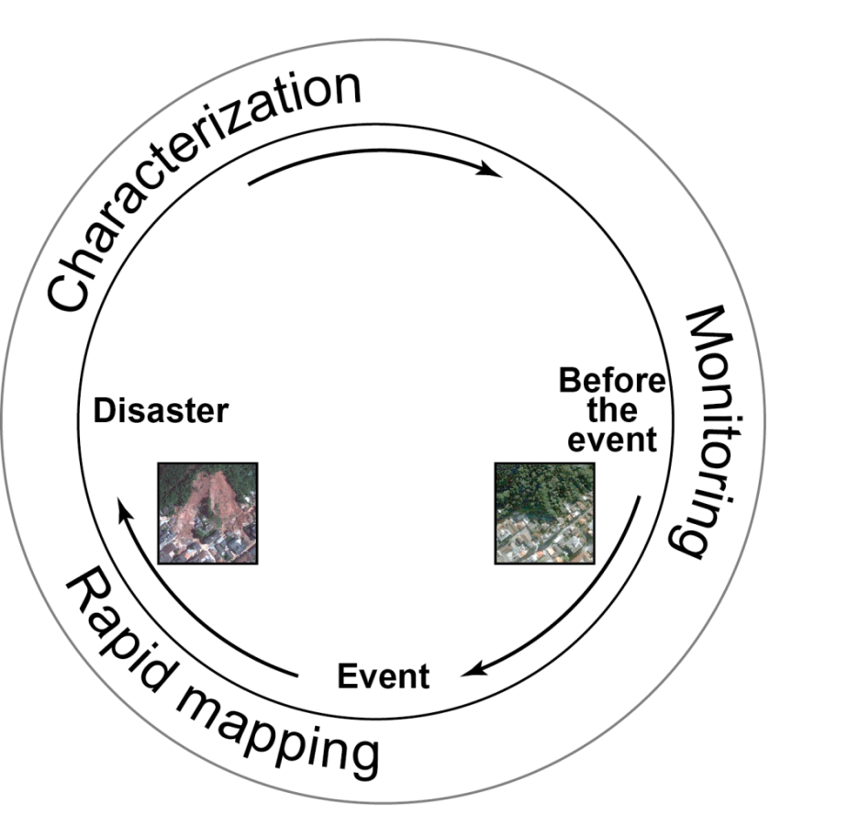
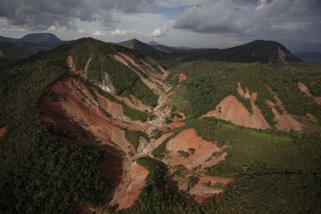
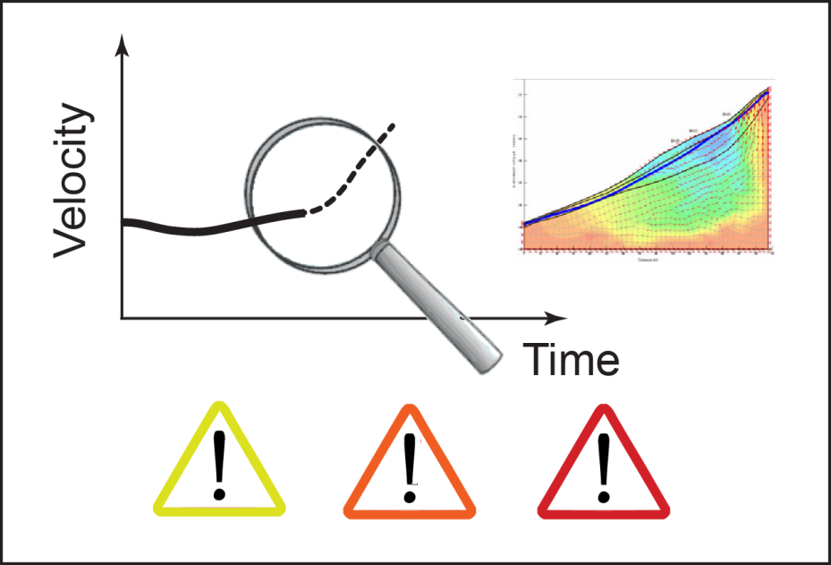

Landslide Remote Sensing
What?
(Type, Activity)
How?
(Displacement,
Mechanism)
Where?
(Location)
When?
(Forecast)
Notes:
Nepal earthquake – add Nick rosser, Sigrid rosser – offset by Nepal earthquake. Sigrid extended 2011 to analyze relationship between EQ-landslide activity and usual background. How does landslide activity go “back to normal” after a major event. Usually the activity is not limited to just a short period, but have to understand how the activity goes back to stead state.
Connected to events for longer term monitoring. Slides from Sigrid: take home point – create methodology/demonstration of long term monitoring analysis as input for hazard and risk assessment

Slide 6
Landslides Pilot: Main Goals
  To demonstrate the effective exploitation of Earth observations (EO) data and technologies to detect, map and monitor landslides and landslide prone hillsides, in different physiographic and climatic regions.
  To apply satellite EO across the cycle of landslide disaster risk management, including preparedness, situational awareness, response and recovery with a distinct multi-hazard focus on cascading impacts and risks.
Notes:
Key message regarding the new pilot :
- it's about multi-hazard and multi-sensor approach to disaster resilience and risk reduction
- the multi-hazard tactic is to advance data fusion, integration and analysis, leveraging existing pilots as they end their 3 years. Starting with the new pilot we will look at earthquake, volcano and flood inducing cascading effects such as landslide and debris flow.

Slide 7
Pilot Objectives
Establish effective practices for merging different Earth Observation data (e.g. optical and radar) to better monitor and map landslide activity over time and space.
Demonstrate how landslide products, models, and services can support disaster risk management for multi-hazard and cascading landslide events.
Engage and partner with data brokers and end users to understand requirements and user expectations and get feedback through the activities described in objectives 1-2.

Slide 8
Key Pilot Outputs
& Deliverables
- Report on recommended practices for the combined exploitation of SAR and Optical imagery and technologies for landslide detection, mapping and monitoring”. (Objective A)
- Report on effective methodologies and strategies for considering multi-hazard and cascading aspect of landslides through multi-temporal landslide mapping from multiple triggers (leveraging information/interactions with the volcano, flood and earthquake pilots) (Objective A-C)
- Landslide event inventory and activity (monitoring) maps produced using optical and SAR imagery and technologies, and their combination, for selected case studies / geographical areas. (Objectives B-C)
- Report on end user engagement strategies and characterize enablers, challenges, barriers to effective transfer of information, knowledge and technologies. (Objective D)

Slide 9
Proposed key user communities
Users: national, regional and local governments, civil protection agencies, meteorological and geological services, land use planning decision makers, disaster risk reduction specialists with NGOs and international organisations, industry (including e.g., insurance, transport, forestry sectors).
Practitioners: landslide modelers, scientists and engineers in hydrology, water and environment ministries, meteorological and geological services, satellite data providers, volcano observatories, and value added service companies.
Institutional bodies responsible for communication of risk (gap between technical level and shared information with communities): research institutions with operational responsibilities.
General public: landslide event information for some of the case studies will be made available to the general public for increased awareness of these hazards and remote sensing capabilities, although the main focus of the pilot is on specialized users.

Slide 10
Proposed regional study leads
Region | Regional Point of Contact
Nepal | Nick Rosser, Sigrid Roessner, Dalia Kirschbaum
Pacific Northwest, US | Jonathan Godt, Dalia Kirschbaum
Southeast Alaska | Marten Geertsema
Peru | Jeff Kargel
Caribbean (Cuba/Lesser Antilles) | Enrique Castellanos, Jean-Philippe Malet
China | Zeng-Guang Zhou (TBD)
Indonesia | TBD
Notes:
Other potential focus areas

Slide 11
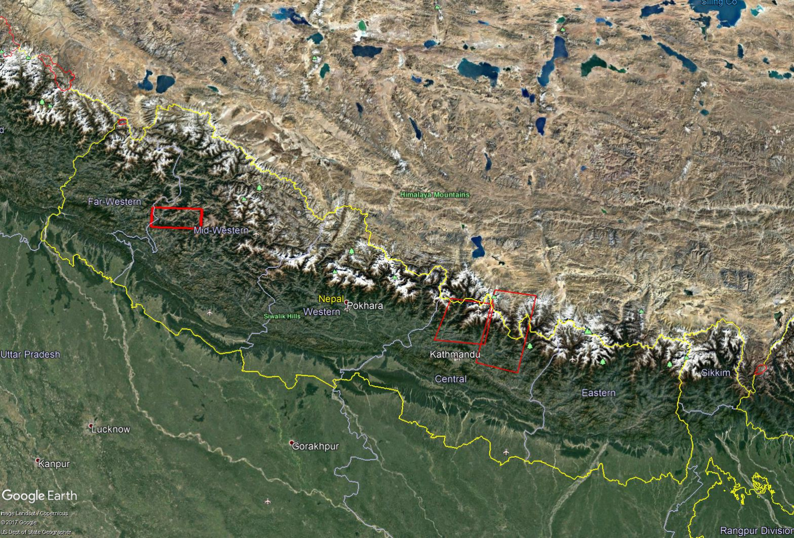
Nepal tasking areas
Karnali
Trishuli
Arniko

Slide 12
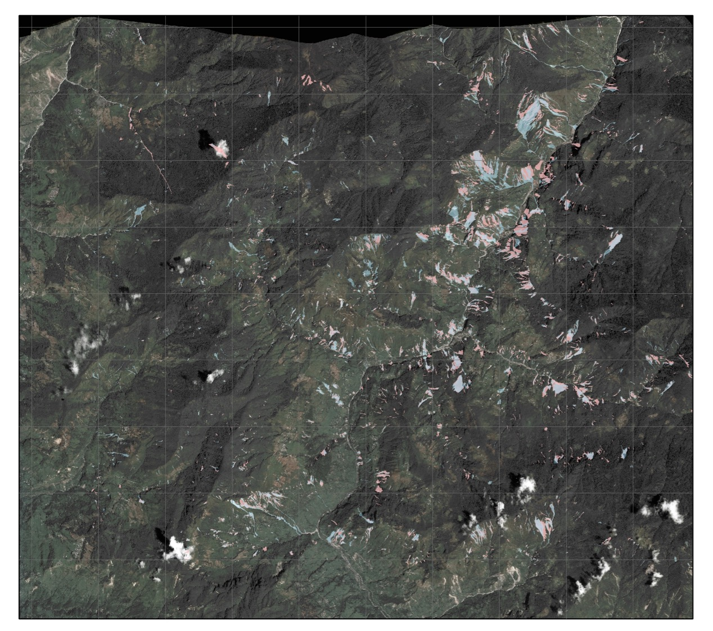
Pre- & post-monsoon landslide mapping, 2015
Pre- & post- monsoon
WorldView & Quickbird
  May 2014 & 24th May 2015
Pléiades image
  9th September 2015
Significant registration errors in steep topography
Results:
389 pre-EQ landslides (c. 1.3 / km²)
2,626 post-EQ landslides (c. 9 / km²)
2,550 post-monsoon landslides
5 km
Slides from N. Rosser/Durham

Slide 13
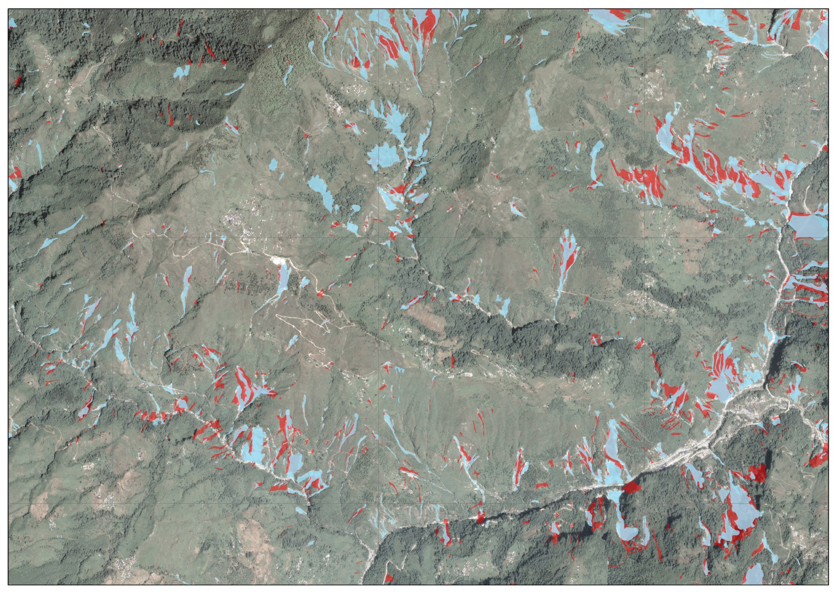
Pre- & post-monsoon landslide mapping, 2015
Combined EQ & monsoon landslides
1 km
Slides from N. Rosser/Durham

Slide 14
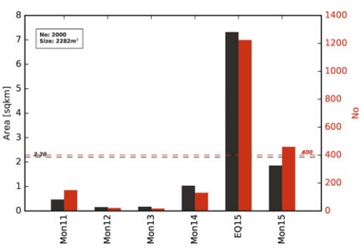
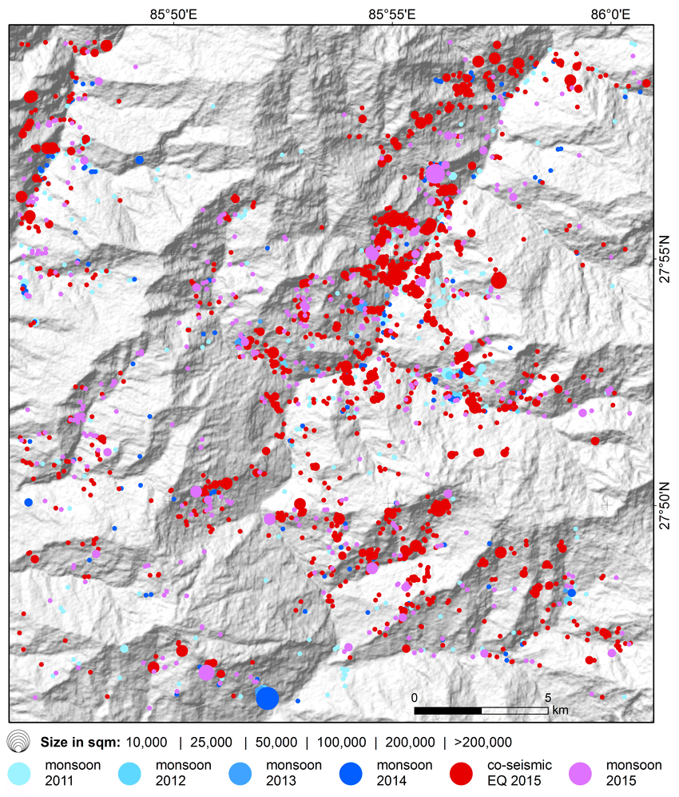
Multi-temporal monsoonal landslide along Pasang Lhamu Highway, Nepal
Multi temporal monsoonal landslide inventory (2011 – 2015) derived from a time series of 13 Rapideye Level 3A data.
2000 landslides with sizes ranging from 200 m² to 0.76 km² affecting a total area of 10.9 km².
1224 landslides triggered by 2015 Gorkha earthquake.
Behling and Roessner (2017)

Slide 15
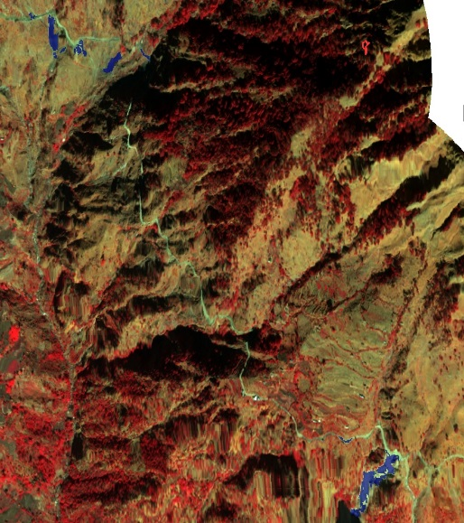
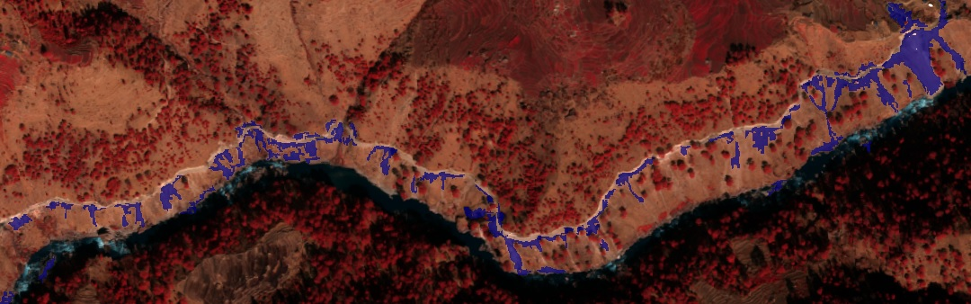
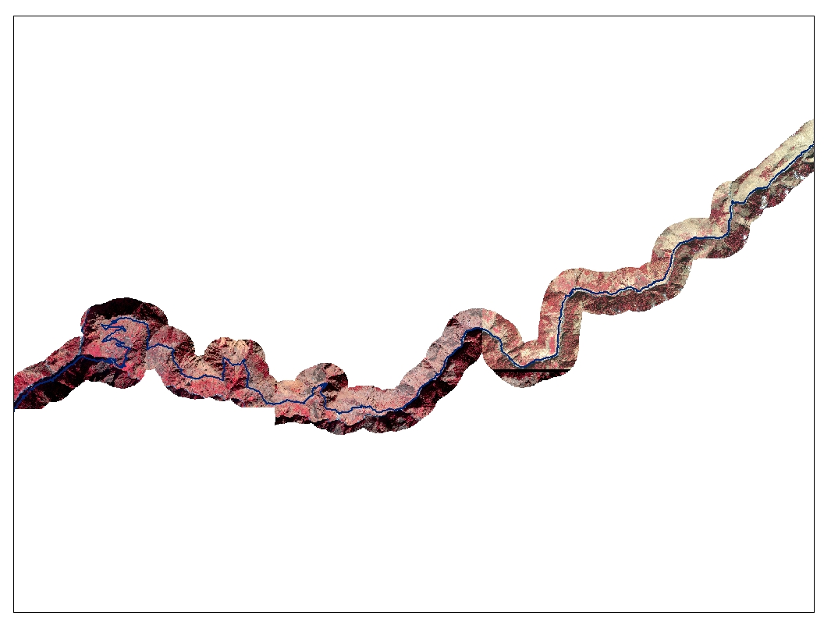
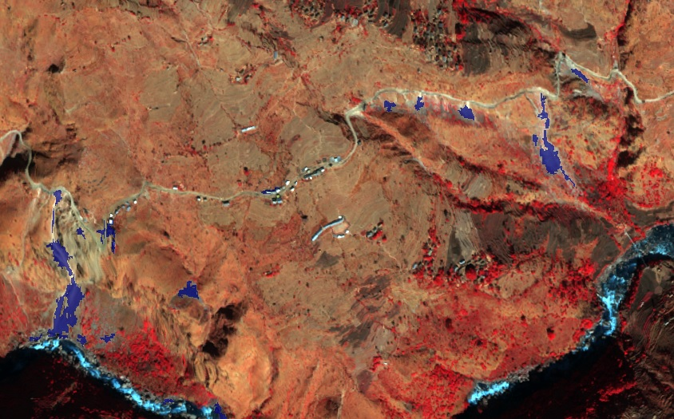
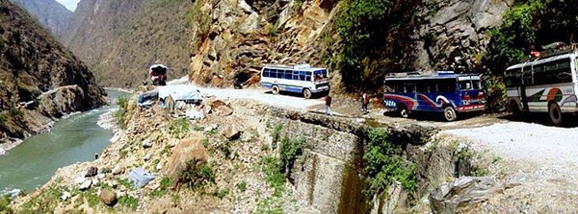
Object oriented analysis based landslide mapping (Karnali Highway, Nepal)
Three stretch along the 60 km highway identified to be highly affected by landslides.
Data obtained from Ditigal Globe
(NASA/USRA)
@KarnaliKo

Slide 16
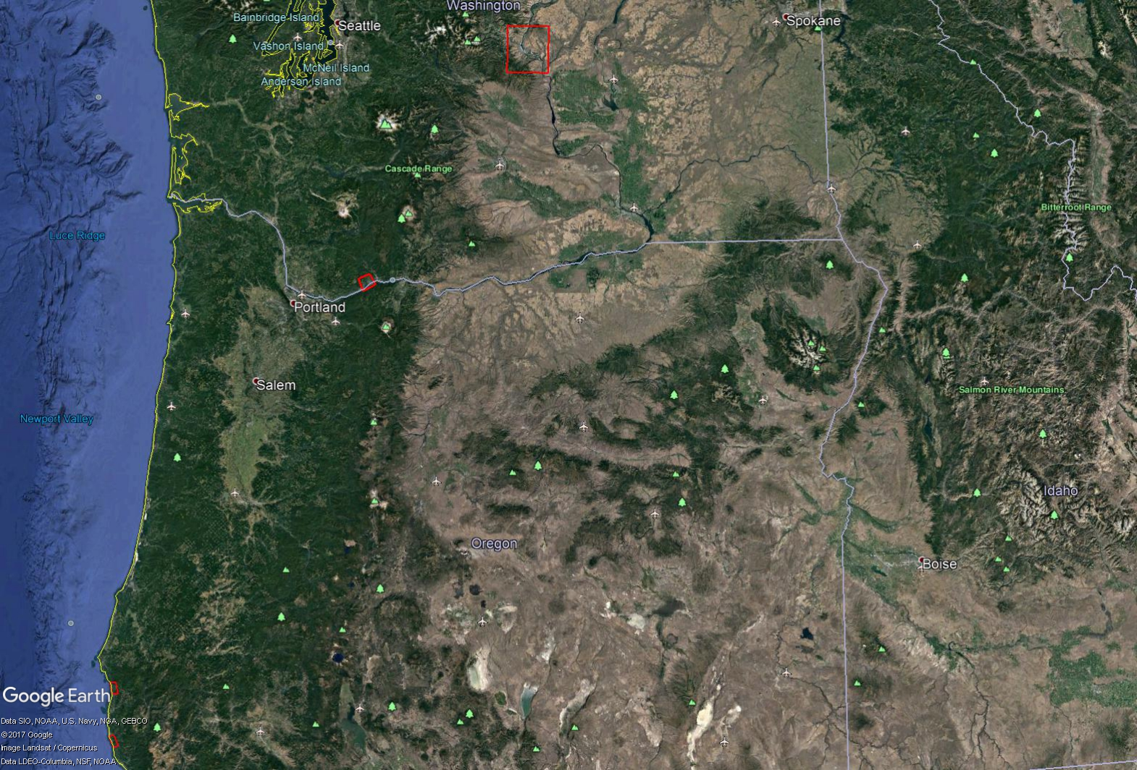
PNW tasking areas
Wenatchee landslide
Cascade landslide
Arizona Inn landslide
Hooskanaden landslide

Slide 17
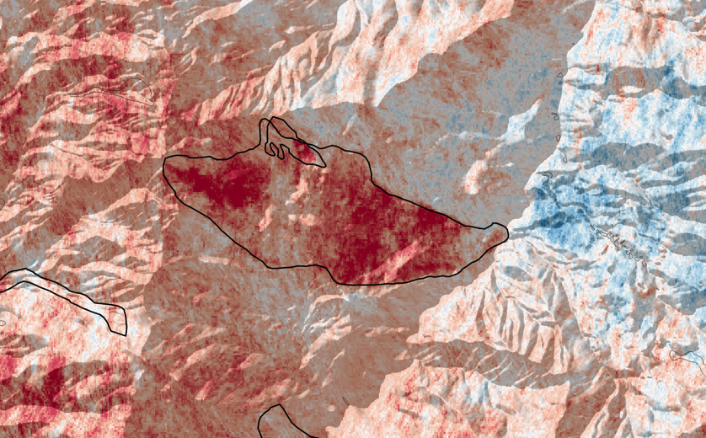
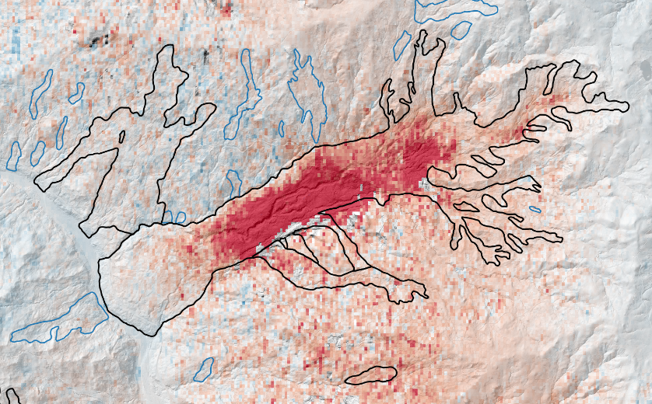
Landslide Monitoring
North California / Eel River
InSAR time series Offset Tracking
A. Handwerger, M.-H. Huang, E.J. Fielding
displacement
displacement
precip.
precip.

Slide 18
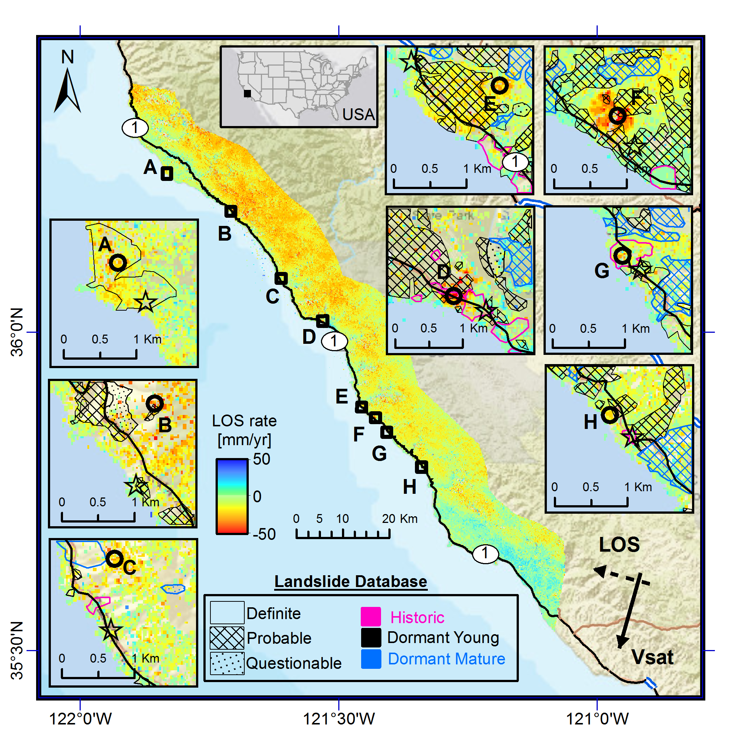
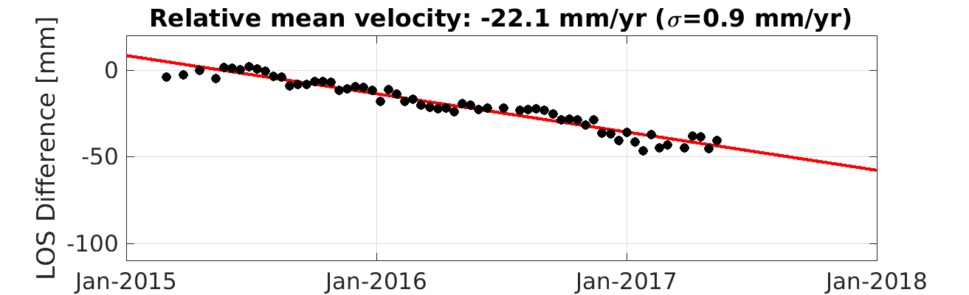
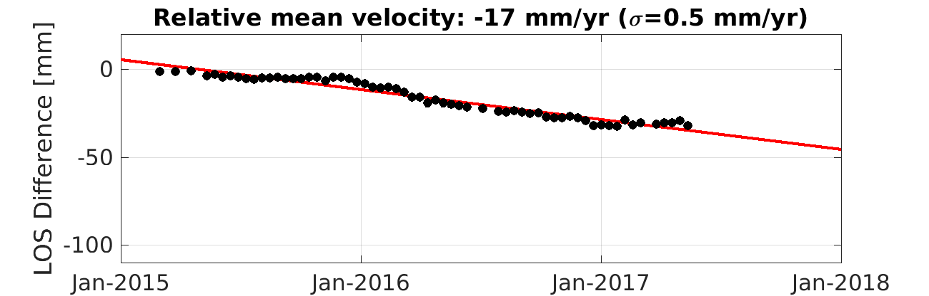
Time-series InSAR research Demonstration of landslide mapping using Sentinel-1 (PNW, USA)
Map shows average line-of-sight surface displacement rates between Oct 2014-May 2017 using Sentinel 1 SAR data and processed using JPL’s ISCE processor and StaMPS time-series package.
LOS time-series with respect to each reference
A
H
D. Bekaert, P. Agram, and H. Fattahi. (Jet Propulsion Laboratory, California Institute of Technology)

Slide 19
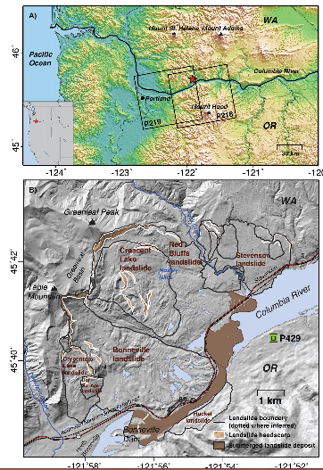
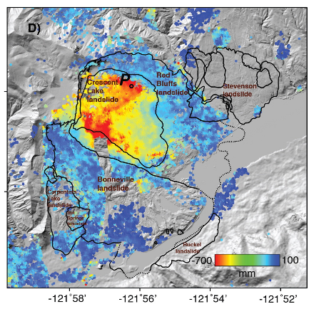
Previous demonstrations of InSAR movement analyses for Washington State Landslides
(Columbia River)
Landslide Monitoring
Washington / Columbia River
Movement (in mm) of the Crescent Lake Landslide from 2007 to 2011 using InSAR techniques
Source: https://www.smu.edu/-/media/Site/Dedman/Academics/Departments/EarthSciences/PDF/Lu/136_Hu_et_al_InSAR_Cacades_Landslide_Complex_RSE_2016.ashx?la=en

Slide 20
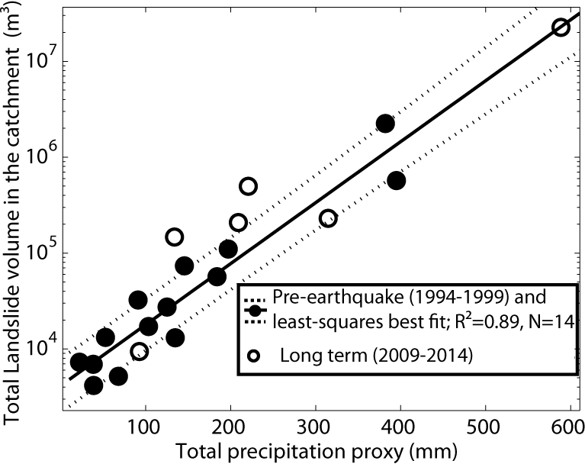
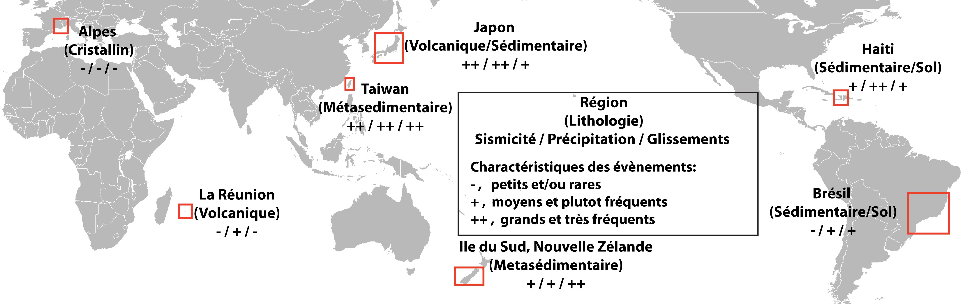

Generalizing the creation of EO-based inventories after major triggering events
Empirical relation in Taiwan
Systematizing the creation of EO-based landslide inventory after major triggering events (ETQ > threshold M_{L}; rainfall event > XX mm) at the global scale
Document the triggering event (seismology, EO-based rainfall estimate using GPM)
Create scaling laws relating landslide intensity to the triggering events
CNES project: Post-doc project of Odin Marc at CNRS/EOST
Ethiopie
(Volcanique)
+, ++, +
Notes:
Nepal earthquake – add Nick rosser, Sigrid rosser – offset by Nepal earthquake. Sigrid extended 2011 to analyze relationship between EQ-landslide activity and usual background. How does landslide activity go “back to normal” after a major event. Usually the activity is not limited to just a short period, but have to understand how the activity goes back to stead state.
Connected to events for longer term monitoring. Slides from Sigrid: take home point – create methodology/demonstration of long term monitoring analysis as input for hazard and risk assessment

Slide 21
Pilot Status
Pilot started in Fall 2016, most licensing agreements have been signed and we hope to obtain data within the next month
The first focus has been on primary study regions (Nepal and the Pacific Northwest, US) but we will move focus to other experimental regions early next year
It is an open community and we welcome new members, ideas, and research opportunities!

Slide 22
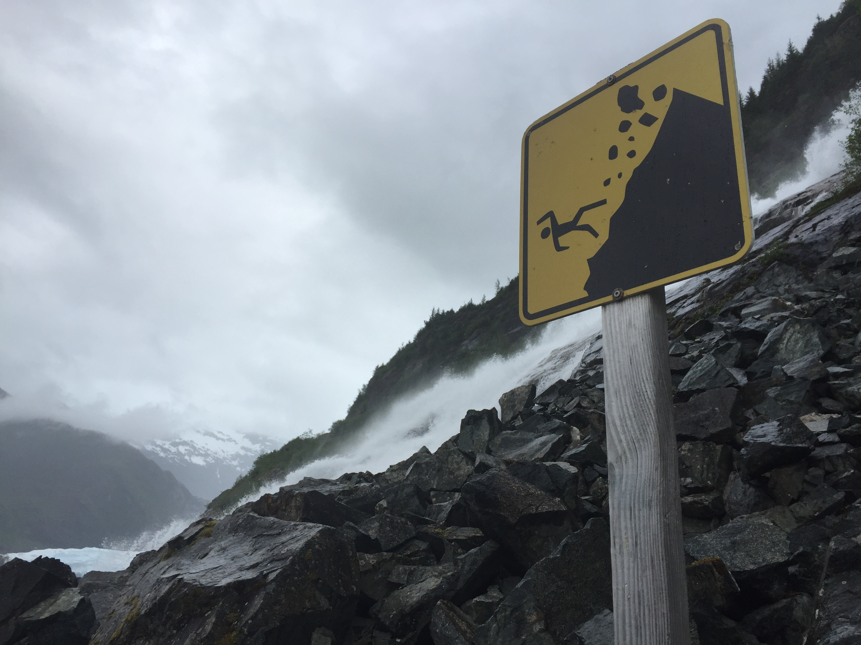
Thank you for your attention
Dalia Kirschbaum, dalia.b.Kirschbaum@nasa.gov
Jonathan Godt, jgodt@usgs.gov
Sigrid Roessner, roessner@gfz-potsdam.de
Jean-Philippe Malet, jeanphilippe.malet@unistra.fr

