Slide 1
CEOS Disaster Risk Management
Seismic hazards Pilot
Showcase
CEOS WG Disasters meeting, 4-8 September 2017

Slide 2
Seismic Hazards pilot – Context and objectives
With respect to the objectives derived from the Santorini report http://esamultimedia.esa.int/docs/EarthObservation/Geohazards/esa-geo-hzrd-2012.pdf
… the Seismic Hazards pilot set the following objectives:
Support the generation of globally self-consistent strain rate estimates and the mapping of active faults at the global scale by providing EO InSAR and optical data and processing capacities to existing initiatives, such as the iGSRM
[role of EO: wide extent satellite observations]
Concrete target for the Pilot: Test, validate and start production in representative priority areas.
Support and continue the GSNL
[role of EO: multiple observations focused on supersites]
Concrete target for the Pilot: Help the GNSL access and exploit data.
Develop and demonstrate advanced science products for rapid earthquake response
[role of EO: observation of earthquakes with M>5.8]
Concrete target for the Pilot: Generate EO based earthquake response products.

Slide 3
Seismic Hazards pilot – Contributors and examples of end users
The pilot is supported by:
6 space agencies: ESA, NASA, ASI, CNES, DLR, JAXA
8 geoscience centres with EO practitioners from 5 countries focusing on 11 sites (AOIs) worldwide:
  INGV (IT)
  COMET (UK)
  NASA JPL (US)
  CNR IREA (IT)
  University of Miami (US)
  NOA (GR)
  UNAVCO (US)
  ISTerre/IPGP(FR)
End users: Italian Civil Protection Department (DPC), Greek Earthquake Planning and Protection Organization (EPPO
Notes:
“Derived objective for the Pilot”: THE SUBSET OF EACH BIG (10 years) SANTORINI OBJECTIVE

Slide 4
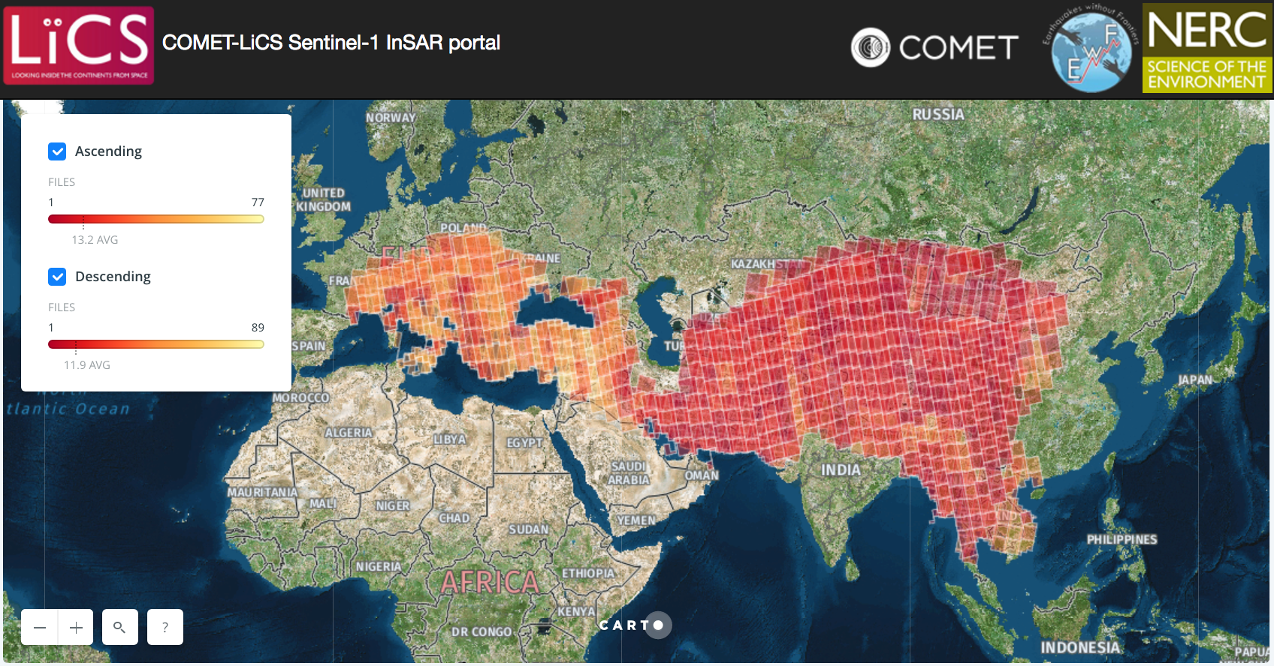
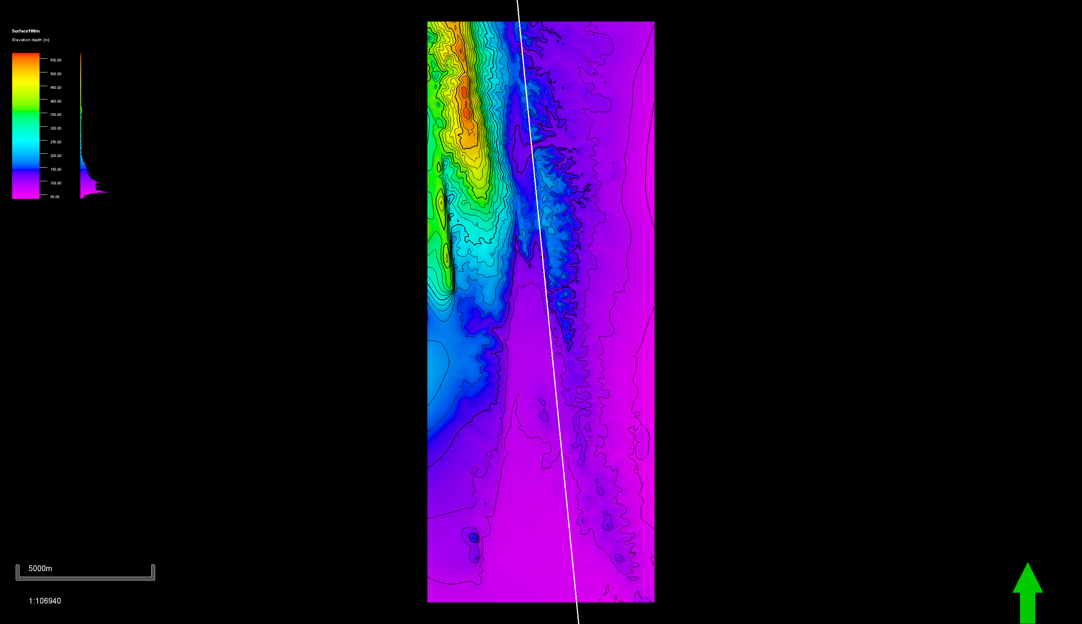
Achievements – Objective A
  The Seismic Hazards pilot met its objectives, in particular:
  Objective A: Support the generation of globally self-consistent strain rate estimates and the mapping of active faults at the global scale by providing EO InSAR and optical data and processing capacities to existing initiatives, such as the iGSRM [role of EO: wide extent satellite observations]
  Pilot objective: Test, validate and start production in representative priority areas
  Strain rate mapping:
  The methodology is validated e.g. over Turkey by COMET (UK) and California by Univ. Miami (with EO data collections provided outside CEOS)
  The global production has started: the entire length of the North Anatolian Fault System has been already processed by COMET
  Active fault mapping:
  Stereo optical data used to support fault reconnaissance mapping locally over limited areas (by University of Leeds and COMET)
  First analysis of the need for large scale fault reconnaissance mapping
COMET’s LiCSAR portal.
Preliminary results over the Sagaing fault in Myanmar.
Notes:
There are already GSNL sciense users using the GEP (INGV, NOA).

Slide 5
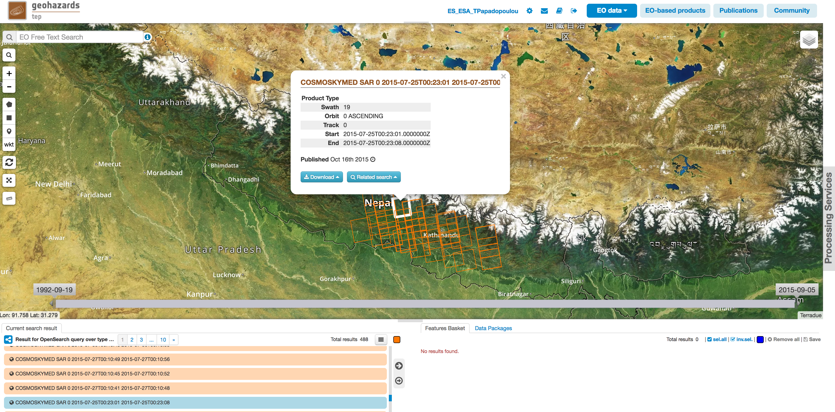
Achievements – Objective B
  Objective B: Support and continue the GSNL [role of EO: multiple observations focused on supersites]
  Pilot objective: Help the GNSL access and exploit data
  The GEP successfully supported the GSNL experts for data delivery, on demand processing (mainly InSAR) and the integration of chains dedicated to GSNL activities (e.g. SISTEM by INGV Catania)
  The pilot supported the Gorkha earthquake Event Supersite, with the additional analysis of ALOS-2 data (not provided through the GSNL).
Notes:
There are already GSNL sciense users using the GEP (INGV, NOA).

Slide 6
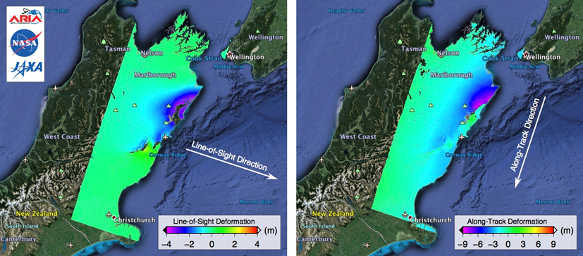
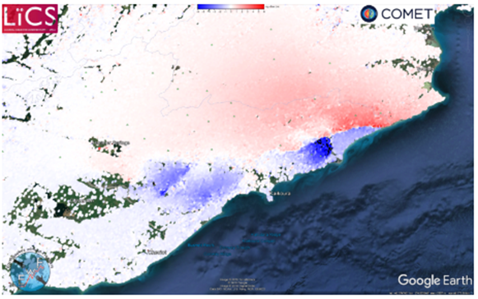
Achievements – Objective C
  Objective C: Develop and demonstrate advanced science products for rapid earthquake response [role of EO: observation of earthquakes with M>5.8]
  Pilot objective: Generate EO based earthquake response products
  since November 2014 the seismic pilot provided support to 8 earthquakes with magnitude > 5.8 in 5 countries worldwide, in 5 countries: Nepal (Gorkha), Greece (Cephalonia and Lefkada), Ecuador (Muisne), New Zealand (Kaikura) and Italy (Amatrice, Visso and Norcia). Typically, users are geoscience centres.
  In a few cases, products derived from pilot work were also used by end users (e.g. Italian Civil Protection, Greek Earthquake Planning and Protection Organization (EPPO))
Coseismic Range Offsets from Sentinel-1 SAR data highlighting the fault trace and numerous fault segments.
Results were online 5.5 hours after satellite acquisition.
ALOS-2 interferograms showing LOS and Along Track deformation, generated by NASA JPL over Kaikura, New Zealand.
Notes:
There are already GSNL sciense users using the GEP (INGV, NOA).

Slide 7
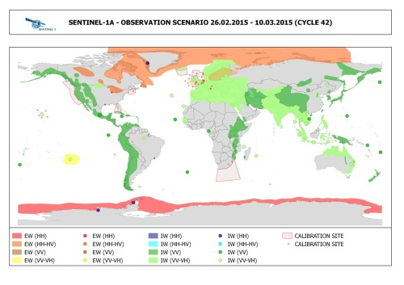
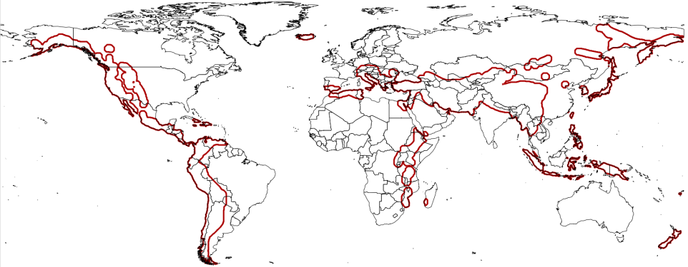
Achievements – Other
  Other outcomes:
  Collaboration with mission operators to optimize EO coverage against thematic priority areas of the pilot: there is a high correlation between the Sentinel-1 acquisitions and target areas of the pilot community
  Examine gaps of the acquisition plans over high seismic risk megacities: confirmed that most sites at least partially covered by SAR data
  Promotion: in total 23 publications, 2 presentations, 2 posters and 10 web-stories/ articles stemmed out of pilot work.
Notes:
There are already GSNL sciense users using the GEP (INGV, NOA).

Slide 8
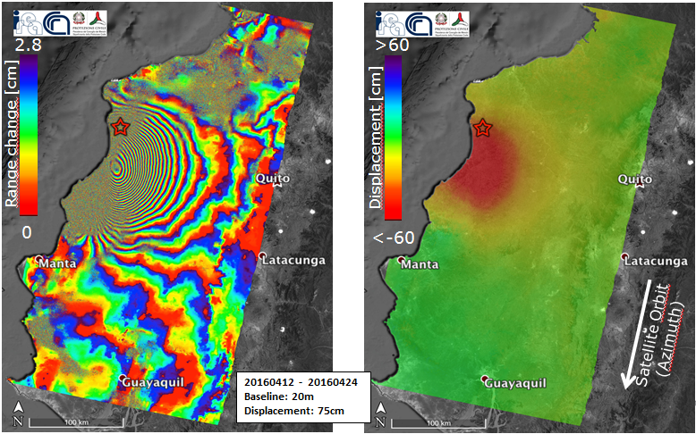
Example – 2016 Ecuador earthquake
Earthquake in Ecuador (Mw 6.0 in Muisne) on 16 April 2016
-April 17, 2016: the Ecuador government asked assistance to the Directorate-General Humanitarian Aid and Civil Protection of the European Commission. Italy declared the emergency state for the Ecuador earthquake (under the coordination of the United Nations).
  CEOS Seismic Hazards Pilot partner: Institute for Electromagnetic Sensing of the Environment (CNR-IREA is a Center of Competence on DInSAR for the Italian Civil Protection Department (DPC).
  A detailed report on the surface deformations was provided by CNR-IREA, which was also forwarded to the Ecuadorian authorities of civil protection. The generated deformation maps were used:
  (a) to understand the extension of the area affected by displacement and better focus the activities during the emergency
  (b) to model the seismogenic fault in order to increase the knowledge on the earthquake and its causes.
Interferogram and displacement map generated by CNR-IREA, exploiting two Copernicus Sentinel-1 acquisitions of 12 and 24 April 2016.

Slide 9
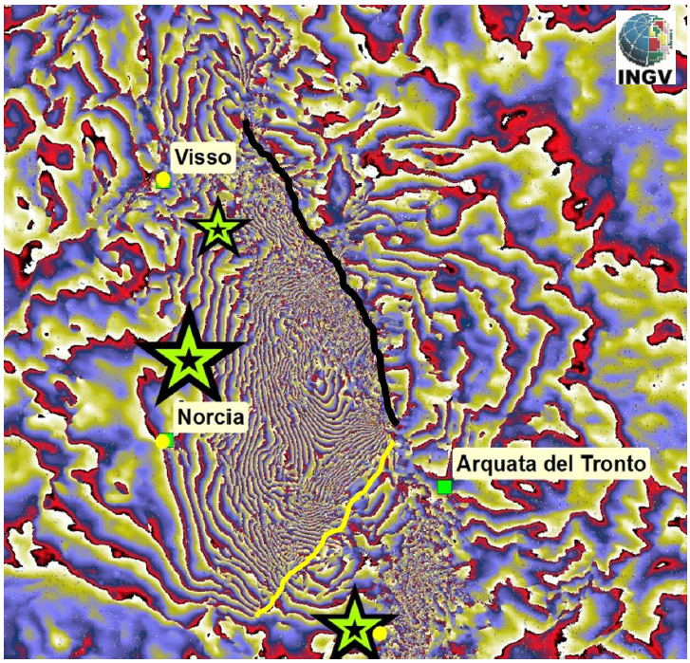
Example – 2016 Central Italy earthquakes
Earthquake in Central Italy (Mw 6.0 in Amatrice) on 24 August 2016 (recorded about 300 fatalities), followed by two earthquakes on 26 October (Mw 5.4 and 5.9 in Visso) and an earthquake on 30 October (Mw 6.5 in Norcia) (the largest event recorded in the last 30 years in italy)
CEOS Seismic Hazards Pilot partner: National Institute of Geophysics and Volcanology of Italy (INGV) triggered the CEOS Seismic Pilot within the 24 August, with the aim to access and exploit EO data for Active Tectonics Mapping. The Italian Space Agency (ASI) organised the data tasking and delivery to support this event.
Products and detailed reports about the events were provided to the Italian Civil Protection Department (DPC) by the main CoC (INGV) and others CoCs (e.g. CNR-IREA).
Sentinel-1 interferogram, showing the linear fringe discontinuities corresponding to ground breakage: 1-2 m displacement on the Monte Vettore fault.
Notes:
A detail of the descending Sentinel-1 interferogram, showing the linear fringe discontinuities corresponding to ground breakage. The black line has been identified with a co-seismic scarp with 1-2 m displacement on the Monte Vettore fault. The yellow line has not been verified into the field but may represent the surface expression of a lateral fault which has been modeled by the inversion of InSAR data.

Slide 10
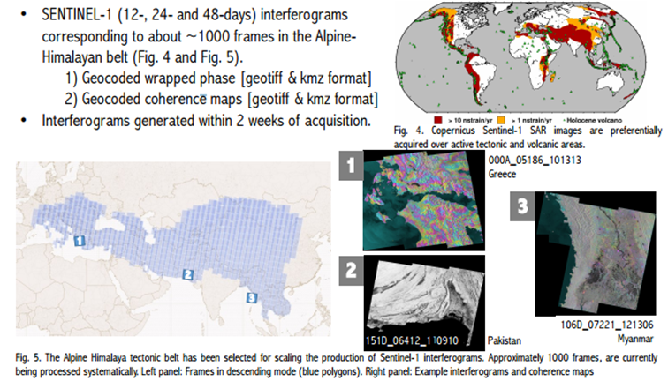
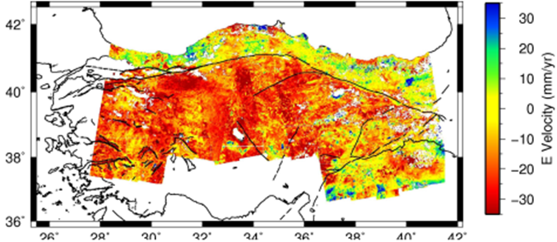
Example: LiCSAR - Tools for automated generation of Sentinel-1 frame interferograms by COMET
Working with new types of data: SENTINEL-1 generates massive volumes of data with high duty cycle, shorter revisits, and wider swaths than previous missions (e.g. ENVISAT).
East-West component of the surface displacement rates from October 2014 to April 2016 using ascending and descending passes over the entire length of the North Anatolian Fault System.
The LiCSAR InSAR products are generated within two weeks of acquisition of Sentinel-1 images. Over 1000 frames have being processed systematically over the Alpine-Himalayan Belt. First LiCSAR results were presented in the AGU 2016 for large scale Sentinel-1 frames processing for the entire North Anatolian Fault.
Details: http://comet.nerc.ac.uk/COMET-LiCS-portal/

Slide 11
Success of the pilot
Seismic Hazards pilot successfully addressed seismic hazards by providing:
  access to data
  access to tools & hosted processing
  Primarily focused on EO practitioners from geoscience centres (expert users) and has few end users (e.g. civil protection agencies of Italy and Greece)
  Benefit: helped analyze the impact of the events and better elaborate scientific advice to support end users in their decision making process.
  High value benefit to geoscience centres and end users: some already expressed the need to continue the activity and expand its objectives, for instance:
    strain rate and active fault mapping to be expanded in a global basis,
    earthquake response to expand in 10-12 events per year
  Well-set example of collaboration to exploit data & tools; makes it a good basis for a new initiative with broader goals to achieve greater impact.
The partners confirm the relevance and importance of the long-term objectives defined in Santorini and the need to continue to address them through a consolidation activity to be started in end 2017.
In dialogue with the partners we defined new targets for a follow on activity.

Slide 12
Proposed follow-on: a Seismic Hazards
Consolidation activity
  A follow-on activity is proposed and is based on the objectives from the Santorini report with new and theme-specific targets:
  Not on an emergency basis
  Pursue global strain rate mapping that is a long process
  Expand active fault mapping from regional to global coverage primarily with VHRO for fault reconnaissance mapping
  Pursue support to GSNL
  Develop a collaborative framework with geoscience centres to achieve adoption of technology by decision makers, establish a consensus methodology for product generation and reach decision makers
  On an emergency basis
  Exploit EO data to derive advanced tectonic products for earthquake response: expand to target of at least 10-12 EQ per year
  Articulate with EO disaster response capabilities e.g. the Charter to make sure users are aware of and use it.

Slide 13
Proposed follow-on: Contributions
  Pilot leads have started gathering contributions from space agencies:
  ESA
  ASI
  DLR
  CNES
  Partners from the community (8 geoscience centres so far):
COMET /UK
CNR-IREA /Italy
INGV /Italy
ISTerre/Institut de Recherche pour le Développement (IRD) /France
National Observatory of Athens (NOA) /Athens
Harokopeion University of Athens (HUA) / Greece
CEO-YachayTech / Ecuador
CNRS IPGP /France
(new partners)

Slide 14
Conclusion
  The Pilot activity is closing
    Formal closure End November
    No additional data requests expected in this framework
    Some VA results still pending, will be integrated in the Final Report (intended early Q4 2017)
  A new Seismic Hazard Consolidation activity is proposed
    A Draft was circulated on 30 August (Proposition_Seismic_Hazards_Consolidation_Phase)
    Awaiting approval with the aim to kick off in End 2017.

Slide 15
Thank you
Philippe Bally, ESA philippe.bally@esa.int
Stefano Salvi, INGV stefano.salvi@ingv.it
Theodora Papadopoulou, ARGANS Ltd. c/o ESA tpapadopoulou@argans.co.uk

