Slide 1

Recovery Observatory (RO)
Haiti Hurricane Matthew RO – An Overview
CEOS Pilots Showcase
Buenos Aires September 4th, 2017
Helene de Boissezon, CNES
Agwilh Collet, CNES
Andrew Eddy, AG - ROOT Secretary
Committee on Earth Observation Satellites

Slide 2
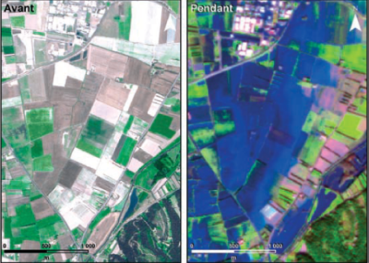
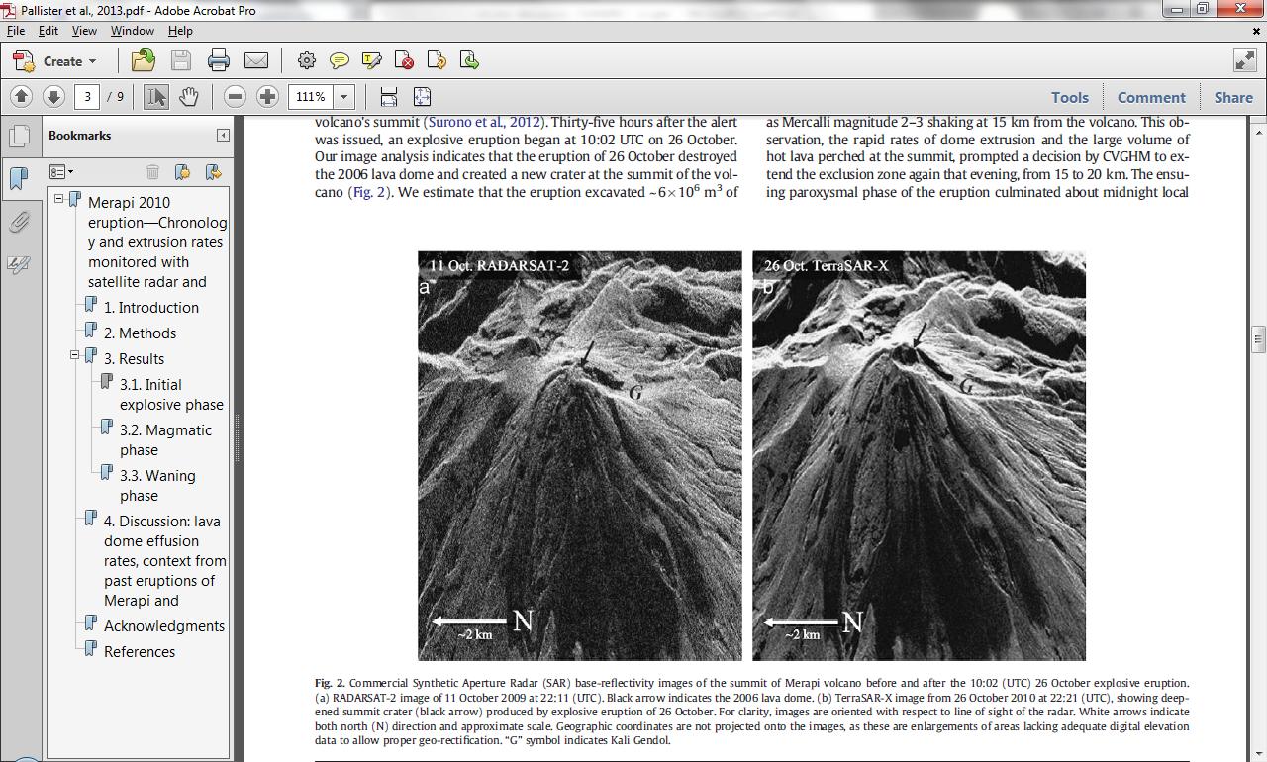
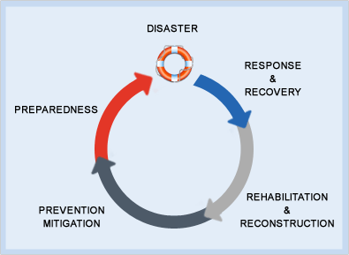
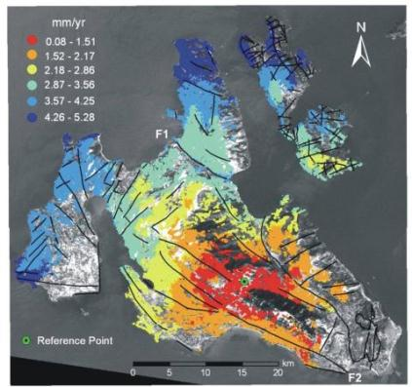
Disaster Risk Management & Satellite EO
Notes:
Space agencies have traditionally focused on response, with some degree of success. But other phases could benefit a lot from EO satellite images, among which the months et years after a major disaster, for addressing recovery and rehabilitation issues.

Slide 3
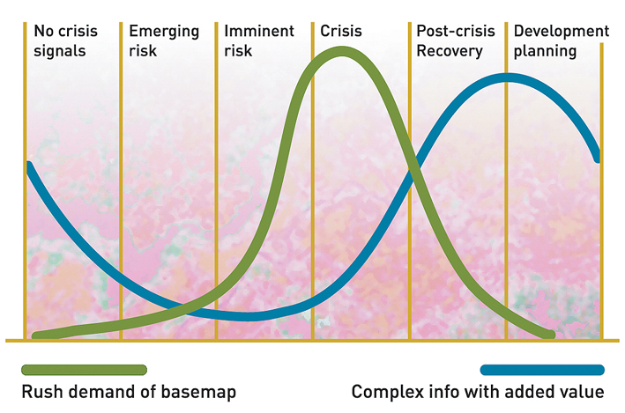
Geo-Information in
Response & Recovery
Recovery Observatory added value
Highest current use during crisis – need to develop methodologies and products for recovery planning and monitoring
Demand for geo-information
Slide adapted from UNOSAT Luca dell’Oro
Notes:
The availability and sharing of timely and relevant information is critical for assisting rescue and humanitarian operations.
As shown here in the graph in the immediate aftermath of an event there is a peak in the demand of data and information including maps. When addressing post crisis and development planning, there is a need in much more complex products, requiring new methods and a lot of external data.

Slide 4
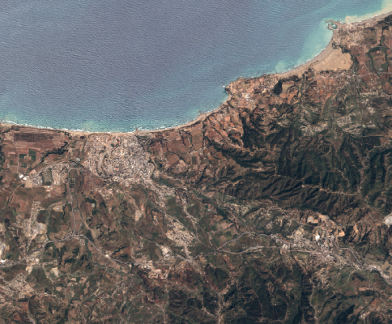
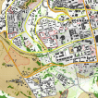

What does the RO consist of?
Free and open collection of images and maps at several scales
Field data for validation
Strong capacity building component
Overview area
Mid-scale products from Sentinel data at 10m resolution
Change in landcover, open spaces
Vegetation loss or re-growth
Agriculture
Update frequency:
every 10 days to 6 months
Overview
AOI
Urban
zoom 1
Zooms
Large scale products from very high resolution data
Protected areas,
Settlements,
Infrastructures, …
Update frequency:
Every 6 months; tuned to applications
Urban
zoom 2
Notes:
The Recovery Observatory pilot has been created in 2014 to demonstrate the value of using satellite Earth Observations to support Recovery from a major disaster, in the near-term (1 year) and long-term (3-4 years).
The RO aims to offer free and open access to data and information useful in planning and monitoring recovery, but also to serve as a forum of exchange and collaboration on recovery related issues to foster resilience at the community level

Slide 5
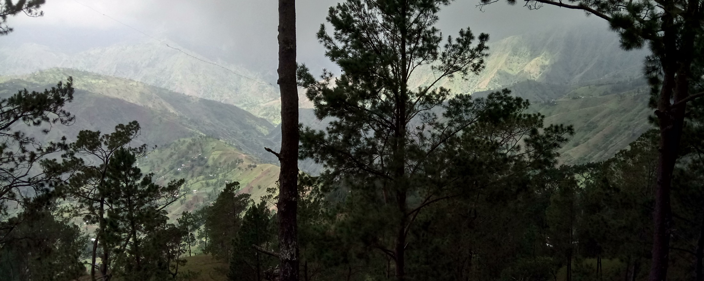
RO Status Overview
A Reminder of Haiti’s diversity
  Triggering of the RO decided by CEOS Chair in consultation with CEOS Principals, December 22, 2016, after Hurricane Matthew - October 2016
  Mission to Haiti 31 Jan - 3 Feb 2017 to establish partnership with Haiti RO users and stakeholders
  Mission to Haiti 29 May – 2 June 2017 to establish RO users connection and feedback from first products

Slide 6
RO Status Overview
Infra dvt
RO Lessons
learned
Product def.
Image requ.
RO Haïti Triggering
22/12/16
Early RO evaluation
2015 2016 2017 2018 2019 2020
jfmamjjasond jfmamjjasond jfmamjjasond jfmamjjasond jfmamjjasond jfmamjjasond
PDNA
Matthew hurricane
in Haïti
04/10/16
Malawi, Nepal demos
Missions (Haiti, WB/UN)
(2 to 3 per year)
1st
2nd
Workshop
29 May-1Jun
Notes:
4 year real life demonstration
After an initial period of operations, the post Matthew RO will be evaluated in late 2017 or early 2018.
Lessons learned will be documented to improve the operations of the post Matthew RO until 2020 and to define a generic concept of RO that should result in broader use of EO during the recovery phase for future major disasters events.

Slide 7
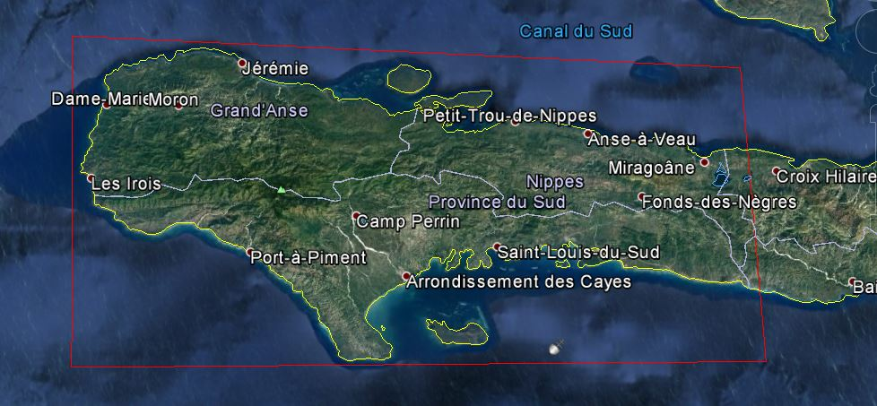
Haiti RO to cover three departments: Grand’Anse, Sud, and Nippes

Slide 8
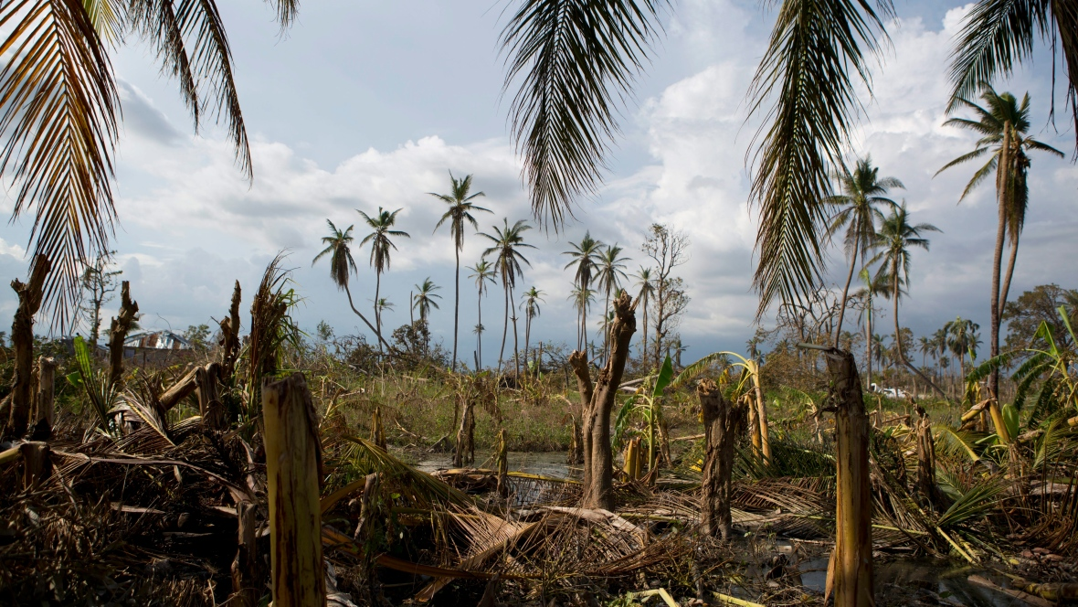
Area of Interest - Zoom
Rebecca Blackwell/Associated Press
Environment / Agriculture monitoring : a key to success
Macaya National Park :a biosphere reserve by UNESCO (2016)
Notes:
Broken banana trees stand in a flooded field in the village of Sous-Roche, on the outskirts of Les Cayes, South of Macaya National Park, Haiti, after Hurricane Matthew. It could take up to 10 years for mature fruit trees to fully grow back. (Rebecca Blackwell/Associated Press)

Slide 9
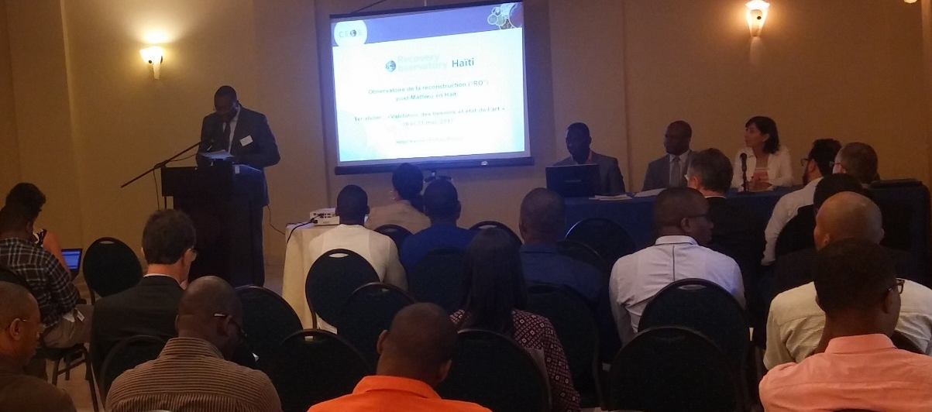
RO Mission to Haiti
Workshop users : 29 May to 2 June, 2017
Validation of needs and state of the art with Haitian users, organized by CNIGS/CNES.
Introduced by the Head of the Ministry of Planning cabinet, CNIGS director, UNDP deputy country director, ONEV director.
CNES :
Helene de Boissezon
Frederic Moll
Agwilh Collet
CIMA/ASI :
Giorgio Boni
RO Secretary :
Andrew Eddy

Slide 10
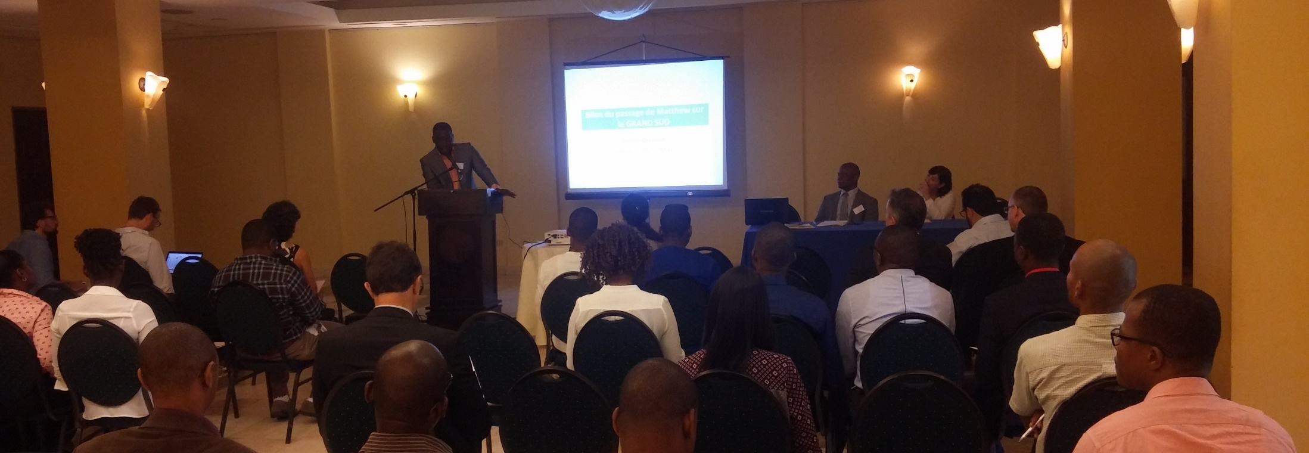
Workshop users #1
46 participants from
Ministry of Planning, CNIGS, CIAT, ONEV, Mining and Energy department, Ministry of Environment, Ministry of Agriculture, Nature Resources and Rural development, Delegation of European Union, Echo Field, French embassy, CNSA (National Coordination of Food Security) , UNDP, UNEP, SERTIT, CIMA

Slide 11
Workshop users #1
Forests, coastal and protected natural areas
Health, Populations displacement
Landslides, seismic risks
Watersheds, flooding
Infrastructure and road communication
Agriculture and food security
Technical web infrastructure
6 Value-added product themes, 1 technical
Haitian + CEOS speaker
Haitian concrete examples / showcases
Discussion to define priorities for value added products

Slide 12
Feedback from
Workshop users #1
Strong Haitian presence and support for RO concept
Plan to link existing tools & platforms for increased synergy: Common portal RO, HaitiData.org, RASOR, KAL-Haiti, future ONEV environmental information service.
In each theme:
  Definition of key partners and key users
  Feedback from first products and improvement
  Choose zoom area(s) to highlight
    Map of future works
Plan the Copernicus EMS Risk&Recovery requests
Strong need in Capacity Building (not directly addressed in CEOS WG Disasters framework)

Slide 13
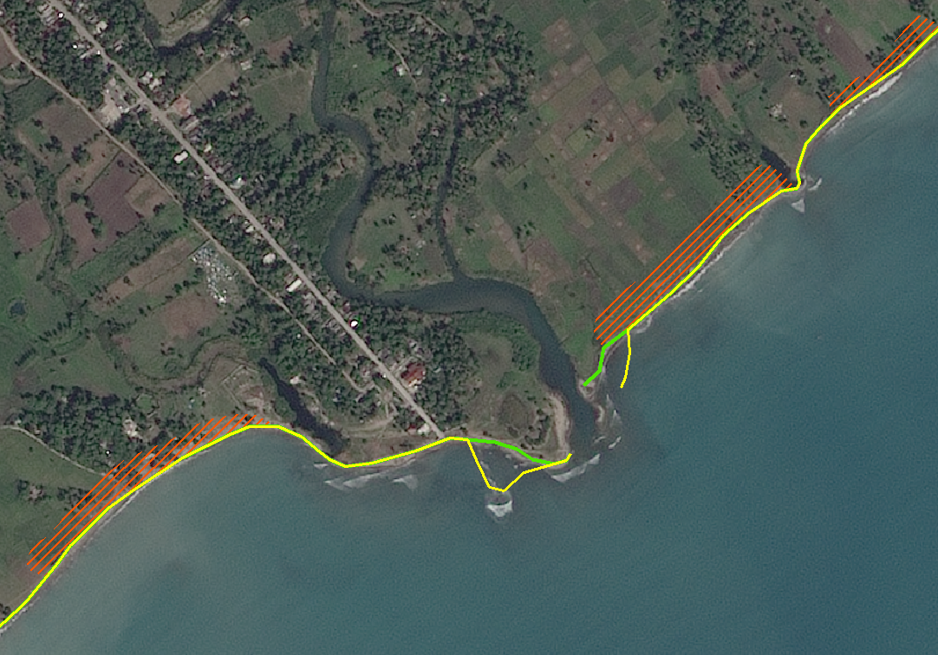
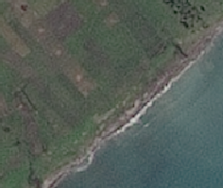

Workshop users #1 :
Concrete example
Forests, coastal and protected natural areas
Secteur 1 : Plaine des Cayes
Torbech
Spot 7 1,5m
Image before Matthew 08/01/2016
Deposits / Erosion
Deposits / Erosion
Geometry modification: Progress of Coastline
Study funded by CNES

Slide 14
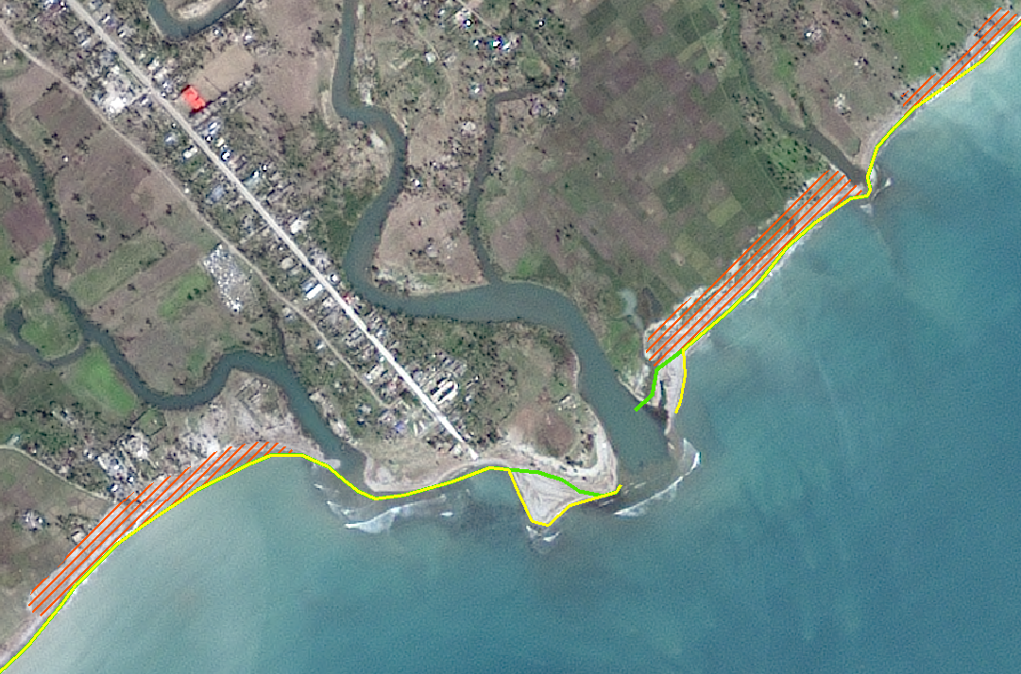
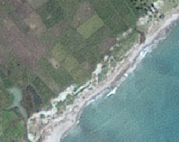
Workshop users #1 :
Concrete example
Forests, coastal and protected natural areas
Secteur 1 : Plaine des Cayes
Torbech
Spot 7 1,5m
Image post Matthew 14/02/2017
Deposits / Erosion
Deposits / Erosion
Geometry modification: Progress of Coastline
Study funded by CNES

Slide 15
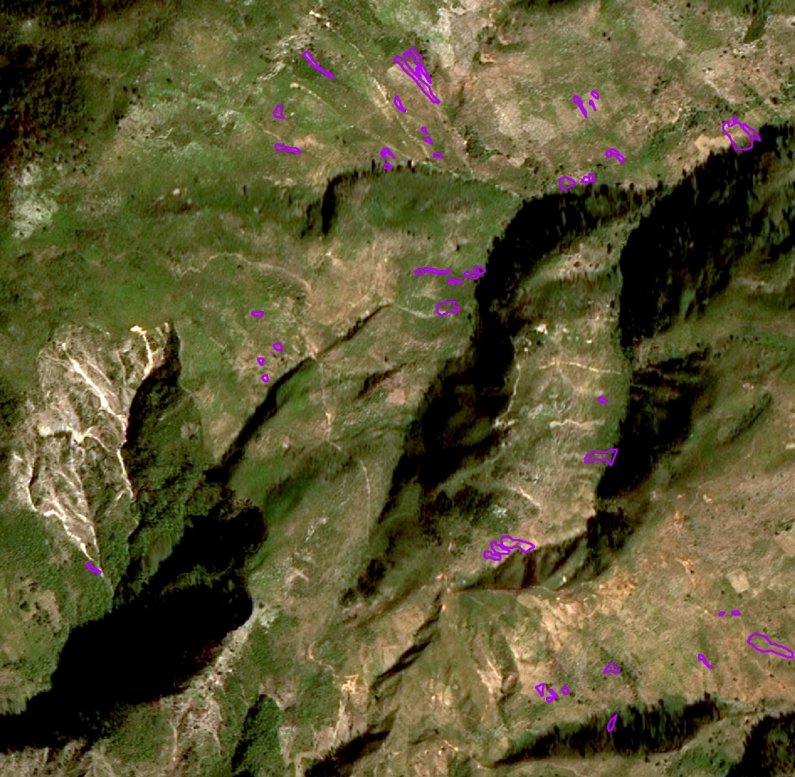
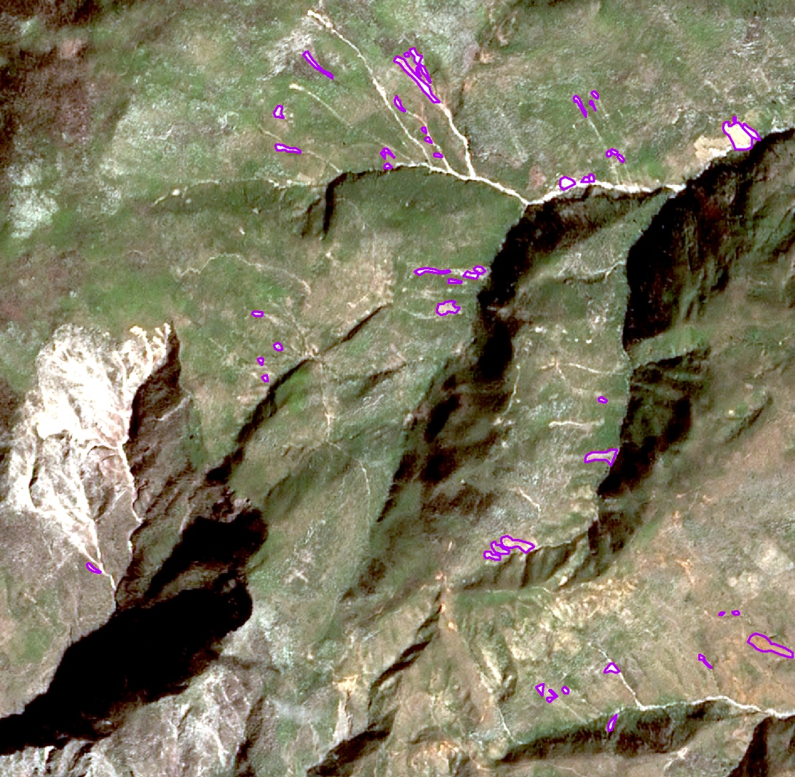
Workshop users #1 :
Concrete example
Landslides, seismic risks
SPOT 6 – Pre Matthew
January 2016
SPOT 7 – Post Matthew
February 2017
Application of ALADIM to pre / post-Matthews images (SPOT)
Deposit channels are difficult to map (+ ~ 30% of affected areas).
Shadows on the west and north slopes can cause an underestimation of total displacement.
Very complex landscape for automated mapping

Slide 16
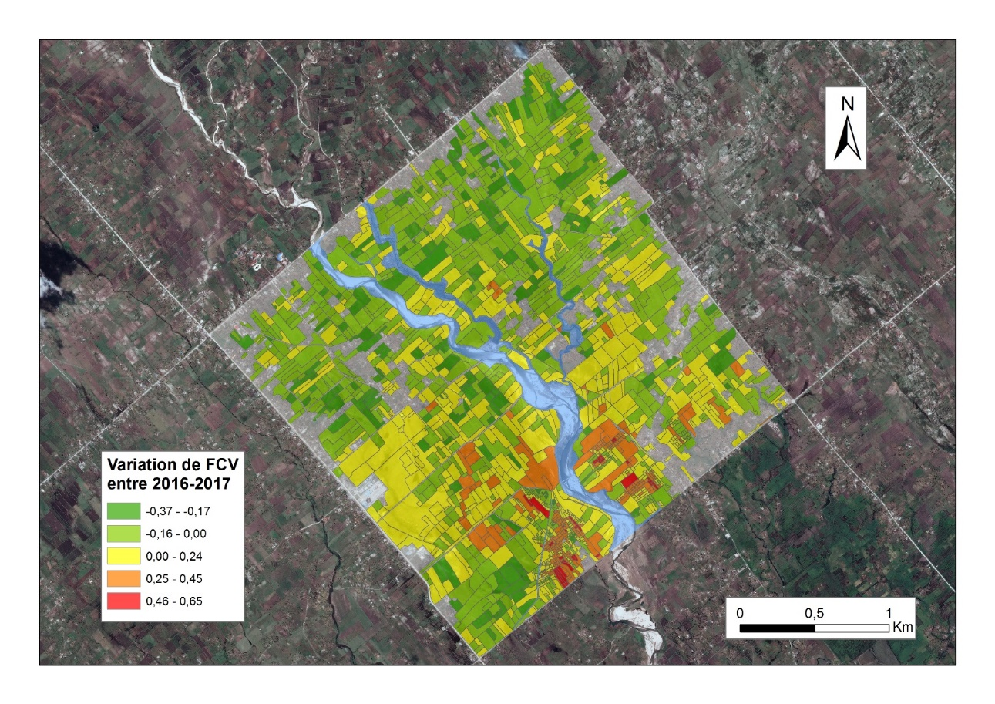
Workshop users #1 :
Concrete example
Agriculture
Secteur de la Plaine des Cayes
Evidence of pre/post-event variation
SPOT6 MS of 08/01/2016 and SPOT 7 MS du 14/02/2017
Fraction of the Vegetation Cover (calculate from NDVI) Evolution betwen 2016 and 2017
Study funded by CNES

Slide 17
Planned works 1/3
Forests, coastal and protected natural areas
Health, Populations displacement
Thematic | Product | Frequency | DATA | Area
Forest and protected natural aresas | Status of regeneration in protected areas - Classification and detection of change Monitoring of habitat resettlement (if possible). Map of forest ecosystems Forest Monitoring Follow-up of the Mangrove | Annual | Optical THR and HR | Macaya Park Grand Bois RB la Hotte
Coastal Zone | Monitoring of the coastal zone (zoom on change – scientific product) OCS – Coastal ecosystem | Annual | Optical THR and HR Sentinel 3 | West and South coast only
Displacement of population and rural habitats | Removal / Construction of damaged buildings Change in use of urban land Temporary housing (progress and location) Type of reconstruction | 2 per years for 2 years | Optical THR | Jérémie Additional Areas TBD ?
Health | Mapping risk of vector-borne diseases | Baseline 2017 then Annual | TBD - Need not confirmed at this stage

Slide 18
Planned works 2/3
Agriculture and food security
Watersheds, flooding
Thematic | Product | Frequency | DATA | Area | Comment
Watersheds Monitoring | Monitoring : RéNOP (OCS); Ground movement ; loss of soil | Baseline + update after major events | MNT Optical and Radar HR and THR | Priority basins (vulnerability, stake, representativeness) | CIMA Foundation. / RASOR CNIGS Radar ability
 | Mapping and assessment of flooded areas | Crisis | SAR Lidar | Entire Area with identification of key points according to the event | CNIGS (+expert in hydraulic modeling) Capacity to activate the Charter
 | Early Warning : Hydrometeo monitoring model Flood routing | Real time (Flood period) | Pluviometry (automatic stations) ; weather image (Imerg); Radar; Caribbean Weather services | Priority basins (vulnerability, stake, representativeness) | CNIGS (+expert in hydraulic modeling)
Agriculture | Evaluation of agricultural change | Baseline before/after Then 2 to 3 times / year | HR and THR Optical | Zooms on the plains of Jérémie, Port Salut et Les Cayes Access required to field data (for sample sites and validation) | Nomenclature adapted to the South Basic product over the entire area, dynamically updated with Sentinel flows

Slide 19
Planned works 3/3
Landslides, seismic risks
Infrastructure and road network
Product | Frequency | DATA | Area | Comment
Landslide Automated change detection | Pré / Post event | Optical THR HR |  | Very high resolution required to identify low amplitude movement
Monitoring with quantification of displacements (horizontal deformation fields) By the application of correlation methods of time series images | 3 to 6 months TBC | Optical HR, THR Stereo for MNT ? | Zoom on les Cayes – Jérémie Road Jérémie, les abricots | Final product: Maps with displacement fields / speed per period and a map summarizing the sectors and their movements over the period Access to field data essential (for characterization) Catalog displacements on zoom
Quarry Detection and Development | Bi annual | THR | Arniquet quarry | For regulation
Landslide Monitoring by radar amplitude image correlation tests | Bi annual | Radar TerraSAR-X | Idem monitoring | (e.g. offset-tracking) need of HR radar data
Mapping of Road network | Baseline + annual | Optical HR (primary road), THR for secondary VHR or HR SAR (after storms) | RO area | Calculation of RAI Comparison with CNIGS and UNDP network Precise MTN required Secondary dirt road

Slide 20

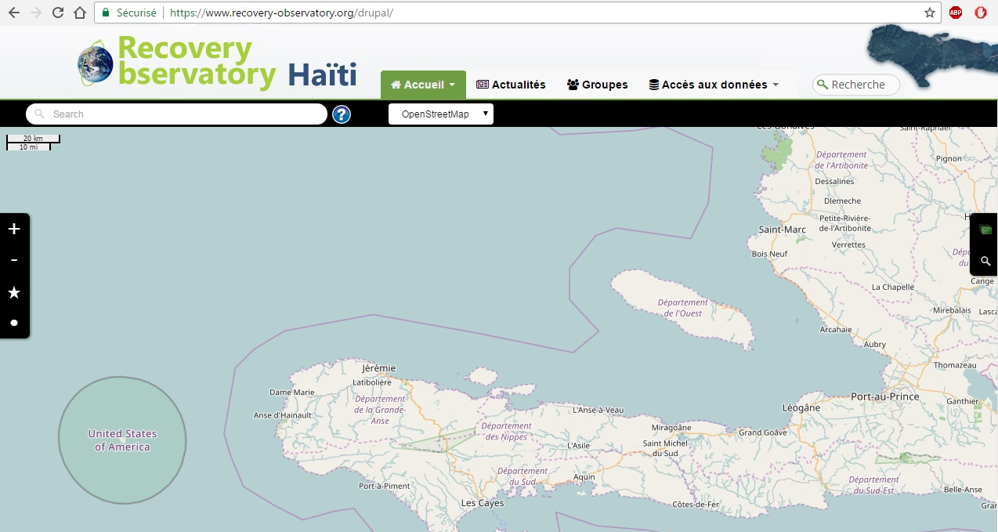
RO Dotcloud Platform
www.recovery-observatory.org
Translation of key texts. Multilingual by October.

Slide 21
Haiti RO Steering Committee #1
Day-to-day management of the RO – telcon every 3/4 months
Member of the Haiti RO Steering Committee (SC) :
- Michèle ORIOL (CIAT)
- Boby PIARD (CNIGS)
- Dwinell BELIZAIRE (ONEV)
- Martine THERER and Chiara MELUCCI (UNDP)
- Mare LO and Sergio DELL’ANNA (WB)
- Simona ZOFFOLI and Giorgio BONI (ASI/ CIMA)
- Stéphane CHALIFOUX (CSA)
- Hélène de BOISSEZON (CNES)
First SC meeting planned on 27th September 2017
Notes:
Centre national d’information geo-spatiale (CNIGS)
CIAT – Comite interministeriel pour l’amenagement du Territoire
ONEV – Observatoire national pour l’environnement et la vulnerabilite

Slide 22
Haiti RO - Next steps
Development of first applications based on identified requirements from Users workshop
Haitian Web Portal for all Spatial Data being established
Technical mission end 2017, to validate 1st products, plan capacity building and dissemination
Solicitation of new funding and partners to augment applications offered and to develop Capacity Building capacities
Reporting to major stakeholders (WB, GFDRR, UN)

Slide 23
RO Timeline
To August 2017 – Haiti RO Establishment
Discussion of MOUs with Haitian users and partners, Establishment of IT infrastructure with charter images, baseline pre/post-event
First User workshop in Haiti to provide further input to the ROOP and finalise the Haiti RO baseline.
Sept 2017 to early 2018 – Haiti RO Commissioning
Incorporating the first products into the Haiti RO and ensuring easy access
Definition of capacity building plan
Solicitation of new partnerships (for value-adding and capacity building)
Animating the user forum; Encouraging and promoting Haiti RO use. First “early evaluation”, with a report to Haiti RO Steering Committee
To end 2020 – Haiti RO Steady-state Operation / Generic RO definition
Ensure IT updates, engage in capacity building activities, generate regular products, report on Haiti RO annually to stakeholders and partners
Analysis of Haiti RO operation & results, to derive Generic RO specifications
Preparation of Haiti RO closure, including evaluation and legacy strategies.

Slide 24
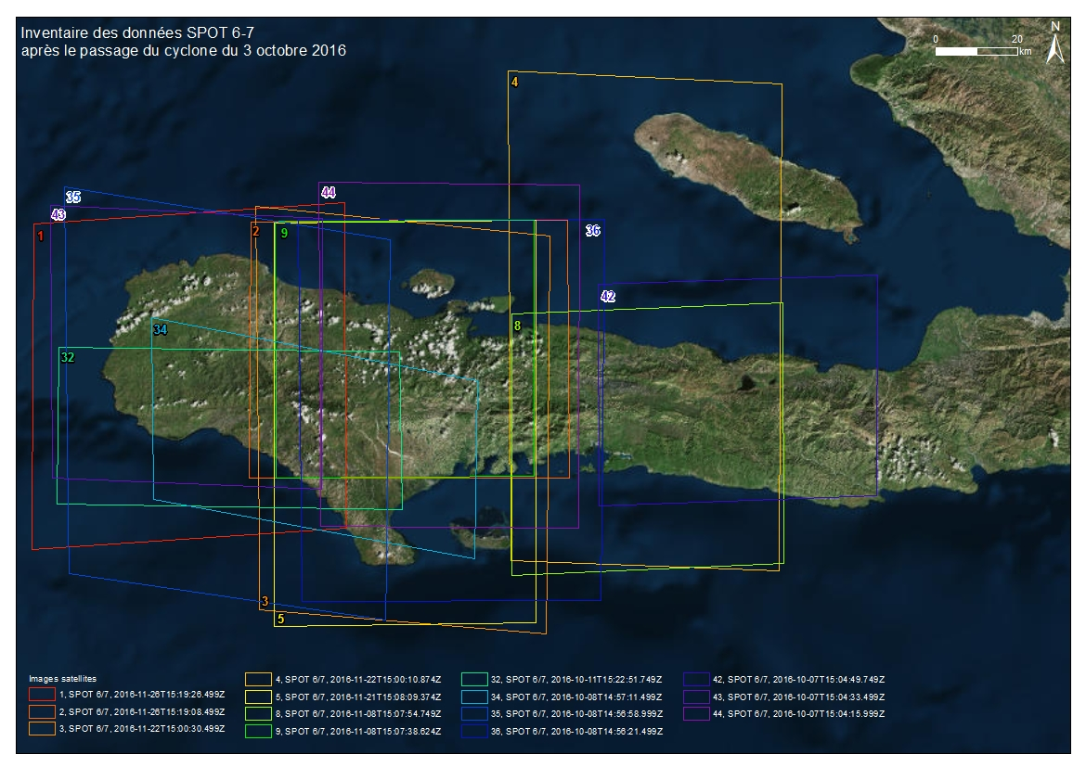
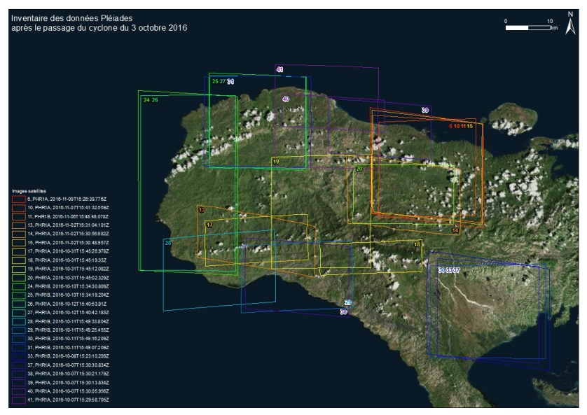
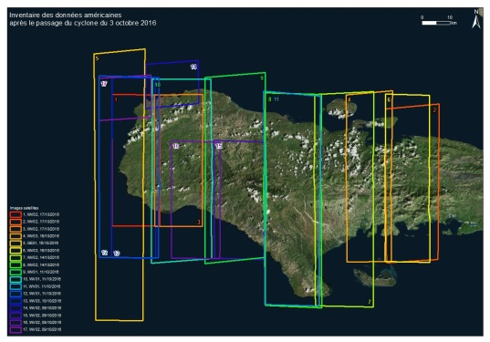
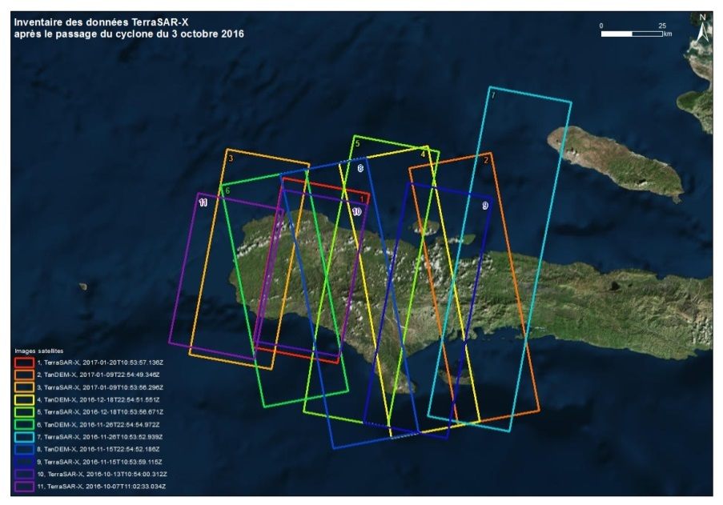
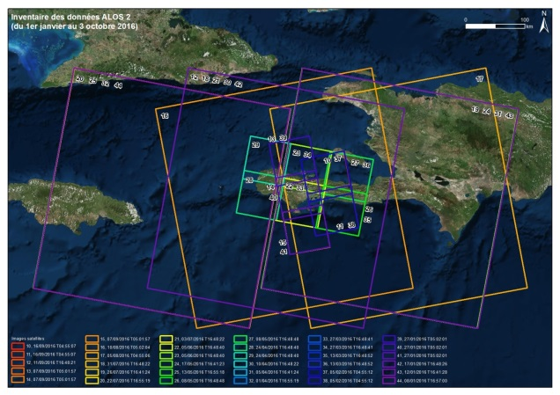
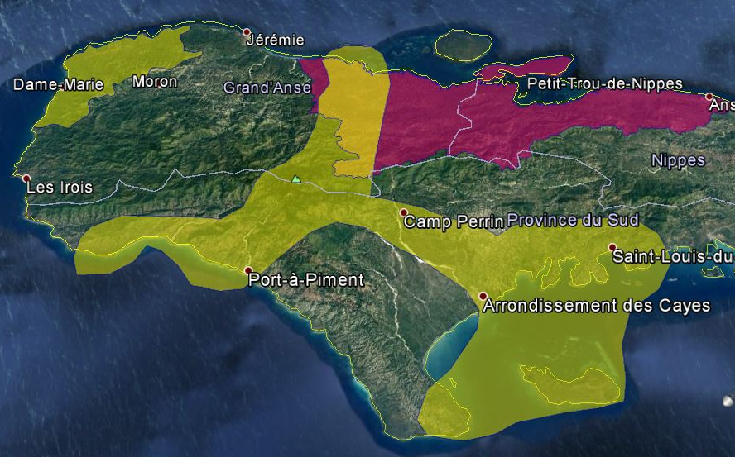
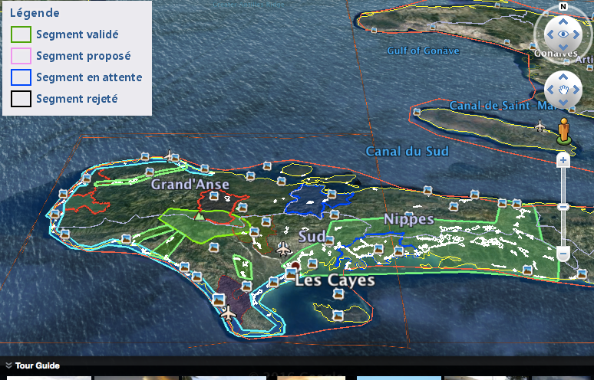
THANK YOU
FOR
YOUR ATTENTION

