Slide 1

CEOS Disaster Risk Management Flood Pilot
Presented at the CEOS Disasters Working Group Meeting #8 in Buenos Aires, Argentina
Co-Lead Stu Frye (stuart.frye@nasa.gov)
Co-Lead Bob Kuligowski (bob.kuligowski@noaa.gov)
NASA Rep to the CEOS WGDis David Green (david.s.green@nasa.gov)
4 September 2017

Slide 2
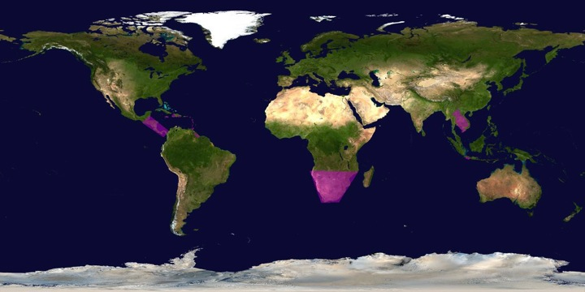
CEOS DRM Flood Pilot Overview
Goal: demonstrate effective application of EO to the full cycle of flood management at all scales by:
  Objective A: Integrating information from existing NRT global flood monitoring / modeling systems into a Global Flood Dashboard;
  Objective B: Delivering EO-based flood mitigation, warning, and response products and services through regional end-to-end pilots
  Objective C: Encouraging at least base-level in-country capacity to access EO and integrate it into their operational systems and flood management practices
Flood
Pilot
Regions
In Purple
2

Slide 3
How Data Have Been Exploited
Geographic Area | Product | Value Added Partner
Global | Flood extent maps and flood forecasts | Dartmouth Flood Observatory, University of Maryland
Haiti | Flood extent maps, flood risk maps, landslide maps, flash flood guidance / threat maps, integrated risk assessment platform | SERTIT, CIMA, INGV, Altamira, CIMH, RASOR FP7, NOAA/HRC
Other Caribbean islands, Central America | Flood damage maps, change detection products, co-registered map overlays | CATHALAC, CIMH, NASA/GSFC, RCCP (Costa Rica)
Namibia | Flood extent maps, flood warning products, co-registered map overlays | Namibia Hydrology Dept, Namibian Water Authority, NASA
Zambezi basin | Flood extent maps, flood forecast models, flood hazard maps, flood depth forecasts | Lippmann Institute (HAZARD, WATCHFUL), Deltares, RSS
Mekong | Flood extent maps, flood risk maps, flash flood guidance / threat maps | Mekong River Commission, ADPC, NASA, NOAA, HRC, USGS, Univ. of South Carolina, Texas A&M , IMWI
Java (Bandung, Jakarta, Cilacap) | Flood risk maps, subsidence maps tied to flood risk, tsunami risk maps (Cilacap only), flood extent maps | SERTIT, Deltares, CIMA, Altamira, INGV, RASOR FP7,
Products used by: national end users, civil protection agencies, World Bank, Red Cross, World Food Program, River Commissions (Kavango, Zambezi, Mekong)
3

Slide 4
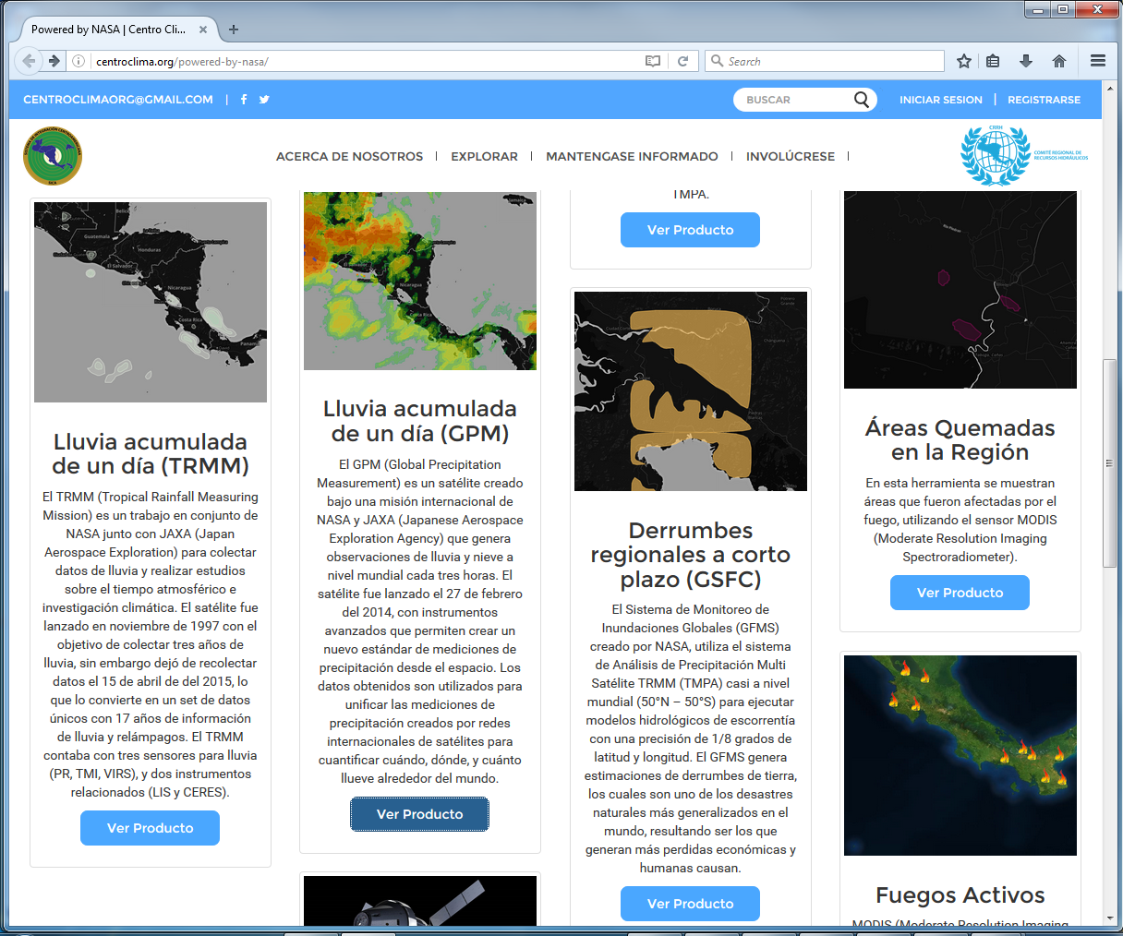
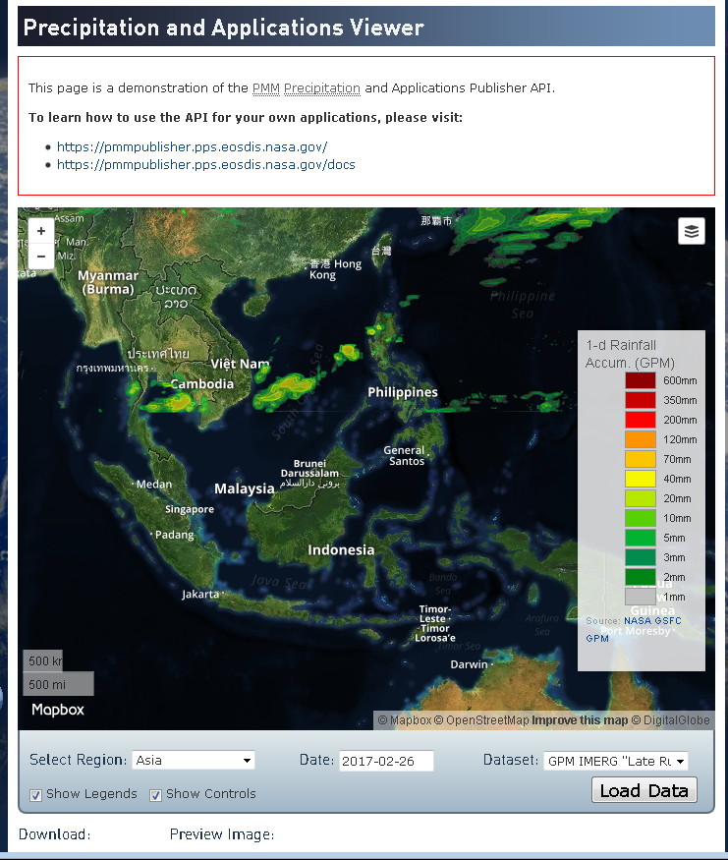
Streamlined Real-Time Data Access
Central America
Southeast Asia
http://centroclima.org/powered-by-nasa/
https://pmm.nasa.gov/precip-apps
4
Notes:
Updates on OpenGeoSocial API for global dashboard?

Slide 5
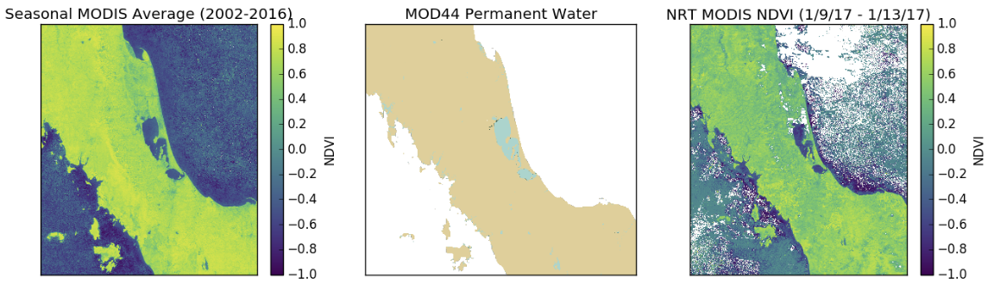
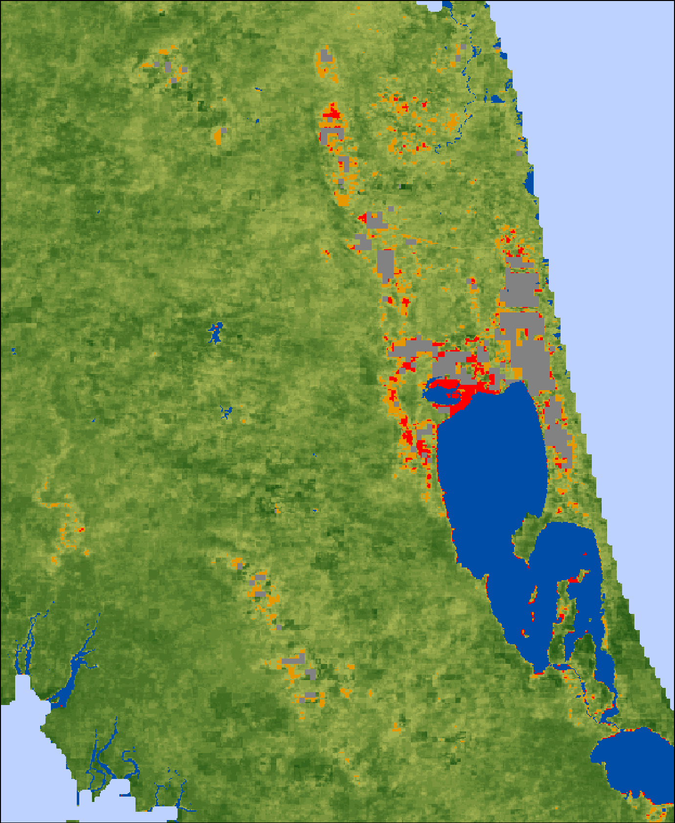
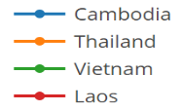
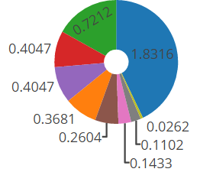
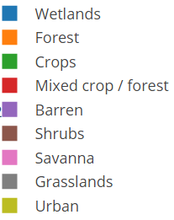
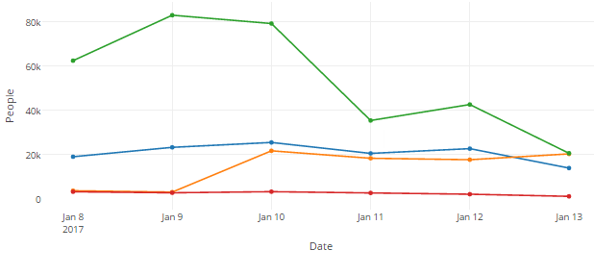
New Real-Time Flood Products
Southern Thailand Flooding as of 1/13/17
Figure 2
Figure 1
A
B
C
Spectral Training and Image Classification
Incorporate Socioeconomic Data
Impacted Landcover (sq km.) in Thailand (as of 1/13)
Population Exposed to Flooding
(as of 1/13)
B
A
Figure 3
MODIS satellite observations and derived information products (e.g. flooded areas and socioeconomic impacts) are being used by regional NGO’s like the Asian Disaster Preparedness center to identify floods and associated impacts to people and infrastructure in near real-time.
Credit: A. Ahamed, J. Bolten, NASA GSFC
Interactive Web Map: http://projectmekongnasa.appspot.com
5
Notes:
Technical Description of Figures:
Figure 1: (A) Map of MODIS Aqua / Terra NDVI in Southern Thailand averaged over the length of the MODIS record for the 8-day surface reflectance product (MOD09Q1) acquired annually on January 9. (B) Permanent Water Bodies (MOD44) dataset used to train surface water classifiers which are applied to detect flooding from Near Real-Time MODIS imagery. (C) 4-day Aqua/Terra Near Real-Time NDVI composite image showing flooded conditions in Southern Thailand.
Figure 2: Shows the flood classifier calculated in Figures 1A – 1B applied to Figure 1C in order to classify high confidence flooded areas (red), medium confience flooded areas (orange), and non-flooded areas (others). Flood extent resolution is 250m resolution; and the method has been validated with multiple high resolution radar sensors across multiple years and conditions, achieving 87% accuracy.
Figure 3: (A) Landcover (sq. km) impacted by high confidence flooding in Thailand for the time period 1/9/17 – 1/13/17. Flooded areas are those shown in Figure 2. Landcover data is derived from MOD12Q1 Landcover products and the Global Landcover Facility GLCF Classification scheme. (B) Population per country at risk of flooding for the time period 1/9/17 – 1/13/17. Population data derived from Worldpop (http://worldpop.org).

Slide 6
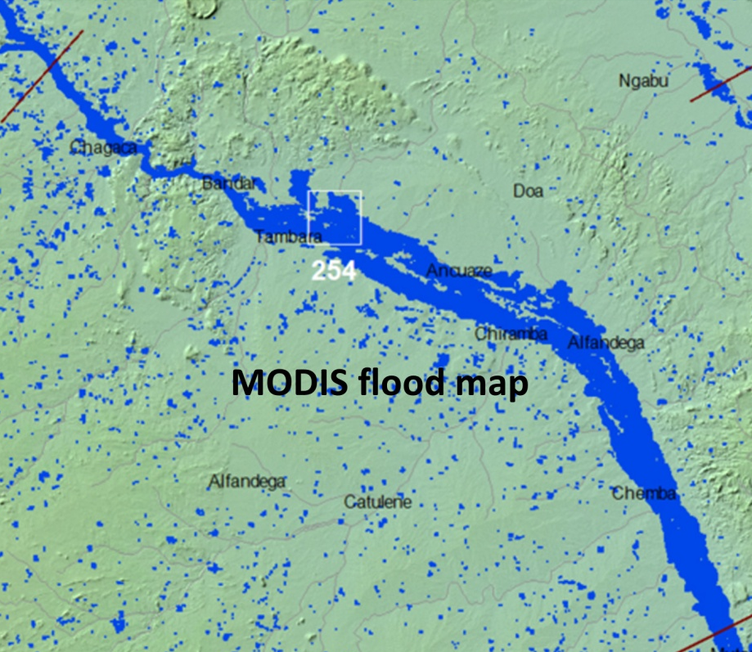
Better Flood Observations for Better Forecasts
Pink outline: Simulation based on HydroSHEDS stream network & river widths.
Blue area: Simulation based on Landsat-derived stream networks & river widths.
More realistic and complete stream networks from EO data leads to improved flood model simulations in regions with few gauges (Credit: G. Schumann, UCLA)

Slide 7
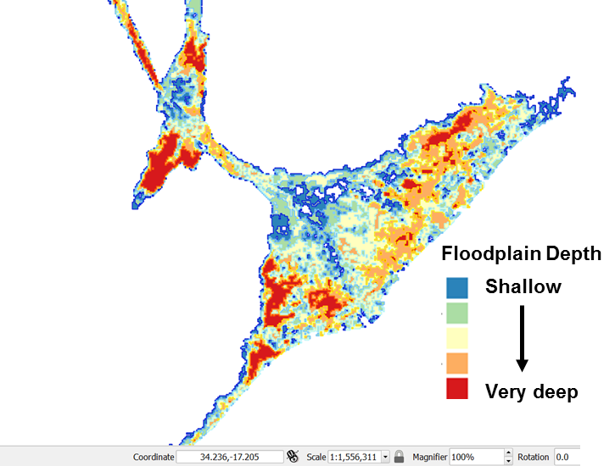
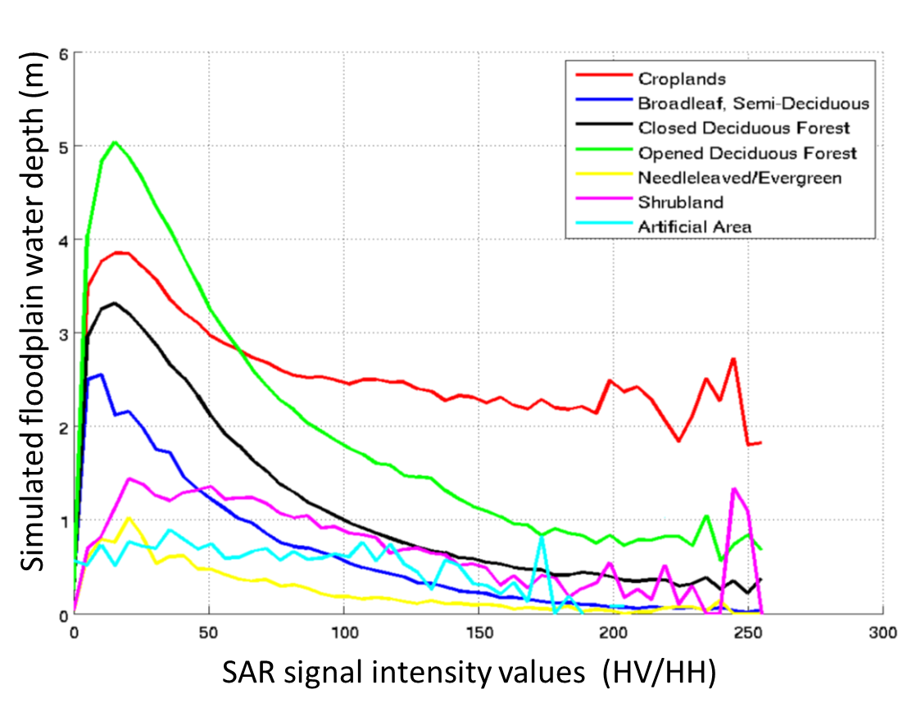
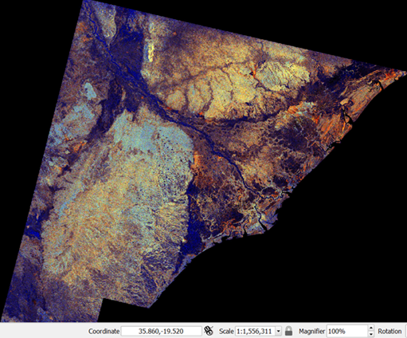
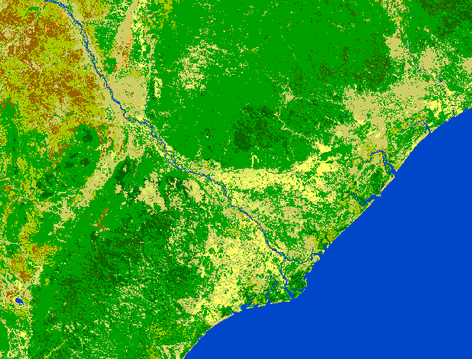
Better Forecasts of Flood Depth
2-D flood model simulation based on Water Balance Model (WBM) long-term simulated hydrologic flows
ALOS-PALSAR L-band flood image of the 2015 event. RGB composite of multiple polarizations (HV, HH, HV/HH)
Detailed land cover classification (2009) based on ESA’s GLOBCOVER: http://due.esrin.esa.int/page_globcover.php
Coupled WBM-LISFLOOD-FP flood model is capable of simulating floodplain depth magnitudes. Cross-validating those with ALOS L-band polarizations for different flooded vegetation can improve satellite-based flood mapping.
Contributors: G. Schumann, V. Dang, A. Kettner & B. Brakenridge

Slide 8
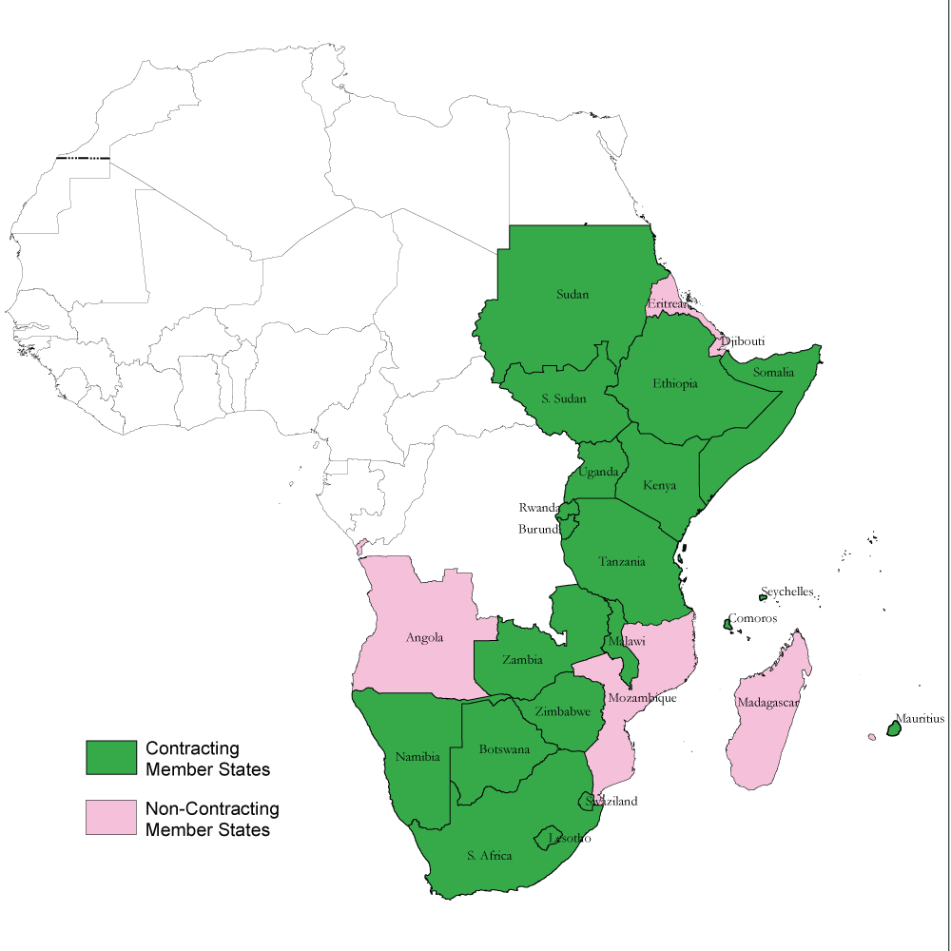
Local Capacity for Flood Modeling
Hong / Flaming (U. of Oklahoma / NOAA) installed the Ensemble Framework for Flash Flood Forecasting (EF5) model at the Regional Centre for Mapping of Resources for Development (RCMRD) in Kenya.
This model produces real-time products on RCRMD’s Amazon cloud that are distributed through the Open GeoSocial API under RCRMD control (web interface is being implemented).
Training in the RCRMD member states is ongoing.
RCRMD member states

Slide 9
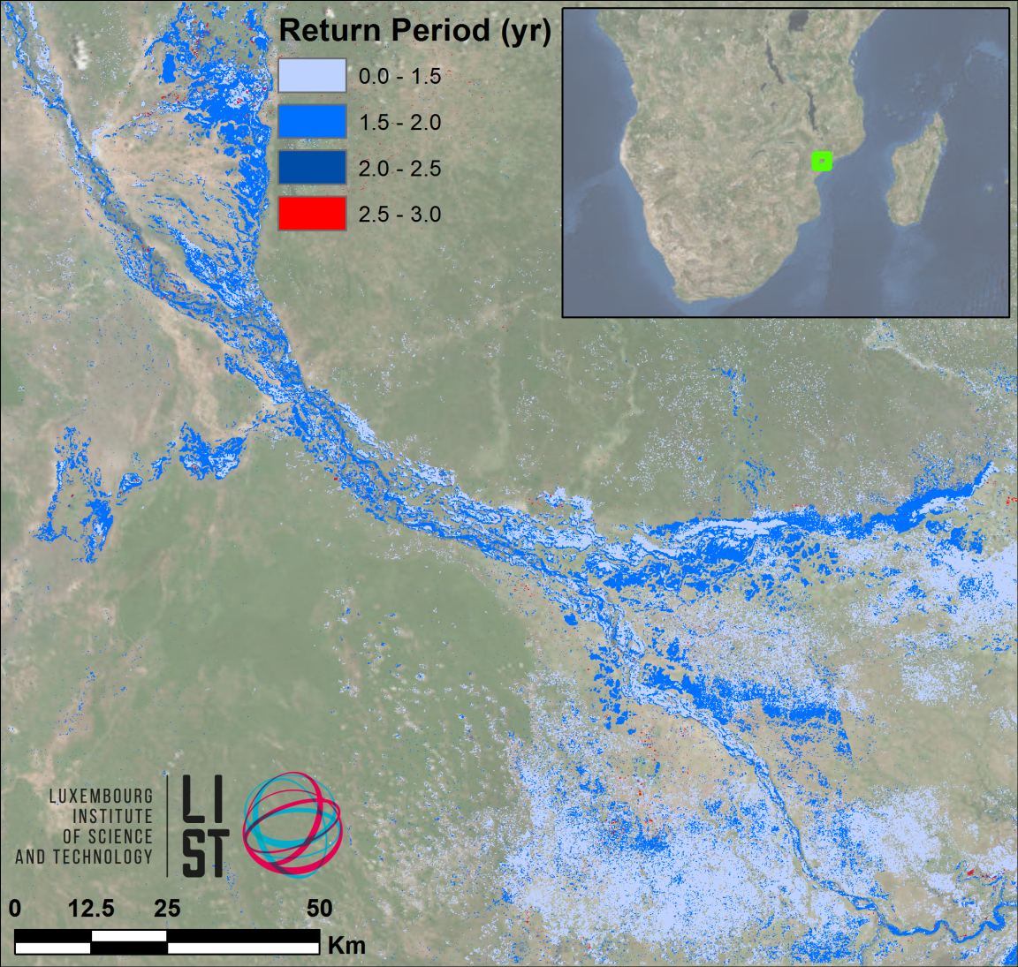
Better Estimates of Flood Severity
LIST flood hazard maps determine flood severity by comparing flood extent in a SAR image with computed extent / return period from simulated historic floods
The UN World Food Programme has shown interest

Slide 10
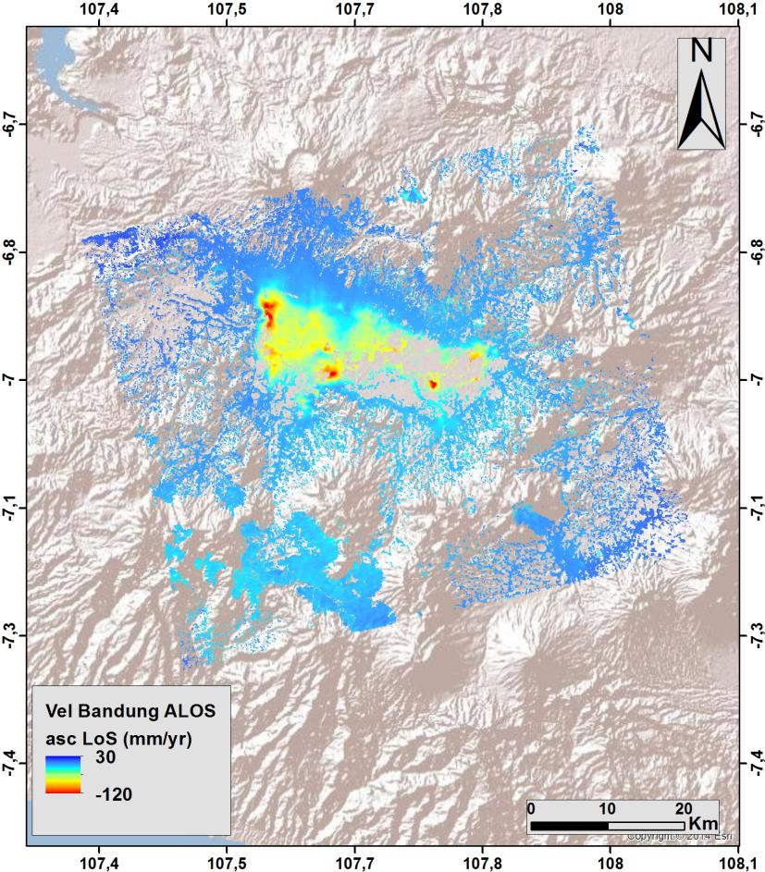
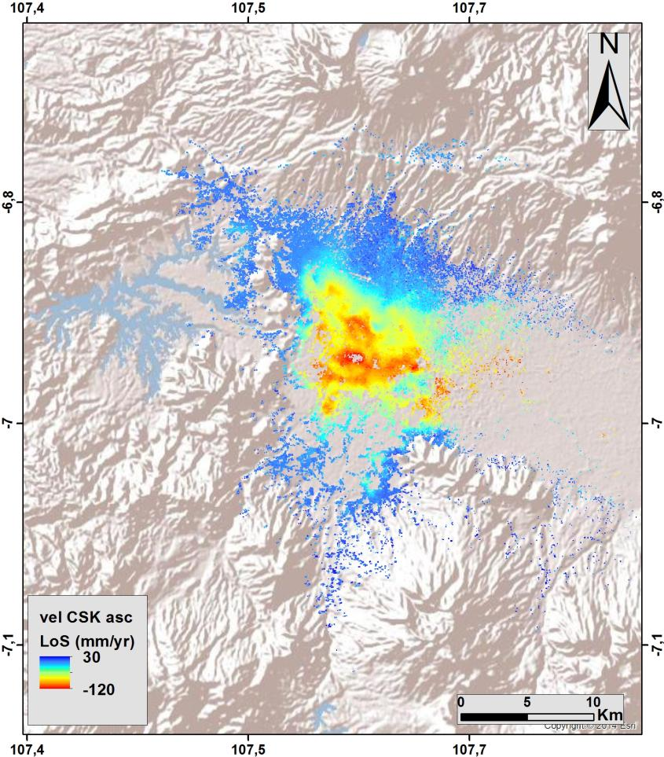
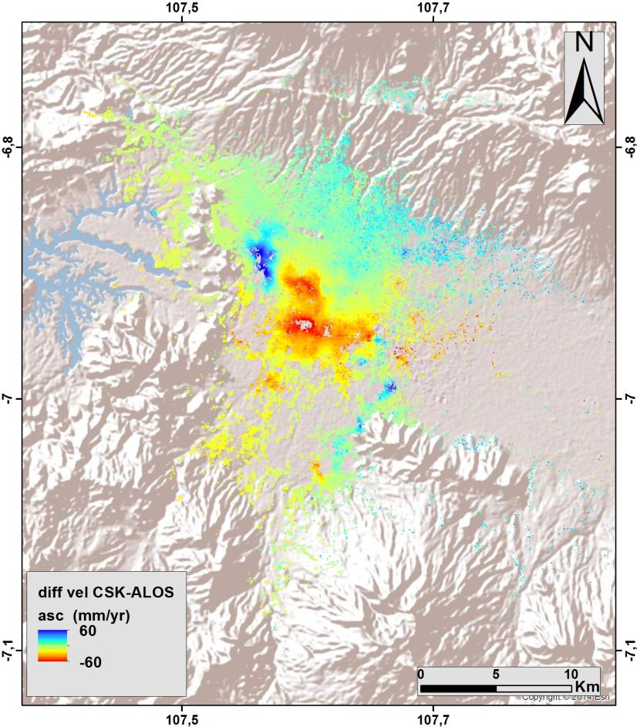
Evaluating Subsidence…
Subsidence Mapping by INGV (RASOR)
ALOS ascending (2007-2011)
CSK ascending (2013-2015)
Difference (CSK-ALOS)
(red = increased rate of subsidence)

Slide 11
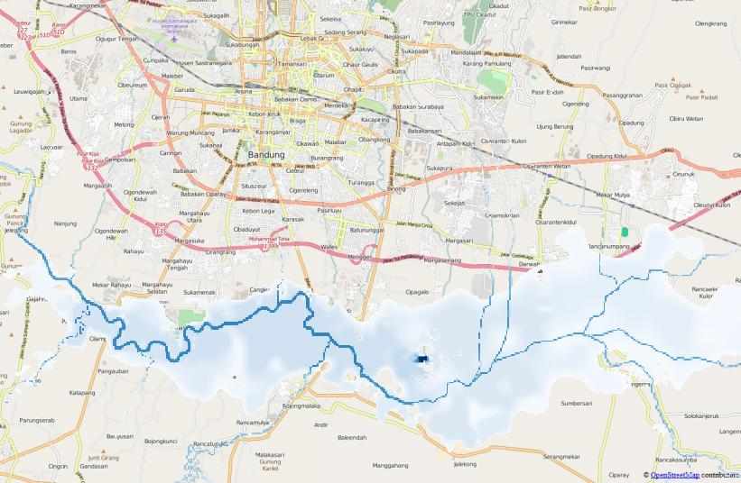
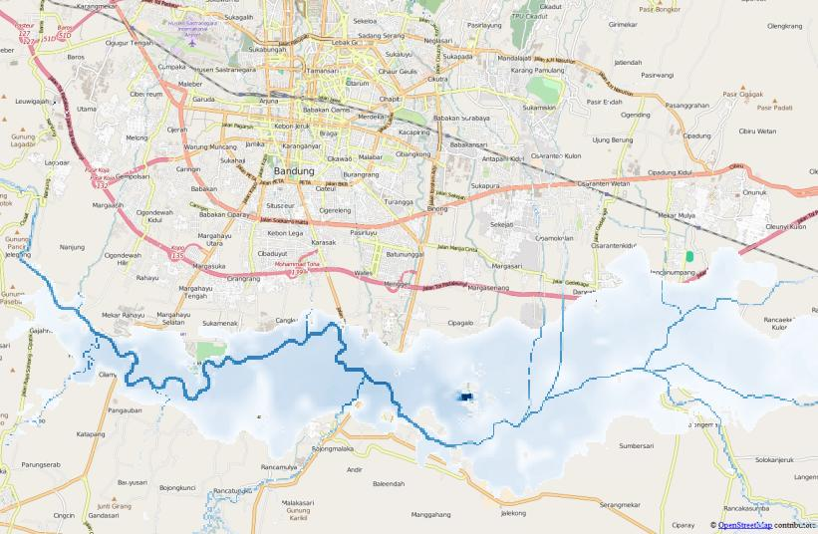
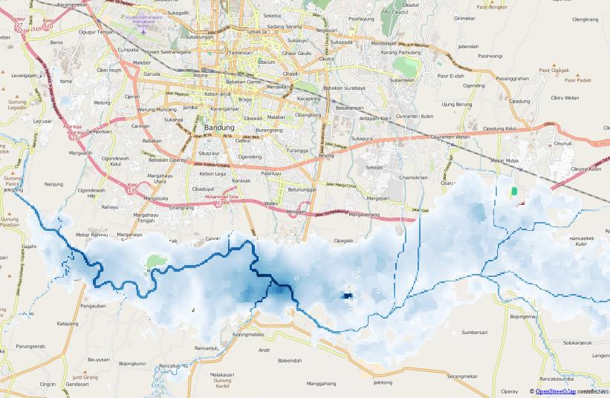
…and Its Impact on Potential Future Floods
Inundation depths calculated for subsidence scenarios in 2014, 2020 and 2050 based on rainfall from the Dec 2014 flood
2014
0 - 1 m
1 - 2 m
2 - 3 m
3 - 4 m
4 - 5 m
5 - 6 m
6 - 7 m
7 - 8 m
8 - 9 m
9 - 10 m
> 10 m
2020
2050
Notes:
The RASOR flood models were employed to simulate the 2014 floods in Malaysia and to analyze how the inundation depths would increase if the SAR-based subsidence projections for 2020 and 2050 become reality. In each case, the TRMM historical rainfall from December 2014 was used as input. Flood impact was computed using EO based exposure data and vulnerability functions available via the RASOR platform.

Slide 12
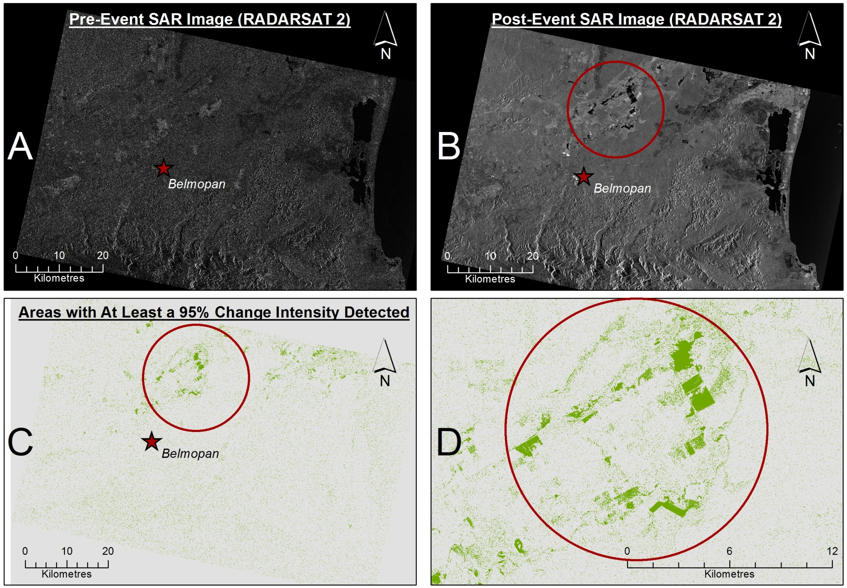
Developing Local Capacity to Evaluate Flood Damage
12
Notes:
CIMH has experimented with a processing routine which compared two RADARSAT 2 images (pre-event and post-event) for an identical area in which Belmopan, Belize is relatively central. The result of the process produced an image which highlighted a series of regions for which it is suggested that a level of 95% change intensity occurred. Please see the attached image for which the following labeled sections are explained below:
A - The Pre-event image
B - The Post-event Image
C - The result of the change detection routine (where features in green represent detected changes)
D- A close up of some of the larger change features from the result.

Slide 13
User Comments
“These files [of flooding in Sri Lanka in May 2016] are perfect for me and our needs…Your outreach and forward thinking about open data really does save lives.” – Blake Giradot, Humanitarian Open Street Map Team
“This [flood products for Louisiana in May 2016 converted to GIS layers] is absolutely the direction we want to head.”—C. Vaughan, Federal Emergency Management Agency (FEMA)
“We see our success as the openings we made with all the assistance offered and given by our CEOS partners. Some components [include] the tremendous access to satellite images and the actual use of these images by our staff…and last but not least the capacity building and access to new techniques for our young professionals.”—Namibia Department of Water Affairs, Hydrology Division Director Pauline Mufeti

Slide 14
Looking Forward
Although the official Flood Pilot will end in December, a number of participating efforts will continue, including:
  Lower Mekong River Basin Project (NASA GSFC/SERVIR) which includes locally-produced flood maps and products showing flood impacts
  Dartmouth Flood Observatory (Univ. Of Colorado), which has received support to collaborate with Remote Sensing Solutions to develop a more comprehensive “one-stop shop” for global flood disaster response assistance
  Global Flood Monitoring System (U. of Maryland) will continue to provide automated flood forecasts to users worldwide
  Global Flash Flood Guidance (HRC), which provides real-time flash flood forecasts to roughly 10% of the entire global population
GEO-DARMA will leverage and extend other Pilot efforts though the details are still being worked out
In the Americas, the AmeriGEOSS Disasters Group will extend flood DRM accomplishments from the Caribbean and Central America region to all participating GEO countries in Latin America

Slide 15
Questions / Discussion

