Slide 1
RUSSIAN EARTH OBSERVATION SYSTEM

Slide 2
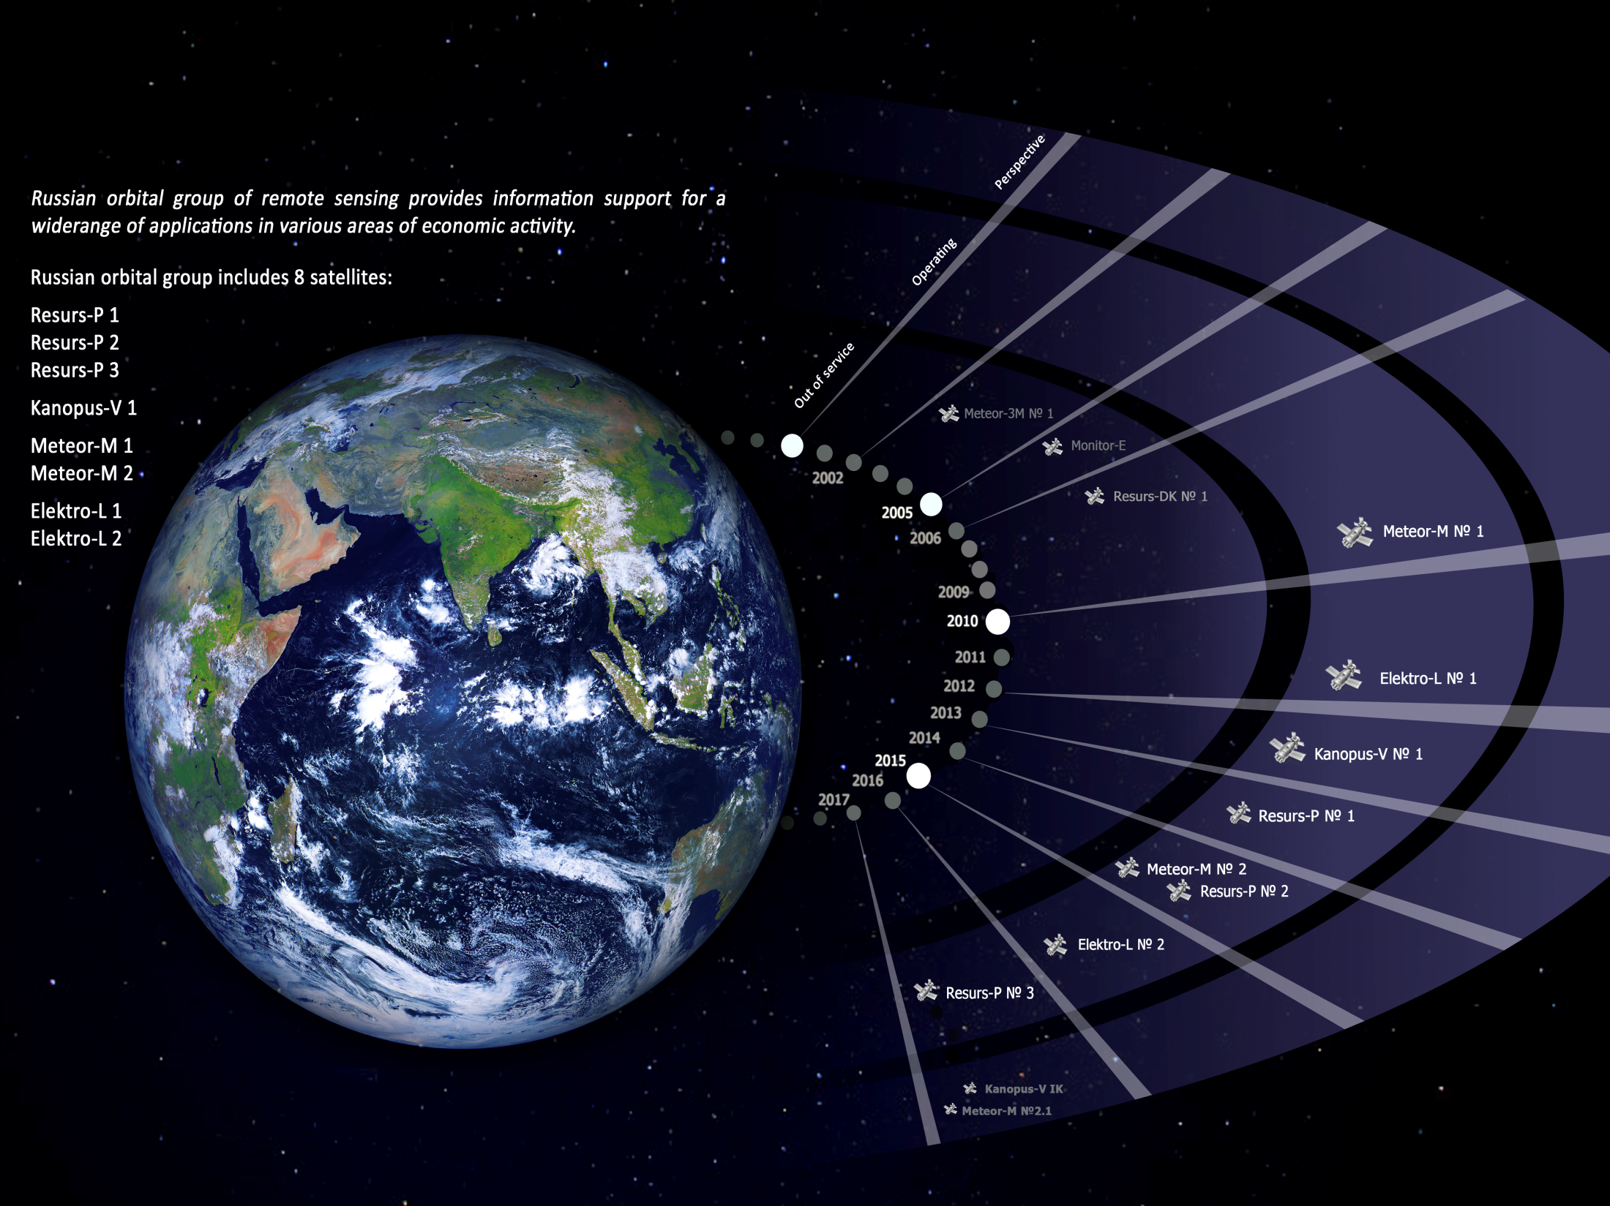
The Russian Earth Observation Satellite Constellation
© JSC «Russian Space Systems»
2

Slide 3
INFORMATION CAPABILITIES OF RUSSIAN Earth Observation SATELLITE CONSTELLATION
Satellite / Characteristics | Resurs-DK | Resurs-P |  |  |  | Kanopus-V |  | Meteor-M |  |  | Electro-L
Launch Date (dd-mm-yyyy) | 15.06.2006 (archive only) | 25.06.2013 (Resurs-P1) 26.12.2014 (Resurs-P2) 13.03.2016 (Resurs-P3) |  |  |  | 22.07.2012 |  | 17.09.2009 (Meteor-M1) 08.07.2014 (Meteor-M2) |  |  | 20.01.2011 (1) 11.12.2015 (2)
Active Lifetime (years) | 3 | 5 |  |  |  | 5…7 |  | 5 |  |  | 10
Instrument | Geoton | Geoton | GSA | ShMSA |  | PSS | MSS | KMSS* |  | MSU-MR* | MSU-GS*
 |  |  |  | VR | SR* |  |  | MSU-50* | MSU-100*
Swath Width (km) | 28 / 16** | 38 | 25 | 97 | 441 | 23 | 20 | 900 | 900 | 2800 | Entire disk of the Earth
Spatial Resolution (m): Panchromatic (PAN) Multispectral (MS) | 1 / 3** 2–3 / 3–5** | 1 3 | – 30 | 12 23.8 | 60 120 | 2.1 – | – 12 | – 60 | – 120 | – 1000 | VIS – 1000, IR – 4000
Spectral Bands | 4 | 6 | 96-255 | 6 | 6 | 1 | 4 | 3 | 3 | 6 | 10
Revisit Period (days) | 6–10 | 3–4 |  |  |  |  |  | 1–3 |  |  | 15–30 minutes
* Open access data; ** Before / after September 2011
Satellite / Thematic Tasks | Cartography | Ecological Monitoring | Infrastructure Object Monitoring | Environmental Management | Natural Resources Monitoring | Monitoring of Man-Made and Natural Disasters
Resurs-DK | 1:10,000 and smaller | + | + | + | + | +
Resurs-P | 1:10,000 and smaller | + | + | + | + | +
Kanopus-V | 1:25,000 and smaller | + | + | + | + | +
Meteor-M | 1:500,000 and smaller | + | – | + | – | +
Electro-L | – | – | – | + | – | Large-scale +

Slide 4
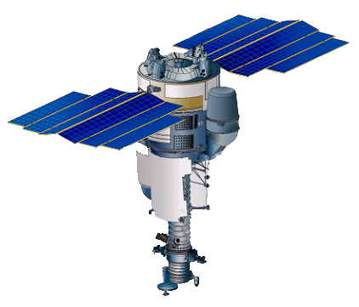
RESURS-DK
Mission Purpose
Near real-time acquiring of highly informative data in visible and near-IR spectral range for ecological monitoring, natural resources inventory, mineral exploration, and mapping
Onboard Instrument
Highly Detailed-Resolution Optical Camera [Geoton]
Resolution PAN (0.58-0.80µm) – 1m / 3m*
Resolution MS (3 bands, 0.5-0.8µm) – 2-3m / 3-5m*
Swath width – 28km / 16km*
Launch date – June 15, 2006
Current Tasks
Inventory of natural resources, topographic and thematic mapping
Monitoring of the biosphere pollution sources;
Monitoring of emergencies
Research activities

Slide 5
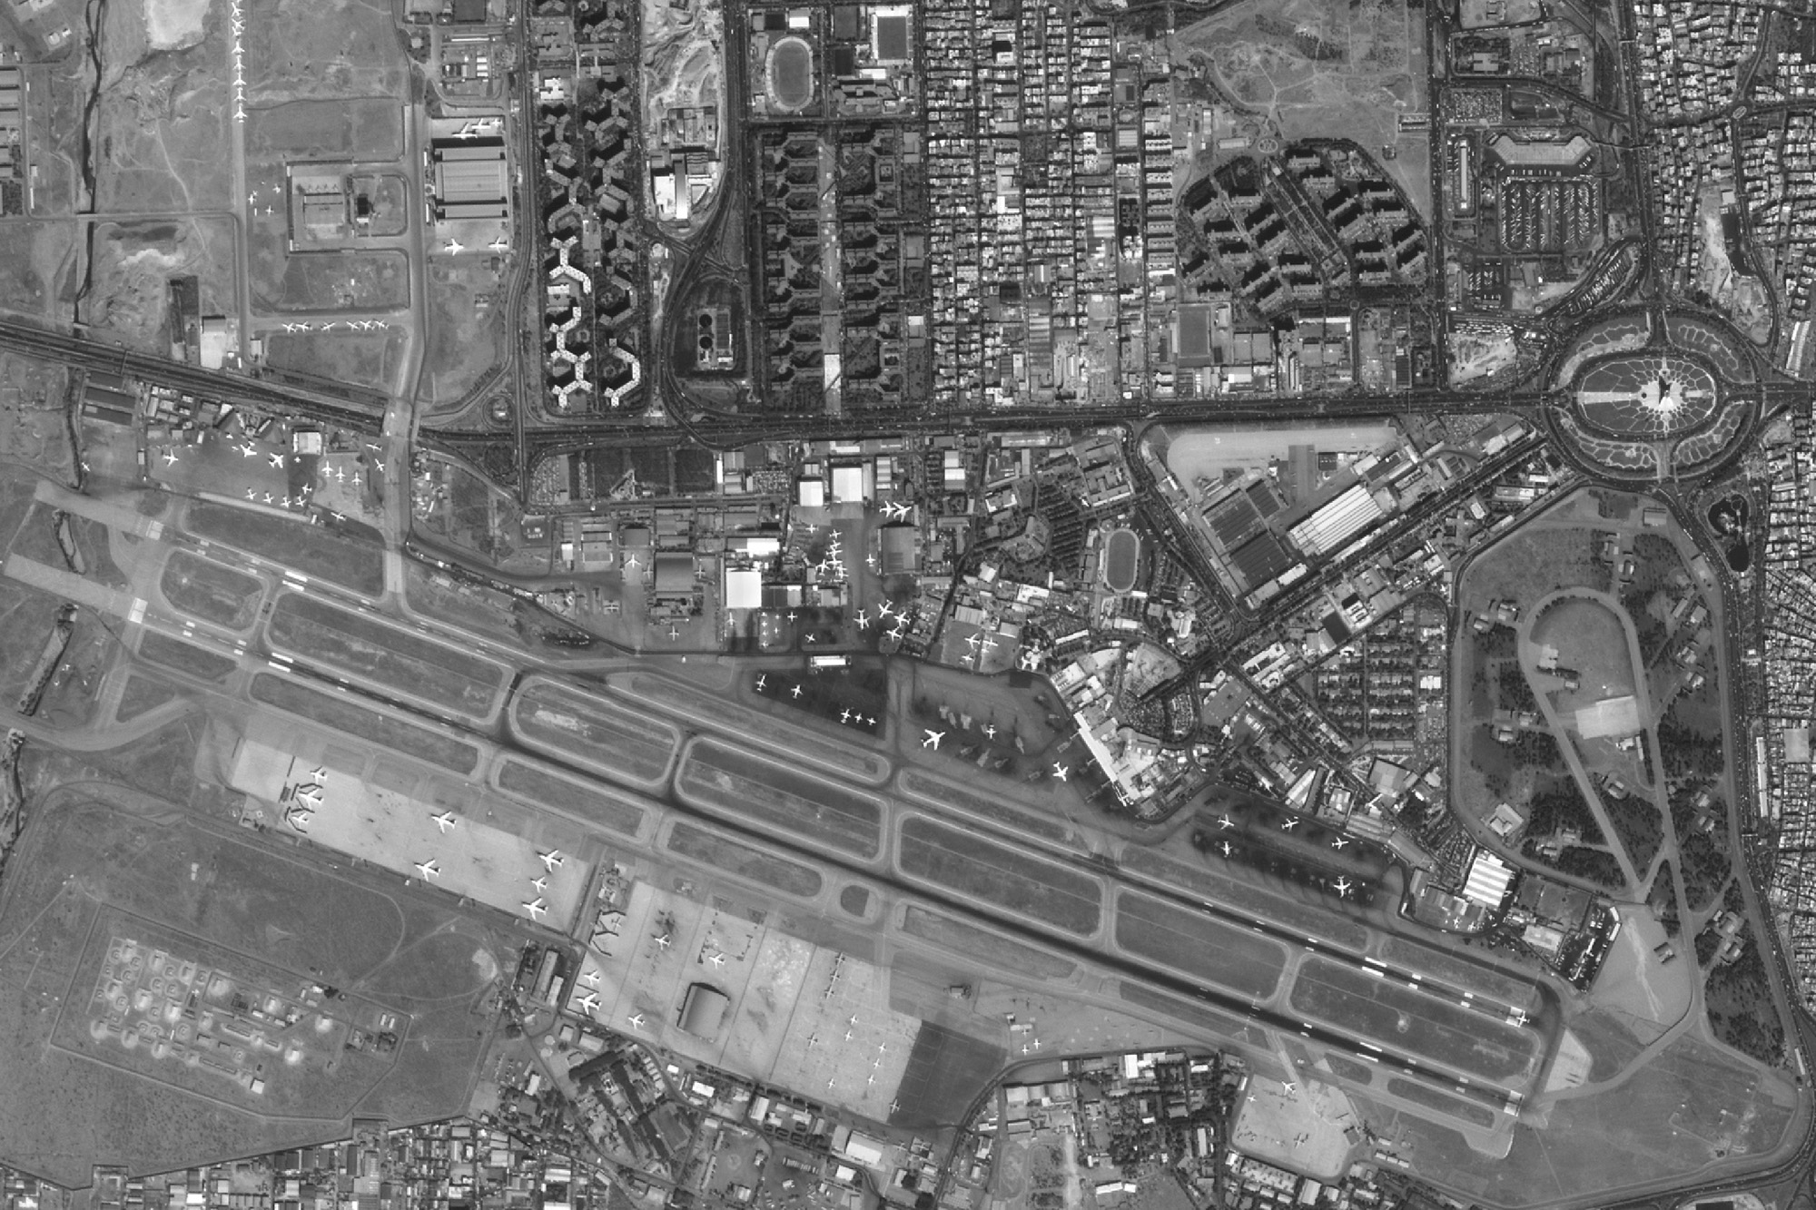
Resurs-DK
Tehran
© JSC «Russian Space Systems»
5

Slide 6
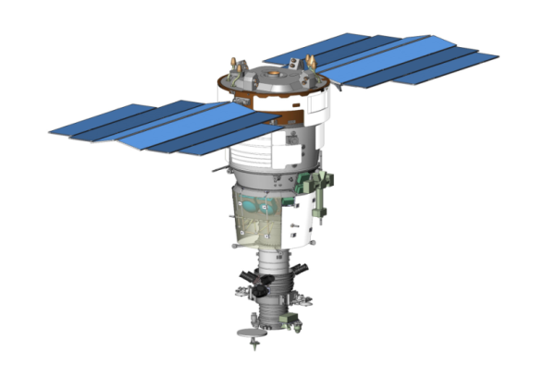
RESURS-P
Mission Purpose
Near real-time acquiring of highly informative data in visible and near-IR spectral range for ecological monitoring, natural resources inventory, mineral exploration, and mapping
Onboard Instruments
Highly Detailed-Resolution Optical Camera [Geoton]
Resolution PAN (0.58-0.80µm) – 0.9m
Resolution MS (5 bands, 0.45-0.90µm) – 3m
Swath width – 38km
2 Wide-Swath Optical Cameras [ShMSA]
High Resolution Camera [ShMSA-VR]
Resolution PAN (0.58-0.80µm) – 12m
Resolution MS (5 bands, 0.43-0.90µm) – 23.8m
Swath width – 97km
Medium Resolution Camera [ShMSA-SR]
Resolution PAN (0.58-0.80µm) – 60m
Resolution MS (5 bands, 0.43-0.90µm) – 120m
Swath width – 441km
Hyperspectral Camera [GSA]
Resolution (96-255 bands, 0.4-1.1µm) – 30m
Swath width – 25km
Launch date – 25 June, 2013 (Resurs-P1)
26 December, 2014 (Resurs-P2)
13 March 2016 (Resurs-P3)
Current Tasks
Maps creation and update (scale 1:10,000 and smaller)
Environmental ecological monitoring
Operational emergencies monitoring
Respond to agriculture and forestry challenges
Socio-economic infrastructure monitoring

Slide 7
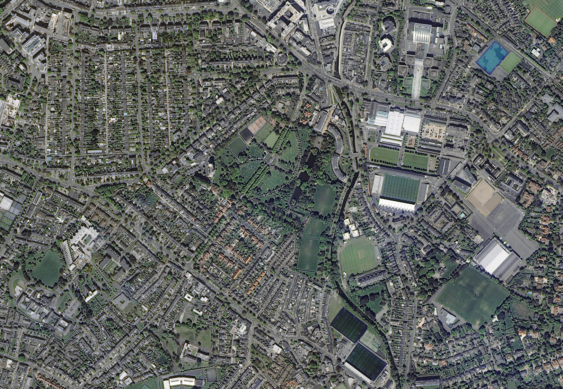
Resurs-P
Dublin
© JSC «Russian Space Systems»

Slide 8
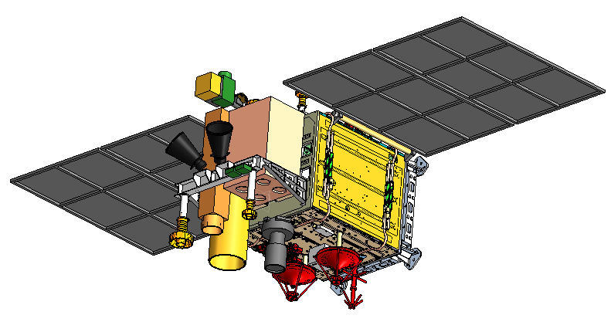
KANOPUS-V
Mission Purpose
Near real-time acquiring of highly informative data in visible and near-IR spectral range for ecological monitoring, natural resources inventory, mineral exploration, and topographic mapping
Onboard Instruments
PAN Optical System [PSS]
Resolution (0.54-0.86µm) – 2.1m
Swath width – 23km
MS Optical System [MSS]
Resolution (4 bands, 0.46-0.84µm) – 12m
Swath width – 20km
Launch date – July 22, 2012 (Kanopus-V1)
Next launch – the end of 2015 (Kanopus-V-IK)
Current Tasks
Maps creation and update (scale 1:25,000 and smaller)
Environmental ecological monitoring
Operational emergencies monitoring
Respond to agriculture and forestry challenges
Socio-economic infrastructure monitoring

Slide 9
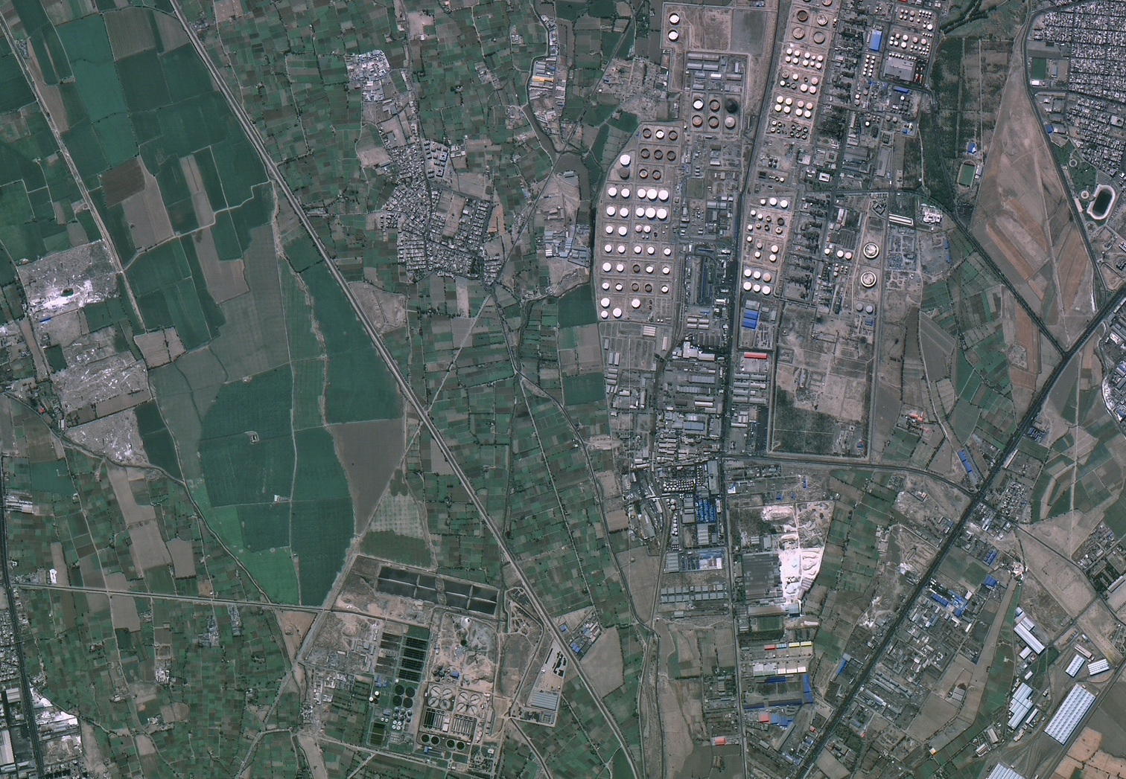
Kanopus-V
Tehran
© JSC «Russian Space Systems»
9

Slide 10
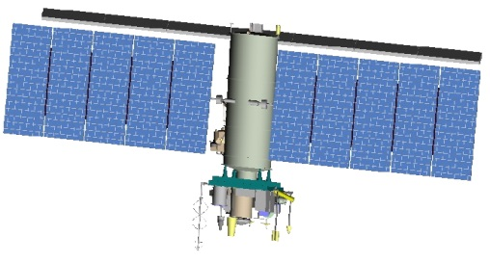
METEOR-M
Mission Purpose
Operational acquiring of cloudiness and the Earth’s underlying surface data, hydrometeorological data acquisition, heliogeophysical measurements, Earth’s resources study, and ecological monitoring
Onboard Instruments
2 Medium-Resolution Optical Camera [KMSS]
Land-Using Camera [MSU-100]
Resolution MS (3 bands, 0.53-0.90µm) – 60m
Swath width – 900km
Marine-Using Camera [MSU-50]
Resolution MS (3 bands, 0.37-0.69µm) – 120m
Swath width – 900km
Low-Resolution Optical Camera [MSU-MR]
Resolution MS (6 bands, 0.5-12.5µm) – 1000m
Swath width – 2800km
Launch date – 17 September, 2009 (Meteor-M1)
Launch date – 8 July, 2014 (Meteor-M2)
Next launch – the beginning of 2016 (Meteor-M2.1)
Current Tasks
Environmental monitoring
Ice conditions monitoring
Operational emergency monitoring
Monitoring of radiation and heliogeophysical conditions in near-Earth space

Slide 11
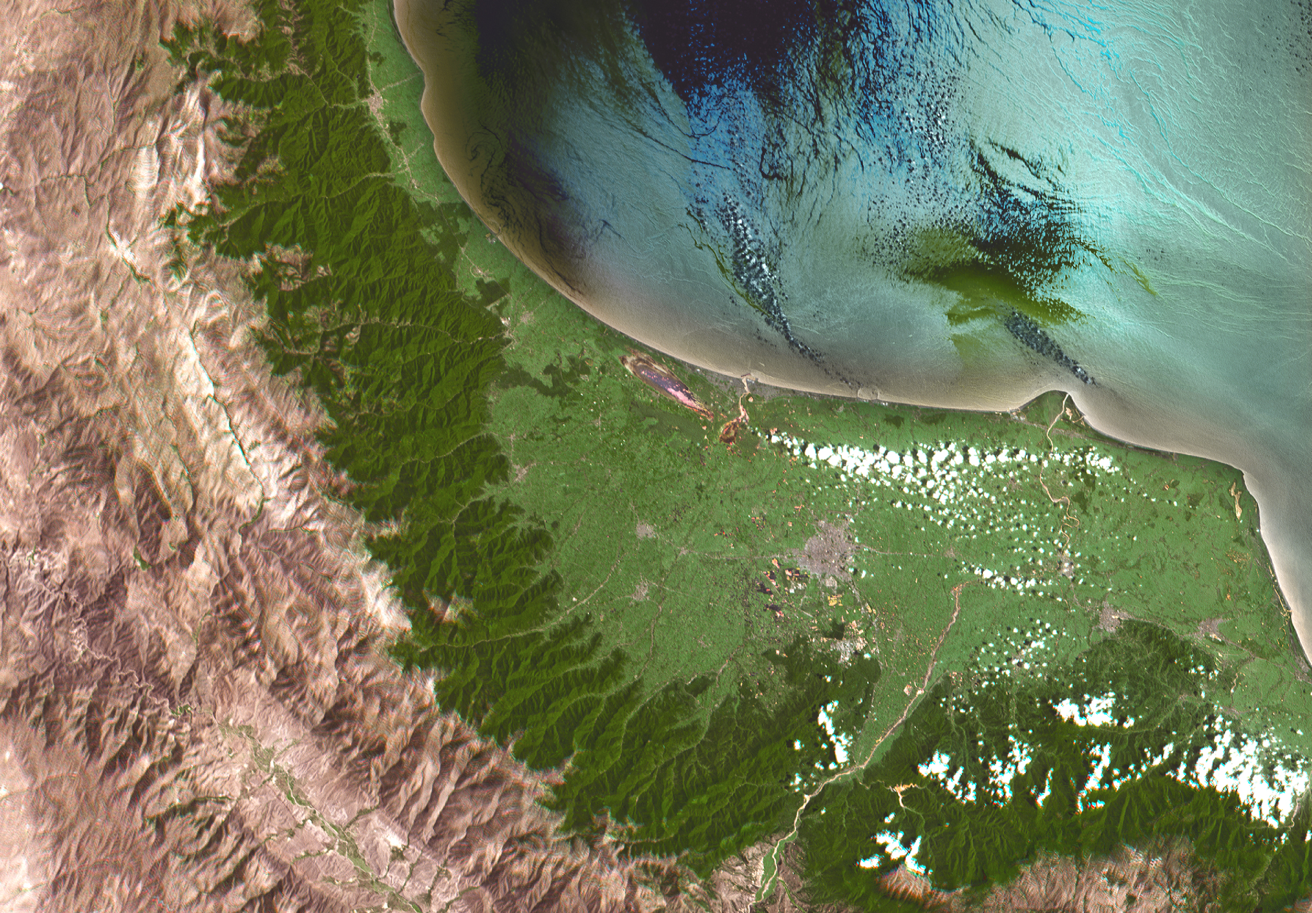
Meteor-M
Rasht
© JSC «Russian Space Systems»
11

Slide 12
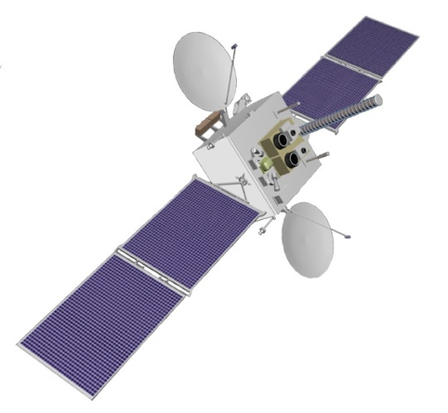
ELECTRO-L
Mission Purpose
Operational acquiring of cloudiness and the Earth’s underlying surface data, hydrometeorological data acquisition, heliogeophysical measurements
Onboard Instrument
Geostationary MS Optical Camera [MSU-GS]
Coverage area – the entire disk of the Earth
Resolution VIS (3 bands, 0.5-0.9µm) – 1000m
Resolution IR (7 bands, 3.5-12.5µm) – 4000m
Swath width – 900km
Revisit period in 24h – 30min (as scheduled) /
– 15min (on ground commands)
Launch date – January 20, 2011 (Electro-L1)
December 11, 2015 (Electro-L2)
Current Tasks
Operational imaging of the Earth’s underlying surface
The World Ocean state monitoring
Global monitoring of emergencies

Slide 13
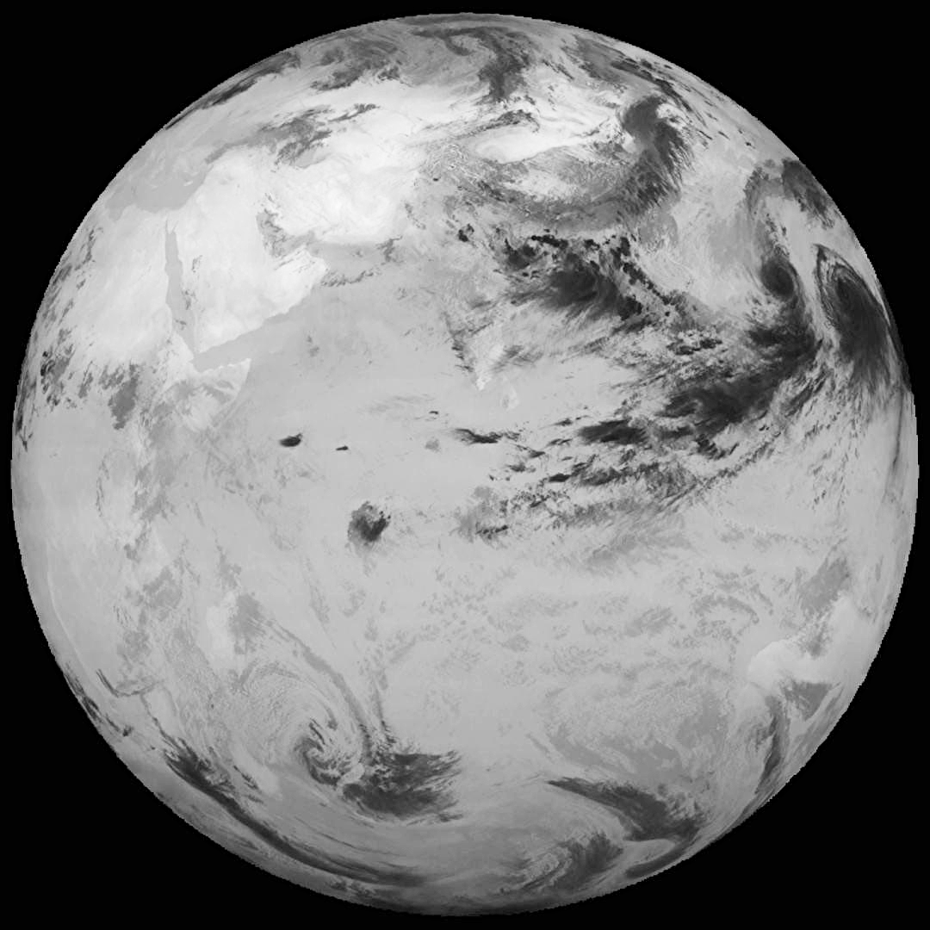
ELECTRO-L
Visible bands (RGB)
IR band (10,2-11,2µm)
© JSC «Russian Space Systems»
13

Slide 14
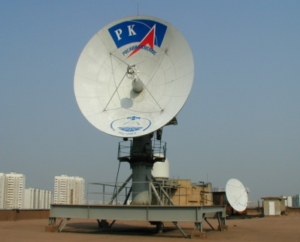
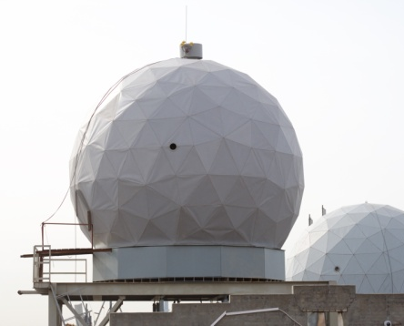
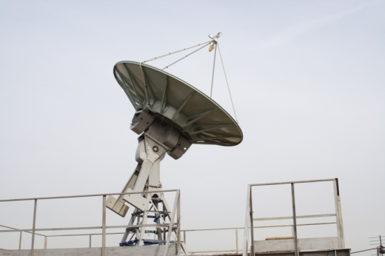
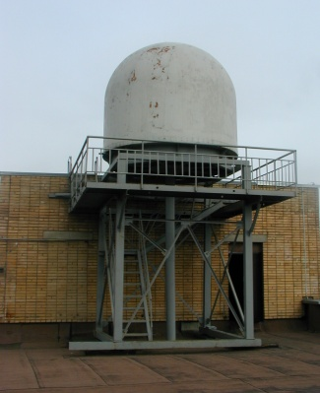
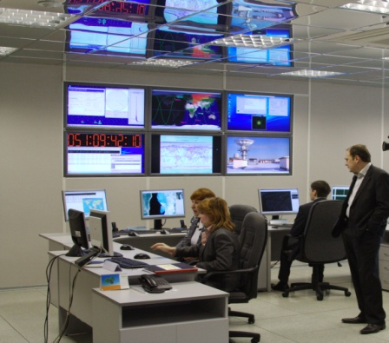
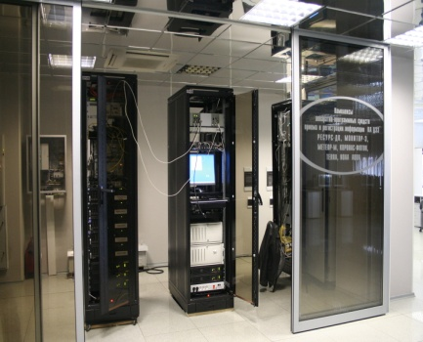
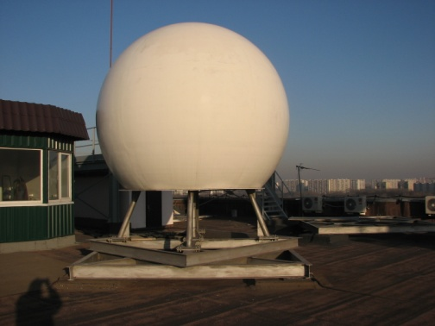
Russian and foreign Earth Observation Data receiving and recording FACILITIES
RC-7
RC-5
RC-3
RC-2
EO Data Receiving and Recording Complex
Space Communication Station
The antenna complexes provide data receiving at the rate between 5 and 320 Mbps of Х-band with left and right polarization, for 24 hours – up to 30 satellites

Slide 15
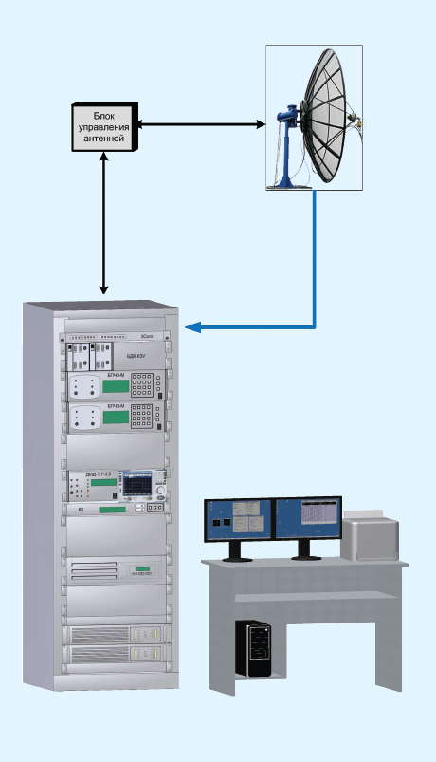
RECEIVING COMPLEXES BEING DEVELOPED BY NTS OMZ OF JSC “RUSSIAN SPACE SYSTEMS”
Complex | PK 2.4 | PK 3.1 | PK 3.6
Antenna type | Axial-symmetric parabola с f/d=0,4
Antenna size, m | 2.4 | 3.1 | 3.6
Rotary support | Double-elevation
Polarization | Right-hand (L­band), right- ad left-hand (Х­band)
Operating frequencies MHz | 1690­-1710; 7450­-7550; 8000­-8400
Receive rate, Mbps | Up to 310Mbps in Х­band (155Mbps in each channel), up to 3.0 Mbps in L­band
Quality factor, dB/K | 20 | 22 | 24
Antenna complex/Rotary support weight no more than, kg | 60/260 | 80/350 | 110/350
Rotary support power consumption, no more than, W | 100 | 100 | 100
Reception area | Entire upper hemisphere including zenith area
Primary power supply | 220W, 50Hz
Antenna complex operating temperature range, C | ­40... +50
Antenna complex deployment conditions | Under radar dome

Slide 16
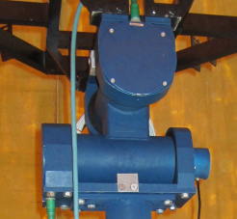
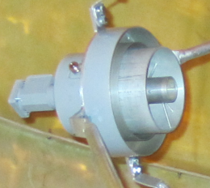
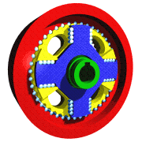
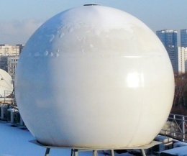
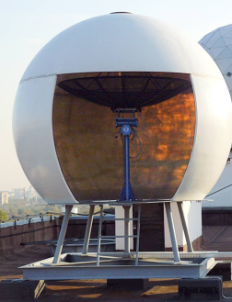
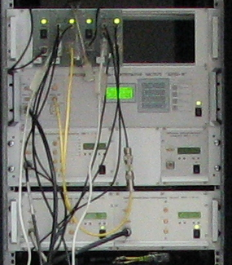
BASIC ENGINEERING SOLUTIONS CHOSEN IN DEVELOPING RECEIVING COMPLEXES
Double-elevation scheme of rotary support construction |  | Antenna complex feed is dual-band (X- and L-band)
New types of cycloidal speed reducers used in rotary support |  | Use of radio receiver
Receiving complex is automatic |  | Radio paths have the capabilities of controlling and adjusting: - Given receive frequencies Modulations - Data receive rate

Slide 17
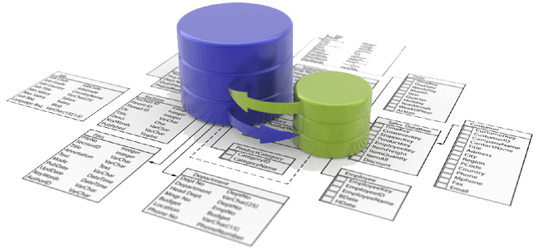
Technological scheme of RUSSIAN operator’s Cycle
Value-added Processing
External Users
Standard Processing
CATALOG
(Jobs / Data)
Customer Interaction
Receiving and Registration
Planning
Data Storage
System

Slide 18
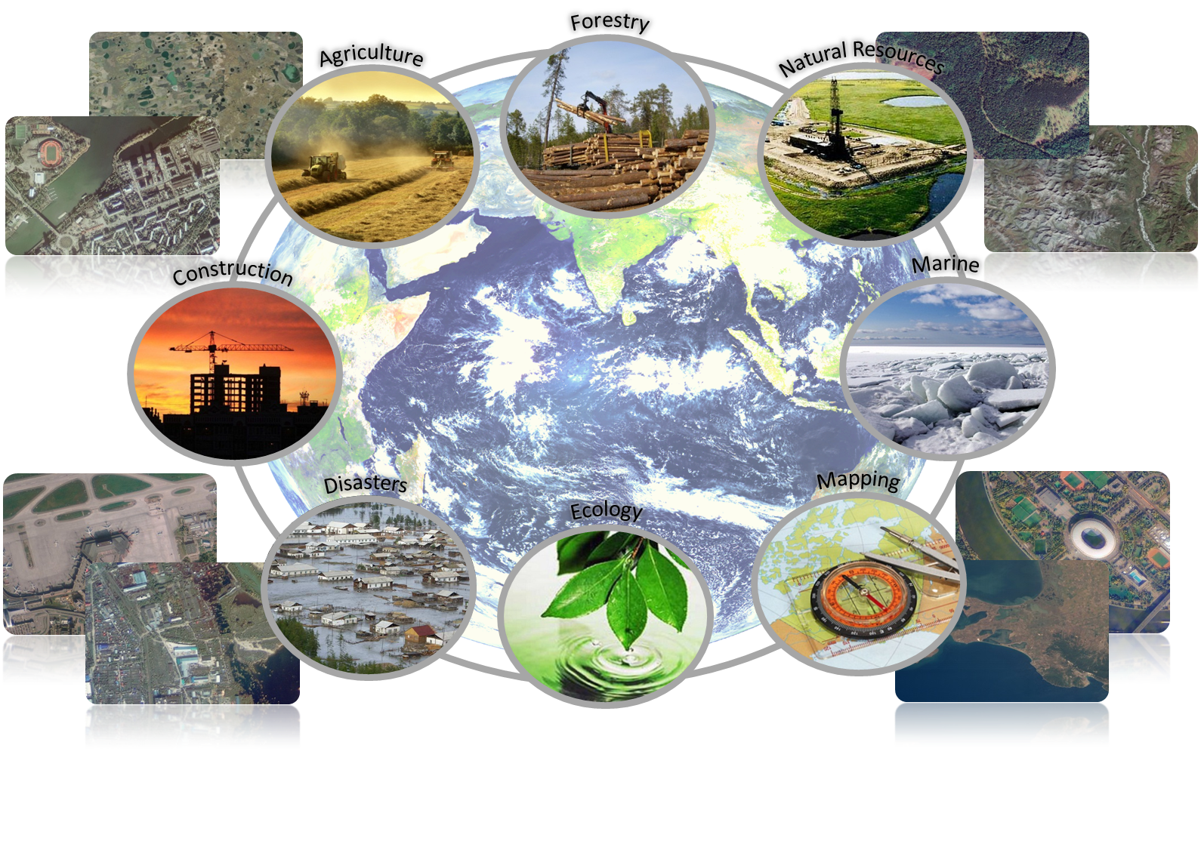
Earth Observation DATA APPLICATIONs

Slide 19
MAPPING

Slide 20
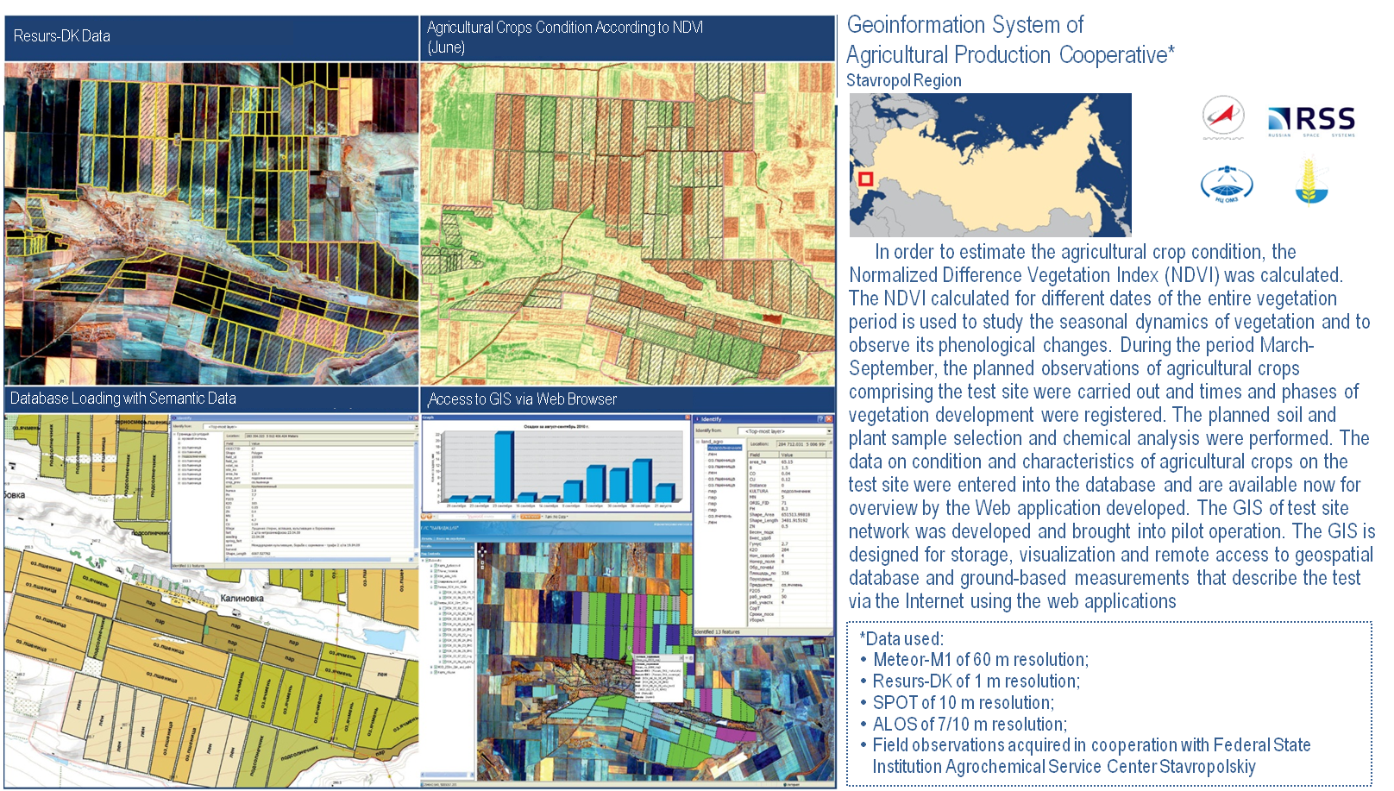
AGRICULTURE

Slide 21
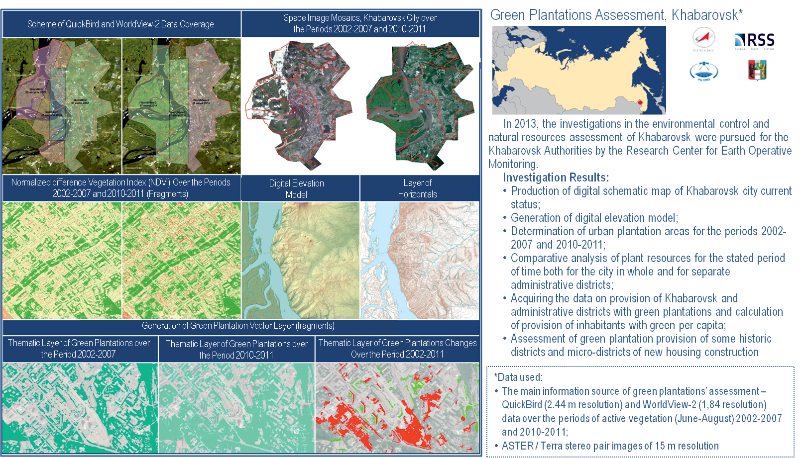
City Vegetation

Slide 22
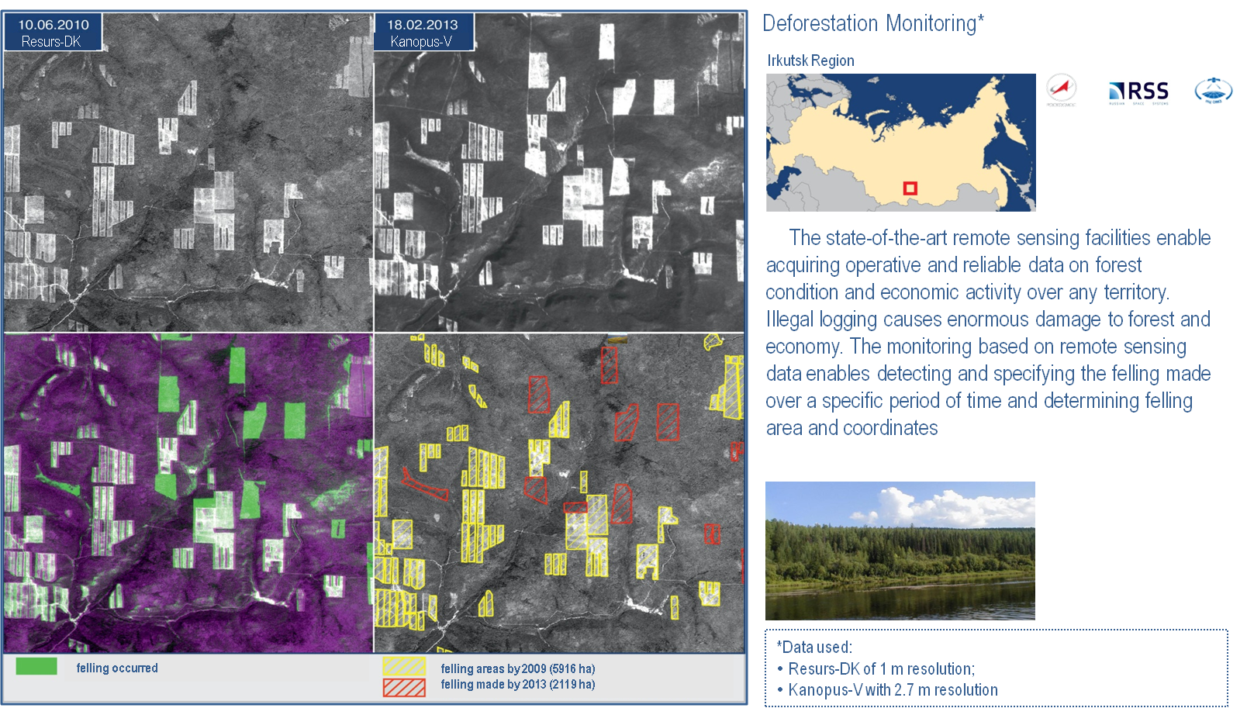
FORESTRY

Slide 23
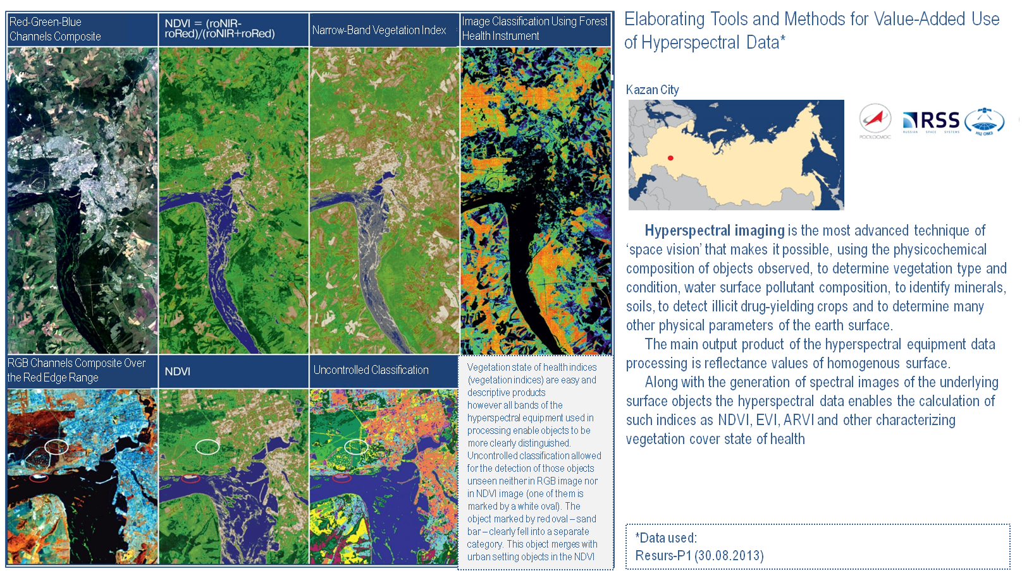
NATURAL RESOURCES

Slide 24
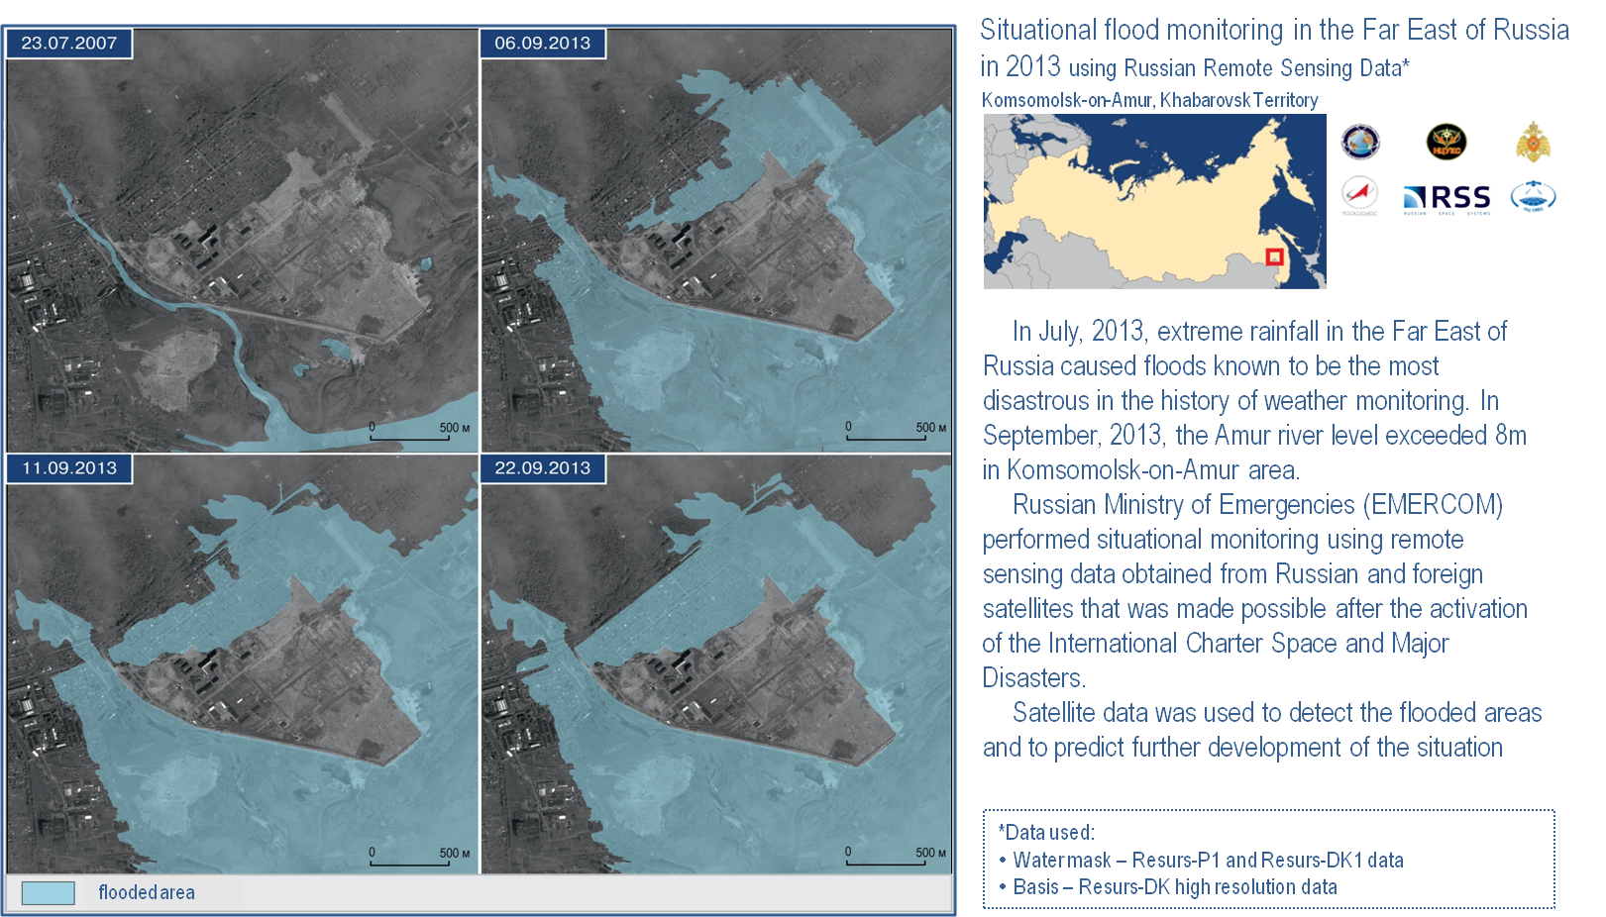
River Floods

Slide 25
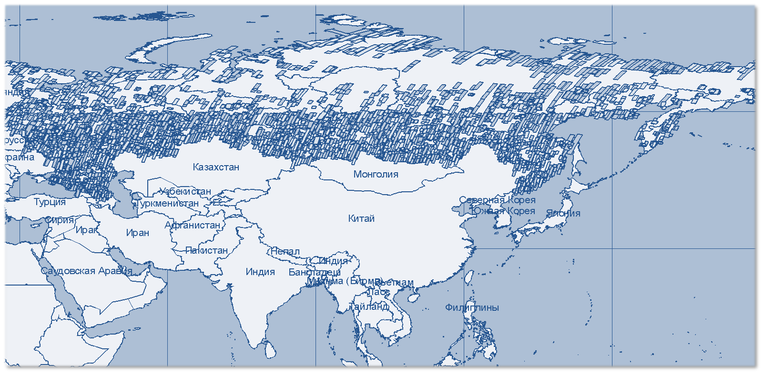
Resurs-P data covering diagram
The area of the Russian territory coverage by Resurs-P1 and -P2 (PAN and MS data) is more than 30 million sq. km since 2013

Slide 26
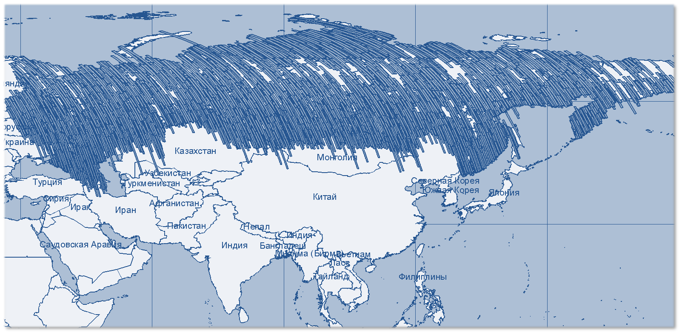
Kanopus-V data covering diagram
The area of the Russian territory coverage by Kanopus-V1 (PAN and MS data) is more than 50 million sq. km since 2013

Slide 27
Hydrometeorology
Natural Resources
THE RUSSIAN EARTH OBSERVATION SATELLITE CONSTELLATION 2006–2020
Meteor-M1
Meteor-M2
Meteor-M2.1
Meteor-M2.3
Meteor-M2.4
Meteor-M3
Hydrometeorology
Electro-L1
Electro-L2
Electro-L3
Meteor-M2.2
Electro-L4
Electro-L5
Arctica-M1
Arctica-M2
2006
2009
2011
2012
2013
2014
2015
2016
2017
2018
2019
2020
Resurs-DK
Resurs-P1
Resurs-P2
Resurs-P3
Kanopus-V-IK
Resurs-P4
Resurs-P5
Resurs-PM1
NATURAL RESOURCES
Kanopus-V1
Kanopus-V3
Kanopus-V5
Obzor-R1
Kanopus-V4
Kanopus-V6
MS (visible and IR) data
SAR data
Kondor-FKA1
Kondor-FKA2

Slide 28
Thank you for attention!

