Slide 1


CEOS Recovery Observatory
MALAWI DEMONSTRATOR – October 2016
Agriculture monitoring in the Elephant Marsh area between 2013 and 2016

Slide 2
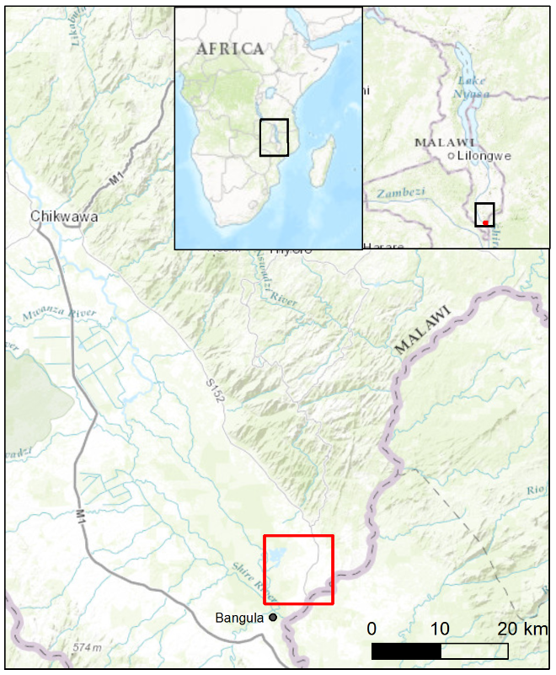
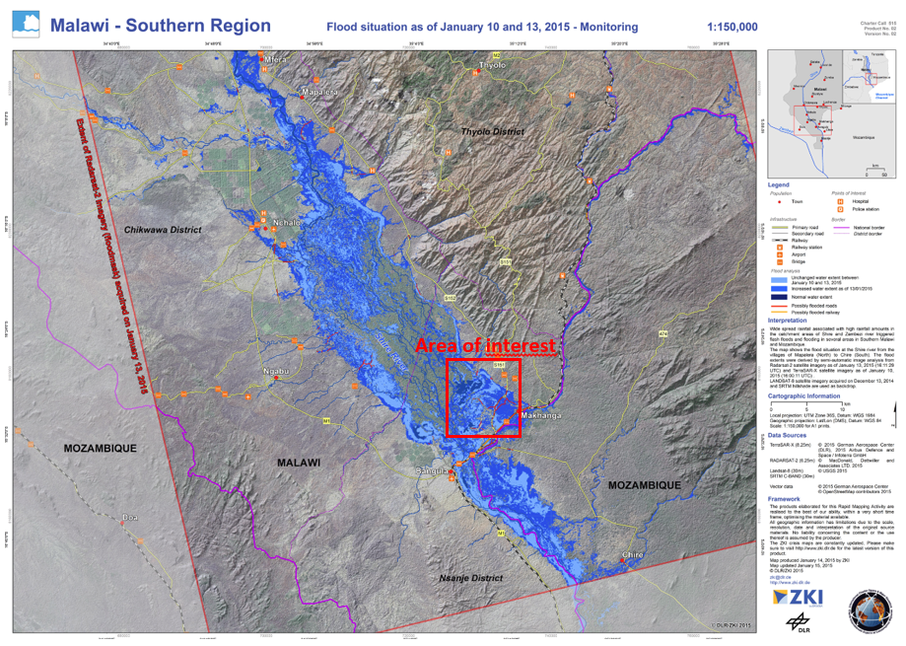
1. Context and overview of the study
Area of interest
January 2015, severe rainfall caused historical flooding in Malawi
Charter is triggered the 8th of January by the Department of Disaster Management Affairs of Malawi
Elephant Marsh : wetland where the fishery and agriculture are crucial livelihoods for the local communities
Area 10 km x 10km at the border between Malawi and Mozambique (Ruo River)
Area of interest
Ruo River

Slide 3
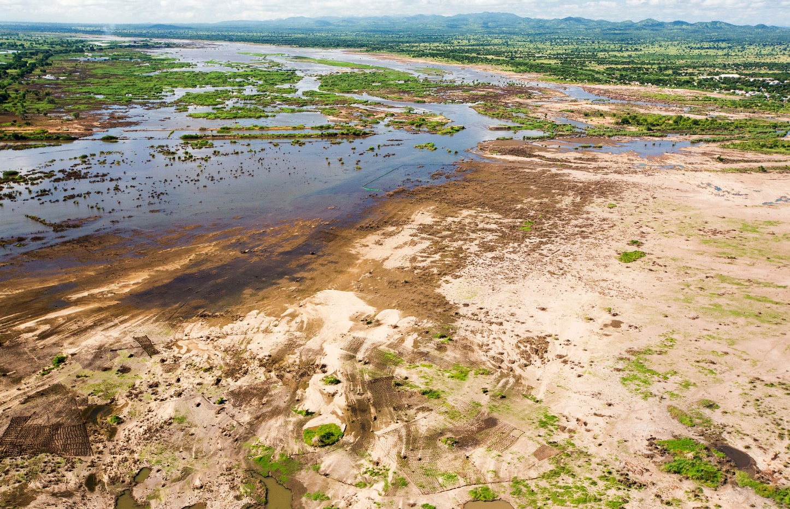
What the landscape in the abandoned agricultural area looks like.
Alluvial deposits and traces of crops in still humid areas are clearly visible (19th March 2015).
© Ashley Cooper/ globalwarmingimages.net

Slide 4

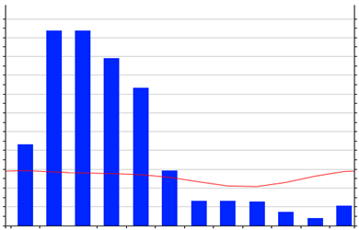
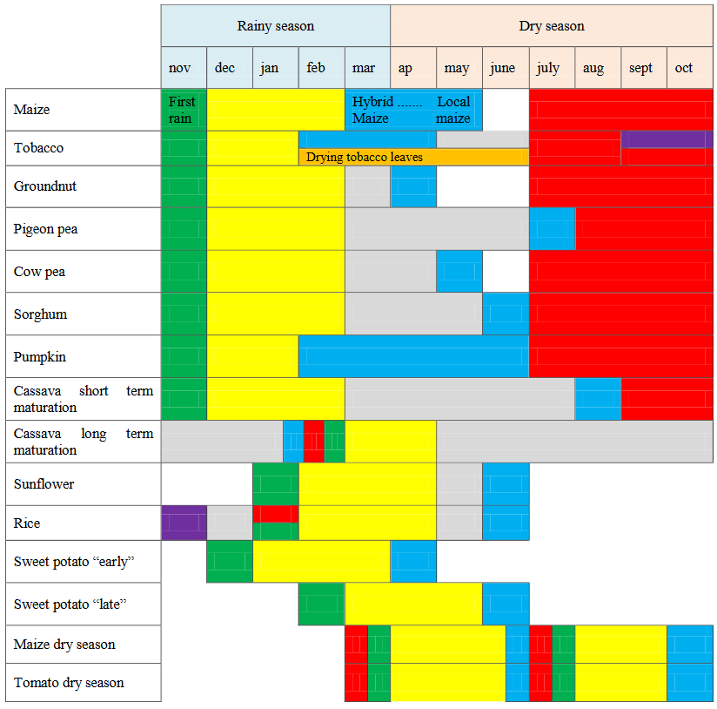
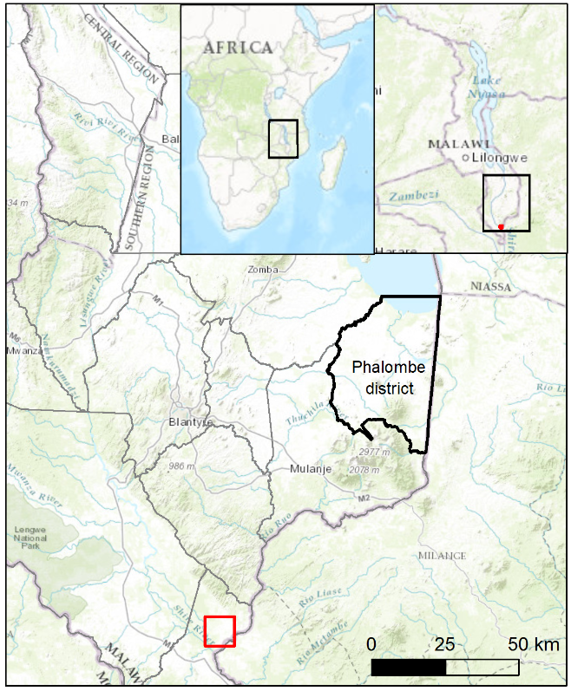
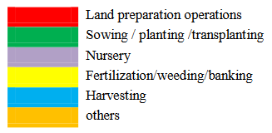
1. Context and overview of the study
Agriculture in the area
Small-scale farm sector
Subsidence agriculture
Crop calendar in the Phalombe District

Slide 5
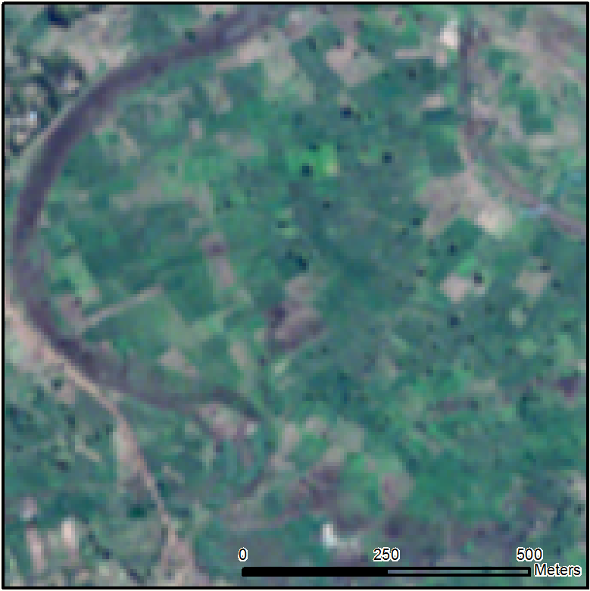
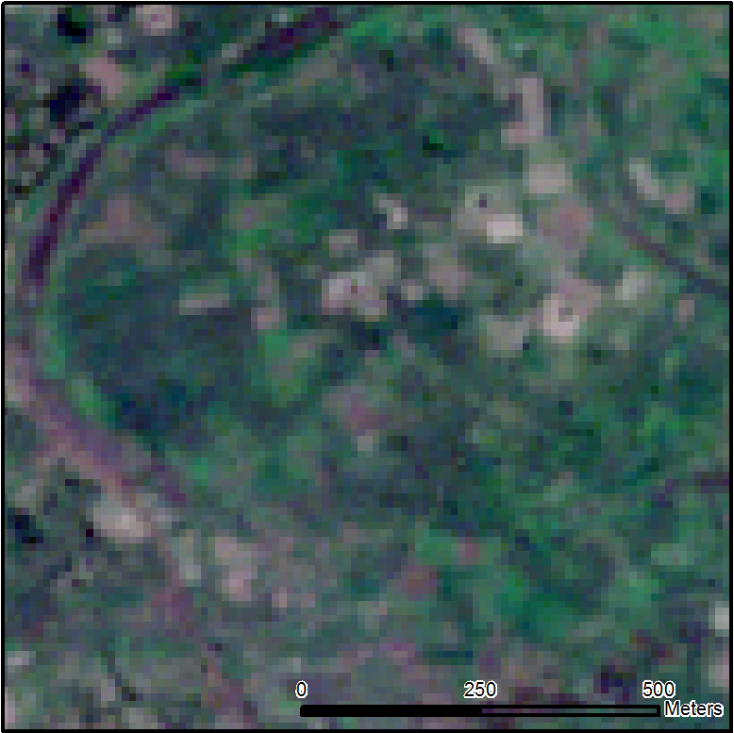
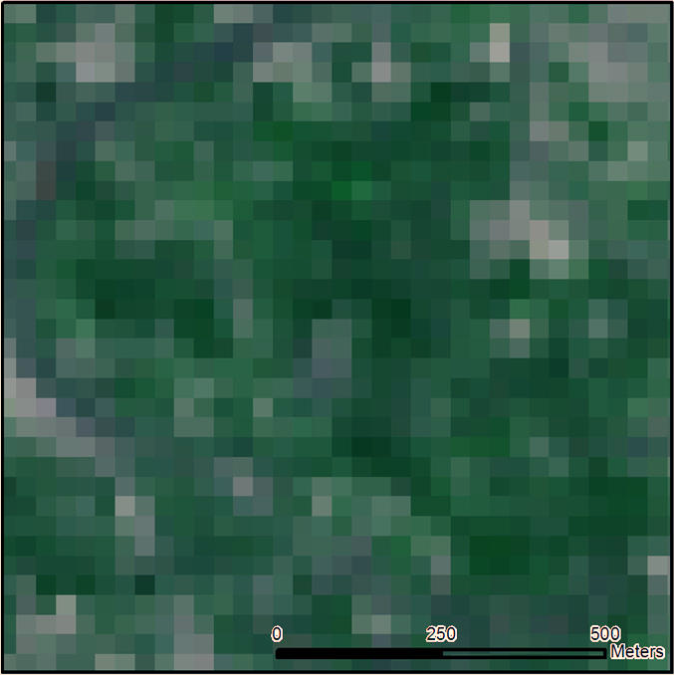
1. Context and overview of the study
Imagery used
SPOT-6
Pixel size: 6 m
25/07/2015
PAN 1.5 m
MS 6 m (3 VIS, 1 NIR)
Tasking on-demand
Sentinel-2
Pixel size: 10 m
30/07/2016
MS 10 m (3 VIS, 1 NIR)
MS 20 m (4 NIR, 2 SWIR)
MS 60 m (1 VIR, 1 NIR, 1 SWIR)
Systematic acquisition
Landsat-8
Pixel size: 30 m
25/07/2015
PAN 15 m
MS 30 m (4 VIS, 1 NIR, 2 SWIR)
MS 100 m (2 TIRS)
Systematic acquisition

Slide 6
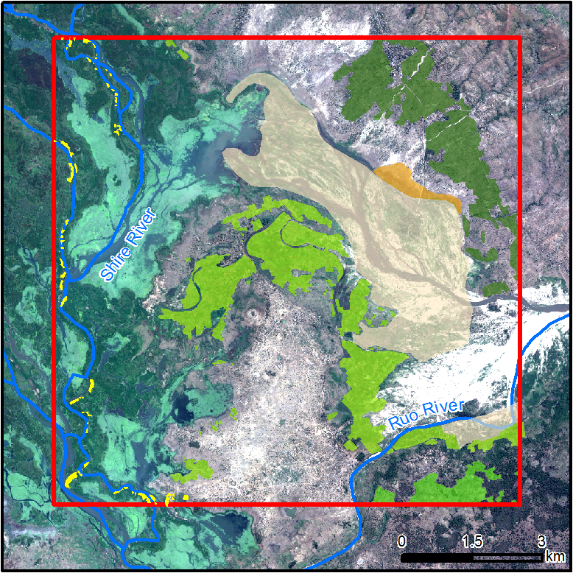






2. Delineation of agricultural areas (SPOT-6)
Interpretation
Small isolated agricultural area
Large agricultural areas. High density foliage and geometric patterns
Large agricultural areas. No active vegetation but geometric patterns.
Large agricultural areas in Mozambique. No active vegetation but geometric patterns. Isolated trees. Forest clearings
Large area of abandoned agricultural land, covered by alluvial deposits. Agricultural area most affected by the 2015 floods
Small abandoned irrigated area (rice)

Slide 7
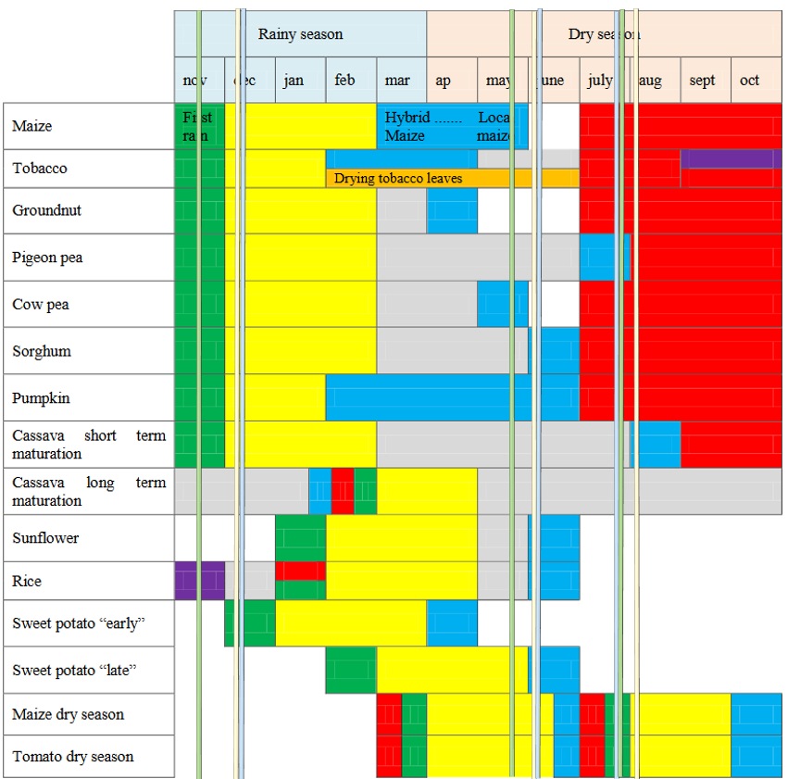
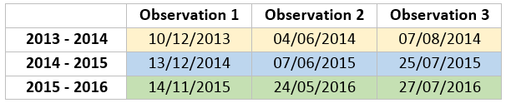
3. Studying flood impact on agricultural areas (L8)
Data selection
1
2
3
Selection of consistent dates between agricultural seasons to facilitate the comparison between them

Slide 8
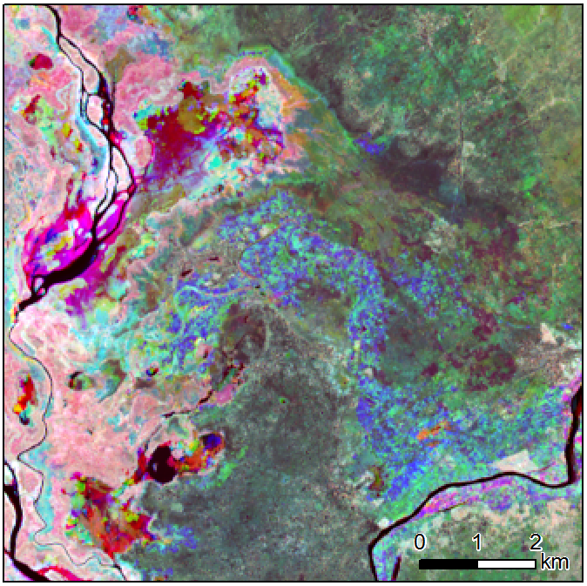
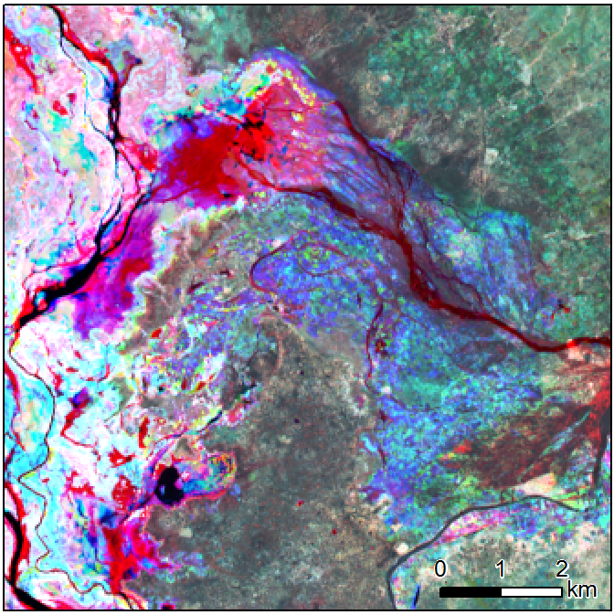
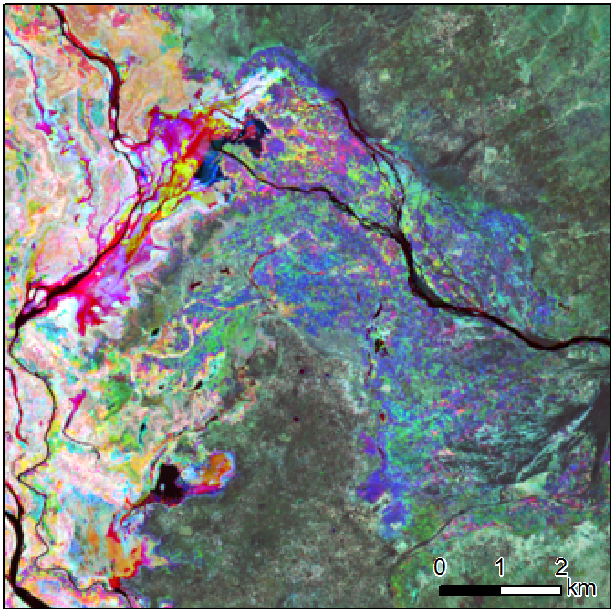
3. Studying flood impact on agricultural areas (L8)
Processing
Season 2013 - 2014
Coloured composition
Blue band : 10/12/2013
Green band : 04/06/2014
Red band : 07/08/2014
Season 2014 - 2015
Coloured composition
Blue band : 13/12/2014
Green band : 07/06/2015
Red band : 25/07/2015
Season 2015 - 2016
Coloured composition
Blue band : 14/11/2015
Green band : 24/05/2016
Red band : 27/07/2016

Slide 9
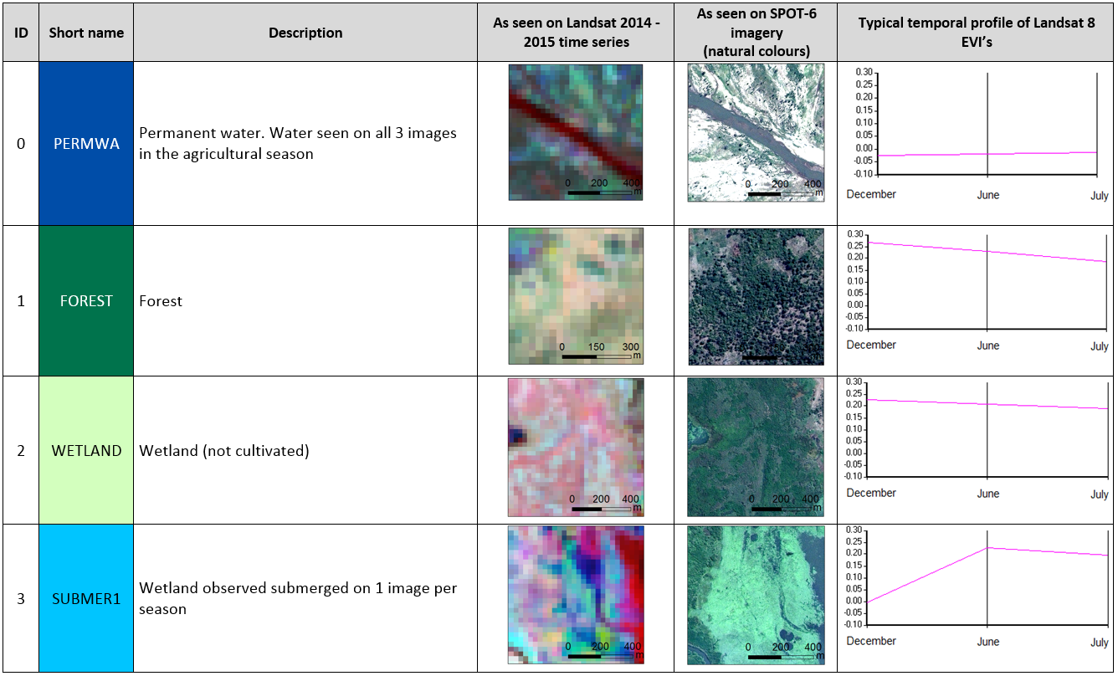
3. Studying flood impact on agricultural areas (L8)
Land-use description

Slide 10
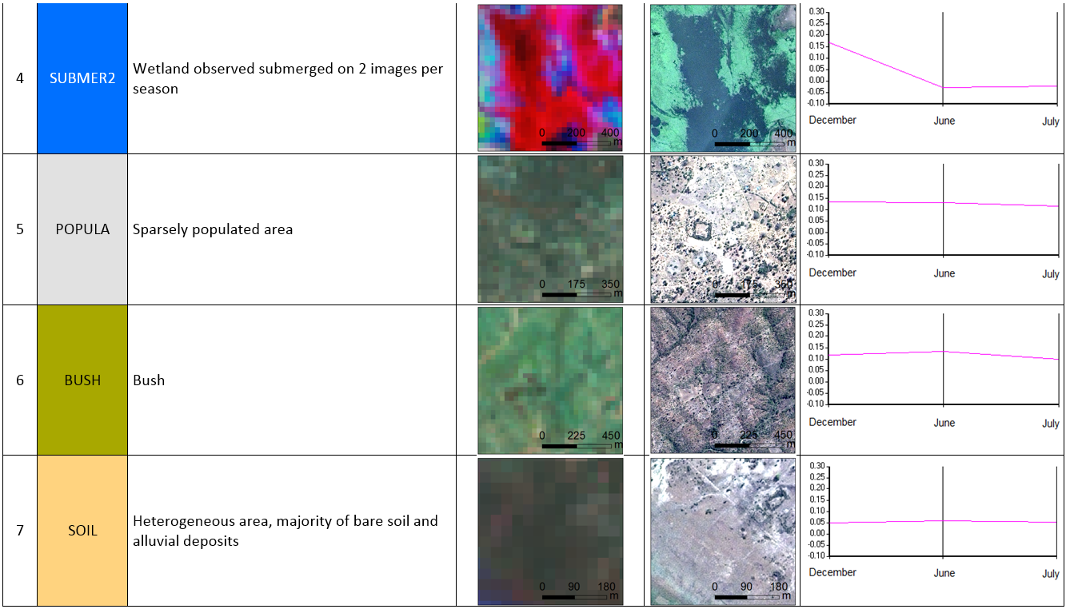
3. Studying flood impact on agricultural areas (L8)
Land-use description

Slide 11
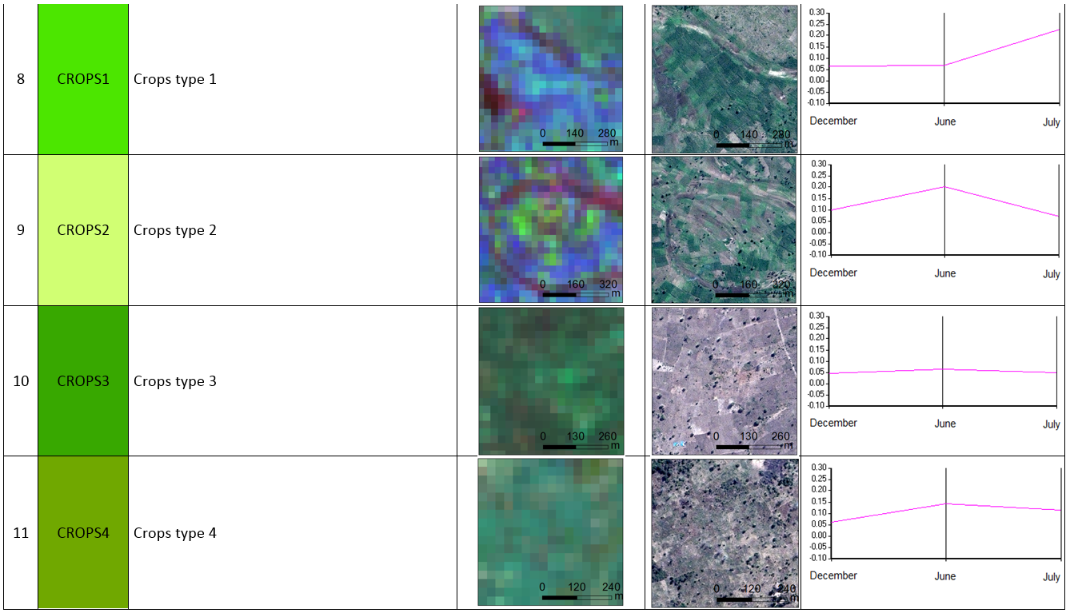
3. Studying flood impact on agricultural areas (L8)
Land-use description

Slide 12
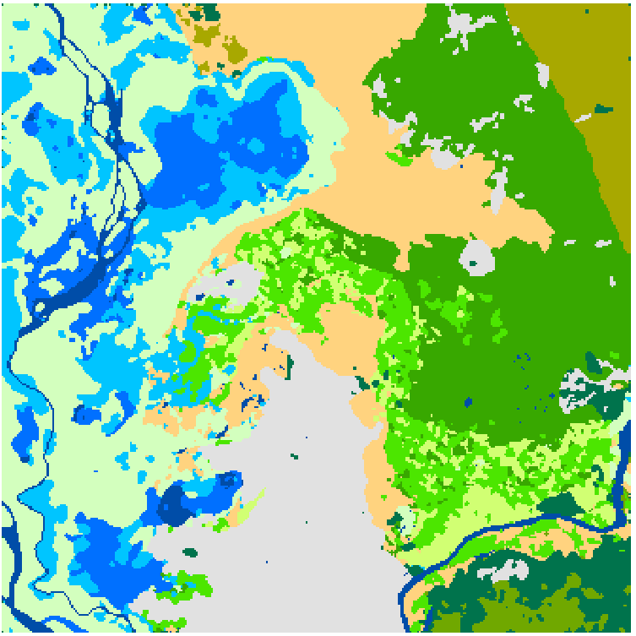
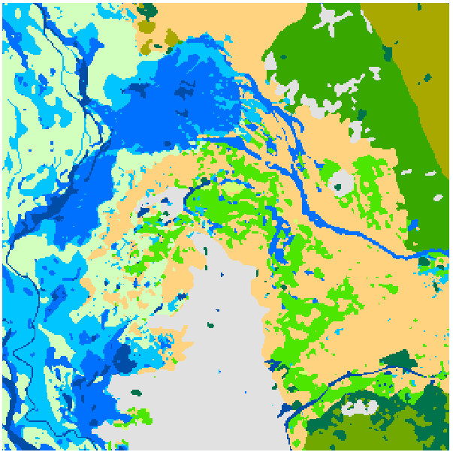
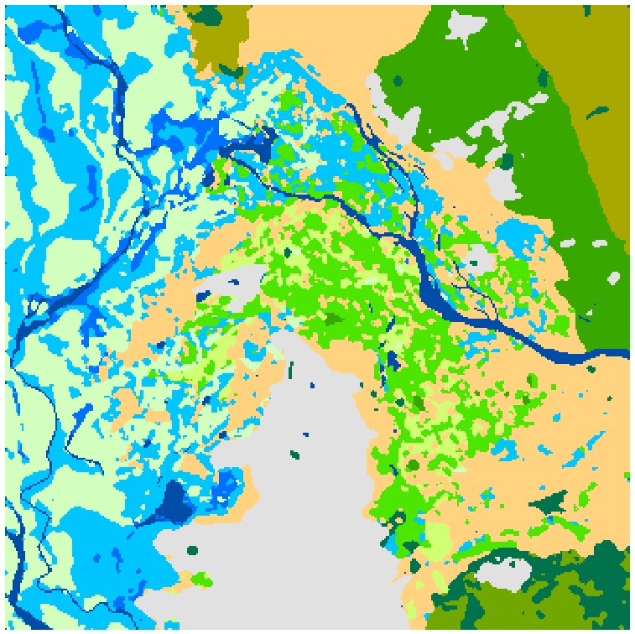
3. Studying flood impact on agricultural areas (L8)
Season 2013 - 2014
Baseline
Season 2014 - 2015
Critical flooding early 2015
Season 2015 - 2016
Severe drought
Large variations are
the trends to focus on

Slide 13
3. Studying flood impact on agricultural areas (L8)
Cross-tabulated land-use statistics
Changes between 2013-2014 and 2014-2015 seasons - Flooding period

Slide 14
3. Studying flood impact on agricultural areas (L8)
Cross-tabulated land-use statistics
Changes between 2014-2015 and 2015-2016 - Recovery period

Slide 15
3. Studying flood impact on agricultural areas (L8)
Cross-tabulated land-use statistics
Changes between 2013-2014 and 2015-2016 - pre/post flooding

Slide 16
3. Studying flood impact on agricultural areas (L8)
Cross-tabulated land-use statistics
These results should be taken with caution:
Spatial resolution of Landsat-8 (30 m)
Number of images used in the time series
Absence of ground truth / validation
In particular, the surfaces classified as CROPS1 north of the new riverbed on the 2015-2016 season are abandoned.
Large variations are the trends to focus on

Slide 17
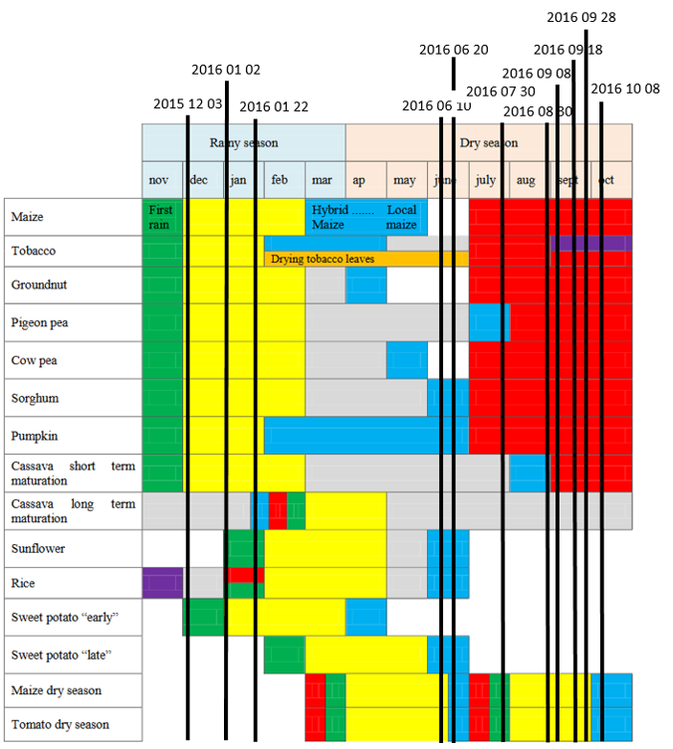
4. Crop-wise analysis for the 2015-2016 season (S2)
Data inventory and selection

Slide 18
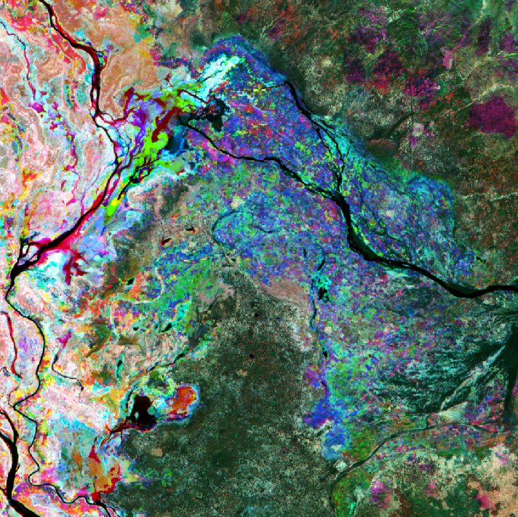
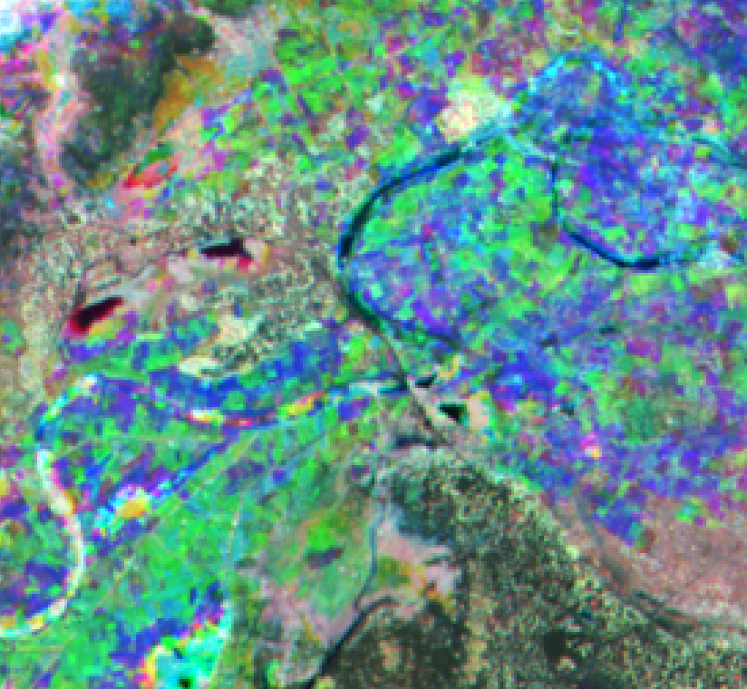
4. Crop-wise analysis for the 2015-2016 season (S2)
Processing
Enhanced Vegetation Index calculated from surface reflectance images
Layer stack of EVI layers per agricultural season
Season 2015 - 2016
Coloured composition
Blue band : 03/12/2015
Green band : 10/06/2016
Red band : 30/07/2016

Slide 19
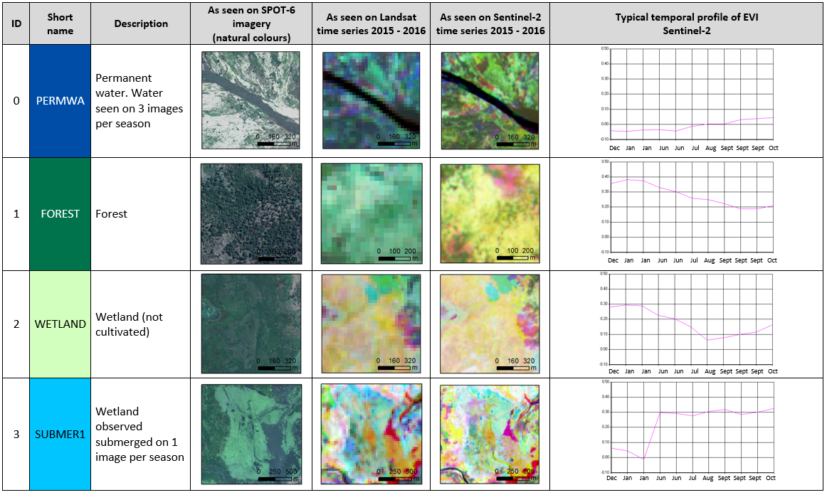
4. Crop-wise analysis for the 2015-2016 season (S2)
Land-use description

Slide 20
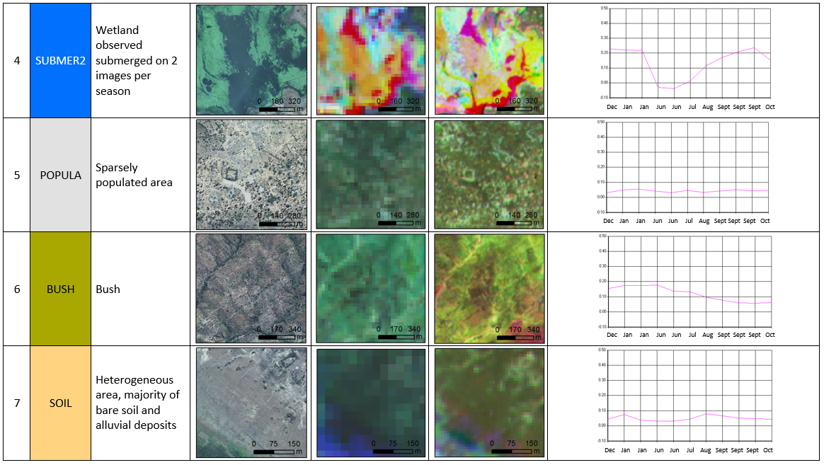
4. Crop-wise analysis for the 2015-2016 season (S2)
Land-use description

Slide 21
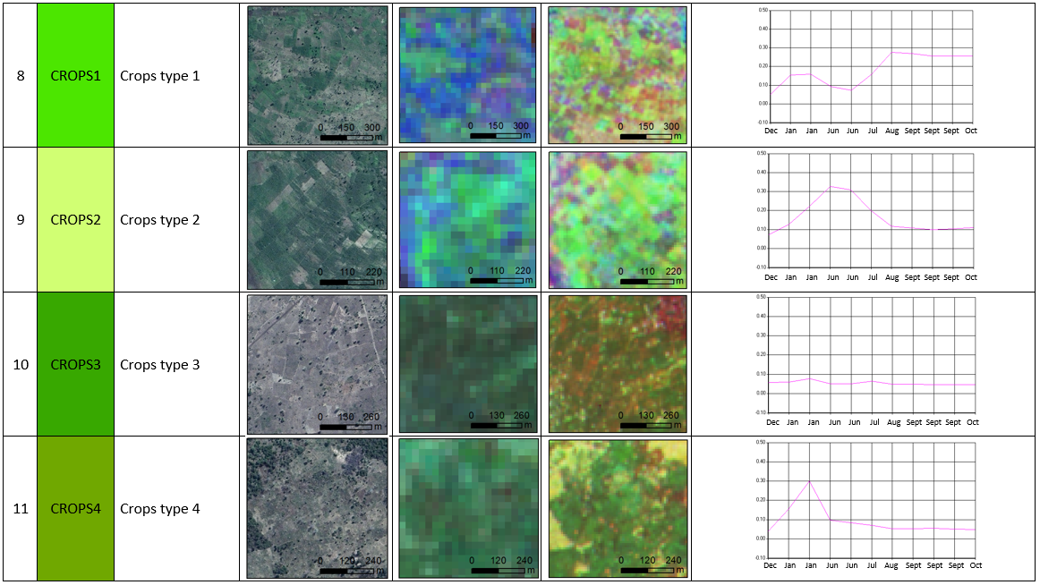
4. Crop-wise analysis for the 2015-2016 season (S2)
Land-use description

Slide 22
4. Crop-wise analysis for the 2015-2016 season (S2)
Assignation of crops types to crops classes
ID | Short name | Description | Potential crops type
8 | CROPS1 | Crops type 1 | Several vegetation cycles are observed during a year, which could correspond to a main crop in rotation with another intra-calendar crop, or with a fallow period. Based on the crop calendar used for this analysis, it is not possible to take a decision on the crop type without more specific expertise.
9 | CROPS2 | Crops type 2 | Maize (late harvesting) Tobacco Sorghum Sunflower Rice Pigeon pea
10 | CROPS3 | Crops type 3 | Tobacco Groundnut Cow pea Sorghum Pumpkin Sunflower Sweet potatoes Various vegetables
11 | CROPS4 | Crops type 4 | Tobacco Groundnut Cow pea Sorghum Pumpkin Sunflower Sweet potatoes Various vegetables

Slide 23
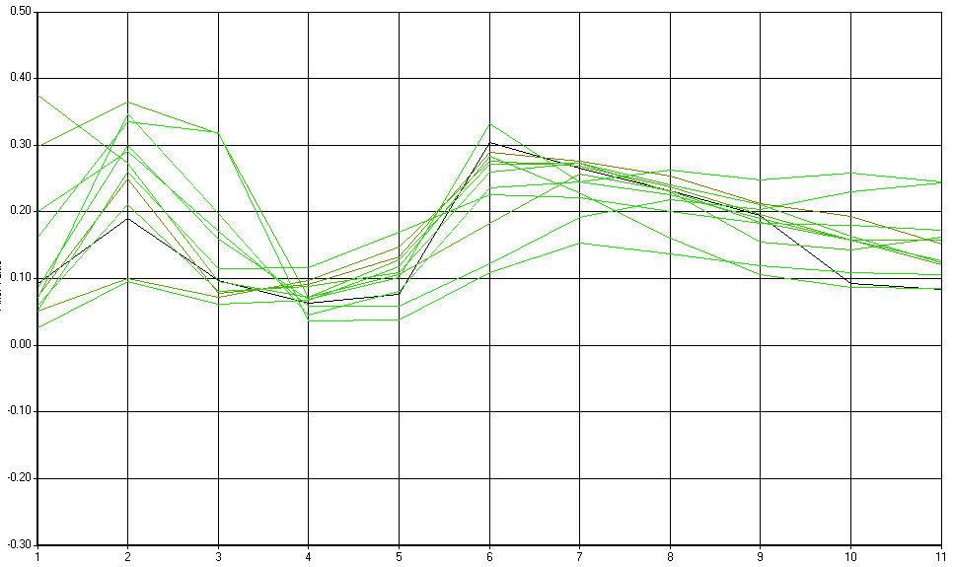
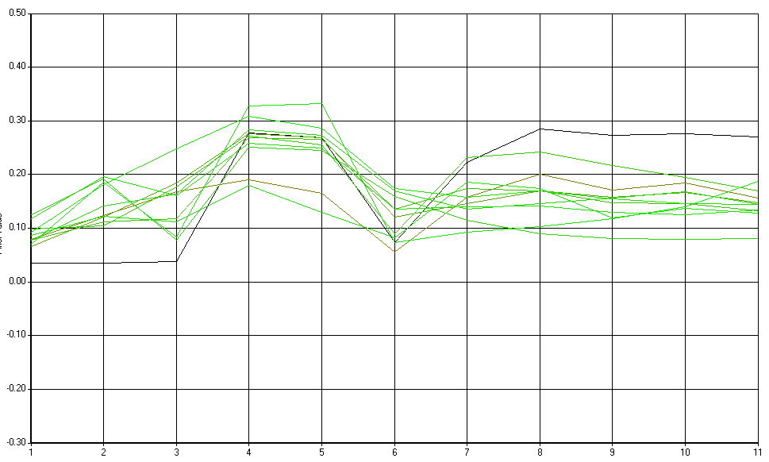
4. Crop-wise analysis for the 2015-2016 season (S2)
Assignation of crops types to crops classes
Matching should be taken with caution :
Crop calendar of Phalombe district
Absence of images between February and May
Significant variations of temporal profiles
Only ground expertise could consolidate this results
focus the analysis to more relevant classes grouping
fewer crop per class
increasing thematic classes
CROPS1 temporal profiles
CROPS2 temporal profiles

Slide 24
5. Conclusion
Goals achieved:
Development of a methodology based on the exploitation of time series
Quantification of the impact of the 2015 flood event
Detection and characterization of several agricultural classes
Lessons learnt from the study:
Paramount importance of ground expertise
Data sampling / exhaustiveness of the time series
Importance of high resolution data

Slide 25
6. Technical recommendations
Integrate ground observation and agricultural expertise
  To base the analysis on a specific crop calendar and focus the assumptions on crops type
Study a combined use of both Landsat-8 and Sentinel-2 images within time series
  To improve the sampling of the time series
Study an integration of SAR polarimetry into the time series
  To detect harvesting during the wet season
Integrate 1 or 2 VHR imagery per season
  To provide a spatialization of the ground observations supporting assumptions on agricultural crops

Slide 26


CEOS Recovery Observatory
MALAWI DEMONSTRATOR – October 2016
Example of state of the road S152 from the Thabwa Junction in the context of the recovery following the floods of January 2015
Non-exhaustive inventory. Refer to report for exhaustive assessment.

Slide 27
CEOS Recovery Observatory
Context and overview of the study
Data
Situational analysis
  Key information
  General state of the road
  Significant damages
  State of the bridge
  State of the culverts
  State of the fording sites and aprons
  Surrounding activities
Conclusion

Slide 28
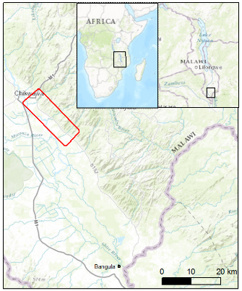
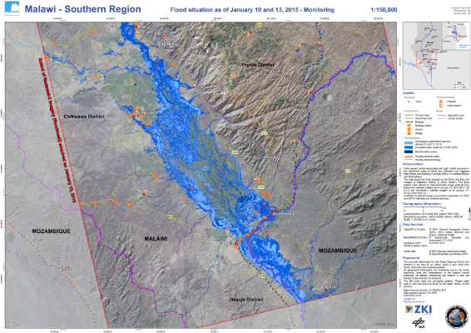
1. Context and overview of the study
Area of interest
January 2015, severe rainfall caused historical flooding in Malawi
Charter is triggered the 8th of January by the Department of Disaster Management Affairs of Malawi
Road S152 (Thabwa-Masenjere-Fatima) has been particularly impacted by the rains.
Emergency works have been carried out and completed in June 2015
Area of interest
Area of interest

Slide 29
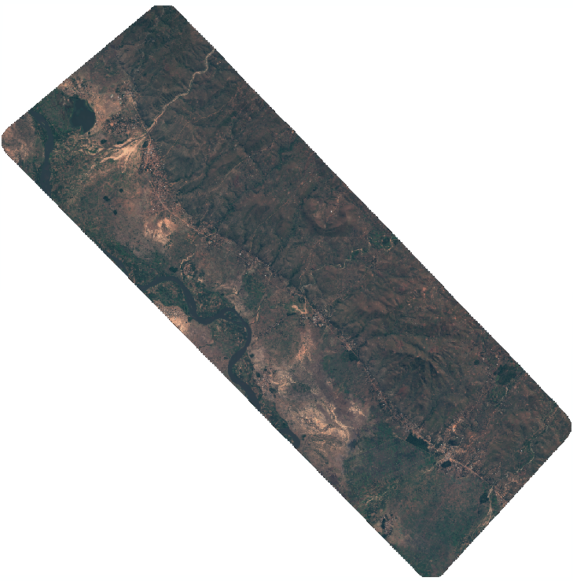
2. Data
Post-event image:
Pleiades-HR 1B acquired on 11/08/2016, spatial resolution 50 cm
Baseline (Google Earth):
26/10/2013 (pre-event). Source: Pleiades (CNES/Airbus DS), 50 cm
29/10/2014 (pre-event). Source: DigitalGlobe, 50 cm
20/01/2015 (post-event). Source: DigitalGlobe, 50 cm
27/01/2015 (post-event). Source: DigitalGlobe, 50 cm
What we are looking for:
Any changes that have taken place after the flood event:
Construction works
Significant damages
Any new activities
But also:
State of the bridges, culverts, fording sites and aprons

Slide 30
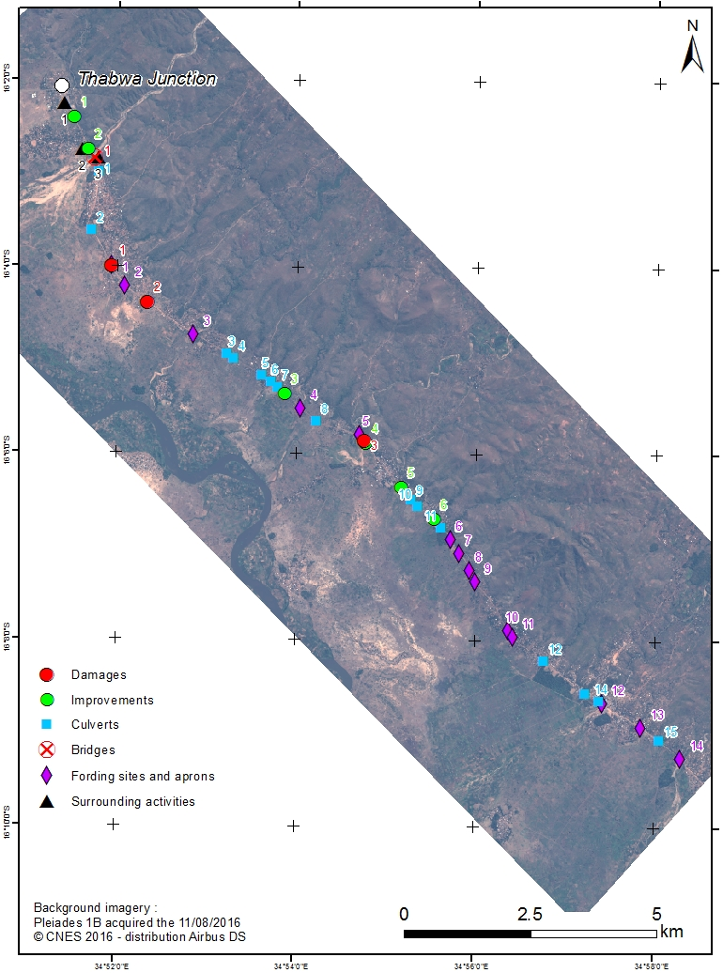
3. Situational analysis
Key information
Each symbol in the following map shows the location of the sites analyzed in the satellite images. Some sites are described in this document, with snapshots of full resolution satellite images (Pleiades image and the baseline). For an complete analysis of the sites, please refer to the report.
Improvements seen slide 6
Bridge seen slide 10
Damages seen slide 8
Culverts seen slide 9
Length analyzed | 19.8 km
Nature of the road surface | bare soil
Number of bridges | 1
Number of culverts | 15
Number of fording sites and aprons | 14
Number of populated areas crossed | 13
Altitude of the start point (Thabwa junction) | 100 m (SRTM 1”)
Altitude of the end point (Chikadza) | 97 m (SRTM 1”)
Improvement seen slide 7
Fording sites seen slide 11

Slide 31
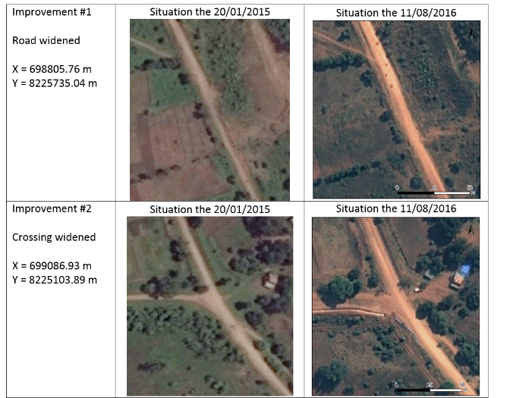
3. Situational analysis
General state of the road
The general state of the road is good. Since the baseline, it appears that the road has been rehabilitated and widened, in some locations from a width of approximately 5-6 m to 8-9 m.
Post-event image
Pléiades, 50 cm
Baseline imagery
DigitalGlobe 50 cm
(Google Earth)
Non-exhaustive inventory
Refer to report for exhaustive assessment
Post-event image
Pléiades, 50 cm
Baseline imagery
DigitalGlobe 50 cm
(Google Earth)

Slide 32
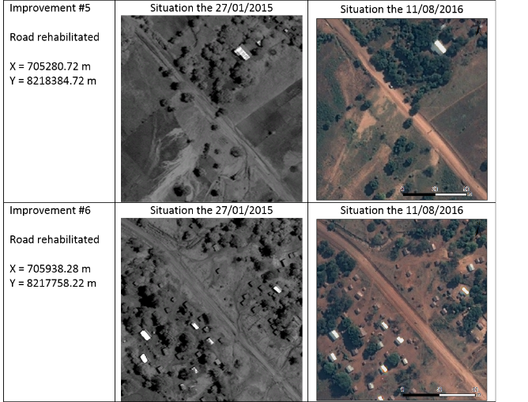
3. Situational analysis
General state of the road
Baseline
(DigitalGlobe, 50 cm Google Earth)
Post-event image
(Pléiades, 50 cm)
Non-exhaustive inventory
Refer to report for exhaustive assessment

Slide 33
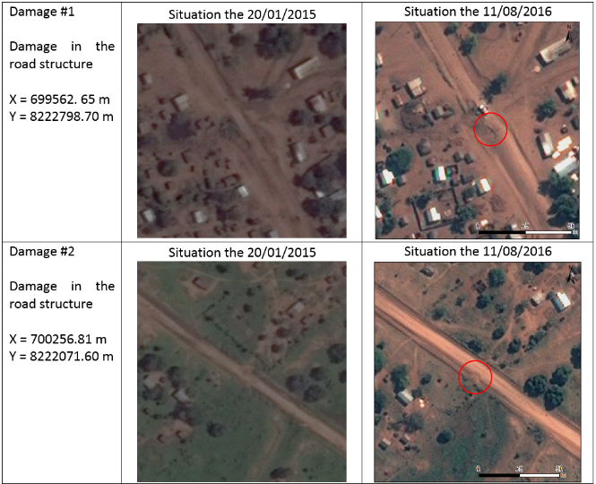
3. Situational analysis
Significant damages
Baseline
(DigitalGlobe, 50 cm Google Earth)
Post-event image
(Pléiades, 50 cm)
Non-exhaustive inventory
Refer to report for exhaustive assessment

Slide 34
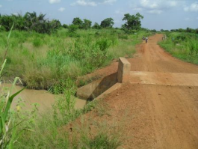
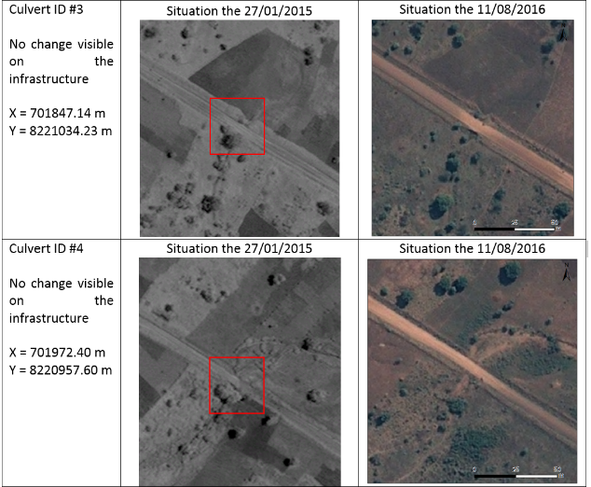
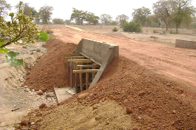
3. Situational analysis
State of the culverts
Baseline
(DigitalGlobe, 50 cm Google Earth)
Post-event image
(Pléiades, 50 cm)
Source SHIdF (Togo)
Source ECHA (Burkina Faso)
Non-exhaustive inventory
Refer to report for exhaustive assessment

Slide 35
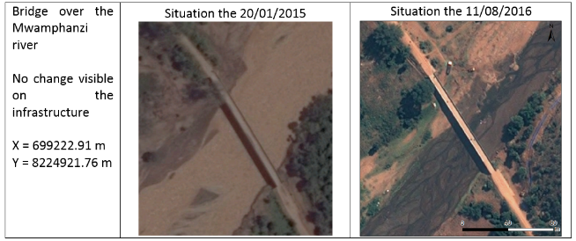
3. Situational analysis
State of the bridge
Baseline
(DigitalGlobe, 50 cm Google Earth)
Post-event image
(Pléiades, 50 cm)
Non-exhaustive inventory
Refer to report for exhaustive assessment

Slide 36
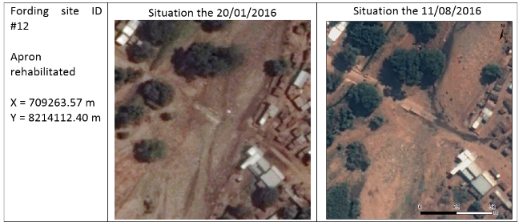
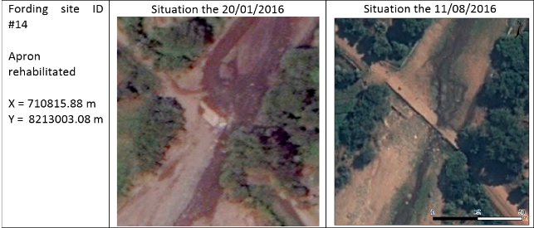
3. Situational analysis
State of the fording sites and aprons
Baseline
(DigitalGlobe, 50 cm Google Earth)
Post-event image
(Pléiades, 50 cm)
Non-exhaustive inventory
Refer to report for exhaustive assessment

Slide 37
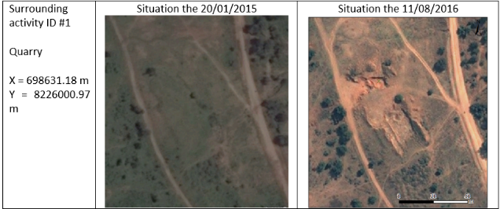
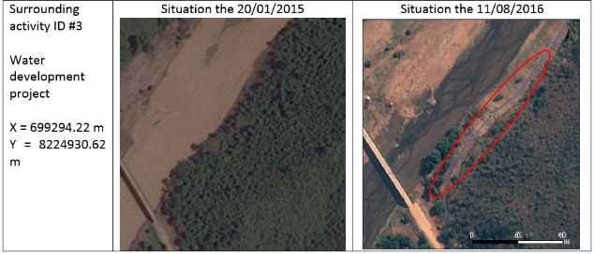
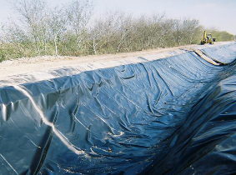
3. Situational analysis
Surrounding activities
Baseline
(DigitalGlobe, 50 cm Google Earth)
Post-event image
(Pléiades, 50 cm)
Non-exhaustive inventory
Refer to report for exhaustive assessment
Source WesternAG (Delta Lake)

Slide 38
4. Conclusion
This study confirmed Very High Resolution Satellite capacities:
significant enlargements of a road are visible
significant rehabilitations of the road surface are visible
above a certain size, damages in the road surface are visible
water flows crossing a road are visible
rehabilitations of aprons are visible, in case of deposits removal
construction sites like water projects (irrigation for example) are visible
Without ground truth, it wasn’t possible to assess which changes were not visible.
Considering project monitoring and evaluation, the cost-benefit ratio of space-based observation needs to be compared with traditional methods (field mission).

Slide 39
CEOS Recovery Observatory
NEPAL DEMONSTRATOR – October 2016
Progress on the monitoring of the reconstruction after the 2015 earthquake in the area of Mainapokhari

Slide 40
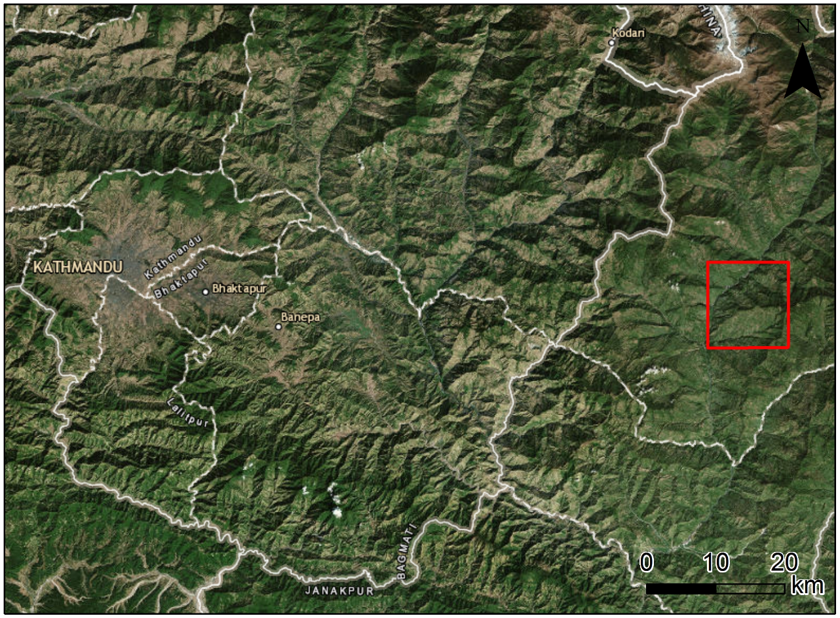
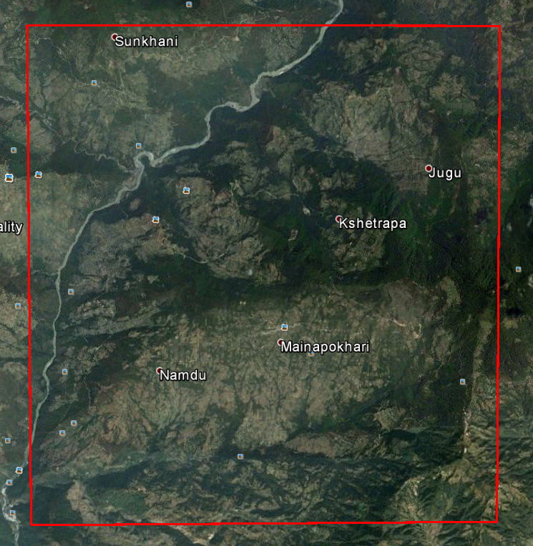
1. Context and overview of the study
Area of interest
25th of April 2015, 11:56, Earthquake with a magnitude of 7.2
Heavy casualties as well as extensive building damages
The International Charter has been triggered the 25th of April 2015 the by the Disaster Management Support (DMS) Programme Office of the Indian Space Research Organisation (ISRO) and UNITAR/UNOSAT on behalf of UNICEF
RO demonstrator : area 10 km x 10km, 80km east of Kathmandu
Epicenter 80 km
Area of Interest

Slide 41

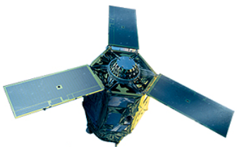
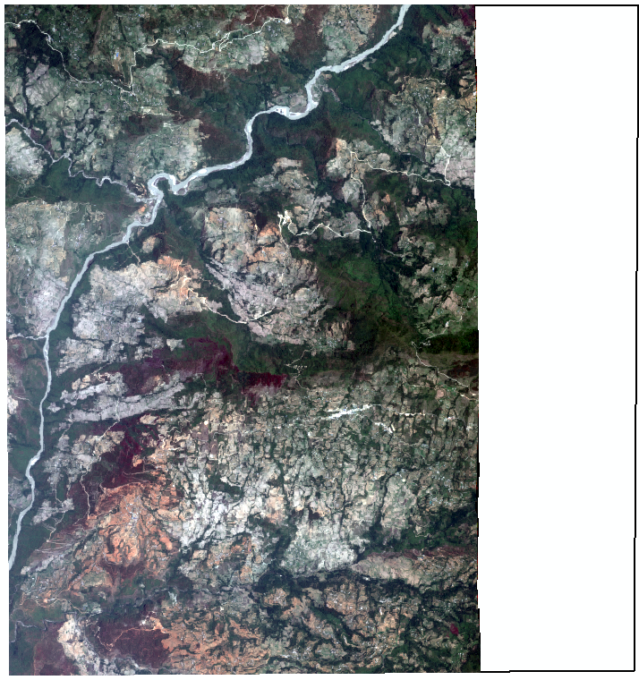



2. Data
2 Pleiades images acquired the 13th of June 2014 (10 months before the earthquake)
1 Pleiades image acquired the 8th of May 2015 (13 days after the earthquake)
1 Pleiades image acquired the 7th of November 2016 (19 months after the earthquake)
25/04/2015
2014
2015
2016
13/06/2014
08/05/2015
08/11/2016
Viewing angle
8 °
Viewing angle: 29 °
Viewing angle: 17 °
Viewing Angle
12 °

Slide 42



3. Building grading
Examples
13/06/2014
08/05/2015

Slide 43


3. Buildings grading
Examples
13/06/2014
08/05/2015

Slide 44


3. Buildings grading
Examples
13/06/2014
08/05/2015

Slide 45

4. Damage assessment map
Number of buildings | 9246
Buildings constructed between the 13/06/2014 and the 08/05/2015 | 287 (3 %)
Grade 1 (Negligeable to moderate damage) | 6747 (73 %)
Grade 2 (Substential to very heavy damage) | 1786 (19 %)
Grade 3 (destruction) | 426 (5 %)
These figures should be taken with caution. the interpetation on the post-event image is delicate due to :
the angle of the post-disaster image
the size of the buildings

Slide 46


5. Recovery map
Total number of buildings the 07/11/2016 (19 months after the EQ) | 9655
Number of buildings cleared up | 2787
Number of buildings without visible changes | 6338
Buildings re-constructed identically between the 08/05/2015 and the 07/11/2016 | 134 | 100 %
stage "foundations excavated" | 2 | 1.5 %
stage "walls erected" | 49 | 36.6 %
stage "construction complete" (roof visible) | 83 | 61.9 %
New buildings constructed between the 08/05/2015 and the 07/11/2016 | 3183 | 100 %
stage "foundations excavated" | 2 | 0.1 %
stage "walls erected" | 13 | 0.4 %
stage "construction complete" (roof visible) | 3168 | 99.5 %
These figures should be taken with caution. the interpetation on the post-event image is delicate due to :
the angle of the post-disaster image
the size of the buildings

Slide 47
6. Recovery map

Slide 48
7. State of the reconstruction by grading level
 | Number of buildings cleared up | Number of buildings without visible changes | Under re-construction Foundations visible | Under re-construction Walls erected | Re-construction complete | Total
Level 1 Negligeable to moderate damages | 1756 ( 26.0 %) | 4963 ( 73.6 %) | 1 ( 0.0 %) | 26 ( 0.4 %) | 1 ( 0.0 %) | 6747 (100 %)
Level 2 Substantial to very heavy damages | 717 ( 40.1 %) | 1043 ( 58.4 %) | 1 ( 0.0 %) | 19 ( 1.2 %) | 6 ( 0.3 %) | 1786 (100 %)
Level 3 Completely destroyed | 284 ( 66.7 %) | 63 ( 14.8 %) | 0 ( 0.0 %) | 3 ( 0.7 % ) | 76 ( 17.8 %) | 426 (100 %)

Slide 49
7. State of the reconstruction by grading level

