Slide 1
Recovery Observatory (RO) Haiti Hurricane Matthew RO Status and Next Steps Report on demonstrator activities Presentation to WGD, March 16, 2017 Agwilh Collet, Helene de Boissezon Steven Hosford, CNES Mare Lo, GFDRR Andrew Eddy, ROOT Secretary
Committee on Earth Observation Satellites

Slide 2
Plan
Haiti Recovery Observatory
Status Overview
First mission to Haiti and feedback
Acquisition Plan
Next Steps
Management
Demonstrator activities
Malawi
Nepal

Slide 3
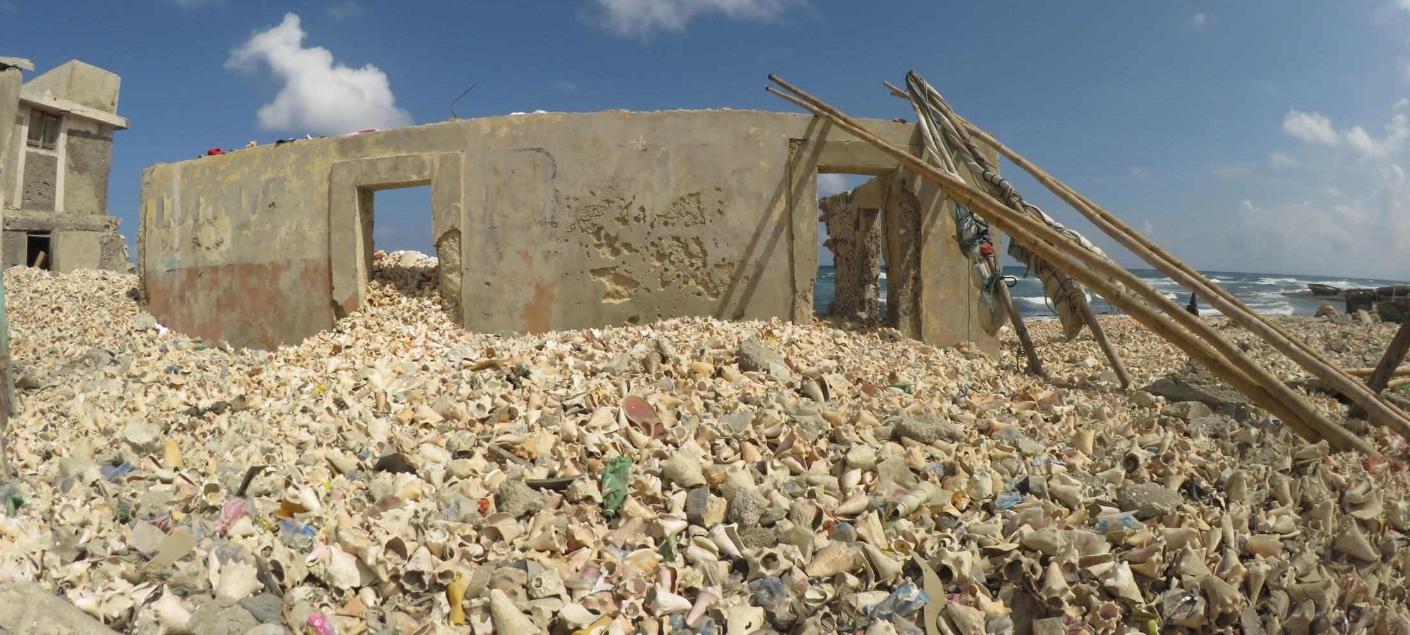
RO Status Overview
House full of seashell
Triggering of the RO decided by CEOS Chair in consultation with CEOS Principals, December 22, 2016, after significant impact of Hurricane Matthew in Southwest Haiti (October 2016);
Mission to Haiti 31 Jan - 3 Feb 2017 to establish partnership with Haiti RO users and stakeholders

Slide 4
RO Status Overview
Infrastructure
Product definition, image requirements
Lessons
learned
RO Haiti Triggering
12/22/16
Early RO evaluation
2015 2016 2017 2018 2019 2020
jfmamjjasond jfmamjjasond jfmamjjasond jfmamjjasond jfmamjjasond jfmamjjasond
PDNA
Today
Hurricane Matthew
in Haïti
10/04/16
Malawi, Nepal
Demonstrators
Missions to Haiti (2 to 3 per year)
1st
31 Jan – 3 Feb
Workshop
Week of 29 May
Notes:
Recovery Observatory (RO) infrastructure developed by CEOS partner agencies in 2015
CNES-commissioned study on RO product definition and image requirements presented to DRM stakeholders in 2015
Applications demonstrators 2016 (Malawi; Nepal)
Triggering of the RO decided by CEOS Chair in consultation with CEOS Principals, December 22, 2016, after significant impact of Hurricane Matthew in Southwest Haiti (October 2016)
Mission to Haiti 31 Jan - 3 Feb 2017 to establish partnership with Haiti RO users and stakeholders
PDNA released 3 February by Haitian Government
http://bit.ly/2jUHKWW
User workshop in Haiti late May 2017;
Early RO evaluation fall 2017;
Matthew RO to continue for three to four years (TBD with user community)
Lessons learned and sustainability strategy after evaluation of 1st RO

Slide 5
Hurricane Matthew – Haïti 2016
Evaluation des Besoins Post Désastre
Post Disaster Needs Assessment PDNA
Notes:
CHAPITRE I. Profil du pays et ses vulnérabilités
1.1. Profil d’Haïti ....................................................................................................... 1
1.2. Vulnérabilités aux désastres naturels......................................................... 3
CHAPITRE II. Le cyclone mathieu et la réponse à la catastrophe
2.1. Le passage du cyclone mathieu....................................................................... 7
2.2. La réponse du gouvernement.......................................................................... 9
2.3. La réponse internationale............................................................................. 10
CHAPITRE III. La méthodologie et le processus pdna en haïti
3.1. La méthodologie pdna......................................................................................13
3.2. Le processus pdna en Haïti.............................................................................15
CHAPITRE IV. Bilan des effets et des besoins post-mathieu
4.1. L’ampleur du désastre......................................................................................19
4.2. Les besoins globaux ..........................................................................................24
4.3. Les effets et les besoins des différents secteurs....................................27 V. Impact macro-économique
5.1. Développements macroéconomiques récents................................................51
5.2. Projections initiales pour 2017 et 2018......................................................... 53
5.3. Méthodologie......................................................................................................... 54
5.4. Projections post-mathieu................................................................................... 55
CHAPITRE VI. Impact humain et social
6.1. Impact du cyclone mathieu sur le bien-être général de la population affectée 6.2. En focus : la sécurité alimentaire et le passage du cyclone mathieu
CHAPITRE VII. Stratégie de relèvement
7.1. La stratégie générale de relèvement ...............................................................71
7.2. Les principes directeurs du processus de relèvement ...............................77
7.3. Les axes stratégiques.............................................................................................78 7.4. Le cadre institutionnel d’opérationnalisation de la stratégie..............81

Slide 6
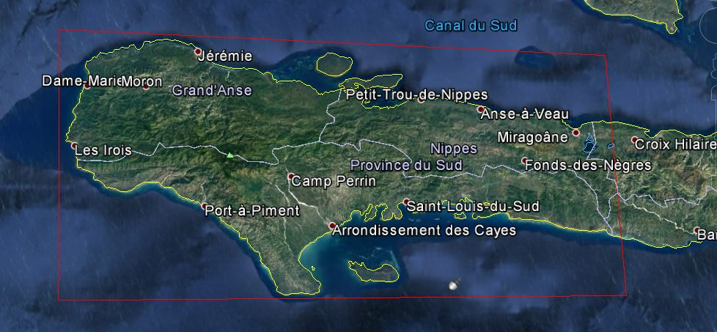
Haiti RO to cover three departments: Grand’Anse, Sud, and Nippes

Slide 7
Potential RO Partners, Users, Practitioners
National government users :
3 early partners : CNIGS, CIAT, ONEV
Other desired partners : ministries (planning, interior, agriculture, finance…)
Academia: universities and institutes (UEH, UniQ, UNDCayes, ENS...)
CEOS agencies :
Italy (ASI), China (CAS), France (CNES), Europe (ESA), Japan (JAXA), USA (NASA, NOAA, USGS) - Possibly Germany (DLR), Canada (CSA). Open to others…
DRM stakeholders and donor bodies :
WB, GFDRR, UNDP, EU, UNEP, UNOPS, WHO, UN Habitat, UNOOSA,… NGO, crowdsourcing and collaborative associations :
Potentiel 3D, OSM, ……
International scientific community:
CIMH, CIMA, INGV, CIRAD, CESBIO, ….
Notes:
Ministère de la planification; Ministère de la Protection civile ; Ministère de l’intérieur et des collectivités territoriales ; Ministère de l’agriculture, des ressources naturelles et du développement rural (MARNDR) ; Ministère des finances.
In addition, Haitian universities and institutes of higher learning are expected to play a role as centres of excellence and partners in the RO. These include: UEH, UNIQ, Université Notre-Dame des Cayes.
CEOS Agencies:
The following CEOS agencies have expressed support for RO triggering in Haiti:
ASI: CSK archived and newly acquired data; possible support to Italian providers of value-added products.
China/AOE/CAS: scientific research on RO area of interest and possible data contribution.
CNES: archived and newly acquired Pleiades and SPOT data; IT infrastructure; project management support; ROOT secretariat and general coordination support; value adding support to French industry.
ESA: ESA is proposing the following contribution in the course of year 2017; the ESA contribution is to be defined in the successive years:
Sentinel-1, 2 and 3 data and technical advice
Tools and services for terrain motion mapping, landslide hazard mapping and possibly other relevant geohazard types
JAXA: possible ALOS-2 data acquisition.
CIMH (Caribbean Institute for Hydrology and Meteorology), CIMA (Italy - hydrology, exposure, and vulnerability assessment), INGV (Italy - geohazards), IRD (France – Institut de recherche pour le developpement), CIRAD (France – Agricultural research for development), CESBIO (France – Centre d’etudes spatiales de la biosphere).

Slide 8
RO Mission to Haiti
31 January to 3 February, 2017
Joint CNES-GFDRR mission on behalf of RO to establish partnership with RO user sand stakeholders and develop consensus on user needs for the RO
CNES:
Helene de Boissezon
Aurelie Sand
GFDRR:
Gian Michele Toglia
ROOT Secretary:
Andrew Eddy

Slide 9
Consultations – Mission to Haiti (Jan/Feb 2017)
CNIGS
CIAT
ONEV
Ministere de la planification
UNDP
UNEP
WHO (World Health Organization)
IOM (International Organization for Migration)
Delegation of European Union
Open Street Map/3D Potential
Univ Notre-Dame des Cayes, UniQ (Quisqueya), UEH, ENS
Notes:
CNIGS : National Center for Geo-Spatial Information CIAT : Interministerial Committee for Territorial Development
ONEV : National Observatory of the Environment and Vulnerability

Slide 10
Feedback from consultations (1/2)
Strong support for RO concept
Desire to link RO to existing tools and platforms for increased synergy: HaitiData.org, KAL-Haiti, RASOR, new ONEV environmental information service
Role of local champions
CNIGS technical implementation and leadership
CIAT user needs coordination
Ministry of planning linkages to national and local recovery efforts
ONEV linkages to environmental and eco-system monitoring
Strong interest of universities and research communities

Slide 11
Feedback from consultations (2/2)
Area to be extended to the three administrative units
Main application areas :
Agriculture and food security
Forests and protected areas
Coastal zone monitoring and coastal settlements
Population displacement and rural settlements
Road networks and accessibility
Landslides and water system monitoring (river bed and river discharge monitoring)
Baseline pre and immediately post event; update every six months over AoI; hotspots with more detailed, more frequent coverage; thematic applications led by theme leaders (e.g. Environment- ONEV); reactive update after future events.

Slide 12
ROOP Preliminary Product List 1/2
Baseline mapping | Pre-event baseline landcover map of area of interest
 | After event baseline map showing categories of damage over AoI Update with schools and health centres and road network
Housing | Progress of housing reconstruction (routine product) 1 or 2 years only?
 | Population displacement monitoring product (routine product)
Transport | Status of critical transportation points (input to Rural Access Index) (routine product)
Agriculture | Agricultural change assessment (science product)
Health | Vector-based disease risk product (science product)

Slide 13
ROOP Preliminary Product List 2/2
Environment | Status of regeneration, deforestation and human impacts (and other parameters?) in protected areas (routine product)
 | Coastal zone monitoring with focus on reefs (reef health) and coastline (sedimentation, river discharge, coastline change) – (science product)
 | Integrated watershed monitoring (science product)
 | Ground movements: landslide (base map and update after major met events or seismic event) and fault mapping (science product)
 | Evolving hazards – change detection map of high risk vulnerable areas ; flooding after new met events (science product)

Slide 14
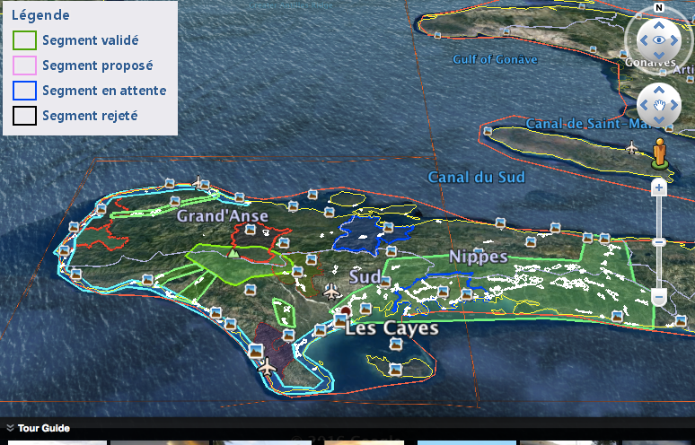
RO monitoring needs being mapped out by CIAT, ONEV and others :
CIAT input on priority monitoring
Legend :
Coastline monitoring
Vegetation Cover
Progression of Informal settlements
Others AoI
Charter activation for Matthew in Haiti
Notes:
The Macaya, :situation of the vegetation cover
Corridor Miragoâne - Les Cayes :progression of informal settlements
Coastal zone Les Cayes - Jérémy : in particular the coastline
Dame-Marie Corridor Jérémie : progression of informal settlements
The group of communes : progression of informal settlements
Port Salut
Arniquet
Around Chantal
Around the English
Around Port à Piment
Beaumont
About The Source
Anse d'Hainault
Dame Marie
Saint Louis of the South
Barradère
Erosion of mountain areas to the sea
The situation of cocoa, coffee and cashew nuts,

Slide 15
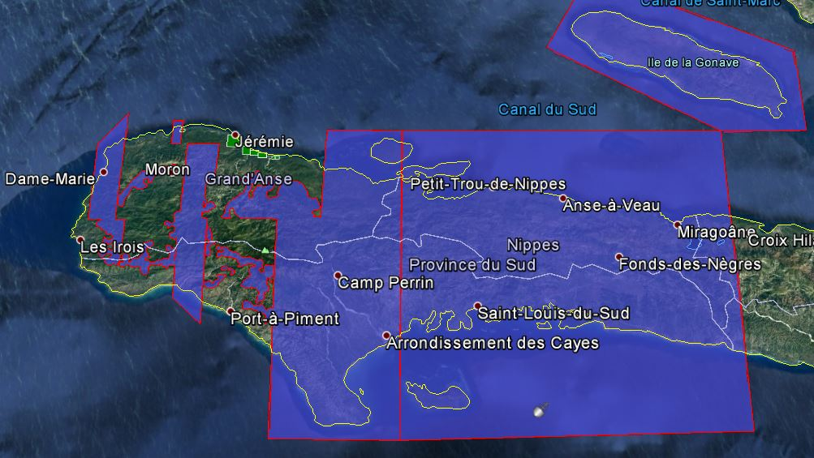
RO monitoring needs being mapped out by CIAT, ONEV and others :
IOM input on priority monitoring
(International Organization for Migration)
Legend :
VHR priority
Missing EO data
Drone Data
Notes:
Recent feedback from IOM indicates that actual areas of interest may be in areas already mapped after event to show reconstruction, as opposed to missing areas, where 5 months later we will see mixture of damage and reconstruction.

Slide 16
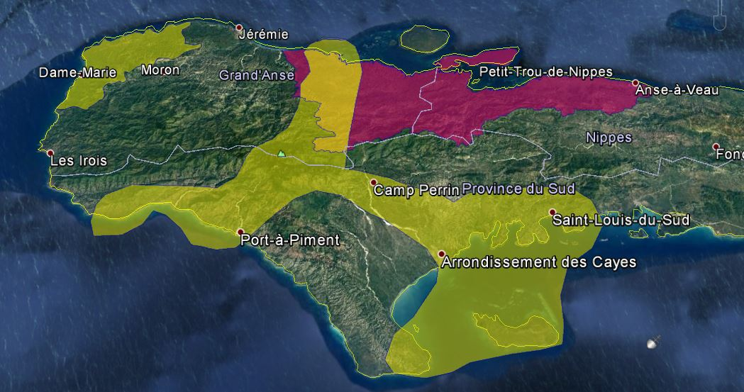
RO monitoring needs being mapped out by CIAT, ONEV and others :
ONEV input on priority monitoring
(National Observatory of the Environment and Vulnerability)
Legend :
Minister of the Environment area of interventions
ONEV priority

Slide 17
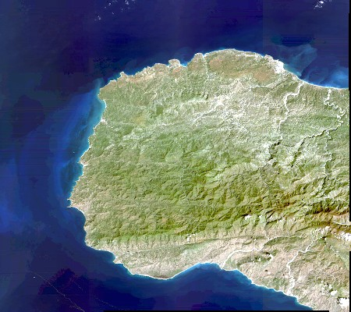
RO Acquisition Plan
Overview
AOI
Free and open collection of images and maps at several scales
Field data for validation
Strong capacity building component
An HR cover of the entire AOI, few VHR on zoom before and after Matthew
(Optical and SAR) for reconstruction planning Regular programming for reconstruction monitoring
Zoom
Zoom
Zoom
Zoom
Zoom

Slide 18
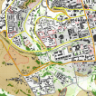
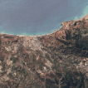
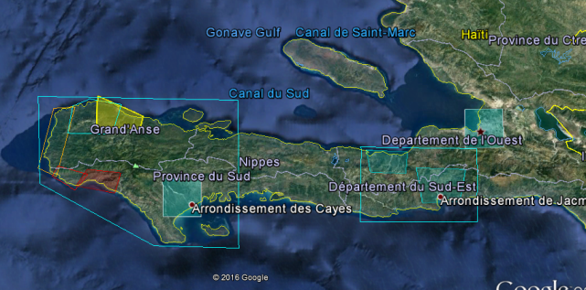
RO Baseline :
Pre/Post Matthew
An HR cover of the entire AOI, few VHR on zoom before and after Matthew
(Optical and SAR) Archive Existing data :
TerraSAR-X, Spot, Landsat, WV, ALOS-2,
Radarsat-2, Pléiades, Drones images
Action : Discuss Archive Data quota
with CEOS RO partners
Charter activation for Matthew in Haiti
ROSCOSMOS- Resurs p ROSCOSMOS- Kanopus v
CNES - Pléiades
CSA – Radarsat-2
Action : Charter- CEOS agreement

Slide 19
RO acquisition plan : Overview Area
Overview area
Mid-scale products : overview AOI
Change in landcover, open spaces
Vegetation loss or re-growth
Agriculture
Coastal apps
HR Optical : SPOT, Landsat-8, Sentinel-2
Medium/Low Resolution Optical : MODIS, Sentinel-3
HR SAR: CSK, TSX, ALOS-2, Radarsat-2
DEM
Update frequency:
every 10 days to 6 months
(Agriculture, landcover, landslides, environmental monitoring, Coastal apps, Flood and landslide hazard products )
Charter Acquisition
ROSCOSMOS, RESURS_P, 2016-10-09, 22:20:00

Slide 20
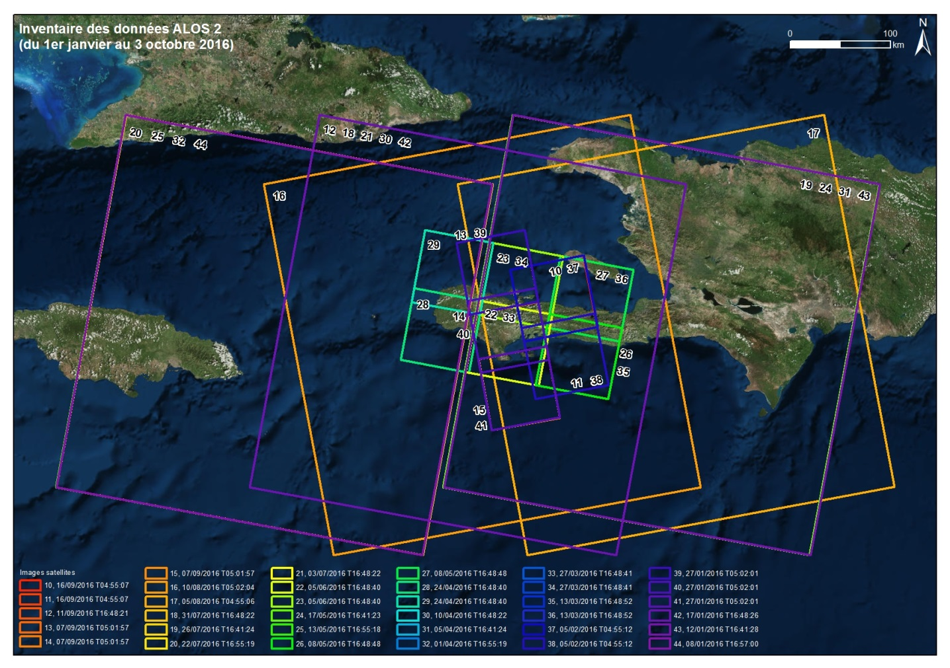
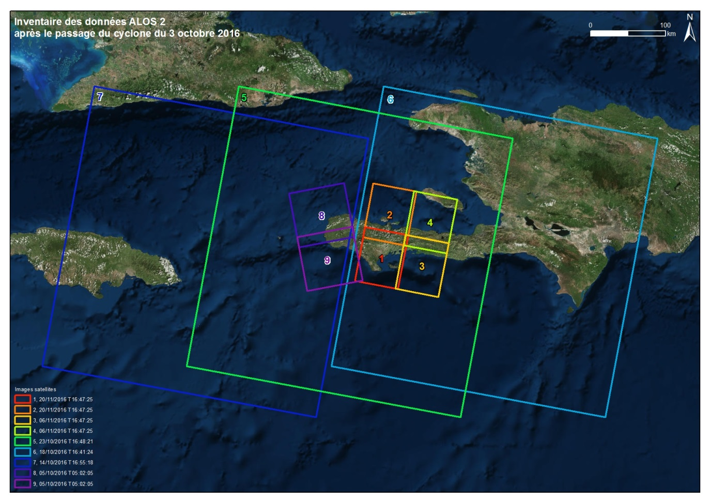
Existing Data : ALOS-2
Pre event : 05/06/2016 T16:48:40 24/04/2016 T16:48:40 08/05/2016 T16:48:48
Post event :
20/11/2016 T16:47:25
06/11/2016 T16:47:25
05/10/2016 T05:02:05

Slide 21
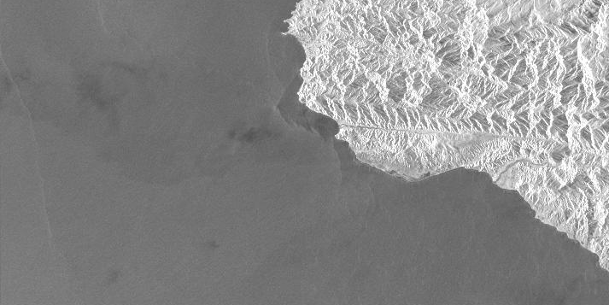
Existing Data : ALOS-2 (Flood Pilot Data)
Alos-2
Post Event
JAPAN-JAXA-ALOS2-EICS
05/10/2016 T05:02:05
155218
155153

Slide 22
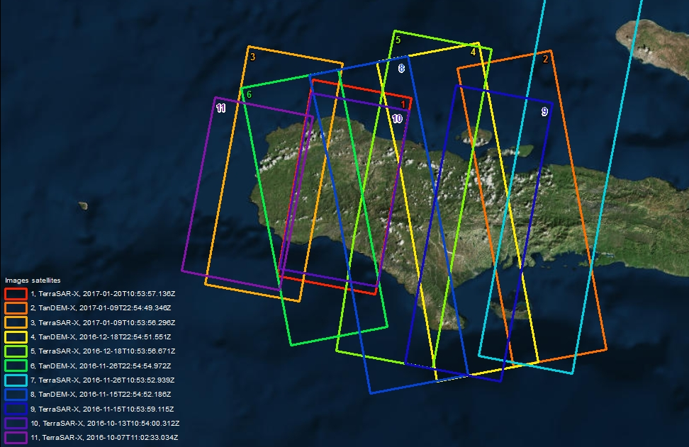
Existing Data :
TerraSAR-X TanDEM-X

Slide 23
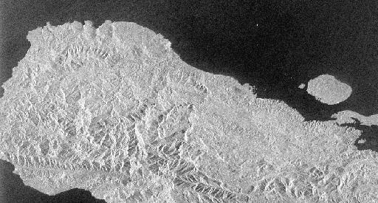
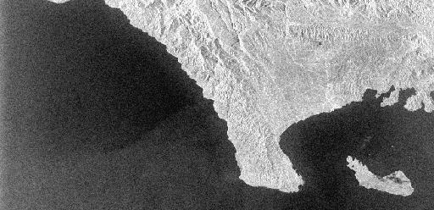
Existing Data : Radarsat-2
Two areas
Pre event : 11/02/2016 23:12
06/03/2016 23:12
30/03/2016 23:12
23/04/2016 23:12
17/05/2016 23:12
10/06/2016 23:12
04/07/2016 23:12
21/08/2016 23:12
Post event :
07/10/2016 10:56:04 08/10/2016 23:12:13 01/11/2016 23:12:12 25/11/2016 23:12:10

Slide 24
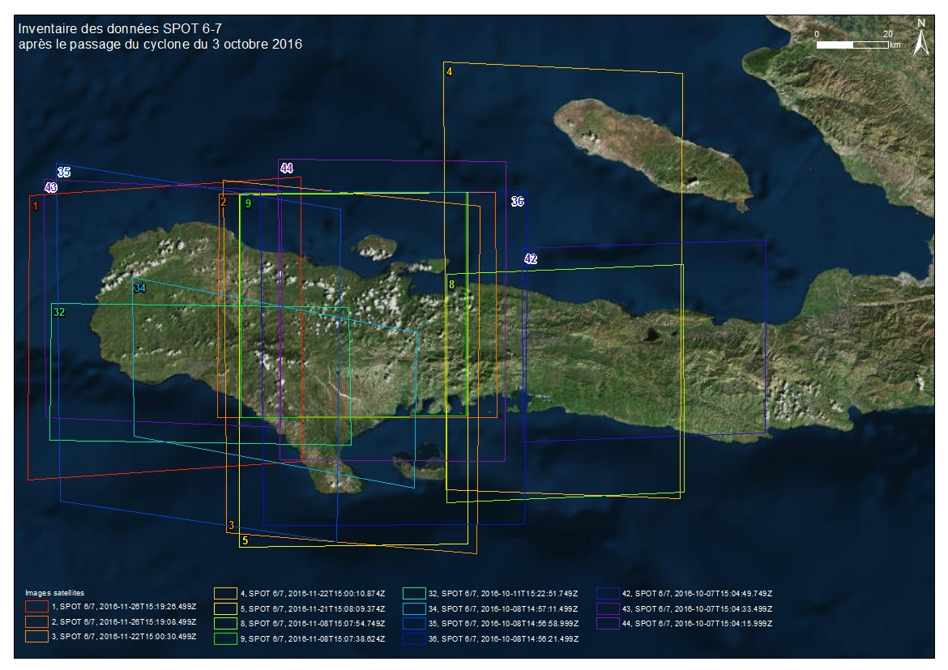
Existing Data : SPOT 6/7
The entire AOI has been covered on February 1st and 14, 3 images cloud free
Pre Event : 25/06/2016 – 26/01/2016
Post Event : 08/10/2016

Slide 25
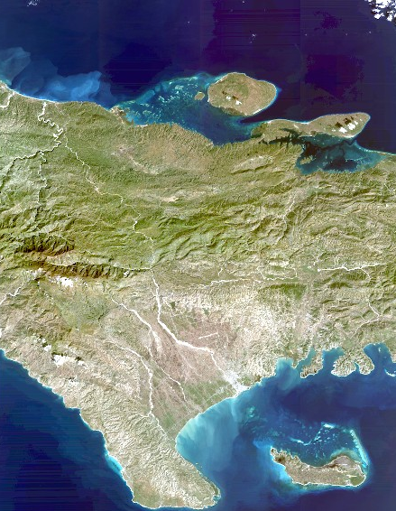
Existing Data : SPOT 6/7
Notes:
February 2017 images

Slide 26
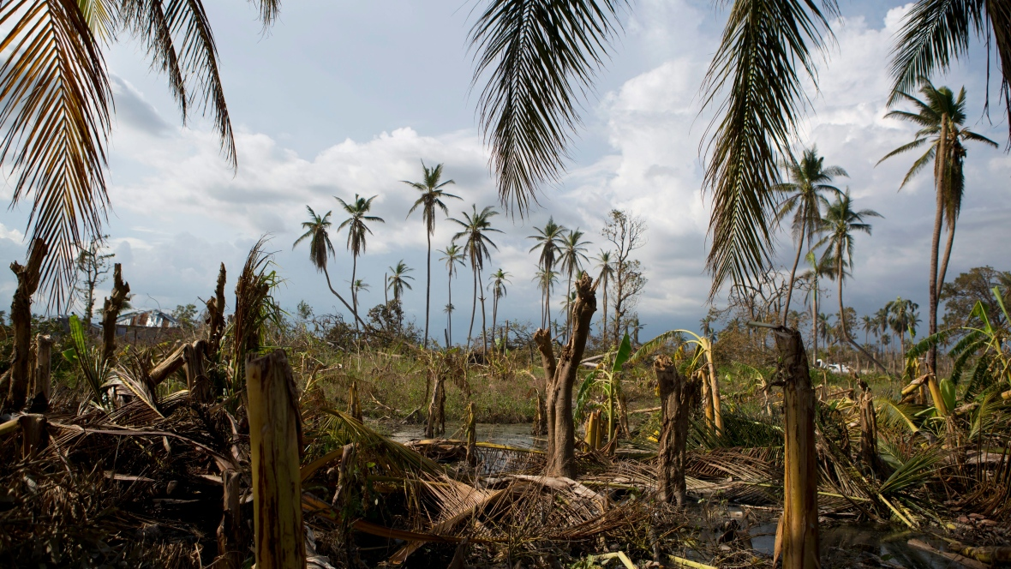
Ro Acquisition Plan – Zoom Areas
Rebecca Blackwell/Associated Press
Environment / Agriculture monitoring : a key to success
Macaya National Park : a biosphere reserve by UNESCO (2016)
Notes:
Broken banana trees stand in a flooded field in the village of Sous-Roche, on the outskirts of Les Cayes, South of Macaya National Park, Haiti, after Hurricane Matthew. It could take up to 10 years for mature fruit trees to fully grow back. (Rebecca Blackwell/Associated Press)

Slide 27
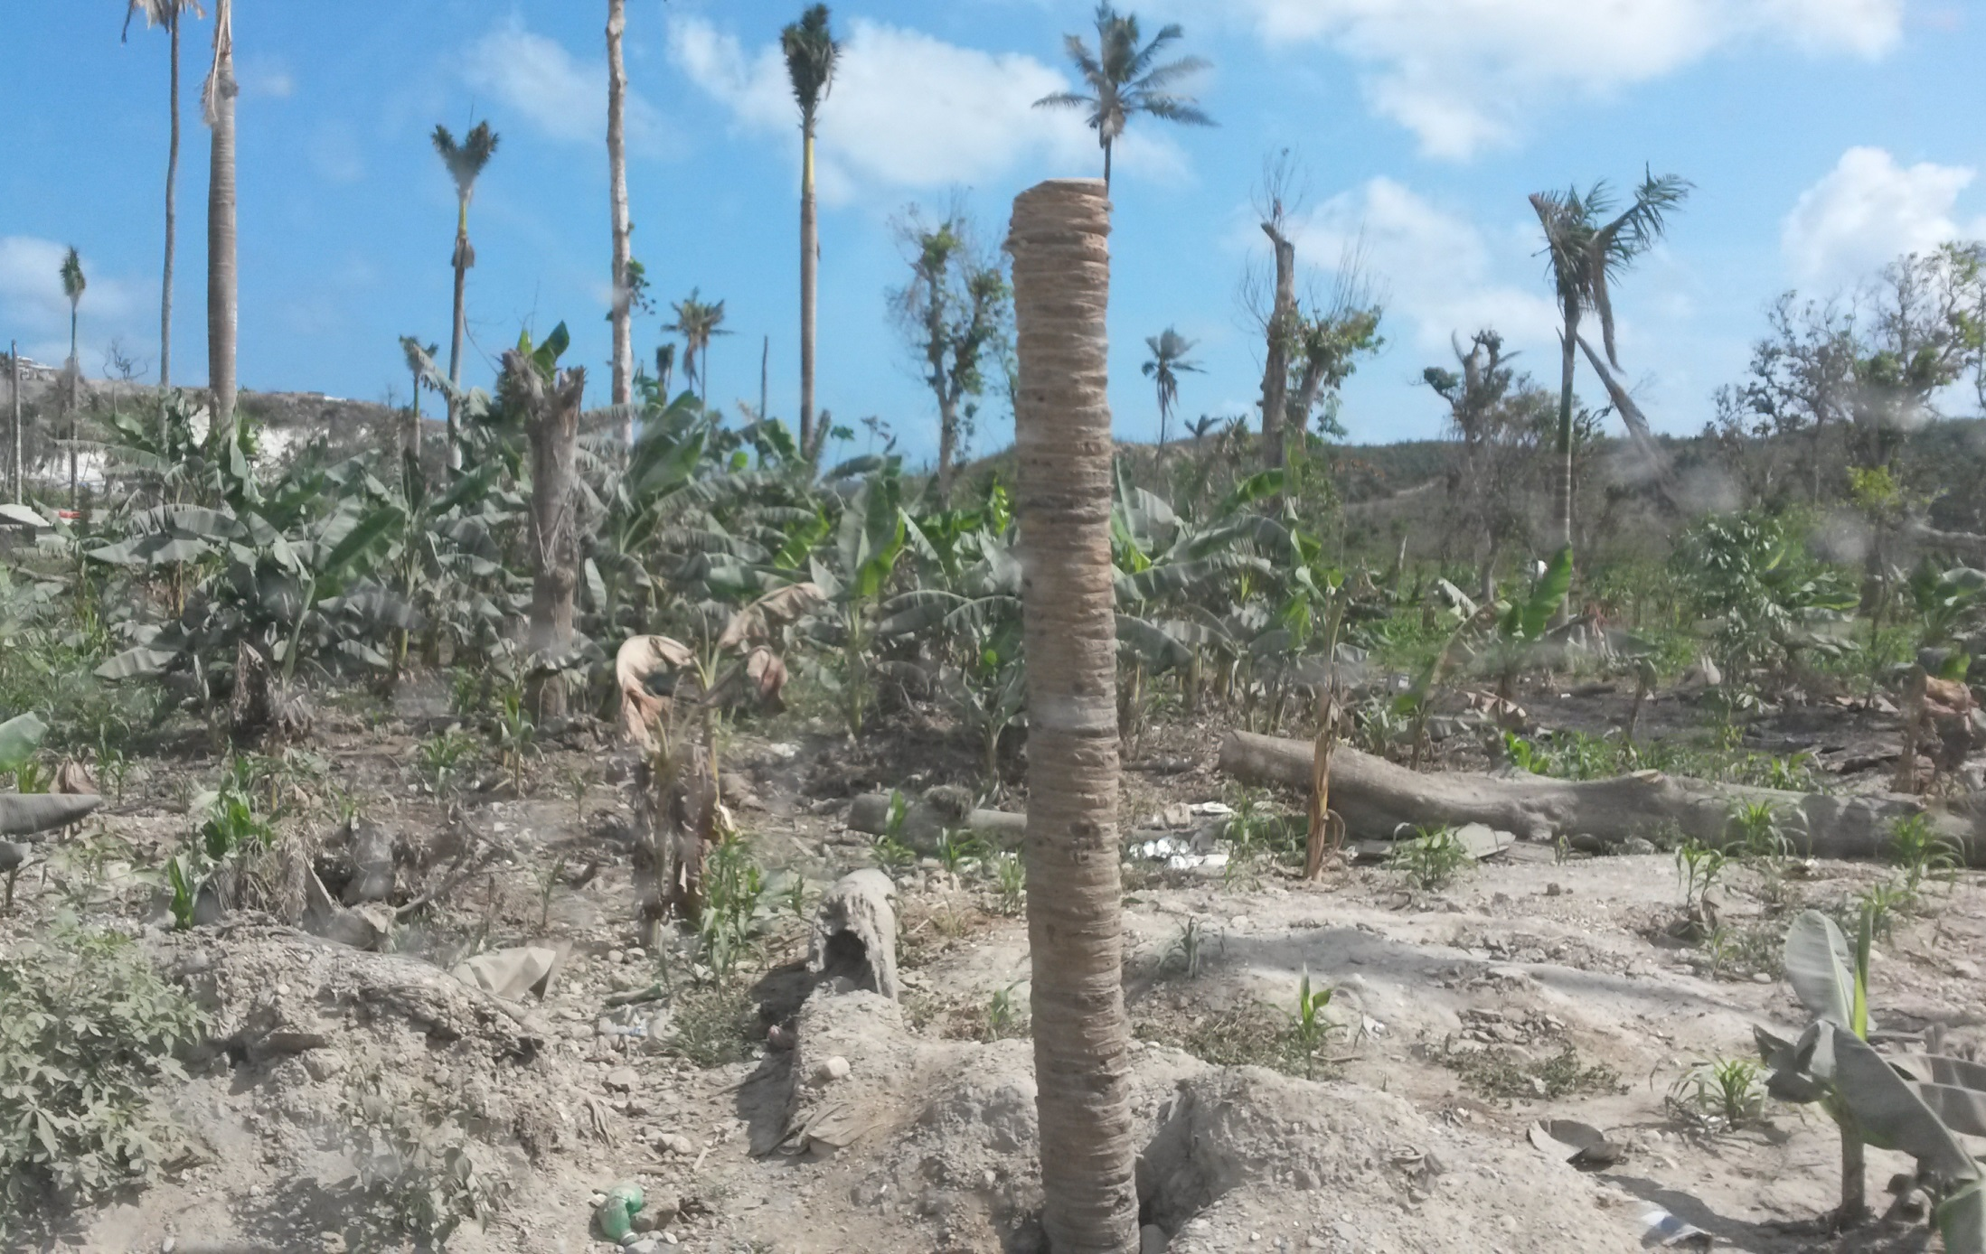
Ro Acquisition Plan – Zoom Areas
South West of Haiti 10.02.2017

Slide 28
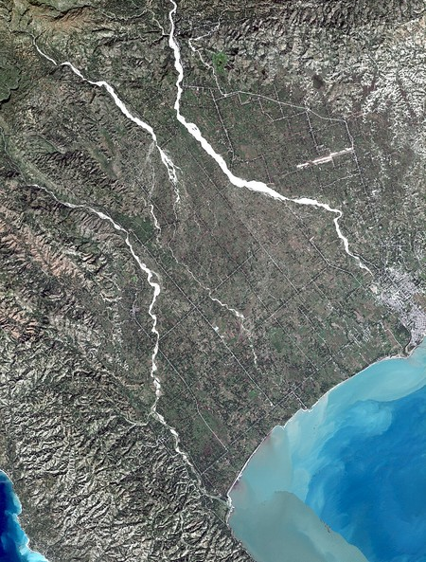
Ro Acquisition Plan – Zoom Areas
Several target already defined :
Macaya National Park
Urban Area (Port salut, Les Cayes..)
Infrastructures monitoring (Hospital..) Population movement (Dame-Marie Corridor Jérémie )
Coastline monitoring (zone Les Cayes - Jérémy )
Erosion of mountain area to the sea Pine forests, Situation of the cocoa, coffee and the cashew nut culture,
Landslide Area, Watershed …
Users input still being received analysis in ROOP late March
VHR Optical : Pléiades, (GeoEye, Woldview 1/2/3)
VHR SAR : Alos-2, CSK, TSX, Radarsat-2 Spotlight
Possible Update frequency:
Every 6 months; tuned to applications
Notes:
The Macaya, :situation of the vegetation cover
Corridor Miragoâne - Les Cayes :progression of informal settlements
Coastal zone Les Cayes - Jérémy : in particular the coastline
Dame-Marie Corridor Jérémie : progression of informal settlements
The group of communes : progression of informal settlements
Port Salut
Arniquet
Around Chantal
Around the English
Around Port à Piment
Beaumont
About The Source
Anse d'Hainault
Dame Marie
Saint Louis of the South
Barradère
Erosion of mountain areas to the sea
The situation of cocoa, coffee and cashew nuts,

Slide 29
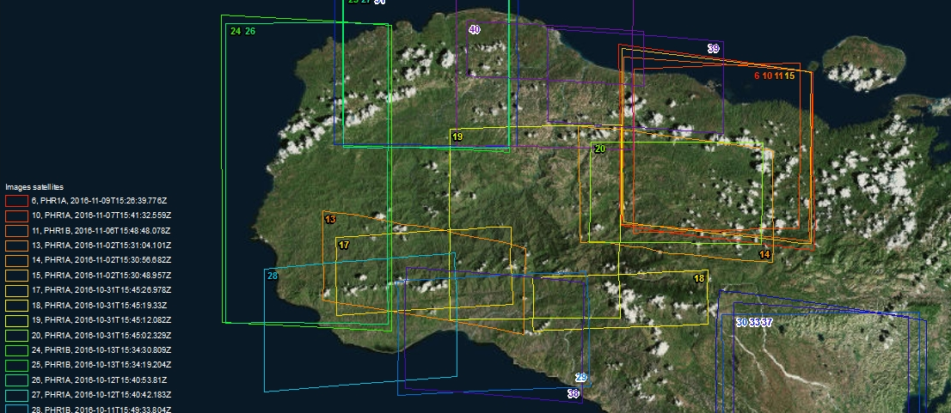
Existing Data : Pléiades

Slide 30
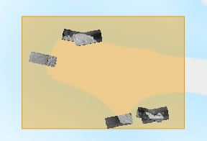
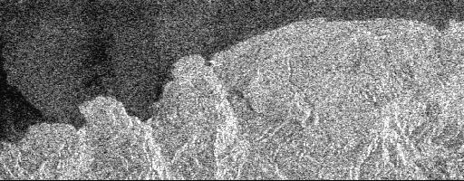
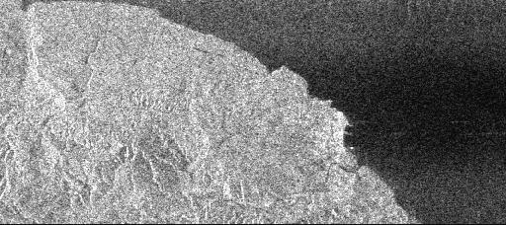
Existing Data : Radarsat-2
Spotlights Post Event
15/10/2016 23:08
15/10/2016 23:08
24/10/2016 11:00
29/10/2016 22:59
31/10/2016 10:56
31/10/2016 10:56

Slide 31
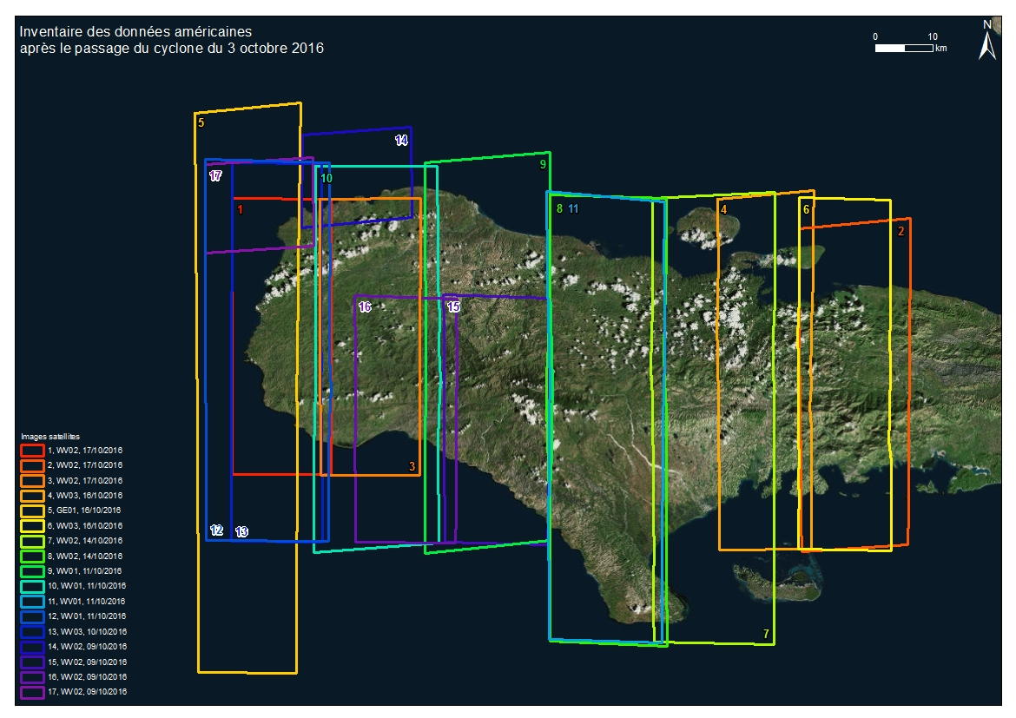
Existing Data : WV-1/2, Geoeye
Pre event : WV02 28/09/2016
WV02 29/08/2016
WV02 13/08/2016
WV01 07/08/2016
WV02 27/07/2016
WV02 17/07/2016
WV02 06/07/2016 WV02 07/06/2016 WV01 12/06/2016 GEO1 07/06/2016 WV01 28/03/2016 WV01 23/02/2016
Post event :
From 09/10/2016 To 17/10/2016

Slide 32
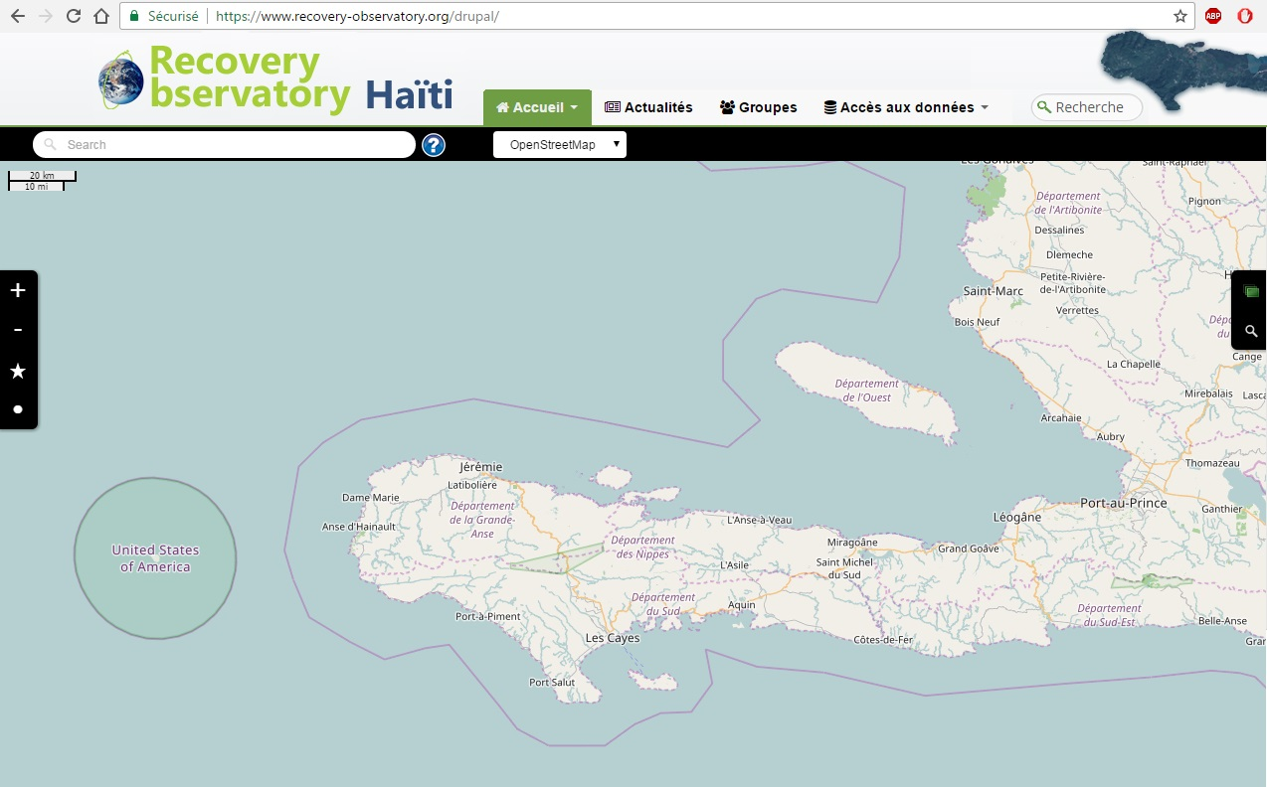
RO Dotcloud Platform creation on-going – first version late April 2017
Notes:
In French for now with english resume. French : due to local actors Will be a fluent website … in the future

Slide 33
Next steps
Update of Operations Plan (ROOP) to be developed in cooperation with Haitian partners and international DRM community in March 2017
Development of pilot applications based on identified requirements for presentation at May workshop
Sollicitation of new funding and new partners to augment monitoring applications to be offered
“Table Verte” contacts and Haiti presentation by RO Team (CNIGS, 29 and 30 March) in Port-Salut
May User Workshop – proposed for 29 and 30 May or 30 and 31 May in Port-au-Prince

Slide 34
User Workshop – Port-au-Prince
(May 29 and 30 or May 30 and 31)
Bring together local, national and international RO users to present recovery plans of government and NGOs in affected areas;
Showcase preliminary RO platform, with pilot applications for review and improvement proposals by users;
Discuss capacity building plan and specific initiatives to ensure increased capacity at national and local levels;
Discuss improvements and ideal ‘steady-state’ RO;
Discuss functionalities required (database, archive search, platform, portal, product generation, etc) for integrated EO-based information systems in Haiti; review role of different projects;
Discuss dissemination strategies to ensure full RO access for users with different levels of capacity.

Slide 35
Timeline
To June 2017 – RO Establishment
Discussion of MOUs with Haitian users and partners,
Sollicitation of new partnerships (especially for value-adding)
Establishment of IT infrastructure with charter images, baseline pre/post-event
Development of capacity building plan
First User workshop in Haiti to provide further input to the ROOP and finalise the RO baseline.
June to fall 2017 – RO Commissioning
Incorporating the first products into the RO and ensuring easy access;
Animating the user forum;
Encouraging and promoting RO use.
First “early evaluation”, with a report to RO Steering Committee
To end 2021 (est.) – RO Steady-state Operations
Ensure IT updates, engage in capacity building activities, generate regular products, report on RO annually to stakeholders and partners
Preparation of closure, including evaluation and legacy strategies.

Slide 36
Proposed Haiti RO Management
Haiti RO will set up a Project Team, made up of local stakeholders, international DRM community, value adders, academia, and CEOS satellite community. All RO contributors and users are de facto members of Project Team. All ROOT members invited to join.
Haiti RO Steering Committee (SC) to be made up of Haiti champions CNIGS, CIAT and ONEV, together with GFDRR/WB, and UNDP as representatives of the international community, and two or three volunteers ROOT CEOS agencies.
Haiti SC to meet via teleconference once every three months to oversee RO development and address issues that arise, and face to face as required.
Day-to-day management of RO to be undertaken by project team on a decentralized basis (project leadership by CNIGS; technical project management support by CNES).
Notes:
Centre national d’information geo-spatiale (CNIGS)
CIAT – Comite interministeriel pour l’amenagement du Territoire
ONEV – Observatoire national pour l’environnement et la vulnerabilite

Slide 37
World Reconstruction Conference (WRC3) 6-7 June 2017 Brussels
To support the implementation of Priority 4 of the Sendai Framework for Disaster Risk Reduction 2015 – 2030
Notes:
Boby Piard DG of CNIGS will present RO on behalf of team, at invitation of World Bank.

Slide 38
Structure:
3 days of Conference and Tour&Taxi (at The Square)
5 plenaries
21 technical sessions
WRC3 website: https://www.gfdrr.org/wrc3
Registration: To be launched by the end of Feb. 2017

