Slide 1

Committee on Earth Observation Satellites
GEO-DARMA KO
Workshop and Status Report
Ivan Petiteville, ESA
Andrew Eddy, Athena Global
Disasters WG
15 March 2017

Slide 2
KO Workshop 14 March
Objectives:
  Understand Sendai Framework priorities as they apply to EO
  Examine Sendai Framework monitoring indicators and relevance for EO
  Examine regional organizations of interest
  Take stock of relevant regional DRR programs in three regions
  Begin planning for 1st SC meeting and Concept workshop in Cancun
Results:
  17 people brainstormed around GEO-DARMA objectives and content of Concept Document/prototyping phase
  Steering Committee partly established and 1st mtg planned for Global Platform in May; new members to be sought to round out existing confirmations; Concept Workshop planned for May (participants to be identified, exact time and venue still TBD, possible help from GEO Sec on logistics)
  Strong opportunities for EO data linked to existing DRR projects (during Prototyping Phase) and possibly Sendai Framework Implementation & Monitoring (Targets / Indicators)
  Excellent discussions on next steps – next meeting (telcon) planned for review of Regional organisations and projects
  Potential Participation in GEO-DARMA expressed at KO Workshop from external institutions e.g. CIMA Foundation, NCEO, ..
  Contact and involvement with Regional Institutions has recently begun. Some key partners (UNESCAP, GFDRR, etc) engaged at senior levels – work underway to reach out to large number of institutions for Technical Committee; should be well advanced by May 2017; possible support from GEO Sec, NCEO… (review of list, contacts and outreach)

Slide 3
Proposed GEO-DARMA Steering Committee Members (in bold confirmed)
Tiziana Bonapace, Director ICT and DRR, UNESCAP
Francis Ghesquiere, Head, GFDRR
Michael Szoenyi, Group Head of Flood Resilience, Zurich Insurance group
Mohammed Ibrahim, Principal programme officer, ECOWAS Commission
Faisal Djalal, Chairperson, Asia-Pacific Alliance for Disaster Management
Peeranan Towashiraporn, Capacity Development Specialist, Asian Disaster Preparedness Center (ADPC)
Ivan Petiteville, GEO-DARMA PoC, CEOS / ESA
Mamadou Toure, Founder and Chairman, Africa 2.0 Foundation
Joseph Tocco, Chief Executive, Americas, XL Catlin
Gilles Ollier, Head of EO, DG Innovation, European Commission
Ronald Jackson, Executive Director, Caribbean Disaster and Emergency Management Agency (CDEMA)
Irene Céspedes, General Director, Regional Center for Disaster Information for Latin America and the Caribbean (CRID)

Slide 4
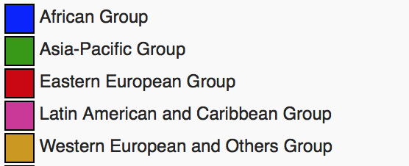
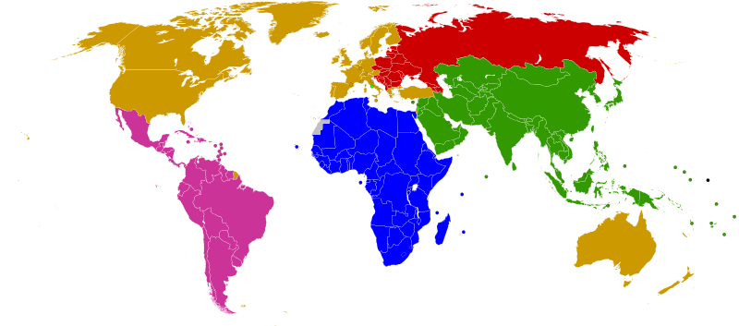
GEO-DARMA Partnership Approach
.
ASEAN
ADRC
SDMC (SAARC)
UNESCAP
APEC
LAS
PIFS
Asia-Pacific
Africa
Latin America
Caribbean
SADC
LAS
ECOWAS
CILSS
IGAD
UNECA
CDEMA
CEPRELAC
INDM (OAS)
CAPRADE
CRID
ECLAC
International: consider regional processes and programmes of World Bank, GFDRR, UNDP, UNEP, UNESCO, UNISDR, across all regions, especially in areas where there is no regional organisation (e.g. Central Asia)

Slide 5
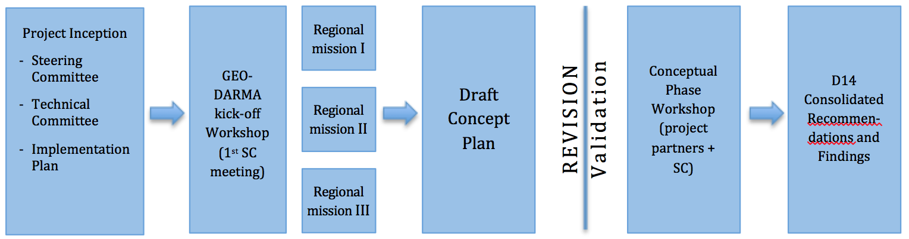
Work Flow – Concept Phase
(KO to 8 Mo)
Work Logic – Conceptual Phase (KO – M8)

