Slide 1
CEOS Disaster Risk Management Proposition to the CEOS WG Disasters: The Geohazards Lab
CEOS WG Disasters meeting, 14-16 March 2017

Slide 2
Overview of the Proposition
New initiative proposed in the frame of CEOS with already 4 CEOS members intending to contribute
Aims to address priorities of the Sendai Framework for Disaster Risk Reduction 2015-2030 using satellite EO
Main goal: provide an EO processing & e-collaboration environment to exploit EO data to assess geohazards and their impact
Support and complement CEOS WG Disasters activities (on-going pilots, follow-on activities and the RO), GEODARMA.
While CEOS activities focus on providing data to users, the Geohazards Lab will complement these activities with additional EO processing. The contribution of the Geohazards Lab is not required for the CEOS activities to achieve their goals.

Slide 3
Challenges
Based on lessons learnt from the Seismic Hazards pilot activity some challenges have been identified:
many users aren't aware or cannot afford EO based solutions
EO techniques need to be adopted by users (standards, norms)
some new EO missions' data are large in volume
some EO applications require complex or intensive processing
some EO applications require to maintain, reprocess and compare EO based VA products
the EO data and derived VA products are costly to generate for the objectives of the community (e.g. with regional/global coverage)
As a contribution from ESA to the CEOS WG Disasters (seismic, volcano and landslides) the Geohazards Exploitation Platform has provided an EO processing and an e-collaboration environment. It has demonstrated benefits:
support expert users from CEOS and the GSNL with hosted processing
support users who aren't processing experts (black boxes)
help users in regions with limited bandwidth (EO results versus large EO data files)
optimise impact over time with the persistency of results (on-line publication of results).
These concrete achievements from precursor platform activities are the basis for a broader joint approach with several space agencies.

Slide 4
Opportunities
The Geohazards Lab is a new initiative to help the user community augment the impact of the CEOS WG Disaster activities. It is focused on geohazards (seismlic, volcano, landslides) and is intended to maximise how user needs are met with hosted processing and e-collaboration by:
addressing the complexity and timeliness of massive volume processing
finding more cost effective approaches to acheive greater geographic coverage
raising awareness and share results with geoscience centers and end users
supporting capacity development activities with on-line solutions

Slide 5
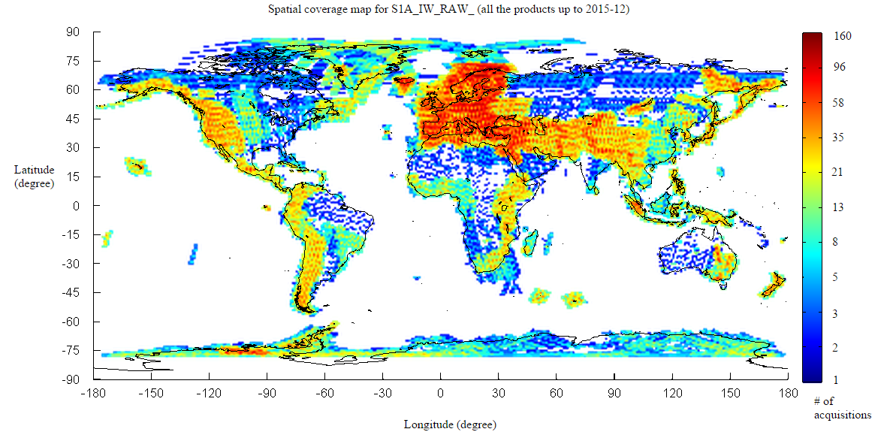
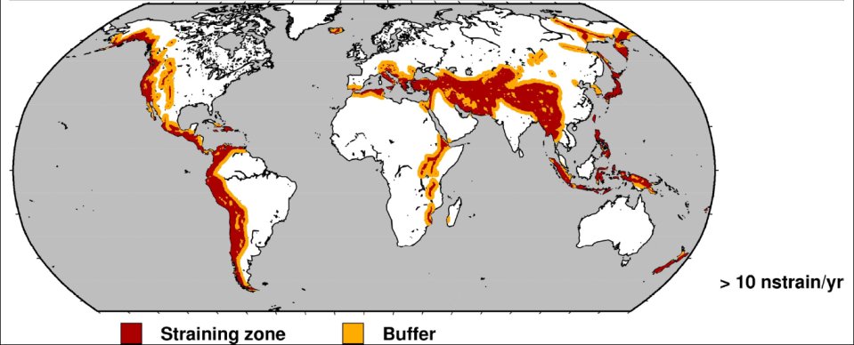
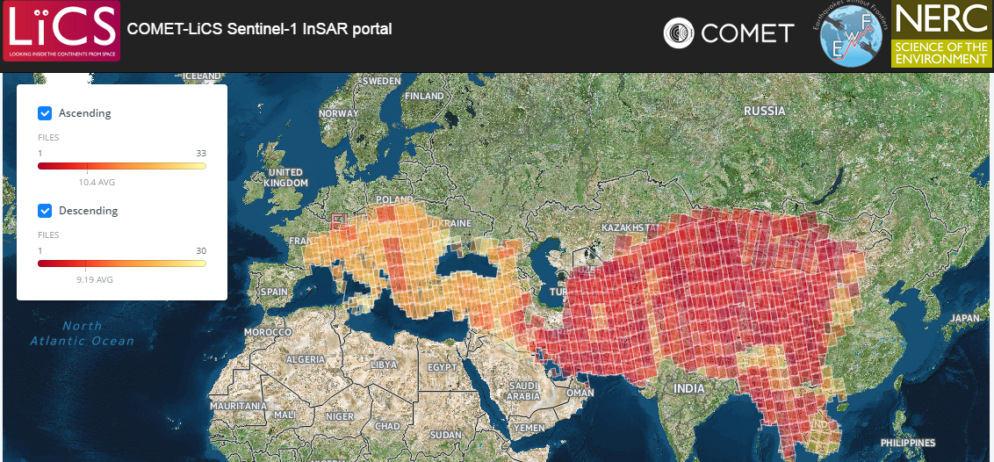
Examples of challenge & opportunity:
Sentinel-1 and Sentinel-2 change the way satellite EO is exploited for DRR:
Using Sentinel-1 complex data over the world tectonic mask requires to process 200+ pairs of images every day (2800+Giga).
Similarly using Sentinel-2 all land surfaces of the world are covered every 5 days (4+ Tera per day).
To adress this requires
a new approach for data exploitation.

Slide 6
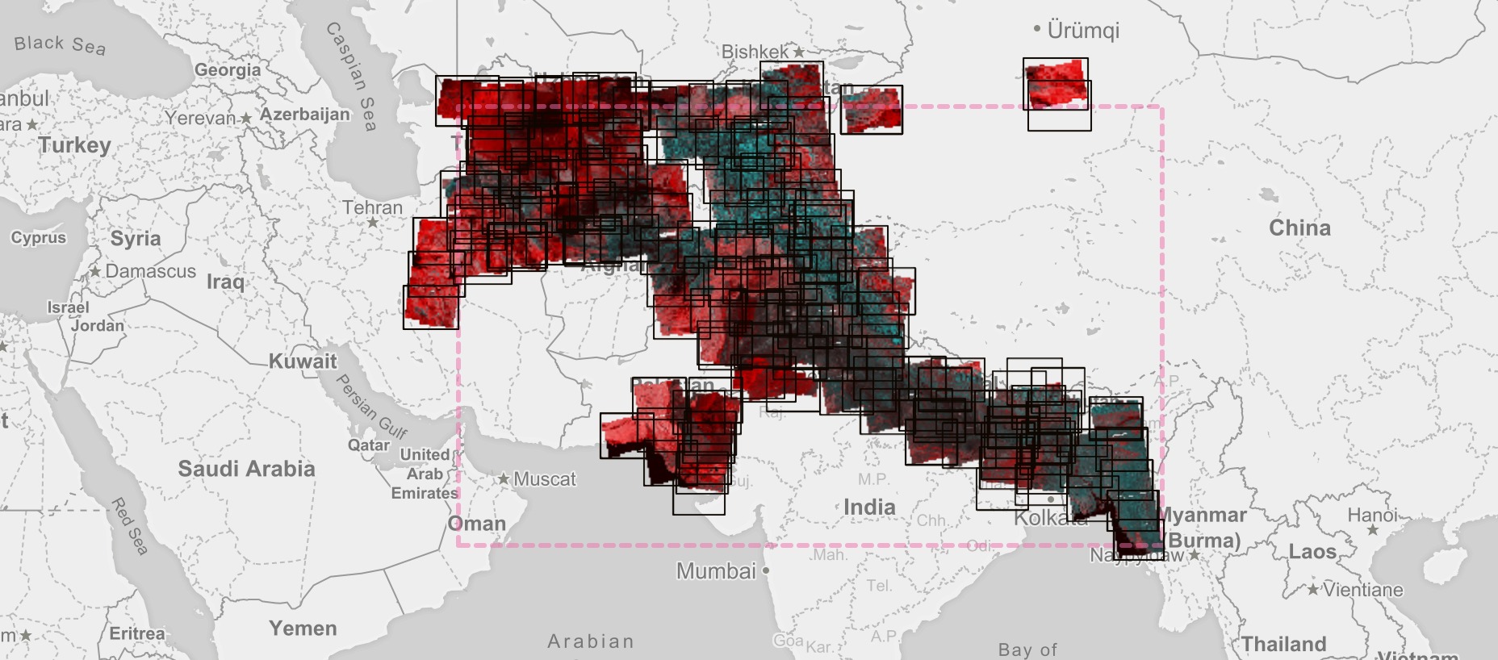
Example of challenge & opportunity:
Illustration of the systematic production of the DLR InSAR Browse chain using Sentinel-1 data on the GEP. Region: Himalayas.
Note: the Geohazards Exploitation Platform is a pilot within the CEOS WGISS

Slide 7
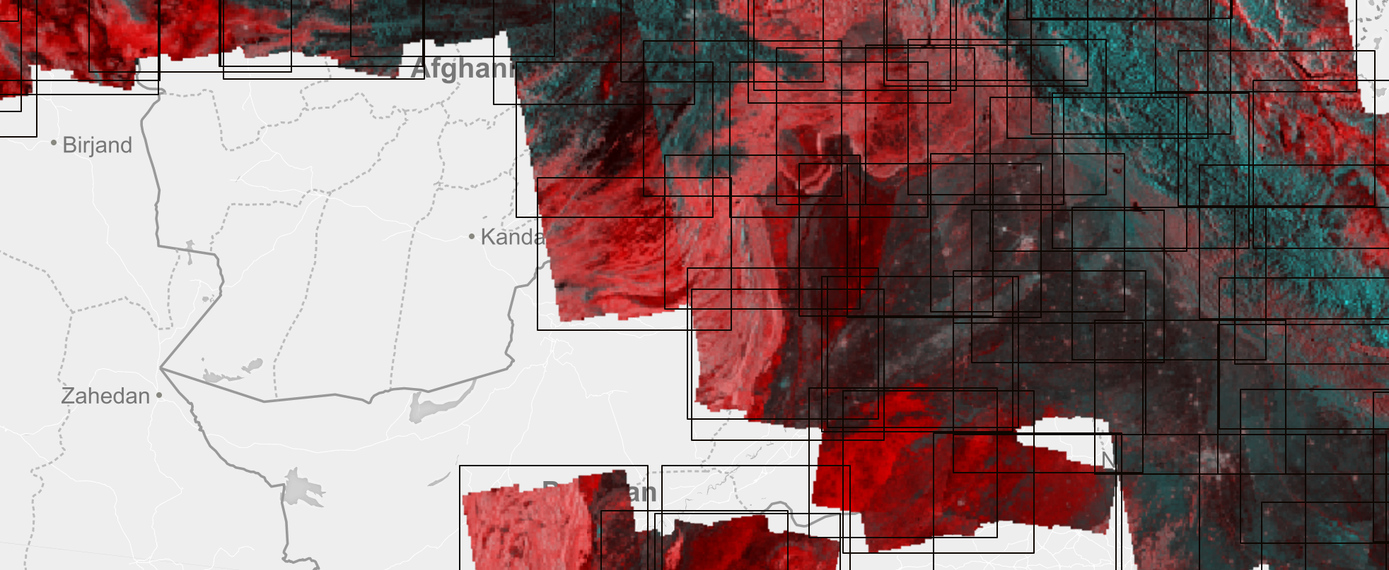
Example of the Himalayas:
Illustration of the systematic production of the DLR InSAR Browse chain using Sentinel-1 data on the GEP.

Slide 8
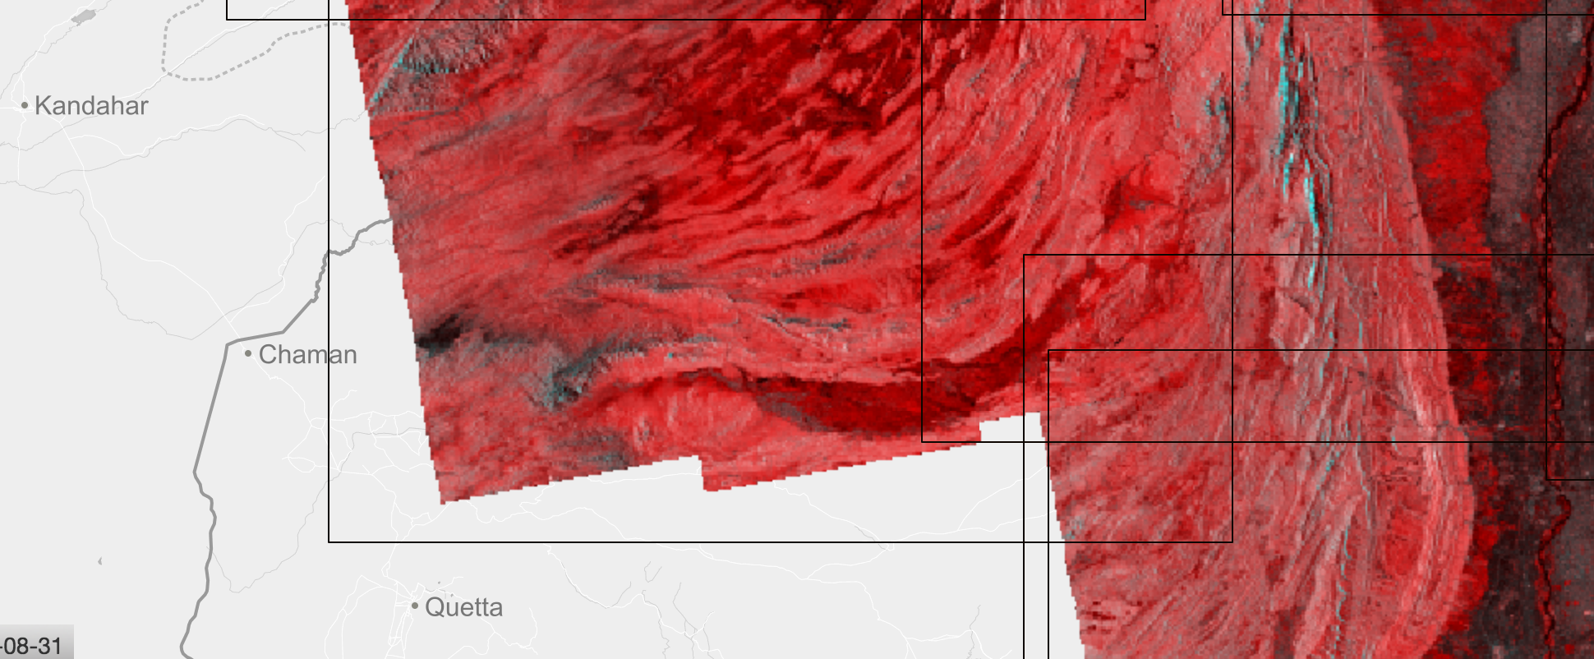
Example of the Himalayas:
Illustration of the systematic production of the DLR InSAR Browse chain using Sentinel-1 data on the GEP.

Slide 9
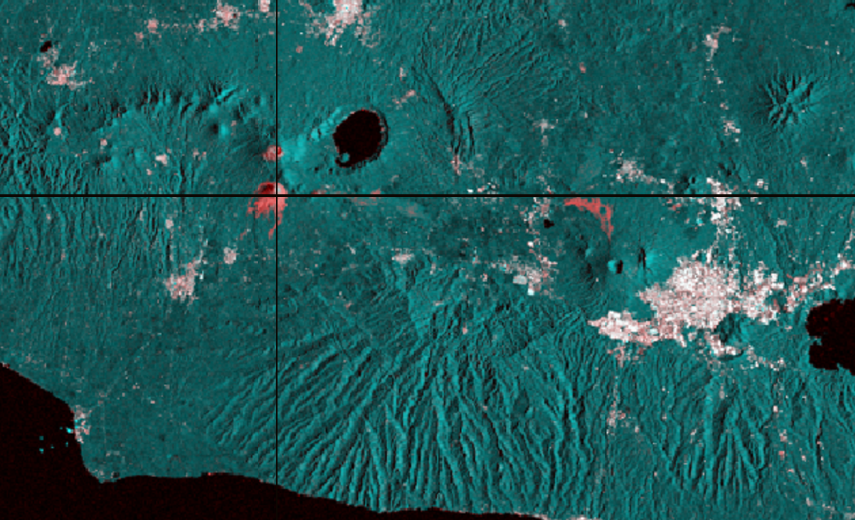
Example with a volcanic area:
Illustration of the systematic production of the DLR InSAR Browse chain using Sentinel-1 data on the GEP. Region: El Salvador.

Slide 10
A new activity with the seismic hazards community
A new activity is proposed with a view to start in 2017 with the goals to:
achieve awareness and acceptance of EO based solutions with expert users (in line with the CEOS pilots, follow-on activities, RO, GSNL and GEODARMA)
enable EO applications with massive volume and/or intensive processing, such as in the case of terrain motion monitoring based on InSAR or stereo-optical data,
increase access to expert users in regions where it is difficult to download large EO data products while the results of hosted processing generally are much smaller files (i.e. the democratisation of space technology),
ensure the persistency of results and allow to share and transform processing chains (geotagging results and publication, integration and evolution of processing chains)
reduce the cost of EO exploitation via the mutualization of resources (resources provisioning, processing chains)

Slide 11
Activities intended
1. Pursue & expand hosted processing following the Seismic pilot example:
provide data access to users: Supplying data is not the priority of the Geohazards Lab
coordinate the CEOS agencies mutual efforts in the realm of on-line processing for geohazards, enhancing complementarity and identifying possible cooperation between different parallel projects.
2. Unify access and exploitation of the assets provided by CEOS contributors:
make sure that users are aware of the assets available,
unify the method to access services,
support common authentication framework to allow users to exploit services, tools and data with a single identity
allow service integrators to develop algorithms and tools in a common shared environment,
establish shared governance rules
3. Liaise with existing CEOS WG Disasters activities and the DCT to:
make sure that the data delivery operations of CEOS activities is executed in a smooth fashion via the CEOS WG Disasters DCT
exploit complementarity with hosted processing.
Collaboration of platforms under the Geohazards Lab to improve how users exploit EO in an on-line environment; connected to Copernicus DIAS to access EO mission data.

Slide 12
Examples of users
User | Affiliation | Country | Expert user processing data | End user (not doing processing) | Engaged in precursor pilot?
Stefano Salvi | INGV | IT | Expert user |  | Directly
Christian Bignami | INGV | IT | Expert user |  | Directly
Cristiano Tolomei | INGV | IT | Expert user |  | Directly
Haris Kontoes | NOA | GR | Expert user |  | Directly
Tim Wright | University of Leeds/COMET | UK | Expert user |  | Directly
Barry Parsons | University of Oxford/COMET | UK | Expert user |  | Yes
Francesco Casu | CNR IREA | IT | Expert user |  | Yes
Eric Fielding | NASA JPL | USA | Expert user |  | Yes
Falk Amelung | University of Miami | USA | Expert user |  | Yes
Erwan Pathier | ISTERRE / University of Grenoble-Alpes | FR | Expert user |  | Yes
Marie-Pierre Doin | ISTERRE / University of Grenoble-Alpes | FR | Expert user |  | Yes
N/A | DPC | IT |  | End user | No
Issak Parcharidis | HUA | GR | Expert user |  | No
N/A | OASP | GR |  | End user | No
Pierre Briole | ENS (Laboratoire de Géologie de l’Ecole normale supérieure) | FR | Expert user |  | No
Paul Arellano | School of Geological Sciences and Engineering Hacienda San José s/n - Proyecto Yachay | ECU | Expert user |  | No
Abdelilah Tahayt | University of Rabat | MA | Expert user |  | No
Fabio Bovenga | CNR ISSIA, GAP srl / Polytechnic and University of Bari | IT | Expert user |  | No
Tom Ingleby | University of Leeds | UK | Expert user |  | No
Raphael Grandin | Institut de Physique du Globe de Paris (IPGP) | FR | Expert user |  | No
Dominique Rémy | Laboratoire de Dynamique Terrestre et Planétaire | FR | Expert user |  | No
Morteza Sedighi | National Cartographic Center, Tehran – Iran | IR | Expert user |  | No
Pablo Jose Gonzalez Mendez | University of Liverpool | UK | Expert user |  | No
Example of users from the Seismic hazards community already using the GEP and potentially interested on the Geohazards Lab, some of them being Seismic pilot users. The Geohazards Lab will support the CEOS, GSNL and GEODARMA users and is open to users from the wide geohazards community.

Slide 13
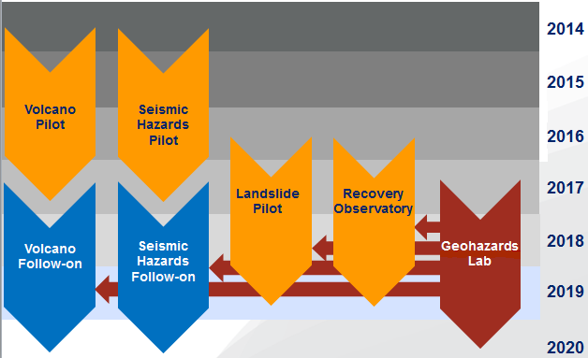
The idea of the Geohazards Lab
Support CEOS, GSNL and GEODARMA activities with data delivery & thematic exploitation, hosted processing (also available to other geohazards users):
Hosted processing

Slide 14
Concrete objectives concerning DRR activities
Not on an emergency basis
Processing for hazard and risk assessment across geohazards themes (tectonics, volcanoes, landslides):
support other CEOS Pilots, follow-on activities and the Recovery Observatory
common processing tools used and systematic monitoring chains
support GSNL (earthquake & volcano supersites)
support GEODARMA
On an emergency basis
Support the generation of advanced tectonic products for earthquake response
Support other EO based advanced processing products e.g. for landslide monitoring, thermal signatures of volcanic eruptions, etc.

Slide 15
The Geohazards Lab and users
The CEOS WGD Pilots and Recovery Observatory perform EO exploitation activities with these users:
academia/universities
geoscience centres & volcano observatories, in some cases EO experts
The Geohazards Lab has the goal to complement them with an additional processing environment. As a baseline the Geohazards Lab intends to support users of WGD Pilots and Recovery Observatory, on a best effort basis provided resources are available. The Lab is also able to support other DRM users not in CEOS
Notes:
The Geohazards Lab is aiming to provide advanced science products to different types of users:
- geoscience centres doing research or mandated to provide technical advice to national DRM authorities. Geoscience centers such as geological surveys, geophysics centres looking at tectonic hazards and volcano observatories are the first line users focused on the scientific use of data that aim to understand the physics of geohazards and better characterise, understand and model such risks. In many cases, they have an advisory role in decision making of DRM authorities. For volcanic activity, such users have been identified in Latin America by the Volcano pilot e.g. SERNAGEOMIN (Chile), Observatorio San Calixto (Bolivia), Instituto Geofísico del Perú (Peru), Instituto Geofísico de la Universidad Nacional de San Agustín (Peru); Instituto Geofísico, Escuela Politécnica Nacional, (Ecuador), Servicio Geológico Colombiano (Colombia), INETER (Nicaragua) and the Buenos Aires Volcanic Ash Advisory Center (Argentina).
- geoscience centres already contributing to the Geohazards Lab precursor activities: examples of geoscience centers already contributing to precursor seismic activities such as the GEP are INGV, CNR-IREA and CNR IRPI in Italy the ARIA center of NASA JPL and USGS in the USA, NOA in Greece, BGS and COMET/Univ. Leeds & Bristol in the UK, CNRS EOST, ENS, IPGP, ISTerre and BRGM in France. Respectively, geoscience centers already contributing to precursor volcanic activities are Univ. Bristol in the UK, Cornell Univ., Univ. Miami, NOAA and the Pensylvania State Univ. in the USA and CNR-IREA in Italy.
- national DRM authorities can be considered as second-line users. Examples include the Dipartimento della Protezione Civile (DPC) in Italy who work with Italian specialists to exploit EO based information for decision making. In Italy the precursor activity looking at advanced tectonic products to support DPC is the national SIGRIS project of ASI. As a baseline the Geohazards Lab articulates with national disaster response activities such as SIGRIS and with international EO disaster response capabilities such as the International Charter, Copernicus EMS, Sentinel Asia, etc. in order to make sure users are aware and use them. The Geohazards Lab will fully take into account the role of national and international initiatives with an operational mission. The main contribution of the Geohazards Lab will be to help develop or reinforce the ability of geoscience centres to support national DRM authorities.
- other users that may benefit from the Geohazards Lab include national user organisations in the context of international development; beyond DRM authorities a range of national users have information needs related to natural hazard risk management such as for instance authorities in charge of basin for water resources management (reservoir monitoring against erosion and landslides, etc.), of transportation, energy and extractives, etc.
- in addition users from industry may benefit from the capability (e.g. civil engineering, insurance, etc.) although the Geohazards Lab is more focus on science than end to end solutions such as provided by Value Adding service providers.

Slide 16
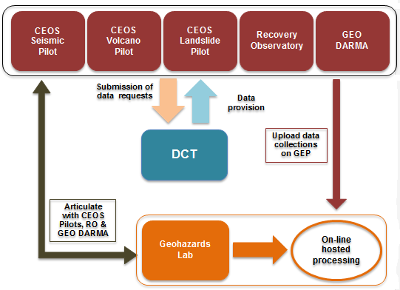
Collaborations
GEODARMA:
provide access to data, tools and processing resources (on a best effort basis) to GEODARMA.
GSNL: support the GSNL objectives by providing access to a processing environment.
Other CEOS WG Disasters activities:
fully articulate with current and follow-on CEOS activities
provide a mechanism to access data and a scientific processing and e-collaboration environment.
CEOS WGISS activities: collaborate to support the realisation of a WGISS pilot; identified contribution: the GEP. A workplan has been written to prepare the pilot exercise.
nextGEOSS: on-going discsussions to include the Geohazards Lab and its services within the GEOSS Common Infrastructure.

Slide 17
Contributions from space agencies
… so far 4 space agencies …
- ESA: access to the Geohazards Exploitation Platform including: data storage, processing software (InSAR and stereo-optical processing chains), e-collaboration environment; man-power (staff & support under consultancy contract): scientific animation and promotion of information and results; support to coordination/governance.
- DLR: on a voluntary basis provide:
higher level science products derived from Sentinel-1 and TerraSAR-X data
access to the automated Sentinel-1 interferometric chain.

Slide 18
Contributions from space agencies
… so far 4 space agencies …
ASI: shall make available CEOS and GSNL Cosmo-SkyMed collections through the GEP (already done for the Nepal event supersite). Further details TBD.
CNES intends to provide:
Processing services developed by the French Solid Earth community within the forM@Ter data centre including systematic InSAR processing, DEM processing and optical image correlation.
Potential contribution to a pool of specific human resources dedicated to the Geohazards Lab initiative
Contribution from other CEOS agencies :TBD

Slide 19
User organisations that expressed interest
Geoscience centers with EO expertise that have already provided their contribution
CNRS-EOST /France
IPGP /France
COMET /UK
ISTerre/Institut de Recherche pour le Développement (IRD) /France
CEO-YachayTech / Ecuador
Geoscience centers with EO expertise that might contribute (TBC)
NASA JPL /USA
INGV /Italy
CNR-IREA /Italy
HUA /Greece
University of Miami /USA

Slide 20
Next steps
Identify contributors and users.
Continue identifying resources for oversight/coordination incl. :
manage links with other WG Disasters activities
make available the EO processing chains (more than 10+ available in the precursor GEP)
organise governance of resources to support hosted processing
define a protocol with CEOS agencies that contribute to the Geohazards Lab. As a baseline ESA will provide access to the GEP. This protocol is to develop collaboration with agencies willing to contribute to the processing environment (e.g. platform resources federation)
liaise with expert users about data exploitation
This approach will be presented by the CEOS chair in the CEOS meetings in Q2-Q3 2017.

Slide 21
Thank you
For further information: Geohazards Lab initiative proposal:
http://esamultimedia.esa.int/docs/EarthObservation/Geohazards/2017-03-13_The_Geohazards_Lab_initiative_Draft_2.0.pdf
Philippe Bally, ESA Philippe.Bally@esa.int ‎
Theodora Papadopoulou, ARGANS c/o ESA Tpapadopoulou@argans.co.uk

