Slide 1
Status Report on Volcano Pilot Project
Mike Poland (USGS)
Simona Zoffoli (ASI)
WG Disasters #7
Rome, Italy
14–16 March 2017

Slide 2
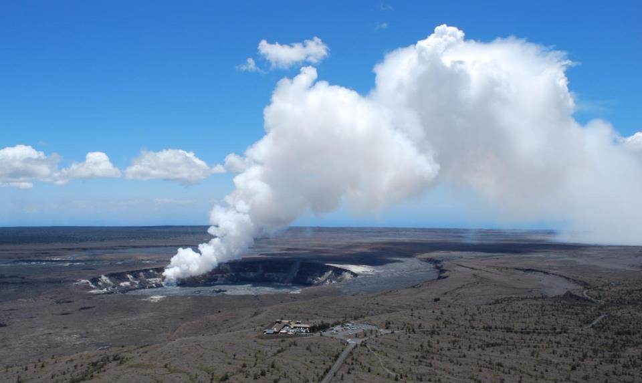
Overview
Pilot Background
Supersites and large event
Results for Latin America
Evaluation and sustainability

Slide 3
Pilot Team
Juliet Biggs, David Arnold (University of Bristol)
Susi Ebmeier (University of Leeds)
Matt Pritchard, Francisco Delgado (Cornell University)
Christelle Wauthier (Penn State University)
Falk Amelung (University of Miami)
Fabrizio Ferrucci (Open University)
Mike Pavolonis (NOAA)
Rick Wessels (USGS)
Eugenio Sansosti (IREA-CNR)
Elske de Zeeuw - van Dalfsen (KNMI)

Slide 4
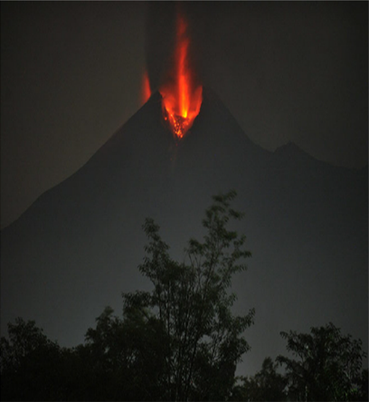
WHY?
Volcano Pilot
Over 300,000 people have been killed by volcanoes since the 1600s.
Hundreds of millions live within 20 km of an active volcano today.
In 2010, the Eyjafjallajökull eruption brought losses of $200m/day, and 100,000 cancelled flights.
Merapi, Indonesia, erupting in 2010. From Pallister and others, 2013

Slide 5
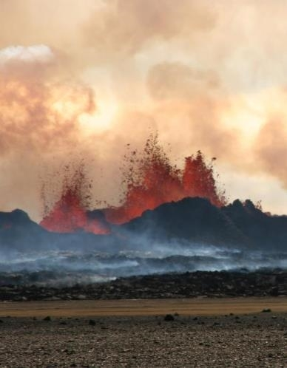
WHAT IS MISSING?
Volcano Pilot
Large monitoring gaps exist at many hazardous volcanoes around the world
Current EO data collection is not usually coordinated for volcano monitoring
Need systematic observations before, during, and after volcanic events
Bardarbunga, Iceland, erupting in 2014.
Photo credit: M Parks

Slide 6
Pilot objectives
Objective A – Regional Demonstration
Demonstrate the feasibility of global volcano monitoring of Holocene volcanoes by undertaking regional monitoring of volcanic arcs in Latin America, using satellite EO data to track deformation as well as gas, ash, and thermal emissions.
Objective B – GSNL
Multi-disciplinary, multi-platform monitoring of a few volcanoes that represent a diverse cross section of eruptive activity and unrest.
Objective C – Significant Global Event
Specific study of a major eruption with significant regional or global impact, providing data for a comprehensive analysis of all aspects of the eruption cycle, including local, regional, and global impacts.

Slide 7
Objective B: Supersites
Work continues on approved volcano Supersites:
  Hawai‘i
  Iceland
  Italy
  Ecuador
  New Zealand
Critical for hazards assessment and mitigation efforts and highly valued by local agencies
Volcano supersites provide opportunities for scientific innovation due to the availability of high spatial and temporal resolution datasets

Slide 8
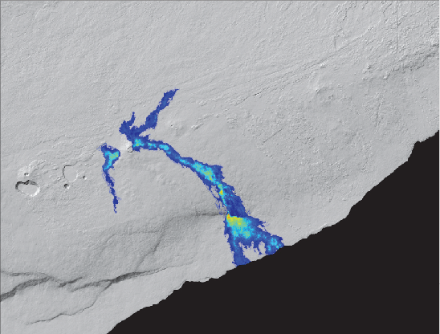
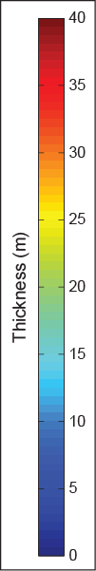
Objective B: Hawaiʻi
TanDEM-X-derived lava flow thickness 2011-2013

Slide 9
Objective B: Hawaiʻi
0.3
0.3
0.2
Magma Supply Rate (km³/yr)
0.1
?
?
?
0.0
2000
2005
2010
2015

Slide 10
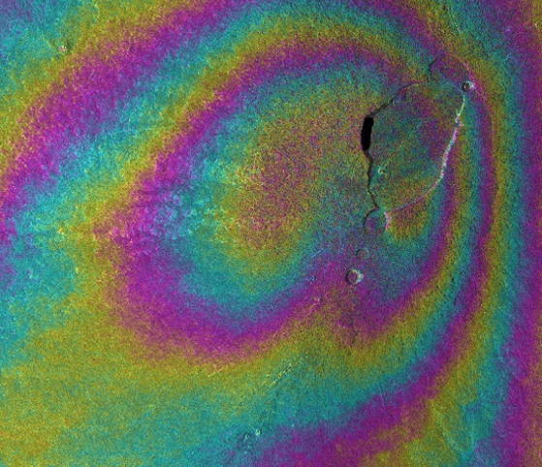
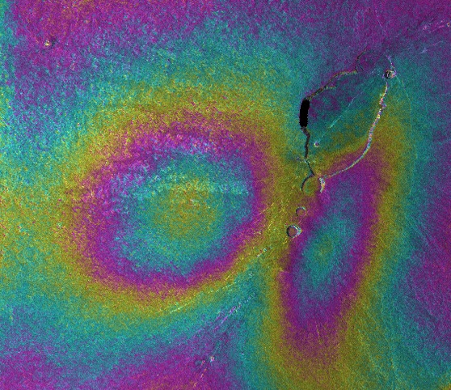

Objective B: Hawaiʻi
March-August 2015
August-December 2015
Inflation of Mauna Loa volcano, Hawaiʻi
Cosmo-SkyMed
Inflation source changed location in mid-2015…

Slide 11
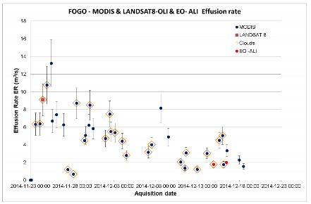
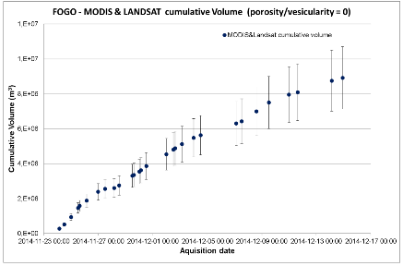
Objective C: Fogo demonstrator
Proposal has been submitted to ensure rapid access to data if a large volcanic event occurs
Fogo eruption serves as a demonstration
courtesy Fabrizzio Ferucci, Open University

Slide 12
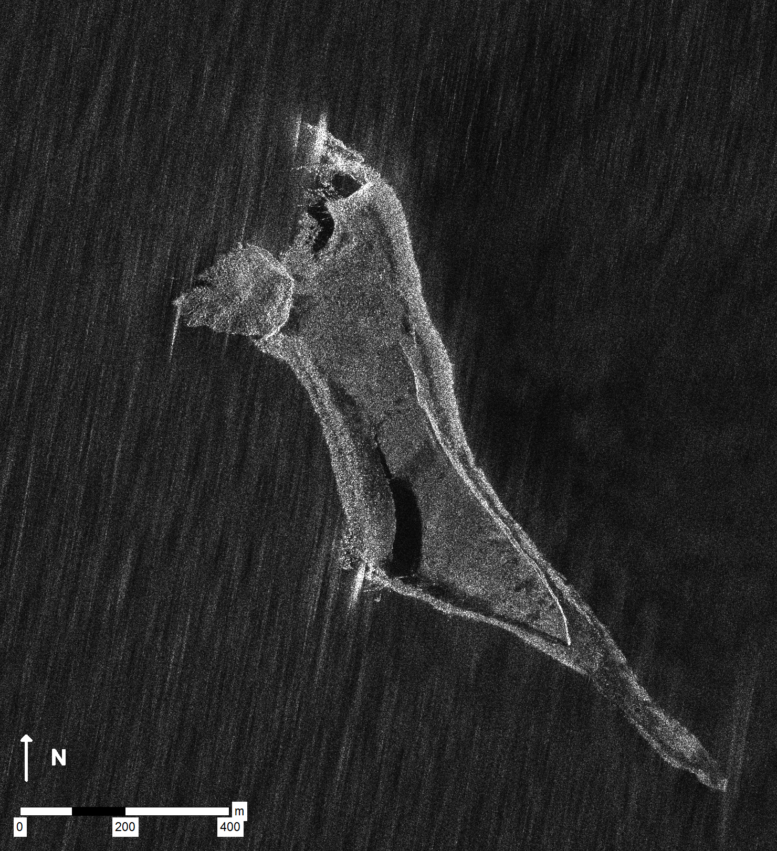
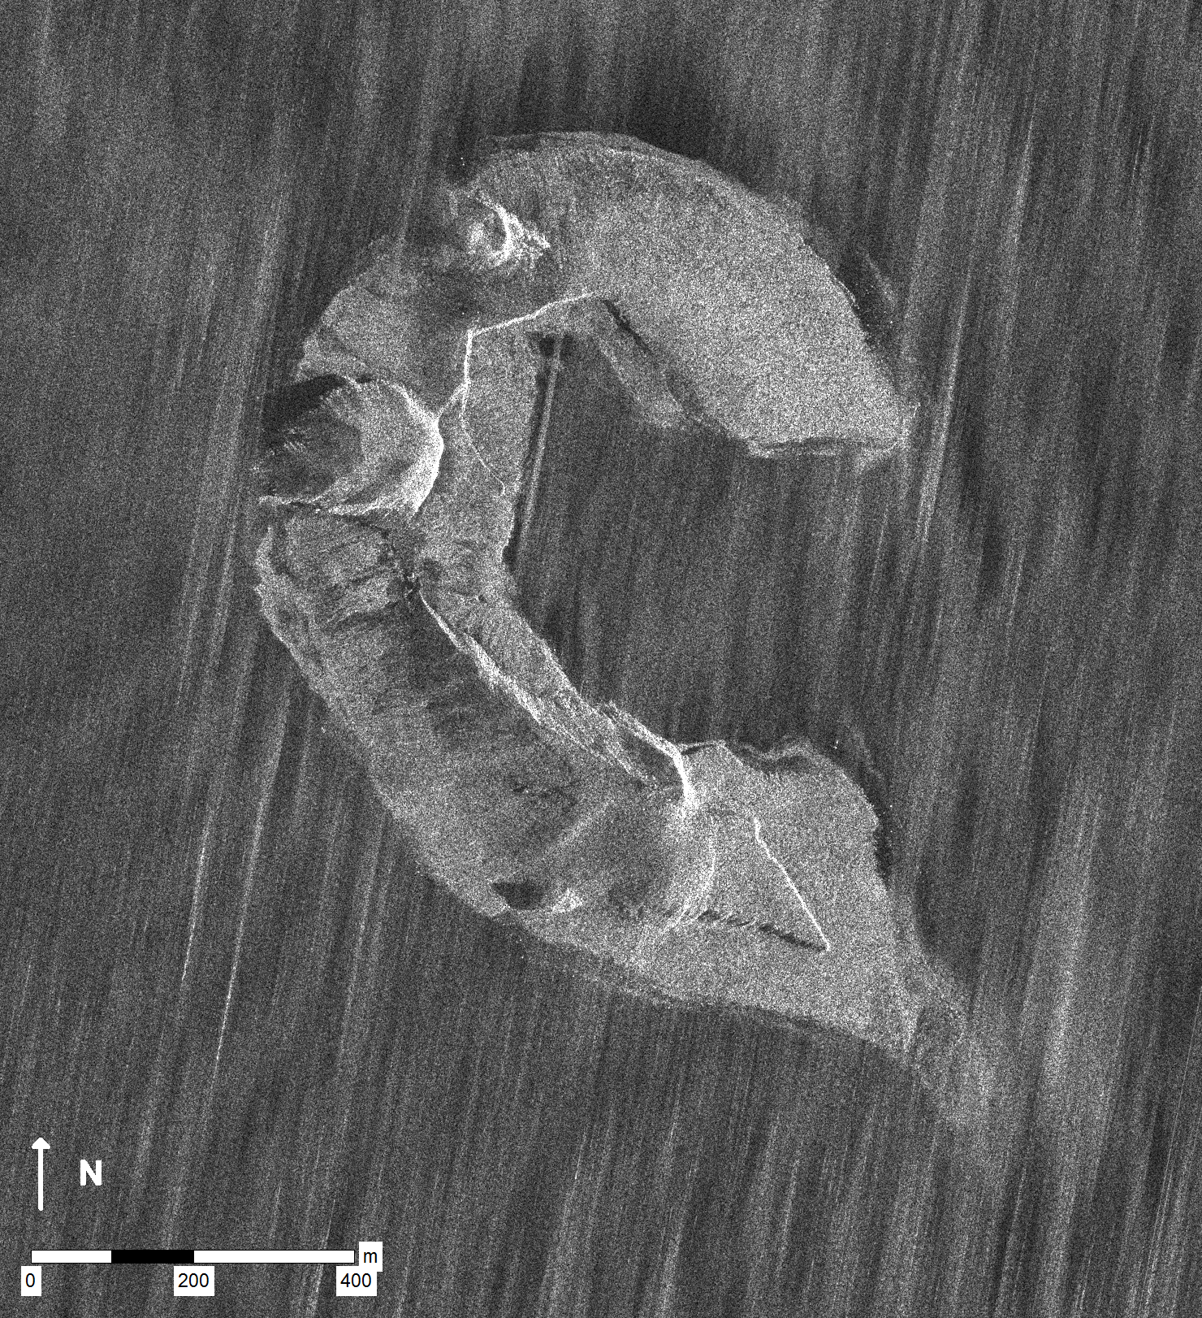
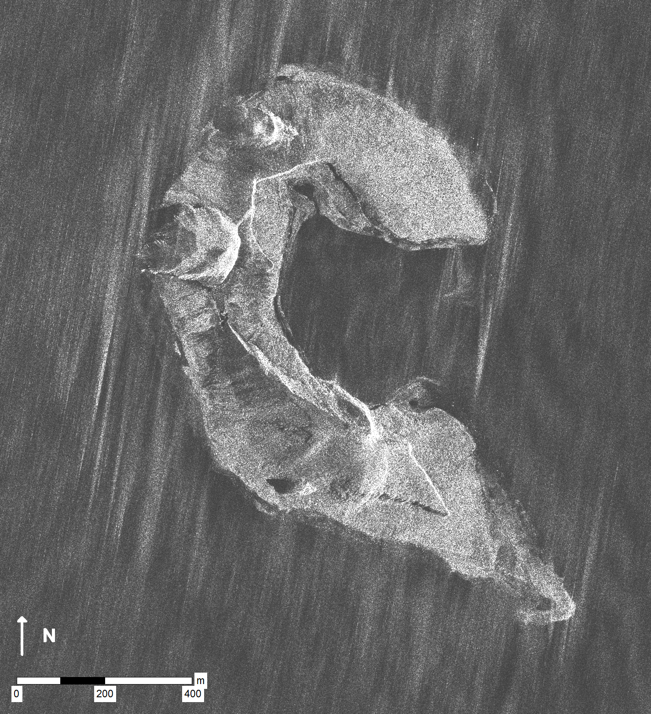
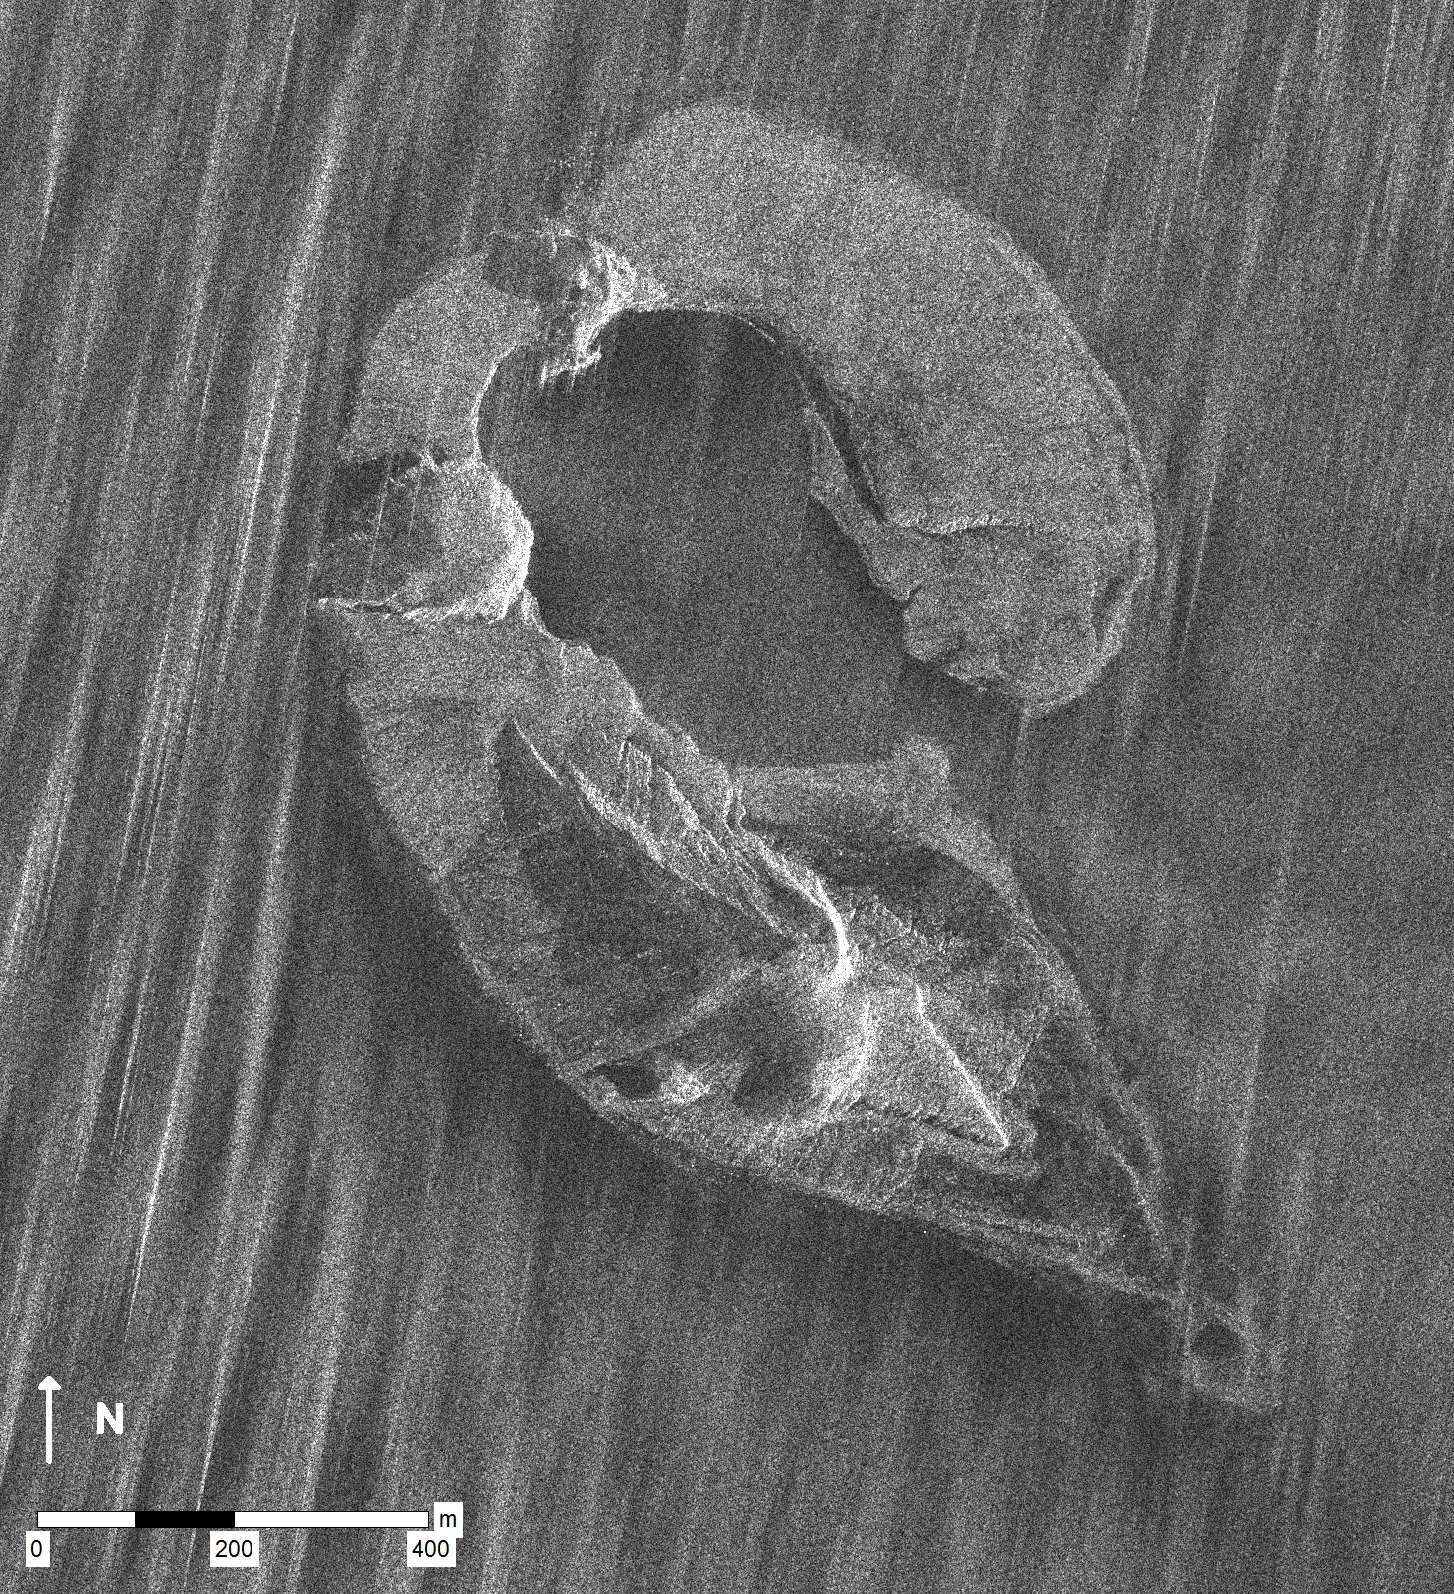
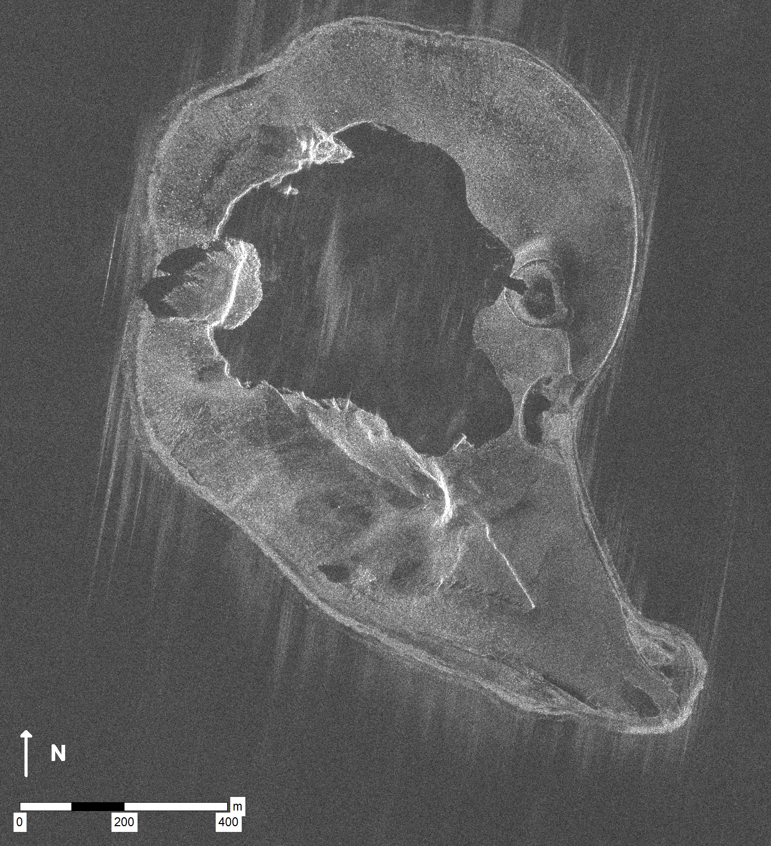
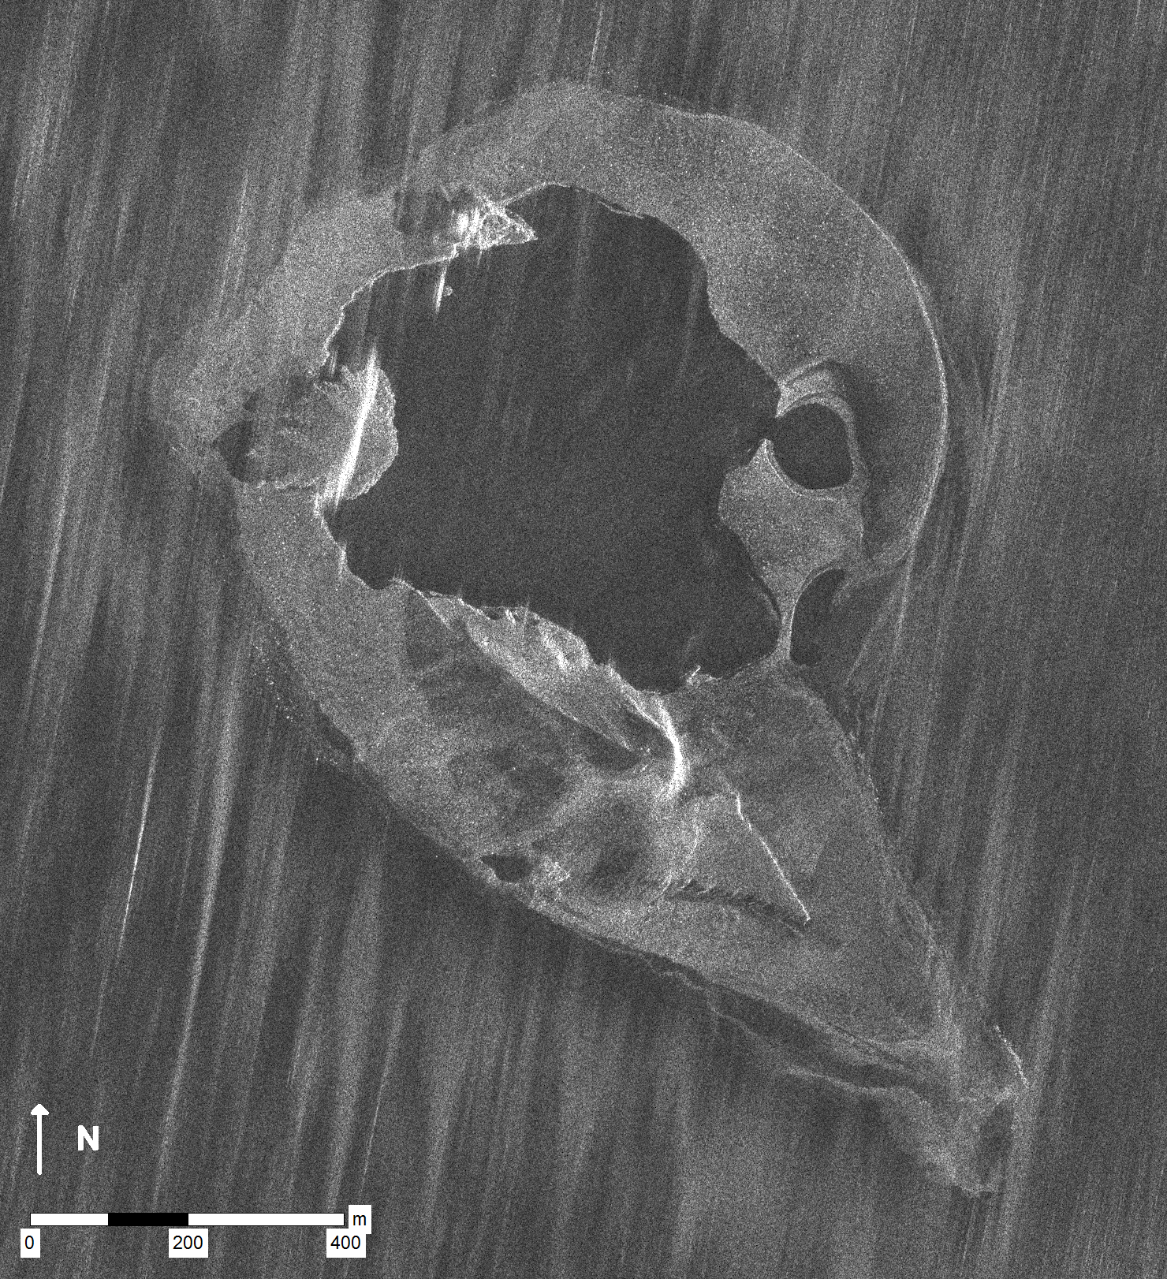
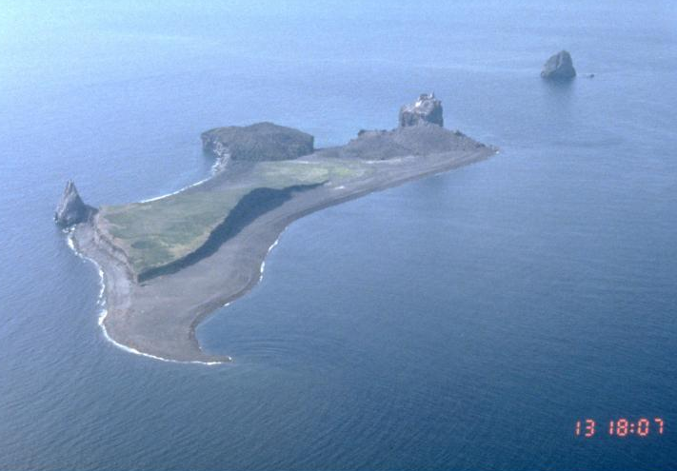
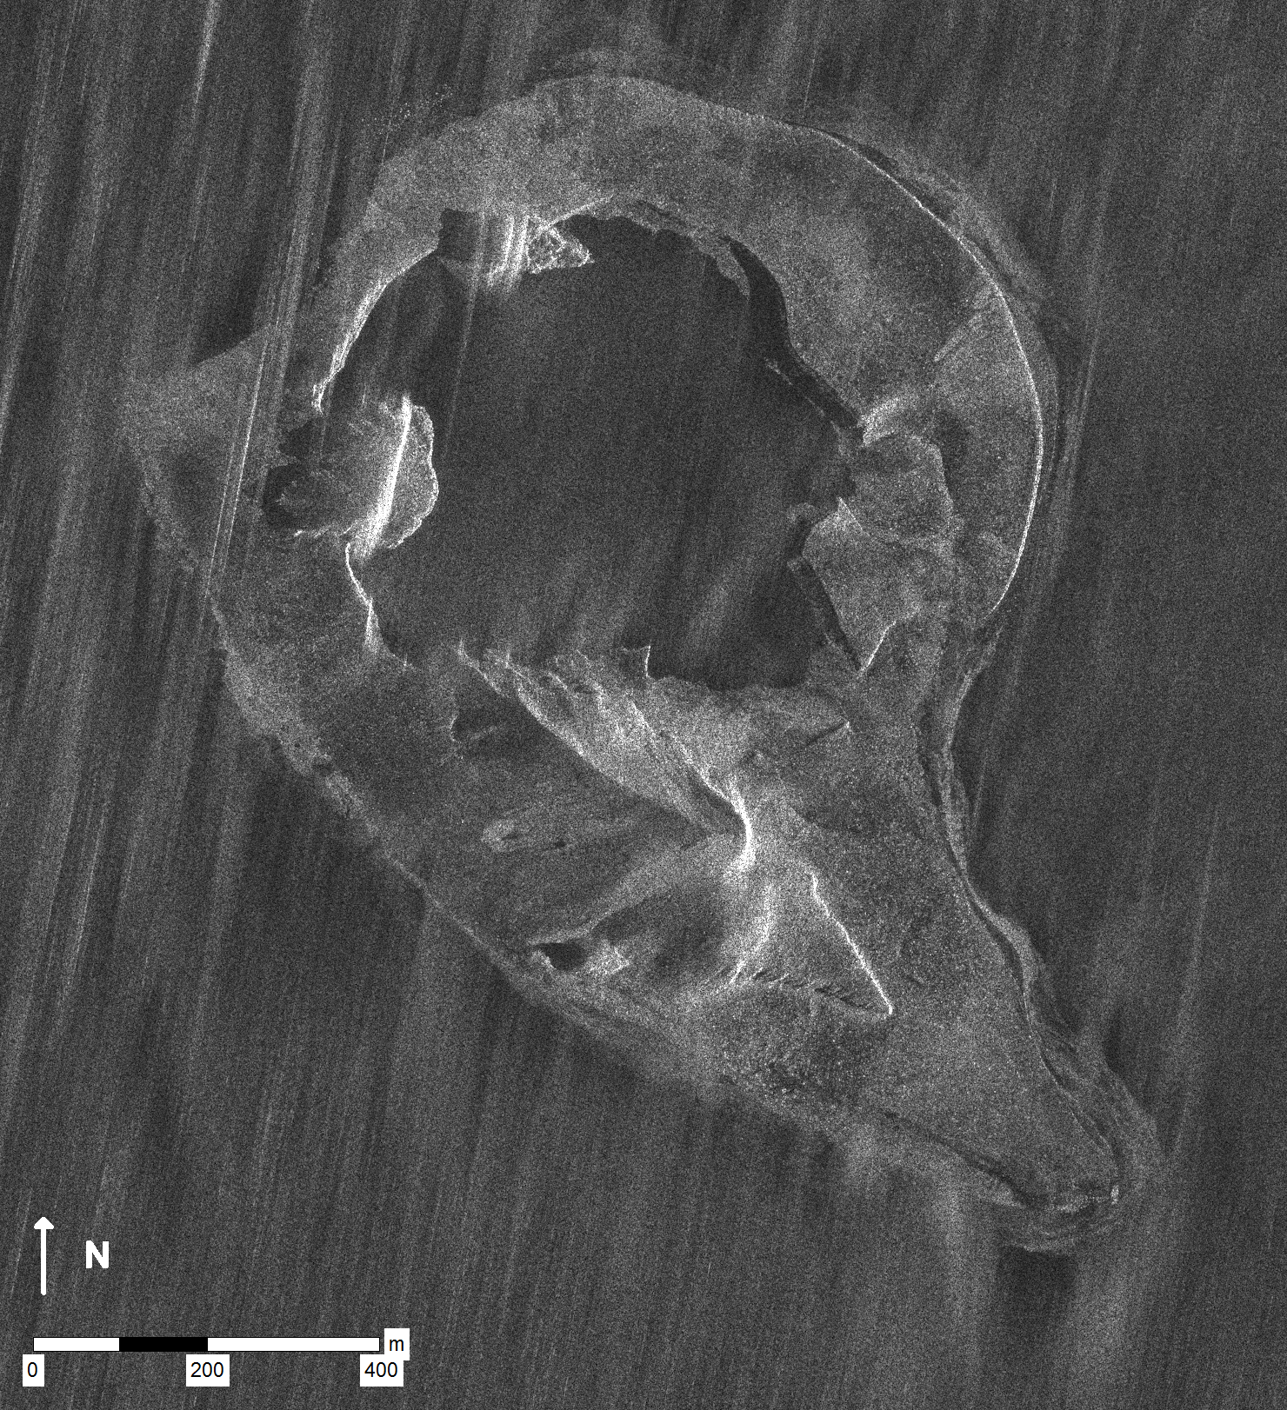
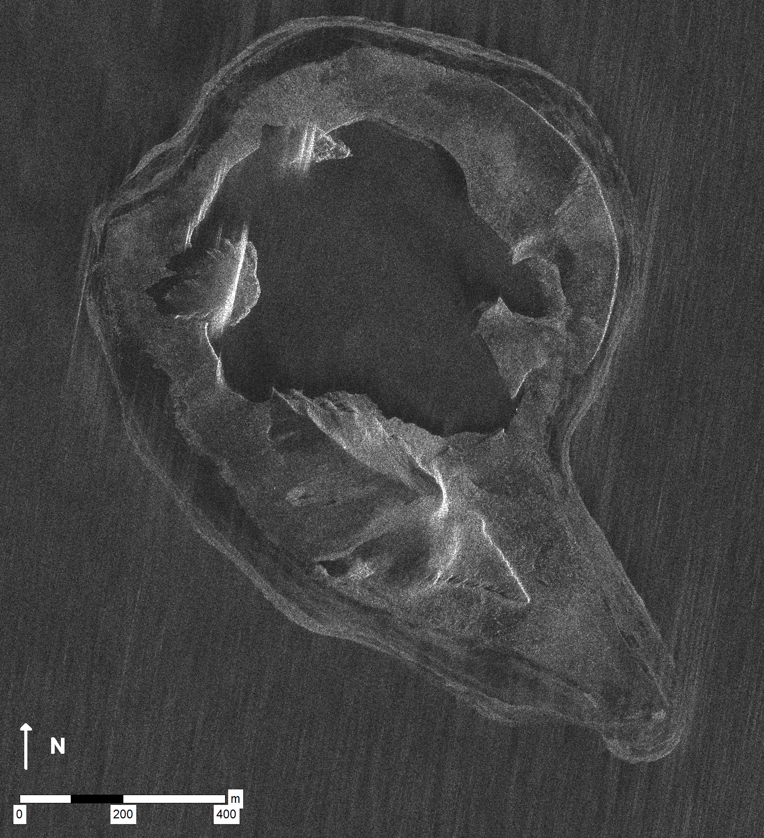
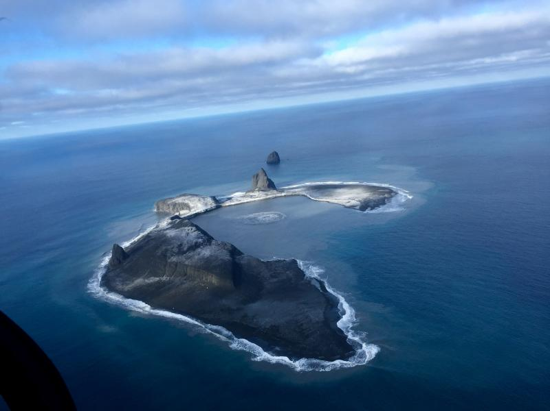
Objective C: Bogoslof demonstrator
June 13, 1998
January 10, 2017
20081021
20170123
20170124
20170127
20170208
20170216
20170224
20170224
20170304

Slide 13
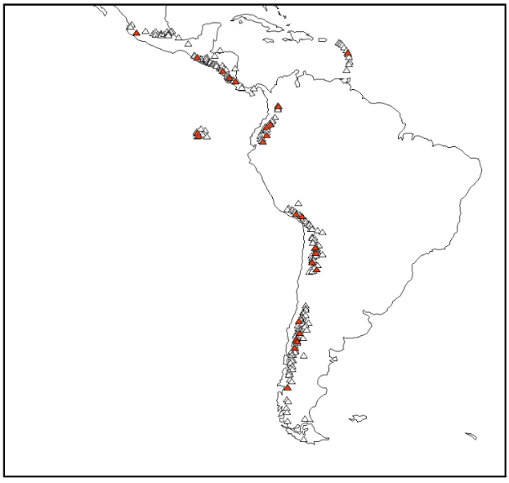
Objective A: Regional demonstration
Demonstrate how EO data can be used to cost-effectively monitor all 315 volcanoes that erupted in the last 10,000 years in the region
Identify volcanoes that may became active in the near future
Track new and ongoing eruptive activity
Why Latin America?
Diversity of environments
Abundant volcanic activity
Benefits to local users
64% of volcanoes in the region have no ground monitoring of any type
Notes:
Triangles are all volcanoes in Latin America. Red triangles are target volcanoes from the CEOS pilot plan. Black boxes and text show regions for planned quarterly monitoring with C-Band (Sentinel-1) and L-Band (ALOS 2) InSAR. Grey text shows the local end users (monitoring agency).

Slide 14
Objective A Efforts by Partner
Topic/region | Value Added Partner
Northern Andes and Lesser Antilles SAR | University of Bristol, KNMI
Southern and Austral Andes SAR | Cornell University
Galápagos SAR | IREA/CNR
Mexico SAR | University of Miami
Central America SAR | Pennsylvania State University
Detection of ash plumes and thermal anomalies | NOAA
Development and testing of EO-based methodology for improved monitoring of surface deformation | All
Capacity-building and training activities in countries that do not currently have access to abundant EO data and/or the ability to process and interpret such data | All
Collect feedback from users | All

Slide 15
SAR Data Usage
Mission | Allocated | Notes
RADARSAT-2 | 270 | Quota exhausted. Coherence in HH seems to be better that that of VV with Sentinel.
COSMO-SkyMed | 900 | Baselines are sometimes poor, but large datasets thanks to background mission is very helpful.
TSX | 400 | Lack of a background mission means acquisitions are few, but interferometric pairs are always easy to find.
ALOS-2 | 200 | Quota nearly exhausted. Primary value is improved coherence due to L-band frequency.
TDX (CoSSC exp.) | 150 | Exceptional value thanks to ability to map topography at any time of day or in any kind of weather.
Sentinel-1a/b | N/A | Reliable acquisitions, but spatial resolution limits ability to see small-scale patterns.

Slide 16
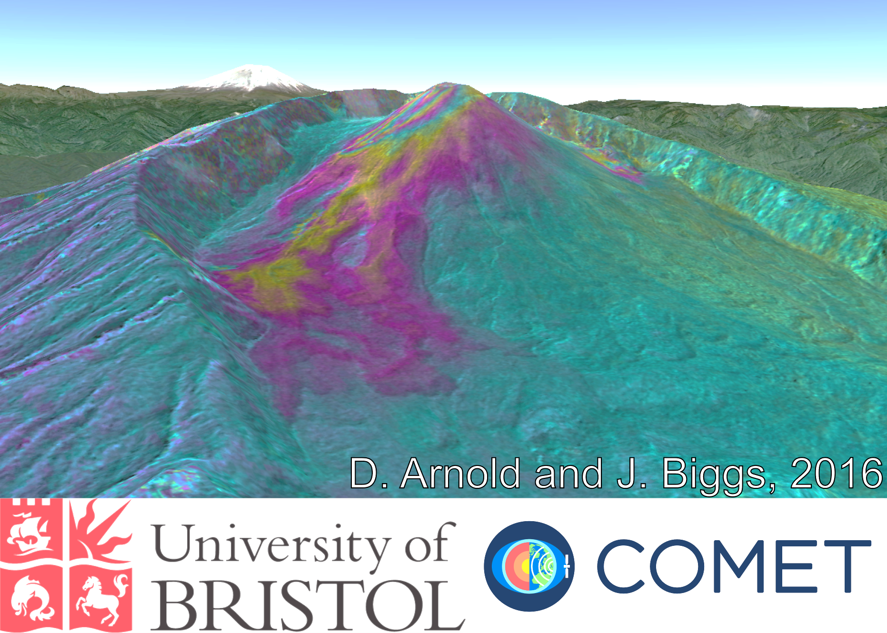
Noteworthy results
Pacaya (Guatemala)
  Santiaguito (Guatemala)
    Masaya (Nicaragua)
      Arenal (Costa Rica)
        Soufrière Hills Volcano (Montserrat)
          Chiles – Cerro Negro (Colombia / Ecuador)
            Reventador (Ecuador)
            Cotopaxi (Ecuador)
          Wolf (Galápagos)
        Fernandina (Galápagos)
      Sabancaya (Perú)
    Cordón Caulle (Chile)
  Calbuco (Chile)
Villarica (Chile)

Slide 17
Detection of volcanic plumes
The Buenos Aires VAAC receives volcanic thermal anomaly and ash cloud alerts from the NOAA VOLcanic Cloud Analysis Toolkit (VOLCAT).

Slide 18
Detection of volcanic plumes
The Washington VAAC issues advisories for many volcanoes in Latin America, and it receives volcanic thermal anomaly and ash cloud alerts from VOLCAT.

Slide 19
Thermal, ash, and gas emissions
MSG-3 0° 20170203 06:15 UTC
RGB: MIR-TIR(11μm)-TIR(12μm)
MSG-1 41.5° 20170203 06:15 UTC
RGB: MIR-TIR(11μm)-TIR(12μm)
Piton de la Fournaise
Thermal anomalies are excellent for tracking eruptions due to the high revisit frequency of geostationary weather satellites. Effectiveness of SO₂ measurements is challenged by infrequent revisits due to a lack of geostationary sensors capable of detecting gas emissions.

Slide 20
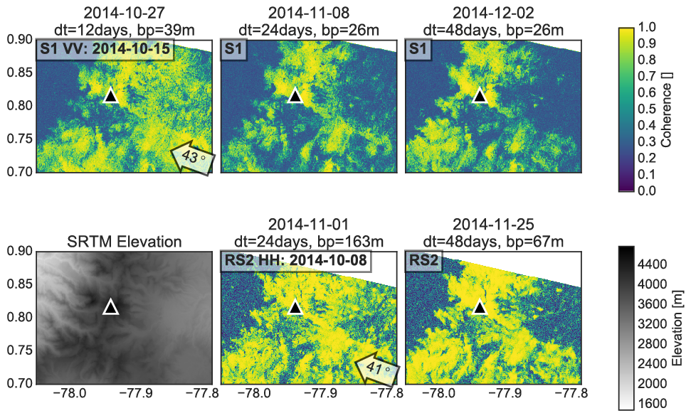
Coherence: RSAT vs. Sentinel
Chiles – Cerro Negro (Colombia / Ecuador border)

Slide 21
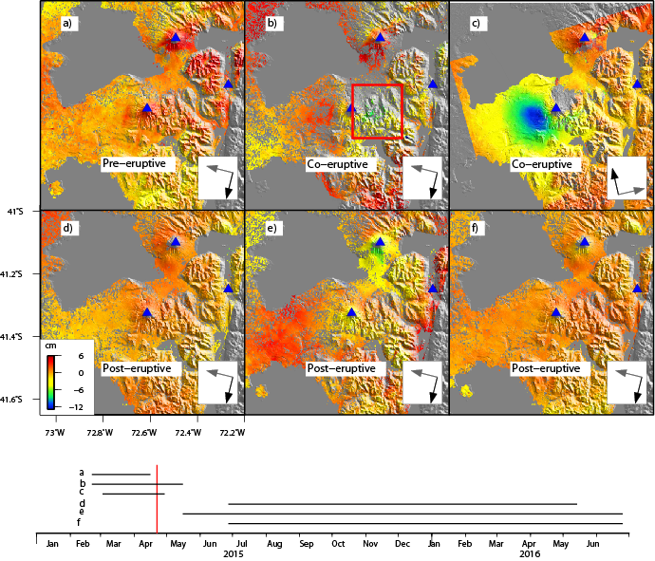
Calbuco, Chile
ALOS-2 interferograms are very coherent, excellent for assessing deformation associated with 2015 Calbuco eruption

Slide 22
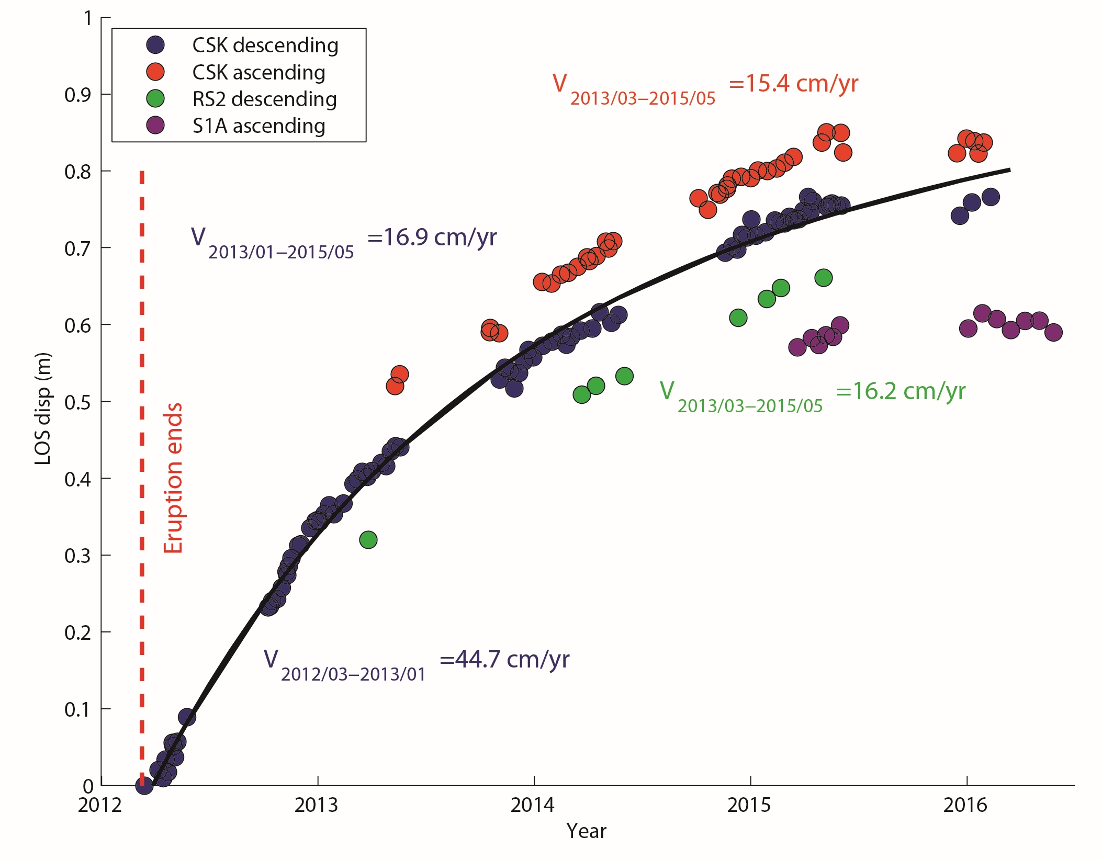
Cordón Caulle, Chile
Inflation of Cordón Caulle, Chile, has been a significant result of the pilot. This deformation would not otherwise be known without pilot data.
The inflation seemed to have stopped in mid-2015.

Slide 23
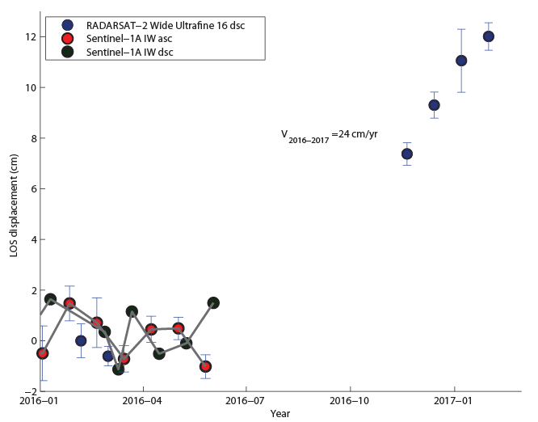
Cordón Caulle, Chile
New results indicate that inflation at Cordón Caulle resumed in mid-2016!
In response to these observtions, OVDAS is installing a continuous GNSS station to establish ground-based monitoring of the volcano.

Slide 24
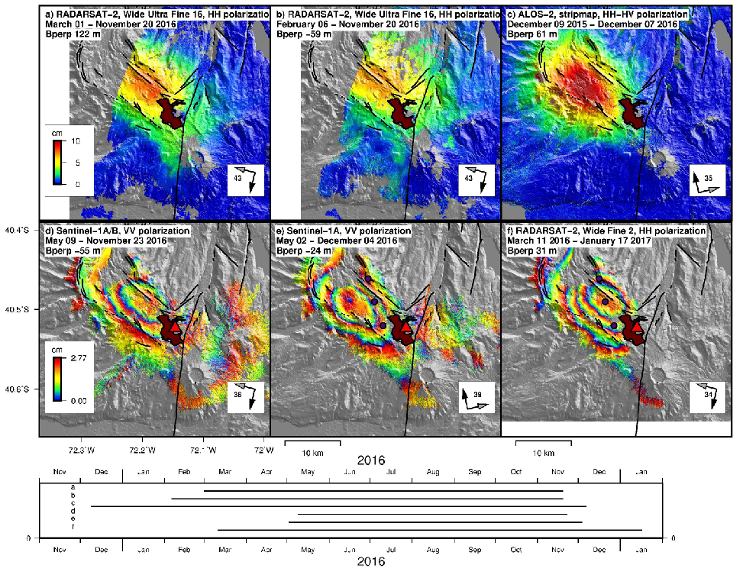
Cordón Caulle, Chile
L-band coherence makes a difference at Cordón Caulle.

Slide 25
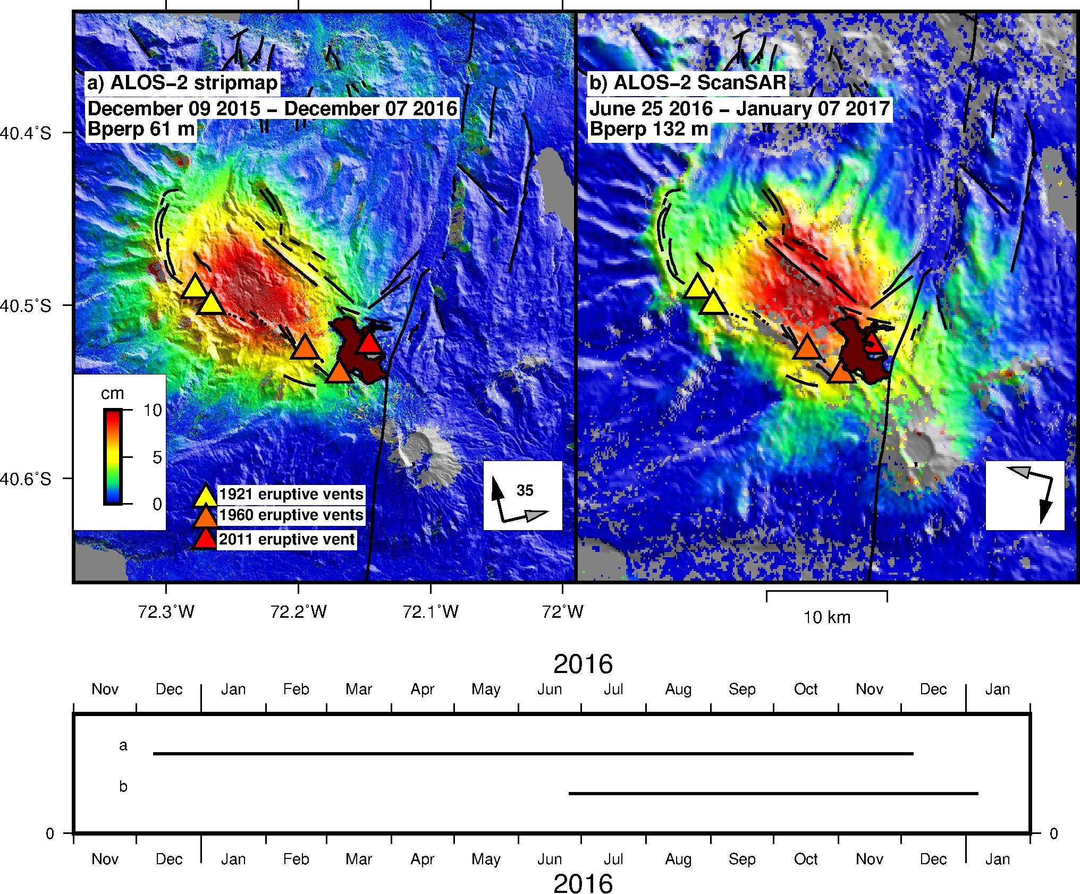
Cordón Caulle, Chile
ALOS-2 wide-swath vs. stripmap
Exceptional coherence!

Slide 26
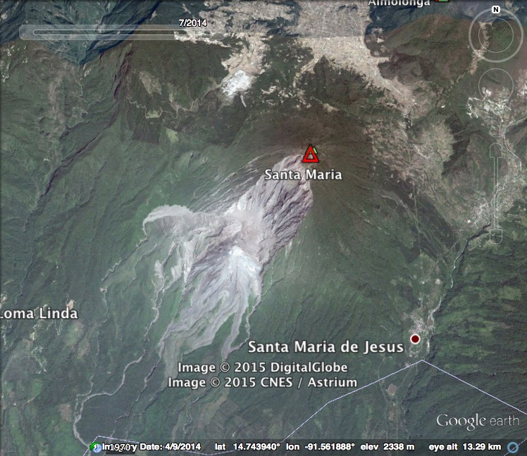
Santiaguito, Guatemala
X and C-band InSAR: correlation limited to the lava flow and upper flanks

Slide 27
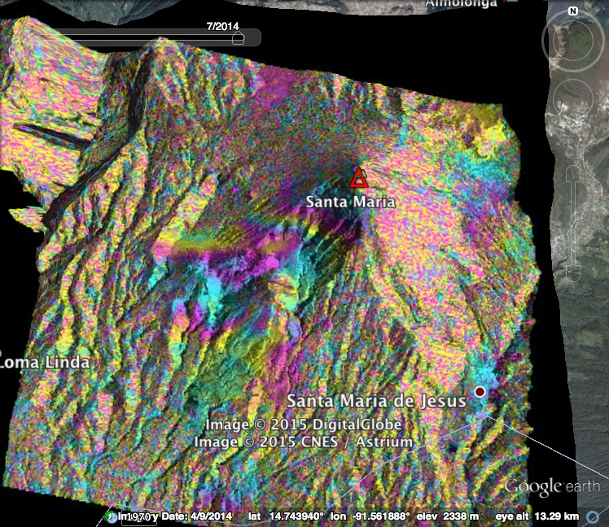
Santiaguito, Guatemala
151103_151114
TerraSAR-X, descending
X and C-band InSAR: correlation limited to the lava flow and upper flanks
range change (cm)
0
1.5

Slide 28
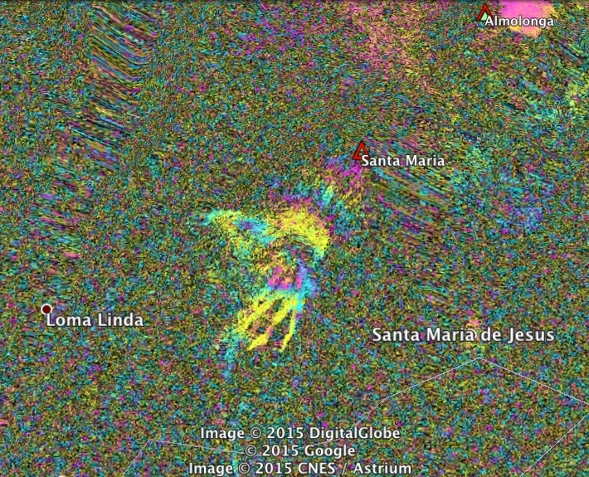
Santiaguito, Guatemala
150206_150326
RADARSAT-2, descending
Same signals visible on RADARSAT-2 interferogram!
Deformation? Ash plume?
range change (cm)
0
3

Slide 29
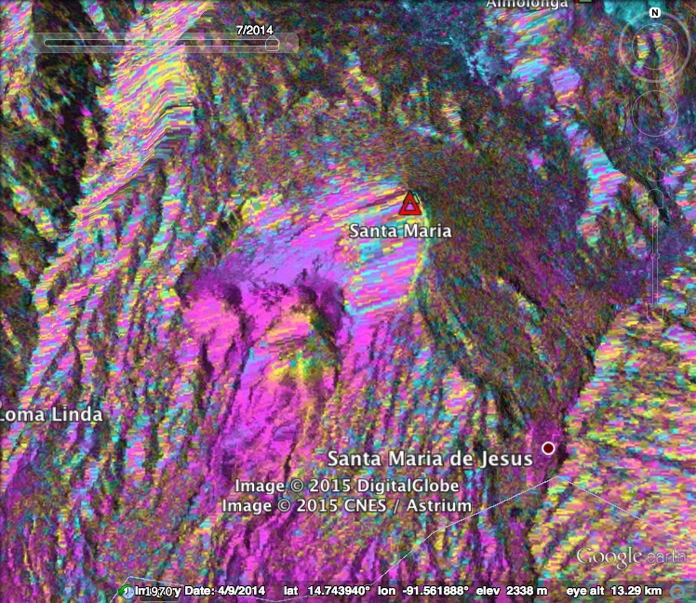
Santiaguito, Guatemala
150205_150917 ALOS-2, ascending
L-band InSAR: signal correlation more extended!
LOS subsidence of Caliente’s southern flank?

Slide 30
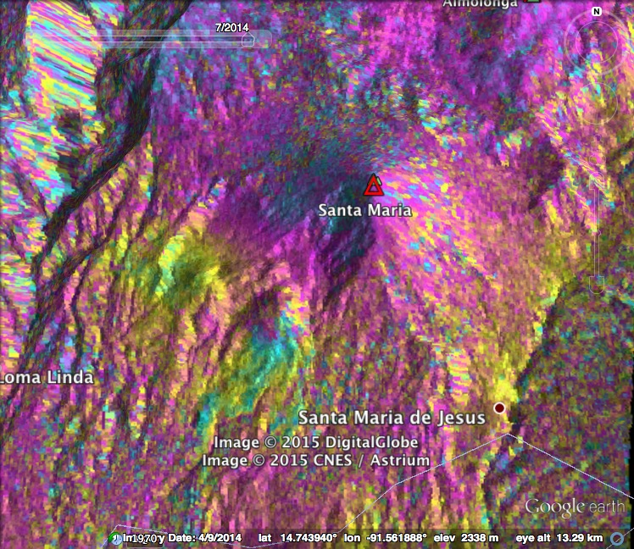
Santiaguito, Guatemala
150722_151014
ALOS-2, descending
L-band InSAR: signal correlation more extended!
LOS subsidence of Caliente’s southern flank + other subsiding areas?

Slide 31

Fuego and Pacaya, Guatemala
160622_161012
ALOS-2, descending
Good coherence with ALOS-2 on both Pacaya and Fuego, Guatemala.
Sentinel-1 interferograms are not coherent at either volcano
Fuego
Pacaya

Slide 32
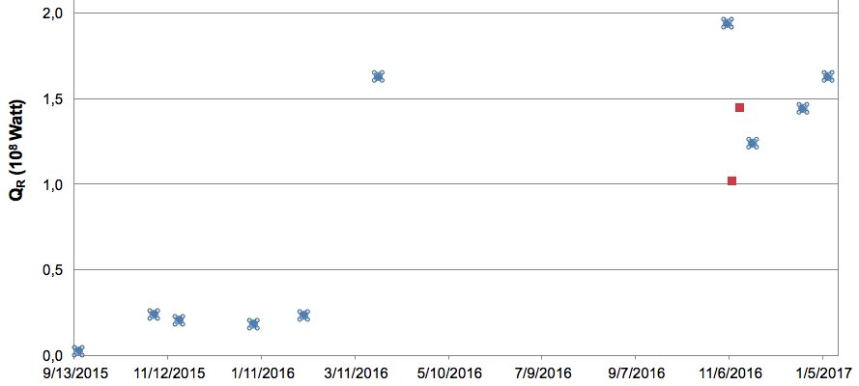
Masaya, Nicaragua
September 16, 2015
November 3, 2015
November 19, 2015
January 6, 2016
February 7, 2016
March 26, 2016
Masaya lava lake
September 2015 - January 2017
November 5, 2016
November 8, 2016
November 13, 2016
November 21, 2016
December 23, 2016
January 8, 2017

Slide 33
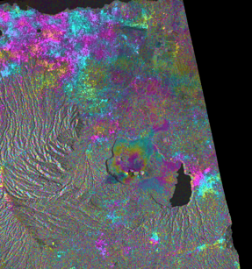
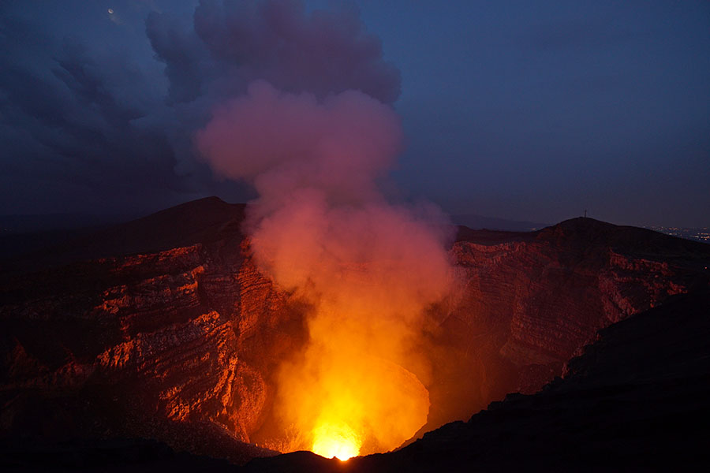
Masaya, Nicaragua
CSK
2015-11-18 to 2015-12-16
Inflation of the crater area of Masaya coincident with an increase in levels of activity and rise in lava lake height in late 2015.
range change (cm)
0
1.5

Slide 34
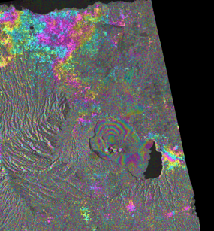
Masaya, Nicaragua
CSK
2015-10-17 to 2016-03-09
Deformation does not appear after April 2016
CSK time series analysis is in progress
range change (cm)
0
1.5

Slide 35
Masaya, Nicaragua
2015-12-17 to 2016-01-20 Sentinel-1
2015-12-17 to 2016-06-12 Sentinel-1
range change (cm)
0
3
Masaya inflation also appears in Sentinel interferograms. Modeling of these data suggest a pressure increase at ~1.5 km beneath the surface.

Slide 36

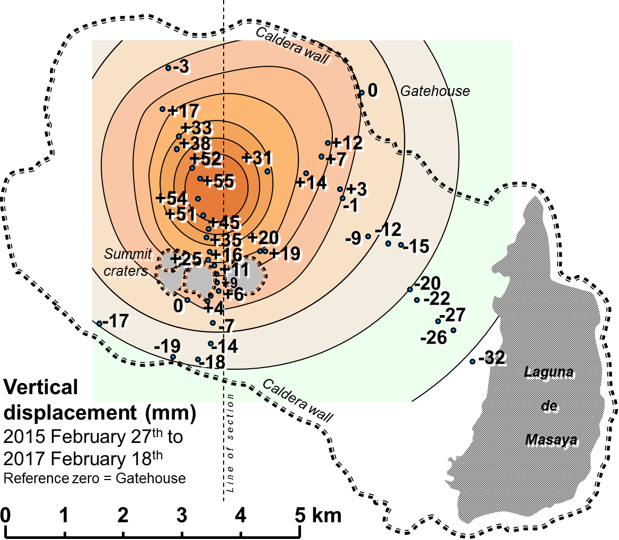
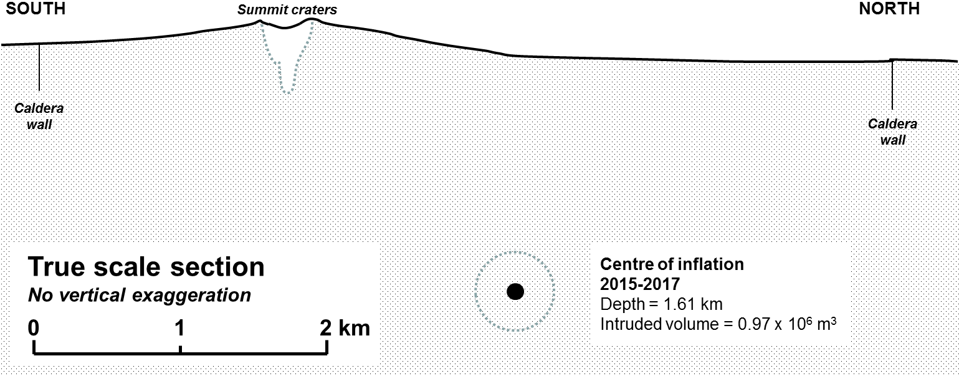
Masaya, Nicaragua
range change (cm)
Levelling route. Data, processing and model JB Murray, OU, 2017©
0
1.5
CSK
2015-10-17 to 2016-03-09

Slide 37
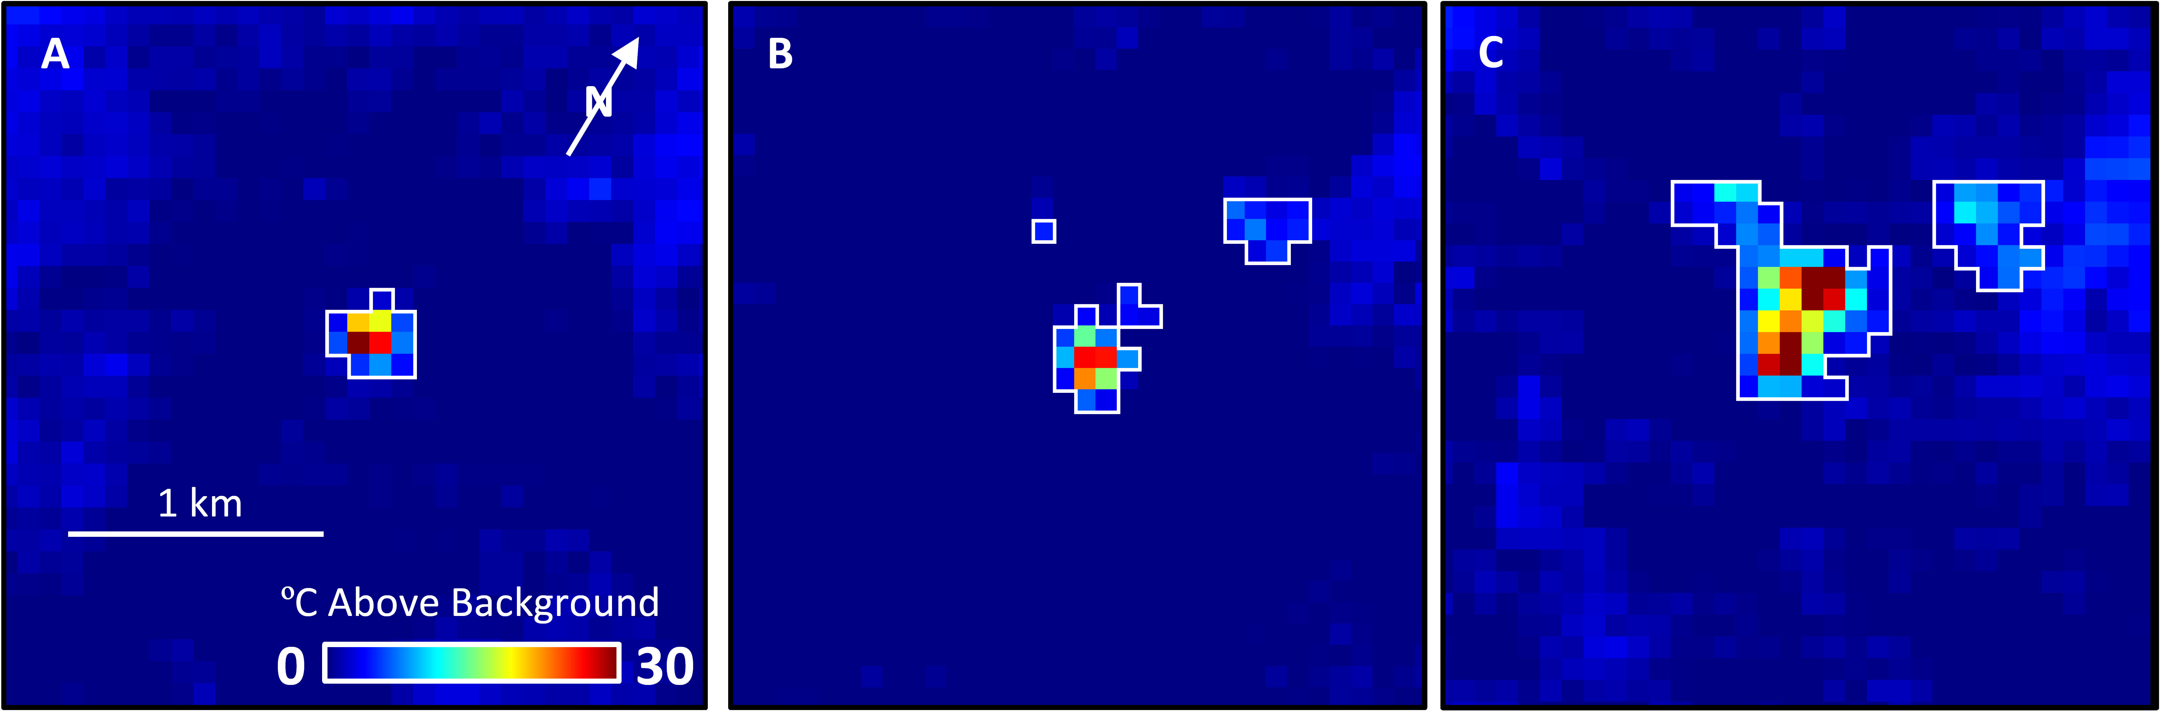
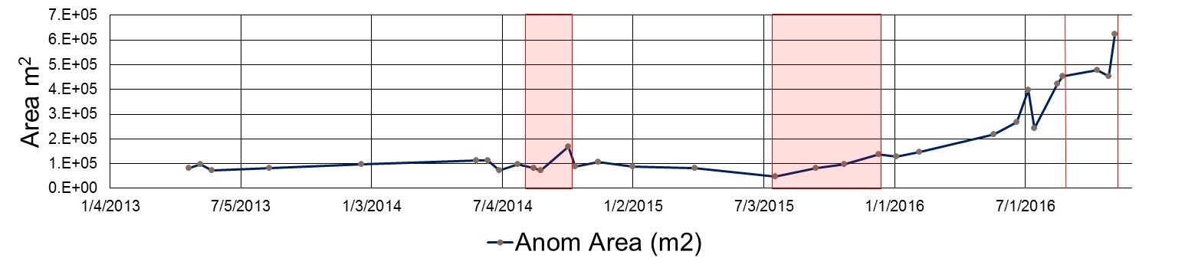
Sabancaya, Peru

Slide 38
Results: Lessons learned
L-band data are critical for coherence in vegetated areas
HH RSAT-2 interferograms seem to offer better coherence than VV Sentinel-1 interferograms. The reason for this difference is not clear.
A “background mission” that acquires data over active volcanoes has great value for when a system becomes restless
Poor baselines for interferometry can be compensated for to a degree by numerous acquisitions
Low data latency is important for crisis situations
Topographic data are critical

Slide 39
Publications
Ebmeier, S. K., J. Biggs, C. Muller and G. Avard (2014). Thin-skinned mass-wasting responsible for edifice-wide deformation at Arenal Volcano, Frontiers in Earth Science, 2, 35, doi:10.3389/feart.2014.00035.
Jay, J. A., F. J. Delgado, J. L. Torres, M. E. Pritchard, O. Macedo, and V. Aguilar (2015). Deformation and seismicity near Sabancaya volcano, southern Peru, from 2002 to 2015. Geophysical Research Letters, 42(8), 2780–2788, doi:10.1002/2015GL063589.
Muller, C., R. del Potro, J. Biggs, J. Gottsman, S. K. Ebmeier, S. Guillaume, P-H. Cattin and R. van der Laat (2015). Integrated velocity field from ground and satellite geodetic monitoring: Insights from Arenal volcano. Geophysical Journal International, 200(2), 863–879, doi:10.1093/gji/ggu444.
Delgado, F., M. Pritchard, D. Basualto, J. Lazo, L. Cordova, and L. Lara (2016). Rapid re-inflation following the 2011–2012 rhyodacite eruption at Cordón Caulle volcano (Southern Andes) imaged by InSAR: Evidence for magma reservoir refill. Geophysical Research Letters, 43(18), 9552–9562, doi:10.1002/2016GL070066.
Ebmeier, S. K., J. R. Elliott, J. M. Nocquet, J. Biggs, P. Mothes, P. Jarrín, M. Yépez, S. Aguaiza, P. Lundgren, and S. V. Samsonov (2016). Shallow earthquake inhibits unrest near Chiles–Cerro Negro volcanoes, Ecuador–Colombian border. Earth and Planetary Science Letters, 450, 283–291, doi:10.1016/j.epsl.2016.06.046.
Arnold, D. W. D., J. Biggs, G. Wadge, S. K. Ebmeier, H. M. Odbert, and M. P. Poland (2016). Dome growth, collapse, and valley fill at Soufrière Hills Volcano, Montserrat, from 1995 to 2013: Contributions from satellite radar measurements of topographic change. Geosphere, 12(4), 1300–1315, doi:10.1130/GES01291.1.
Morales Rivera, A. M., F. Amelung, and P. Mothes (2016). Volcano deformation survey over the Northern and Central Andes with ALOS InSAR time series. Geochemistry, Geophysics, Geosystems, 17(7), 2869–2883, doi:10.1002/2016GC006393.
Naranjo, M. F., S. K. Ebmeier, S. Vallejo, P. Ramón, P. Mothes, J. Biggs and F Herrera (2016). Mapping and measuring lava volumes from 2002-2009 at El Reventador Volcano, Ecuador, from field measurements and satellite remote sensing. Journal of Applied Volcanology, 5, 8, doi:10.1186/s13617-016-0048-z.
Stephens, K. J., S. K. Ebmeier, N. K. Young, and J. Biggs (in revision). Transient deformation associated with explosive eruption measured at Masaya volcano (Nicaragua) using Interferometric Synthetic Aperture Radar. Journal of Volcanology and Geothermal Research
Wnuk, K., and C. Wauthier (in revision). Temporal evolution of surface deformation and magma sources at Pacaya Volcano, Guatemala revealed by InSAR. Journal of Volcanology and Geothermal Research.
Delgado F., M. E. Pritchard, S. Ebmeier, P. Gonzalez, and L. Lara (in review). Recent unrest (2003–2015) imaged by space geodesy at the highest risk Chilean volcanoes: Llaima, Villarrica and Calbuco (Southern Andes). Journal of Volcanology and Geothermal Research.
Arnold, D.W.D., J. Biggs, G. Wadge, S. K. Ebmeier, S. Vallejo, M. F. Naranjo, P. Mothes, and M. P. Poland (in prep). Variable time-averaged lava extrusion rate at El Reventador Volcano, Ecuador. Bulletin of Voclanology.

Slide 40
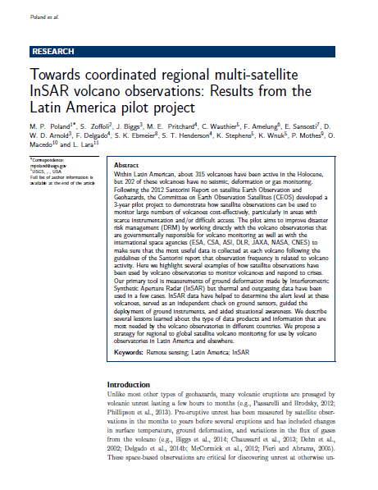
Publications
A summary publication is in preparation and will describe the pilot project, lessons learned, and potential future applications.

Slide 41
Evaluation criteria
Identification of new areas of unrest through regional InSAR monitoring.
Uptake by Latin American volcano monitoring agencies of EO-based methodologies for tracking deformation, as well as gas, thermal, and ash emissions.
Utilization of EO data for operational monitoring by volcano observatories at Supersite targets.
Interest expressed by volcano community to broaden approaches adopted in pilot (especially regional monitoring and new methodologies for EO-based monitoring) through representative bodies such as IAVCEI, WOVO or GVM.

Slide 42
Sustainability: Paths forward
Option 1—status quo: No dedicated FTE. Space agencies provide limited access to data for regional (or global?) monitoring. Coordination on a best-effort basis (through IAVCEI commission?). Need to identify a coordinator for this work.
Option 2—dedicated effort: FTE hired to coordinate satellite volcano monitoring and connect space agencies, academic researchers, and end users (VDAP could house this position). Space agencies provide access to data. Organized response to crises and capacity-building efforts.

Slide 43
Challenges to sustainability
Hiring freeze in USA currently prohibits bringing on new FTE for dedicated EO volcano-monitoring efforts, but ASI is hiring 2 researchers that might contribute
Unclear how space agencies will respond to requests for more data
Limited funding for academic researchers (voluntary participation is not viable in the long term and will hamper efforts to educate students)
NOAA/NESDIS volcanic activity alerts are generated on a best-effort basis; long-term sustainability is an open question

Slide 44
Coming Up…
Journal of Applied Volcanology article describing pilot results and value to end users submitted in 2017
Powell Center (2017–2019)
  ~20 volcano remote sensing experts
  Global in scope
  USGS sponsored
  Use existing databases to understand the best satellite indicators of potential eruptions
  Provide feedback to space agencies on needed data
  Provide guidance on how to communicate with VOs
IAVCEI Scientific Assembly workshop (August 2017)
IAVCEI Commission on Volcano Geodesy

Slide 45
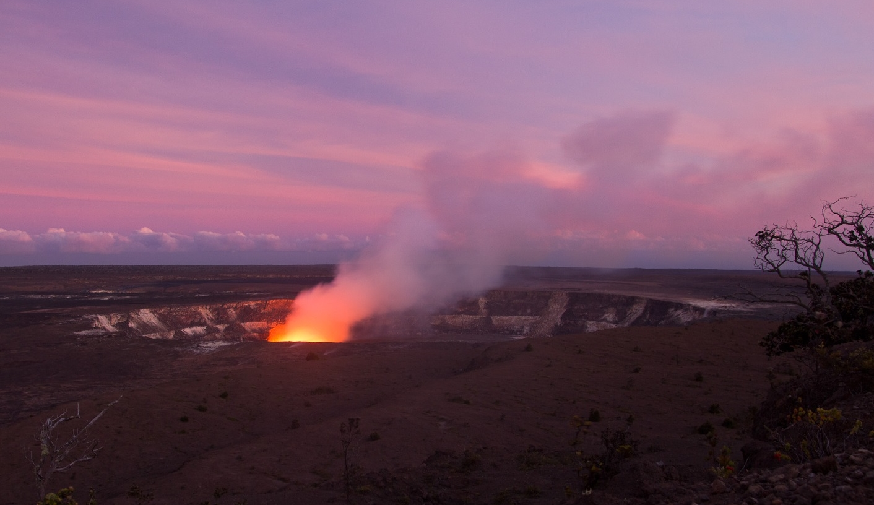
Thank you

