Slide 1
Status Report on the Seismic Hazards Pilot
Philippe Bally (ESA)
Stefano Salvi (INGV)
Theodora Papadopoulou (ARGANS c/ ESA)
WG Disasters #7
Rome, Italy
14-16 March, 2017

Slide 2
Outline
Seismic Hazards pilot - Status
Results from pilot work to date
  1. EO data access for pilot users
  2. EO processing
  3. Awareness - Promotion of results
  4. Observations strategy
Issues and risks identified
Sustainability strategy
Conclusion

Slide 3
Seismic Hazards pilot - Status

Slide 4
Seismic Hazards pilot - Status
As of today:
A Collaboration of ESA, NASA, ASI, CNES, DLR, JAXA, and other partners: INGV, COMET, NASA JPL, CNR IREA, University of Miami, University of Pavia, NOA, UNAVCO and ISTerre/IPGP.
The GEP is available since March 2015: supports both EO data access, EO data processing and e-collaboration.
Strong collaboration with the Supersite initiative GSNL.
Continued collaboration of pilot group with EO mission operators (e.g. Sentinel-1 mission manager) to optimize coverage against thematic priority areas of the Pilot.
Development of tools for automated generation of Sentinel-1 frame interferograms on the COMET-LiCSAR; the entire length of the North Anatolian Fault System has been already processed: E-W component of the surface displacement rates is available.
Supported response to earthquakes since August 2016: Italy (Amatrice, Visso and Norcia) and New Zealand. On-going work for Nepal, Greece and Ecuador. In total, the pilot responded in 8 earthquakes in 5 countries since November 2014.

Slide 5
Seismic Hazards pilot - Objectives
Support the generation of globally self-consistent strain rate estimates and the mapping of active faults at the global scale by providing EO InSAR and optical data and processing capacities to existing initiatives, such as the iGSRM
[role of EO: wide extent satellite observations]
Support and continue the GSNL
[role of EO: multiple observations focused on supersites]
Develop and demonstrate advanced science products for rapid earthquake response.
[role of EO: observation of earthquakes with M>5.8]

Slide 6
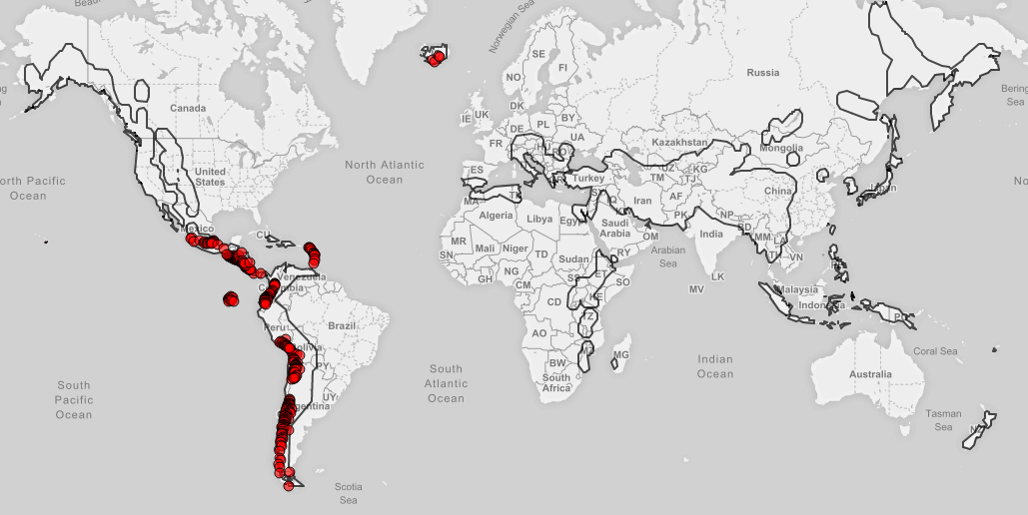
Overview of activities (1)
Objective A:
Turkey validation of interseismic strain measurements:
  Analysis with TSX data will be completed by summer 2017.
  The entire length of the North Anatolian Fault System has been already processed (Sentinel-1): E-W component of the surface displacement rates is available.
Alpine-Himalayan Belt: About 1000 frames processed (including NAFS); A larger area to be selected to process all data since the beginning of the Sentinel-1 mission.
Mapping China (Haiyuan) and Iran (Shahdad) active faults: on-going work.
CEOS priority areas masks are available on the GEP GeoBrowser:
─ Seismic Pilot
Volcano Pilot
A detailed report fot the pilot activities is presented later in slide 49.
Notes:
There are already GSNL sciense users using the GEP (INGV, NOA).

Slide 7
Overview of activities (2)
Objective B:
The pilot continued to support the Gorkha earthquake Event Supersite.
No other Event Supersites have been established in the period.
The CEOS has continued to support the active Permanent Supersites, see presentation from S. Salvi about the GSNL.
Historical COSMO-SkyMed and TerraSAR-X data for the GSNL to be accessed through the GEP.
Chains integrated on GEP (by e.g. INGV) to supportGSNL users.
Objective C:
  ALOS 2 data obtained through the Seismic pilot for the Gorkha Event Supersite (since JAXA does not support GSNL), ongoing work is focusing on post-seismic deformation (a paper on the earthquake is in review).
  On-going analysis of the Lefkada (Greece) earthquake in November 2015.
  On-going analysis of the Amatrice, Visso and Norcia (Italy) earthquakes in August and October 2016.
On-going analysis of the Kaikoura (New Zealand) earthquake in November 2016.
A detailed report fot the pilot activities is presented later in slide 49.
Notes:
There are already GSNL sciense users using the GEP (INGV, NOA).

Slide 8
Users
Academia
Primarily focusing on scientific research.
Geoscience centres doing research or mandated to provide technical advice to national DRM authorities
Geological surveys, geophysics centres looking at tectonic hazards focused on the scientific use of satellite data that aim to understand the physics of geohazards and better characterise, understand and model such risks. In some cases, EO experts (process, analyse, validate, integrate the EO satellite data ) are part of geoscience centers.
The end users (e.g. national DRM authorities, industry etc.)
Exploit real value of EO-based information products for risk e.g. government administrations (e.g. civil protection authorities), private sector bodies (e.g. insurance industry), private citizens.

Slide 9
  Results from pilot work in the period March 2016- August 2016
  1. EO data access for pilot users

Slide 10
EO data access for Pilot users
Following the arrangement made by ESA with ASI, DLR and JAXA to support data dissemination through the Geohazards Exploitation Platform (GEP):
-COSMO-SkyMed data for the Nepal Event Supersite are available for GSNL users (Obj. B) that have signed the ASI license form. All COSMO-SkyMed data for GSNL, Volcano and Seismic pilot shall be accessed through the GEP (ASI: currently updating Hardware).
-TerraSAR-X data can be accessed through the platform. Users are re-directed to the DLR portal for downloading. Access granted after registration.
-ALOS-2 data for Seismic and Volcano pilot users are available on the GEP.
-For a fair portion of the tectonic mask, dense ESA archive data (ERS, ENVISAT) are available (70+ terabytes) and work is on going to fully cover the area; Copernicus Sentinel-1 data are available through the Scihub https://scihub.esa.int/
-ESA made an arrangement with CNES, to host Pleiades DEMs on the GEP. Access will be restricted to CEOS Seismic pilot users.

Slide 11
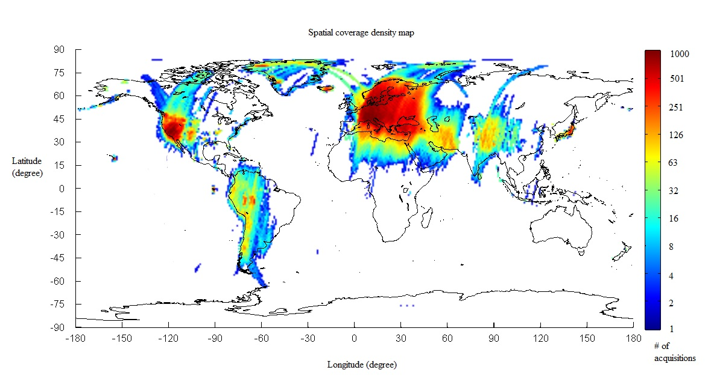
Available ERS, Envisat &
Copernicus Sentinel-1 SAR & Sentinel-2 data
Sentinel-1 made available (in raw as well as SLC format) starting with CEOS Pilot targets and with the goal to gradually provide global coverage.
Sentinel-2 are made available.
Sentinel-3 are made available.
ERS & Envisat SAR data:
Current ENVISAT ASAR IM Level-0 Data
Current ERS SAR IM Level-0 Data
(70+ terabytes)
ERS & ENVISAT Level-0 data available as of February 2016.
Notes:
A pltaform for EO processing rather than data distribution or dissemination. Agreement with CEO Spartners for access and accounting of specific data collections (CDEOS Pilots and Geohazard Supersites).

Slide 12
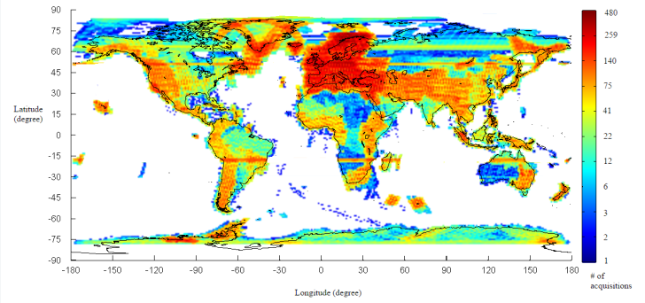
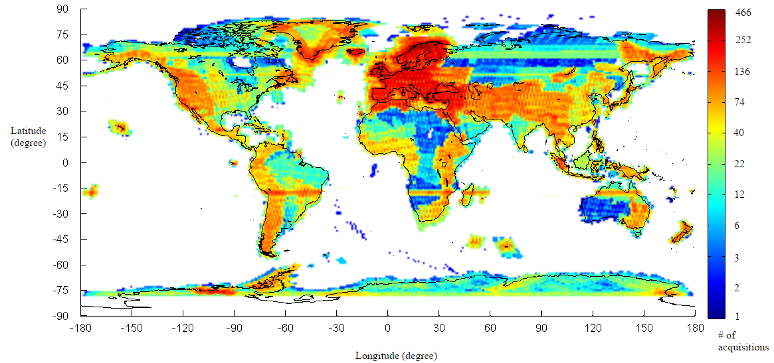
Available Copernicus Sentinel-1A SAR data – Spatial Coverage
S-1 RAW data available as of December 2016
Since November 2015, all Sentinel-1 products contain Restituted orbits (generally good for InSAR, no need to await Precise orbits).
S-1 SLC data available as of December 2016
SLC products
now available for almost all S-1 acquisitions

Slide 13
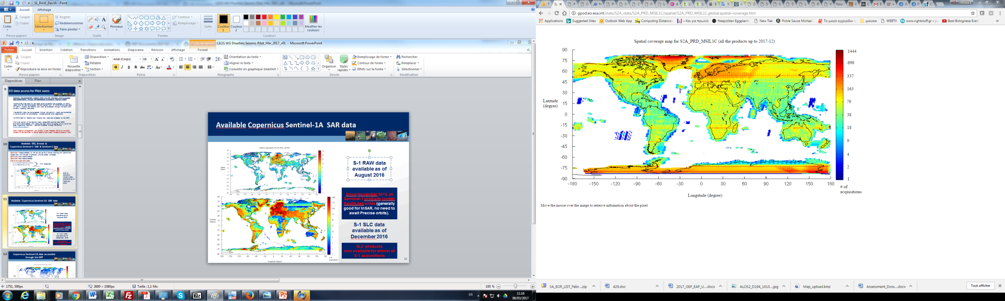
Copernicus Sentinel-2A data accessible through the GEP
There are several Optical processing chains on the GEP :
STEMP of INGV
MPIC chain of Univ. Strasbourg
Hot Spot Maps, Noveltis
Vegetation Vigor maps, Noveltis
Orpheo Toolbox, etc).

Slide 14
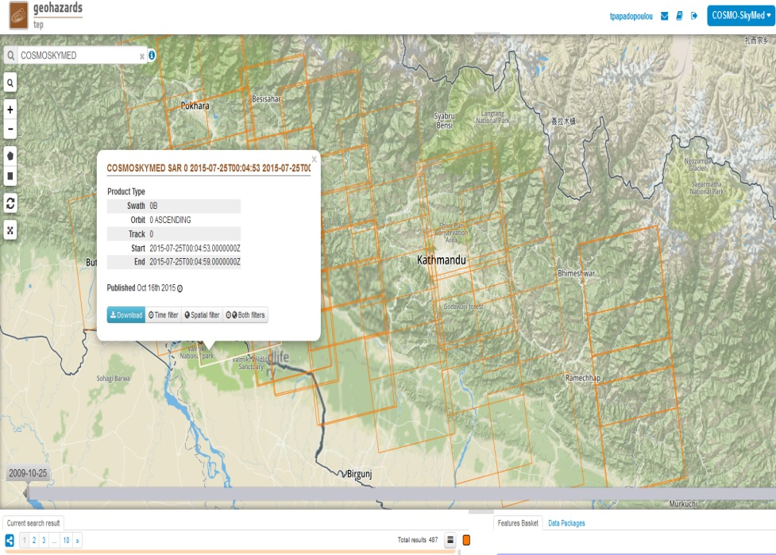
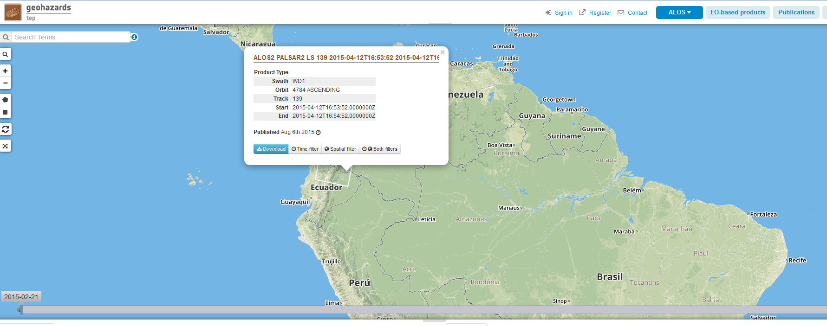
GEP supporting the GSNL and the Volcano pilot
COSMO-SkyMed data collections over Nepal available through the GEP (only for authorized users having signed the ASI license form).
ALOS-2 images over Latin America volcanoes are available through the GEP. The ALOS-2 collections (up to 11 terabytes) were accessed by Volcano pilot users.

Slide 15
Seismic Pilot: Yearly Quota
Agency | ASI | CNES Pleiades | CSA | DLR | ESA | JAXA ALOS-2 | NASA | USGS Landsat-8
Number of Images | 300 | 50 | 2 | on request | * | 100 | - | -
*ESA: large dataset through the GEP (ERS & ENVISAT 70+ Tera and Copernicus Sentinel-1 & Sentinel-2 gradually)
DLR (TerraSAR-X): quota shall be provided, if requested
CNES (Spot): no quota provided
Freely available sources: no quota (e.g. USGS L8).
-ALOS-2 data available up to 31 March 2017.

Slide 16
ALOS-2 quota available up to 31 March 2017
ALOS-2 data requests
NASA JPL to provide additional requests to complement the available ALOS-2 datasets over Turkey, Nepal and Central Andean Subduction
Creeping faults in Philippines (M6,7 EQ on February 10).
Quota available: 125 images

Slide 17
Data use
AOI | ASI | CNES Pleiades | CSA | DLR | ESA | JAXA ALOS-2
China | 92 | 18
Iran | 46
NAF |  |  |  | 296 | ~1000 (Alpine-Himalayan belt) | 24
Nepal | Covered by GSNL event supersite |  |  |  |  | 27
Andes |  |  |  |  |  | 8
Greece | 60 |  | 6 | 65 | >2
Italy | 2 | 14 |  |  | 8 | 4
New Zealand |  | 27 |  |  | >2 | 12
In bold, images requested and used during this reporting period.
Note: number of data requested, provided and used is different. To be further discussed with CEOS agencies.
Notes:
Barry Parsons informed me that the CSK acquisistions for China and Iran will end in October 2017 and March 2018 respectively. Can this be discussed within the meeting? Is it acceptable? If we find sustainable paths for the future of the pilot what happens in the meantime (the time between the end of the pilot and the start of a new project)?

Slide 18
  Results from pilot work in the period March 2016- August 2016
  2. EO processing

Slide 19
  Central Italy earthquakes
  (24 August, 26 and 30 October 2016)

Slide 20
Central Italy Earthquakes: Activation
On 24 August 2016 at 3:36:32 CEST an earthquake hit Central Italy. It measured 6.0 on the moment magnitude scale and its epicentre was close to Accumoli in a depth of 4±1 km. Buildings in the villages of Amatrice, Accumoli and Arquata del Tronto collapsed and caused nearly 300 fatalities.
The same day as the earthquake hit Central Italy, the CEOS Seismic Pilot was activated by the specialists of INGV, the national institute of Geophysics and Volcanology of Italy, with the aim to access and exploit EO data for Active Tectonics Mapping.
Two months later, on October 26, two events of Mw 5.4 and 5.9 occurred about 30 km to the NW in Visso. These shocks were then followed on October 30 by an earthquake of Mw 6.5 occurring close to Norcia, which further increased the damage level in the area. This was the largest earthquake recorded in the last 30 years in Italy.
Products and detailed reports about the events were provided to the Italian Civil Protection Department (DPC) by the main CoC (INGV) and others CoCs (e.g. CNR-IREA)
Gregorio Borgia/AP Photo

Slide 21
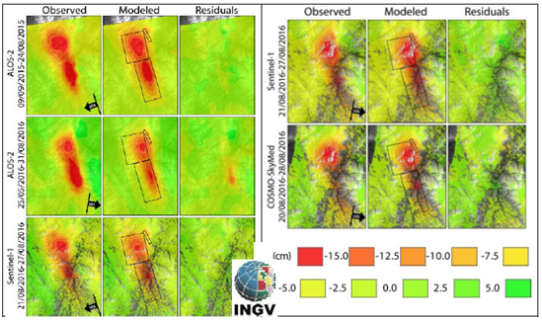
Amatrice Earthquake: Sentinel-1, ALOS-2 and CSK Input datasets for source modeling
Input InSAR datasets and results of the source modeling. For each dataset the inverted data (Observed column) the model simulation (Modeled column) and the difference (Residuals column) is shown. These results refer to the source model shown in the next figure.

Slide 22
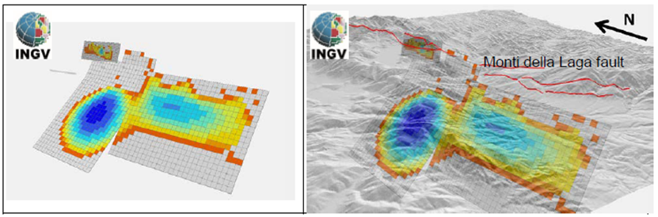
Amatrice Earthquake: Source model by INGV
The source model for the August 24 Amatrice earthquake. It is composed of two nearly co-planar ruptures. The northern rupture shows deeper and stronger slip. The shallow small fault at the northern end simulates the gravitational deformation observed in the Monte Vettore western flank. This is not connected with the deep slip and is likely not directly related to the fault dislocation.

Slide 23
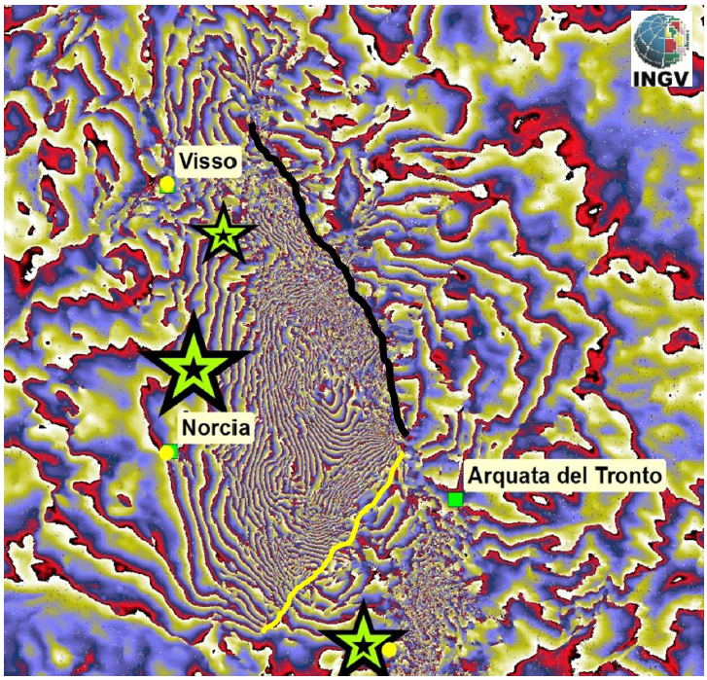
Visso and Norcia Earthquakes: Sentinel-1 interferogram generated by INGV
A detail of the descending Sentinel-1 interferogram, showing the linear fringe discontinuities corresponding to ground breakage. The black line has been identified with a co-seismic scarp with 1-2 m displacement on the Monte Vettore fault. The yellow line has not been verified into the field but may represent the surface expression of a lateral fault which has been modeled by the inversion of InSAR data.

Slide 24
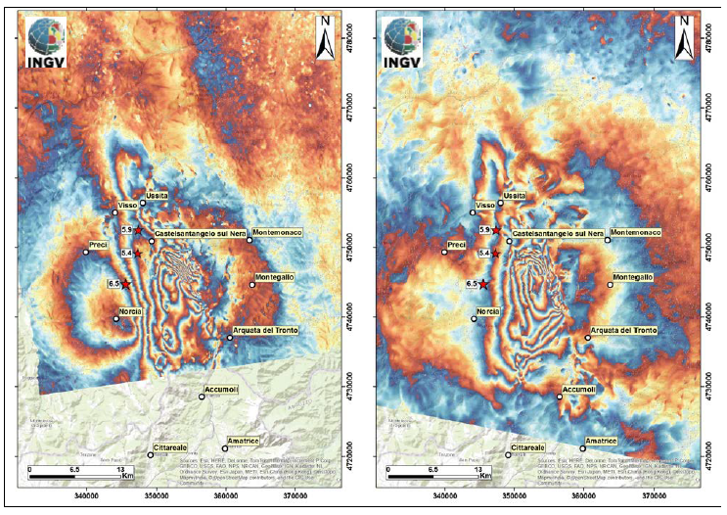
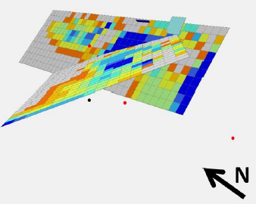
Visso and Norcia Earthquakes: Source model by INGV based on ALOS-2 interferograms (by INGV and CNR-IREA)
The source model (based on ALOS-2 unwrapped interferograms) for the October 26 and 30 events. The main rupture occurred on the Monte Vettore-Monte Bove fault, extended NNW for over 25 km.
ALOS 2 interferograms showing the cumulated ground deformation caused by the October 26 (Visso) and 30 (Norcia) earthquakes. The left image shows an ascending interferogram covering the period August 24 - November 02, 2016. The right image shows a descending interferogram covering the period August 31 - November 09. The mainshocks of October 26 and 30 are shown as red stars. Each colour fringe represents 12 cm of Line of Sight ground displacement.

Slide 25
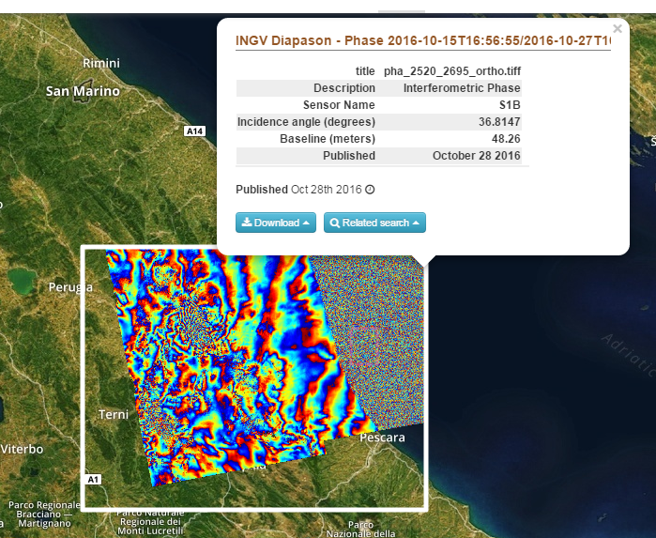
2016 Visso (IT) Earthquake: example of hosted processing on the GEP
Interferogram based on the GEP-hosted processing chain DIAPASON of the French space agency CNES and processed by INGV using Sentinel-1 acquisitions of 15th and 27th October 2016.

Slide 26
  New Zealand earthquake of 13 November 2016

Slide 27
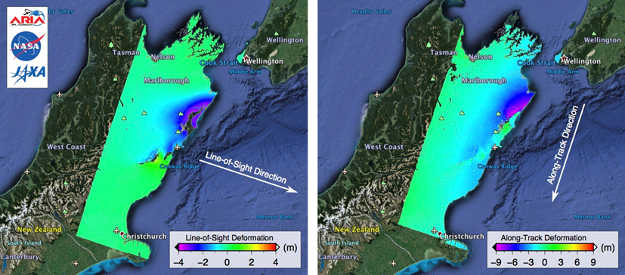
Kaikura (NZ) Earthquake: ALOS-2 interferograms generated by NASA JPL
ALOS-2 data were used for the generation of interferograms showing LOS and Along Track deformation.

Slide 28
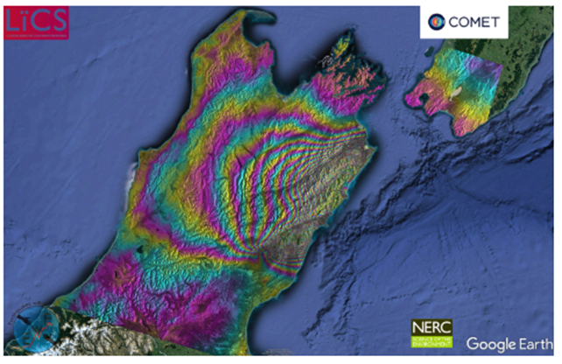
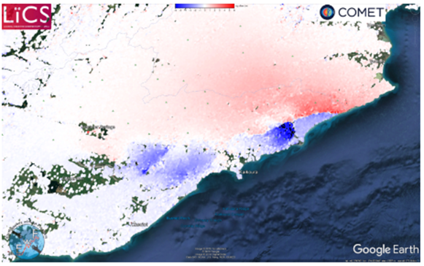
Kaikura (NZ) Earthquake: ALOS-2 and Sentinel -1 results generated by COMET
ALOS-2 interferogram from track 195 showing the coseismic displacement field after the 2016 New Zealand earthquake.
Coseismic Range Offsets from Sentinel-1 SAR data highlighting the fault trace and numerous fault segments.
Results were online 5 hours 27 minutes after satellite acquisition.

Slide 29
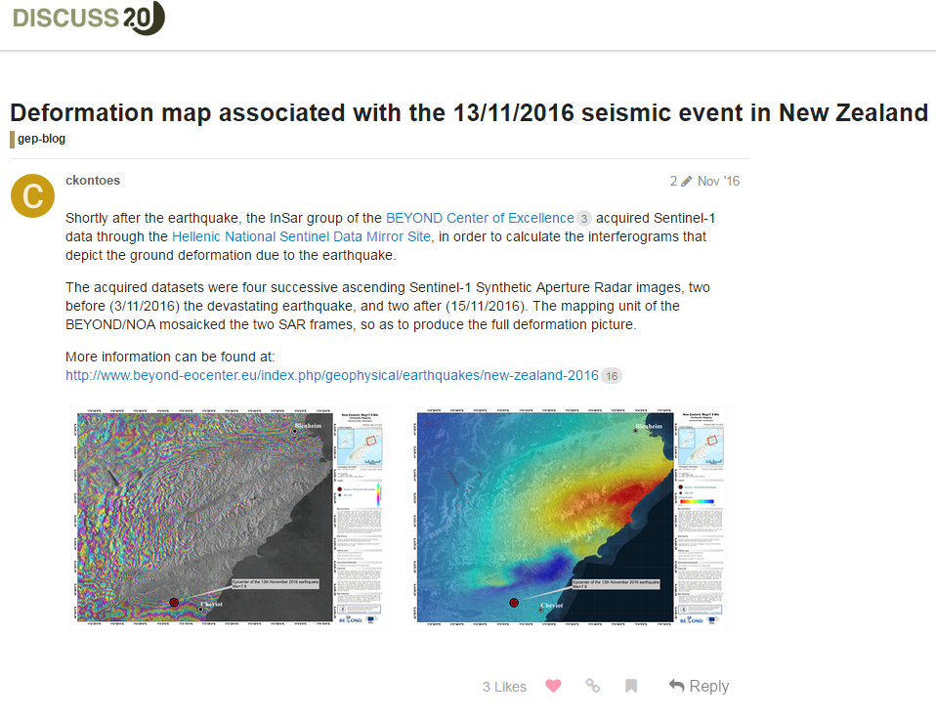
Kaikura (NZ) Earthquake: Sentinel-1 interferograms generated by NOA
Sentinel-1 deformation maps for the New Zealand seismic event on 13 November 2016.

Slide 30
  EO processing by COMET using the LiCSAR system

Slide 31
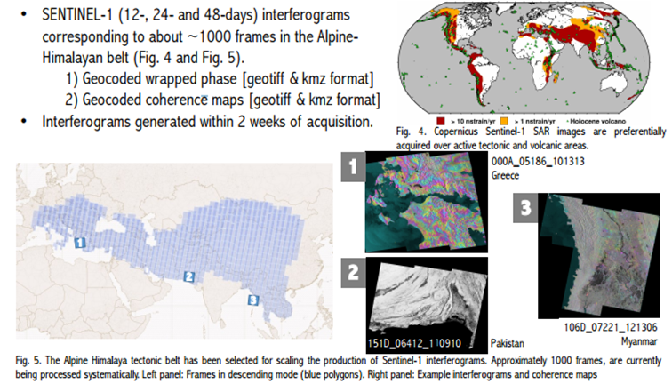
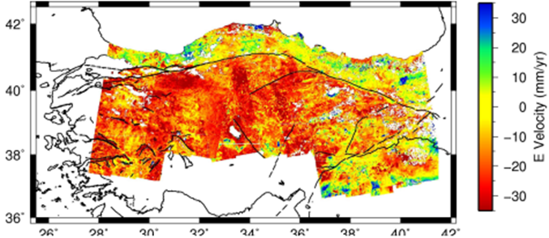
COMET-LiCSAR: Tools for automated generation of Sentinel-1 frame interferograms
SENTINEL-1 generates massive volumes of data with high duty cycle, shorter revisits, and wider swaths than previous missions (e.g. ENVISAT).
East-West component of the surface displacement rates from October 2014 to April 2016 using ascending and descending passes over the entire length of the North Anatolian Fault System.
The LiCSAR InSAR products are generated within two weeks of acquisition of Sentinel-1 images. Approximately 1000 frames are currently being processed systematically over the Alpine-Himalayan Belt. First LiCSAR results were presented in the AGU 2016 for large scale Sentinel-1 frames processing for the entire North Anatolian Fault. LiCSAR products shall be made available through GEP in the next months. The next steps are to process a larger area and reprocess the entire Sentinel-1 mission since 2014. http://comet.nerc.ac.uk/COMET-LiCS-portal/

Slide 32
Helping pilot users with on demand processing (GEP)

Slide 33
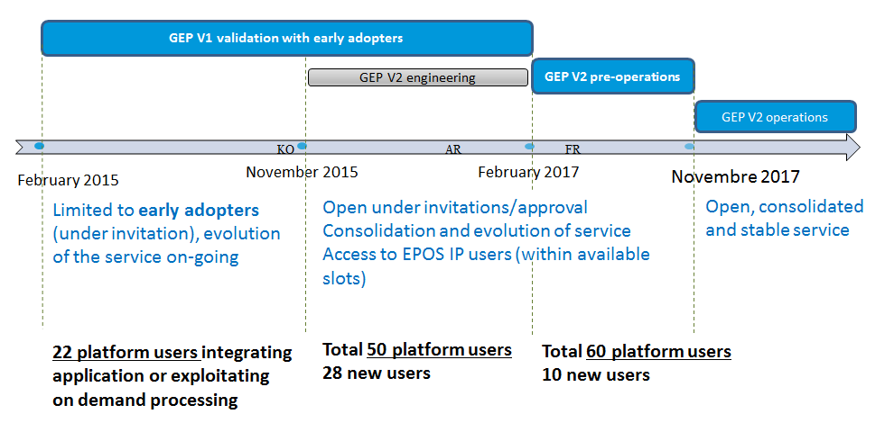
GEP Roadmap

Slide 34
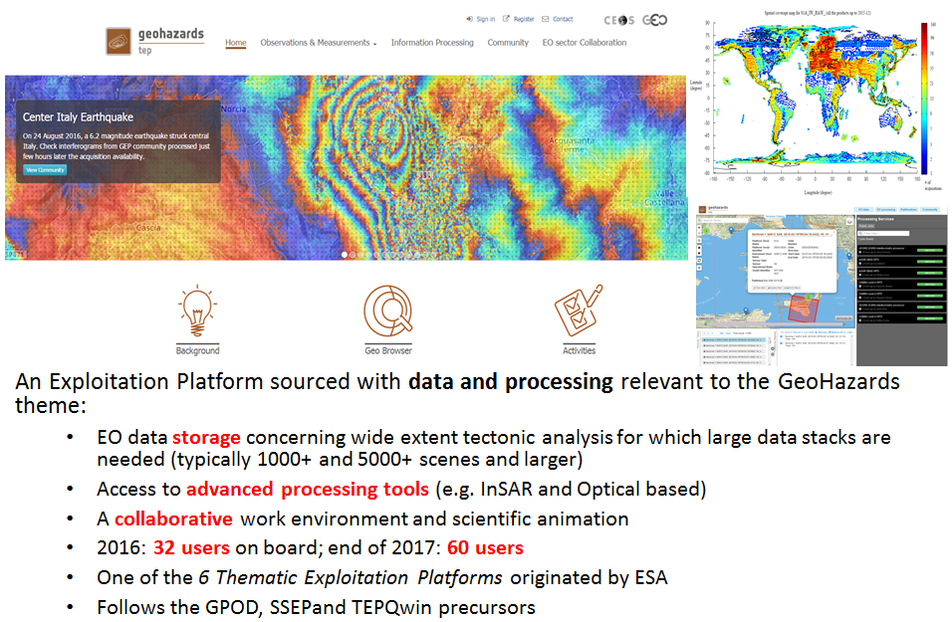
GEP: an innovative response
An Exploitation Platform sourced with data and processing relevant to the GeoHazards theme:
  EO data storage concerning wide extent tectonic analysis for which large data stacks are needed (typically 1000+ and 5000+ scenes and larger)
  Access to advanced processing tools (e.g. InSAR and Optical based)
  A collaborative work environment and scientific animation
  March 2017: 47 users; end of 2017: 60 users
  One of the 6 Thematic Exploitation Platforms originated by ESA
  Follows the GPOD, SSEP and TEP-Qwin precursors

Slide 35
Examples of Early Adopters,
Validation Phase started in March 2015 (1)
User organisation | Areas
Ecole Normale Supérieure de Paris (France) | Etna, Italy and Corinth Rift, Greece
DLR IMF (Germany) | European tectonic mask
Altamira Information (Spain) | Test sites on landslides and earthquakes
ISTerre (France) | Subduction zones of Latin America, the NAFZ and Tibet.
INGV Roma (Italy) | Alto Tiberina Fault and Fogo Cape Verde
INGV Roma (Italy) | Marmara, East sector of NAFS
INGV Roma (Italy) | Haiti and West Java
ETH (Switzerland) | Large surface deformations caused by landslides in Bhutan Himalaya
NOA (Greece) | Geohazard sites in Greece
SATIM (Poland) | Silesia & Warsaw (Poland)
Obs. Physique du Globe de Clermont-Ferrand (France) | Piton de la Fournaise in La Réunion, Cordon del Azufre / Lastarria in Chile–Argentina
INGV Catania (Italy) | Etna & Campi Flegrei / Vesuvius
British Geological Survey (UK) | Urban areas of Great Britain
University of Leeds (UK) | Active deformation in the Alpine-Himalayan belt
ESA | Over calibration sites: Rain forest, Germany (DLR targets), Australia Milan, Chicago, Sao Paulo
ESA(Progressive Systems SLR) | Greater Cairo, South Rayan dune field, Middle Egypt province and Aswan province
CNR IREA (Italy) | Tests on Italian volcanoes and Hawaiian and Japanese volcanic and seismic areas
Universita De L’ Aquila (Italy) | Abruzzo region: L’ Aquila and Teramo for post-seismic ground displacements
University College of London (UK) | UK landslides
University of Rabat(Morocco) | Morocco seismic activity
Volcanoes
Earthquakes
Landslides
Subsidence

Slide 36
Examples of Early Adopters,
Validation Phase started in March 2015 (2)
User organisation | Areas
CNR ISSIA (Italy) | Indonesia
IPGP (France) | Asia, N& S America, Indian Ocean
Universidad de Concepcion (Chile) | Southern Andean zone
Laboratoire de Dynamique Terrestre et Planétaire (France) | South America active volcanoes and tectonics
BRGM (France) | French coast subsidence
AIM CEA (France) | La Reunion
National Cartographic Center (Iran) | Iran
Instituto Geologico y Minero de Espana (Spain) | SouthEast Spain
USGS (USA) | Latin America volcanoes
CVGHM (Indonesia) | Indonesian and Mexican volcanoes
Yachay Tech (Ecuador) | Ecuador areas with active seismic activity and active volcanoes
CNES (France) | Validation of tools for interferometric coherence over Syria and France
Volcanoes
Earthquakes
Landslides
Subsidence
47 users up to early March 2017 (4 more users have been selected to get on board in March)
7 of them being CEOS pilot users (5 Seismic pilot users and 2 Volcano pilot)
Mainly European users, but also 6 users from: Asia (Indonesia and Iran), Africa (Morocco), South America (Ecuador and Chile) and North America (USA).
PoC for applications: geohazards-tep@esa.int

Slide 37
  Results from pilot work in the period March 2016- August 2016
  3. Awareness – Promotion of results

Slide 38
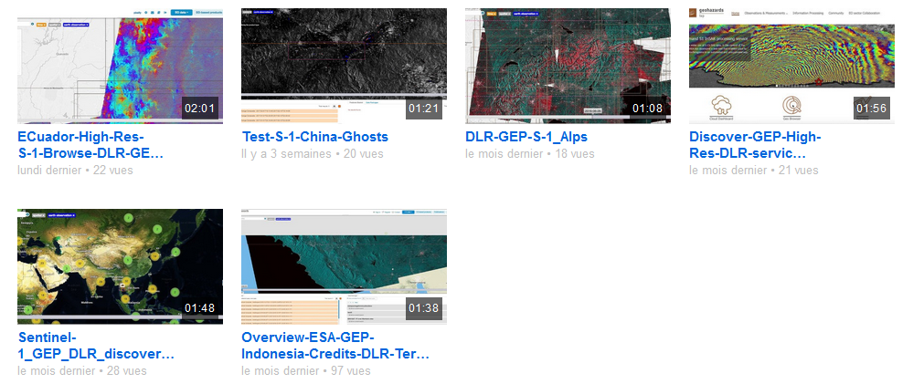
Awareness – Promotion of results
CEOS Pilot users can promote their results through:
CEOS website (http://ceos.org/ )
GSNL portal (http://www.earthobservations.org/gsnl.php )
Geohazards Exploitation Platform ( https://geohazards-tep.eo.esa.int/ ).
Using Sentinal-1 InSAR Browse service: http://www.dailymotion.com/video/x5eswz2_ecuador-high-res-s-1-browse-dlr-gep_tech
A number of videos is available on how to use processing chains and generate results

Slide 39
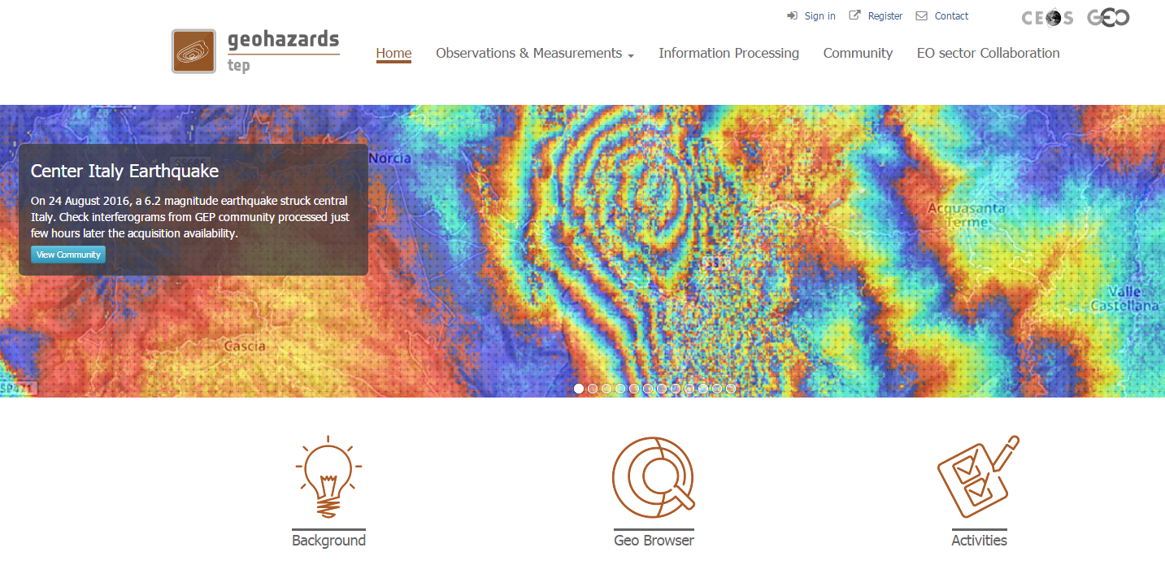
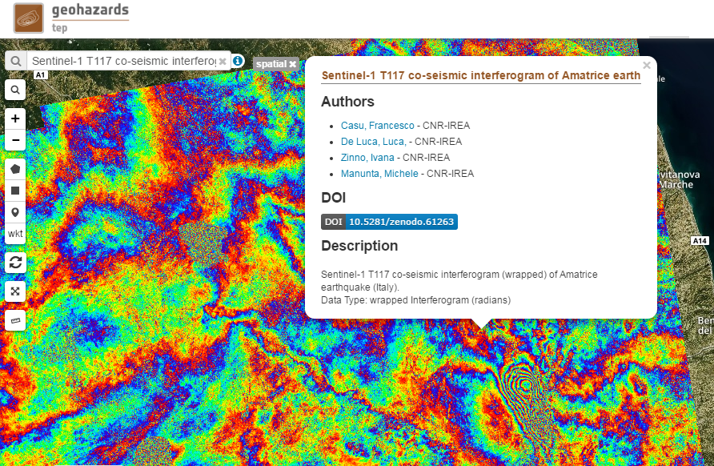
Example of promotion of results on the GEP for the Central Italy Earthquake (1)
Sentinel-1 T117 co-seismic interferogram of Amatrice earthquake (Italy) generated by CNR-IREA through the ESA G-POD platform
Notes:
All products generated on GEP for the Central Italy earthquake were gathered under a link on the carousel of GEP’s homepage. Currently the list includes 3 results from INGV and one from CNR IREA.

Slide 40
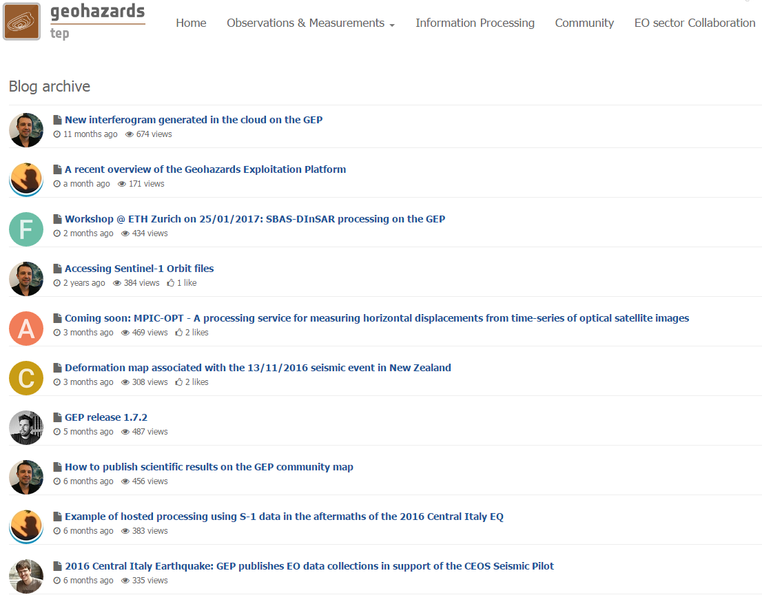
Example of promotion of results on the GEP for the New Zealand Earthquake (2)
A number of posts are published on the GEP Blog concerning CEOS data collections, first products generated by CEOS Seismic pilot team etc. In the example: Sentinel-1 deformation maps generated by NOA over Kaikoura.

Slide 41
Publications (1)
In total: 20 papers, 2 presentations, 2 posters and 3 web-articles published.
NOA
http://www.beyond-eocenter.eu/index.php/geophysical/earthquakes/new-zealand-2016
COMET
http://comet.nerc.ac.uk/
http://www.bbc.co.uk/news/science-environment-38323832
Elliott JR; Walters RJ; Wright TJ (2016) The role of space-based observation in understanding and responding to active tectonics and earthquakes, Nature Communications, 7, doi: 10.1038/ncomms13844
Hussain E; Hooper A; Wright TJ; Walters RJ; Bekaert DPS (2016) Interseismic strain accumulation across the central North Anatolian Fault from iteratively unwrapped InSAR measurements, Journal of Geophysical Research: Solid Earth, 121, pp.9000-9019. doi: 10.1002/2016JB013108
Floyd MA; Walters RJ; Elliott JR; Funning GJ; Svarc JL; Murray JR; Hooper AJ; Larsen Y; Marinkovic P; Bürgmann R; Johanson IA; Wright TJ (2016) Spatial variations in fault friction related to lithology from rupture and afterslip of the 2014 South Napa, California earthquake, Geophysical Research Letters, 43, pp.6808-6816. doi: 10.1002/2016GL069428
Hussain E; Wright TJ; Walters RJ; Bekaert D; Hooper A; Houseman GA (2016) Geodetic observations of postseismic creep in the decade after the 1999 Izmit earthquake, Turkey: Implications for a shallow slip deficit, Journal of Geophysical Research: Solid Earth, 121, pp.2980-3001. doi: 10.1002/2015JB012737
Wright TJ (2016) The earthquake deformation cycle, ASTRONOMY & GEOPHYSICS, 57.
Elliott JR; Jolivet R; Gonzalez PJ; Avouac JP; Hollingsworth J; Searle MP; Stevens VL (2016) Himalayan megathrust geometry and relation to topography revealed by the Gorkha earthquake, Nature Geoscience, 9, pp.174-180. doi: 10.1038/ngeo2623
Poster at AGU 2016: LiCSAR: Tools for automated generation of Sentinel-1 frame interferograms, Pablo J. González, Richard J. Walters, Emma Hatton, Karsten Spaans, Alistair McDougall, John Elliott, Andrew J. Hooper, and Tim J. Wright

Slide 42
Publications (2)
INGV and CNR-IREA
Gruppo di lavoro IREA-CNR & INGV, 2016. Sequenza sismica di Amatrice: risultati iniziali delle analisi interferometriche satellitari, DOI: 10.5281/zenodo.60935
Gruppo di lavoro IREA-CNR & INGV, 2016. Sequenza sismica di Amatrice: aggiornamento delle analisi interferometriche satellitari e modelli di sorgente, DOI:10.5281/zenodo.61682
Gruppo di lavoro IREA-CNR & INGV, 2016 Sequenza sismica di Amatrice: risultati iniziali delle analisi interferometriche satellitari, DOI: 10.5281/zenodo.60938
Gruppo di lavoro IREA-CNR & INGV, 2016 “Sequenza sismica del Centro Italia 2016-2017: aggiornamento delle analisi InSAR e modello preliminare di sorgente per gli eventi del 18/1/17”, DOI: 10.5281/zenodo.266966
Gruppo di Lavoro INGV sul terremoto in centro Italia, 2016. Rapporto di sintesi sul Terremoto in centro Italia Mw 6.5 del 30 ottobre 2016, doi: 10.5281/zenodo.166019
Gruppo di Lavoro INGV sul Terremoto in centro Italia, 2017. Relazione sullo stato delle conoscenze sulla sequenza sismica in centro Italia 2016-2017 (aggiornamento al 2 febbraio 2017), doi: 10.5281/zenodo.267984
Presentation at AGU 2016 meeting: S. Salvi et al., 2016, Co-seismic deformation fields and source modelling for the 2016 Central Italy events from the inversion of InSAR and GPS data, AGU 2016
Bignami, C., Tomolei, C., Pezzo, G., Guglielmino, F., Atzori, S., Trasatti, E., Antonioli, A., Stramondo, S. and Salvi, S., 2016. Source identification for situational awareness of August 24th 2016 central Italy event. Annals of Geophysics, 59.
Poster at AGU 2016 meeting: Casu, F., et al., “The Mw 6.0 2016 Amatrice (Italy) Earthquake: Source Geometry Inferred from DInSAR Measurements and Geological Data”, S43F-3207 AGU Fall Meeting 2016
Lavecchia, G., R. Castaldo, R. de Nardis, V. De Novellis, F. Ferrarini, S. Pepe, F. Brozzetti, G. Solaro, D. Cirillo, M. Bonano, P. Boncio, F. Casu, C. De Luca, R. Lanari, M. Manunta, M. Manzo, A. Pepe, I. Zinno, and P. Tizzani (2016) “Ground deformation and source geometry of the August 24, 2016 Amatrice earthquake (Central Italy) investigated through analytical and numerical modeling of DInSAR measurements and structural- geological data”, Geophys. Res. Lett., 43, 12,389–12,398, doi: 10.1002/2016GL071723

Slide 43
Publications (3)
NASA JPL
Kargel, J. S., et al. (2016), Geomorphic and geologic controls of geohazards induced by Nepal’s 2015 Gorkha earthquake, Science, 351(6269), 140+online, doi:10.1126/science.aac8353.
Yue, H., et al. (2016, in press), Depth varying rupture properties during the 2015 Mw 7.8 Gorkha (Nepal) earthquake, Tectonophysics, doi:10.1016/j.tecto.2016.07.005.
Presentation at EGU General Assembly 2017: A Bayesian analysis of the 2016 Pedernales (Ecuador) earthquake by Baptiste Gombert et al., Session SM2.1/EMRP4.12 - Earthquake source processes - Imaging methods, numerical modeling and scaling , Abstract identification number EGU2017-12363.
Huang, M.-H., E. J. Fielding, C. Liang, P. Milillo, D. Bekaert, D. Dreger, and J. Salzer (2017), Coseismic deformation and triggered landslides of the 2016 Mw 6.2 Amatrice earthquake in Italy, Geophysical Research Letters, 44(3), 1266-1274, doi:10.1002/2016GL071687.
Liang, C., and E. J. Fielding (2016), Interferometric Processing of {ScanSAR} Data Using Stripmap Processor: New Insights From Coregistration, {IEEE} Trans. Geosci. Remote Sensing, 54(7), 4343--4354, doi:10.1109/TGRS.2016.2539962.
Liang, C., and E. J. Fielding (2017, in press), Measuring Azimuth Deformation With L-Band ALOS-2 ScanSAR Interferometry, IEEE Transactions on Geoscience and Remote Sensing, PP(99), 1-14, doi:10.1109/TGRS.2017.2653186.
Liang, C., and E. J. Fielding (2017, in press), Interferometry With ALOS-2 Full-Aperture ScanSAR Data, IEEE Transactions on Geoscience and Remote Sensing, PP(99), 1-12, doi:10.1109/TGRS.2017.2653190.

Slide 44
  Results from pilot work in the period March 2016- August 2016
  4. Observations strategy

Slide 45
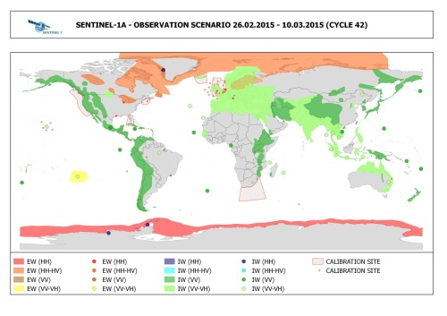
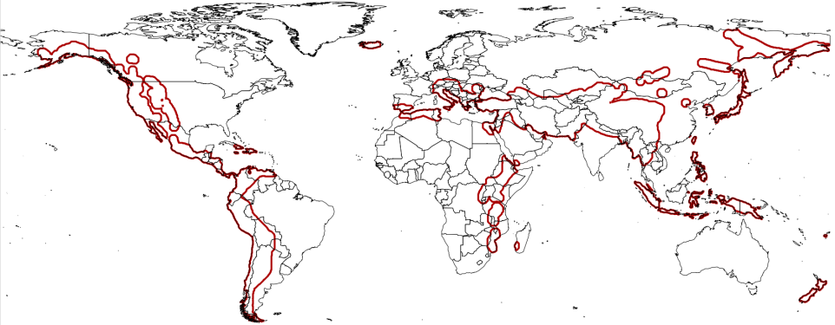
Observations strategy
Continuous exchanges between Seismic Hazards pilot lead and Sentinel-1 mission Project Manager in order to cover the entire tectonic mask. There is a high correlation between the Sentinel-1 acquisitions and target areas of the pilot community.
Study of the examination of the gaps of existing acquisition plans over megacities in areas of high seismic risk: Most sites are at least partially covered by SAR sensor and are:
-sites with high repeat coverage using Sentinel-1 and ALOS-2
-sites with rare coverage using ascending or descending acquisitions from Radarsat-2, TerraSAR X, and COSMO-SkyMed.
https://sites.google.com/a/ingv.it/satellite-monitoring-of-geohazard-prone-megacities---satgeomeg/home

Slide 46
Issues and risks associated to the execution of the pilot

Slide 47
Issues & risks identified
User base consists essentially of EO and geophysical science users. The way to reach end-users is through a science user.
Earthquake response: difficult to identify end-users in advance as earthquake location and time are not predictable
Accounting of data accessed can be difficult in absence of user feedback.
Organizing data supply to users has been time-consuming.
Moving from standalone processing to an ecosystem of hosted services is time consuming and requires changes of behavior. However, low level tasks (data selection, data fetching, selection of set up of processing chains) are not a burden to users anymore, showing direct benefit to users.
In the context of pilot; many opportunities have been identified and are discussed in later in the Sustainability Strategy.

Slide 48
Sustainability strategy

Slide 49
Achievements against pilot objectives
  Based on the Seismic Hazards pilot objectives, the following were achieved:
  Objective A
  Strain rate mapping:
  The methodology is validated
  The global production has started; the entire length of the North Anatolian Fault System has been already processed
  Active fault mapping:
  Stereo optical data used to support fault reconnaissance mapping locally over limited areas
  Potential of exploiting stereo data for both DEM generation and deformation mapping has been demonstrated
  Objective B
  The GEP successfully supported the GSNL experts for data delivery, on demand processing chains and the integration of chains dedicated to GSNL activities
  Objective C
  The Seismic pilot provided support response to 8 earthquakes with magnitude > 5.8 in 5 countries since November 2014
  In a few cases, products derived from pilot work were used by end users
  Further achievements:
  Collaboration with EO mission operators to optimize coverage against thematic priority areas of the pilot: There is a high correlation between the Sentinel-1 acquisitions and target areas of the pilot community
  Study of the examination of the acquisition plans’ gaps over megacities in areas of high seismic risk: Most sites are at least partially covered by SAR sensor
  In total: 21 publications, 2 presentations, 2 posters and5 web-stories/articles stemmed out of pilot work.
Notes:
There are already GSNL sciense users using the GEP (INGV, NOA).

Slide 50
Detailed Achievements
  Based on the Seismic Hazrads pilot objectives, the following were achieved:
  Objective A
  Strain rate mapping:
  The methodology is validated and the global production has started, strain rate measurements will be available within Q4 2017
  Development of tools for automated generation of Sentinel-1 frame interferograms; the entire length of the North Anatolian Fault System has been already processed
  Active fault mapping:
  Stereo optical data used to support fault reconnaissance mapping locally over limited areas
  The pilot has shown the potential of exploiting stereo data for both DEM generation and deformation mapping in the instance of an earthquake (currently such methods cannot be deployed due to technical and cost barriers)
  Objective B
  The GEP successfully provided to support to the GSNL for data delivery
  The GEP provided on demand processing chains (e.g. the CNES chain DIAPASON)
  The GEP supported GSNL experts for the integration of chains dedicated to GSNL activities (e.g. SISTEM with INGV Catania
  Objective C
  The Seismic pilot provided support response to 8 earthquakes with magnitude > 5.8 in 5 countries since November 2014
  The pilot managed demonstrate the value of InSAR based products, which provide critical information about precise terrain motion
  In a few cases, products derived from pilot work were used by end users (e.g. Italian Civil Protection Department/DPC)
  Effort (through on-going discussions) to reach geoscience centers and end-users, to be continued in a follow-on activity
  Good articulation with Charter: an agreement was put in place to share pilot products with the Charter PM to support end users with hazard mapping products.
  Further achievements:
  Collaboration with EO mission operators (e.g. Sentinel-1) to optimize coverage against thematic priority areas of the pilot
  Study of the examination of the gaps of existing acquisition plans over megacities in areas of high seismic risk: Most sites are at least partially covered by SAR sensor
  In total: 21 publications, 2 presentations, 2 posters and5 web-stories/articles stemmed out of pilot work.

Slide 51
Lessons learnt from the pilot (1)
Scope and objectives
Pilots with clear objectives (concrete community objectives, scientific products, operational context)
Good articulation with Charter & Copernicus EMS: no confusion nor interference with operational disaster response capabilities.
Data order & delivery
Procedure to obtain post-event EO data acquisitions sometimes too slow.
Some data sources made available very late in the project,
Data exploitation
VHRO very useful for fault reconnaissance mapping (Obj, A & C)
Sentinel-1 data boosted the use of SAR data for strain rate maps, at least over areas with considerable ground deformation.
Use of X-band data very useful to measure creep and local strain accumulation across large fault zones (results will be provided by June 2017).
Successful use of SAR data for Obj. C in most cases, however limitations due to lack of pre-event SAR coverage.
Many users hardly provide detailed feedback, hence difficulty in accounting for data used.
Access to hosted processing to simplify EO exploitation
  Users don’t have to download large data files (benefit in countries with Internet bandwidth limitations)
  Users don’t have to be processing experts (EO chains are automated);
  Users can share, compare, reprocess data (persistency of results, back analysis)

Slide 52
Lessons learnt from the pilot (2)
Seismic pilot and end users
The pilot carefully addresses expectations of expert users (partners) and end users.
Work with expert users to adapt geo-information to ensure products are exploited / adopted by end users / decision makers.
Pre-existing relationship between the providers of the scientific information and the local decision-makers is fundamental to ensure the timely uptake of the information during the emergency.
Important to provide local users/decision makerswith results generated with a consensus method when there is limited capacity to interpret EO based measurements.
Recommendations about advanced products for earthquake response:
Improving the accuracy of ground deformation measurements requires a multi-sensor InSAR coverage is needed. At least one X-, C- and L- interferogram to be used for each orbit direction
For timeliness and accuracy, several InSAR datasets need to be made available to generate the preliminary source models useful for the initial situational awareness.
Improve source detail: Constrain modeling with ground-based information and invert SAR results with geodetic and seismic data (GPS displacements, strong motion data, broadband seismograms).

Slide 53
Challenges identified
Challenges identified:
many users aren't aware or cannot afford EO based solutions
EO techniques need to be adopted by users (standards, norms)
some new EO missions' data are large in volume
some EO applications require complex or intensive processing
some EO applications require to maintain, reprocess and compare EO based VA products
the EO data and derived VA products are costly to generate for the objectives of the community (e.g. with regional/global coverage)

Slide 54
Threats in case of no follow-on after the pilot
Largest threat in sustainability of the activity: end of data contribution by CEOS agencies. This may lead to:
Acquisitions’ gaps in on-going work and studies until a follow-on activity is accepted and implemented.
Jeopardising collaborations established during the pilot activity
  In transitional period between the end of the pilot and the implementation of a follow-on activity: the team might be dispersed into separate DRM activities.
Activity limited in using open access data (Sentinel, Landsat) while the main objective of CEOS and is to increase and strengthen the use of relevant satellite EO in DRM (in particular VHR SAR and VHRO).

Slide 55
Proposed approach
Initiate a follow-on activity, with the following objectives:
  Not on an emergency basis
  Pursue global strain rate mapping (Obj. A) that is a long process
  Scale-up active fault mapping (Obj. A) from regional to global coverage priamarily with VHRO for fault reconnaissance mapping
  Pursue support to GSNL
  Develop a collaborative framework with geoscience centres to achieve adoption of technology be decision makers, establlish a consensus methodology for product generation and reach decision makers (e.g. mandated Disaster Response authorities).
  Demonstrate efficiency of EO-based monitoring methodologies as a complement to in-situ measurements
  On an emergency basis
  Exploit EO data to derive advanced tectonic products for earthquake response (Obj. C) Expand the earthquake response products with the target of at least 3 EQ per year
  Increase product level
  Articulate with EO disaster response capabilities e.g. the Charter to make sure users are aware of and use it (typically satellite based damage maps).

Slide 56
Benefit to users
Academia: able to access data for scientific research.
Geoscience centers already contributing to the Seismic pilot activities (part of the activity):
The seismic expert user team (partners), will:
    access EO data for research and response to earthquakes
    establish a consensus methodology for providing more accurate information to end users
- Geoscience centers doing research or with a mandated to provide technical advice to national Disaster Response authorities (recipients of products, out of the CEOS activity) will retrieve advanced science products to analyse the events and the impact and better support the decision making process.

Slide 57
Data expected by the communnity for follow-on activities
Agency | ASI Cosmo-SkyMed | CNES Pleiades | CSA RADARSAT | DLR TerraSAR-X | ESA Sentinel-1 & 2 | JAXA ALOS-2
Number of Images per year for Seismic Hazards | 200-400 | 50-100 | 50-100 | 60-120 | open | 60-120
Other EO data collections (SAR and Optical including VHRO) to be exploited with processing without download (EO data are accessed by the processing environment but the user can only download the value adding product).

Slide 58
Next steps
Identify contributors and users.
Identify coordinators/leads, responsible for:
  receiving data requests
  approving requests (after consultancy from the expert users)
  ordering data and coordinate with the DCT
  making available the data
  making available the advanced science products
  liaising with expert users and end-users for any issues that concern data order, data access and data exploitation
  reporting on activities
  developing links with other WG Disasters activities
  making sure results are published
  maintaining a list of all activations with information such as the timeliness of facts (data request, data order, data provision, first result etc.), requestor, the data distribution list, the number and type of data provided, the results, publications based on the results etc.
For further information: Geohazards Lab initiative presentation.

Slide 59
Steps beyond 2017:
Q4 2017 - Required data volumes identified and agreed
Q3 2018 - Define procedures to access data.
Q4 2018 - Develop a procedure to make data available in a timely fashion.
Q1 2020 - Develop a collaborative framework with geoscience centres and coordinate with them for bridging the gap with end users.
Q2 2020 - Help end users better understand advanced EO methods.

Slide 60
Conclusion
Seismic Hazards pilot successfully addressed seismic hazards by providing:
  access to data
  access to tools and hosted processing
  mainly after emergencies.
  Primarily focused on EO practitioners and has few end users (e.g. DPC)
  Well-set example to establish the basis of a new initiative, well-perceived by contributing geoscience centres.
  Pilot leads have started gathering contributions from space agencies and other partners.
  Proposed follow-on initiative:
  the first analysis of the follow on identifies objectives from the Santorini report http://esamultimedia.esa.int/docs/EarthObservation/Geohazards/esa-geo-hzrd-2012.pdf and has also new specific objectives (5+3 objectives taking into account the 3 objectives of the pilot)

Slide 61
Thank you!

