Slide 1

Communicating the success of the pilots
Committee on Earth Observation Satellites
Stéphane Chalifoux, WGD Chair
Andrew Eddy, WGD Secretary
WGD#7, Rome, Italy
March 14-16, 2017

Slide 2
Pilot background
Flood, Seismic Hazards, and Volcano Pilots approved by SIT April 2014 and run to end 2017
Recovery Observatory formally approved by plenary November 2015 and the Recovery Observatory (RO) was triggered on December 22, 2016 to track and support recovery efforts in Haiti in the wake of Hurricane Matthew, to run for 3 to 4 years (2017-2021)
Landslide pilot planning begun 2015; approved at plenary 2016; may run to end 2019.
Some activities may continue, or be linked to new initiatives (e.g. GEO-DARMA), while others will cease.
Vision for sustainability and way forward in development for approval at 2017 Plenary

Slide 3
How to report success?
  Publication on web site. Each pilot lead to provide ½ page general public summary and then a link to more detailed information.
  Current target is 2 web stories a year (could do more).
  Publication of articles in specialized scientific journals.
  Presentations at international meetings.
  Glossy ‘pilot report’ highlighting pilot results to be published in April 2017, as a preparation of the pilot successor strategy for 2017.
  Strengthen linkage with international organizations (UN, GEO, WB…)

Slide 4
Hardcopy DRM Pilot Report
Hardcopy, glossy document to be published by ESA by April 2017 for SIT-32
Report will provide overview of DRM objectives, and then focus on success stories from within each thematic area
Report will document how specific initiatives from within each thematic area led to increased end user engagement in satellite-based disaster risk management
Report includes end user testimonials on how satellite use changed their approach to DRM
To be defined:
Title - Any suggestions?
Distribution strategy (who and where: physical or digital…)

Slide 5
CEOS Disaster Website
By the end of the summer, review of the Disasters pages
  From a structure perspective
  From a text perspective
  From a contact perspective
Web stories:
  Volcano pilot (March 2017)
  RO (October 2017)

Slide 6
GEO-DARMA initiative
GEO-DARMA began in mid-October, starting with its Concept Phase (Data Access for Risk Management)
First projects are expected to be put forward for approval at the fall CEOS meetings

Slide 7
GP-STAR
Global Partnership on Space Technology Applications for Disaster Risk Reduction (GP-STAR)
Support the implementation of the Sendai Framework for Disaster Risk Reduction 2015-2030
- Fostering the use of Space-based Technologies and Applications and Earth observation in the context of the Sendai Framework
- Providing advice to governments, organizations, and projects on the use of space technologies and applications in disaster risk reduction efforts, and the provision of relevant publications
- Partnership shall integrate international, regional and national organizations involved in space science and technologies, Earth observation, disaster risk reduction and civil protection

Slide 8
GP-STAR
Chair: Mexican Space Agency
Co-Chair: Disaster Management Center Government of Sri Lanka
The following Working groups have been established in December 2016
Name of Working Group | Sendai framework component | Members
“Cancun”: Preparation of GP-STAR side event, including brochure, fact sheets and GP-STAR web page, for Global Platform Session Cancun, Mexico 2017 | All | GEO, UN-SPIDER, DMC-SL, ISPRS (tbc), IWG-SEM, CEPREDENAC, AEM
Volcanos (tbc) | Priority 1 | DLR, CEPREDENAC, CEOS (tbc), GEO POs (tbc), ISPRS (tbc)
Droughts | Priorities 1 and 4, global targets and indicators | DMC-SL, IWMI, UNCCD, WMO, CNE-DR, ESCAP, ZFL UniBONN , ISPRS (tbc), GEO POs (tbc), UNU-EHS
Sand and dust storms | Priorities 1 and 4 | UNCCD, WMO (tbc), NDRCC (tbc), SDIM (tbc), ISA –Iran (tbc), UN-SPIDER, ISPRS (tbc)
Tsunami | Global targets and indicators | Tohoku University, MMAF-Indonesia, Sentinel Asia, UN-SPIDER, GEO, ISPRS (tbc)
Flood | Priorities 1 and 4, global targets and indicators | IWMI, IWG-SEM, Sentinel Asia (tbc), DMC-SL, CNE-DR, GEO POs (tbc), CEOS (tbc), EC [DG-JRC, COPERNICUS] , DLR (tbc), WMO, UNCCD
Notes:
Chair: Mexican Space Agency (Julio Castollo)
Co-Chair: Disaster Management Center Government of Sri Lanka (Samamsiri Srimal)

Slide 9
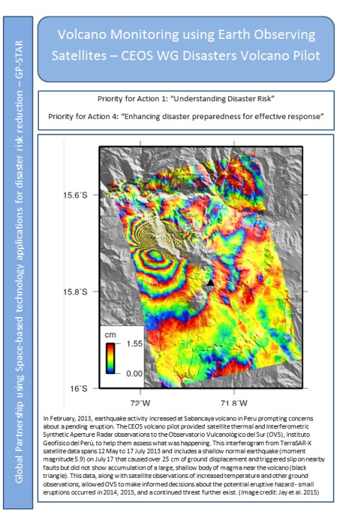
GP-STAR
Global Partnership on Space Technology Applications for Disaster Risk Reduction (GP-STAR)
WGDisasters contribution:
  GP-STAR Meetings and Website
  Volcanoes WG (fact sheet)
  Floods WG
  Special events
GP-STAR side event at the Global Platform for Disaster Risk Reduction meeting in May 2017, organized by The United Nations Office for Disaster Risk Reduction.

Slide 10
GEOSS Common Infrastructure (GCI)
GCI for Disasters - Virtual Session Structure
Establish a Dialogue between the GCI and the SBA Teams and relative initiatives (SBA = Societal Benefit Area)
Hear the needs and suggestions from the community in terms of Data in the GCI
Hear the needs and suggestions from the community in terms of Functionalities in the GCI
Assess with the community the need/benefit of establishing a thematic Community Portal
Build applications using GCI data– towards Plenary (Building a GEO Atlas by SBA)
Notes:
GEO is a coalition of governments and participating organizations having as its mission the implementation of the Global Earth Observation System of Systems (GEOSS) to meet the need for timely, quality long term global information as a basis for sound decision-making.
Earth observations from diverse sources, including satellite, airborne, in-situ platforms, and citizen observatories, when integrated together, provide powerful tools for understanding the past and present conditions of Earth systems, as well as the interplay between them.

Slide 11
GEOSS Common Infrastructure
GCI for Disasters - Virtual Session Structure
- Interesting GEOSS Portal
- Could be used for dissemination
- Could be used for end-users/partners research
How to link with GEO-DARMA?
How to link with ongoing/future activities?

Slide 12
Communications and Outreach
Conferences
- ISRSE (Tshwane, South Africa, 8-12 May, 2017)
- World Reconstruction Conference 3 (Brussels, 6-8 June, 2017)
Meetings
- Global Platform (22-26 May, Cancun, Mexico)
- GEO-DARMA Steering Committee and Concept Workshop (week of 22 May, Cancun, Mexico)

Slide 13
International Charter Space and Major Disasters
Promoting the Charter Universal Access initiative to the countries participating in CEOS pilots
Aiming to provide all the countries in the world with an easy access to the charter and its EO satellite resources in support of major disasters
Allows national disaster management authorities to submit a request
Proper procedures have to be followed, but to activate the Charter the affected country will not have to be a Charter Member
Meet three basic criteria:
Be a national disaster management authority or a delegate agency
Have the capacity to download and use maps
Activation request must be in English
Requested outreach materials and points of contacts (direct link)

