Slide 1
Meeting Objectives
Committee on Earth Observation Satellites
Stéphane Chalifoux, WGD Chair Andrew Eddy, WGD Secretary
WGD#7, Rome, Italy
March 14-16, 2017

Slide 2
Accomplishments
Three thematic pilots nearing completion
RO was triggered for Hurricane Matthew in Haiti and demonstrator to showcase/validate applications are nearly completed; 1st RO mission to Haiti has very successfully engaged national end-users and international community.
New Landslide Pilot started
Data flowing well for all existing pilots and supersites (including from the International Charter)
New GSNL supersites under evaluation at DCT
Awareness and Communications regarding pilots good, including up-to-date website information and glossy report in preparation

Slide 3
Objectives of this meeting
Objectives:
Reporting on pilots :
Draft final reports for volcanoes, floods and seismic hazards;
Review of sustainability strategies for each thematic area.
Moving forward with new activities – GEO-DARMA, Haiti RO, Landslide Pilot, New Proposal: Geohazards Lab
Plan of action:
Establish action plan to address outstanding elements and complete pilots on schedule and issues to be addressed and discussed related the landslide pilot, RO and GEO-DARMA
Prepare material for CEOS SIT-32:
Floods, Volcanoes and Seismic Hazards Reporting (based on the evaluation report and open discussion)
ALOS data use within the Pilot and alignment with JAXA priorities
New GSNL for approval
Rapid success of the RO over Haïti
Notes:
JAXA's current priorities regarding CEOS are carbon, forest and the UN SDGs.

Slide 4
Pilots reporting at SIT-32
One main goal of the meeting will be to develop a presentation per pilot (2 slides) to present initial evaluation-outcomes at SIT-32.
Slide 1:
Will the pilot achieve initial objectives approved 4 year ago (table)?
What is the sustainability strategy (1-2 lines)?
Slide 2:
At this point, what are the benefits to end-users and the scientific community (success, bullet point)?
At this point, what would be a realistic way forward (high level and possible implications by CEOS Members)?

Slide 5
Lessons learned from CEOS pilots
Some questions to think of for the final report
How did the pilot achieve its objectives?
How did all the members of the pilot contribute? In what way? If they didn’t all contribute, why and what was learned?
What was learned using the pilot approach?
Did the pilot provide valued feedback to the organizations contributing data? If yes, in what way? If not, why?
What were the benefits from the pilot?
What were the challenges and how were they resolved?
If we were to do it again what would be done differently?
How did the pilot define its end point?
How did the pilot plan for what happens next?

Slide 6
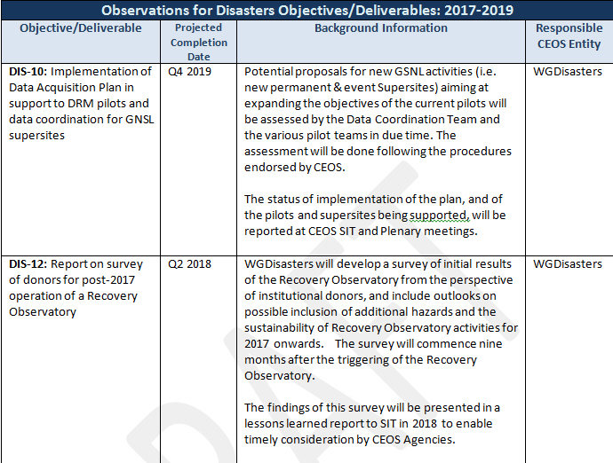
CEOS Work Plan 2017-2019 Disasters Objectives

Slide 7
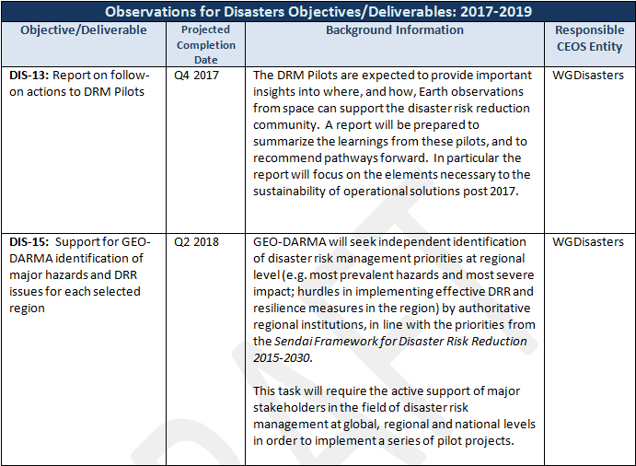
CEOS Work Plan 2017-2019 Disasters Objectives

