Slide 1

Committee on Earth Observation Satellites
GEO-DARMA
Ivan Petiteville, ESA
CEOS WG Disasters
Meeting # 6
6 – 8 September 2016

Slide 2
GEO-DARMA Goal
GEO-DARMA Concept still to be consolidated
Goal:
Enhance use of EO data for better-informed Disaster Risk Reduction and Resilience decision making
How:
Series of end-to-end projects addressing priorities of the “Sendai Framework for Disaster Risk Reduction 2015-2030”.
International Cooperation. Engagement of all stakeholders (end users, data & risk information providers, internat./national agencies, donor institutions,…)
Notes:
DARMA = Data Access for Risk Management.
The Japanese Daruma or Darma, a traditional handmade Japanese wishing doll (referred to as a "GOAL DOLL") that keeps people focused on achieving their goals.

Slide 3
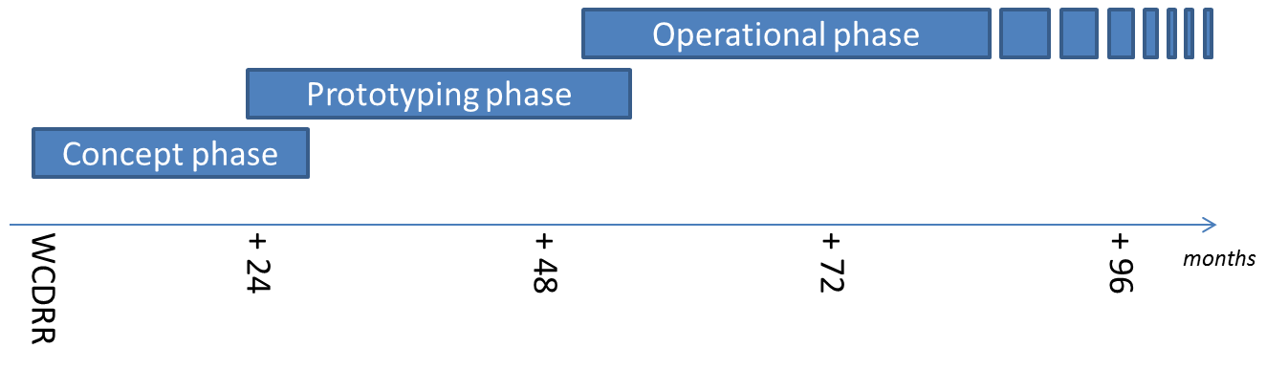
GEO-DARMA Partnership
Intention: build an international partnership with key stakeholders to define a strategy addressing high priorities of Sendai framework with resources available, on a best effort basis, adopting a phased approach
if extra resources and funding
identified
8
24

Slide 4
GEO-DARMA Concept Phase
Data providers not fully aware of DRR priorities & user needs, and users not aware of EO potential.
Dialogue with knowledgeable regional bodies needed for ….
.. independent assessment of DRR priorities for 2015-2030:
At regional level, 2 or 3 independent and authoritative regional institutions such as World Bank, GFDRR, UNESCAP, UNISDR, UNDP, UNOOSA, RCMRD, others, … (start with 3 regions: Africa, Asia-Pacific and Latin American and Caribbean)
Identification of hazards affecting most of the countries in the region (e.g. highest human and economic losses) or of transboundary risks that require regional and multi-country involvement.
Identification of 1st set of national projects within the region that could integrate EO in their objectives and delivery.

Slide 5
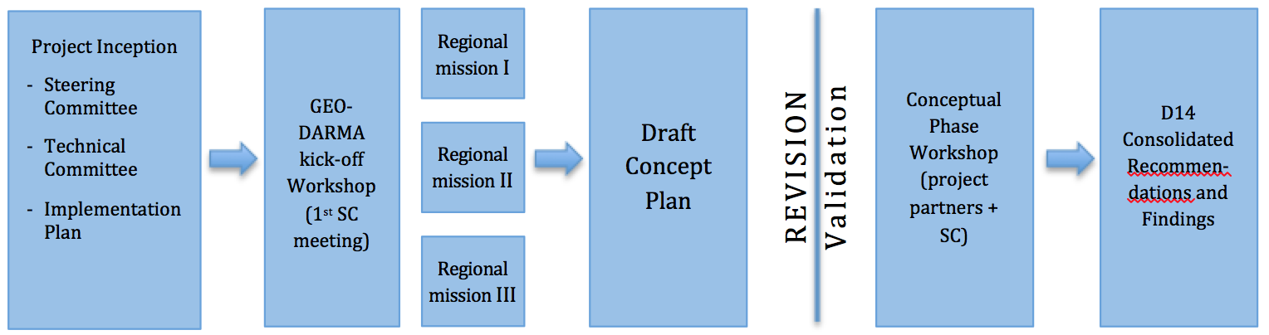
Work Flow – Concept Phase
(KO to 8 Mo)
Work Logic – Conceptual Phase (KO – M8)

Slide 6
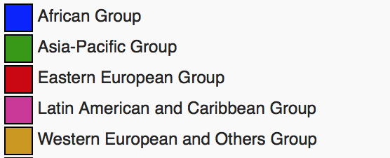
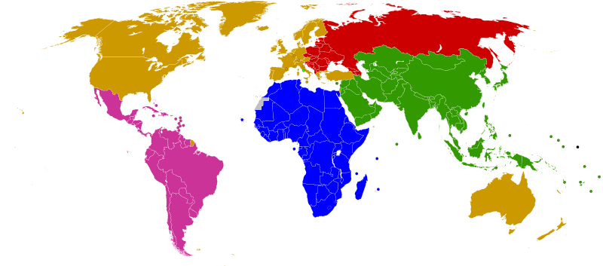
GEO-DARMA Partnership Approach
.
ASEAN
ADRC
SDMC (SAARC)
UNESCAP
APEC
LAS
PIFS
Asia-Pacific
Africa
Latin America
Caribbean
SADC
LAS
ECOWAS
CILSS
IGAD
UNECA
CDEMA
CEPRELAC
INDM (OAS)
CAPRADE
CRID
ECLAC
International: consider regional processes and programmes of World Bank, GFDRR, UNDP, UNEP, UNESCO, UNISDR, across all regions, especially in areas where there is no regional organisation (e.g. Central Asia)

Slide 7
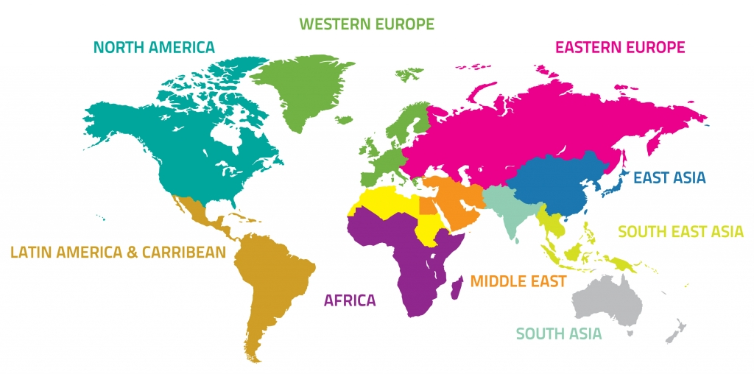

GEO-DARMA – Just an Example !
Identification of users needs and DRR priorities per region
For each region:
Types of hazards,
DRR Issues to be solved,
Initial countries

Slide 8
GEO-DARMA Prototype Phase
1. Realistic assessment of recommendations from Regional Institutions, given resources from the potential actors (e.g. data providers, value-added information providers, ..)
2. Define and implement possible prototype projects at country level to address recommended priorities;
close iterations with end users;
maximum reuse of existing initiatives / activities incl. operational, research, capacity building, …
3. Progressive extension to neighboring countries where applicable.
4. If “successful” prototype projects and if strong request from end users to continue → Assess transition to operation with identification of donors for future operational phase

Slide 9
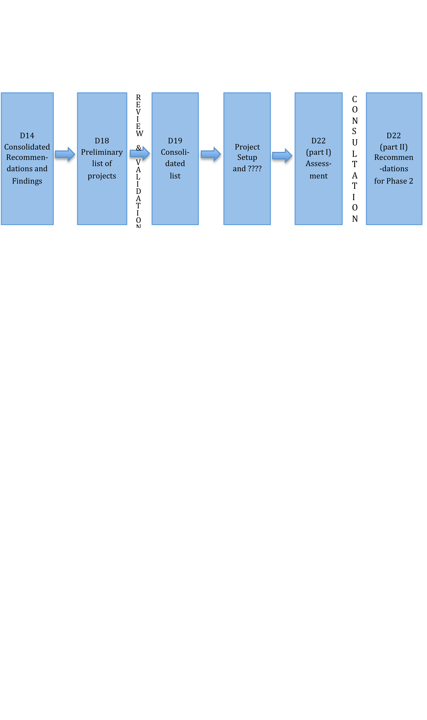
Work Flow – Prototyping Phase
(9 Mo to 24 Mo)

Slide 10
GEO-DARMA – Just an Example !
Prototype projects – progressive extension to neighbouring countries

Slide 11
GEO-DARMA Governance
Propose to adopt governance structure similar to GFOI incl. Steering Group (high level persons representing International Organisations, Institutional Donors, end-User Communities, Scientific communities, National Disaster Management Agencies, National Resource Management Agencies, …)
Partnership to be built progressively according to needs / activities:
Controlled growth to avoid large unmanageable heterogeneous group with diverging objectives.
1st group: initial partners to serve needs of Concept Phase → mainly international / regional active Stakeholders that can contribute to the consolidation of GEO-DARMA proposal and execution of Concept phase (mainly to generate recommendations)
2nd group: 1st group + national countries + practitioners … to define and execute series of projects in response to recommendations. Progressive growth of 2nd group when prototype solutions are progressively applied to neighboring countries.

Slide 12
GEO-DARMA Next Steps
GEO-DARMA documentation:
Implementation Plan provided to GEO SEC (10 Aug.)
New GEO-DARMA initiative proposed in GEO WP 2016
Status: no major activities in 2016. GEO-DARMA proposal has been successfully reviewed by the GEO Programme Board for inclusion in the GEO 2017-2019 WP. In parallel, contractual support to the GEO-DARMA Lead will kick-off in coming weeks.
Next critical step: Identify initial GEO-DARMA Partners in particular Regional Institutions

Slide 13
GEO-DARMA Status &
Issues (1/2)
GEO-DARMA proposal endorsed by GEO Plenary (Nov. 2015) but dormant since Plenary.
Currently CEOS is the only official contributor (and PoC):
UNESCAP, UNISDR-America already contacted before GEO Plenary
At both the GEO Plenary and UNISDR S&T conference, CEOS has proposed UNOOSA to coordinate both the Regional Institutions and the Capacity Building activities. No follow-on reaction from UNOOSA.
No real support from GEO Secretariat to attract other potential contributors though World Bank’ interest has been mentioned by GEO SEC. Missing full-time Disaster expert at GEO Secretariat .

Slide 14
GEO-DARMA Status &
Issues (2/2)
To foster the kick-off of GEO-DARMA, contractual support to the Lead (Ivan Petiteville) will start soon.
Two workshops planned 2017: KO workshop and end of concept phase workshop
GEO-DARMA proposal has been successfully reviewed by the GEO Programme Board for inclusion in the GEO 2017-2019 WP.
Creation of a GEO-DARMA subgroup within WGDisasters agreed in Bonn but the GEO-DARMA has only one member …. …… Ivan P. !!
GEO-DARMA could be an excellent opportunity to start follow-on activities, based on the current pilots projects.
Next critical step: Identify initial GEO-DARMA Partners in particular Regional Institutions and organize regional missions

