Slide 1

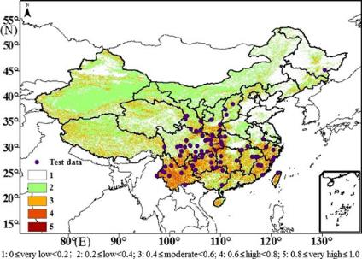
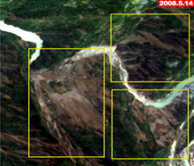


Potential Chinese Landslide Pilot Region:
CEOS Working Group on Disasters Meeting #6
South-western China
Zeng-Guang Zhou
zgzhou@aoe.ac.cn
Key Laboratory of Quantitative Remote Sensing Information Technology, Academy of Opto-Electronics (AOE), Chinese Academy of Sciences (CAS)
CVO, Vancouver, USA, 6-8 September, 2016

Slide 2
Outline
1 Landslide Hazards in China
2 Potential Chinese Landslide Pilot Region
3 Related Research Project

Slide 3
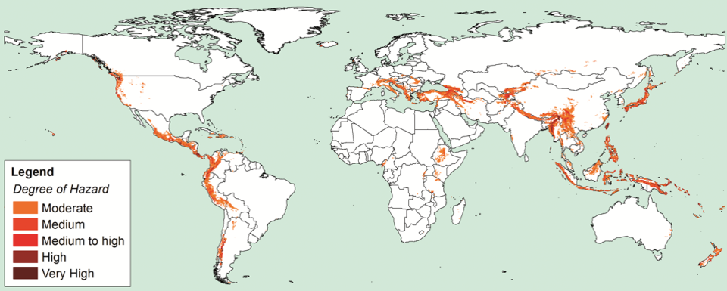
1. Landslide Hazards in China
Global Strong Earthquake
(Ms≥7.0)
Epicenter Distribution
(1970 ～ 2011)
(Jusong Shi et al., 2012)
Global Landslide Hazards Distribution
(Nadim et al., 2006)

Slide 4
1. Landslide Hazards in China
● History Earthquake Epicenter (Ms>6)
● History Earthquake Epicenter (Ms>8)
Wenchuan Ms8.0
Earthquake
May 12, 2008
Plateau of Tibet
High incidence of
strong earthquakes
(Ms>6)
India Plate
Major active faults and history earthquake epicenter map of China (Jusong Shi et al., 2012)

Slide 5
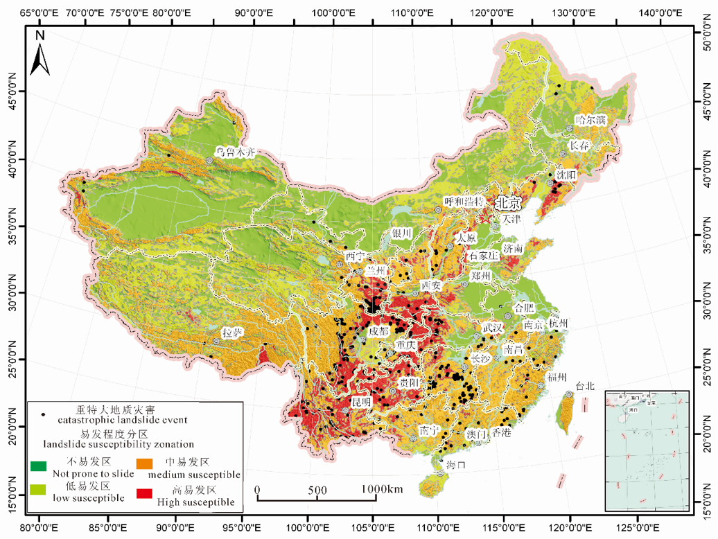
1. Landslide Hazards in China
● Catastrophic landslide event (2001-2010)
■ High Landslide susceptibility zone
Threating
280,000 potential
landslide hazards*
10 million people
200 billion property
Damaging
People’s property
Infrastructure
Eco-environment
in mountain areas
(*China Geological Survey)
Landslide susceptibility map and catastrophic landslide events during 2001-2010 in China (Jusong Shi et al., 2012)

Slide 6
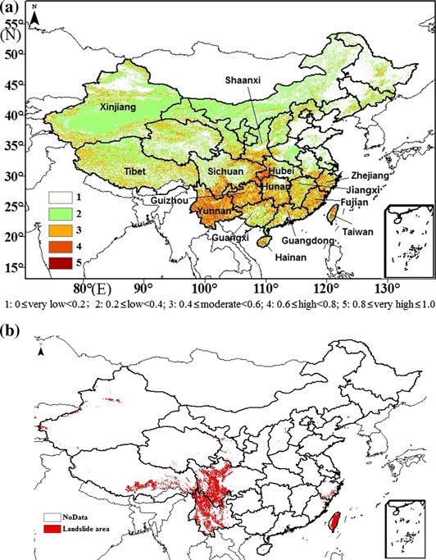
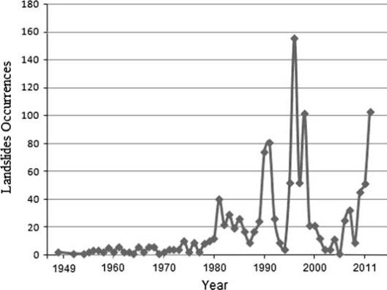
1. Landslide Hazards in China
Chinese landslide susceptibility map
derived from surface multi-geospatial data
The number of landslide events over 60 years
China’s Landslide Hazards hotspot map
based on NGI’s work in 2005
(Nadim et al. 2006)

Slide 7
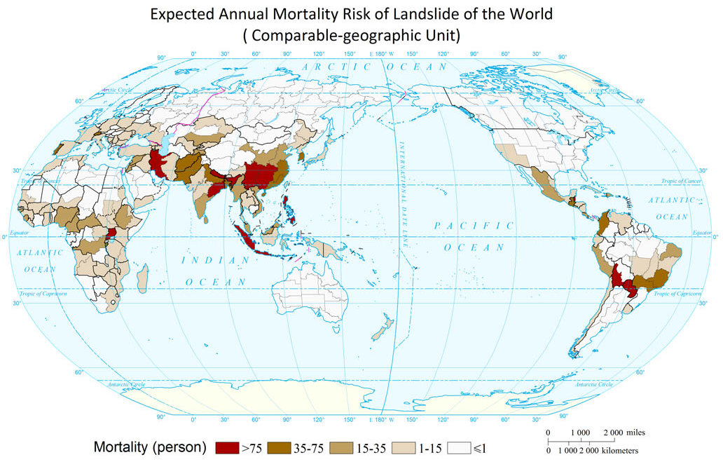
1. Landslide Hazards in China
China (southwestern area) has highest landslide mortality risk !
(Mapping Landslide Risk of the World, Wentao Yang et al., 2015)

Slide 8
Outline
1 Landslide Hazards in China
2 Potential Chinese Landslide Pilot Region
3 Related Research Project

Slide 9
2. Potential Chinese Landslide Pilot Region
2.1 Pilot Region: SW China
2.2 Landslides after Wenchuan Ms8.0 Earthquake
2.3 Pilot Objectives & Outputs

Slide 10
2. Potential Chinese Landslide Pilot Region
2.1 Pilot Region: SW China
● Study areas of remote sensing based landslide analysis
About ¾ studies focusing on SW China
5%
8%
10%
4%
40%
13%
3%
4%
6%
3%
(from investigation of 100+ studies of remote sensing based landslide analysis in China)

Slide 11
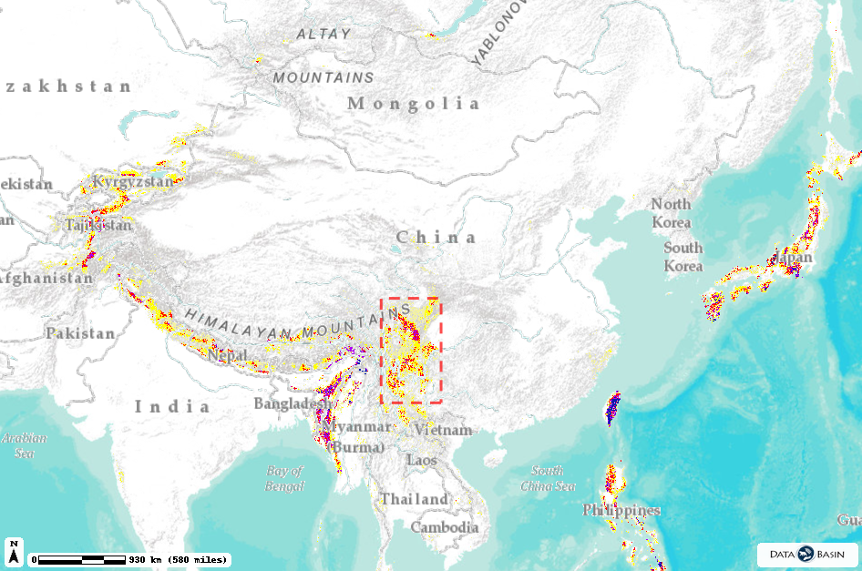
2. Potential Chinese Landslide Pilot Region
2.1 Pilot Region: SW China
Legend
Global Landslide Hazards Distribution
1-6
7
8
9
Beijing
10
Pilot Region:
SW China
Active earthquake
& Landslide-prone
region
Shanghai
Hong Kong
Global Landslide Hazards Distribution
https://databasin.org/datasets/b5c842f4b248464593a7673f5ad7f10f
Credits:
Center for Hazards and Risk Research (CHRR); Center for International Earth Science Information Network (CIESIN), Columbia University; Norwegian Geotechnical Institute (NGI)

Slide 12
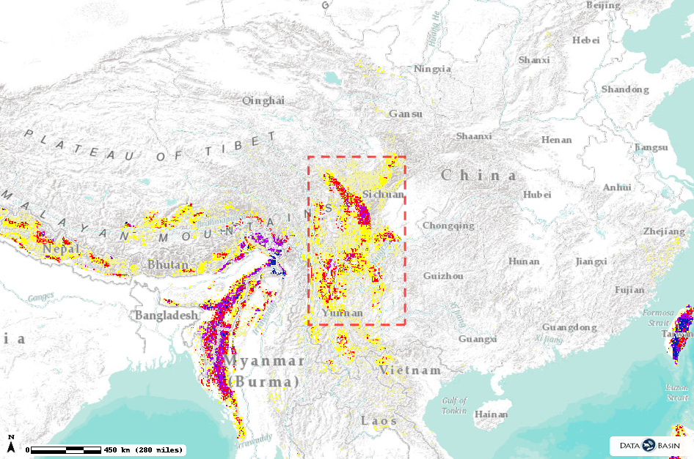

2. Potential Chinese Landslide Pilot Region
2.1 Pilot Region: SW China
Legend
Wenchuan Ms8.0 Earthquake
  May 12, 2008
  ≈ 48,000 landslides*
  ≈ 70,000 fatalities
  (20,000 by landslides)
Beijing
Global Landslide Hazards Distribution
1-6
7
8
9
10
Shanghai
Ludian Ms6.5 Earthquake
  August 3, 2014
  1,000+ big landslides
  617 fatalities by earthquake
  Thousands killed in landslides
Hong Kong
Global Landslide Hazards Distribution
(*Runqiu Huang et al., 2011)
https://databasin.org/datasets/b5c842f4b248464593a7673f5ad7f10f
Credits:
Center for Hazards and Risk Research (CHRR); Center for International Earth Science Information Network (CIESIN), Columbia University; Norwegian Geotechnical Institute (NGI)

Slide 13
2. Potential Chinese Landslide Pilot Region
2.1 Pilot Region: SW China
2.2 Landslides after Wenchuan Ms8.0 Earthquake
2.3 Pilot Objectives & Outputs

Slide 14
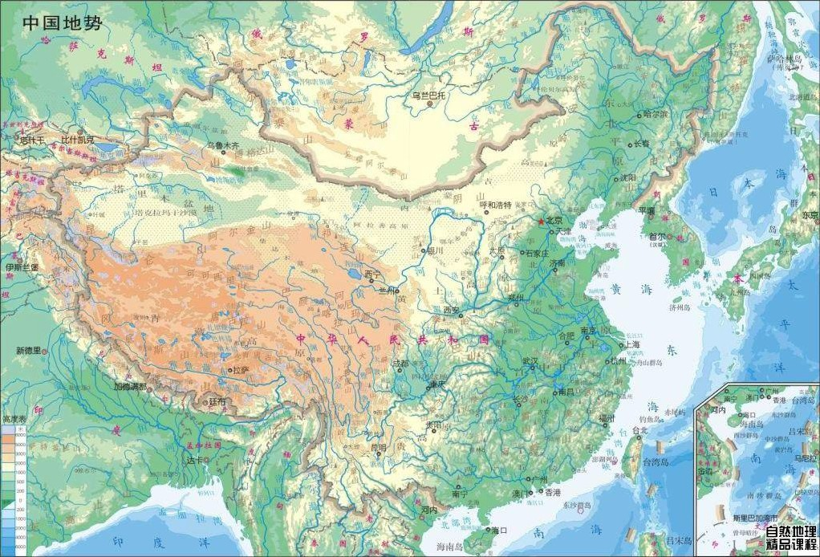
2. Potential Chinese Landslide Pilot Region
2.2 Landslides after Wenchuan Ms8.0 Earthquake
2nd terrain
Wenchuan Ms8.0
May 12, 2008
Beijing
Plateau of Tibet
Shanghai
Chengdu
Lhasa
India Plate
HongKong

Slide 15
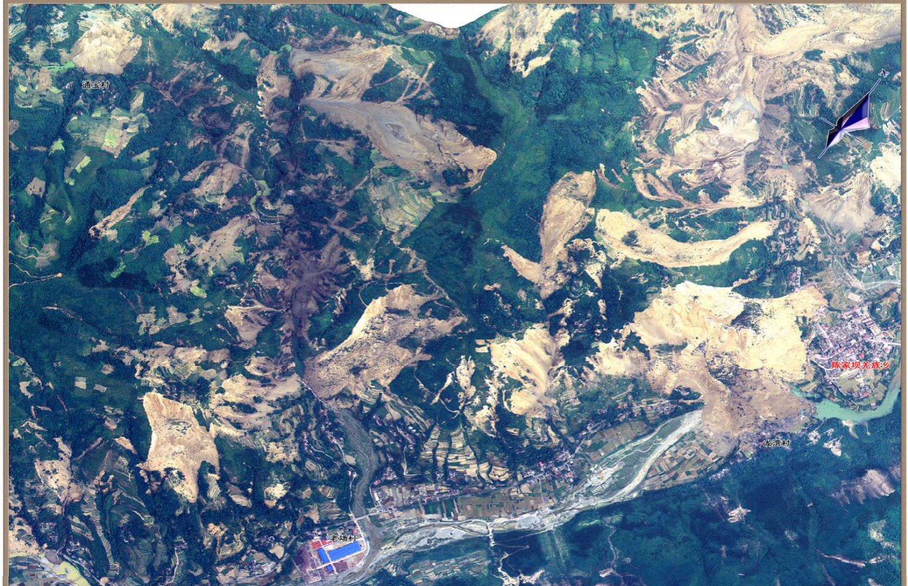

2. Potential Chinese Landslide Pilot Region
2.2 Landslides after Wenchuan Ms8.0 Earthquake
Tens of thousands of landslides triggered by the earthquake

Slide 16
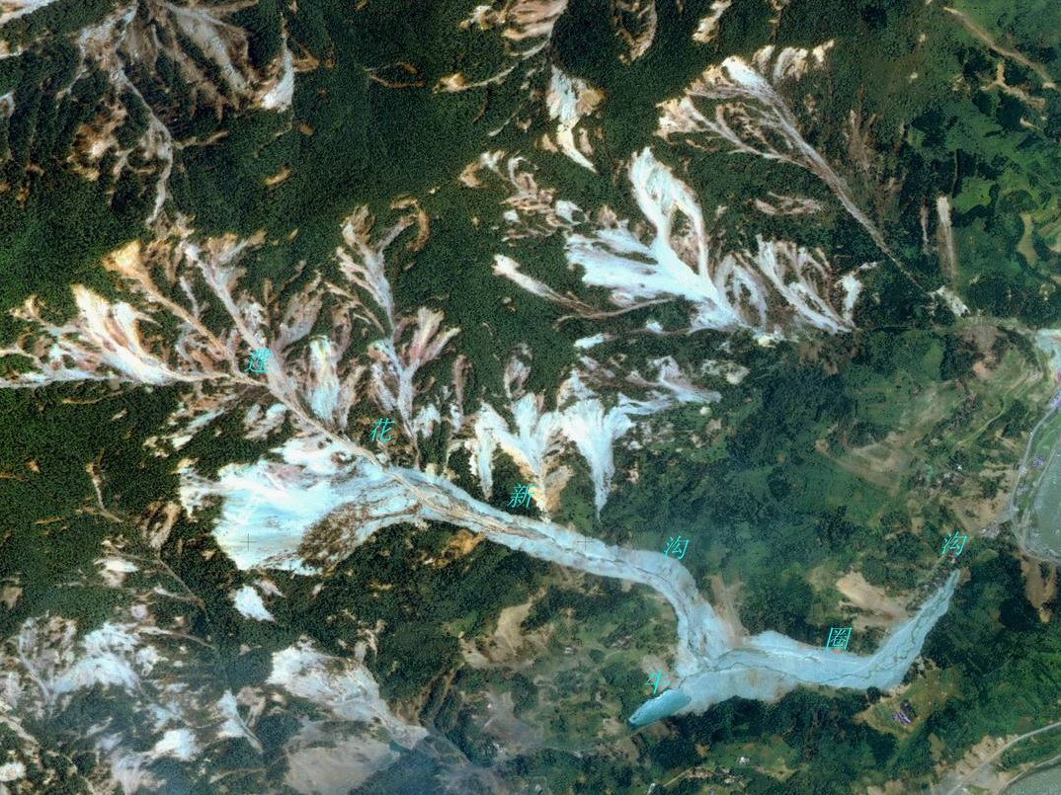
2. Potential Chinese Landslide Pilot Region
2.2 Landslides after Wenchuan Ms8.0 Earthquake
Landslide-debris is 4km long in run-out
Crushing 1
Crushing 3
Crushing 4
Crushing 2

Slide 17
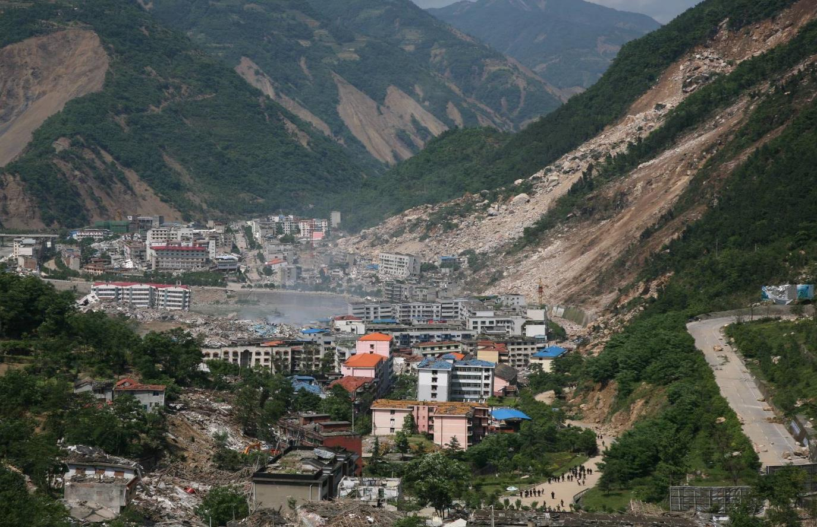

2. Potential Chinese Landslide Pilot Region
2.2 Landslides after Wenchuan Ms8.0 Earthquake
The Rockslide consists of limestone

Slide 18
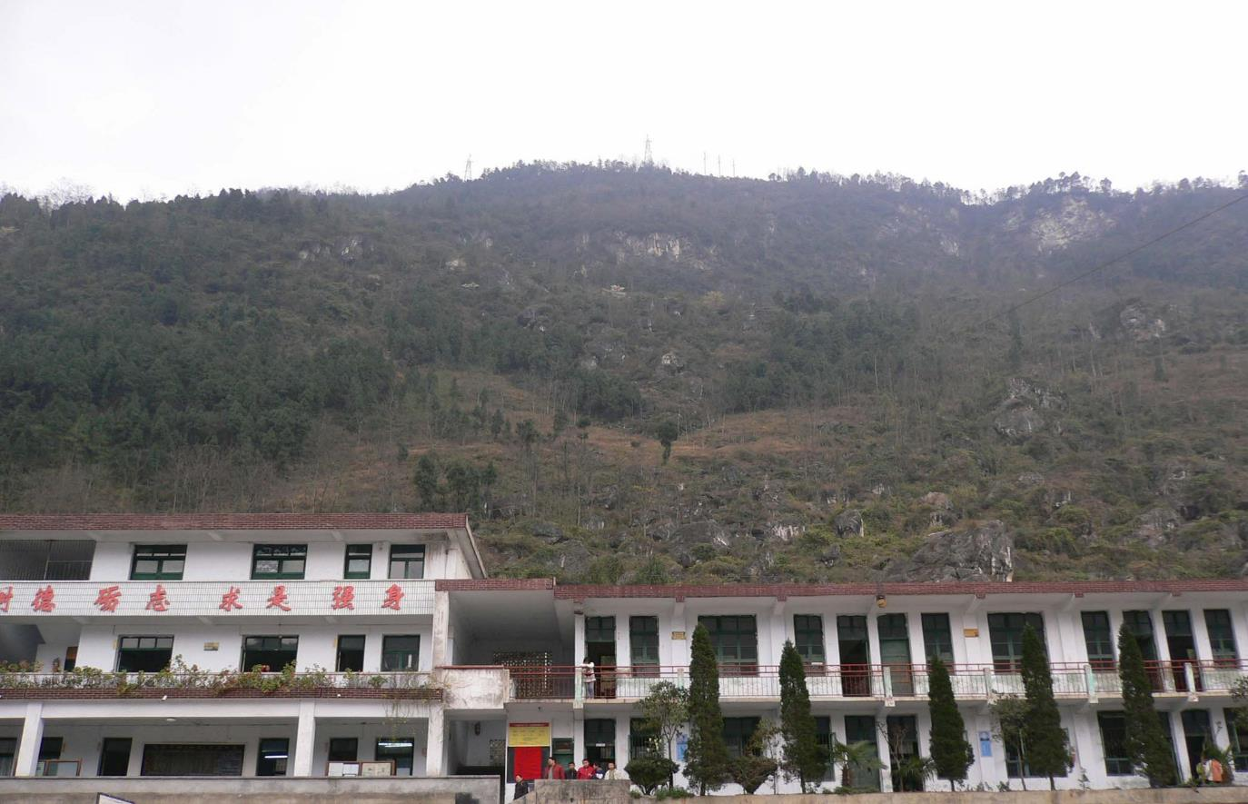

2. Potential Chinese Landslide Pilot Region
2.2 Landslides after Wenchuan Ms8.0 Earthquake
350 students at school and ready to class
(Photo in 2007.9)

Slide 19
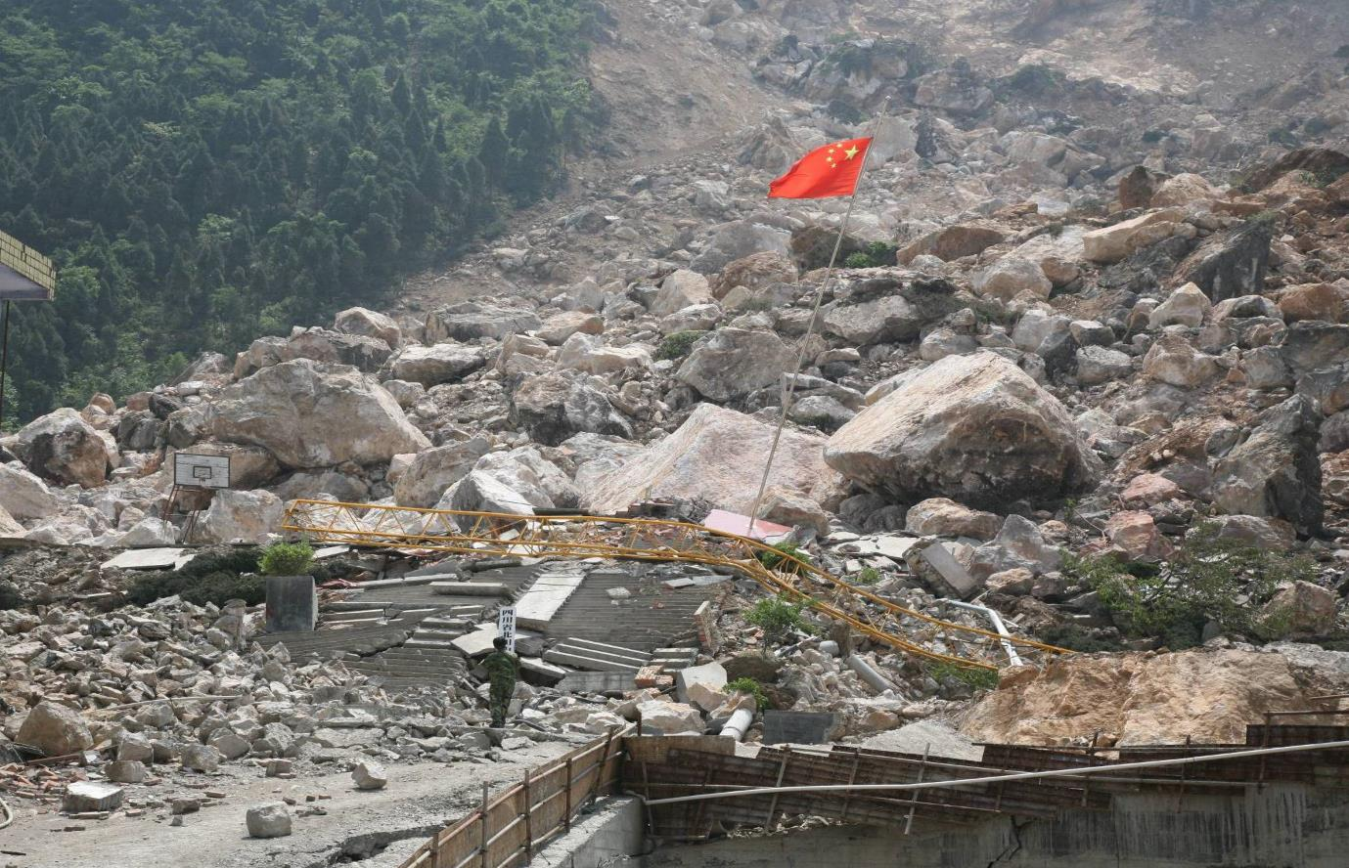
2. Potential Chinese Landslide Pilot Region
2.2 Landslides after Wenchuan Ms8.0 Earthquake
Flag was standing upright alone, but ?
350 fatalities
(Photo in 2008.5)

Slide 20
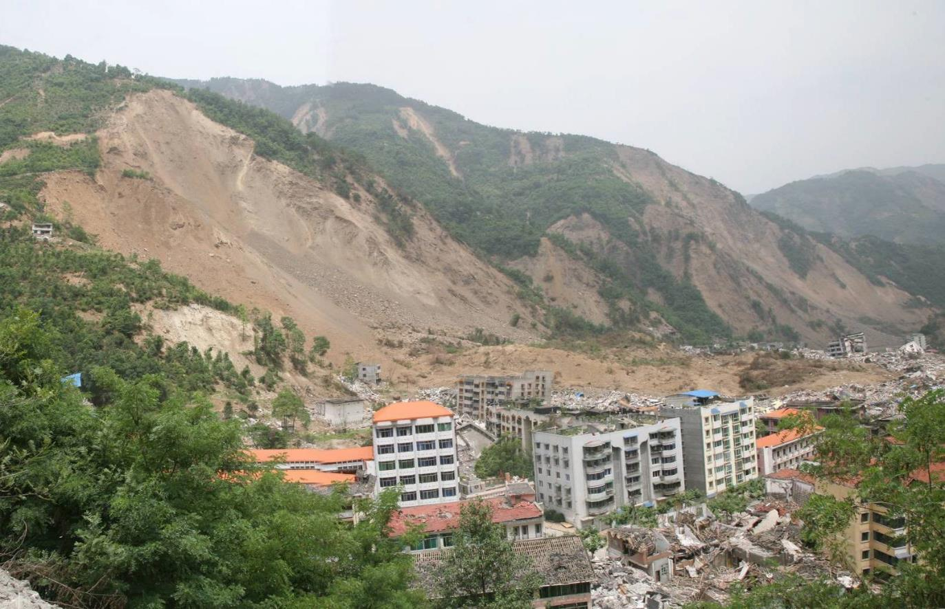
2. Potential Chinese Landslide Pilot Region
2.2 Landslides after Wenchuan Ms8.0 Earthquake
1600 deaths by earthquake landslide
1600 fatality

Slide 21
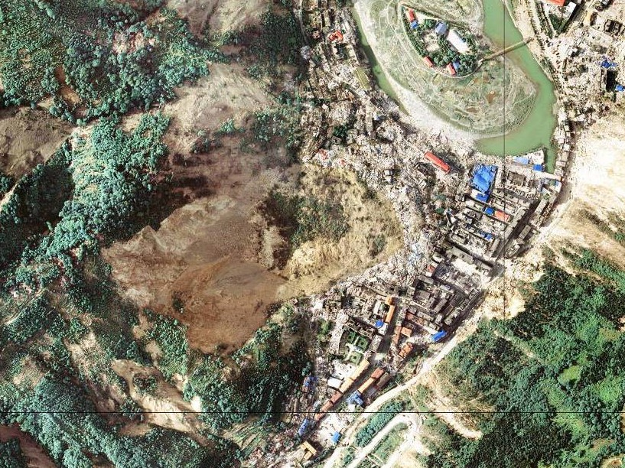
2. Potential Chinese Landslide Pilot Region
2.2 Landslides after Wenchuan Ms8.0 Earthquake
Half of town was buried by landslide
1600 fatality

Slide 22

2. Potential Chinese Landslide Pilot Region
2.2 Landslides after Wenchuan Ms8.0 Earthquake
Landslide Name | Landslide Place | Volume (million m³) | Deaths
城西滑坡 | 北川县老城王家岩 | 4.80 | 1600
都—汶路滑坡 | 都江堰—九寨沟旅游公路 | 100 | 1000
樱桃沟滑坡 | 北川县陈家坝乡茶园梁村 | 1.88 | 906
北川新中滑坡 | 北川县新县城中学新区 | 2.40 | 500
陈家坝滑坡 | 北川县陈家坝场镇 | 12 | 400
东河口滑坡 | 青川县红光乡东河口村 | 10 | 260
太洪村滑坡 | 北川县陈家坝乡太洪村 | 2 | 150
红村电站滑坡 | 石邡县石亭江红村电站 | 1 | 150
红岩村滑坡 | 北川县陈家坝乡红岩村 | 4.8 | 141
黎明村滑坡 | 都江堰市黎明村（213线） | 0.2 | 120
罐滩滑坡 | 安县雎水镇罐滩 | 1.44 | 100
小龙潭崩塌 | 彭州市银厂沟景区 | 0.05 | 100
大龙潭沟口崩塌 | 彭州市银厂沟景区 | 0.1 | 100
谢家店滑坡 | 彭州市九峰村7社 | 4 | 100
Deaths due to earthquake landslides (>100)

Slide 23








2. Potential Chinese Landslide Pilot Region
2.2 Landslides after Wenchuan Ms8.0 Earthquake
1000
900
800
700
600
500
400
300
200
100
0
Places
933
869
748
709
Pre-earthquake
After-earthquake
232
151
153
156
1
2
3
4
Collapse
Landslide
Debris flow
Unstable slope
Potential hazards in the counties of extreme severe hazards before/after earthquake

Slide 24
2. Potential Chinese Landslide Pilot Region
2.1 Pilot Region: SW China
2.2 Landslides after Wenchuan Ms8.0 Earthquake
2.3 Pilot Objectives & Outputs

Slide 25
2. Potential Chinese Landslide Pilot Region
2.3 Pilot Objectives & Outputs
Objectives
  Objective A:
  Develop effective methodologies for merging multi-source optical satellite imagery to better detect regional landslides in case of earthquake.
  Objective B:
  For selected case studies areas (e.g., Wenchuan or Ludian) in SW China, monitor landslides hotspots using multi-source optical satellite EO on a quarterly to monthly basis.

Slide 26
2. Potential Chinese Landslide Pilot Region
2.3 Pilot Objectives & Outputs
Outputs
  Output A:
  Report on effective methodologies for multi-temporal landslide detection using multi-source optical satellite images.
  Output B:
  Multi-temporal landslide inventory produced using multi-source optical satellite images for selected case studies areas (e.g., Wenchuan or Ludian) in SW China.

Slide 27
Outline
1 Landslide Hazards in China
2 Potential Chinese Landslide Pilot Region
3 Related Research Project

Slide 28
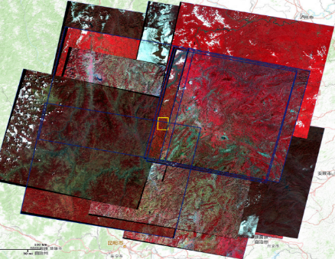
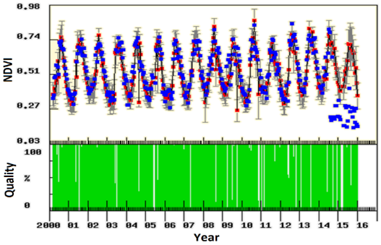



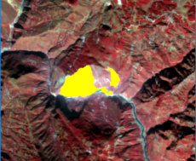
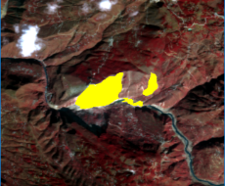
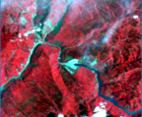


3. Related Research Project
Change Detection in Big Data of Satellite Image Time Series
(funded by Chinese Academy of Sciences for 2016-2018.)
Goal:
Develop methods for change detection using multi-source satellite image time series.
Demonstrate how the method can support multi-temporal landslide detection.
Multi-source
optical images
(Landsat, Spot, HJ, GF, ZY, etc.)
Time series
change detection
…
High-freq
images
time series
Multi-temporal landslide
detection
…

Slide 29
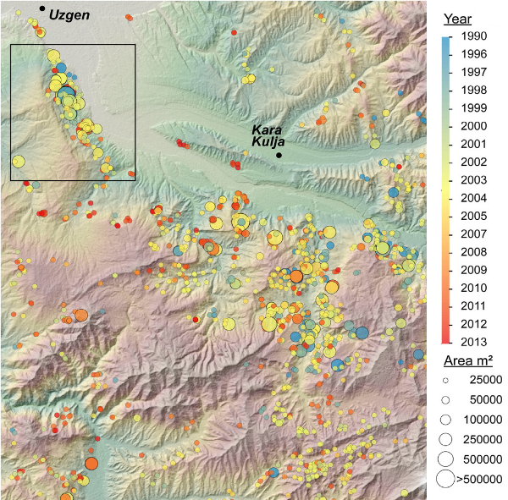
3. Related Research Project
Change Detection in Big Data of Satellite Image Time Series
(funded by Chinese Academy of Sciences for 2016-2018.)
Expected highlights:
Merging multi-source optical satellite images time series.
Detecting changes in image time series
on a monthly basis.
Detecting regional landslides over
space and time after an earthquake.
Yearly multi-temporal landslide inventory
in Kyrgyzstan
(Robert Behling, et al., 2016)

Slide 30
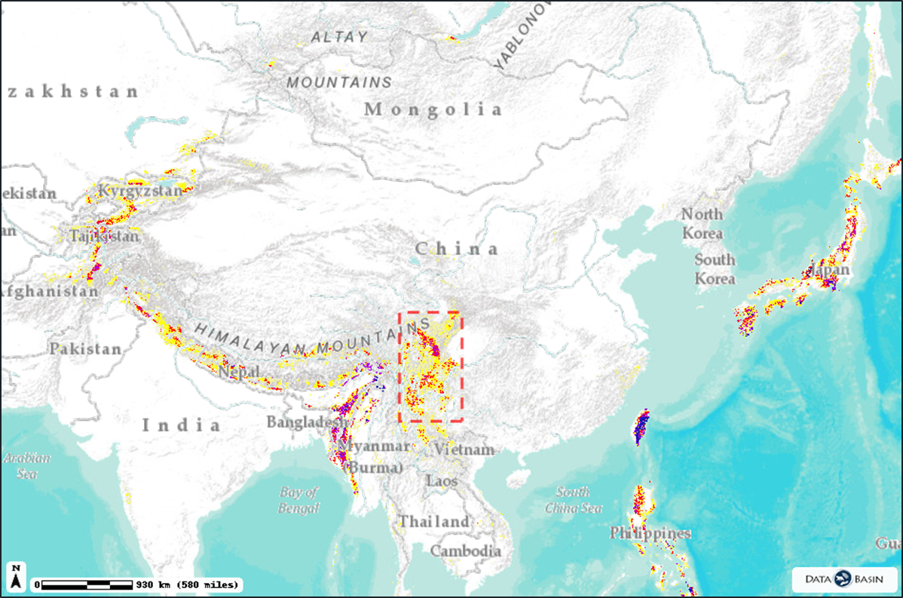
Potential Chinese Landslide Pilot Region: SW China
Thanks

