Slide 1

Committee on Earth Observation Satellites
Landslide Disaster Working Group
Pilot:
September 8th, 2016

Slide 2

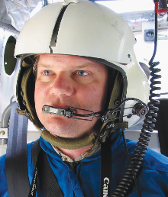


Co-leads of landslide pilot
Dr. Dalia Kirschbaum, NASA Goddard Space Flight Center, Maryland, USA
Dr. Jonathan Godt, Landslide Hazards Coordinator, U.S. Geological Survey, Colorado, USA
Dr. Jean-Philippe Malet, School and Observatory of Earth Sciences, University of Strasbourg, France
Dr. Sigrid Roessner, GFZ German Research Centre for Geosciences, Germany

Slide 3
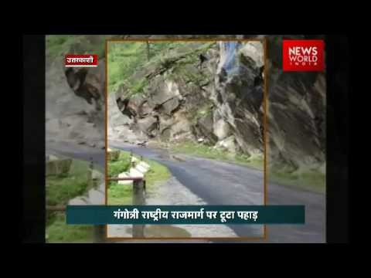
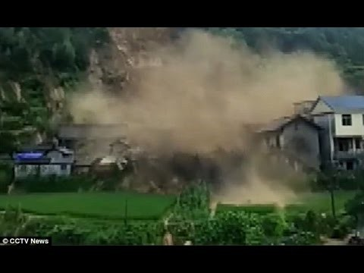
Selected Landslides, July 2016
(around the world)
Rockslide on the highway to Gangotri, Uttarakhand in northern India, Published July 24, 2016
https://www.youtube.com/watch?v=FK6g4IlH7j0
Landslide affecting houses in a village of central China’s Hunan Province.
Published on Jul 19, 2016
https://www.youtube.com/watch?v=gXNdV9_8kCk

Slide 4
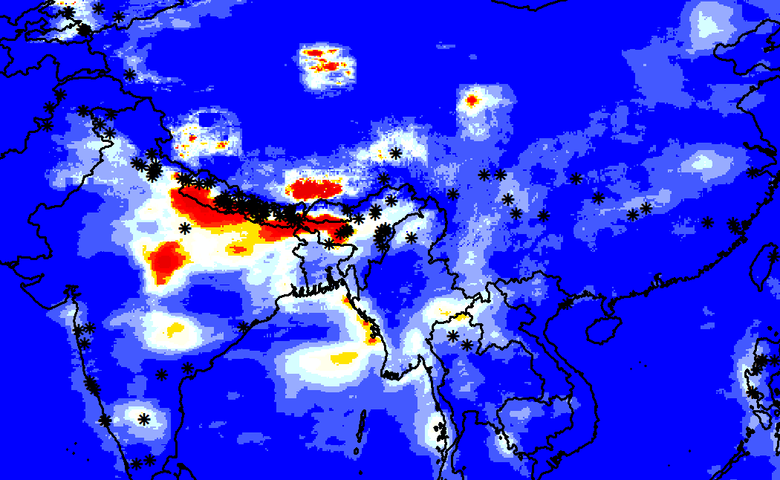
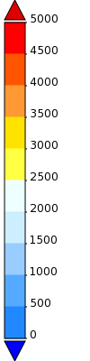
Landslides and rainfall, July 2016
GPM Rainfall accumulation and reported landslides, July 2016
Rainfall-triggered landslides reported by the NASA’s Global Landslide Catalog
mm

Slide 5
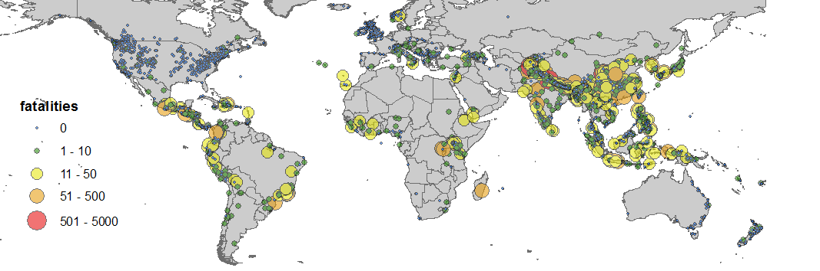
Landslide impacts
Global distribution of rainfall-triggered landslides
# of landslides
# of fatalities
Source: GLC, 2007-2016
Notes:
Global phenomon where landslides can happen around the world, but we need to be flexible with the regions we consider

Slide 6
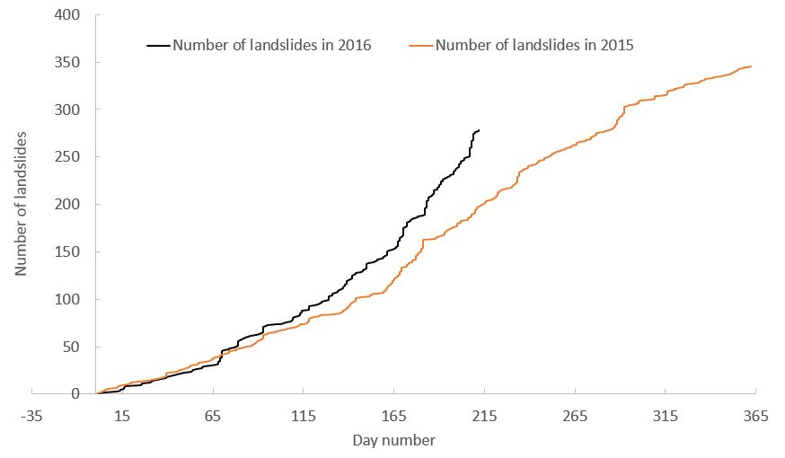
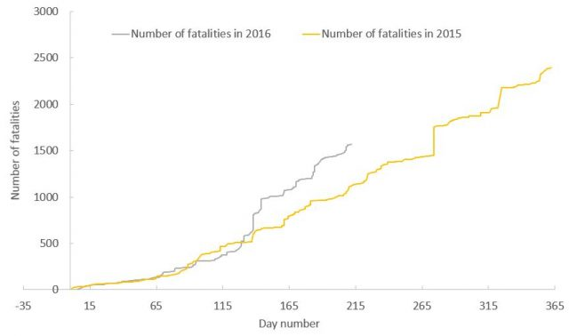
Landslide Fatalities (2015-16)
Fatality-inducing landslide events and losses
Comparing 2016 to 2015
http://blogs.agu.org/landslideblog/2016/08/01/2016-landslide-losses/

Slide 7
Landslides Pilot: Main Goals
  To demonstrate the effective exploitation of Earth observations (EO) data and technologies to detect, map and monitor landslides and landslide prone hillsides, in different physiographic and climatic regions.
  To apply satellite EO across the cycle of landslide disaster risk management, including preparedness, situational awareness, response and recovery with a distinct multi-hazard focus on cascading impacts and risks.
Notes:
Key message regarding the new pilot :
- it's about multi-hazard and multi-sensor approach to disaster resilience and risk reduction
- the multi-hazard tactic is to advance data fusion, integration and analysis, leveraging existing pilots as they end their 3 years. Starting with the new pilot we will look at earthquake, volcano and flood inducing cascading effects such as landslide and debris flow.

Slide 8
Status for Landslide WG
December 2015: Convened first Disaster Landslide Pilot meeting (virtual)
January-Feb 2016: Conducted survey of participants to define expertise, interests, and areas of focus
March 2016: Introduction of potential Landslide Pilot at CEOS #5 meeting in Bonn, Germany
April 2016: In person meeting of pilot participants in Vienna, Austria
July 2016: Drafted CEOS DRM Landslide Pilot Plan and further defined study areas and co-leads
August 2016: Co-lead meeting to discuss further development of study areas and Landslide Pilot Plan
September 2016: Propose plan to CEOS Disaster WG for approval as 4th disaster pilot
September 2016: Establish the Landslide Pilot web presence on CEOS.ORG with a summary of goals, objectives and participants

Slide 9
Proposed Objectives
Objective A – Establish effective practices for merging different Earth Observation data (e.g. optical and radar) to better monitor and map landslide activity over time and space.
Objective B – Demonstrate how landslide products, models or services can support disaster risk management for multi-hazard and cascading landslide events.
Objective C – Exploit the experience, data, and lessons learned from ongoing pilots (i.e., seismic hazards, floods, volcanoes).
Objective D – Engage and partner with data brokers and end users to understand user and service requirements, user expectations, and to get feedback through the activities described in objectives A-C.

Slide 10
Proposed CEOS Objectives
Leverage and exploit existing imagery, technology for processing data, and expertise provided for the other three pilots, where applicable, for rapid development and application within landslide/multi-hazard pilot activities;
Improve coordination and sharing of satellite acquisitions and data products in support of landslide management across the existing flood, seismic, and volcano pilots to maximize utility of CEOS contributions;
Demonstrate the value of satellite EO in the context of integrated landslide management practices.
Capture and maximize use of lessons learned from other pilots (volcanoes, earthquakes, floods), including the participation of key contributors and end users of the pilots.

Slide 11
Key Pilot Outputs
& Deliverables
- Report on recommended practices for the combined exploitation of SAR and Optical imagery and technologies for landslide detection, mapping and monitoring”. (Objective A)
- Report on effective methodologies and strategies for considering multi-hazard and cascading aspect of landslides through multi-temporal landslide mapping from multiple triggers (leveraging information/interactions with the volcano, flood and earthquake pilots) (Objective A-C)
- Landslide event inventory and activity (monitoring) maps produced using optical and SAR imagery and technologies, and their combination, for selected case studies / geographical areas. (Objectives B-C)
- Report on end user engagement strategies and characterize enablers, challenges, barriers to effective transfer of information, knowledge and technologies. (Objective D)

Slide 12
Proposed key user communities
Users: national, regional and local governments, civil protection agencies, meteorological and geological services, land use planning decision makers, disaster risk reduction specialists with NGOs and international organisations, industry (including e.g., insurance, transport, forestry sectors).
Practitioners: landslide modelers, scientists and engineers in hydrology, water and environment ministries, meteorological and geological services, satellite data providers, volcano observatories, and value added service companies.
Institutional bodies responsible for communication of risk (gap between technical level and shared information with communities): research institutions with operational responsibilities.
General public: landslide event information for some of the case studies will be made available to the general public for increased awareness of these hazards and remote sensing capabilities, although the main focus of the pilot is on specialized users.

Slide 13
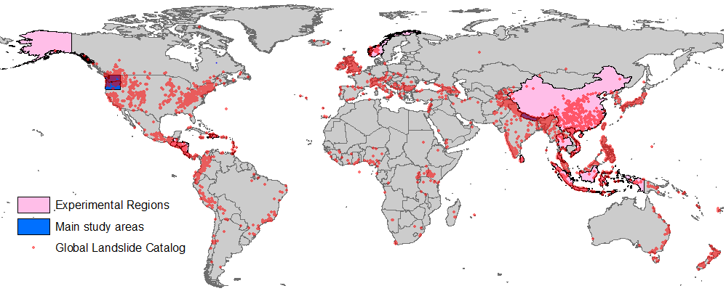
Proposed Regional Foci
Main Focus areas:
  Nepal
  Pacific Northwest, US
Experimental areas:
  SE Alaska
  China
  The Caribbean (Cuba, Haiti, Antillas)
  Sri Lanka/India
Notes:
Sites we want to actively develop but need to prioritize
Other potential focus areas

Slide 14
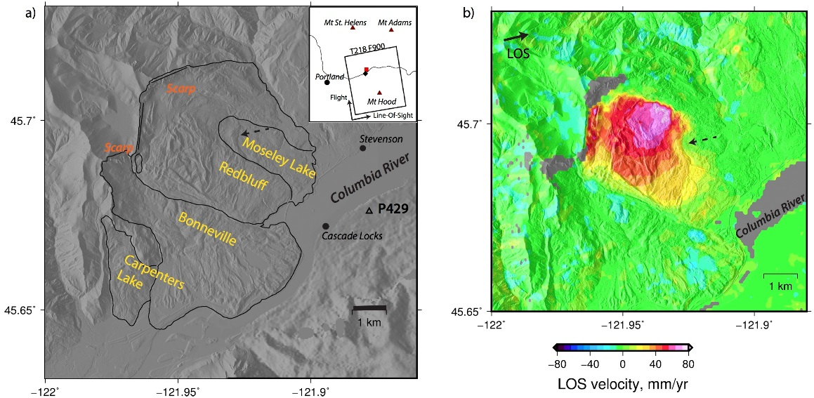
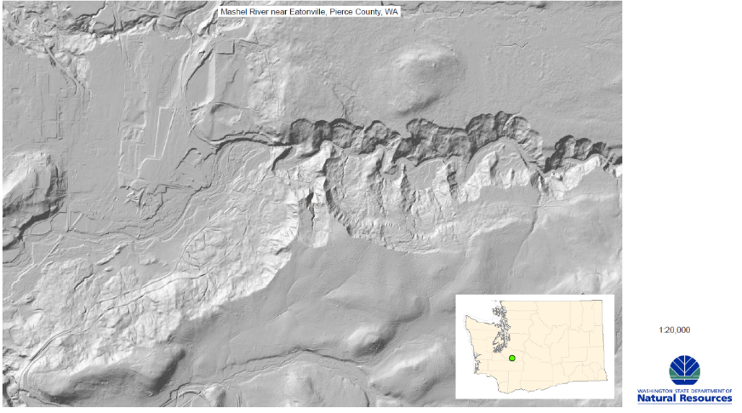
Pacific Northwest, USA
Why: Active geomorphologic and tectonic settings with extensive landsliding throughout the landscape
Who: There is a breadth of experience from USGS, state geological surveys, research groups, NASA, and others with experience apply remote sensing techniques to both monitor active landslides and conduct multi-temporal landslide mapping within the region
What: several existing activities already underway in this region, including engagement from end users (DOTs, NPS, NFS, etc.)
Meeting planned for late September, Denver
(left) Shaded relief map of the Cascade Landslide Complex located along the Columbia River Gorge from a LiDAR DEM. (right) Average line-of-sight velocity measured by InSAR (ALOS-1) indicating active movement of the Redbluff landslide. Warm colors indicate motion away from the satellite in the look direction (black solid arrow). The background shading is based on the 2m-resolution DEM from LiDAR. Figure prepared by Xiaopeng Tong.
Example of multiple slope movements from the Mashel River near Eatonville, WA. Shaded relief from LiDAR, provided by Washington DNR.

Slide 15
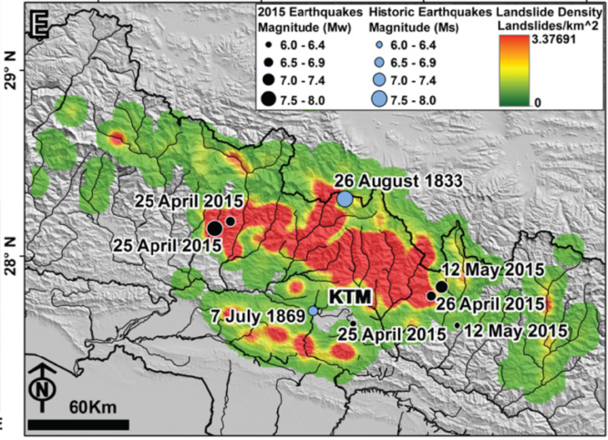
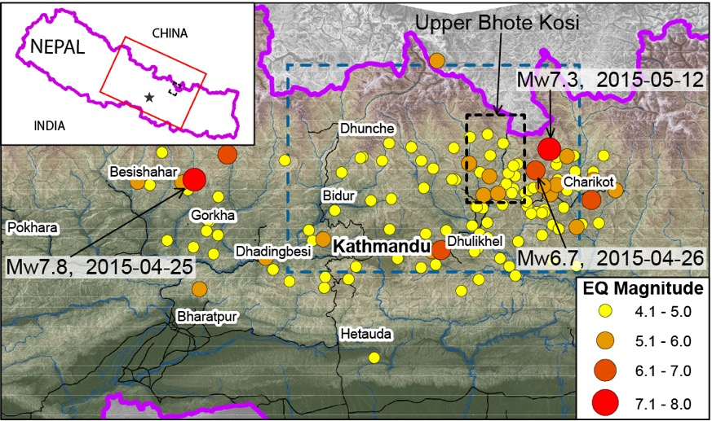
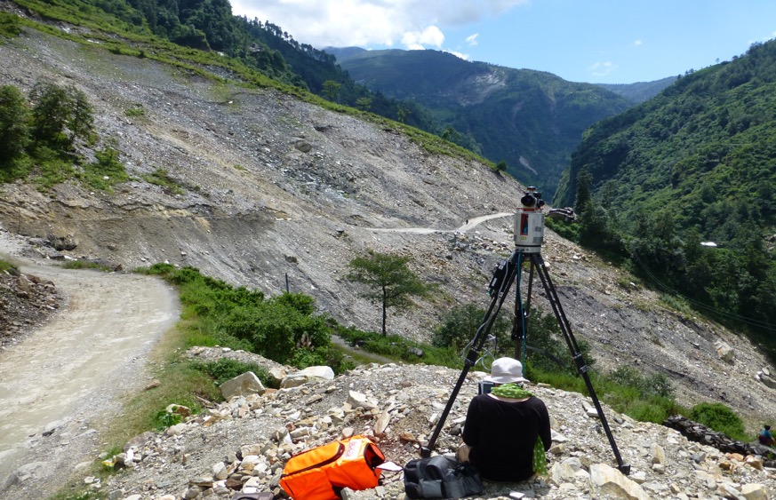
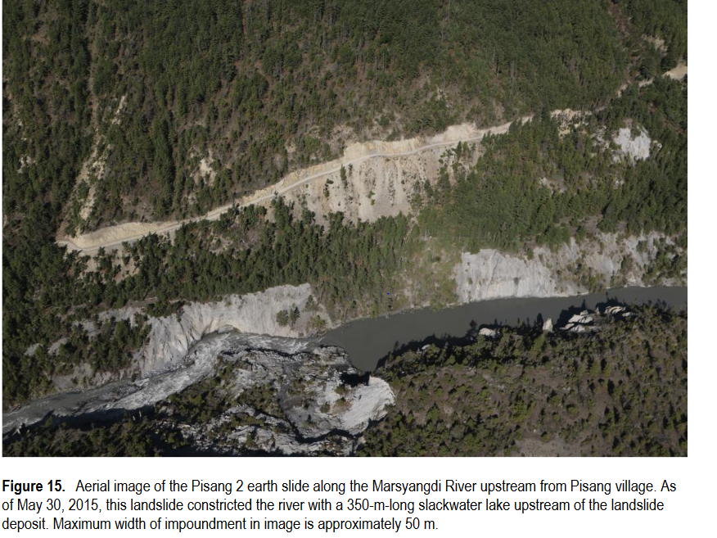
Nepal
Why: highly active tectonic setting with strong monsoon season that triggers hundreds-thousands of landslides each year. Gorka Earthquake, 2015 caused thousands of landslides that were mapped by many different groups.
Who: Wide range of groups working in this area (Durham University, ITC, USGS, NASA, and other academics, and many more) with a breadth of experience and expertise in this region
What: Engagement with stakeholders and regional experts within the region, leverage data from supersite
Kargel, J. S., et al. 2015, Science
Durham, NSET Nepal, BGS, site monitoring and mapping in Sindhupalchowk, Upper Bhote Kosi, Arniko Highway
GFZ Potsdam: Field based
monitoring and remote sensing analysis after Gorkha earth-quake for understanding long- term landsliding and erosion (slides below)
Collins and Jibson, Open-File Report 2015-1142
Notes:
GFZ: automated identification of landslides, see

Slide 16
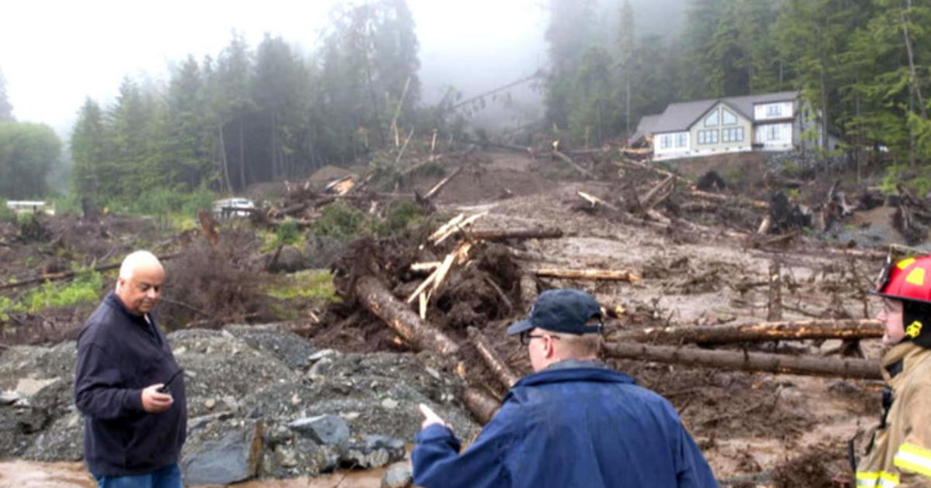
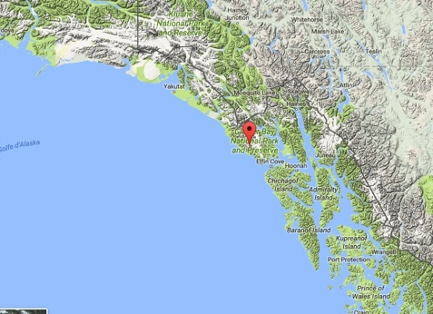
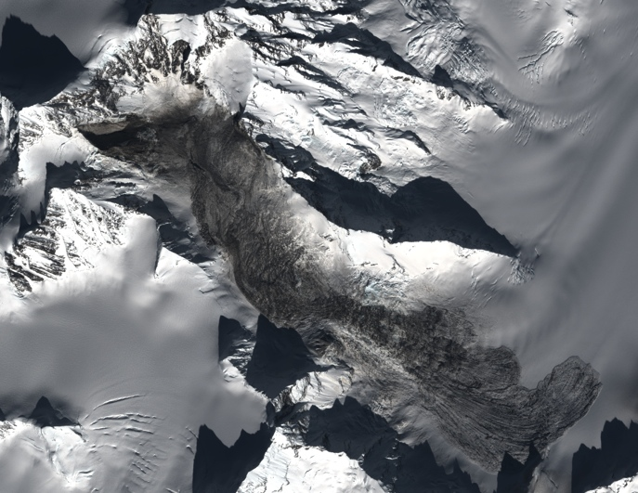
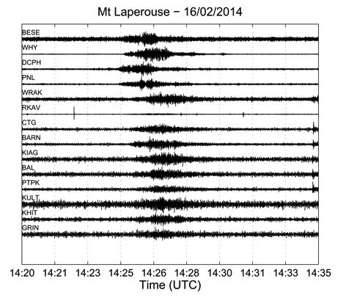
Experimental Regions
Southeast Alaska
  Slow-moving landslides
  Heterogeneous landslide triggers
  Active projects
  End users: National Forest Service, USGS
Sitka, Alaska landslide, August, 2015, James Poulson/The Daily Sitka Sentinel via AP
  Very large rockslides
  Detection and characterization by coupling Earth Observation and seismology
  Active projects (LDO/Columbia NY, EOST/Univ. Strasbourg)
Mont La Pérouse rockslide, 2014/0216(Glacier Bay National Park).Optical imagery (Pléiades) and seismic signals (Starck, Ekström & Hibert; Univ. Columbia and Univ. Strasbourg)
Notes:
Jean-Philippe: Caribbean as well
Enrique. IT and French Antilles
Caribbean in Flood pilot

Slide 17
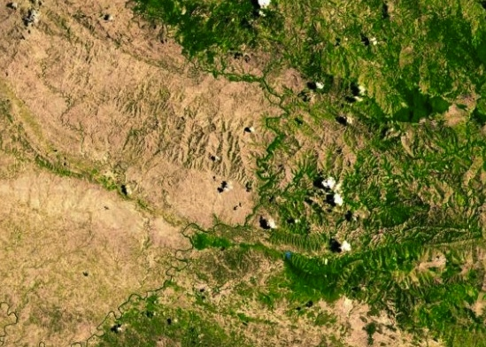
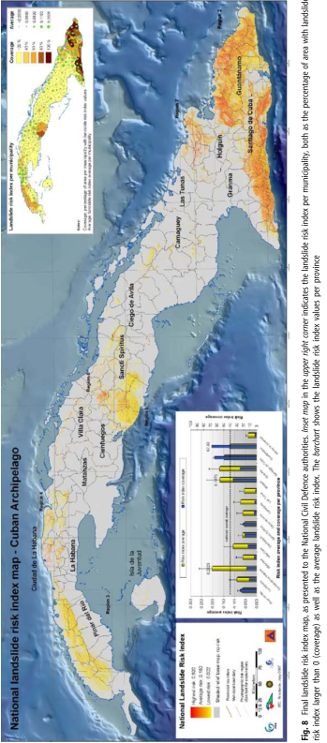
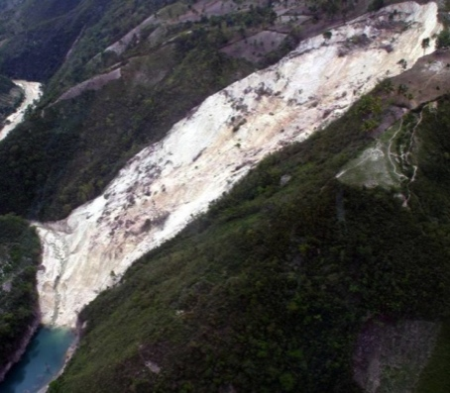
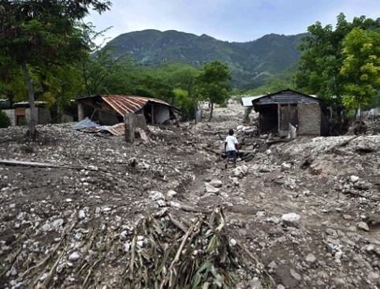
Experimental Regions
The Caribbean: Cuba, Haiti and French Antillas
  Tropical climate, active tectonic region and diverse geomorphologic settings
  Rainfall, Earthquake and Anthropogenic induced failures
  Active engagement from Ministry of Energy and Mines (Cuba), CNIGS (Haiti) and CNRS (French Antillas)
  Active projects (Univ. of Strasbourg, CNES KAL-HAITI)
  Also an experimental region of other Disaster Pilots (floods, volcanoes)
Effects of deforestation on landslide susceptibility
Haiti
Dominican
Republic
Landslide dam (Jacmel, Haiti) triggered by the 2010 ETQ
Cuba
Mudslide (Haiti) triggered
by storm Erika (2015)
Castellanos & Van Westen (2008)
Notes:
Jean-Philippe: Caribbean as well
Enrique. IT and French Antilles
Caribbean in Flood pilot

Slide 18
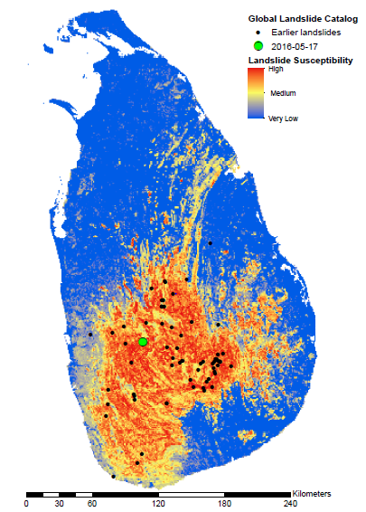
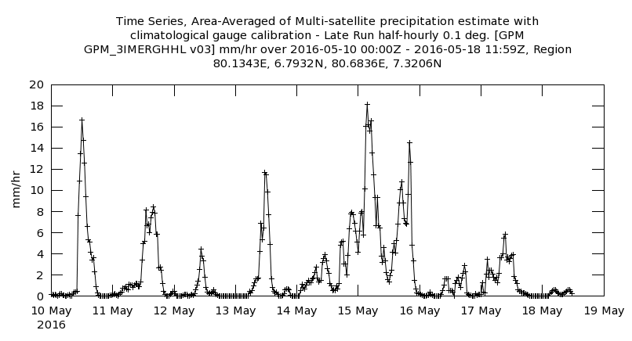
Experimental Regions
Sri Lanka / India
Landslides
On the afternoon of May 17th, 2016, a major landslide event caused at least 92 deaths, with 109 still missing*. The site was rated highly susceptible to landslides in a new global landslide susceptibility map. IMERG data suggest that both antecedent and current rainfall as well as complex topography played a role in the slope failures.
*BBC News (http://www.bbc.com/news/world-asia-36355980)
Credit: Kirschbaum & Stanley, NASA

Slide 19
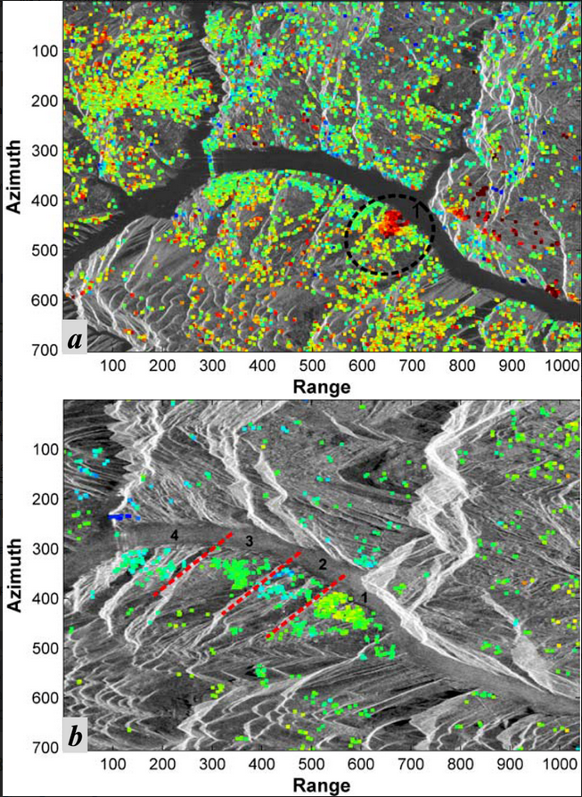
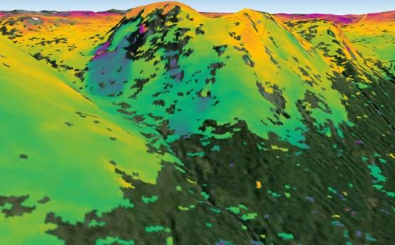
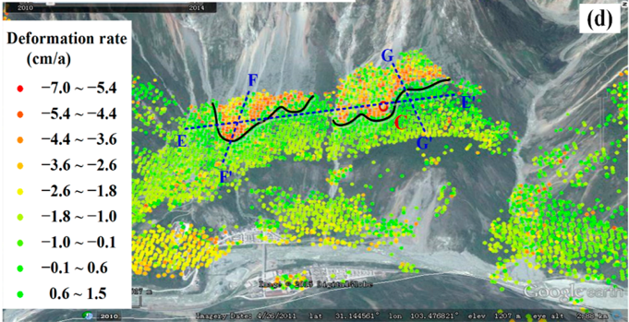
Experimental Areas
China
Norway
Deformation velocities at PS points in Badong identified by PS-InSAR: (a) from Advanced Land Observing Satellite (ALOS) Phased Array L-band Synthetic Aperture Radar (PALSAR) data; (b) from Environmental Satellite (ENVISAT) Advanced Synthetic Aperture Radar (ASAR) ascending data; and (c) from ENVISAT ASAR descending data. The numbered circles outline the two active landslides. The number 1 in (a) refers to the Huangtupo landslide. The red lines in (b) divided the southern riverbank into several significant deformation zones. The red star in (c) indicates the location of the reference point.
Tantianuparp, P., X. Shi, L. Zhang, T. Balz, and M. Liao, 2013: Characterization of Landslide Deformations in Three Gorges Area Using Multiple InSAR Data Stacks. Remote Sens., 5, doi:10.3390/rs5062704.
(Top) A 24-day Sentinel-1 (C-band) interferogram demonstrating landslide mapping in Kåfjord, Norway, where the ground moved ~1 cm. Copyright to ESA. Copernicus data (2014)/ESA/Norut–SEOM Insarap study. (Right) Linear velocity estimated after sophisticated time-series processing of 11 ALOS (L-band) SAR images [Tang et al., 2016] overlaid on optical imagery.

Slide 20
Proposed regional study leads
Region | Regional Point of Contact
Nepal | Nick Rosser, Sigrid Roessner, Dalia Kirschbaum
Pacific Northwest, US | Jonathan Godt, Dalia Kirschbaum
Southeast Alaska | Marten Geertsema
Norway | John Dehls
Caribbean | Enrique Castellanos, Jean-Philippe Malet
China | Zeng-Guang Zhou (TBD)
India / Sri Lanka | TBD
Notes:
Other potential focus areas

Slide 21
Methodology
I. Mapping
  Creating inventories
  Documentation
II. Monitoring
  Routine processing over sample sites
III. EO-based Analysis
  Automatic
  Standardized methods to establish thresholds
Notes:
Uniting pilot regions is we want to see how we can explore the methodologies and application across regions. There have been methods that have been successfully applied

Slide 22

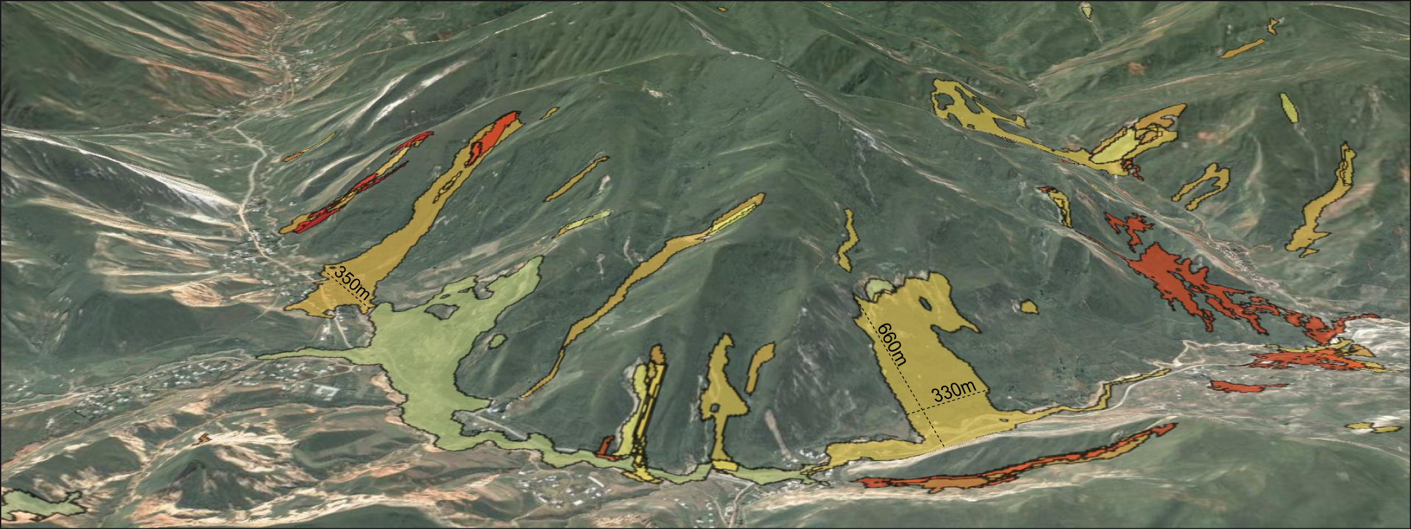
Long-term Landslide Mapping object-based multi-temporal detection
Color corresponds to time of occurence
Automated Approach identifies landslides:
of different shapes, sizes, lithology, activity stage (fresh, reactivation)
of multiple activations (enlargements, secondary movements)
Behling, R., Roessner, S., et al., 2016. Derivation of long-term spatiotemporal landslide activity - A multi-sensor time series approach. Remote Sensing of Environment, 186, 88–104.

Slide 23
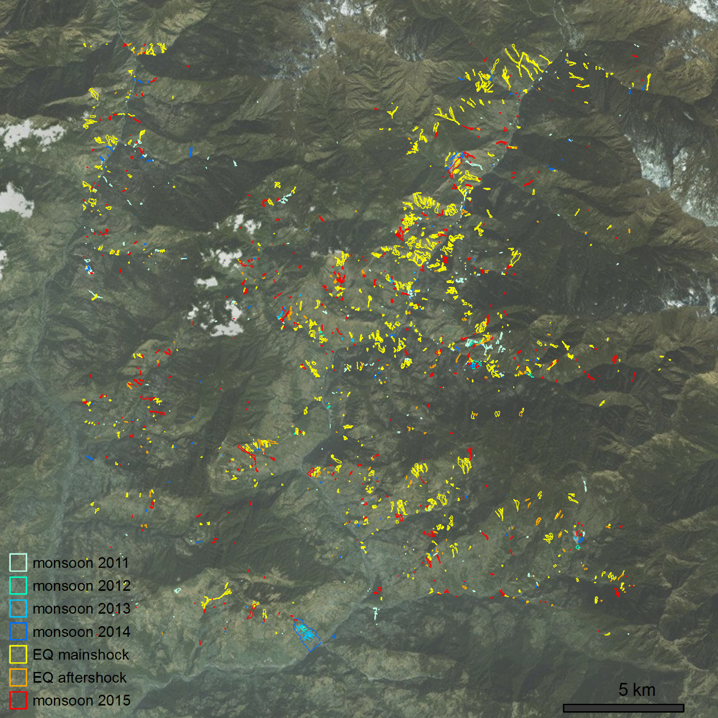
Multi-temporal Landslide Mapping 2015 Gorkha earthquake, Nepal
Need for understanding of relationship between short-term earthquake induced landslide activity and long-term inter-seismic landscape response
Automated analysis of pilot area (25*25 km) using RapidEye and Landsat data (2011 – 2015)
~2000 total landslides
~1000 co-seismic landslides
~500 landslides during monsoon 2015
few 100’s of landslides before
Robert Behling and Odin Marc, GFZ Potsdam

Slide 24
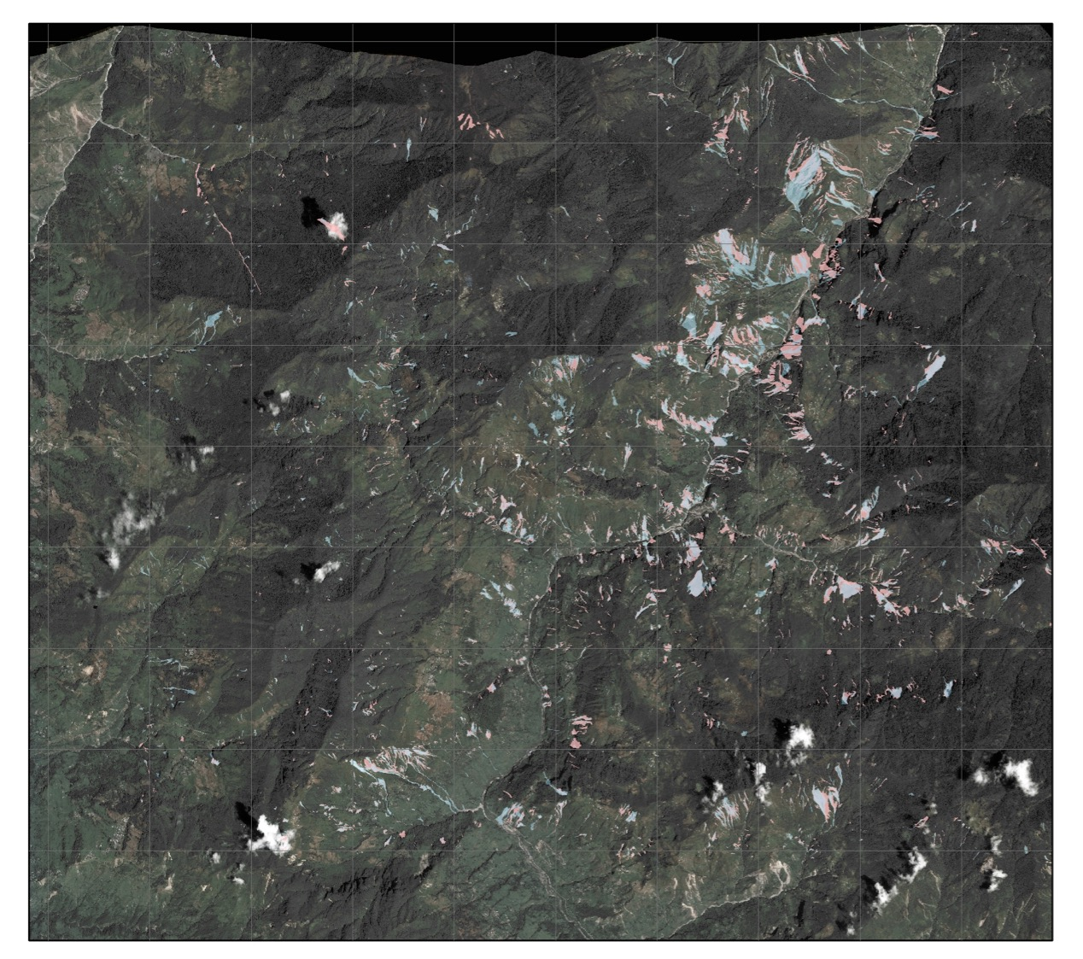
Pre- & post-monsoon landslide mapping, 2015
5 km
Pre- & post- monsoon
WorldView & Quickbird
  May 2014 & 24th May 2015
Pléiades image
  9th September 2015
Significant registration errors in steep topography
Results:
389 pre-EQ landslides (c. 1.3 / km²)
2,626 post-EQ landslides (c. 9 / km²)
2,550 post-monsoon landslides
Slides from N. Rosser/Durham

Slide 25
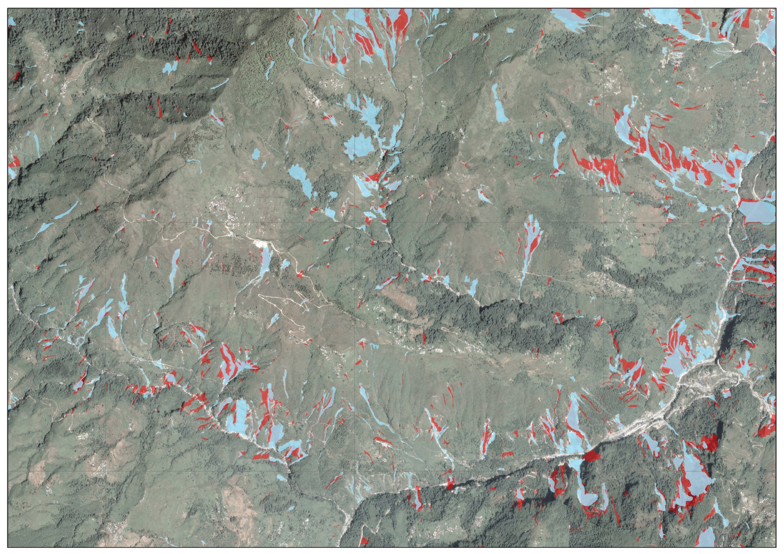
Pre- & post-monsoon landslide mapping, 2015
Combined EQ & monsoon landslides
1 km
Slides from N. Rosser/Durham

Slide 26
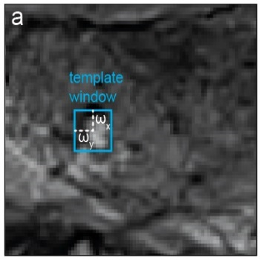
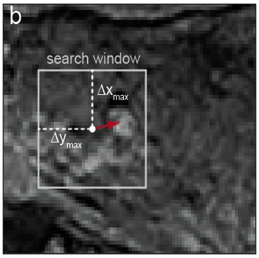
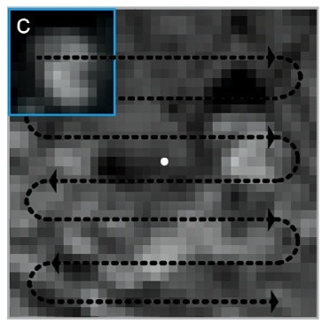
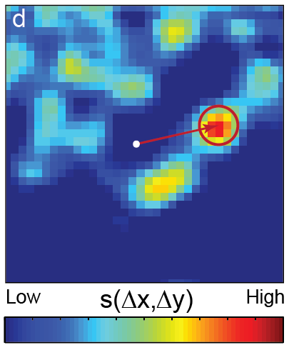
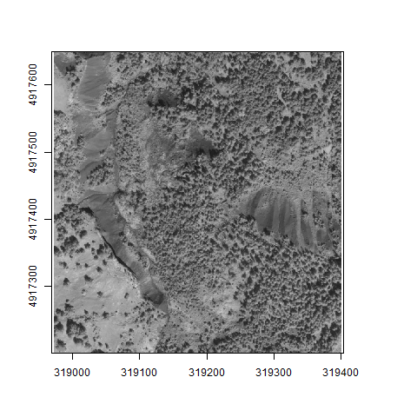
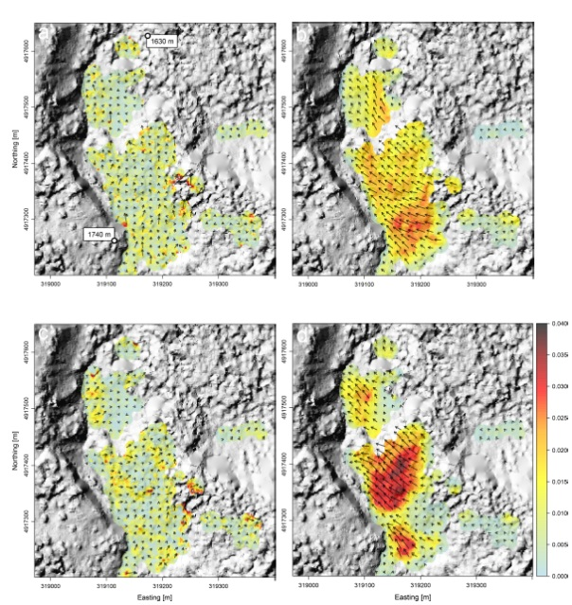

Deformation of Large Landslides
From Time Series of Optical Sensors
Satellite image matching / correlation for time series processing
First image
Later image
Search
Correspondence
Principle of
image correlation
Surface motion of a landslide in the French Alps
over two years (from Pleiades imagery)
(Stumpf & Malet, RSE, 2016 – in press)
Notes:
Jean-Phillipe can send a figure to replace flowcart: idea is that we can document the velocity/displacement, not just a map of the position of the landslide but can document the displacement, additional attribute to what we already have in the inventory

Slide 27
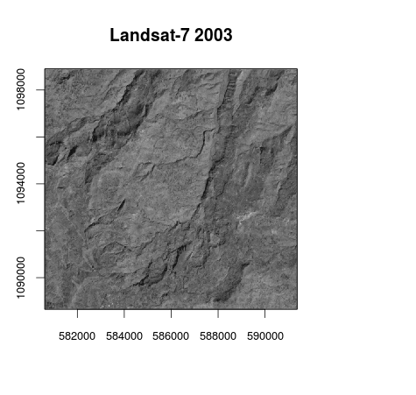
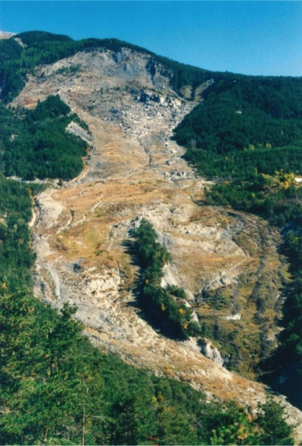
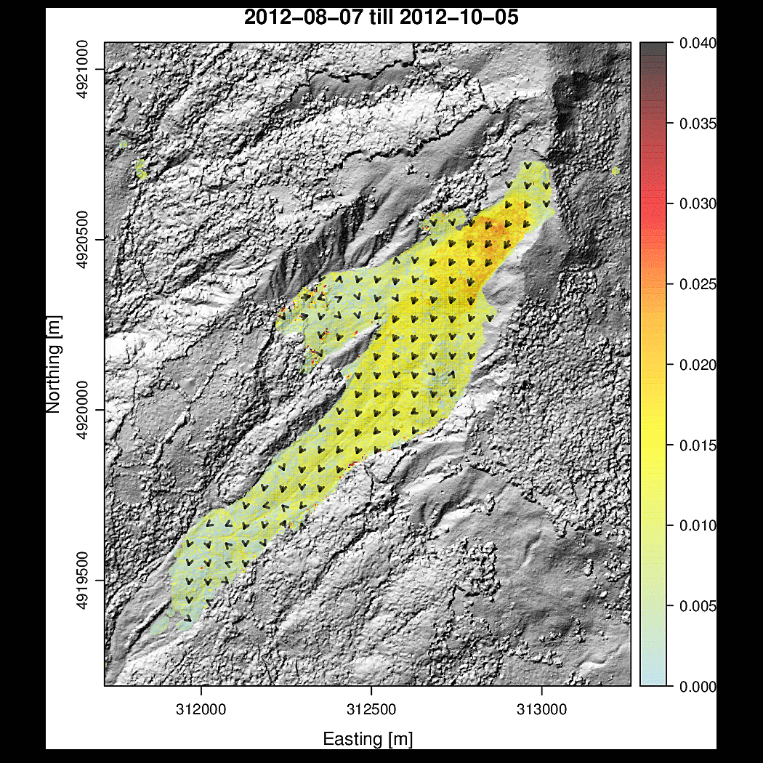
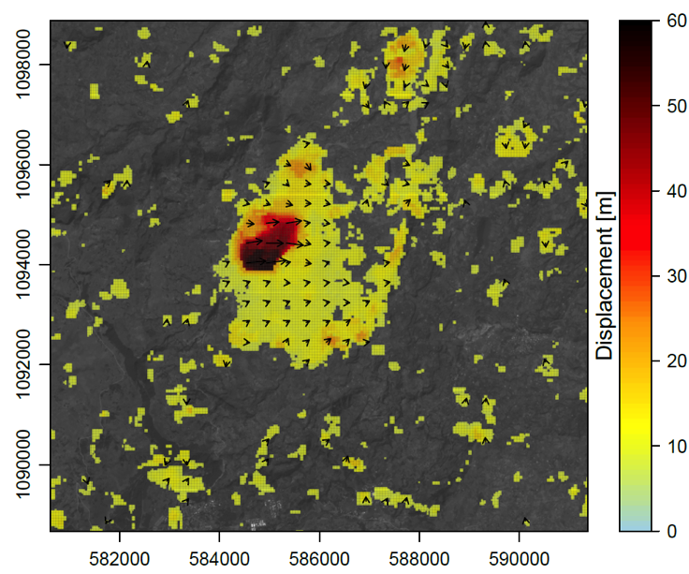
Deformation of Large Landslides
from Time Series of Optical Sensors
  Motion field of the Debre-Sina landslide (Ethiopia) 2003–2016 from a combination of Landsat-7 and Sentinel-2 images
Motion field at La Valette landslide (SE Franch Alps) from a stack of 8 Pléiades images
(Stumpf & Malet, RSE, 2016 – in press)
Notes:
Correlate image from same sensor, or correlate images from different sesors to get estimated motion/velocity

Slide 28
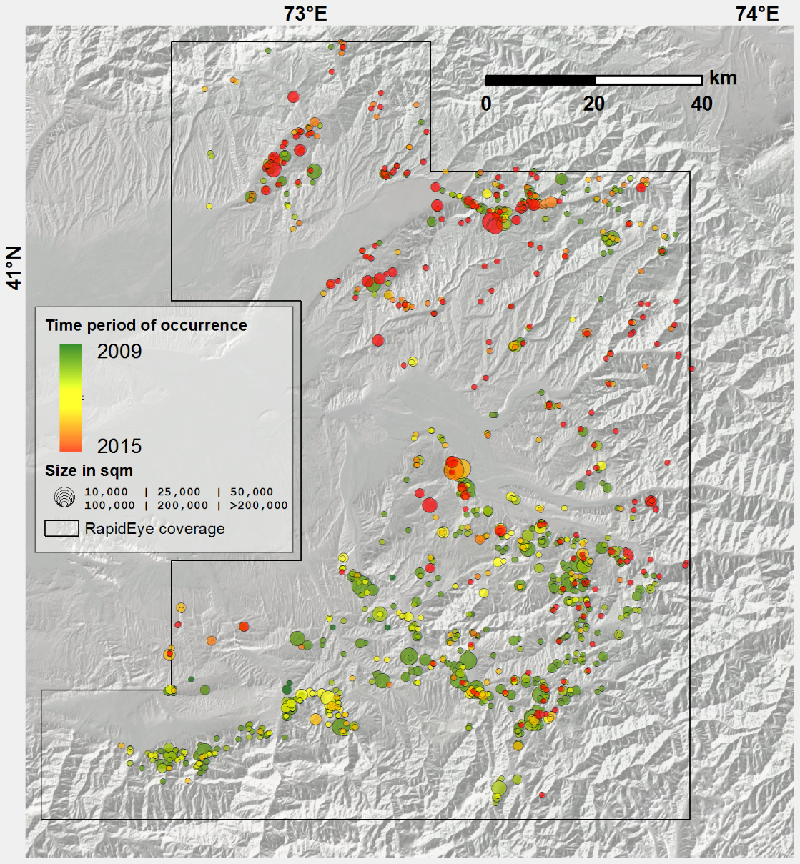
Automated Regular Monitoring of Landslides over Large Areas
Kyrgyzstan: 12,000 km² area
Time period: 2009 - 2015
1022 RapidEye datasets (RESA program)
  intervals up to several days
1239 landslides (~90 reported by authorities)
100 sqm – 0.75 sqkm, 11 km² total
Clear short-term spatiotemporal variations
continuous landslide activity without any
major trigger - need for regular monitoring
Behling, R., Roessner, S., et al., 2014. Automated Spatiotemporal Landslide Mapping over
Large Areas Using RapidEye Time Series Data. Remote Sensing, 9, 8026-8055.
Behling, R., Roessner, S., et al., 2014. Robust Automated Image Co-Registration of Optical
Multi-Sensor Time Series Data: Database Generation for Multi-Temporal Landslide Detection.
Remote Sensing, 6, 2572-2600.

Slide 29
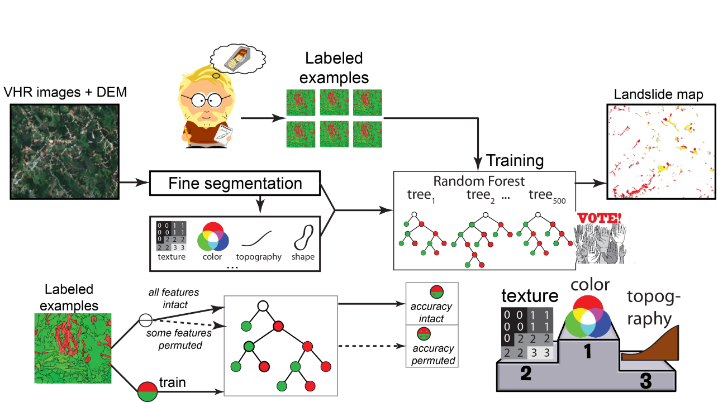
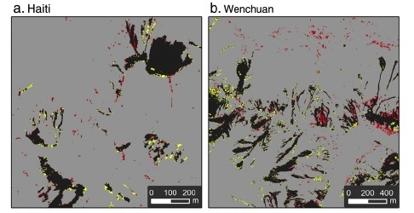
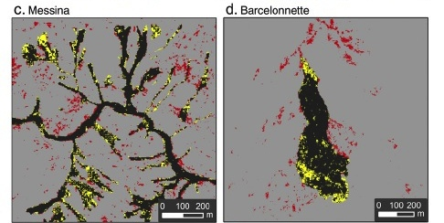


Setup a Reference for Benchmarking
Landslide Detection Algorithms
Several groups are developing detection algorithms for mapping landslide after major triggering events using pre/post event imagery → a benchmark (images + a reference landslide inventory) is needed to improve the quality of the detections
Flowchart of supervised
landslide detection algorithms
(pre/post event imagery)
(Stumpf et al., 2013)
Notes:
Mixing tecture, color and tophopgrahy to define automation of landslides, working on different images. If we can set up a standard for this activity where we have a nice reference dataset, we can create some standard methodologies. All new groups using detection algorithms can use reference datasets to benchmark their own algorithms.

Slide 30
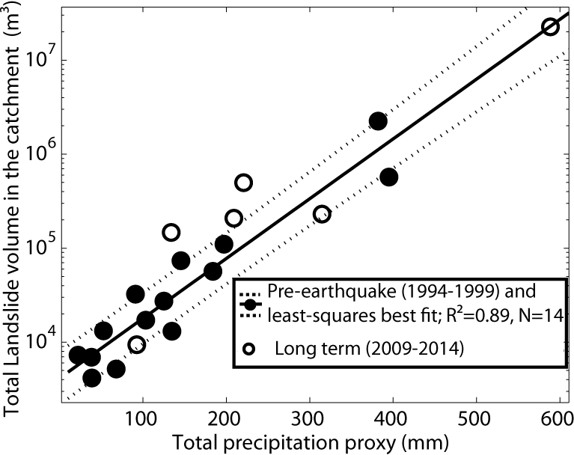
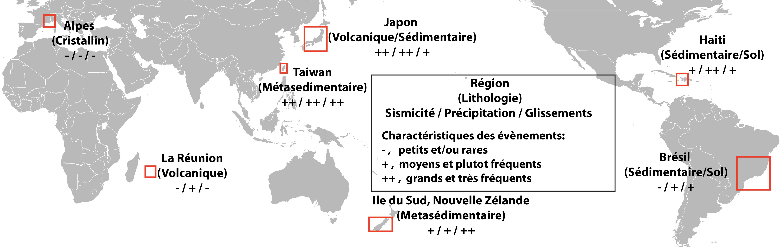
Generalizing the Creation of EO-based inventories after major triggering events
Systematizing the creation of EO-based landslide inventory after major triggering events (ETQ > threshold M_{L}; rainfall event > XX mm) at the global scale
Document the triggering event (seismology, EO-based rainfall estimate using GPM)
Create scaling laws relating landslide intensity to the triggering events
CNES: 3 years post-doc project of Odin Marc
Empirical relation in Taiwan
Ethiopie
(Volcanique)
+, ++, +
Notes:
Nepal earthquake – add Nick rosser, Sigrid rosser – offset by Nepal earthquake. Sigrid extended 2011 to analyze relationship between EQ-landslide activity and usual background. How does landslide activity go “back to normal” after a major event. Usually the activity is not limited to just a short period, but have to understand how the activity goes back to stead state.
Connected to events for longer term monitoring. Slides from Sigrid: take home point – create methodology/demonstration of long term monitoring analysis as input for hazard and risk assessment

Slide 31
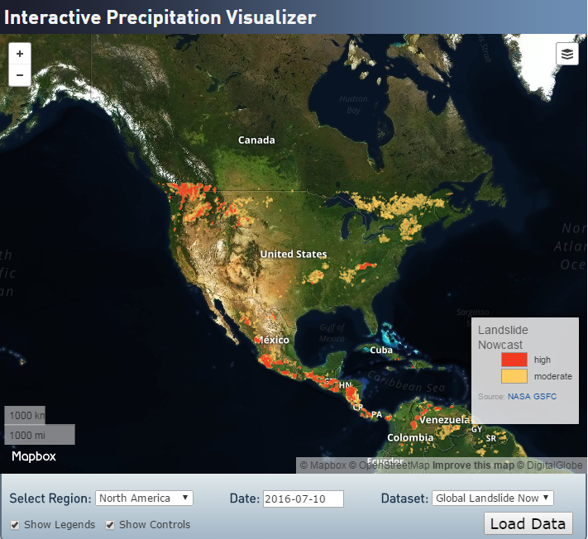
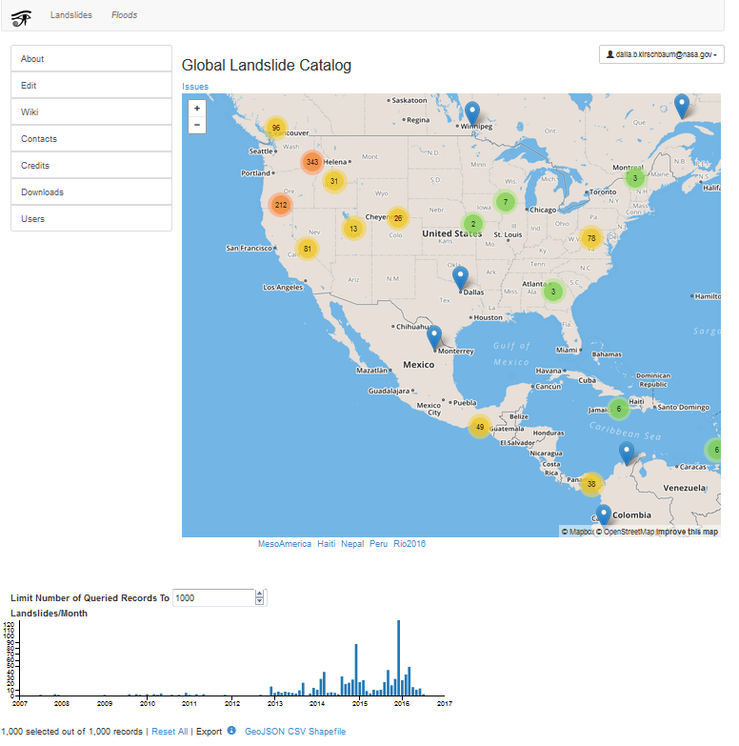
Global efforts
http://ojo-streamer.herokuapp.com/
IN DEVELOPMENT at pmm.nasa.gov

Slide 32
Future: Landslide Modelling
Advanced landslide modelling tools capable of assimilating remote sensing data and products for model initialization and validation.
optical
SAR
API
MODEL
forecast
envir.
data
map
Slide courtesy of Fausto Guzzetti

Slide 33
Take-Aways
Clear community need: Landslide hazards are pervasive and research activities related to application of EO data are often not well-coordinated between regions
Proposed study regions intersect many of existing pilots and have established projects
Methodology – test methodologies in study regions to compare and establish best practices for community
Establish a benchmark dataset: work across pilot regions to create a dataset that can be used for future algorithm development and calibration
Landslide Pilot in development: seeking new participants and regional SMEs
Open to suggestions and guidance: particularly from other pilots and end users

Slide 34
Next steps & Data needs
Data Needs: Working with other pilots to determine data availability within other pilot regions to inform the new data request list
Officially approve Landslide Pilot
Work across pilots to determine previously acquired dates/locations
Confirm study sites for landslide pilot
  Confirm leads for each focus area
Define pilot objectives to address in each study site
Determine data/sensor needs based on Pilot objectives and current/planned activities

Slide 35
Data Requests: to be populated
Mission / Instrument | Agency | Image Counts
 |  | Existing Data from other pilots | New Data Requests | Cumulative Total
Optical - Moderate Resolution (10 to 100 m)
Sentinel-2A / MSI | ESA
EO-1 / ALI | NASA
Landsat-8 / OLI | USGS
Optical - High Resolution (<10 m)
SPOT (archive only) | CNES
Pleiades | CNES
L-Band SAR
ALOS-2 / PALSAR-2 | JAXA
C-Band SAR
Sentinel-1A / SAR | ESA
Sentinel-1B / SAR | ESA
Radarsat-2 / SAR-C | CSA
X-Band SAR
Cosmo Sky-Med / SAR-2000 | ASI
TerraSAR-X | DLR

Slide 36
Thank you!
Dalia Kirschbaum, dalia.b.Kirschbaum@nasa.gov
Jonathan Godt, jgodt@usgs.gov
Sigrid Roessner, roessner@gfz-potsdam.de
Jean-Philippe Malet, jeanphilippe.malet@unistra.fr

Slide 37
Extra Slides

Slide 38
CEOS Landslide Pilot Survey
What is your area(s) of expertise or operational authority or responsibility (e.g. research focus or disaster response and recovery)?
In what geographic region(s) do you primarily work or have responsibility (e.g. Global, national, regional)?
Please rate your interest the proposed Pilot Objectives from Very important to not relevant
Please provide feedback on current objectives in terms of your proposed contribution and suggest ways to modify the objectives to better accommodate your expertise or the group’s collective expertise.
What Earth Observation data are you most interested in acquiring as part of this pilot?
What specific aspects of this activity do you expect to participate in for the duration of the pilot?
The CEOS Landslide Pilot is in the scoping state. Who should be added to this discussion?
Please recommend others who you currently work with or who may be interested in this activity and include organization, point-of-contact name, affiliation, and email contact information.
28 Responses

Slide 39
Current Landslide Pilot Members (50)
Country | Number of participants | Organizations
USA | 18 | NASA, USGS, FEMA, GFDRR (World Bank), Southern Methodist University, U. of Oregon, U. of Washington, U. of Colorado
China | 10 | Academy of Opto-Electronics, CAS, China Earthquake Administration, Institute of Water Resources and Hydropower Research, Institute of Crustal Dynamics, CEA
Italy | 7 | CNR IRPI, ESA, EURAC, INGV, Università degli Studi di Firenze
France | 6 | CEA AIM, CNRS, UJF Grenoble, UNESCO, University of Strasbourg
Germany | 2 | GFZ German Research Centre for Geosciences
UK | 4 | University of Leeds, NERC COMET, University of Durham
Norway | 2 | Norut, Geological Survey of Norway
Kenya | 1 | RCMRD
EU | 1 | European Commission
Nepal | 1 | ICIMOD
India | 1 | ISRO
Barbados | 2 | CIMH
Sri Lanka | 1 | IWMI
Canada | 1 | NRCan
Taiwan | 1 | National Central University of Taiwan

Slide 40
Summary of Expertise
Roles | Research | Disaster Response | Imagery Type
Researcher | Landslide hazard mapping | National Landslide Hazard Program | InSAR for landslide mapping and monitoring
Disaster Response Coordinator | gradual landslide motion in mountain | Disaster Preparedness, Post disaster impact assessments | optical and radar satellite remote sensing for improved landslide process understanding
Manager for disaster preparedness and impact assessment | Initiation processes and early warning | Support to the Government for emergency management as centre of competence for civil protection | Satellite radar interferometry (InSAR) for landslides.
Regional Science Coordination Office | image analysis for automatic event landslide detection | Operational monitoring of landslides | satellite radar for measuring ground deformation
Scientific Advisor for National Civil Protection | optical and radar satellite remote sensing for improved landslide process understanding | Earthquake disaster emergency response and relief | Optical remote sensing with a particular focus on landslide mapping and monitoring
 | forecasting, monitoring and assessment of hydrometeorological related hazards |  | airborne lidar analysis, landslide mechanics
 | debris flow inundation hazard modeling

Slide 41
Regional Foci of participants
Global
Regional
Caribbean
South Asia
Asia
Mediterranean
Tibetan Plateau
Central America
National
US
        Western US, Appalachian States, California, Colorado
France
Norway
Nepal
Italy
China
Kyrgyzstan
Iran
Local/sub-national efforts (catchment scale)
Taiwan, Korea, Japan
Southwest China

Slide 42
Interest in Objectives
 | Objective A | Objective B | Objective C | Objective D
1 - Very Important | 85% | 60% | 15% | 21%
2- Moderately | 10% | 35% | 60% | 52%
3 - Neutral | 5% | 5% | 25% | 21%
4 - Not Important | 0% | 0% | 0% | 5%
Objective A:
Establish effective practices for merging different Earth Observation data (e.g. optical and radar) to better manage landslide detection, mapping, and monitoring.
Developing / testing / benchmarking / sharing tools for high-frequency monitoring and rapid mapping of landslides with satellite EO data
Leverage revisit time of multiple sensors (e.g. the Sentinel constellation (S1, S2) to use EO satellite images as a real source of information for the monitoring of landslide displacement/deformation at high frequency.
              Processing stacks of Optical and SAR images to create horizontal displacement maps over time
              Improve the efficiency in processing remote sensing data for emergency response
              Establishment of benchmark datasets to test available semi-automatic techniques

Slide 43
Comments on Objectives
Objective B:
Create integrated products & services for practices or activities, such as landslide inventories, to support disaster risk management for multi-hazard and cascading landslide events.
Further develop operational services leveraging existing projects on landslide inventory mapping, landslide monitoring and early warning, landslide modeling and interpretation
Demonstrate the rapid emergency response landslide mapping during major disasters in coordination with end users
              Create closer links between remote sensing analysis and the needs for hazard and risk analysis
              Use the longest available time series of remote sensing data to create systematic spatiotemporal assessment of landslide activity

Slide 44
Interest in Data Access
 | SAR | Optical | DEMS | Soil Moisture & rainfall | land use/soils | landslide inventories | LiDAR
Number interested | 15 | 17 | 5 | 3 | 3 | 3 | 2
Percent | 58% | 65% | 19% | 12% | 12% | 12% | 8%
Source | Sentinel-1 and 2,RADARSAT-2, COSMO-SkyMed, ALOS-1 and 2, TerraSAR-X, RISAT | Landsat, IRS, Worldview, Pleiades, SPOT5, SPOT-6/7, QuickBird, GF2, RapidEye, Sentinel-1, Sentinel-2, Venus | TanDEM-X | rainfall (weather data) |  | landslide catalogs | LiDAR
Resolution |  | 1m-10m | <10m
Notes | Polarimetric SAR (amplitude), better if HR/VHR; need the ability to target over specific sites of interest (supersites, Nepal), time series important | Multispectral (VHR better, GSD < 1 m); hyperspectral; time series needed |  |  | soil erosion, regolith depth, exposed bedrock for unconsolidated deposits | landslide maps (specifically after earthquakes) suceptibility maps | Time series would be best

Slide 45
Interest in Thematic Topics
              Monitoring: Develop/advance/communicate monitoring capabilities leveraging and integrating Optical and SAR data (Obj A)
              Mapping: Develop methodologies for multi-temporal image processing over select region to improve/expand landslide mapping/inventories (Obj A)
              Hazard assessment/modeling: Demonstrating how EO data (DEMs, hydrological information, and imagery/SAR) can advance landslide modeling/hazard assessment at a regional scale (Obj B)
              Rapid Assessment: Demonstration of how EO data can be rapidly processed for informed decision making (Obj A & D)
              User/Pilot Engagement: Need to leverage existing connections and those from other pilots to turn products into actionable information (Obj C & D)

Slide 46
Suggested regional study areas
Nepal
Pacific Northwest, U.S. (Oregon, Washington)
China (southwestern area)
4. Caribbean (focus area TBD)

Slide 47
Live data stream
http://community.dur.ac.uk/nepal.2015eq
Slides from N. Rosser/Durham

Slide 48

Monitoring data summary
Tail end of monsoon captured from August onwards
No response to rainfall or aftershocks to date
Heavily damaged slopes remained static, but not necessarily stable
Has anything changed during the monsoon?
Slides from N. Rosser/Durham

Slide 49



Documenting the deformation of large landslides
from time series of optical multi-sensors
MPIC-OPT: Multiple Pairwise Image Correlation
Multiple-pairwise correlation to obtain redundant measurements (e.g. SBAS type of processing)
Stacking and quality control
  Filtering of uncertain matches
  Correction of co-registration residuals
Calculation of indicators for persistent motion and noise reduction through averaging
(Stumpf & Malet, RSE, 2016 – in press)
Notes:
Jean-Phillipe can send a figure to replace flowcart: idea is that we can document the velocity/displacement, not just a map of the position of the landslide but can document the displacement, additional attribute to what we already have in the inventory

