Slide 1
Status of the GSNL initiative
Stefano Salvi
Chair of the Supersites Advisory Committee
CEOS WG Disasters meeting #6, Vancouver, September 2016

Slide 2
The GSNL initiative
A voluntary international partnership aiming to improve, through an Open Science approach, geophysical scientific research and geohazard/risk assessment in support of Disaster Risk Reduction.
The partnership
The scientific community
The in situ data providers
The satellite data providers
The end users
Decision-makers, Civil Protection agencies, governments, regional aviation authorities, etc.

Slide 3
Active Supersites
Hawaiian volcanoes – USGS
Icelandic volcanoes – Univ. of Iceland & IMO
Etna volcano – INGV - Catania
Campi Flegrei volcano – INGV - Naples
Western North Anatolian Fault – KOERI - Istanbul
Taupo Volcano – GNS Science - Lower Hutt
Tungurahua and Cotopaxi volcanoes – IGEPN - Quito

Slide 4
Supersites to be formalized
at the CEOS Plenary
Greek Supersite – Positively reviewed by SAC and accepted as a Candidate Supersite. DCT members have provided decisions on support.
San Andreas Fault Natural Laboratory - Proposal and SAC review circulated to Brenda and Stéphane. Now DCT members should decide on support.

Slide 5
Status of EO data access
Image SAR data are routinely acquired and provided to all Permanent Supersites.
Further development of data distribution infrastructures (SSARA/UNAVCO, SS-Portal/DLR, Data Gateway/ASI, GEP&VA/ESA) is providing better accessibility to these data by the scientific community, however interoperability of platforms is still lagging.

Slide 6
Issues on EO data access
The larger scientific community is still not fully aware of how to access these data (some do not even know that they exist !).
The procedures to access EO data should be improved and made smoother to involve more scientists. Some minor technical and administrative solutions could make a big difference, e.g. online acceptance of data licences, mass data download, web services to retrieve metadata (and data) on GIS platforms, etc.

Slide 7
Status of in situ data access
Most of the older Supersites have now a data sharing infrastructure: Hawaii, Iceland, Etna and Campi Flegrei.
Seismic and geodetic data can easily be discovered, and are mostly accessed online with little or no limitations, however for some Supersites personal requests to the Coordinator are still necessary.
Other data types (e.g. gravity, geochemical data) can be accessed only on request and there are no web interfaces, even for data discovery.

Slide 8
Issues on in situ data access
Full awareness of the existence of open data for a Supersite is lacking. Better outreach and dissemination is needed.
Supersite data infrastructures need funding to be developed. GSNL governance should be lobbying to facilitate national funding.
Licensing and attribution problems are sometimes major obstacles towards data sharing. A common approach would be recommended, it is currently being sought by the EVER-EST project..

Slide 9
Status of processing services
GSNL is presently supported by the ESA GEP, both in terms of data distribution and processing resources for part of the community.
Other services (GPS Plug & Play) can be obtained from UNAVCO and Un. of Nevada.
Possible contribution from JPL ARIA project?
The Virtual Research Environment being developed in the EC EVER-EST project will provide also processing capacities to the three European volcano Supersites at least.

Slide 10
Status of scientific product sharing
Sharing of scientific results in digital format is needed to improve collaborative science and its use.
GSNL 2.0 now requires scientists to share their scientific results in digital format (Supersite review procedures).
A Data Policy draft has been prepared and needs to be finalized. It will need to be formally accepted by the Supersite Coordinators.
Attribution and licensing methods are being studied in the EVER-EST project.
Agreement on common product metadata structures is needed to facilitate re-use by scientists and users.

Slide 11
The GSNL Implementation Plan 2017-2019
New GEO Programme Board wanted to review all initiatives and asked an Implementation Plan for the 2017-2019 activities.
We prepared it, the PB reviewed it and asked some amendments.
Then it was approved at the end of August.
It is a challenging plan, trying to stimulate a networking approach of the initiative, and put more responsibilities on Supersite Coordinators.

Slide 12
Main tasks of GSNL 2.0 IP
For the network governance:
improve internal coordination to transfer knowledge and capacities across Supersites
improve coordination with different organizations/initiatives
promote adoption of common methods for data discovery/access to make this easier for the communities
improve outreach
For the Supersite coordinators and communities:
experiment at the various Supersites innovative approaches to ensure that scientific products are generated to support local end-users. E.g. the international scientific community shares the burden of data analyses to help the local institutes.

Slide 13
The End-users of the active Supersites
Permanent Supersite | End-user
Hawaiian volcanoes, USA | Hawai’I County Civil Defense, Hawai’I Volcanoes National Park
Icelandic volcanoes | Icelandic Police - Dep.t of Civil Protection and Emergency Management, Environmental Agency of Iceland, Directorate of Health
Mt.Etna volcano, Italy | National Department of Civil Protection, Regional Civil Defense
Campi Flegrei & Vesuvius volcano, Italy | National Department of Civil Protection, Regional Civil Defense
Marmara Fault, Turkey | Istanbul municipality
Ecuadorian volcanoes | Secretariat for Risk Management, Regional governments, Municipalities
Taupo volcanic zone, New Zealand | Ministry of Civil Defence and Emergency Management, Department of Conservation, Regional councils, MetService

Slide 14
Estimate of GSNL resources for 2017-2019
Task | Source | Amount/year
1.1 Management | In-kind: INGV, ETH, UNAVCO, IRIS, Univ. of Miami, Univ. Bologna, IPGP | Total in-kind ∼105 K€
1.2 Networking activities | In-kind: INGV, ETH, UNAVCO, IRIS, ESA, USGS, NASA | Total in-kind ∼80 K€
1.3 Data provision | In-kind for in-situ data: INGV, ETH, UNAVCO, IRIS, USGS, EPOS, ESA In-kind for commercial satellite data: ASI, DLR, CSA | Total in-kind ∼200 K€ Total in-kind: 4400K€
1.4 Dissemination & Outreach | Cash: EVER-EST project In-kind: INGV, UNAVCO, ESA, USGS | Total cash ∼40 K€ Total in-kind ∼95 K€
2.1 Supersite management | In-kind: INGV, USGS, Univ. of Iceland, IMO, KOERI, GNS Science, IGEPN | Total in-kind ∼215 K€
2.2 Supersite community building | In-kind: INGV, USGS, Univ. of Iceland, IMO, KOERI, GNS Science, IGEPN | Total in-kind ∼35 K€
2.3 Supersite infrastructure maintenance & development | Cash: EVER-EST project In-kind: UNAVCO, INGV, USGS, Univ. of Iceland, IMO, KOERI, GNS Science, IGEPN, ESA-GEP | Total cash ∼175 K€ Total in-kind ∼385 K€
2.4 Supersite dissemination & outreach | Cash: EVER-EST project In-kind: INGV, USGS, Univ. of Iceland, IMO, KOERI, GNS Science, IGEPN | Total cash ∼50 K€ Total in-kind ∼30 K€

Slide 15
Biennial report for Mt. Etna Supersite
We need to assess the report and decide whether to move the Supersite from Candidate to Permanent.
From the report:
PROs
Reorganization of in situ data, provision of web based platform to access data, provision of web services for remote access. Good relationship with end-users.
CONs:
Only in situ data up to 2011 are shared. End of funding project may impact infrastructure maintenance.
Notes:
Krakatoa tsunami in 1883 killed 35 to 120k.

Slide 16
Biennial report for Vesuvius/C. Flegrei Supersite
We need to assess the report and decide whether to move the Supersite from Candidate to Permanent.
From the report:
PROs
Reorganization of in situ data, provision of web based platform to access data, provision of web services for remote access. Good relationship with end-users.
CONs:
Only in situ data up to 2011 are shared. Scientific community too limited.
Notes:
Krakatoa tsunami in 1883 killed 35 to 120k.

Slide 17
Status of the South East Asia Natural Laboratory
The revised proposal should be jointly coordinated by the Institute of Technology of Bandung (ITB, a University), and the Centre for Volcanology and GeoHazard Monitoring (CVGHM).
Unfortunately none of them has yet submitted the proposal.
Notes:
Krakatoa tsunami in 1883 killed 35 to 120k.

Slide 18
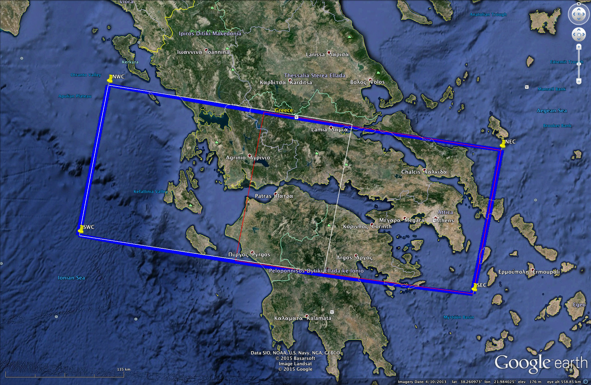
Status of the Greek Supersite proposal
Notes:
Krakatoa tsunami in 1883 killed 35 to 120k.

Slide 19
CEOS support to the Greek Supersite
CSA | YES, 2 years (requested 162)
CNES | YES, 20 standard 20x20km Pleiades scenes for the first year, reappraisal for any additional years
DLR | YES, 60 new scenes + a few archive images (requested 162)
ASI | YES, for a period of 2 years (requested 220)
NOAA | YES, no quota as the data is freely accessible
USGS | YES, no quota as the data is freely accessible
ESA | YES, no quota as the data is freely accessible
JAXA | tbd

Slide 20
Coordinator activities
Contacts with data providers to anticipate satellite tasking.
Organization of a kick off workshop.
Preparation of a Supersite website with a data access infrastructure.

Slide 21
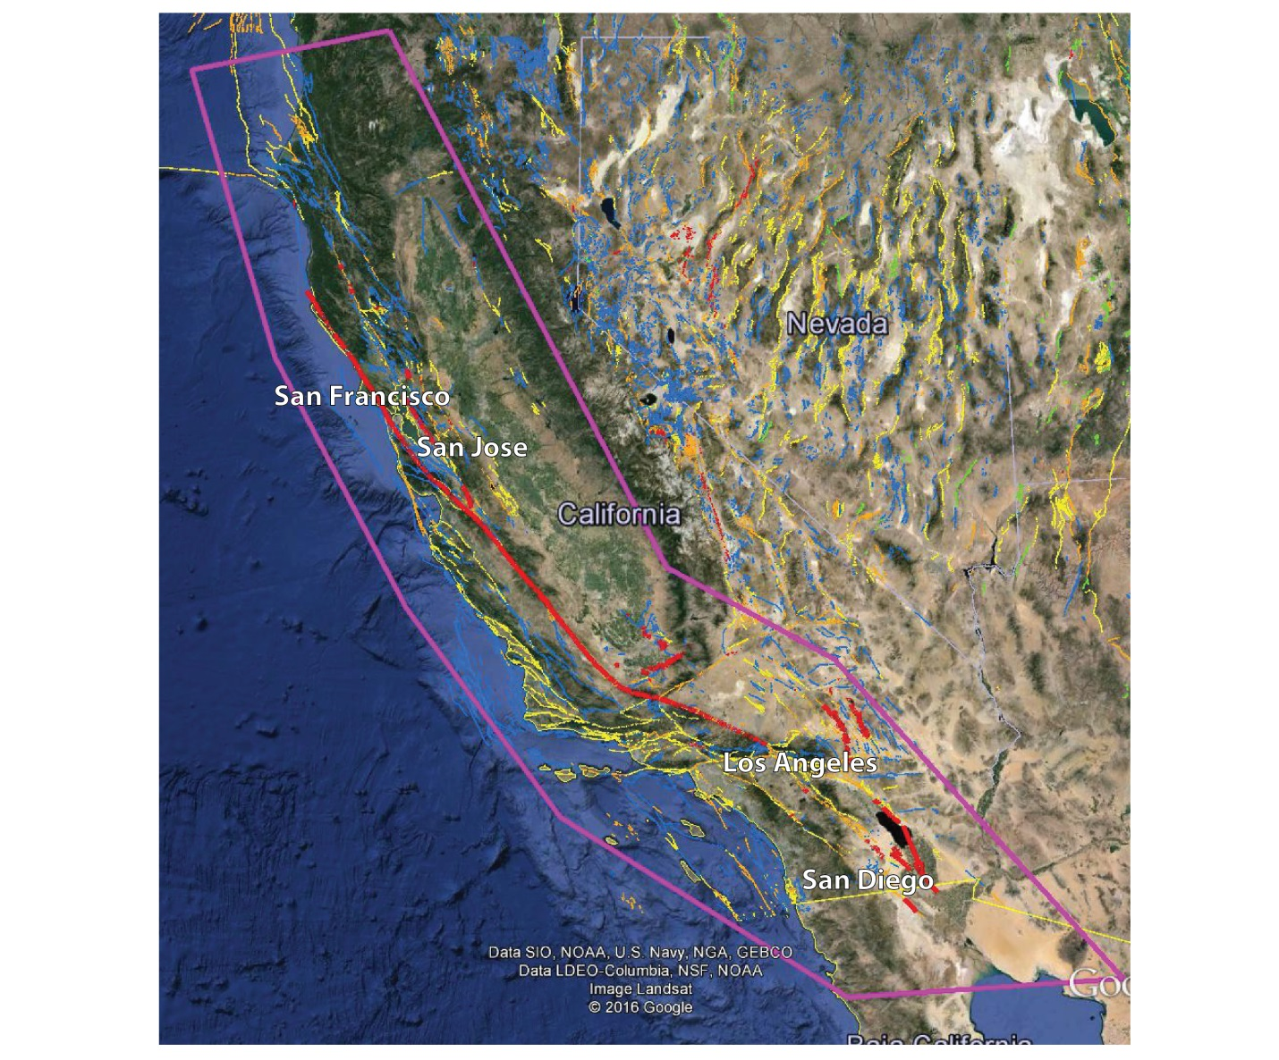
Status of the SAF Supersite proposal
Notes:
Krakatoa tsunami in 1883 killed 35 to 120k.

Slide 22
Reviewed by two scientists and by the SAC
Obviously good scientific objectives and team, as well as potential benefits.
Only few amendments requested:
More details on data dissemination (especially in situ data formats)
Provide a single interface to access all data
Develop a Data Management Plan, dealing also with research product sharing
Detail how non-scientific stakeholders can be involved and how the Supersite can benefit their activities
Provide a letter from USGS committing to support the Supersite Coordinator
Notes:
Krakatoa tsunami in 1883 killed 35 to 120k.

Slide 23
DCT quota assignment is needed
Interseismic analysis
SAR Platform | Archive requests | Yearly acquisitions
TSX Stripmap | 920 | 400 (continuous with archive)
CSK Stripmap (STR_HIMAGE) | 3850 | 400 (continuous with archive)
ALOS-2 (SCANSAR) | 200 | 180 (continuous with archive)
ALOS-2 (STRIPMAP) | 1310 | 400 (in select areas)
Co-seismic analysis
SAR Platform | Archive requests | Yearly acquisitions
TSX Stripmap | 20 | ?
CSK Stripmap (STR_HIMAGE) | 40 | ?
ALOS-2 (SCANSAR+STRIPMAP) | 34 | ?
RSAT-2 | 25 | ?
Notes:
Krakatoa tsunami in 1883 killed 35 to 120k.

Slide 24
SAF Supersite proposal
It is urgent that DCT decides on support, to be able to approve it at the Plenary
Consider that the amount of data requested could increase during earthquakes.
As the community scales up, new image requests could be submitted, better to plan for possible 30-40 % increment in the first 2 years.

